Slide 1
Weekly Report & Discussion
Dingyi Nie
MCL
09/17/2024

Slide 2

PhysioNet Challenge 2012 (P12)
A real-world ICU tabular dataset
~12,000 episodes
37 time series feature variables
Irregularly sampled
5 outcome labels (discrete + continuous)
5 static demographic info fields
Missingness
Missing rates are generally high
Least missing feature: ~23% missing rate
22 out of 37 features have missing rates >90%

Slide 3
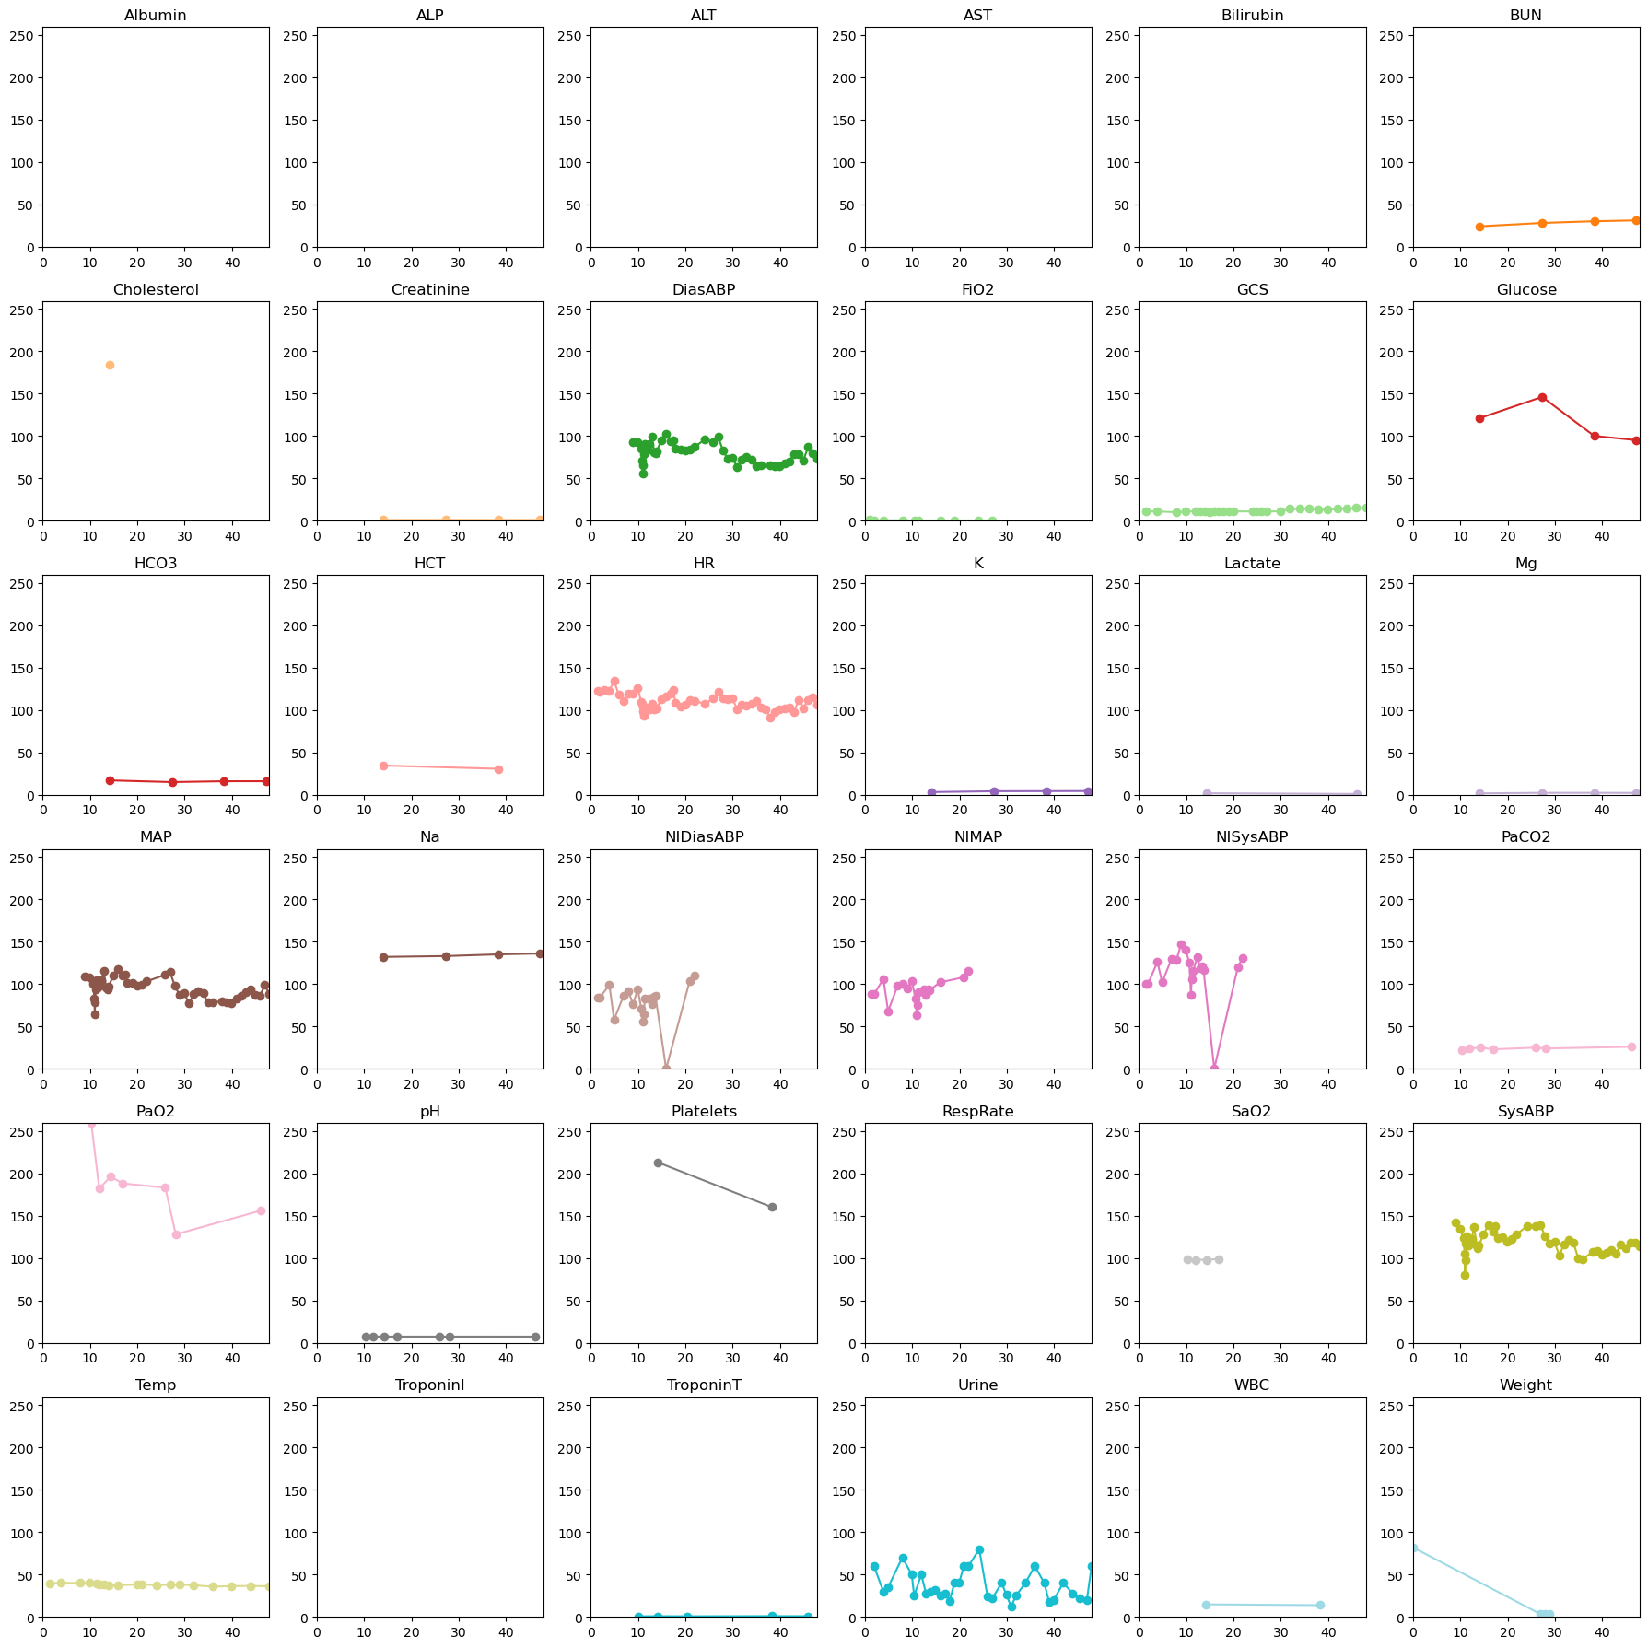

Slide 4
Preprocessing & Preparations
Grouping & padding
Group all observed feature values at the same time into one feature vector (can have NaN)
A time stamp is associated
Pad all sequences to the max length (padding is to the beginning)
Result: a feature array x(L, C) and a time stamp vector (L,) for each episode
More arrays
Mask m, (L, C): 0 for NaN, 1 for true observation
Time interval d, (L, C): time since last true observation for the same feature
Outliers
12 episodes are blacklisted by RAINDROP and ViTST
Feature pre-selection
Rule-based, filtering out features with a std of 0, or a extremely high missing rate
Currently, only one feature (MechVent) is dropped, for having a 0 std on the whole dataset (it’s invariant, hence meaningless)
Splits
train/valid/test = 8/1/1 (following RAINDROP and ViTST)
Normalization
Use mean and std on train set as expectations, normalize all splits’ feature arrays to have 0 mean and 1 std expectations
Label
In-hospital mortality: 0 for death, 1 for survival

Slide 5
Experiment-ready Data
9590 episodes in train set, 1199 in valid and 1199 in test
36 remaining features
Max sequence length 215

Slide 6
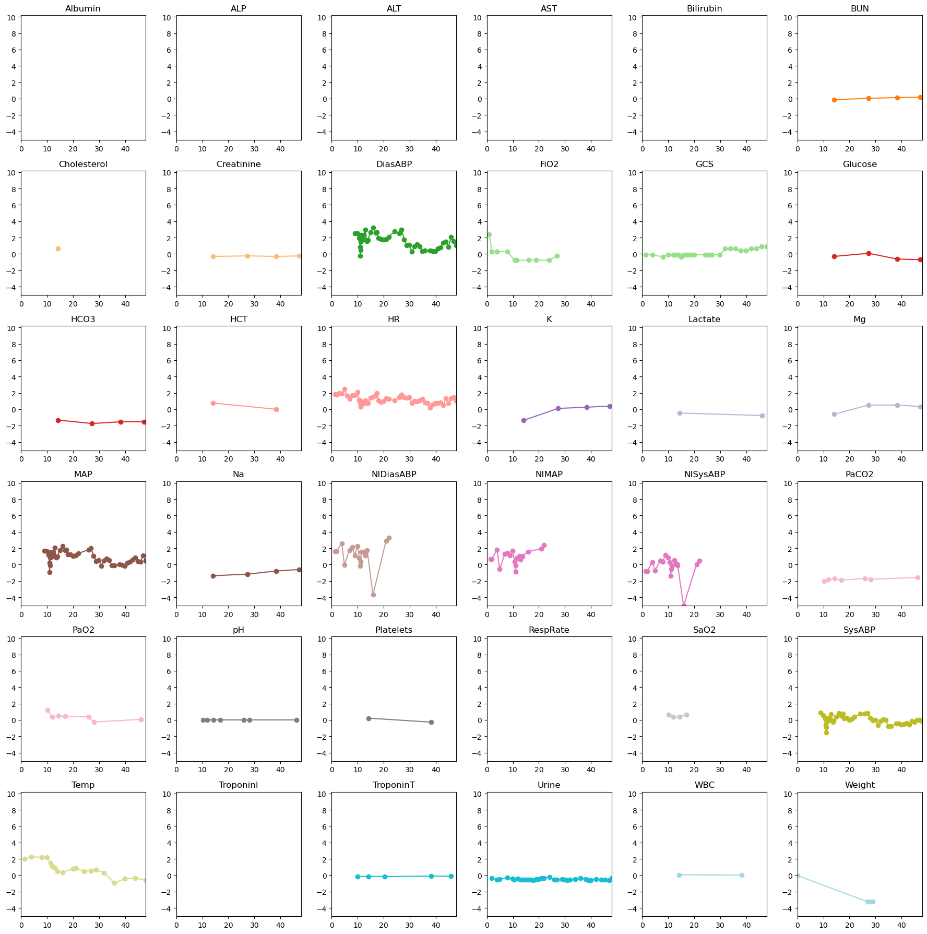

Slide 7
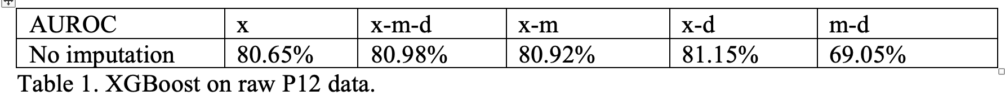
XGBoost on P12 (raw)
A simple XGBoost classifier
100 estimators
Max depth = 3
Learning rate = 0.1
Log loss
Input combinations (xm?d?)

Slide 8
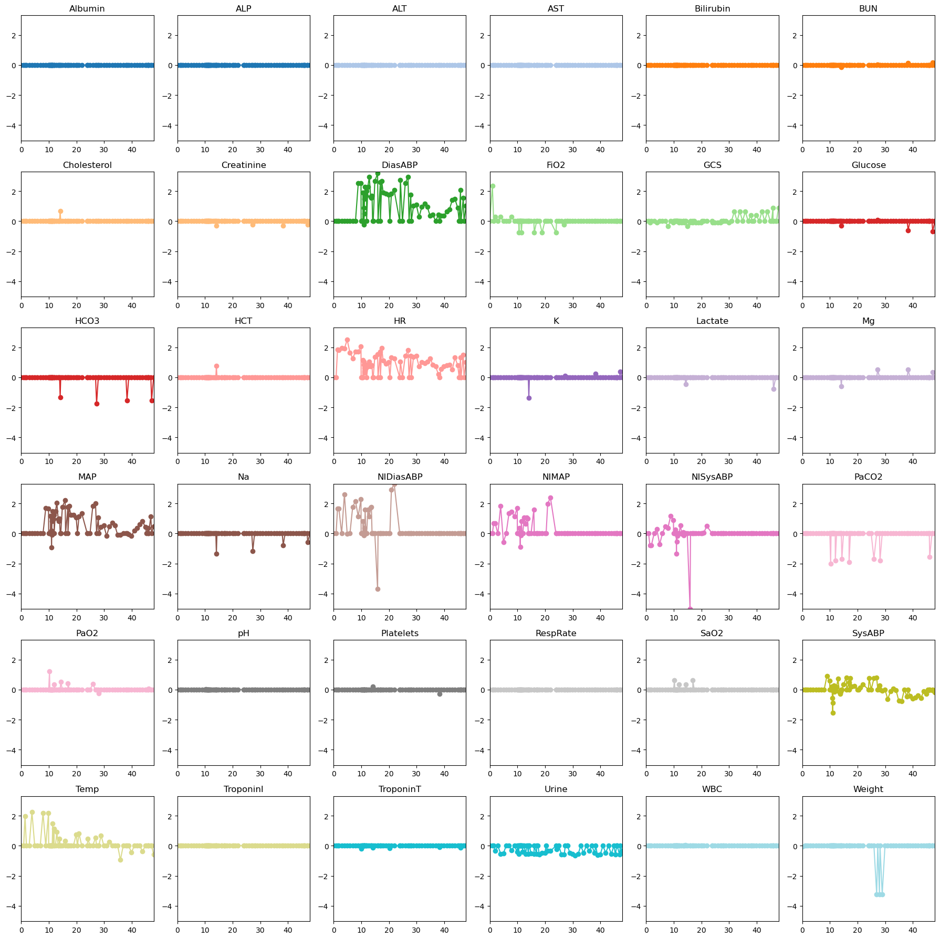
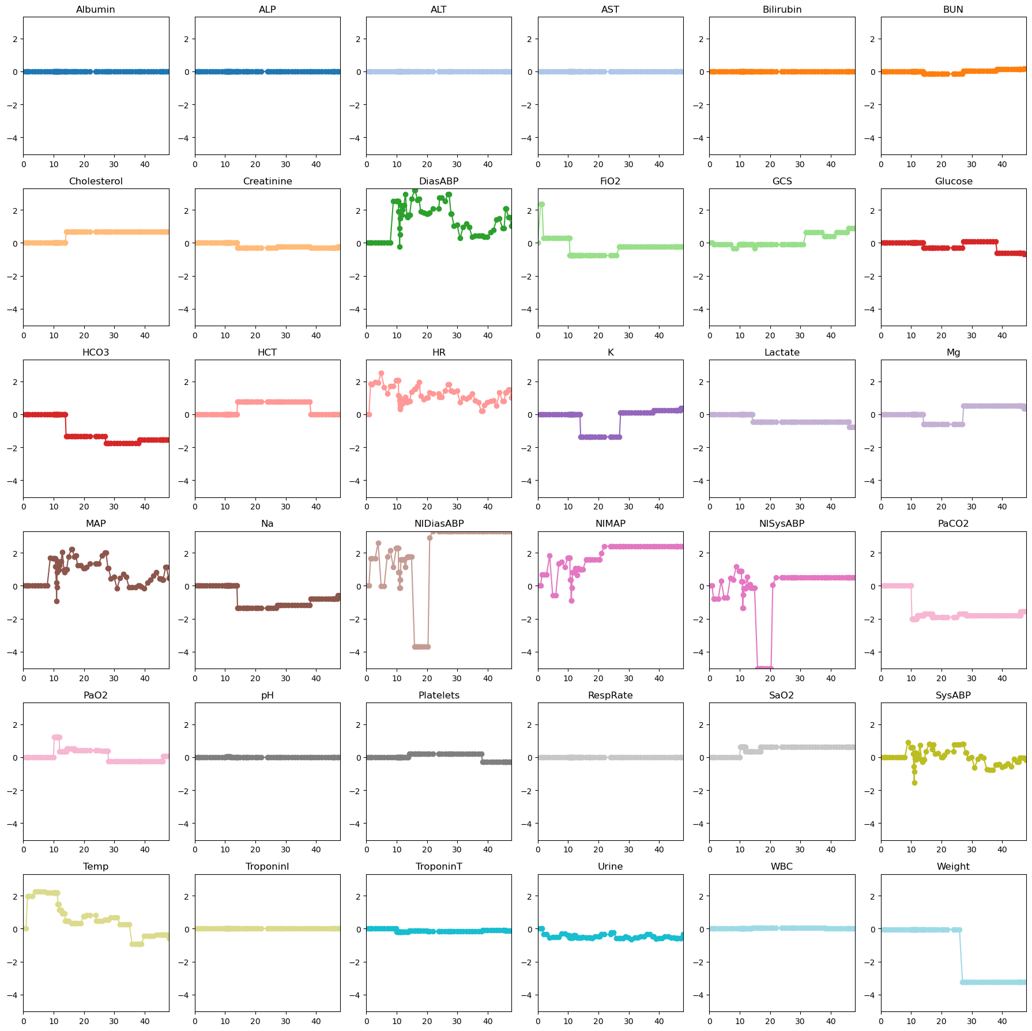
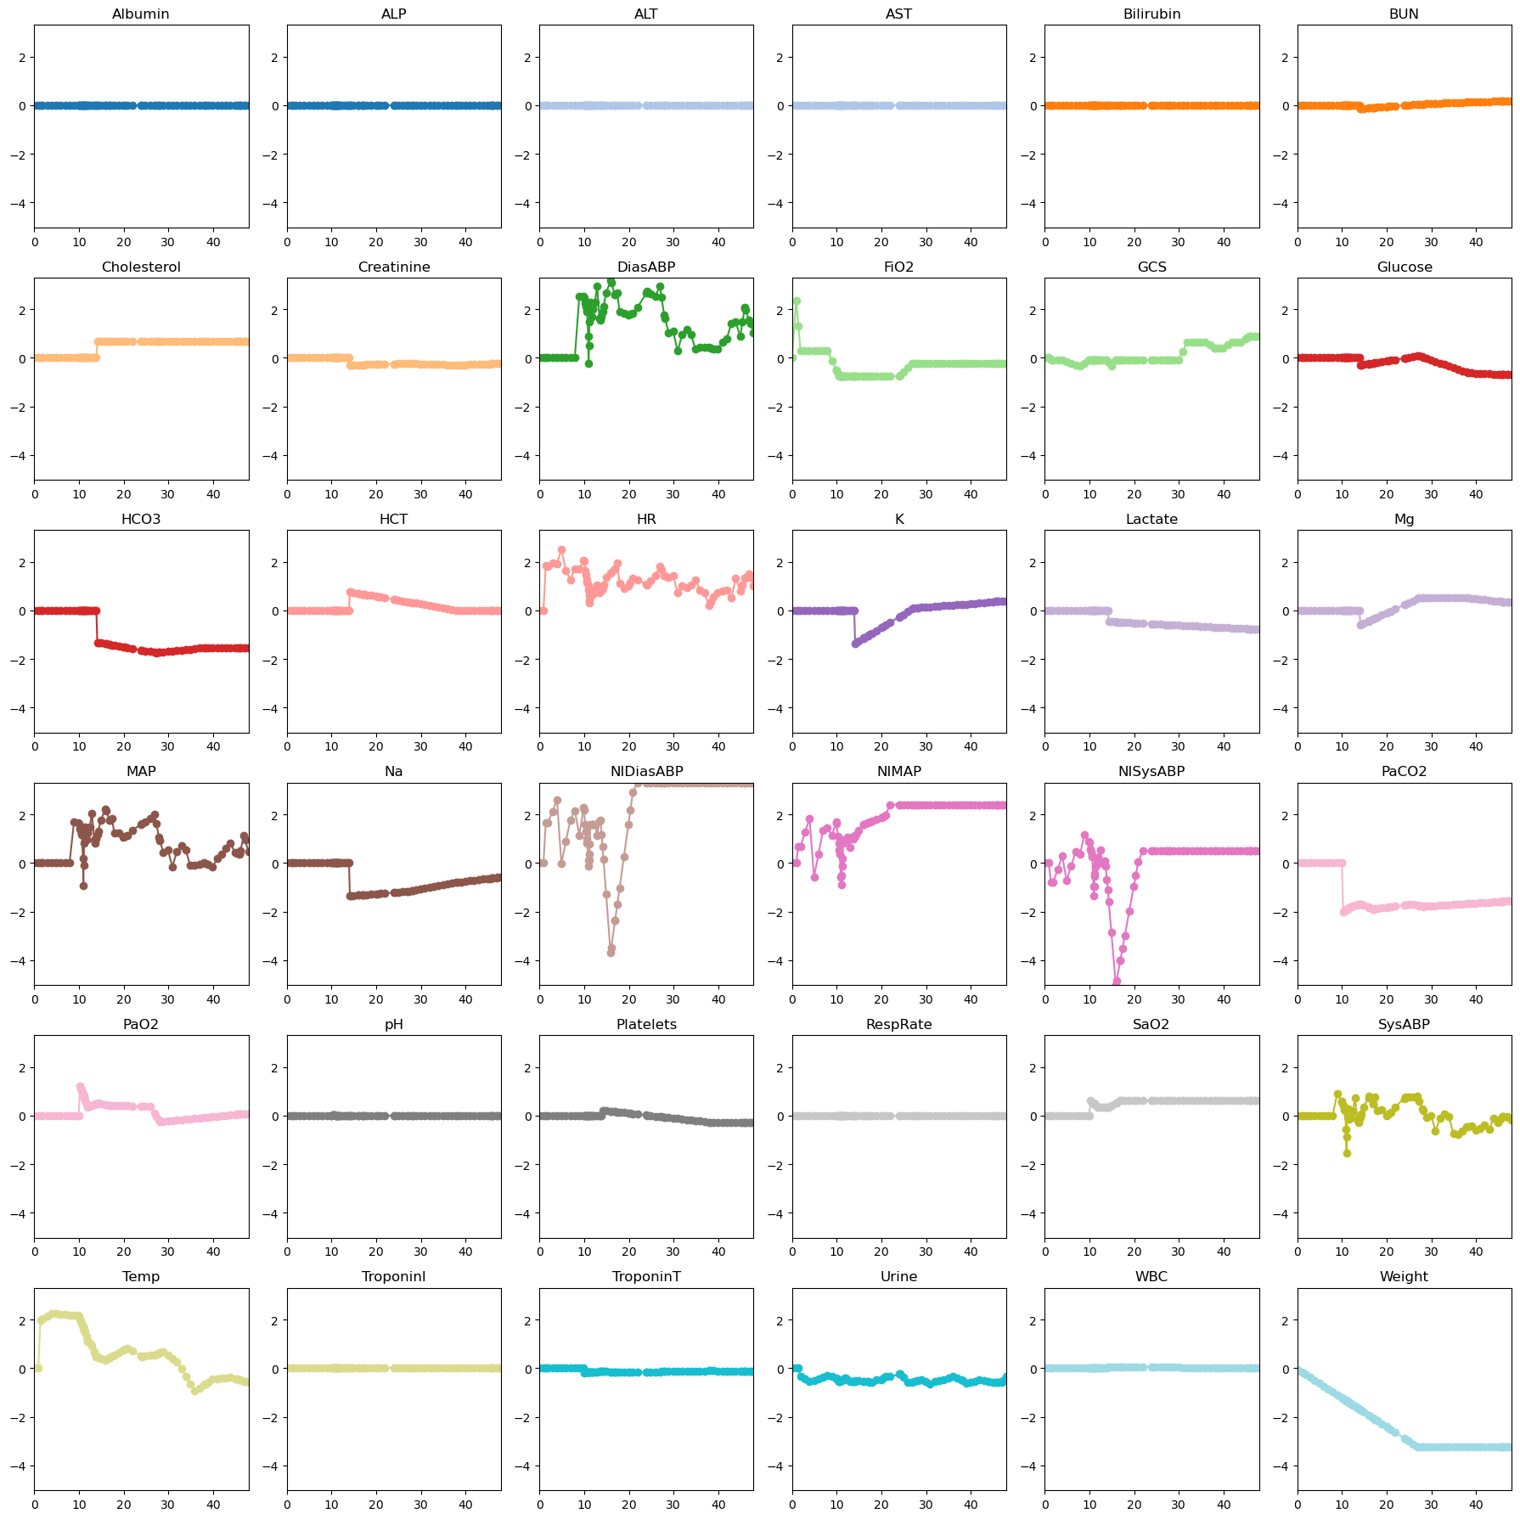
XGBoost on P12 (imputed)
3 imputers
Zero-imputer (same as mean since feature variables are normalized)
Forward-imputer (leading paddings are 0, then fill-forward)
Linear-imputer (leading paddings are 0, then linear interpolation)

Slide 9
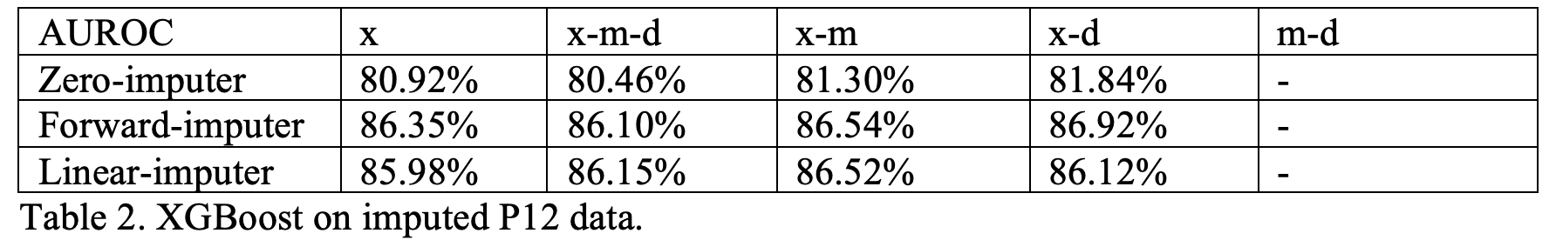
XGBoost on P12 (imputed)
3 imputers
Zero-imputer (same as mean since feature variables are normalized)
Forward-imputer (leading paddings are 0, then fill-forward)
Linear-imputer (leading paddings are 0, then linear interpolation)

Slide 10
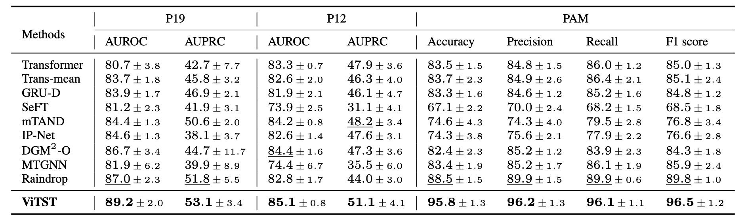
Comparison to DL

Slide 11
Discussion & Feedback

