Slide 1
Weekly Report & Discussion
Dingyi Nie
MCL
09/24/2024

Slide 2
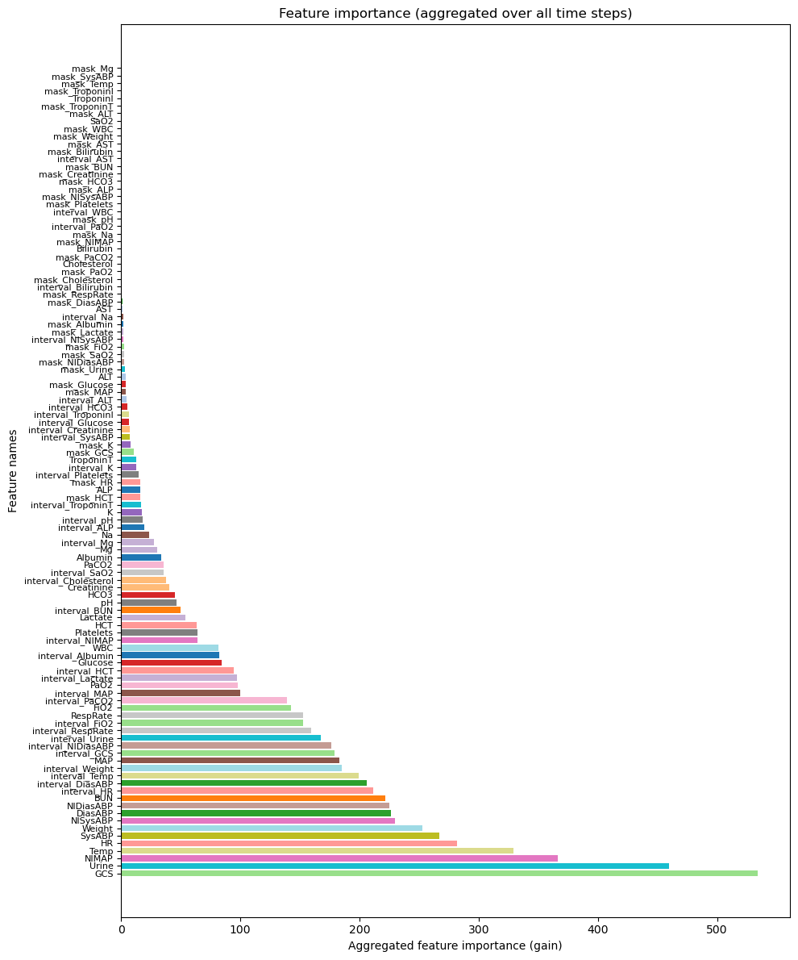
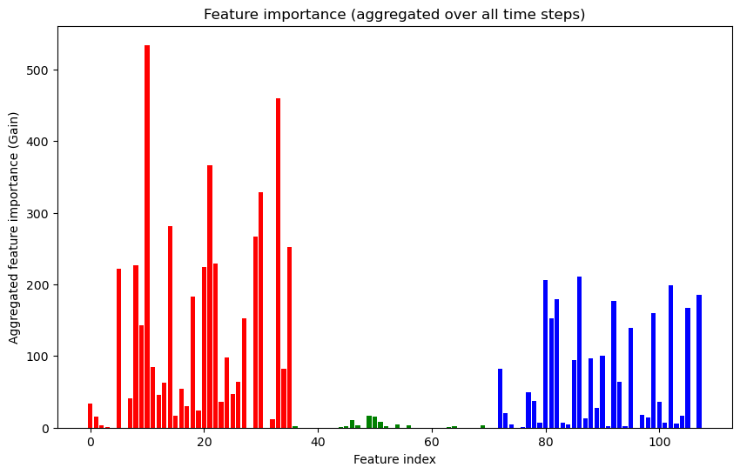
P12 Feature Importance Study
Fit an XGBoost classifier on x-m-d concatenated input
Examine their aggregated gain over all time steps

Slide 3
Differenced Time Series Analysis
Filter out 10 features with the most importance and missing rate <= 80%:
'DiasABP', 'GCS', 'HR', 'NIDiasABP', 'NIMAP', 'NISysABP', 'SysABP', 'Temp', 'Urine', 'Weight’
On these features alone, XGBoost achieves AUROC on validation set:
81.12%, with x-m-d representation
81.05% with x-d representation

Slide 4
Differenced Time Series Analysis
Spectral feature extraction
Differencing time series observations: v′_{t}=v_{t}−v_{t−1}
On average 10~20 observations for each feature
Fitting a Saab transform with kernel size = 5, stride = 1 for each features
Resulting in transformed spectral representations with varying lengths
Forming a fixed shape feature
Average pooling on observed values -> 1 numeric feature
Average pooing on differences -> 1 numeric features
Average pooling on responses to each Saab kernel -> K=5 numeric features
This will give a feature vector length = C * (2+K) = 70

Slide 5
Results
 | Baseline (x-m-d) | Baseline (x-d) | Leaned feature | Learned feature + DFT (n=32)
Validation AUROC | 81.12% | 81.05% | 73.34% | 74.10%

Slide 6
Discussion & Feedback

