Slide 1
Weekly Report & Discussion
Dingyi Nie
MCL
10/01/2024

Slide 2
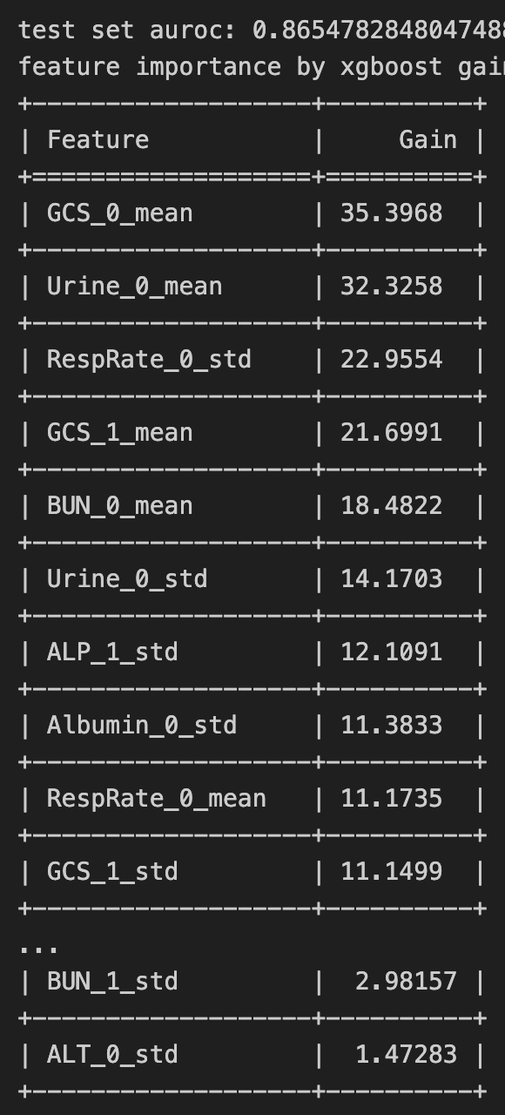
Extraction of 4 Simple Features
Data matrix (N, L, C)
In each episode, for each channel (original feature):
mean0: average observed values
std0: standard deviation of observed values
mean1: average differenced observations
std1: standard deviation of differenced observations
Imputation:
# of observations <= 1:
mean0 <- global channel (feature) average
std0 <- 0
# of observations == 0:
mean1 <- 0
std1 <- 0
Feature matrix (N, 4*C)
In P12, it is (12,000, 148)

Slide 3
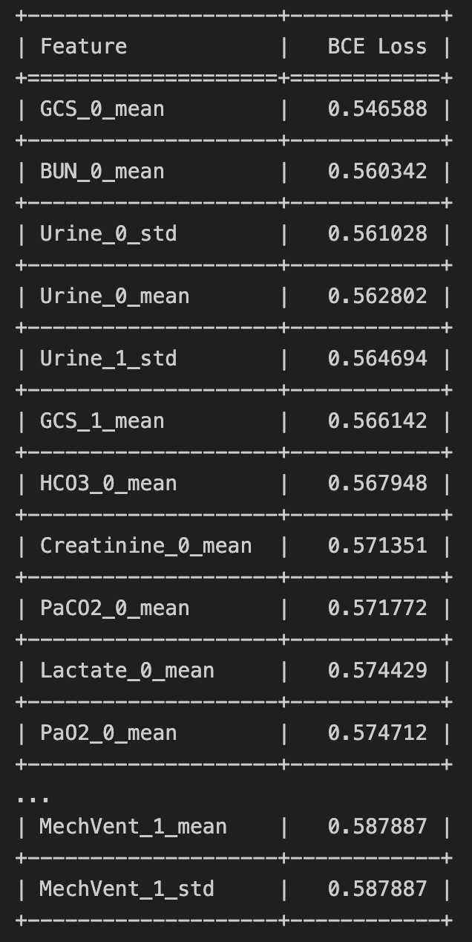
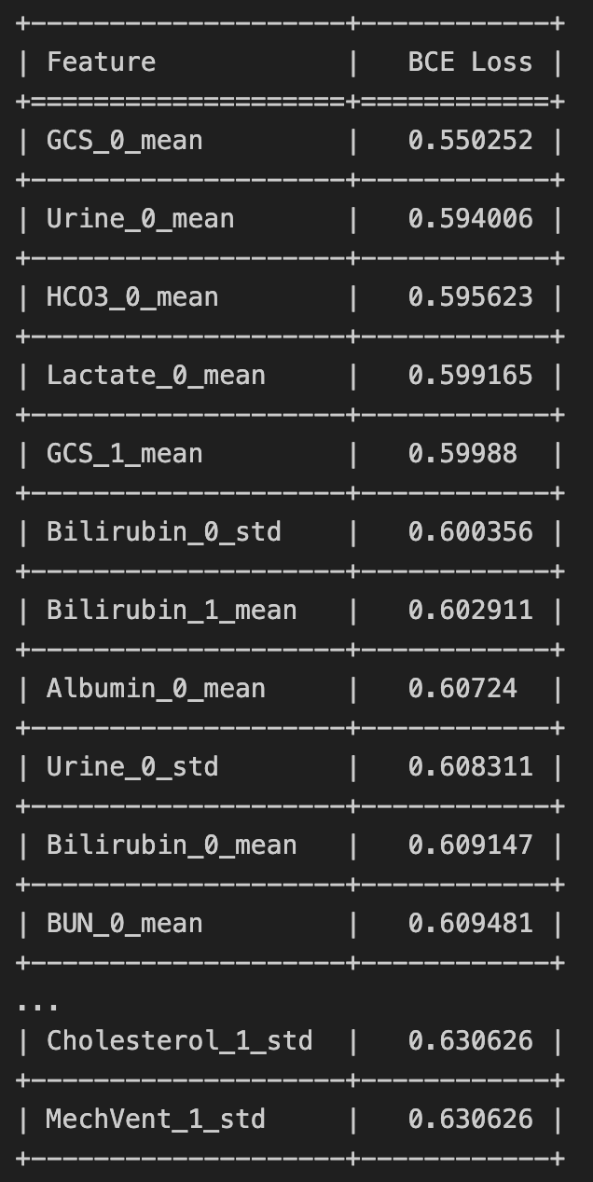
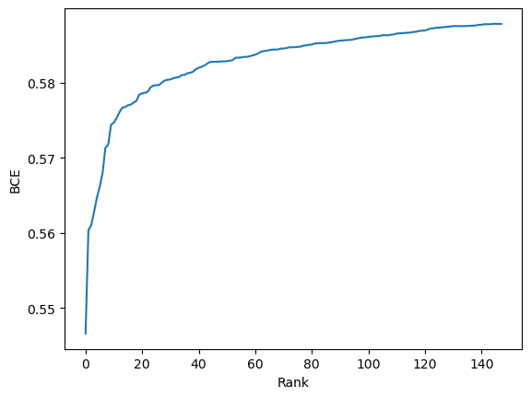
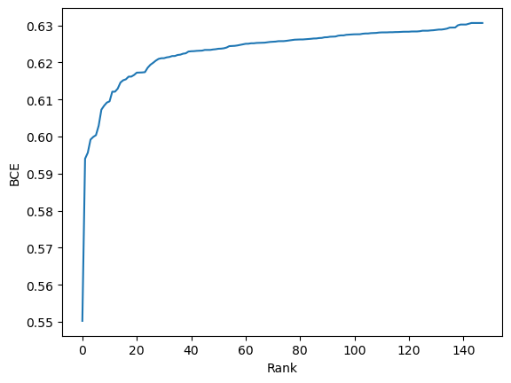
Feature Selection with DFT
Training set elbow point plot
Test set elbow point plot

Slide 4
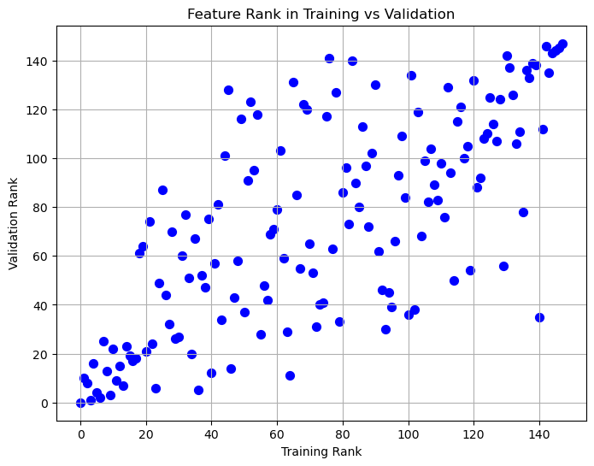
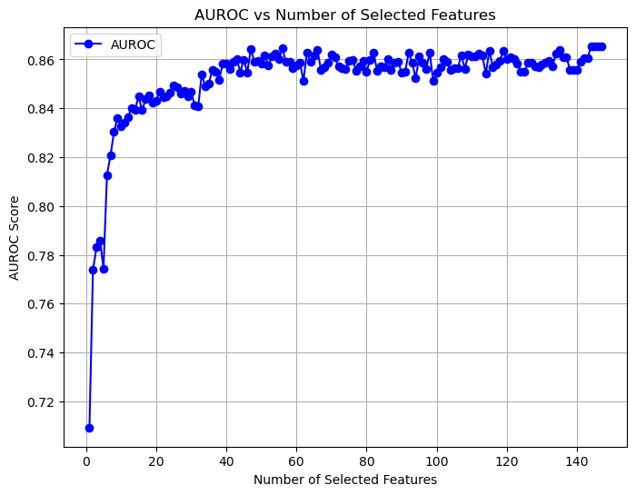
Feature Selection with DFT
Train-valid joint scatter plot
# of selected top ranked features vs test AUROC

Slide 5
Result
Method | Test AUROC
Transformer | 83.3%
Trans-mean | 82.6%
GRU-D | 81.9%
SeFT | 73.9%
mTAND | 84.2%
IP-Net | 82.6%
DGM²-O | 84.4%
MTGNN | 74.4%
Raindrop | 82.8%
ViTST | 85.1%
XGBoost on x-m-d | 86.9%
XGBoost on 4 features | 86.6%

Slide 6
Discussion & Feedback

