Slide 1
Recurrent Neural Networks for Multivariate Time Series with Missing Values Z. Che et al., Scientific Reports '18
Presenter: Dingyi Nie
3/29/24
Notes:
This is a literature review of exploiting multimodal cancer data in context of precision oncology.
It’s a high level review covering a large amount of papers sharing this scope.
We won’t go too deep into every single one of them, or this presentation will end up being extremely long and exhausting.
However we will look into some highlights that will help us get a better idea of:
What are the common data modalities in oncology?
What are the commonly used unimodal models to analyze these independent modalities?
Using these models as building blocks, what are the possible multimodal data integration approaches for precision oncology?
And most importantly, how good are these methods compared to unimodal ones?

Slide 2
Outline
Introduction
Methods
Results
Discussions
Summary

Slide 3
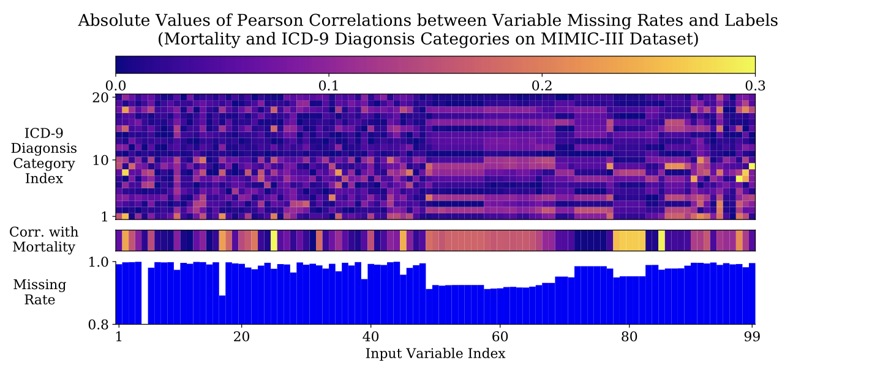
Introduction
Real world time series datasets have missing values
Common strategies
Omit missing data, analyze observed data only – bad performance when missing rate is high
Imputation: smoothing, interpolation, spline – not capturing correlations
Main motivation
The missing patterns are not effectively explored in the prediction model, thus leading to suboptimal analyses results

Slide 4
Outline
Introduction
Methods
Notations
GRU-RNN for time series classification
GRU-D: model with trainable decays (proposed method)
Baselines (imputation & prediction methods)
Results
Discussions
Summary

Slide 5
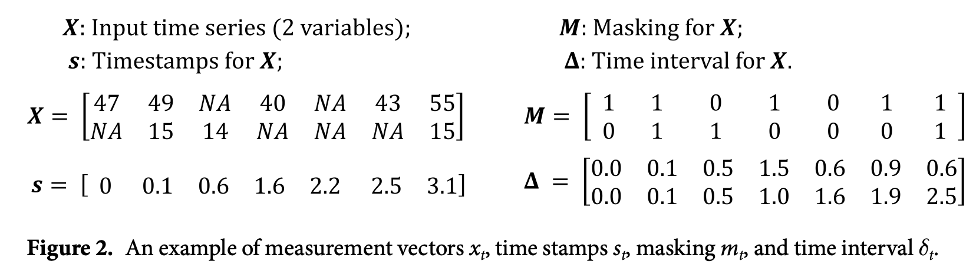
Notations

Slide 6
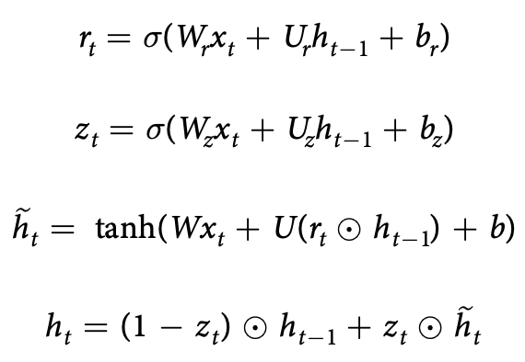
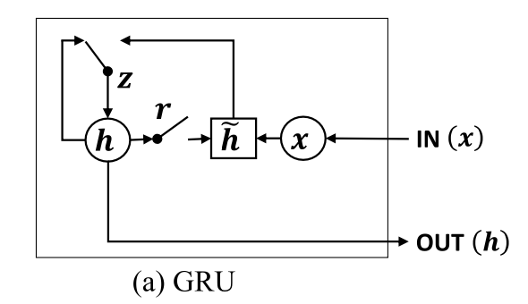



GRU-RNN for time series classification
Vanilla GRU
GRU-Mean
GRU-Simple w/o m
Feeding time stamps only along with input values
GRU-Forward
GRU-Simple w/o δ
GRU-Simple
Feeding masking with zero-filled missing values only in the recurrent neural network
Notes:
m is the mask

Slide 7
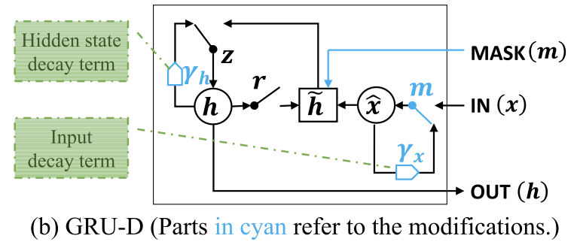


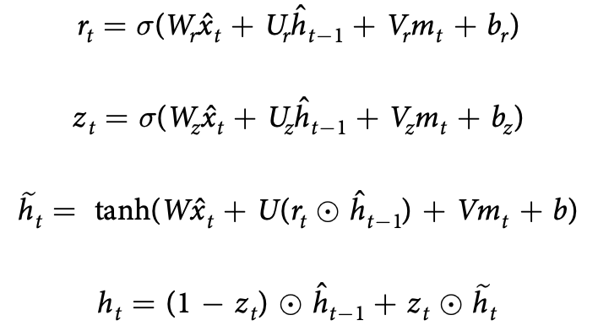
GRU-D: model with trainable decays
Decay rates (2 sets):
Decayed inputs:
Decayed hidden state:
2 empirical properties:
The new decayed unit:
The value of the missing variable tend to be close to some default value if its last observation happens a long time ago
The influence of the input variables will fade away over time if the variable has been missing for a while
Notes:
gamma_t: decay rates (learnable)
Decay rates for input x and hidden state h are different, so we basically have two different sets of learnable parameters: {W_gamma_x, b_gamma_x} and {W_gamma_h, b_gamma_h}

Slide 8
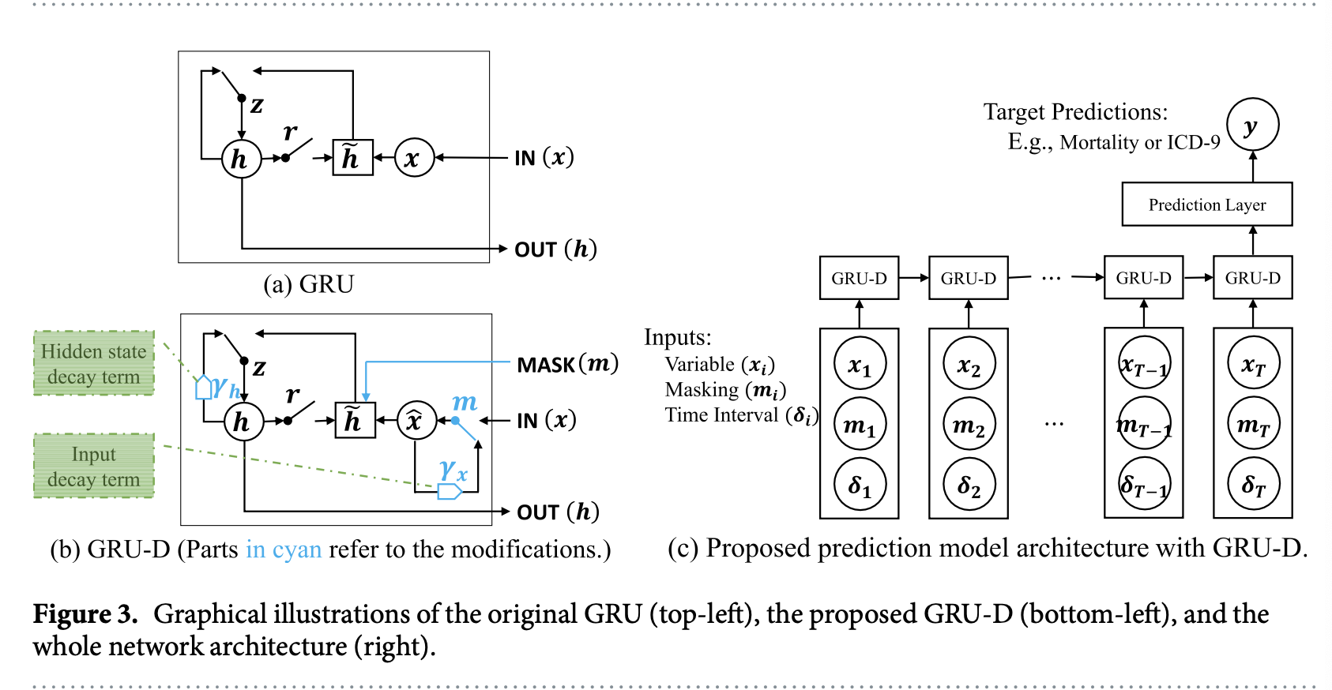
GRU-D: model with trainable decays
Notes:
MLP for prediction layer

Slide 9
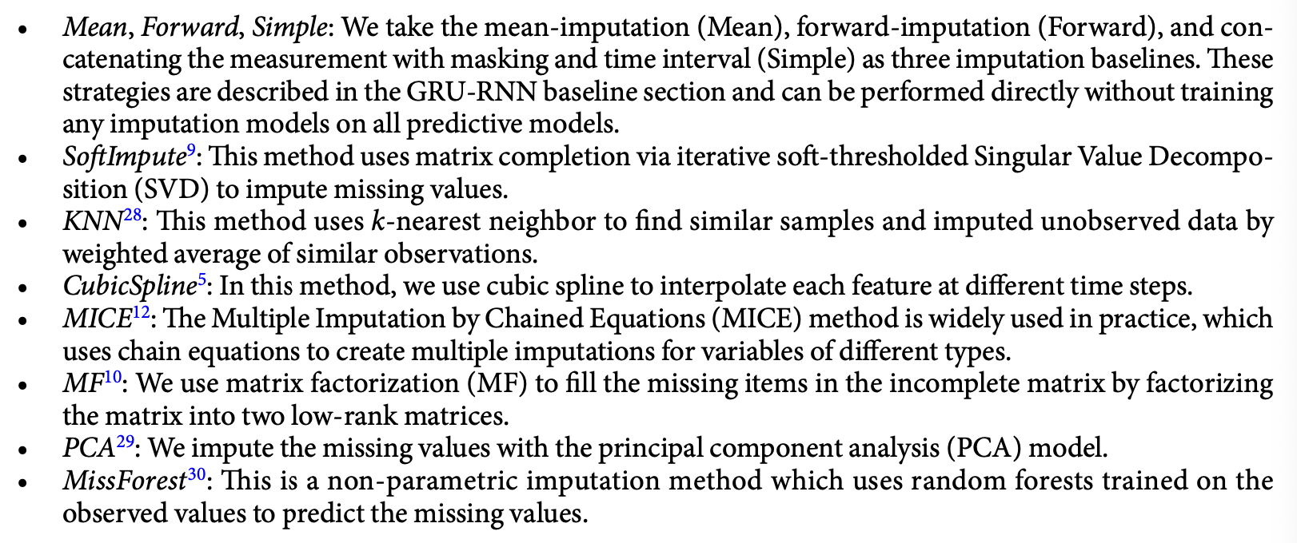
Baselines
Imputation methods

Slide 10
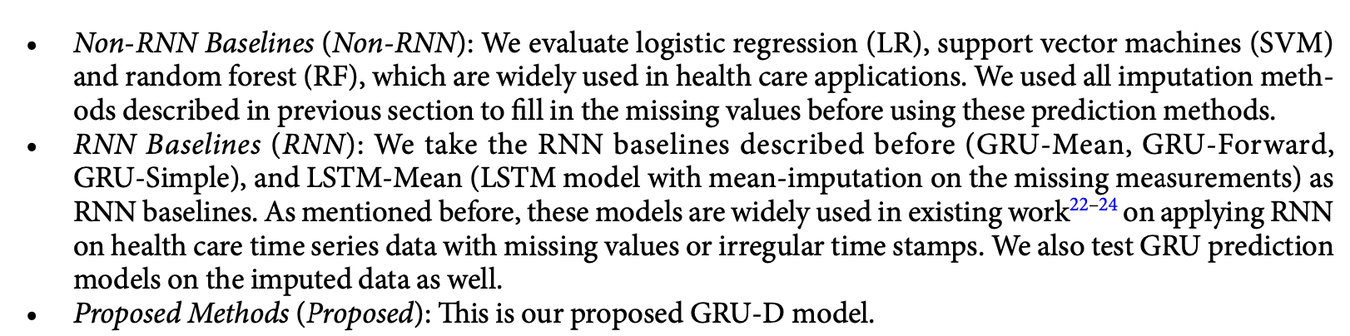
Baselines
Prediction methods

Slide 11
Outline
Introduction
Methods
Results
Dataset & tasks
Experiment results
Discussions
Summary

Slide 12
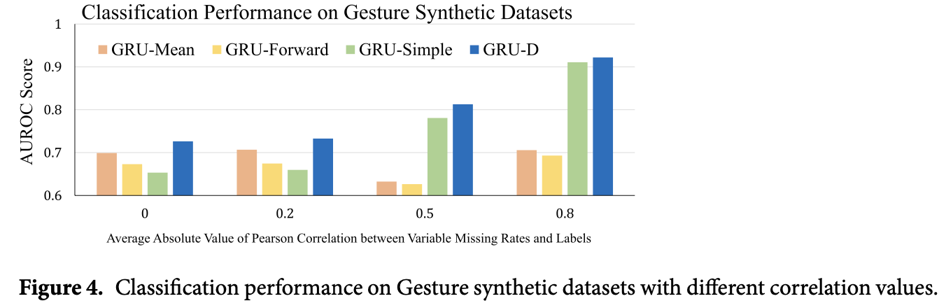
Datasets & tasks
Datasets
Gesture phase segmentation dataset (Gesture)
PhysioNet Challenge 2012 dataset (PhysioNet)
MIMIC-III
Tasks
Mortality prediction (binary classification)
ICD-9 Code (20 diagnosis categories classification)
Preliminary
Exploiting informative missingness on synthetic Gesture with 4 different correlation between missing rate and the label

Slide 13
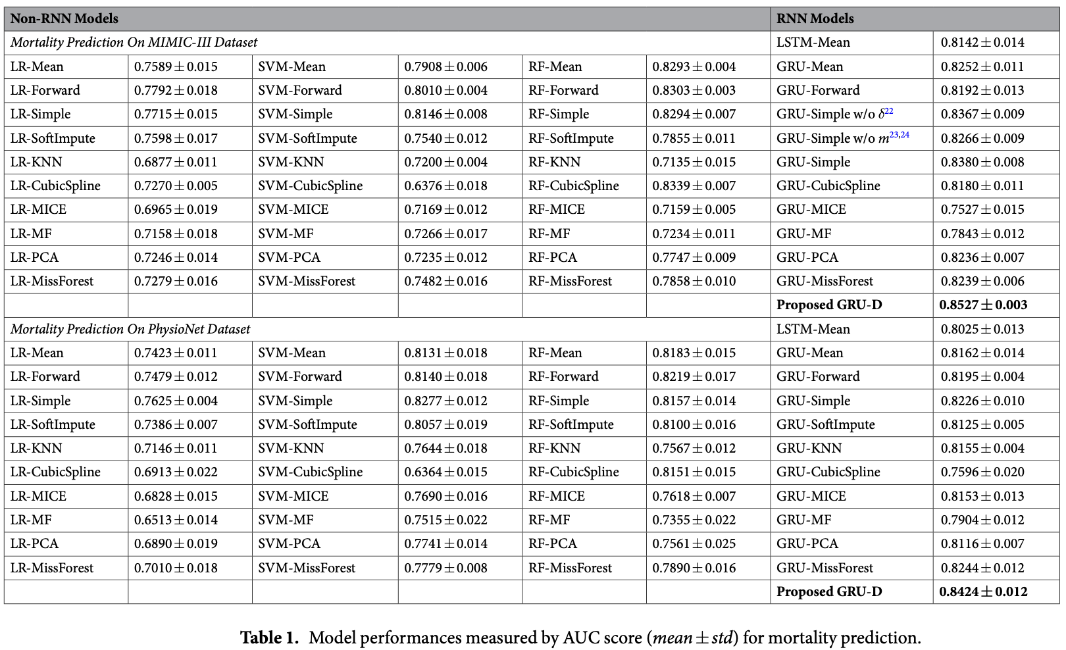
Experiment results

Slide 14
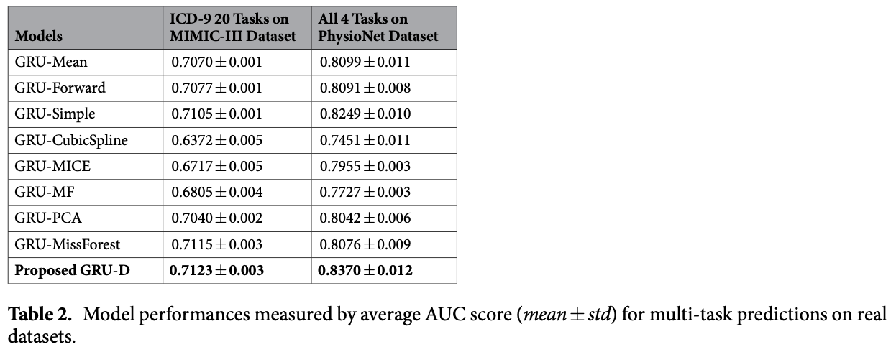
Experiment results

Slide 15
Outline
Introduction
Methods
Results
Discussions
Analysis on learnt decays
Early prediction capacity and model scalability with growing data size
Advantages & limitations
Summary

Slide 16
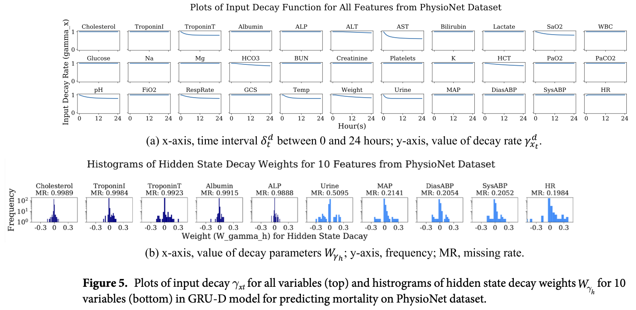
Analysis on learnt decays
Notes:
The decay rate is almost constant for the majority of variables. However, a few variables have large decay which means that the value of the observation at the current time step is very important for prediction, and the model relies less on the previous observations

Slide 17
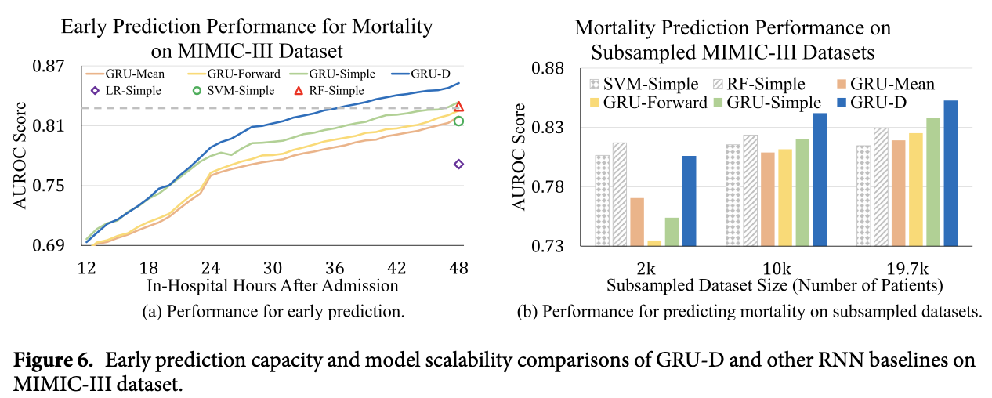
Early prediction capacity and model scalability with growing data size
Notes:
Although the proposed model is trained on the first 48 hours data and makes prediction at the last time step, it can make predictions on the fly with partial observations.

Slide 18
Advantages & limitations
Advantages
GRU-D is among the best of previous MIMIC-III mortality prediction studies
Limitations
If the missingness is not informative at all, or the inherent correlation between the miss- ing patterns and the prediction tasks are not clear, our model may gain limited improvements or even fail
The model is only evaluated in retrospective observational study settings
Notes:
Our model outper- formed the model with similar data settings46 by 1.27% AUROC score among RNN methods.
And a relative improvement of 2.2% AUROC score among non-RNN methods such as LR, SVM, random forest.

Slide 19
Outline
Introduction
Methods
Results
Discussions
Summary

Slide 20
Green Learning

Slide 21
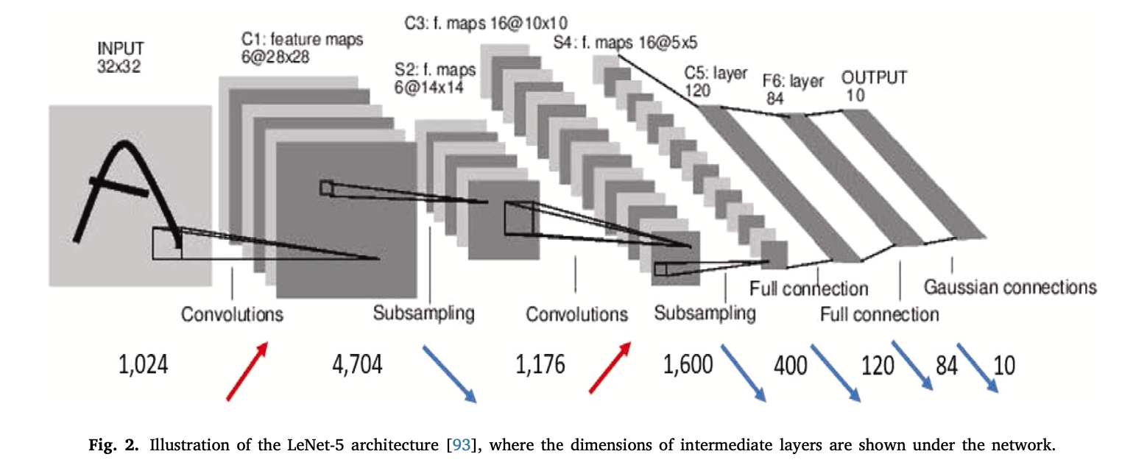
Motivation of GL
DL is successful, but…
Carbon footprint is high
Decision-making mechanism is opaque
Notes:
Where is the representation & where is the feature?
Different stages (feature subnet, decision subnet etc) are not explicitly defined in a typical DL pipeline. If we don’t consider specific paradigms such as pretrain-finetune, then usually DL is just an end2end, highly coupled black box. No modularity. You’ll need to train them all at once.

Slide 22
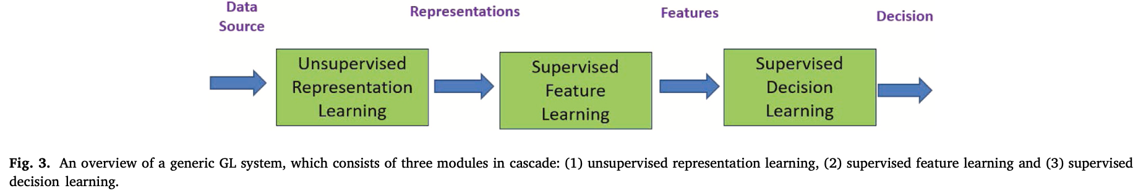
GL: A high-level sketch
GL: a learning paradigm characterized by:
Low carbon footprints
Lightweight models
Low computational complexity
Logical transparency.
Objectives:
Remove redundancy among the data source for concise representations.
Generate expressive representations.
Propose a system architecture that enables ensembles for performance boosting.
Select discriminant/relevant features based on supervision (i.e., training labels).
Allow feature and decision combinations in classifier/regressor design.
Notes:
3 features imo:
Feedforward manner in major parts of the architecture
Ensemble learning: from local to abstract level
Modularity

Slide 23
1. Subspace approximation
The process of
Grouping data (e.g. neighboring pixels) into basic units
Applying signal transforms to reduce correlation among these units
Transform kernels can be either
Predefined, e.g. DCT, FFT, KLT
Or data-driven, e.g. Saab (Subspace approximation via adjusted bias), Saak (Subspace approximation via augmented kernels)
Both are unsupervised
Summary
Focuses on reducing data redundancy for concise representations
Aims for dimensionality reduction without supervision.
Key for creating efficient and interpretable models

Slide 24
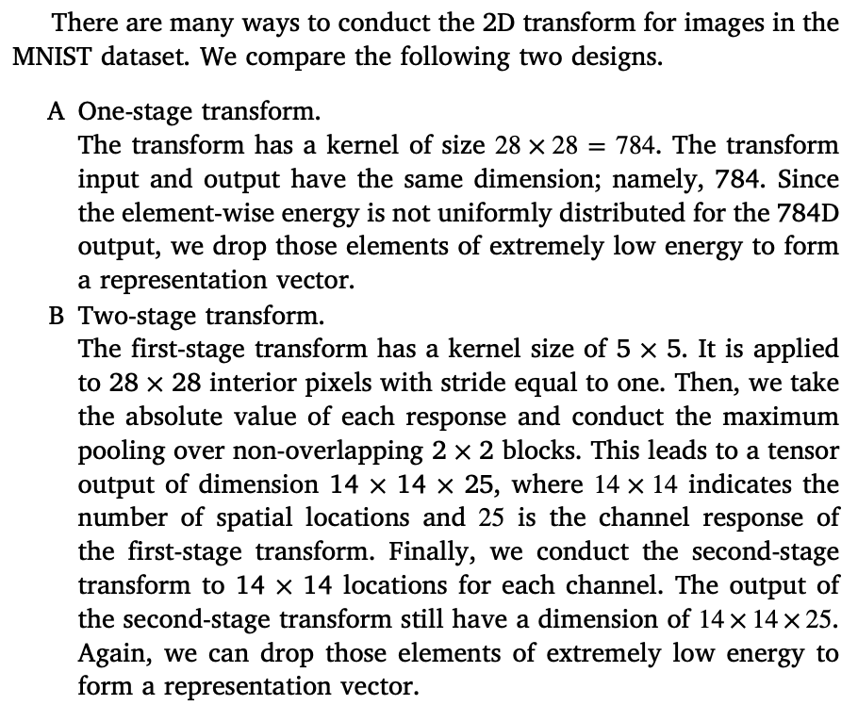
2. Generation of expressive representations
2 strategies for deriving expressive data representations:
single-stage
multi-stage transforms for capturing local and global variations
The generation of expressive representations can be
Unsupervised
Or supervised
Essential for achieving high-performance models
Notes:
This section explores strategies for generating expressive representations from data, crucial for effective machine learning. It contrasts single-stage and multi-stage transforms, with an emphasis on the advantages of the latter for capturing both local and global variations in data. The generation of expressive representations can be unsupervised or supervised, the latter involving the use of labels to guide the representation process, such as in attention mechanisms. GL’s methodology for creating expressive representations is key to its ability to produce models that are not only efficient but also capable of achieving high performance on various tasks.

Slide 25
3. Ensemble-enabled architecture
GL incorporates ensemble approaches to enhance model performance
DL filter responses are latent variables; filter weights change every time backpropagation is performed
GL filter weights are determined in a feedforward one-pass manner, so mechanisms for boosting learning performance is essential
Ensemble-enabled architectures combine responses at various stages to form ensemble features
Improves accuracy while ensuring efficiency and transparency

Slide 26
4. Discriminant features selection
Feature selection methods:
Unsupervised
Semi-supervised
Supervised
A supervised tool for ranking discriminant features: discriminant feature test (DFT)

Slide 27
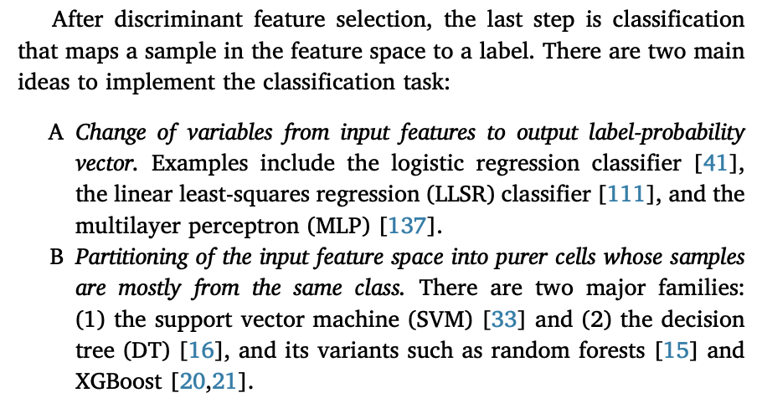
5. Feature space partitioning

Slide 28
Thanks & QA
Presenter: Dingyi Nie
3/29/24

