Slide 1
Stroke Data Analysis Sync
10/03/2024
Dingyi Nie

Slide 2
Outline
Relabeling & Pre-processing
Feature Selection & Post-processing
Regression
Feature Importance Analysis

Slide 3
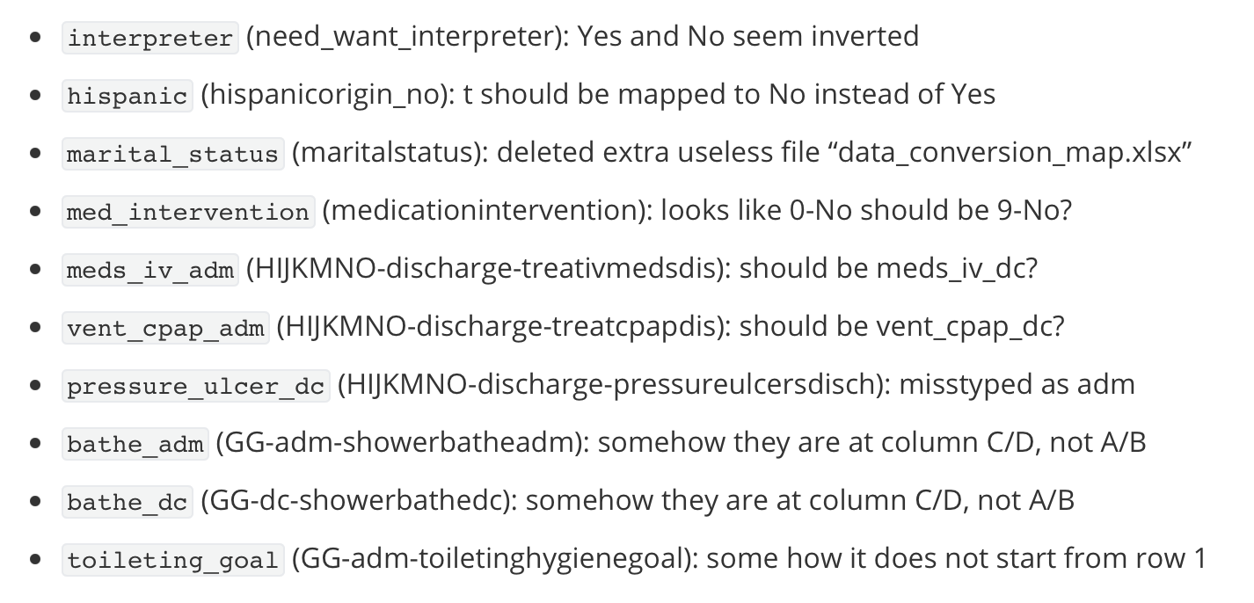
Some corrections to the processing tables

Slide 4
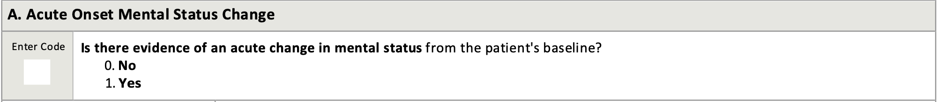
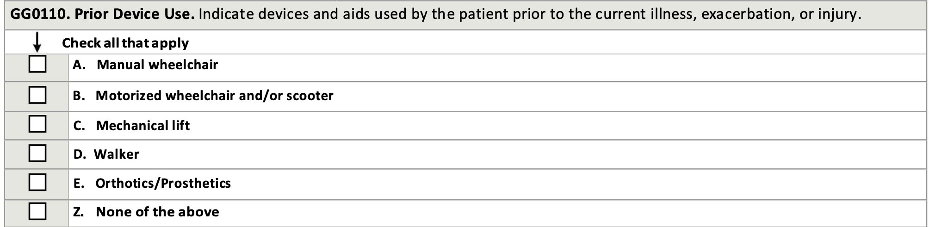
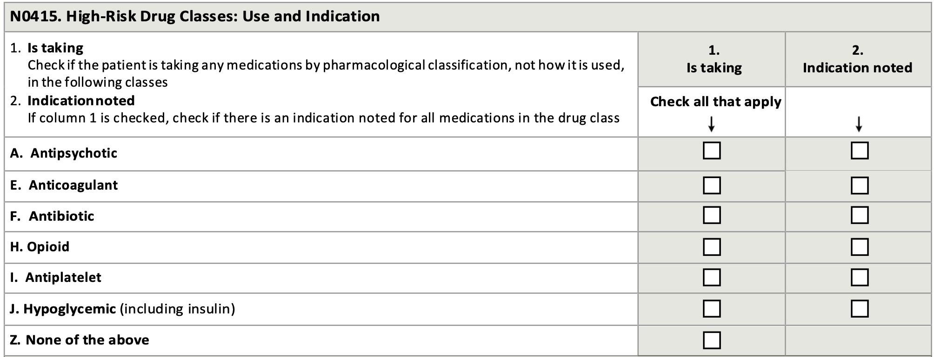
4 types of features
Binary
Including:
“yes or no”
“check all that apply”
Expected format: 0/1
Missing values: must be assigned 0/1 based on some prior assumptions

Slide 5
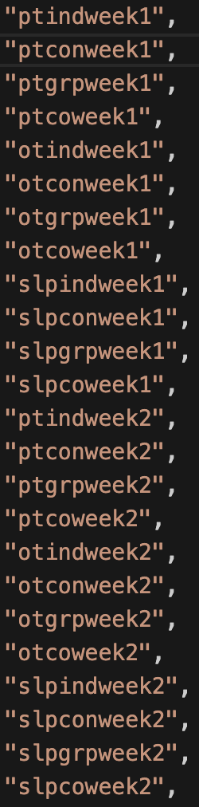
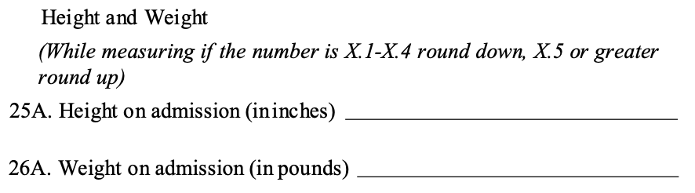
4 types of features
Binary
Numeric
Including:
all continuous numeric fields such as weight and height
treatment doses
Expected format: float64 literal value
Missing values: kept for later imputation

Slide 6
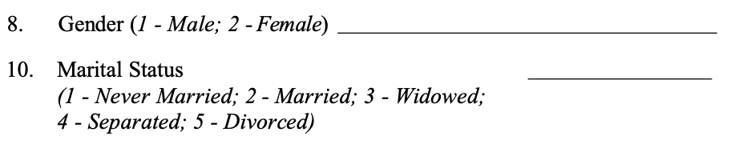
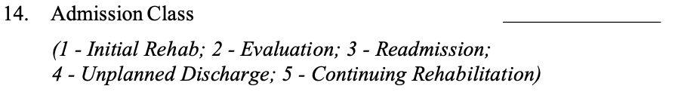
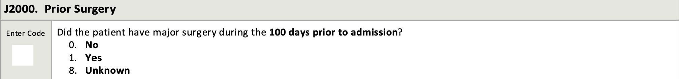
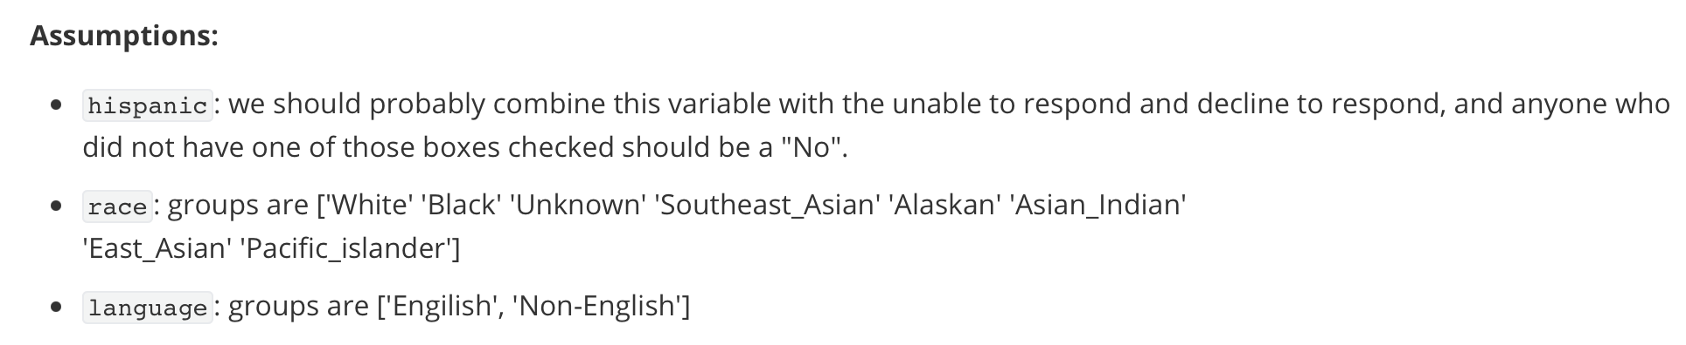
4 types of features
Binary
Numeric
Categorical
Including:
categorized labels (sex, admission unit type, …)
single choice questions with more than 3 possible choices
Expected format: string literal value
Missing values: replaced with “Unknown”

Slide 7
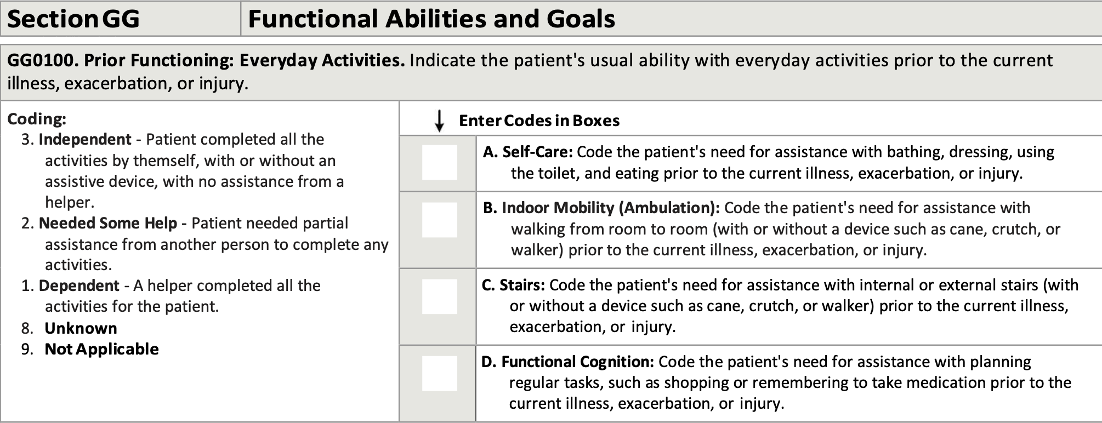
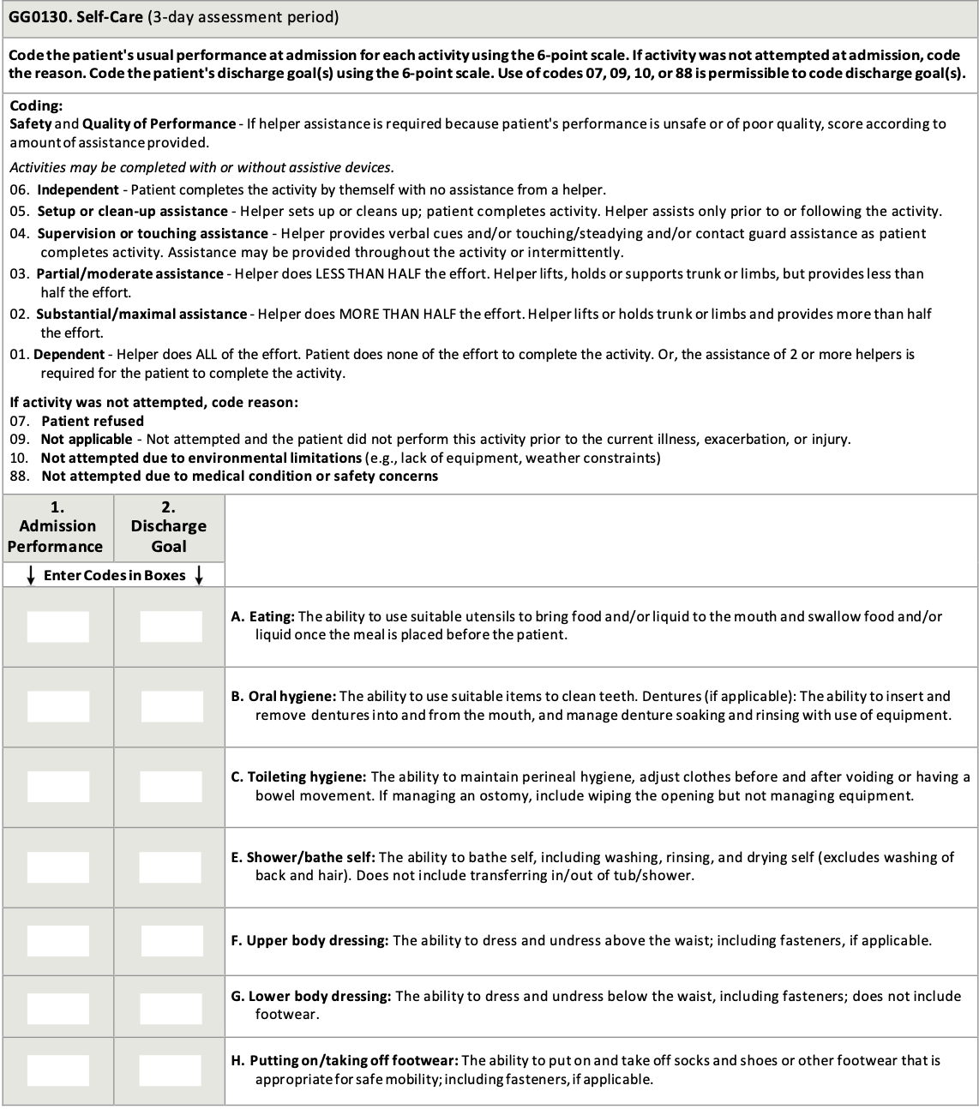
4 types of features
Binary
Numeric
Categorical
Ranked integer
Including:
all integer features with an inherent order, e.g. outcomes
Expected format: int literal value
Missing values: kept for later imputation; for outcome items, replaced with the least ordinal 1

Slide 8
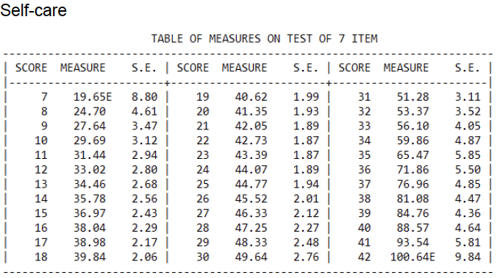
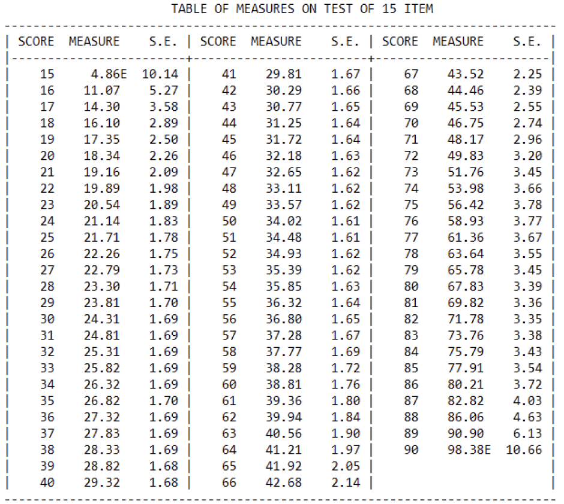
Regression Targets
selfcare_measure_delta
mobility_measure_delta

Slide 9
Outline
Relabeling & Pre-processing
Feature Selection & Post-processing
Interested predictors & outcomes
Imputation
One-hot expansion
Regression
Feature Importance Analysis

Slide 10
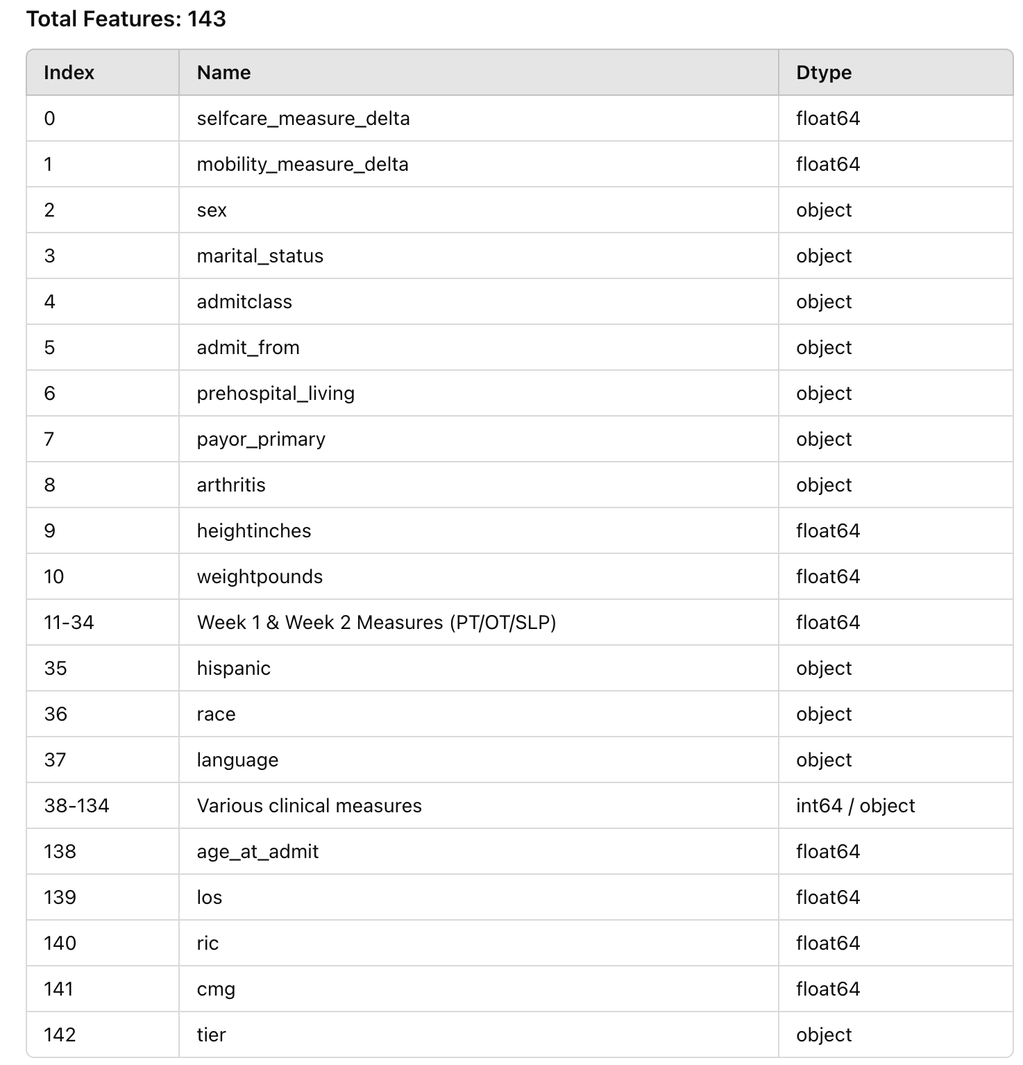
Interested Predictors & Outcomes

Slide 11
Imputation
First, define & fix data splits
Train vs eval vs test = 4:1:1
Default imputation strategy
Binary features: no need for imputation
Numeric features: replace NaNs with the feature’s mean on training set
Categorical features: added extra “Unknown” class, no further need for imputation
Ranked integer features: replace NaNs with the feature’s mode on training set

Slide 12
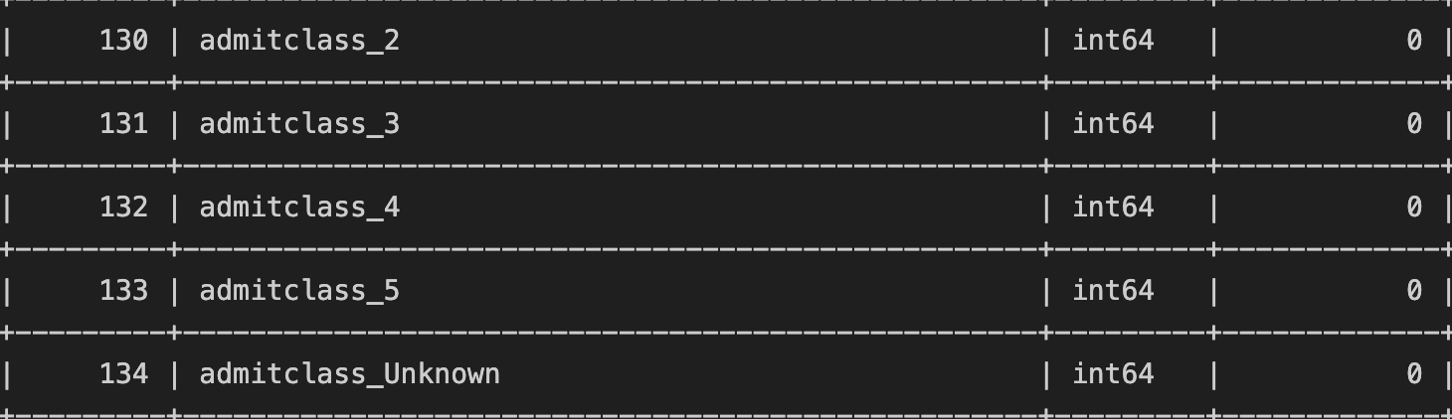
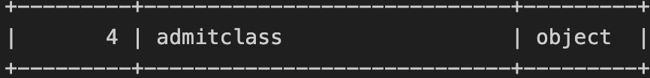
One-hot Expansion
Performed on all categorical features
1 categorical feature with N classes -> N-1 expanded binary features (drop-first)
After expansion, # of features: 142 -> 187
before
after

Slide 13
Outline
Relabeling & Pre-processing
Feature Selection & Post-processing
Regression
Feature Importance Analysis

Slide 14
Recap
185 predictors, 2 targets
selfcare_measure_delta
mobility_measure_delta
Fit the model to training set (2/3)
Random Forest
XGBoost
Tune the hyper parameters on evaluation set (1/6)
Test the regressor on test set (1/6), report metrics:
MSE
R²

Slide 15
Results
Metrics | RF (on train set) | RF (on test set) | XGB (on train set) | XGB (on test set)
Selfcare MSE | 40.79 | 296.9 | 181.6 | 296.2
Selfcare R² | 0.9098 | 0.3411 | 0.5985 | 0.3425
Mobility MSE | 40.80 | 288.5 | 177.5 | 284.7
Mobility R² | 0.9032 | 0.3015 | 0.5787 | 0.3106

Slide 16
Outline
Relabeling & Pre-processing
Feature Selection & Post-processing
Regression
Feature Importance Analysis

Slide 17
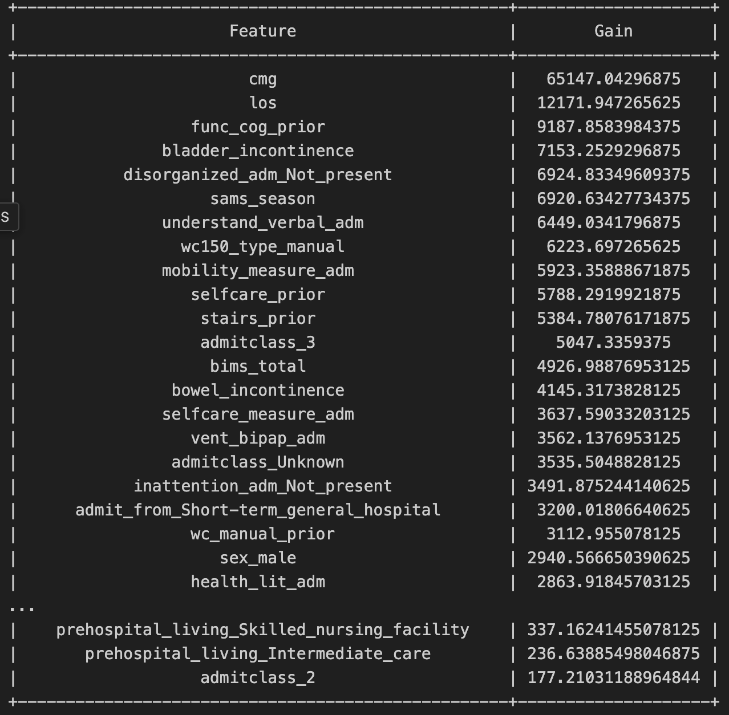
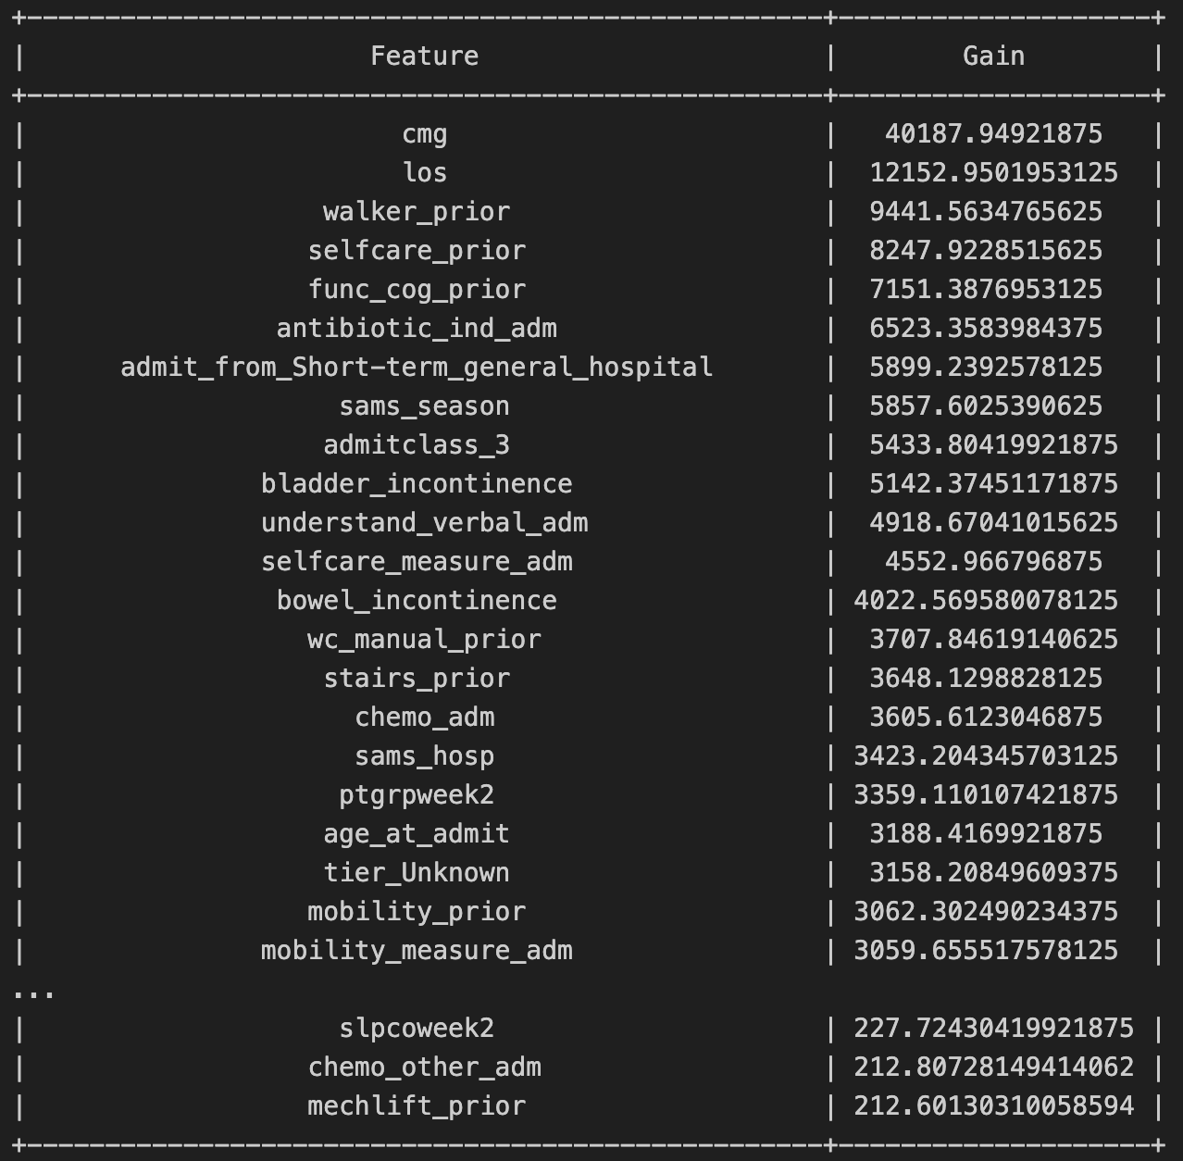
XGBoost - Gain
Measures how much each feature contributes to lowering the global loss
selfcare
mobility

