Slide 1
Advanced Computer Architecture
Daniel Weaver
ra18837

Slide 2
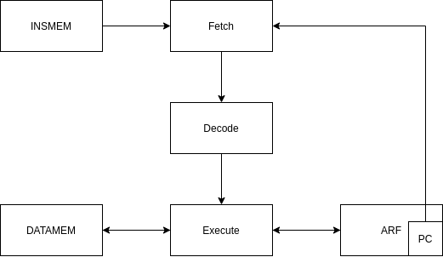
Current Processor Diagram

Slide 3
Features
6 stage pipeline (Fetch, Decode, Issue, Execute, Broadcast, Commit)
Out of Order Execution
Superscalar
Speculative Execution
2 Bit Dynamic Branch Prediction via BTB
Load Store unit with 20 entry LSQ, Branch unit, Mult Div unit, Int unit all with 4 entry grouped reservation stations
Re-order Buffer allowing for register renaming
Broadcast allows for result forwarding
LSQ with go-anyway loads and store forwarding
Non-blocking issues (unless RS’s or ROB is full)
32 registers, 30 general pupose + PC + SP
4096 word memory

Slide 4
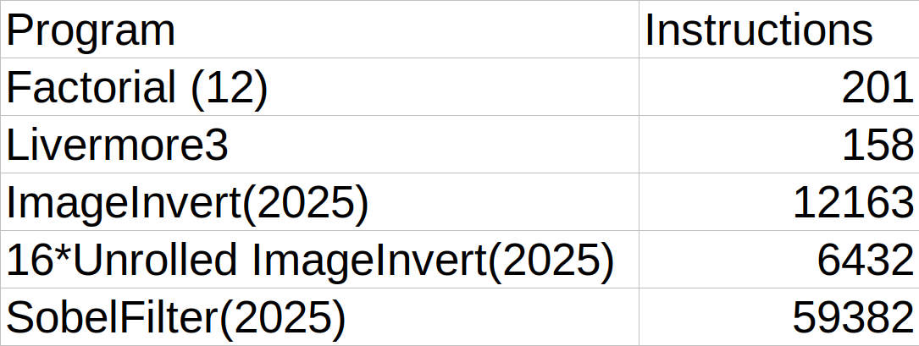
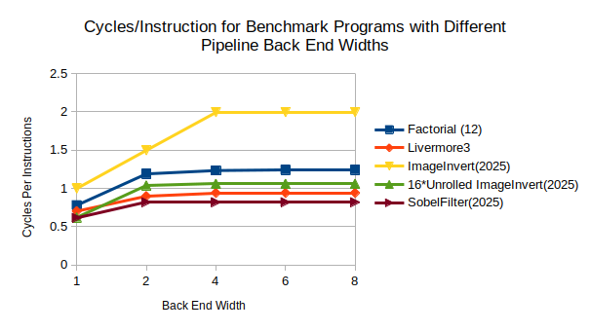
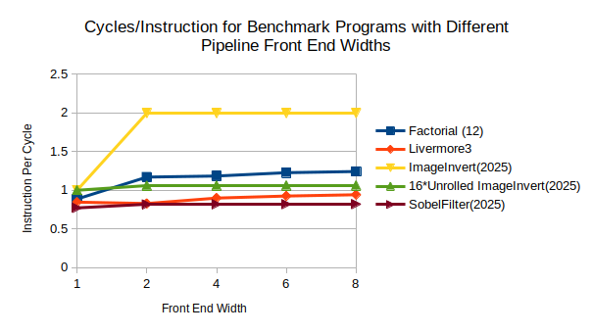
Effect of Pipeline Width
Hypothesis: Increase in pipeline width will increase processor performance (IPC), but performance gains will platau as programs don’t have high enough ILP
Experiment: A selection of programs are run on the processor with 1 integer units, 1 load/store unit, 1 branch unit and 1 mult/div unit. The width of the front end and backend will be increased through 1,2,4,6,8 with the opposing end of the pipeline having a width of 16 as to not bottleneck the other. ROB at 1024
Result:

Slide 5
RS Selection Policy
Hypothesis: Random, oldest first, newest first, most depended on. Random selection and oldest first will have similar performance, random being slightly worse as it is assumed that more instructions will depend on the oldest instruction, most depended on should be fasteset (ties broken by oldest first).
Experiment: A selection of programs will be run on a 4 way superscalar processor, RS’s will each have 4 entries (WHY!!) and the LSQ 20. The selection policy for all RS’s and LSQ will be the same.
Result:

Slide 6
Effect of different no. of execution units
Hypothesis: More execution units will incease performance to a point. Load store units and int units will have the most effect as most of the test programs are made up of these instructions, mult/div and branch units will give less of a performance increase.
Experiment: No. of execution units is increased and ipc is recorded for benchmark programs.
Result:

Slide 7
Benchmarks
How close can cpu get ILP of program
Effect of additional load/store units and int units
RS size
ROB size
Effect of pipelining
Effect of OoO vs pipelining vs non-pipelining
Effect of superscalar
Not taken vs 2 bit dynamic

