Slide 1
STOCK MARKET ANALYSIS AND PREDICTION
Financial Data Science – Summer 2023
Project done by –
Anushka Dhekne (VD19739)

Slide 2
CONTENTS
Motivation
Problem Statement
Solution
Data Gathering
Data Preprocessing
Data Normalization
LSTM Model
Questions Answered
Inference
Prediction Results and Accuracy evaluation
Future Scope and Conclusion

Slide 3
MOTIVATION
The fluctuation of stock prices and the overall stock market is extremely complicated as per the world scenarios and situations going on in the world at that time. The advancement in technologies provides an opportunity to gain steady and regular profits with annual margins from the stock market to get informative indicators to make better predictions in the future and helps to keep the investment risks low.

Slide 4
PROBLEM Statement
The aim of the project is to examine several different data values, analyze different stocks like META, NETFLIX, TESLA, NVIDIA. The analysis includes comparison of stock opening and closing prices at different dates of a year. The prediction of stock returns based on past daily returns and numerical indicators to construct a portfolio of multiple stocks in order to diversify the risk. I have used a supervised learning method – LSTM (Long Short-Term Memory) for stock price forecasting by interpreting irregular / regular data.

Slide 5
solution
Data Gathering and Stock Access
Data Pre-processing and Cleaning
Data Normalization
Data Analysis and Visualization
Data Split – Train and Test
Stock Price Prediction
Accuracy Detection

Slide 6




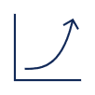
System architecture
Step 1
Step 2
Step 3
Step 4
Step 5
Dataset Preparation & Cleaning
Feature Extraction and Train – Test Split
LSTM Model Construction
Stock Predictions
Accuracy Evaluation

Slide 7
Data gathering
I have considered stocks of companies like META, NETFLIX, TESLA and NVDIA. This data has been taken from the Historical Stock Market Data for 500 companies of S&P 500 Market since the companies have come into existence.
The base features in this data are – Open, High, Low, Close, Adjusted Close, Volume of Daily Stocks as per the S&P500 Index.

Slide 8
Data preprocessing
Step in which data is loaded into the system, it gets transformed and then gets cleaned for model building.
Clean data can be easily parsed and reused for different functions or to interpret the algorithm and predict future values.
Used to handle missing data, noisy data and inconsistent data by transforming or dropping it.

Slide 9
Data normalization
Data needs to be normalized to make it consistent over a given algorithm or machine learning model.
I have used ‘MinMaxScaler’ from the sklearn.preprocessing library to scale the cleaned data to fit it into the LSTM model without losing values or important information.

Slide 10
Lstm model
LSTM stands for long short-term memory networks, used in the field of Deep Learning. It is a variety of recurrent neural networks (RNNs) that are capable of learning long-term dependencies, especially in sequence prediction problems. LSTM networks have been used on a variety of tasks, including speech recognition, language modeling, and machine translation. LSTM is a type of RNN with higher memory power to remember the outputs of each node for a more extended period to produce the outcome for the next node efficiently. LSTM networks combat the RNN's vanishing gradients or long-term dependence issue. It is used for time-series data processing, prediction, and classification. LSTM has feedback connections, unlike conventional feed-forward neural networks.
Alternative Algorithms – Multi-Layered Perceptron, Support Vector Machine

Slide 11
Questions answered In the project
Over a period, what change or difference in price is depicted by the stock in consideration?
What is tentative moving average of a given stock?
What is the daily return on an average of a given stock?
What is the closing price of a given stock and what is the correlation between any given stocks' closing prices?
How much value or amount is risked after investing in a stock?
What will the future closing prices of a given stock be?

Slide 12
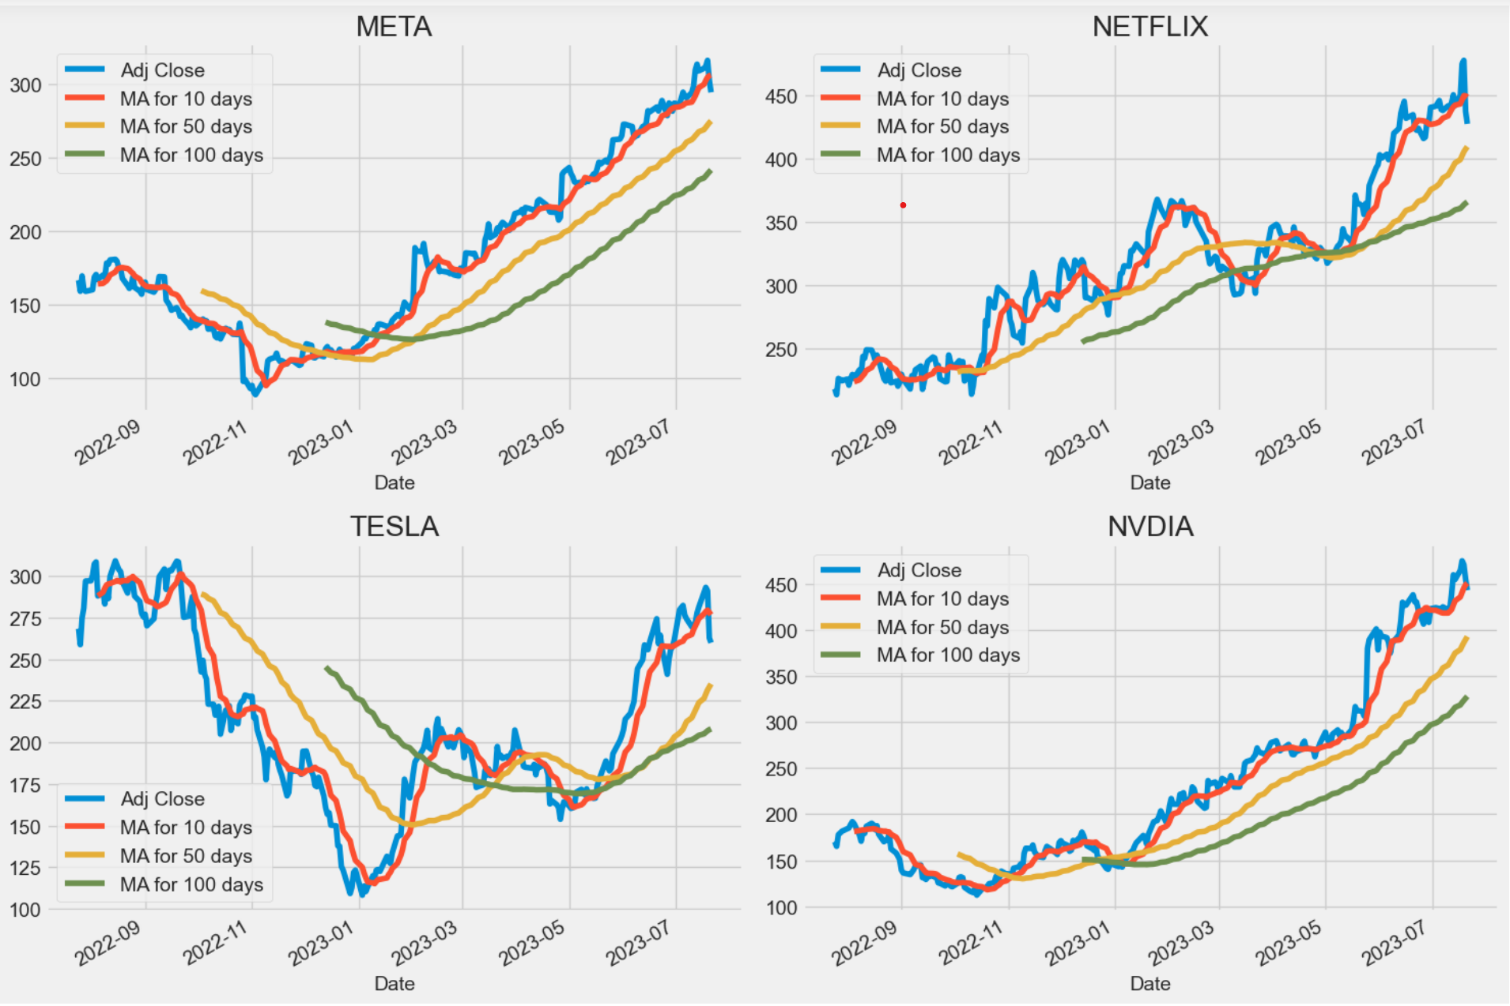
Moving average of stocks
The moving average or is a technical analysis tool to smoothen out price data by creating a constantly updated average price. The average is taken over a specific period, like 10 days, 10 weeks, etc.

Slide 13
inferences
Sales volume (volume of stocks traded that day) have been at a peak during the last quarter for META and NETFLIX, during the first quarter for TESLA and during the second quarter for NVDIA.
The moving average for all 4 companies’ stocks dip extremely low towards the end of the year and show a sharp increase from the second quarter till it reaches the peak around July.
The average daily return has been nullified to be around 0.0 for all four companies.
Numerically and visually, NVDIA and TESLA have the strongest correlation of daily stock return and NVDIA and META have the strongest correlation of stock closing price.
For companies like META and NVDIA, the expected return is always high when the risk in investment is high. For TESLA, even if the investment risk is high, the expected return is quite less. Whereas, for NETFLIX, even if the investment risk is low, the expected return is high.
The closing price history plot of META was maximum during the COVID period from 2020 to 2022. It has dipped way below it’s peak point during the year 2023. It is expected to rise again after 2023.

Slide 14
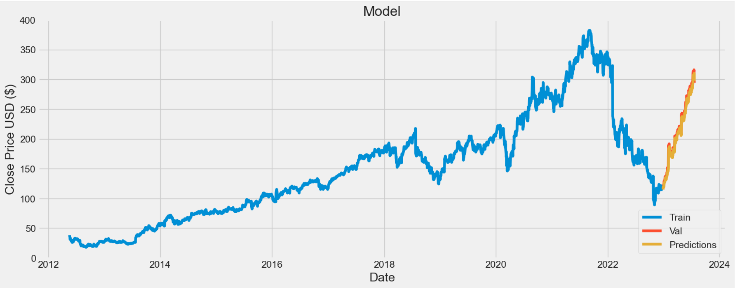
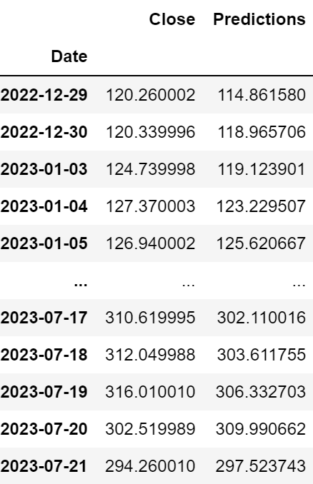
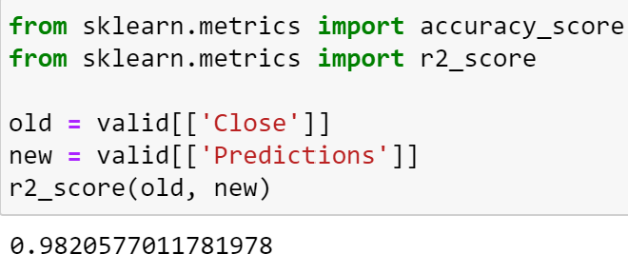
Stock Prediction results and model accuracy evaluation
Prediction Accuracy – 98.20%

Slide 15
Future scope
We can also use social media to predict stock return values. Twitter’s Daily Sentiment Score for each company based upon the user’s tweets about that company and the tweets on that company page. Once the set of features is ready, the data can be normalized for better accuracy and results.

Slide 16
conclusion
In this project, I have used data collected from Yahoo Finance by using the S&P500 Stock Index to predict the future stock closing prices of companies. I have used LSTM – the machine learning model to predict the daily trend of market stocks, which shows high efficiency and accuracy. The accuracy of this model is 98.20%, for 50 epochs.

Slide 17
THANK YOU

