Slide 1
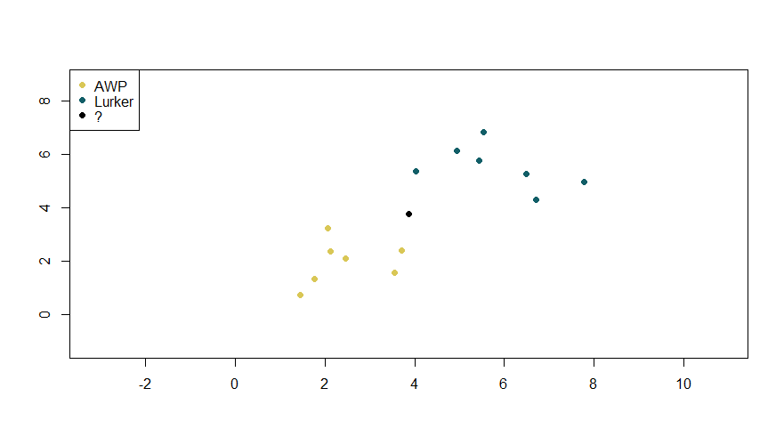
K = 7
K = 3

Slide 2
K = 3

