Slide 1
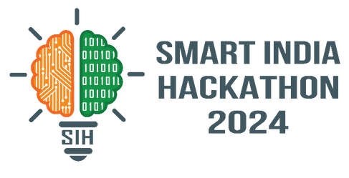

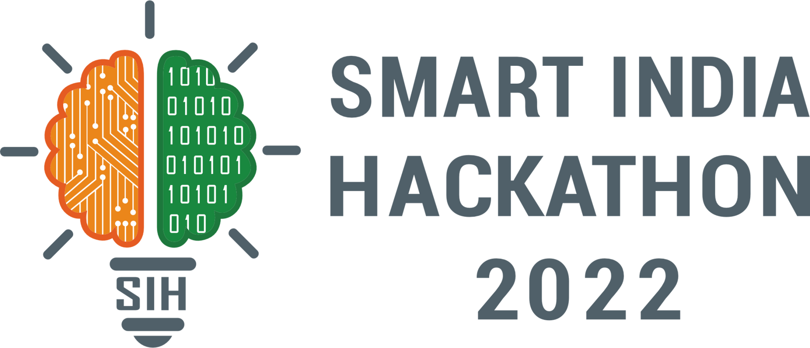
SMART INDIA HACKATHON 2024
TITLE PAGE
Problem Statement ID – 1728
Problem Statement Title- Development of a
Paperless Scholarship Disbursement System
for PMSSS
Theme- Miscellaneous
PS Category- Software
Team ID-
Team Name - Innoverve

Slide 2
IDEA TITLE
Team
innoverve
Proposed Solution
Solution Overview
Scholarship portal: This is a web-based comprehensive, fully digital system for the submission, verification, and disbursement of PMSSS scholarships. Enabling a smoother and faster verification and disbursement of scholarships without the need for hard copies.
Key Features
Fully digital solution: Allows users to upload,submit, and manage the required documents directly through the portal.
Automatic forwarding: Ensures that the important documents reach the financial bureau without delays, and reduces the need for manual handling.
Notifications: Keep students informed about their submissions and payment status through a notification panel.
Secure portal: Enhances security, prevents fraud, and improves document verification processes' efficiency.
Automatic document verification: Streamlines and automates the process of verifying documents without the need of physical copies.
Accessibility features: Provides equal access to upload their documents digitally and track their submission status for all users.
2
Notes:
2

Slide 3
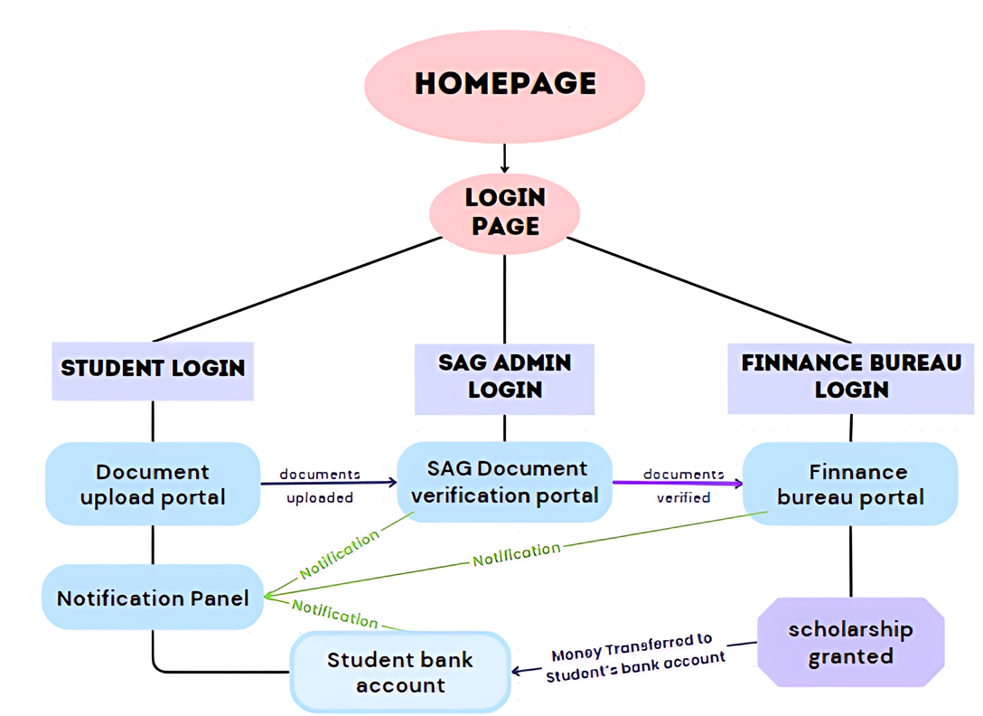




Team
innoverve
TECHNICAL APPROACH
TechStack
Flowchart
CSS
3
Notes:
3

Slide 4
Your Team Name
Team
innoverve
FEASIBILITY AND VIABILITY
Feasibility and Potential challanges:
Internet Connectivity: The system relies on a stable internet connection for both applicants and administrators. Implementing long-range connectivity at low power can assist everyone to participate in the digital world.
Cybersecurity: Robust security measures are vital to protect sensitive student and financial data. Strengthening practices around the protection of sensitive information including encryption, firewalls, etc.
Integration: The system must seamlessly integrate with existing student information systems, Document verification systems, and financial management systems(like upi).
Digital Literacy: Students and staff must have sufficient digital literacy to use the system effectively. Providing training and support can help address any digital literacy gaps.
Scalability: The system should be able to accommodate future growth in the number of applicants and disbursements.
4
Notes:
4

Slide 5
IMPACT AND BENEFITS
Team
innoverve
Your Team Name
Potential Impact on the Target Audience
Students:
Reduced paperwork: Students will no longer need to submit physical documents, saving time and effort.
Faster processing: The digital system can expedite the verification and disbursement process, allowing students to receive funds more quickly.
Improved accessibility: Students in remote areas with limited access to physical offices can easily submit and track their applications online.
Administrators:
Increased efficiency: The digital system can streamline administrative tasks, reducing manual labor and errors.
Improved data management: Electronic records are easier to store, retrieve, and analyze, enhancing data management capabilities.
Enhanced transparency: A digital system can increase transparency in the scholarship disbursement process, reducing the risk of fraud and corruption.
Benefits of the solution:
Social Equality: A digital system can help ensure that scholarships are distributed fairly and equitably to eligible students, regardless of their location or socioeconomic background.
Enhanced accessibility: The system can make it easier for students with disabilities to access scholarships.
Cost savings: The digital system can reduce administrative costs associated with paper-based processes, such as printing, postage, and storage.
Time savings: The system can expedite the disbursement process, allowing students to use the funds more quickly for their educational expenses.
Reduced paper consumption: By eliminating the need for paper documents, the system can reduce the environmental impact of the scholarship program.
Improved sustainability: The digital system can contribute to a more sustainable and environmentally friendly approach to education.
5
Notes:
5

Slide 6
Team
innoverve
Your Team Name
RESEARCH AND REFERENCES
References & Links:
AICTE: For a comprehensive overview of PMSSS.
https://www.aicte-india.org/pmsss-2022-23
buddy4study: To understand the application process of PMSSS.
https://www.buddy4study.com/article/pmsss
National portal of INDIA: To understand the Efforts for Efficiency
https://www.india.gov.in/.
NSP & MNSSBY: To understand and refrence other similar government portals
https://scholarships.gov.in/
https://www.7nishchay-yuvaupmission.bihar.gov.in/
6
Notes:
6

