Slide 1
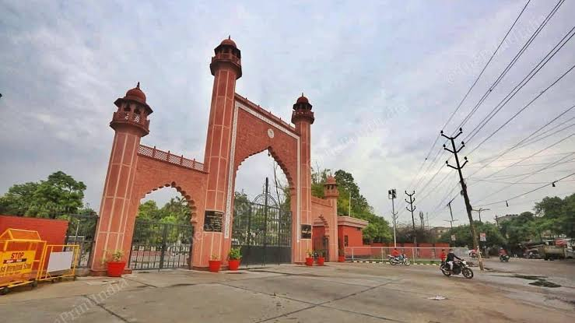
Aligarh
Times
Heritage
The legacy of
Eighteenth-century
French adventures
of Maratha
army at Aligarh
Cover Story
Food for Thought

