Slide 1
Logistic Regression
K-nearest neighbor (KNN) classifier
K-mean clustering
Expectation Maximization (EM) clustering
Hierarchical clustering

Slide 2
Logistic Regression
Slides collected from Internet ----some adapted from the following site
http://personal.ecu.edu/whiteheadj/data/logit/logit.ppt
And from notes from Kimberly Maier, Michigan State University

Slide 3
Why use logistic regression?
There are many important research topics for which the dependent variable is "limited."
For example: whether or not a person smokes, or drinks, or skips class, or takes advanced mathematics. For these the outcome is not continuous or distributed normally.
Binary logistic regression is a type of regression analysis where the dependent variable is a dummy variable: coded 0 (did not smoke) or 1(did smoke)

Slide 4
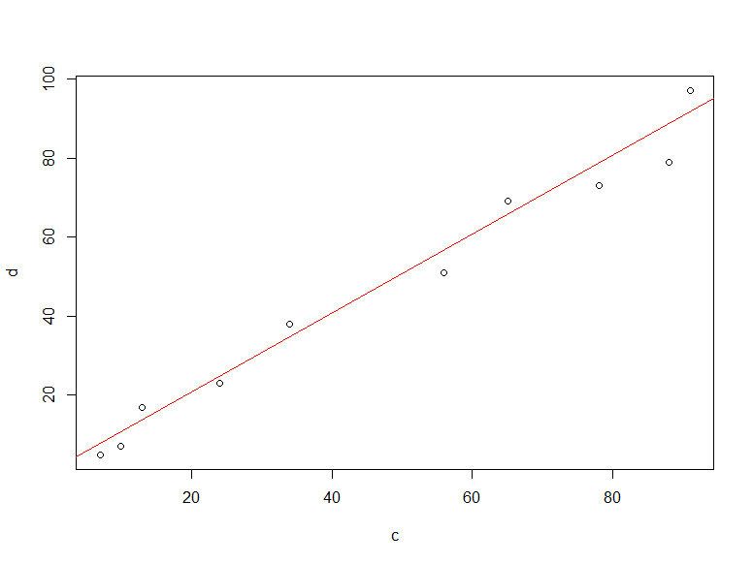
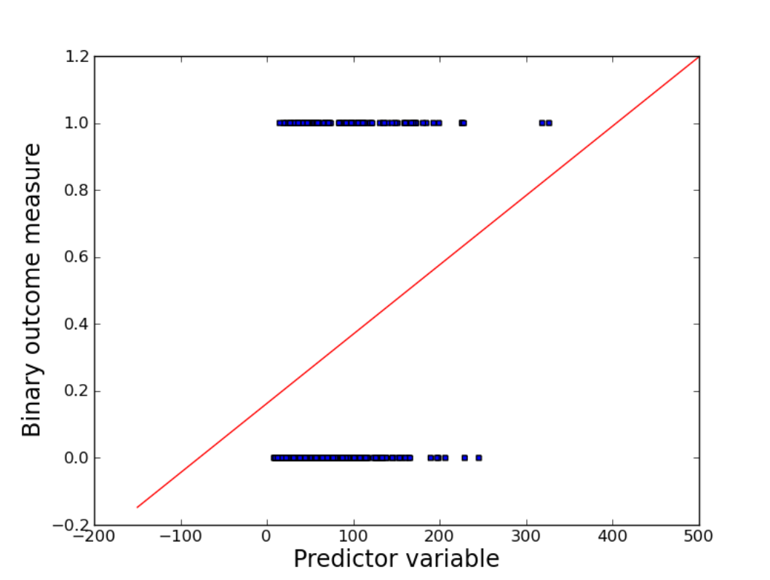
Data types for normal/ordinary regression and Logistic regression
Normal regression is suitable
Logistic Regression is Suitable

Slide 5
A Problem with Linear Regression
What if we have a non-normally distributed dependent variable? The following example depicts the problem of fitting a regular regression line to a non-normal dependent variable).
Suppose you have a binary outcome variable. The problem of having a non-continuous dependent variable becomes apparent when you create a scatterplot of the relationship. Here, we see that it is very difficult to decipher a relationship among these variables.

Slide 6
A Problem with Linear Regression
We could severely simplify the plot by drawing a line between the means for the two dependent variable levels, but this is problematic in two ways: (a) the line seems to oversimplify the relationship and (b) it gives predictions that cannot be observable values of Y for extreme values of X.
The reason this doesn’t work is because the approach is analogous to fitting a linear model to the probability of the event. As you know, probabilities can only take values between 0 and 1. Hence, we need a different approach to ensure that our model is appropriate for the data.

Slide 7
A Problem with Linear Regression
In the OLS regression:
Y = β₀ + β₁X + e ; where Y = (0, 1)
e is not normally distributed because Y takes on only two values
The predicted probabilities or the predicted values of y can be greater than 1 or less than 0

Slide 8
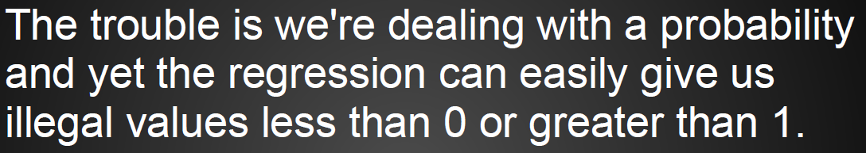
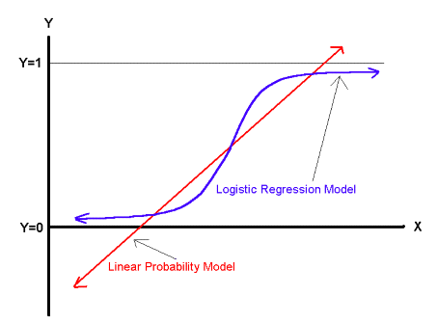
A Problem with Linear Regression
A solution is to calculate probability of y for a given x using the following equation

Slide 9

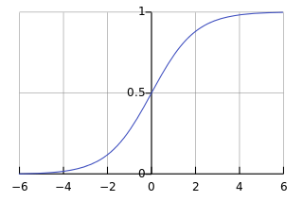
Definition of the logistic function
An explanation of logistic regression can begin with an explanation of the standard logistic function. The logistic function is useful because it can take an input with any value from negative to positive infinity, whereas the output always takes values between zero and one and hence is interpretable as a probability. The logistic function is defined as follows:
A graph of the logistic function with respect to t for the interval (-6,6) is shown in figure below
t vs. F(x)

Slide 10

Definition of the logistic function
Let us assume that t is a linear function of a single variable x. Then, we can express as follows:
And the logistic function can now be written as:
t vs. F(x)

Slide 11

The Logistic Regression Model (Summary)
Using normal regression model we can calculate a value for dependent variable y as follows:
x also can be multidimensional. After estimating y we can calculate the probability of y as follows
Note that F ( x ) is interpreted as the probability of the dependent variable equaling a "success“
Or
F(X) > 0.5 can be regarded as a class and
F(x)<0.5 can be regarded as another class
t vs. F(x)
Logistic regression can be applied not only when the dependent variable is a dummy variable: coded 0 (did not smoke) or 1(did smoke) but also when it is a continuous variable for the purpose of dividing entities in to two classes

Slide 12
K-nearest neighbor (KNN) classifier
Information collected from the following site:
http://www.saedsayad.com/k_nearest_neighbors.htm

Slide 13
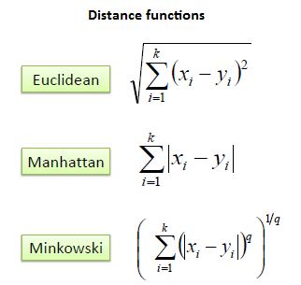
K-nearest neighbor (KNN) classifier
A case is classified by a majority vote of its neighbors, with the case being assigned to the class most common amongst its K nearest neighbors measured by a distance function. If K = 1, then the case is simply assigned to the class of its nearest neighbor.
It should also be noted that these distance measures are suitable for continuous variables.

Slide 14
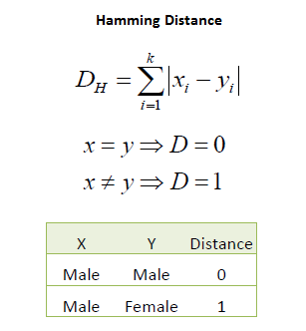

K-nearest neighbor (KNN) classifier
In the instance of categorical variables the Hamming distance might be used.
It also brings up the issue of standardization of the numerical variables between 0 and 1 when there is a mixture of numerical and categorical variables in the dataset.

Slide 15
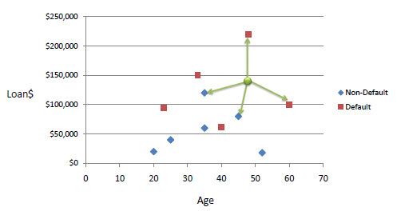
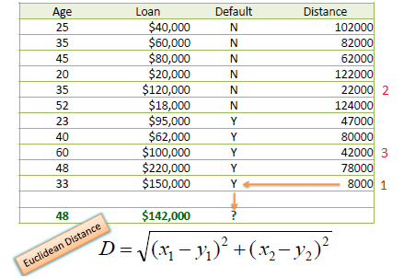
K-nearest neighbor (KNN) classifier
Example:
Consider the following data concerning credit default. Age and Loan are two numerical variables (predictors) and Default is the target.
We can now use the training set to classify an unknown case (Age=48 and Loan=$142,000) using Euclidean distance.
If K=1 then the nearest neighbor is the last case in the training set with Default=Y.
D = Sqrt[(48-33)² + (142000-150000)²] = 8000.01 >> Default=Y
With K=3, there are two Default=Y and one Default=N out of three closest neighbors. The prediction for the unknown case is again Default=Y

Slide 16
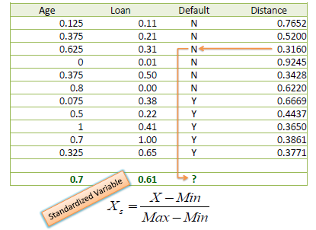
K-nearest neighbor (KNN) classifier
One major drawback in calculating distance measures directly from the training set is in the case where variables have different measurement scales or there is a mixture of numerical and categorical variables. For example, if one variable is based on annual income in dollars, and the other is based on age in years then income will have a much higher influence on the distance calculated. One solution is to standardize the training set as shown below.
Using the standardized distance on the same training set, the unknown case returned a different neighbor which is not a good sign of robustness.

Slide 17
Remarks on KNN clasifier
Choosing the optimal value for K is best done by first inspecting the data.
In general, a large K value is more precise as it reduces the overall noise but there is no guarantee.
Cross-validation is another way to retrospectively determine a good K value by using an independent dataset to validate the K value.
Historically, the optimal K for most datasets has been between 3-10. That produces much better results than 1NN.

Slide 18
K-mean clustering

Slide 19
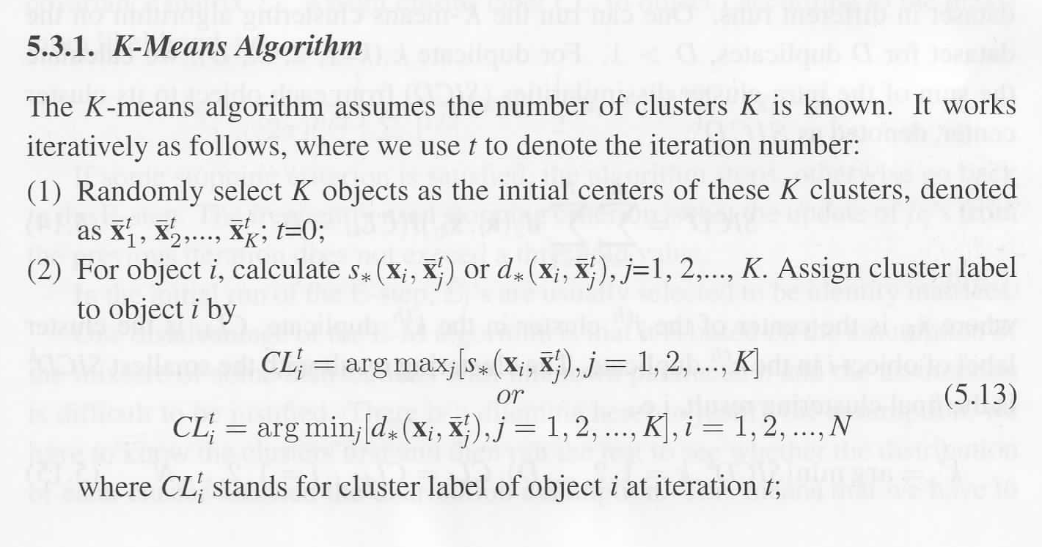
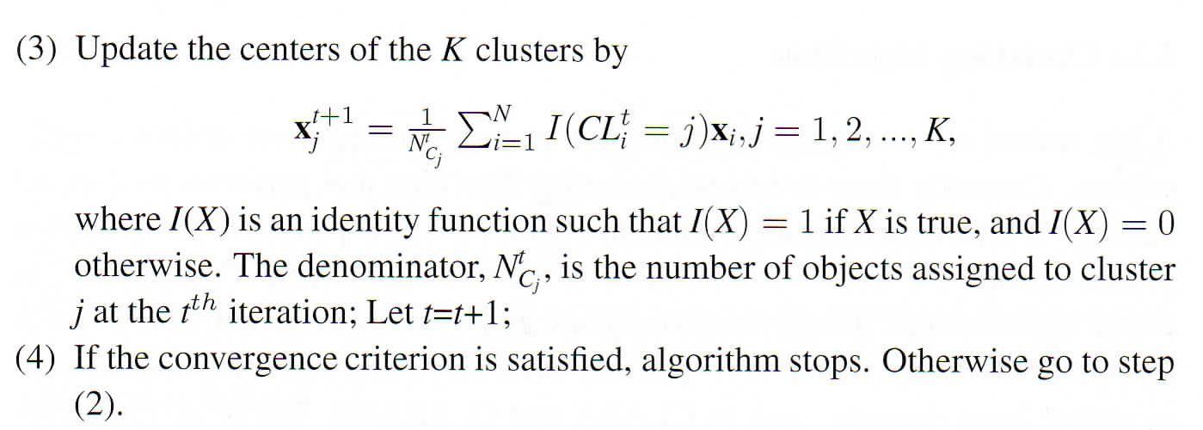
Source: “Clustering Challenges in Biological Networks” edited by S. Butenko et. al.

Slide 20
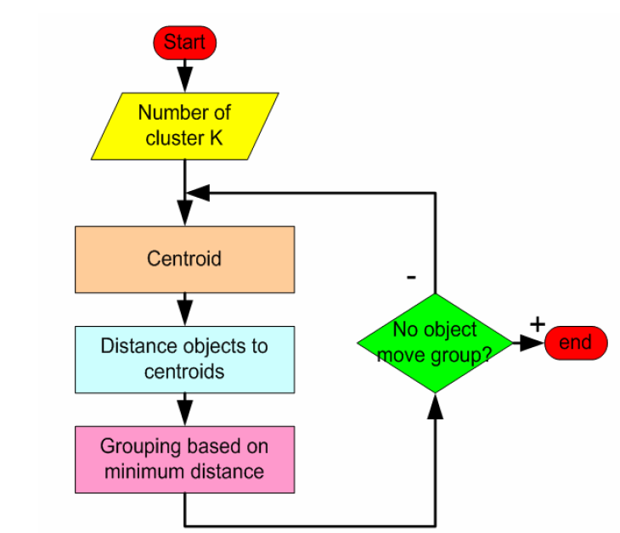
Source:
Teknomo, Kardi. K-Means Clustering Tutorials http:\\people.revoledu.com\kardi\ tutorial\kMean\

Slide 21
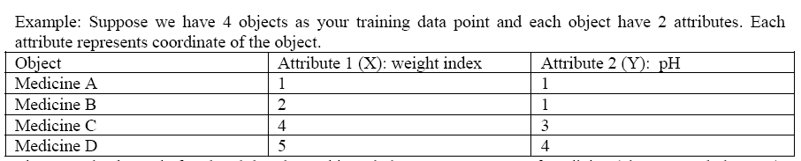
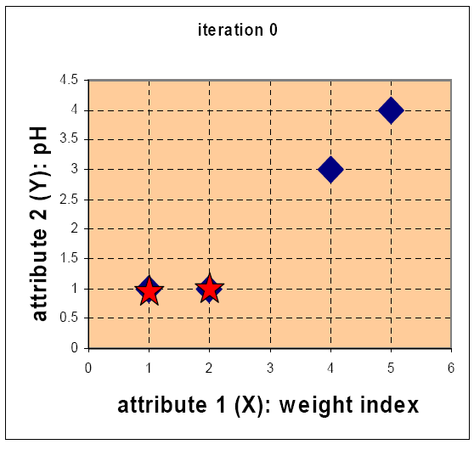
Initial value of centroids: Suppose we use medicine A and medicine B as the first centroids. Let c1 and c2 denote the coordinate of the centroids, then c1 = (1,1) and c2 = (2,1)

Slide 22
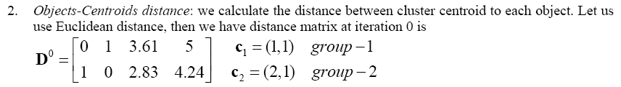
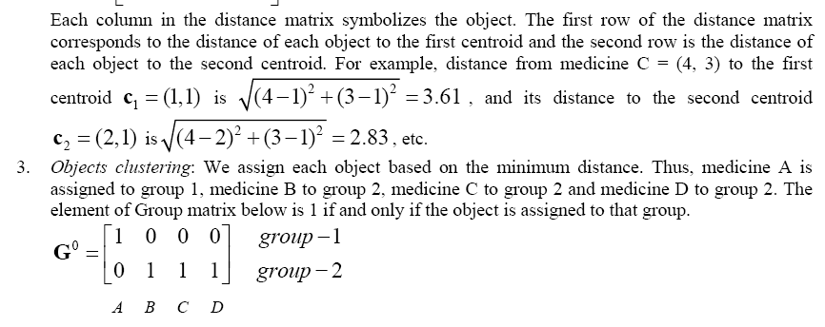

Slide 23
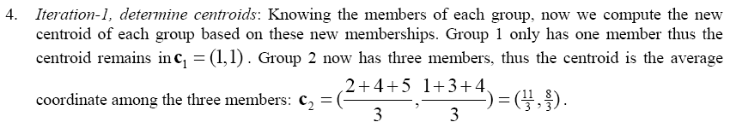
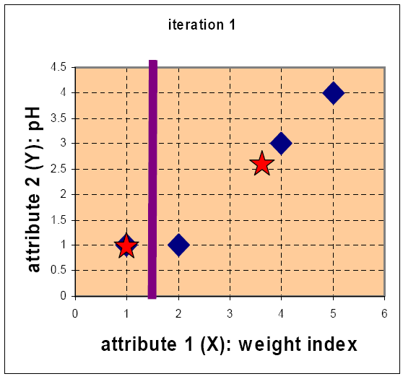
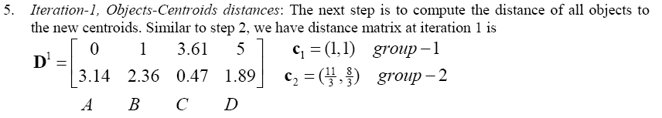
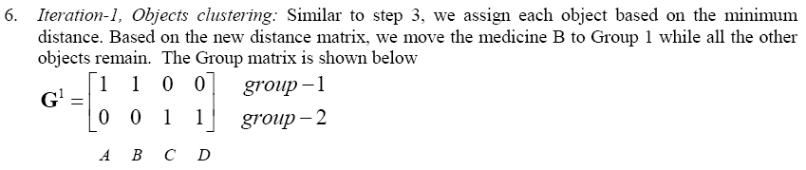

Slide 24
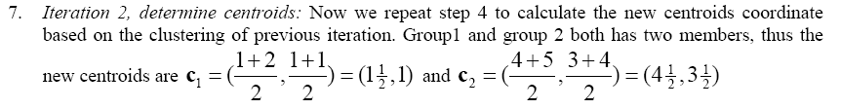
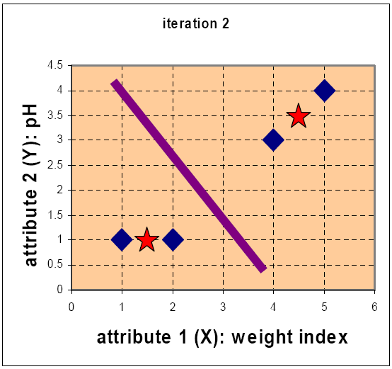
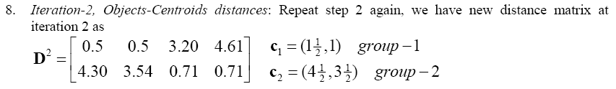
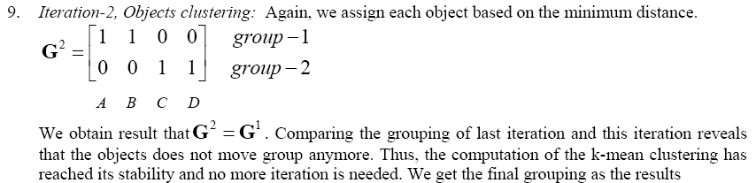

Slide 25

Definition of K-mean clustering from wikipedia
Given a set of observations (x₁, x₂, …, x_{n}), where each observation is a d-dimensional real vector, k-means clustering aims to partition the n observations into k (≤ n) sets S = {S₁, S₂, …, S_{k}} so as to minimize the within-cluster sum of squares (WCSS) (sum of distance functions of each point in the cluster to the K center). In other words, its objective is to find:
where μ_{i} is the mean of points in S_{i}.

Slide 26
Remarks on K-mean Clustering The method we discussed is a simple version of the k-means procedure. It can be viewed as a greedy algorithm for partitioning the n samples into k clusters. It does have some weaknesses:
The way to initialize the means was not specified. One popular way to start is to randomly choose k of the samples.
The results produced depend on the initial values for the means, and it frequently happens that suboptimal partitions are found. The standard solution is to try a number of different starting points.
It can happen that the set of samples closest to µ_{i} is empty, so that µ_{i} cannot be updated. This is an annoyance that must be handled in an implementation, but that we shall ignore.
The results depend on the metric used to measure || x - µ_{i} ||. A popular solution is to normalize each variable by its standard deviation, though this is not always desirable.
The results depend on the value of k.
Collected from http://home.deib.polimi.it/matteucc/Clustering/tutorial_html/kmeans.html

Slide 27
Remarks on K-mean Clustering
This last problem is particularly troublesome, since we often have no way of knowing how many clusters exist.
Unfortunately there is no general theoretical solution to find the optimal number of clusters for any given data set. A simple approach is to compare the results of multiple runs with different k classes and choose the best one according to a given criterion but we need to be careful because increasing k results in smaller error function values by definition, but also an increasing risk of overfitting.
Collected from http://home.deib.polimi.it/matteucc/Clustering/tutorial_html/kmeans.html

Slide 28




Expectation Maximization (EM) clustering
Source: “Clustering Challenges in Biological Networks” edited by S. Butenko et. al.

Slide 29
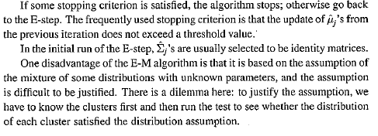
Expectation Maximization (EM) clustering
EM and k-mean clustering has some similarities but also have many dissimilarities
Source: “Clustering Challenges in Biological Networks” edited by S. Butenko et. al.

Slide 30
Hierarchical clustering

Slide 31
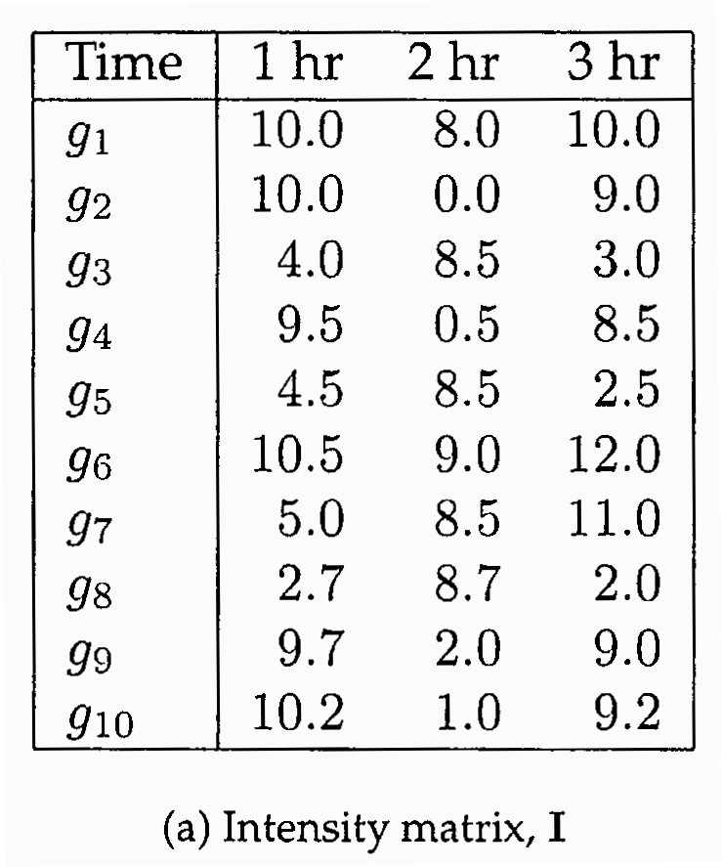
Hierarchical Clustering
In many cases for example in case of microarray gene expression analysis the data is multivariate type.
An Introduction to Bioinformatics Algorithms by Jones & Pevzner
We can apply hierarchical clustering to multivariate data
It is an unsupervised clustering method

Slide 32
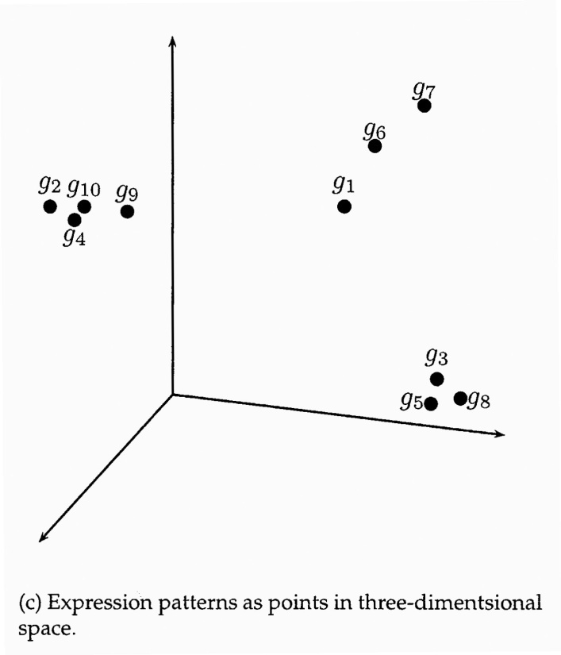
Hierarchical Clustering
If dimension of multivariate data is 3 or less we can cluster them by plotting directly.
An Introduction to Bioinformatics Algorithms by Jones & Pevzner

Slide 33
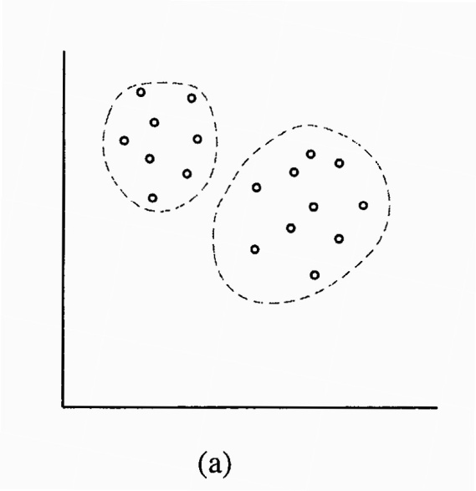
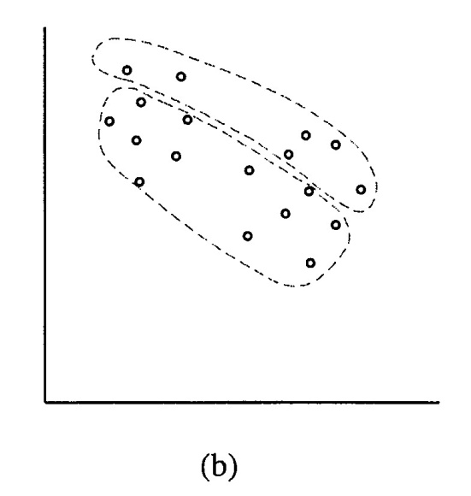
Hierarchical Clustering
Some data reveal good cluster structure when plotted but some data do not.
Data plotted in 2 dimensions
However, when dimension is more than 3, we can apply hierarchical clustering to multivariate data.
In hierarchical clustering the data are not partitioned into a particular cluster in a single step. Instead, a series of partitions takes place.

Slide 34
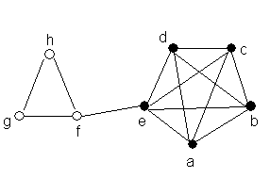
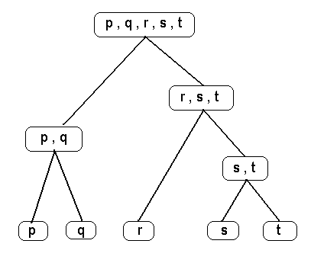
Hierarchical Clustering
Hierarchical clustering is a technique that organizes elements into a tree.
A tree is a graph that has no cycle.
A tree with n nodes can have maximum n-1 edges.
A Graph
A tree

Slide 35
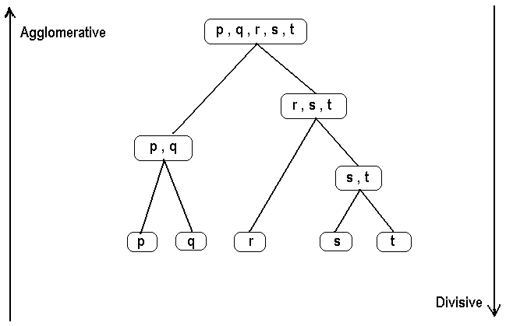
Hierarchical Clustering
Hierarchical Clustering is subdivided into 2 types
agglomerative methods, which proceed by series of fusions of the n objects into groups,
and divisive methods, which separate n objects successively into finer groupings.
Agglomerative techniques are more commonly used
Data can be viewed as a single cluster containing all objects to n clusters each containing a single object .

Slide 36
Hierarchical Clustering
Distance measurements
Euclidean distance between g₁ and g₂

Slide 37
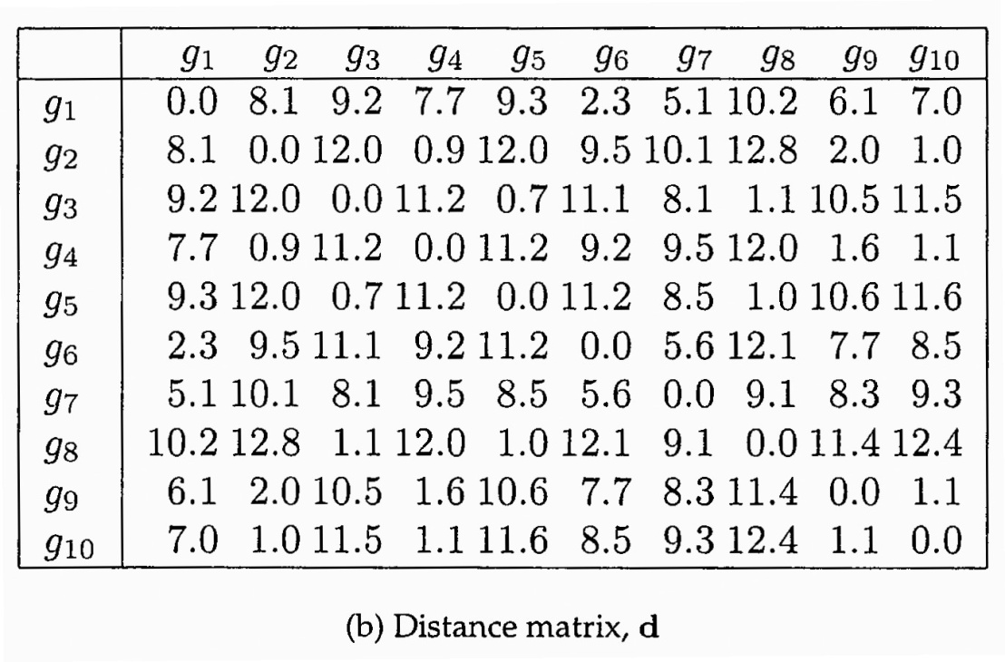
Hierarchical Clustering
An Introduction to Bioinformatics Algorithms by Jones & Pevzner
In stead of Euclidean distance correlation can also be used as a similarity measurement.
For biological analysis involving genes and proteins, nucleotide and or amino acid sequence similarity can also be used as distance between objects

Slide 38
Hierarchical Clustering
An agglomerative hierarchical clustering procedure produces a series of partitions of the data, P_{n}, P_{n-1}, ....... , P₁. The first P_{n} consists of n single object 'clusters', the last P1, consists of single group containing all n cases.
At each particular stage the method joins together the two clusters which are closest together (most similar). (At the first stage, of course, this amounts to joining together the two objects that are closest together, since at the initial stage each cluster has one object.)

Slide 39
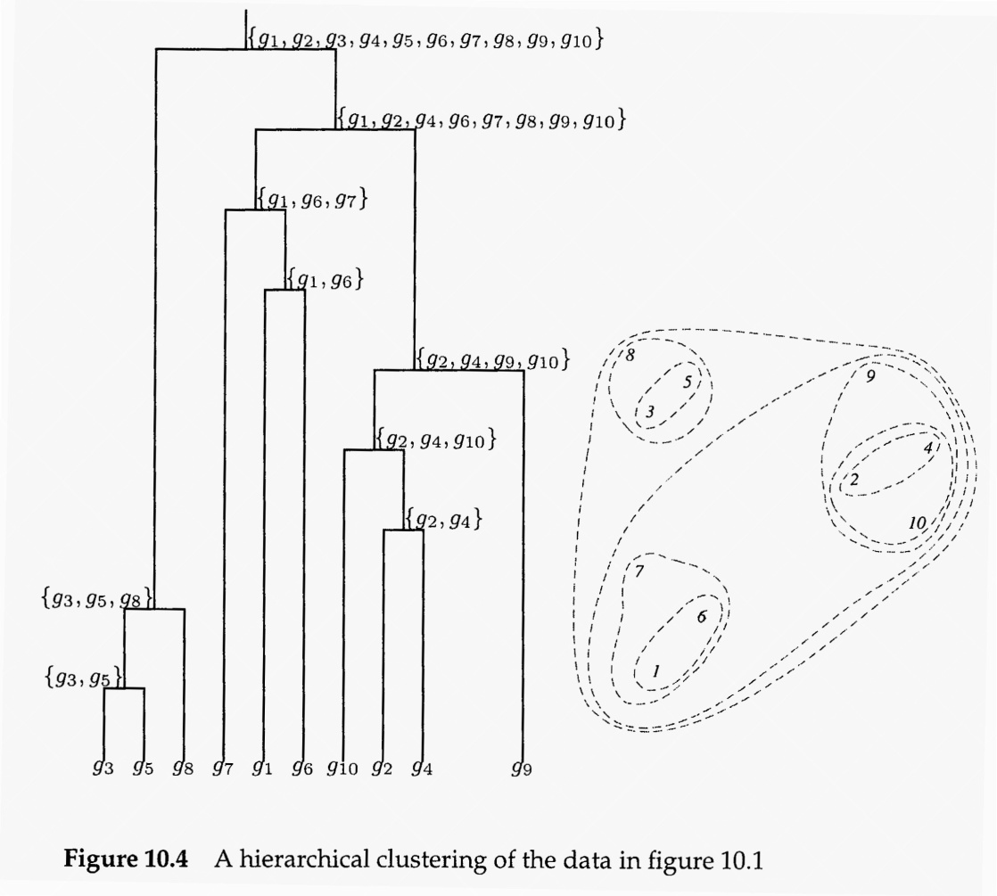
Hierarchical Clustering
An Introduction to Bioinformatics Algorithms by Jones & Pevzner
Differences between methods arise because of the different ways of defining distance (or similarity) between clusters.

Slide 40
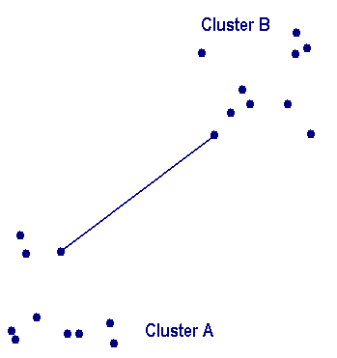
Hierarchical Clustering
How can we measure distances between clusters?
Single linkage clustering
Distance between two clusters A and B, D(A,B) is computed as D(A,B) = Min { d(i,j) : Where object i is in cluster A and object j is cluster B}

Slide 41
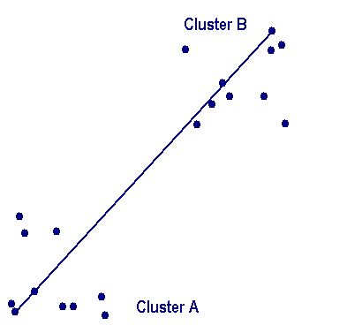
Hierarchical Clustering
Complete linkage clustering
Distance between two clusters A and B, D(A,B) is computed as D(A,B) = Max { d(i,j) : Where object i is in cluster A and object j is cluster B}

Slide 42
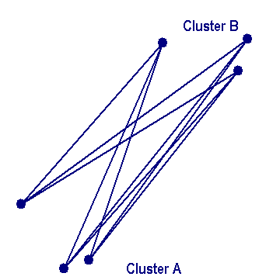
Hierarchical Clustering
Average linkage clustering
Distance between two clusters A and B, D(A,B) is computed as D(A,B) = T_{AB} / ( N_{A} * N_{B})
Where T_{AB} is the sum of all pair wise distances between objects of cluster A and cluster B. N_{A} and N_{B} are the sizes of the clusters A and B respectively.
Total N_{A} * N_{B} edges

Slide 43
Hierarchical Clustering
Average group linkage clustering
Distance between two clusters A and B, D(A,B) is computed as D(A,B) = Average { d(i,j) : Where observations i and j are in cluster t, the cluster formed by merging clusters A and B }
Total n(n-1)/2 edges

Slide 44

Ward method of hierarchical clustering
Ward (1963) proposes that at each analysis step the loss of information that results from the grouping of individuals into clusters can be measured by the total sum of squared deviations of every point from the mean of the cluster to which it belongs.
At each step of the analysis every possible pairs of clusters are considered and the two clusters whose fusion results in the minimum increase in the error sum of squares are combined.
The increase in error sum of squares (E. S. S.) corresponding to fusion of two clusters C_{A} and C_{B} is calculated as follows :
Here is the mean of all entities in C_{A} and C_{B}.

Slide 45
Ward method of hierarchical clustering
In the following figure, the triangular point is the mean of all the other points of cluster A and B
total NA+NB distances are calculated and squared and summed up to measure the E.S.S because of merging cluster A and cluster B.
Therefore in ward method distances between two entities or clusters are not directly calculated. Rather at each step two such clusters or entities are chosen and merged such that the increase in E.S.S. becomes the minimum.

Slide 46
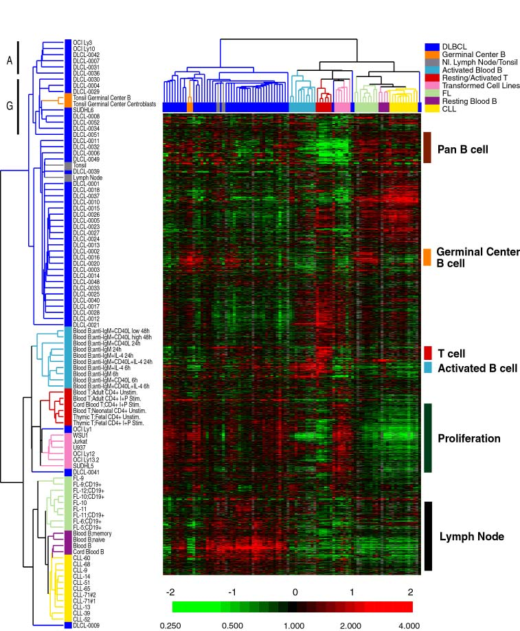
Hierarchical Clustering
Alizadeh et al. Nature 403: 503-511 (2000).

Slide 47
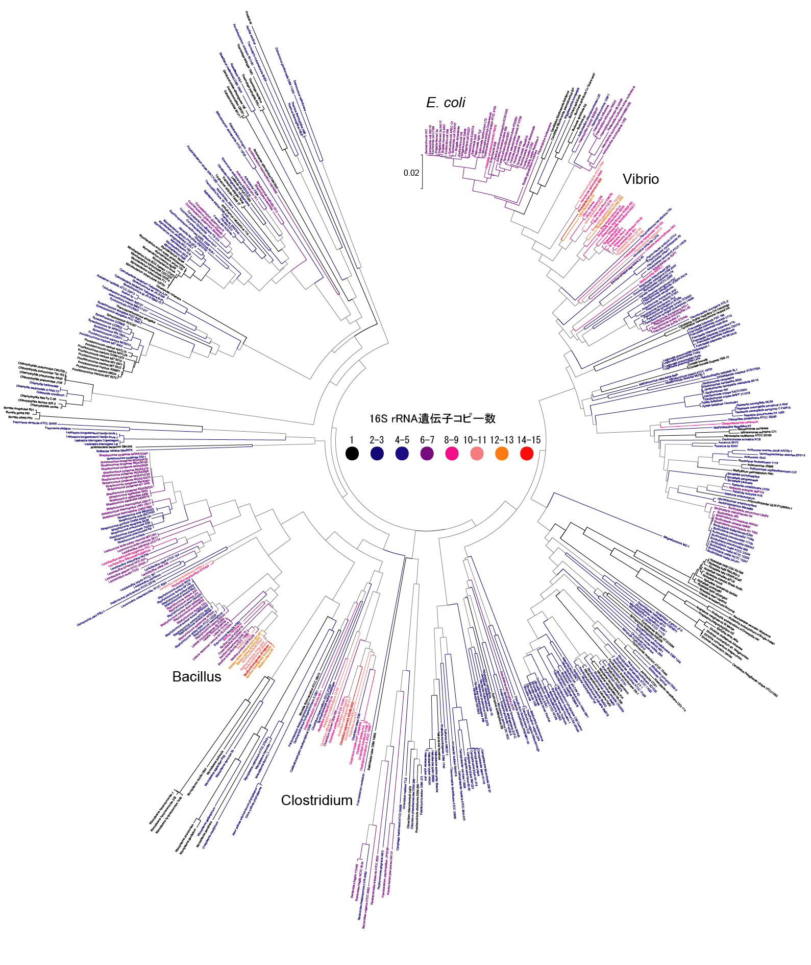
Classifying bacteria based on 16s rRNA sequences.

Slide 48
R and Data Mining: Examples and Case Studies
by
Yanchang Zhao
Good for beginier
Freely available in the following site:
http://researchswinger.org/others/Rdatamining.pdf

