Slide 1
Logistic Regression
glm {stats}
glm is used to fit generalized linear models, specified by giving a symbolic
description of the linear predictor and a description of the error
distribution.
Usage
glm(formula, family, data, …)
Arguments
family : a description of the error distribution and link function to be used in the model. For glm this can be a character string naming a family function, a family function or the result of a call to a family function.
Notes:
Prcomp
iris

Slide 2
Logistic Regression
menarche {MASS}
Proportions of female children at various ages during adolescence who have reached menarche.
Format
[,1] Age Average age of the group
[,2] Total Total number of children in the group
[,3] Menarche Number who have reached menarche
Notes:
Lm
cars

Slide 3
Logistic Regression
> library(MASS)
> data("menarche")
> head(menarche,10)
Age Total Menarche
1 9.21 376 0
2 10.21 200 0
3 10.58 93 0
4 10.83 120 2
5 11.08 90 2
6 11.33 88 5
7 11.58 105 10
8 11.83 111 17
9 12.08 100 16
10 12.33 93 29

Slide 4
Logistic Regression
> menarche.glm = glm(cbind(Menarche, Total-Menarche) ~ Age, family=binomial(logit), data=menarche)
> summary(menarche.glm)
Call:
glm(formula = cbind(Menarche, Total - Menarche) ~ Age,
family = binomial(logit), data = menarche)
Deviance Residuals:
Min 1Q Median 3Q Max
-2.0363 -0.9953 -0.4900 0.7780 1.3675
Coefficients:
Estimate Std. Error z value Pr(>|z|)
(Intercept) -21.22639 0.77068 -27.54 <2e-16 ***
Age 1.63197 0.05895 27.68 <2e-16 ***

Slide 5
Logistic Regression
> menarche.glm = glm(cbind(Menarche, Total-Menarche) ~ Age, family=binomial(logit), data=menarche)
> summary(menarche.glm)
Call:
glm(formula = cbind(Menarche, Total - Menarche) ~ Age,
family = binomial(logit), data = menarche)
Deviance Residuals:
Min 1Q Median 3Q Max
-2.0363 -0.9953 -0.4900 0.7780 1.3675
Coefficients:
Estimate Std. Error z value Pr(>|z|)
(Intercept) -21.22639 0.77068 -27.54 <2e-16 ***
Age 1.63197 0.05895 27.68 <2e-16 ***
The main part of Logistic Regression

Slide 6
Logistic Regression
> menarche.glm = glm(cbind(Menarche, Total-Menarche) ~ Age, family=binomial(logit), data=menarche)
> summary(menarche.glm)
Call:
glm(formula = cbind(Menarche, Total - Menarche) ~ Age,
family = binomial(logit), data = menarche)
Deviance Residuals:
Min 1Q Median 3Q Max
-2.0363 -0.9953 -0.4900 0.7780 1.3675
Coefficients:
Estimate Std. Error z value Pr(>|z|)
(Intercept) -21.22639 0.77068 -27.54 <2e-16 ***
Age 1.63197 0.05895 27.68 <2e-16 ***
You should select “binomial(logit)”
when carrying out logistic regression.

Slide 7
Logistic Regression
> menarche.glm = glm(cbind(Menarche, Total-Menarche) ~ Age, family=binomial(logit), data=menarche)
> summary(menarche.glm)
Call:
glm(formula = cbind(Menarche, Total - Menarche) ~ Age,
family = binomial(logit), data = menarche)
Deviance Residuals:
Min 1Q Median 3Q Max
-2.0363 -0.9953 -0.4900 0.7780 1.3675
Coefficients:
Estimate Std. Error z value Pr(>|z|)
(Intercept) -21.22639 0.77068 -27.54 <2e-16 ***
Age 1.63197 0.05895 27.68 <2e-16 ***
4-quantiles & Regression coefficients.
This result is the same as “lm”.

Slide 8
Logistic Regression
---
Signif. codes: 0 ‘***’ 0.001 ‘**’ 0.01 ‘*’ 0.05 ‘.’ 0.1 ‘ ’ 1
(Dispersion parameter for binomial family taken to be 1)
Null deviance: 3693.884 on 24 degrees of freedom
Residual deviance: 26.703 on 23 degrees of freedom
AIC: 114.76
Number of Fisher Scoring iterations: 4
> plot(Menarche/Total ~ Age, data=menarche)
> lines(menarche$Age, glm.out$fitted, type="l", col="red")

Slide 9
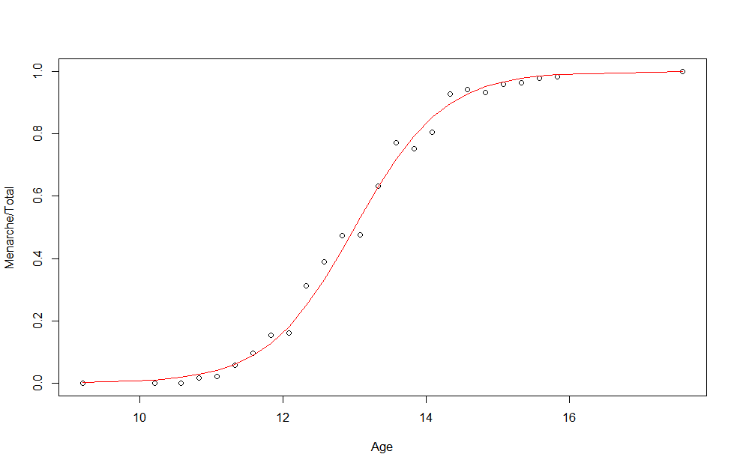
Logistic Regression

Slide 10
Hierarchical Clustering
hclust{stats}
Hierarchical cluster analysis on a set of dissimilarities and
methods for analyzing it.
Usage
hclust(d, method = "complete", …)
Arguments
d : a dissimilarity structure as produced by dist.
method : the agglomeration method to be used. This should be (an unambiguous abbreviation of) one of “ward.D”, “ward.D2”, “single”, “complete”, “average” (= UPGMA), “mcquitty” (= WPGMA), “median” (= WPGMC) or “centroid” (= UPGMC).
Notes:
Lm
cars

Slide 11
Hierarchical Clustering
iris {datasets}
This famous iris data set gives the measurements in centimeters of the variables sepal length and width and petal length and width, respectively, for 50 flowers from each of 3 species of iris. The species are Iris setosa, versicolor, and virginica.
Format
[,1] Sepal.Length Length of sepal
[,2] Sepal.Width Width of sepal
[,3] Petal.Length Length of petal
[,4] Petal.Width Width of Petal
[,5] Species Species are setosa, versicolor, vriginica
Notes:
Prcomp
iris

Slide 12
Hierarchical Clustering
> data <- iris
> data <- data[sample(1:nrow(data),30),]
> head(data,10)
Sepal.Length Sepal.Width Petal.Length Petal.Width
28 5.2 3.5 1.5 0.2
144 6.8 3.2 5.9 2.3
118 7.7 3.8 6.7 2.2
41 5.0 3.5 1.3 0.3
6 5.4 3.9 1.7 0.4
95 5.6 2.7 4.2 1.3
26 5.0 3.0 1.6 0.2
129 6.4 2.8 5.6 2.1
145 6.7 3.3 5.7 2.5

Slide 13
Hierarchical Clustering
> data <- iris
> data <- data[sample(1:nrow(data),30),]
> head(data,10)
Sepal.Length Sepal.Width Petal.Length Petal.Width
28 5.2 3.5 1.5 0.2
144 6.8 3.2 5.9 2.3
118 7.7 3.8 6.7 2.2
41 5.0 3.5 1.3 0.3
6 5.4 3.9 1.7 0.4
95 5.6 2.7 4.2 1.3
26 5.0 3.0 1.6 0.2
129 6.4 2.8 5.6 2.1
145 6.7 3.3 5.7 2.5
Choose 30 samples at random.

Slide 14
Hierarchical Clustering
> data.d <- dist(data[,1:4],method = "euclidean")
> data.cl <- hclust(data.d,method = "ward.D")
> data.cl
Call:
hclust(d = data.d, method = "ward.D")
Cluster method : ward.D
Distance : euclidean
Number of objects: 30
> plot(data.cl,labels = data[,5])

Slide 15
Hierarchical Clustering
> data.d <- dist(data[,1:4],method = "euclidean")
> data.cl <- hclust(data.d,method = "ward.D")
> data.cl
Call:
hclust(d = data.d, method = "ward.D")
Cluster method : ward.D
Distance : euclidean
Number of objects: 30
> plot(data.cl,labels = data[,5])
Create a distance matrix by using “euclidean”.

Slide 16
Hierarchical Clustering
> data.d <- dist(data[,1:4],method = "euclidean")
> data.cl <- hclust(data.d,method = "ward.D")
> data.cl
Call:
hclust(d = data.d, method = "ward.D")
Cluster method : ward.D
Distance : euclidean
Number of objects: 30
> plot(data.cl,labels = data[,5])
The main part of Hierarchical Clustering.

Slide 17
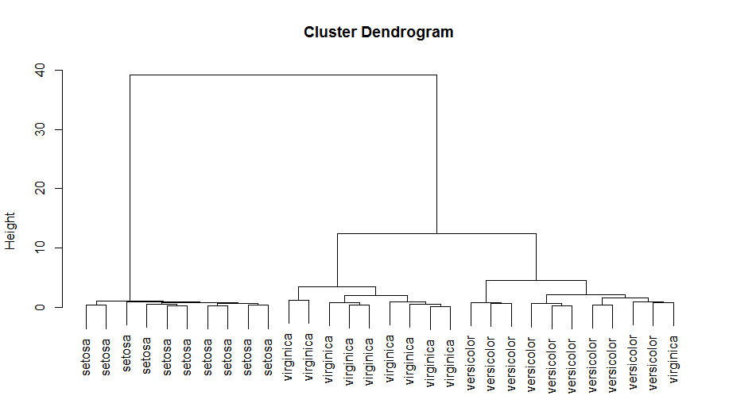
Hierarchical Clustering

Slide 18
K-Means Clustering
kmeans {stats}
Perform k-means clustering on a data matrix.
Usage
kmeans(x, centers, iter.max, algorithm, …)
Arguments
x : numeric matrix of data, or an object that can be coerced to such a matrix.
centers : either the number of clusters, say k, or a set of initial (distinct) cluster centres.
iter.max : the maximum number of iterations allowed.
algorithm : “Hartigan-Wong”, “Lloyd”, “Forgy”, “MacQueen”
Notes:
plsr
mtcars

Slide 19
K-Means Clustering
iris {datasets}
This famous iris data set gives the measurements in centimeters of the variables sepal length and width and petal length and width, respectively, for 50 flowers from each of 3 species of iris. The species are Iris setosa, versicolor, and virginica.
Format
[,1] Sepal.Length Length of sepal
[,2] Sepal.Width Width of sepal
[,3] Petal.Length Length of petal
[,4] Petal.Width Width of Petal
[,5] Species Species are setosa, versicolor, vriginica
Notes:
plsr
mtcars

Slide 20
K-Means Clustering
> data <- iris
> head(data,10)
Sepal.Length Sepal.Width Petal.Length Petal.Width Species
1 5.1 3.5 1.4 0.2 setosa
2 4.9 3.0 1.4 0.2 setosa
3 4.7 3.2 1.3 0.2 setosa
4 4.6 3.1 1.5 0.2 setosa
5 5.0 3.6 1.4 0.2 setosa
6 5.4 3.9 1.7 0.4 setosa
7 4.6 3.4 1.4 0.3 setosa
8 5.0 3.4 1.5 0.2 setosa
9 4.4 2.9 1.4 0.2 setosa
10 4.9 3.1 1.5 0.1 setosa

Slide 21
K-Means Clustering
> data.cl <- kmeans(data,3)
> data.cl
K-means clustering with 3 clusters of sizes 62, 50, 38
Cluster means:
Sepal.Length Sepal.Width Petal.Length Petal.Width
1 5.901613 2.748387 4.393548 1.433871
2 5.006000 3.428000 1.462000 0.246000
3 6.850000 3.073684 5.742105 2.071053
Clustering vector:
[1] 2 2 2 2 2 2 2 2 2 2 2 2 2 2 2 2 2 2 2 2 2 2 2 2 2 2 2 2 2 2 2 2
[33] 2 2 2 2 2 2 2 2 2 2 2 2 2 2 2 2 2 2 1 1 3 1 1 1 1 1 1 1 1 1 1 1
[65] 1 1 1 1 1 1 1 1 1 1 1 1 1 3 1 1 1 1 1 1 1 1 1 1 1 1 1 1 1 1 1 1
[97] 1 1 1 1 3 1 3 3 3 3 1 3 3 3 3 3 3 1 1 3 3 3 3 1 3 1 3 1 3 3 1 1
[129] 3 3 3 3 3 1 3 3 3 3 1 3 3 3 1 3 3 3 1 3 3 1

Slide 22
K-Means Clustering
> data.cl <- kmeans(data,3)
> data.cl
K-means clustering with 3 clusters of sizes 62, 50, 38
Cluster means:
Sepal.Length Sepal.Width Petal.Length Petal.Width
1 5.901613 2.748387 4.393548 1.433871
2 5.006000 3.428000 1.462000 0.246000
3 6.850000 3.073684 5.742105 2.071053
Clustering vector:
[1] 2 2 2 2 2 2 2 2 2 2 2 2 2 2 2 2 2 2 2 2 2 2 2 2 2 2 2 2 2 2 2 2
[33] 2 2 2 2 2 2 2 2 2 2 2 2 2 2 2 2 2 2 1 1 3 1 1 1 1 1 1 1 1 1 1 1
[65] 1 1 1 1 1 1 1 1 1 1 1 1 1 3 1 1 1 1 1 1 1 1 1 1 1 1 1 1 1 1 1 1
[97] 1 1 1 1 3 1 3 3 3 3 1 3 3 3 3 3 3 1 1 3 3 3 3 1 3 1 3 1 3 3 1 1
[129] 3 3 3 3 3 1 3 3 3 3 1 3 3 3 1 3 3 3 1 3 3 1
The main part of K-Means Clustering.
In this case, k = 3.

Slide 23
K-Means Clustering
> data.cl <- kmeans(data,3)
> data.cl
K-means clustering with 3 clusters of sizes 62, 50, 38
Cluster means:
Sepal.Length Sepal.Width Petal.Length Petal.Width
1 5.901613 2.748387 4.393548 1.433871
2 5.006000 3.428000 1.462000 0.246000
3 6.850000 3.073684 5.742105 2.071053
Clustering vector:
[1] 2 2 2 2 2 2 2 2 2 2 2 2 2 2 2 2 2 2 2 2 2 2 2 2 2 2 2 2 2 2 2 2
[33] 2 2 2 2 2 2 2 2 2 2 2 2 2 2 2 2 2 2 1 1 3 1 1 1 1 1 1 1 1 1 1 1
[65] 1 1 1 1 1 1 1 1 1 1 1 1 1 3 1 1 1 1 1 1 1 1 1 1 1 1 1 1 1 1 1 1
[97] 1 1 1 1 3 1 3 3 3 3 1 3 3 3 3 3 3 1 1 3 3 3 3 1 3 1 3 1 3 3 1 1
[129] 3 3 3 3 3 1 3 3 3 3 1 3 3 3 1 3 3 3 1 3 3 1
The size of each cluster(3 clusters)

Slide 24
K-Means Clustering
> data.cl <- kmeans(data,3)
> data.cl
K-means clustering with 3 clusters of sizes 62, 50, 38
Cluster means:
Sepal.Length Sepal.Width Petal.Length Petal.Width
1 5.901613 2.748387 4.393548 1.433871
2 5.006000 3.428000 1.462000 0.246000
3 6.850000 3.073684 5.742105 2.071053
Clustering vector:
[1] 2 2 2 2 2 2 2 2 2 2 2 2 2 2 2 2 2 2 2 2 2 2 2 2 2 2 2 2 2 2 2 2
[33] 2 2 2 2 2 2 2 2 2 2 2 2 2 2 2 2 2 2 1 1 3 1 1 1 1 1 1 1 1 1 1 1
[65] 1 1 1 1 1 1 1 1 1 1 1 1 1 3 1 1 1 1 1 1 1 1 1 1 1 1 1 1 1 1 1 1
[97] 1 1 1 1 3 1 3 3 3 3 1 3 3 3 3 3 3 1 1 3 3 3 3 1 3 1 3 1 3 3 1 1
[129] 3 3 3 3 3 1 3 3 3 3 1 3 3 3 1 3 3 3 1 3 3 1
Cluster mean

Slide 25
K-Means Clustering
> data.cl <- kmeans(data,3)
> data.cl
K-means clustering with 3 clusters of sizes 62, 50, 38
Cluster means:
Sepal.Length Sepal.Width Petal.Length Petal.Width
1 5.901613 2.748387 4.393548 1.433871
2 5.006000 3.428000 1.462000 0.246000
3 6.850000 3.073684 5.742105 2.071053
Clustering vector:
[1] 2 2 2 2 2 2 2 2 2 2 2 2 2 2 2 2 2 2 2 2 2 2 2 2 2 2 2 2 2 2 2 2
[33] 2 2 2 2 2 2 2 2 2 2 2 2 2 2 2 2 2 2 1 1 3 1 1 1 1 1 1 1 1 1 1 1
[65] 1 1 1 1 1 1 1 1 1 1 1 1 1 3 1 1 1 1 1 1 1 1 1 1 1 1 1 1 1 1 1 1
[97] 1 1 1 1 3 1 3 3 3 3 1 3 3 3 3 3 3 1 1 3 3 3 3 1 3 1 3 1 3 3 1 1
[129] 3 3 3 3 3 1 3 3 3 3 1 3 3 3 1 3 3 3 1 3 3 1
Result of k-means clustering

Slide 26
K-Means Clustering
> data.cl <- kmeans(data,3)
> data.cl
K-means clustering with 3 clusters of sizes 62, 50, 38
Cluster means:
Sepal.Length Sepal.Width Petal.Length Petal.Width
1 5.901613 2.748387 4.393548 1.433871
2 5.006000 3.428000 1.462000 0.246000
3 6.850000 3.073684 5.742105 2.071053
Clustering vector:
[1] 2 2 2 2 2 2 2 2 2 2 2 2 2 2 2 2 2 2 2 2 2 2 2 2 2 2 2 2 2 2 2 2
[33] 2 2 2 2 2 2 2 2 2 2 2 2 2 2 2 2 2 2 1 1 3 1 1 1 1 1 1 1 1 1 1 1
[65] 1 1 1 1 1 1 1 1 1 1 1 1 1 3 1 1 1 1 1 1 1 1 1 1 1 1 1 1 1 1 1 1
[97] 1 1 1 1 3 1 3 3 3 3 1 3 3 3 3 3 3 1 1 3 3 3 3 1 3 1 3 1 3 3 1 1
[129] 3 3 3 3 3 1 3 3 3 3 1 3 3 3 1 3 3 3 1 3 3 1
Element 1 belongs to Cluster 2.

Slide 27
K-Means Clustering
Within cluster sum of squares by cluster:
[1] 39.82097 15.15100 23.87947
(between_SS / total_SS = 88.4 %)
Available components:
[1] "cluster" "centers" "totss" "withinss"
[5] "tot.withinss" "betweenss" "size" "iter"
[9] "ifault"
> plot(data,col=data.cl$cluster)

Slide 28
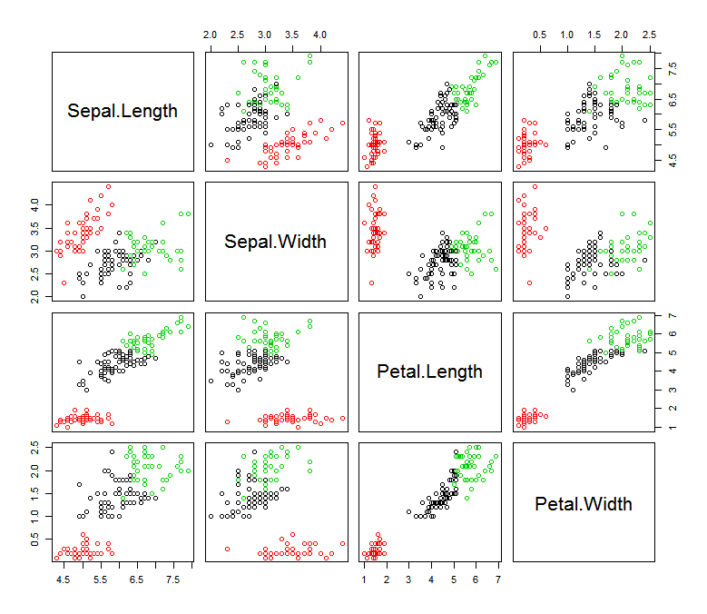
K-Means Clustering

Slide 29
k-Nearest Neighbour Classification
knn {class}
k-nearest neighbour classification for test set from training set. For each row of the test set, the k nearest (in Euclidean distance) training set vectors are found, and the classification is decided by majority vote, with ties broken at random.
Usage
knn(train, test, cl, k, …)
Arguments
train : matrix or data frame of training set cases.
test : matrix or data frame of test set cases. A vector will be interpreted as a row vector for a single case.
cl : factor of true classifications of training set.
k : number of neighbours considered.
Notes:
plsr
mtcars

Slide 30
k-Nearest Neighbour Classification
wine {HDclassif}
These data are the results of a chemical analysis of wines grown in the same region in Italy but derived from three different cultivars.
Format
[,1] Alcohol [,12] OD280/OD315 of diluted wines
[,2] Malic acid [,13] Proline
[,3] Ash
[,4] Alcalinity of ash
[,5] Magnesium
[,6] Total phenols
[,7] Flavanoids
[,8] Nonflavonoid phenols
[,9] Proanthocyanins
[,10] Color intensity
[,11] Hue
Notes:
plsr
mtcars

Slide 31
k-Nearest Neighbour Classification
> install.packages(“HDclassif”)
> library(HDclassif)
> data(wine)
> head(wine,10)
class V1 V2 … … V10 V11 V12 V13
1 1 14.23 1.71 5.64 1.04 3.92 1065
2 1 13.20 1.78 4.38 1.05 3.40 1050
3 1 13.16 2.36 5.68 1.03 3.17 1185
4 1 14.37 1.95 … … 7.80 0.86 3.45 1480
5 1 13.24 2.59 4.32 1.04 2.93 735
6 1 14.20 1.76 6.75 1.05 2.85 1450
7 1 14.39 1.87 5.25 1.02 3.58 1290
8 1 14.06 2.15 5.05 1.06 3.58 1295
9 1 14.83 1.64 5.20 1.08 2.85 1045

Slide 32
k-Nearest Neighbour Classification
> index <- sample(1:nrow(wine),40)
> train.data <- wine[-index,-1]
> train.label <- wine[-index,1]
> test.data <- wine[index,-1]
> test.label <- wine[index,1]
> wine.knn <- knn(train.data,test.data,train.label,k=3)
> wine.knn
[1] 2 3 1 2 3 1 2 3 2 3 2 1 2 3 1 3 3 3 3 1 3 2 1 2 2 3 2 1 1 2 2 1 1 3 2 3 2 3 1 3
Levels: 1 2 3
> sum(wine.knn==test.label)/length(test.label)
[1] 0.7

Slide 33
k-Nearest Neighbour Classification
> index <- sample(1:nrow(wine),40)
> train.data <- wine[-index,-1]
> train.label <- wine[-index,1]
> test.data <- wine[index,-1]
> test.label <- wine[index,1]
> wine.knn <- knn(train.data,test.data,train.label,k=3)
> wine.knn
[1] 2 3 1 2 3 1 2 3 2 3 2 1 2 3 1 3 3 3 3 1 3 2 1 2 2 3 2 1 1 2 2 1 1 3 2 3 2 3 1 3
Levels: 1 2 3
> sum(wine.knn==test.label)/length(test.label)
[1] 0.7
Create training data & test data.
In this case, training data have 40 rows,
and select it at random.

Slide 34
k-Nearest Neighbour Classification
> index <- sample(1:nrow(wine),40)
> train.data <- wine[-index,-1]
> train.label <- wine[-index,1]
> test.data <- wine[index,-1]
> test.label <- wine[index,1]
> wine.knn <- knn(train.data,test.data,train.label,k=3)
> wine.knn
[1] 2 3 1 2 3 1 2 3 2 3 2 1 2 3 1 3 3 3 3 1 3 2 1 2 2 3 2 1 1 2 2 1 1 3 2 3 2 3 1 3
Levels: 1 2 3
> sum(wine.knn==test.label)/length(test.label)
[1] 0.7
The main part of k-NN.
The model is constructed by training data,
and apply it to test data.

Slide 35
k-Nearest Neighbour Classification
> index <- sample(1:nrow(wine),40)
> train.data <- wine[-index,-1]
> train.label <- wine[-index,1]
> test.data <- wine[index,-1]
> test.label <- wine[index,1]
> wine.knn <- knn(train.data,test.data,train.label,k=3)
> wine.knn
[1] 2 3 1 2 3 1 2 3 2 3 2 1 2 3 1 3 3 3 3 1 3 2 1 2 2 3 2 1 1 2 2 1 1 3 2 3 2 3 1 3
Levels: 1 2 3
> sum(wine.knn==test.label)/length(test.label)
[1] 0.7
Result of k-NN

Slide 36
k-Nearest Neighbour Classification
> index <- sample(1:nrow(wine),40)
> train.data <- wine[-index,-1]
> train.label <- wine[-index,1]
> test.data <- wine[index,-1]
> test.label <- wine[index,1]
> wine.knn <- knn(train.data,test.data,train.label,k=3)
> wine.knn
[1] 2 3 1 2 3 1 2 3 2 3 2 1 2 3 1 3 3 3 3 1 3 2 1 2 2 3 2 1 1 2 2 1 1 3 2 3 2 3 1 3
Levels: 1 2 3
> sum(wine.knn==test.label)/length(test.label)
[1] 0.7
Element 1 of test data belongs to Cluster 2.

Slide 37
k-Nearest Neighbour Classification
> index <- sample(1:nrow(wine),40)
> train.data <- wine[-index,-1]
> train.label <- wine[-index,1]
> test.data <- wine[index,-1]
> test.label <- wine[index,1]
> wine.knn <- knn(train.data,test.data,train.label,k=3)
> wine.knn
[1] 2 3 1 2 3 1 2 3 2 3 2 1 2 3 1 3 3 3 3 1 3 2 1 2 2 3 2 1 1 2 2 1 1 3 2 3 2 3 1 3
Levels: 1 2 3
> sum(wine.knn==test.label)/length(test.label)
[1] 0.7
The correct answer rate (70%)

