Slide 1
Support Vector Machine
ksvm {kernlab}
Support Vector Machines are an excellent tool for classification, novelty detection, and regression. ksvm supports the well known C-svc, nu-svc, (classification) one-class-svc (novelty) eps-svr, nu-svr (regression) formulations along with native multi-class classification formulations and the bound-constraint SVM formulations.
Usage
ksvm(formula, data, type, kernel, …)
Arguments
formula : a formula, with a response but no interaction terms.
data : an optional data frame in which to interpret the variables
named in the formula.
Notes:
Lm
cars

Slide 2
Support Vector Machine
> install.packages(“kernlab")
> library(kernlab)
> data <- iris
> head(data,10)
Sepal.Length Sepal.Width Petal.Length Petal.Width Species
1 5.1 3.5 1.4 0.2 setosa
2 4.9 3.0 1.4 0.2 setosa
3 4.7 3.2 1.3 0.2 setosa
4 4.6 3.1 1.5 0.2 setosa
5 5.0 3.6 1.4 0.2 setosa
6 5.4 3.9 1.7 0.4 setosa
7 4.6 3.4 1.4 0.3 setosa
8 5.0 3.4 1.5 0.2 setosa

Slide 3
Support Vector Machine
> train <- data[seq.int(1, 150, by=2),]
> test <- data[setdiff(1:150, train),]
> train.svm <- ksvm(Species ~., data=train, type="C-bsvc", kernel ="rbfdot")
> test.predict <- predict(train.svm,test)
> table(test.predict,test$Species)
test.predict setosa versicolor virginica
setosa 49 0 0
versicolor 1 49 4
virginica 0 1 46

Slide 4
Support Vector Machine
> train <- data[seq.int(1, 150, by=2),]
> test <- data[setdiff(1:150, train),]
> train.svm <- ksvm(Species ~., data=train, type="C-bsvc", kernel ="rbfdot")
> test.predict <- predict(train.svm,test)
> table(test.predict,test$Species)
test.predict setosa versicolor virginica
setosa 49 0 0
versicolor 1 49 4
virginica 0 1 46
Create training data & test data

Slide 5
Support Vector Machine
> train <- data[seq.int(1, 150, by=2),]
> test <- data[setdiff(1:150, train),]
> train.svm <- ksvm(Species ~., data=train, type="C-bsvc", kernel ="rbfdot")
> test.predict <- predict(train.svm,test)
> table(test.predict,test$Species)
test.predict setosa versicolor virginica
setosa 49 0 0
versicolor 1 49 4
virginica 0 1 46
The main part of Support Vector Machine

Slide 6
Support Vector Machine
> train <- data[seq.int(1, 150, by=2),]
> test <- data[setdiff(1:150, train),]
> train.svm <- ksvm(Species ~., data=train, type="C-bsvc", kernel ="rbfdot")
> test.predict <- predict(train.svm,test)
> table(test.predict,test$Species)
test.predict setosa versicolor virginica
setosa 49 0 0
versicolor 1 49 4
virginica 0 1 46
Apply constructed models to test data

Slide 7
Support Vector Machine
> train <- data[seq.int(1, 150, by=2),]
> test <- data[setdiff(1:150, train),]
> train.svm <- ksvm(Species ~., data=train, type="C-bsvc", kernel ="rbfdot")
> test.predict <- predict(train.svm,test)
> table(test.predict,test$Species)
test.predict setosa versicolor virginica
setosa 49 0 0
versicolor 1 49 4
virginica 0 1 46
Result of Sapport Vector Machine

Slide 8
Neural Network
nnet {nnet}
Fit single-hidden-layer neural network, possibly
with skip-layer connections.
Usage
nnet(formula, data, size, …)
Arguments
formula : number of variables randomly sampled as candidates at each split.
data : Data frame from which variables specified in formula are preferentially to be taken.
size : number of units in the hidden layer. Can be zero if there are skip-layer units.
Notes:
Lm
cars

Slide 9
Neural Network
> library(nnet)
> data <- iris
> head(data,10)
Sepal.Length Sepal.Width Petal.Length Petal.Width Species
1 5.1 3.5 1.4 0.2 setosa
2 4.9 3.0 1.4 0.2 setosa
3 4.7 3.2 1.3 0.2 setosa
4 4.6 3.1 1.5 0.2 setosa
5 5.0 3.6 1.4 0.2 setosa
6 5.4 3.9 1.7 0.4 setosa
7 4.6 3.4 1.4 0.3 setosa
8 5.0 3.4 1.5 0.2 setosa

Slide 10
Neural Network
> train <- data[seq.int(1, 150, by=2),]
> test <- data[setdiff(1:150, train),]
> train.nnet <- nnet(Species~., size=3, data=train)
> test.predict <- predict(train.nnet, test, type="class")
> table(test$Species, test.predict)
test.preddict
setosa versicolor virginica
setosa 50 0 0
versicolor 0 49 1
virginica 0 1 49

Slide 11
Neural Network
> train <- data[seq.int(1, 150, by=2),]
> test <- data[setdiff(1:150, train),]
> train.nnet <- nnet(Species~., size=3, data=train)
> test.predict <- predict(train.nnet, test, type="class")
> table(test$Species, test.predict)
test.preddict
setosa versicolor virginica
setosa 50 0 0
versicolor 0 49 1
virginica 0 1 49
The main part of Neural Network

Slide 12
Neural Network
> train <- data[seq.int(1, 150, by=2),]
> test <- data[setdiff(1:150, train),]
> train.nnet <- nnet(Species~., size=3, data=train)
> test.predict <- predict(train.nnet, test, type="class")
> table(test$Species, test.predict)
test.preddict
setosa versicolor virginica
setosa 50 0 0
versicolor 0 49 1
virginica 0 1 49
Result of Neural Network

Slide 13
Self Organizing Map
som {som}
Produces an object of class "som" which
is a Self-Organizing Map fit of the data.
Usage
som(data, xdim, ydim, …)
Arguments
data : a data frame or matrix of input data.
xdim : an integer specifying the x-dimension of the map.
ydim : an integer specifying the y-dimension of the map.
Notes:
Lm
cars

Slide 14
Self Organizing Map
> install.packages(“som”)
> library(som)
> data <- iris
> head(data,10)
Sepal.Length Sepal.Width Petal.Length Petal.Width Species
1 5.1 3.5 1.4 0.2 setosa
2 4.9 3.0 1.4 0.2 setosa
3 4.7 3.2 1.3 0.2 setosa
4 4.6 3.1 1.5 0.2 setosa
5 5.0 3.6 1.4 0.2 setosa
6 5.4 3.9 1.7 0.4 setosa
7 4.6 3.4 1.4 0.3 setosa
8 5.0 3.4 1.5 0.2 setosa

Slide 15
Self Organizing Map
> model <- som(data[,-5] ,xdim=10, ydim=10)
> label <- as.numeric(data[,5])
> plot(model$visual$x, model$visual$y, pch = label,
col = label, cex = 2)
The main part of Self Organizing Map

Slide 16
Self Organizing Map
> model <- som(data[,-5] ,xdim=10, ydim=10)
> label <- as.numeric(data[,5])
> plot(model$visual$x, model$visual$y, pch = label,
col = label, cex = 2)
The main part of Self Organizing Map

Slide 17
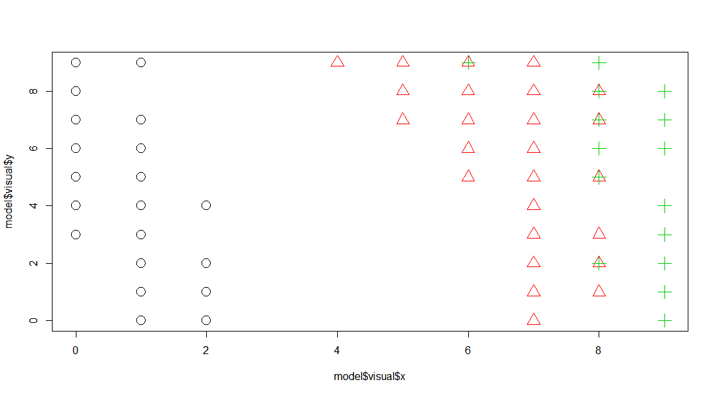
Self Organizing Map

Slide 18
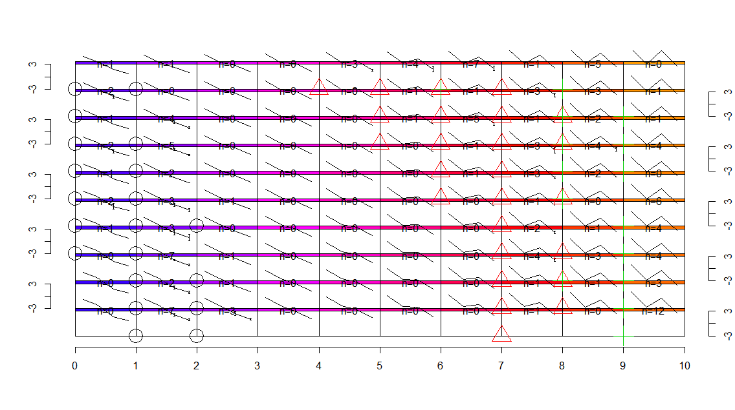
Self Organizing Map
> plot(model)
> points(model$visual$x, model$visual$y,pch = label,
col = label, cex = 3)

