Slide 1



Dmytro Geras - 300932912 Vitalii Pielievin – 300885108
Voter API

Slide 2
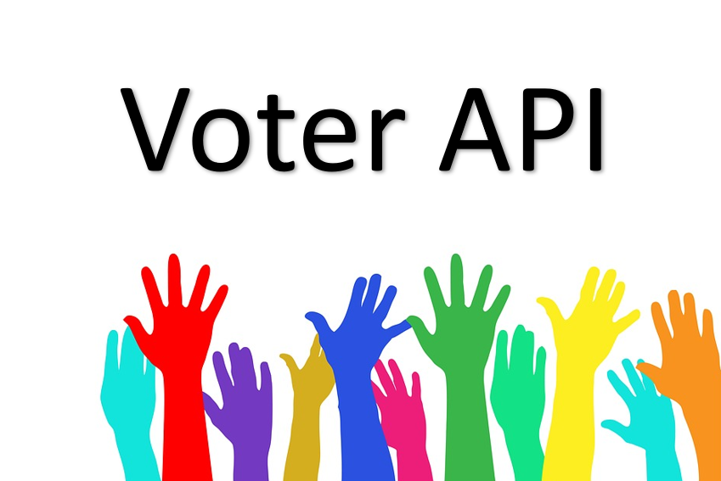
Lessons and experiences gained by doing the project :
We refreshed our knowledge about how to make an application
to support asynchronous
We have learnt principles of REST and implemented Get/post/put/delete methods
We are able to generate our API document using Swagger
We have learnt how to publish our API to AWS Elastic Beanstalk
We know how principles of using APIgee and how to generate portal
for our application using this service and Swagger document.
We have learnt how to serialise and deserialise objects using Webclient and JSON.
To test our API we implemented client application using Google Charts and AJAX.

Slide 3
We wanted to focus on online api and charts, that are so popular nowadays in events like voting on an election or just voting for your favorite product.
The purpose of our API is to provide people with an ability to place/enter information that would be available to rate/vote, you can use it both for voting for the candidates or voting which product is the best one, possibilities of using it are very broad as it would be a simple to use charting project .
Potential customers are developers who for example want to implement voting system for students for what course is the best one to take, or business sites where customers would be able to vote on their products, individuals who would like to get some insight on what is trendy, etc.
https://dmitrogeras-eval-votesystemapi.apigee.io/

