Slide 1
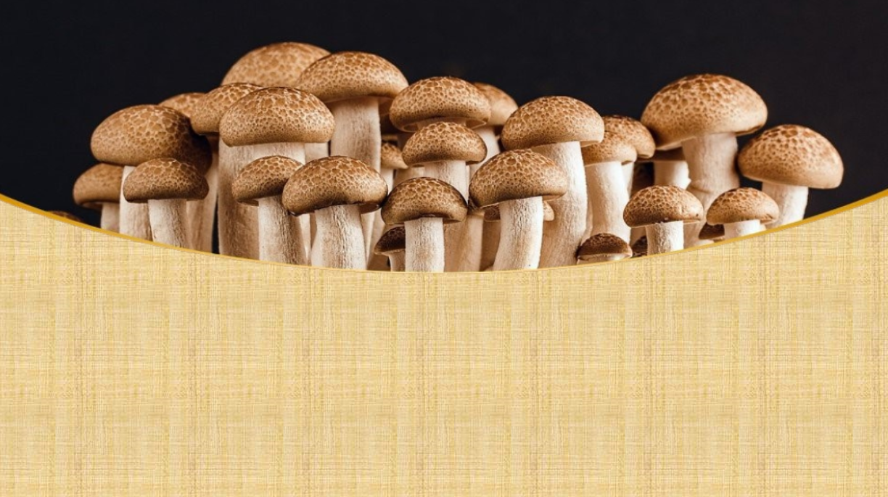
IoT-based Mycoculture Growth Kit
Michael Smith (n10833200)
Dan Moreno (n10835539)
Group 17

Slide 2
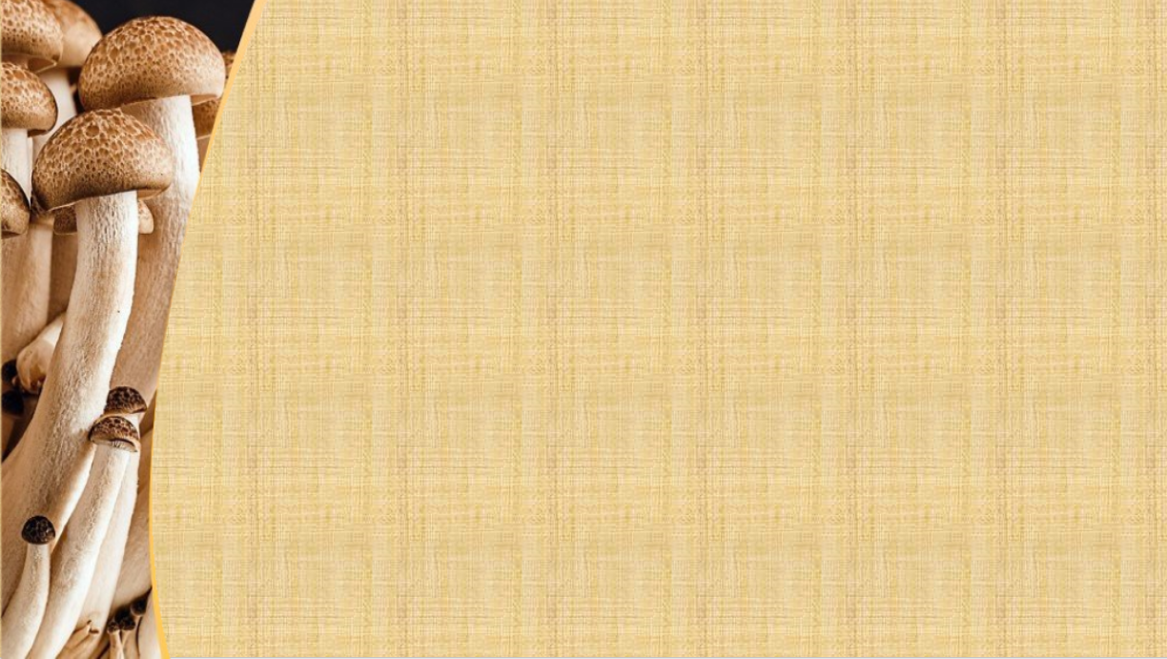




Project Overview:
The project is for the creation of an IoT-based Environmental Management tool for the growth of mushrooms. The prototype will collect data from an enclosed growth environment, transmit it for processing, and test it against specific thresholds to inform a user of needed changes to the growth environment.
Data collected:
Temperature
Air Humidity
Soil Humidity
Light Levels
CO_{2­} Levels
When environmental factors exceed a threshold then lights will be used.
Green light
On: Too much CO₂
Blinking: Error
Red light
On: Too hot
Blinking: Too cold
Blue light
On: Too dry
Blinking: Too wet
Yellow light
On: Too bright
Blinking: Too dark
Mushroom cultivation is a unique hobby and a largely untapped industry, which could benefit from IoT devices. Remotely monitoring means less physical contact will be required leading to a more sterile and stable growth environment. Data collection throughout the process will also lead to the optimizing of environmental settings for different mushrooms over time allowing for greater production.
Notes:
Due to the sensitivity of fungi to environmental conditions as well as invasion of other poisonous molds such as black mold, sterile growth environments are needed. By collecting environmental data from mushroom cultivation, further defined growth profiles can be created for different mushrooms, which can further be automated in any industrial format.

Slide 3

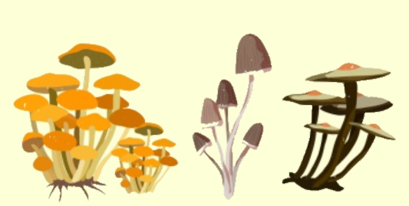
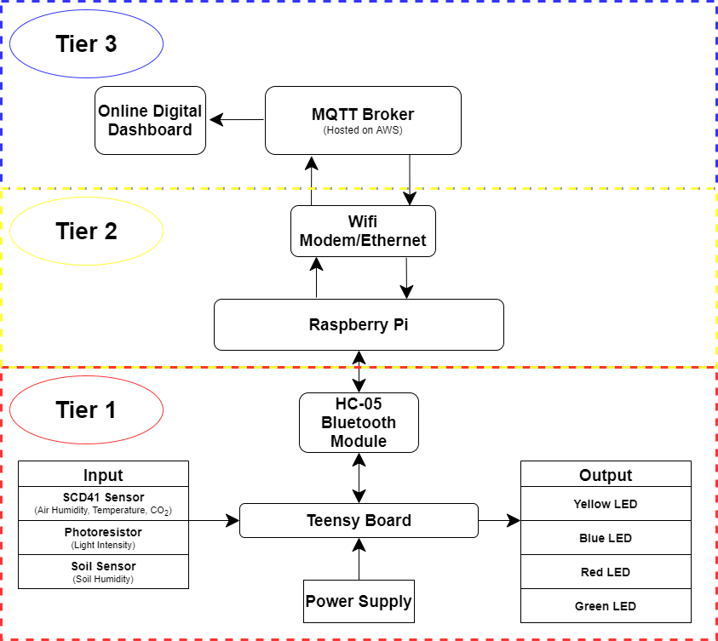

Tier 1 design:
Physical Design:
A Teensy 2.0 device will be connected to a (CO₂ sensor), photoresistor, and soil moisture sensor via a breadboard. This will be placed in a specially designed container to prevent moisture getting to the Teensy device. The sensors will be placed in the growth chamber and a sealant will be applied to limit air access to the Teensy container, while warning lights will be placed outside of the growth chamber and away from humid conditions.
Network Design:
SENDING: Data collection from sensors will be set in a loop to send data in set intervals to the Raspberry Pi via an HC-05 Bluetooth module. The data will be a single string of data describing all the current environment variables.
RECEIVING: The Teensy device will receive commands sent from MQTT clients via Bluetooth. The commands will tell which of the 4 lights to turn on, off, or blink to inform the user of changes needed to the environment.

Slide 4

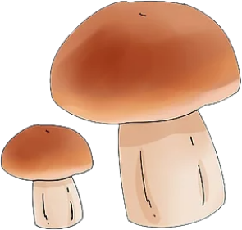
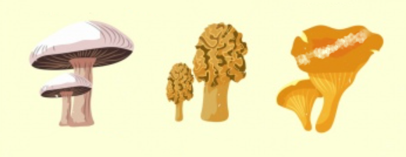
Tier 2 design:
Step 1: Data received via a Bluetooth rfcomm channel needs to be split and reformatted to allow for sending via MQTT.
Step 2: An MQTT publisher is employed that takes the converted sensor data and sends it to an AWS hosted MQTT broker via wifi under the relevant topics.
Step 3: A MQTT client on the Raspberry Pi subscribes to the relevant topics, and if values go outside of set thresholds, commands will be sent back to the Teensy via Bluetooth.
Step 4: The process repeats itself as new data comes to the Raspberry Pi from the Teensy.
Additions: The Raspberry Pi will be setup to connect to multiple Teensy devices, though with only one C02 sensor additional connections would not be fully functional for the final presentation.
Additions: Timing will be setup so that the sending and receiving of commands to and from the Teensy does not conflict with each other.

Slide 5
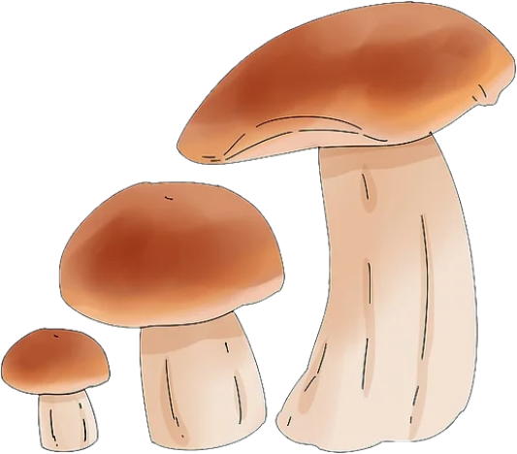
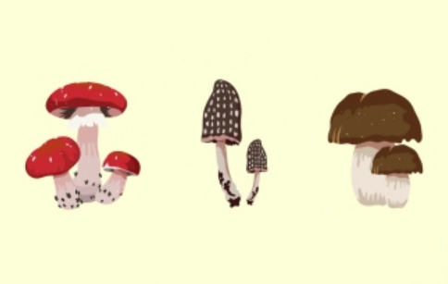
Tier 3 design:
The MQTT broker will be setup in the AWS Cloud, which will receive data from the Raspberry Pi based publisher and send data to the MQTT clients that subscribe to set topics.
Part 1:
The clients on the Raspberry Pi will subscribe to relevant topics allowing the clients to check if values exceed thresholds and send subsequent messages to the Teensy.
Part 2:
The MQTT broker will send data to an online digital dashboard. This will allow users to check current environmental variables online.
Addition: Data sent to the broker will also be logged into a CSV file for future analysis. (This could lead to improvements in growing mushrooms.)
Addition: Current dashboard plan will focus on showing current values (a python flask script has been employed to connect data to a website backend at the moment.

Slide 6
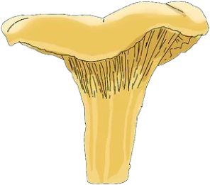
IoT Design Considerations
Avoid Moisture/Water Damage: only sensors have access to the growth chamber, conformal coating on unprotected components, separating components from growth chamber as much as possible.
Indoor Application: easy access to power supply, no worry of adverse weather conditions.
Power Consumption: sleep time of 10 minutes following a transmission from Teensy and the set time for response from Raspberry Pi regarding changes outside set thresholds.
Backup in Case of Internet Issues: an LCD screen to the Raspberry Pi for easier reading of data
Cost: a single Teensy for managing data collection and the lights is proposed.
Security: cryptographic keys for connecting to AWS, use of port other than 1883, ACL lists for publishing data, no ACL list for subscribers. (Intend to be able to share the data with other growers.)
Limitations:
Design limited by available parts (e.g. automation of watering not possible without actuators).
Multiple device application, whereby more Teensy collecting sensor data and receiving commands limited as only one C02 sensor is available, not enough lights, or additional containers.
A mockup for a second device may be possible, but it would lack fully functionality.

Slide 7
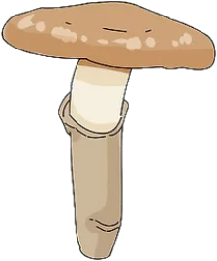
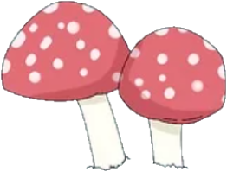
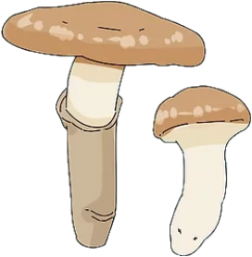
Methodology:
Setup: Ensure hardware is connected to appropriate pins on the Teensy and fully laid out according to the proposed design with sensors and USB power supply and colored lights.
Step 1: Program Teensy for 2-way communication sending sensor data (Air and Soil Humidity, Temperature, Light Intensity, C02 levels) in a string and receiving commands via an HC-05 Bluetooth module.
Step 2: Setup Bluetooth connections for Teensy to the Raspberry Pi, ensuring the RFCOMM channel is correct on the Raspberry Pi and that the serial speed parameter is correct between the Teensy and Raspberry Pi .
Step 3: Setup AWS using shell script to install the MQTT Broker
Step 4: Create a mosquitto.conf file for the broker and setup ACL list/passwords according to desired privacy.
Step 5: The python publisher and subscribers’ IP address for posting and subscribing are set to the AWS IP address and port.
Step 6: Setup the connection to the online digital dashboard (IP address, port, ACL list/password, subscribe to topics). This is currently an html website using flask to connect with data in the backend.
Step 7: Connect LCD screen to the Raspberry Pi.
Step 8: Testing of programming and communication at Tier 1, Tier 1->Tier 2, Tier 2, Tier 2->Tier 1, Tier 2->Tier 3, Tier 3->Tier 2, and Tier 3->Online Dashboard.
Step 9: Install hardware and devices into physical container and retest.
NOTES: Tier 1(Teensy) deals with sensor data and receiving commands from Raspberry Pi for the lights.
Tier 2(Raspberry Pi) deals with processing the data into relevant topics and checking value thresholds from subscribed data.
Tier 3(AWS Broker/website) deals with managing the Sub-Pub process and limiting/allowing access to these functions.
For ease of use, a star configuration whereby everything is connected to the Raspberry Pi.

Slide 8

Task Allocation:
Responsibilities:
Dan Moreno: Extensive programming of solution and optimization of code. Setup and management of hardware and prototype. Editor of presentation.
Michael Smith: Initial simplified programming of solution. Researching mushroom growth conditions to determine the environmental variable thresholds. Main editor and writer of the presentation. Error checker in programming.
Both: Development of ideas and research into methods of implementation at the different tiered levels.

