Slide 1

2nd IEEE International Challenge in Design Methods for Power Electronics
2025 IEEE Power Electronics Society
MagNet Challenge 2
“From Steady-State to Transient Models!”
Tutorial Session 5, Sept. 12th, 2025
Shukai Wang, Hyukjae Kwon, Haoran Li, Thomas Guillod,
Minjie Chen, Charles R. Sullivan
GitHub Repository: https://github.com/minjiechen/magnetchallenge-2
pelsmagnet@gmail.com
MagNet 2025 Organizing Team

Slide 2

Agenda
Webinar 1 – Data and Neural Network Methods
  May 16th Friday, 9 AM EST
Webinar 2 – Analytical Methods (by Dr. Thomas Guillid)
  May 23rd, Friday, 9 AM EST
Webinar 3 – Model Testing and Evaluation Rules
  May 30th, Friday, 9 AM EST
Webinar 4 – Brainstorm and Q&A
  June 6th, Friday, 9 AM EST
Webinar 5 – Pre-Evaluation Rules
  Sept 12th, 10 AM EST

Slide 3
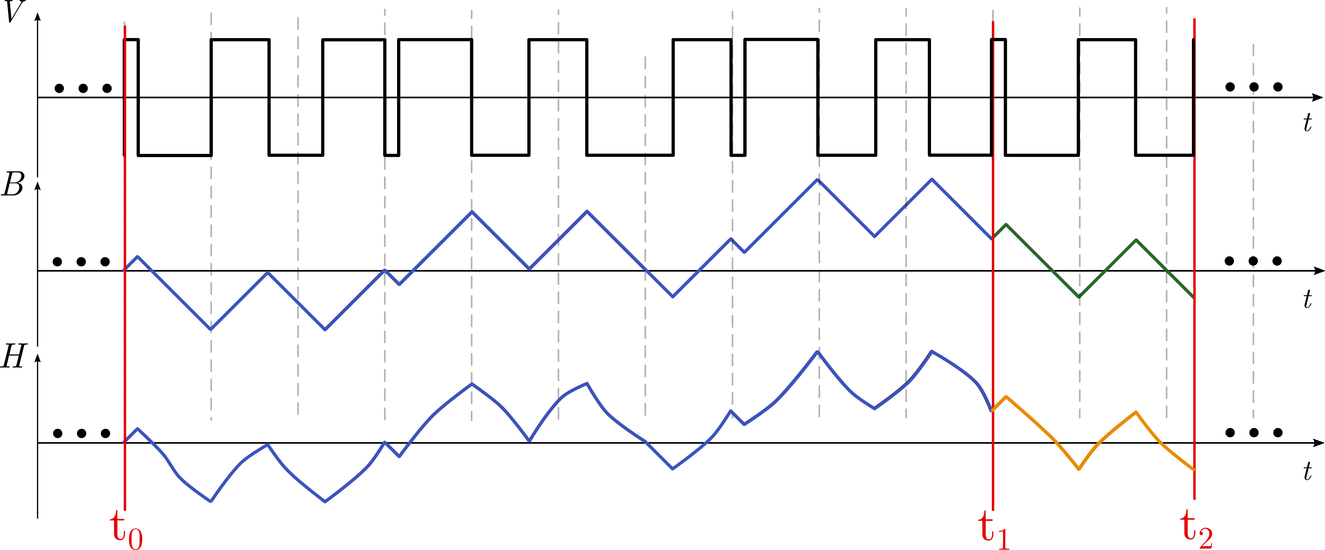
Outcome: A Callable Prediction Function
Output
Your Model
Past
Future
$$H_{t_{1}→t_{2}}=function (B_{t_{0}→t_{1}}\left(t\right), H_{{ t}_{0}→t_{1}}\left(t\right),B_{t_{1}→t_{2}}, T)$$
Future
Past
Output
Hyukjae Kwon, Shukai Wang, Haoran Li, et al. “MagNetX: Extending the MagNet Database for Modeling Power Magnetics in Transient,” TechRxiv. December 11, 2024. Accepted to APEC 2025.

Slide 4






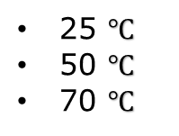
Pre Evaluation Data Format
Sampling frequency!
16 MHz
62.5 ns
Input (Known values)
Output (Unknown values)
Frequency
1,000 Steps
50 kHz
80 kHz
125 kHz
200 kHz
320 kHz
500 kHz
800 kHz
$$B\left(t\right)$$
1 | 2 | . | . | . | . | . | . | . | N-2 | N-1 | N
$$H\left(t\right)$$
1 | 2 | . | . | . | . | . | . | . | N-2 | N-1 | N
90% unknown
$$B\left(t\right)$$
1 | 2 | . | . | . | . | . | . | . | N-2 | N-1 | N
> 4500 total segments per material
$$H\left(t\right)$$
1 | 2 | . | . | . | . | . | . | . | N-2 | N-1 | N
50% unknown
Temperature
$$B\left(t\right)$$
1 | 2 | . | . | . | . | . | . | . | N-2 | N-1 | N
25 $℃$
50 $℃$
70 $℃$
$$H\left(t\right)$$
1 | 2 | . | . | . | . | . | . | . | N-2 | N-1 | N
10% unknown

Slide 5
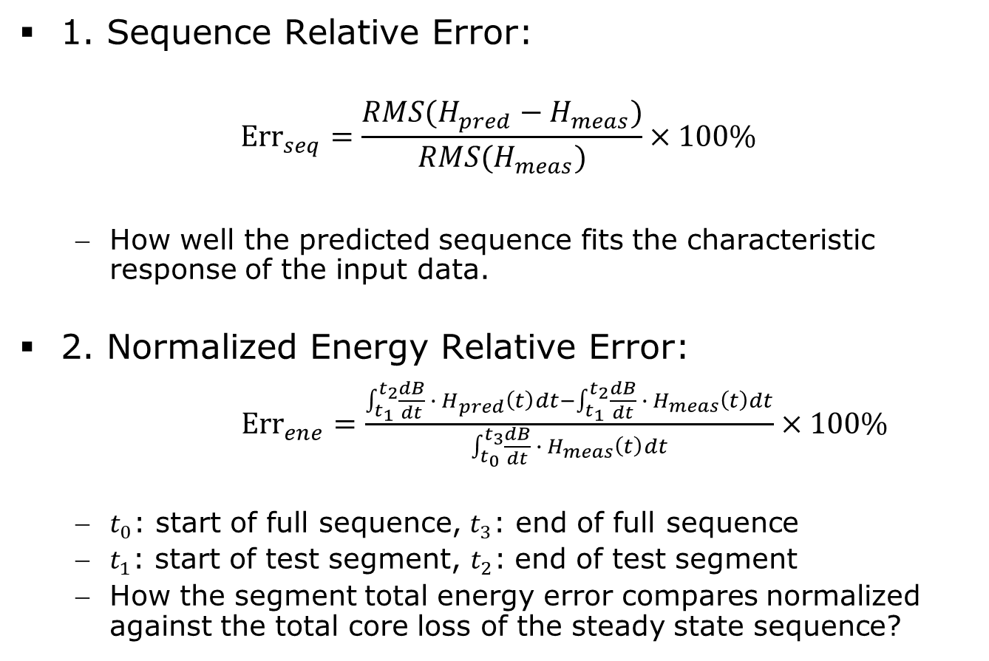
Evaluation Criteria
1. Sequence Relative Error:
$$Err_{seq}=\frac{RMS(H_{pred}−H_{meas})}{RMS(H_{meas})}×100\%$$
  How well the predicted sequence fits the characteristic response of the input data.
2. Normalized Energy Relative Error:
${Err}_{ene}=\frac{\int_{t_{1}}^{t_{2}}{\frac{dB}{dt} ∙ H_{pred}\left(t\right)dt}−\int_{t_{1}}^{t_{2}}{\frac{dB}{dt} ∙ H_{meas}\left(t\right)dt}}{\int_{t_{0}}^{t_{3}}{\frac{dB}{dt} ∙ H_{meas}\left(t\right)dt}}×100\%$
  $t_{0}$: start of full sequence, $t_{3}$: end of full sequence
  $t_{1}$: start of test segment, $t_{2}$: end of test segment
  How the segment total energy error compares normalized against the total core loss of the steady state sequence?
Prediction
Provided
Provided or calculate
Prediction
Provided (core loss)

Slide 6




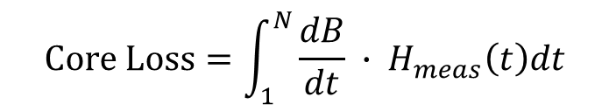




Data Provided
$$Temp$$
1. “Material”_Testing_True
$$Core Loss$$
… …
… …
$$B\left(t\right)$$
1
k | K+1 | . | . | . | . | . | . | . | M-2 | M-1 | M
N
… …
… …
$$H_{meas}\left(t\right)$$
1
k | K+1 | . | . | . | . | . | . | . | M-2 | M-1 | M
N
$$H_{meas}\left(t\right)$$
$$Core Loss=\int_{1}^{N}{\frac{dB}{dt} ∙ H_{meas}\left(t\right)dt}$$
2. “Material”_Testing_Padded
… …
… …
$$H\left(t\right)$$
1
k | K+1 | . | . | . | . | . | . | . | M-2 | M-1 | M
N
$$H_{past}\left(t\right)$$
$$H_{pred}\left(t\right)$$

Slide 7
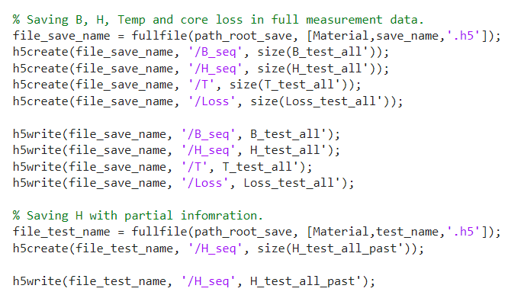
Model Inference
Please visit MagNet Challenge GitHub: https://github.com/minjiechen/magnetchallenge-2
Or MagNetX GitHub: https://github.com/PaulShuk/MagNetX
1. Data Saving: PreTest_Save.mat
1. “Material”_Testing_True
  Original B excitation segment
  Original H excitation segment
  Temperature for each segment
  Full sequence core loss value for each segment
2. “Material”_Testing_Padded
  Partially provided H segment
2. Model Evaluation: Inference.py
3. Result Generation: Error_Distribution_Plot_Template.mat

Slide 8
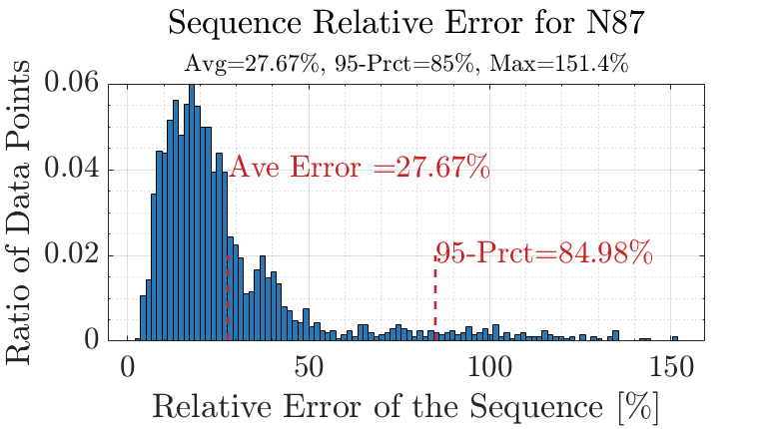
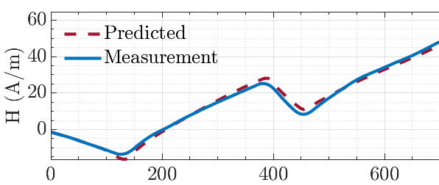
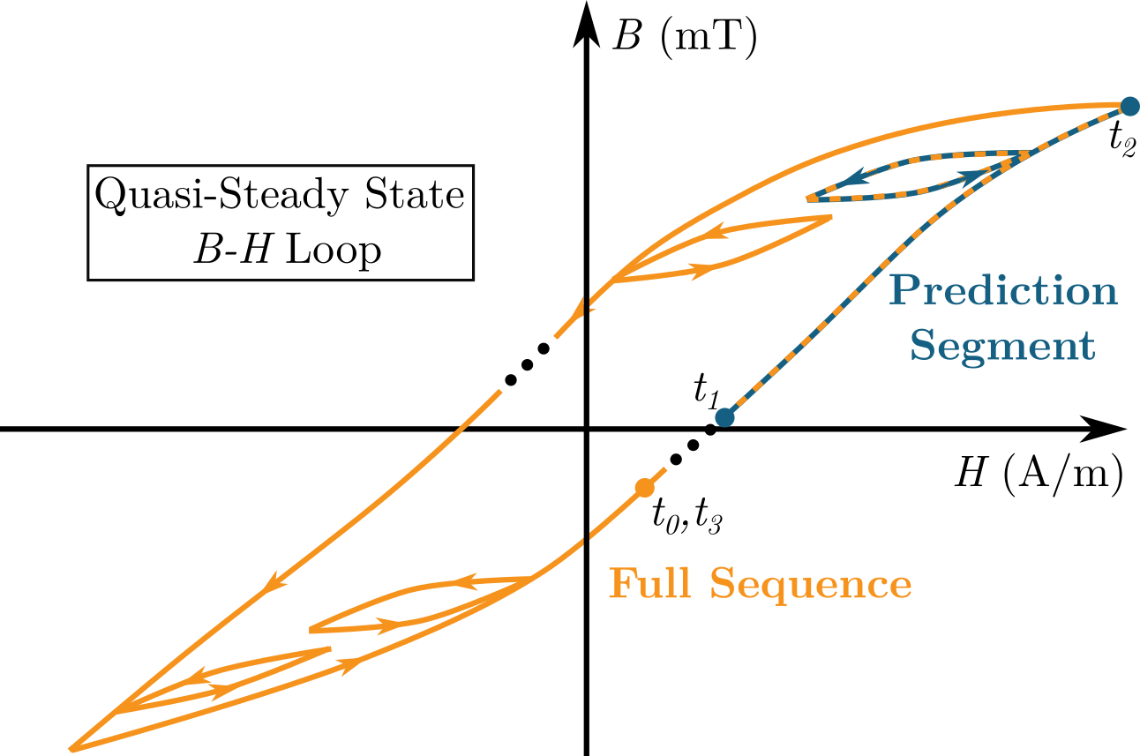
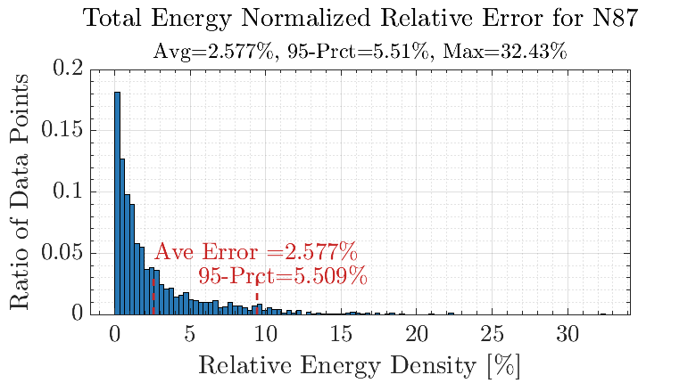
Histogram
Data Points
Notes:
Termplate

Slide 9
Conclusion
1. Training data
10 training materials
Lots of long B(t)-H(t) pairs in full sequence length
Temperature
2. Pre-Evaluation
Random segments provided within the 10 materials
Team self Report results given the evaluation rules for N87 and 3C90 materials for all 3 data splitting scenarios
Result template posted online (Pre_Evaluation_Results)
3. New Materials
November 15th : Pre-Evaluation submission
5 unknown materials partial training data provided
4. Submission
January 15th : Final model submission
Final test segments provided to perform final evaluation
Hyukjae Kwon, Shukai Wang, Haoran Li, et al. “MagNetX: Extending the MagNet Database for Modeling Power Magnetics in Transient,” TechRxiv. December 11, 2024. Accepted to APEC 2025.
Notes:
As long as they submit, we accept.

