Slide 1
WINDTRE – S‑HVC Project Executive Deck
Customer Base Mobile – Giugno 2025
Notes:
Source: /mnt/data/windtre_hvc_club_strategy_20250611191346.pdf

Slide 2
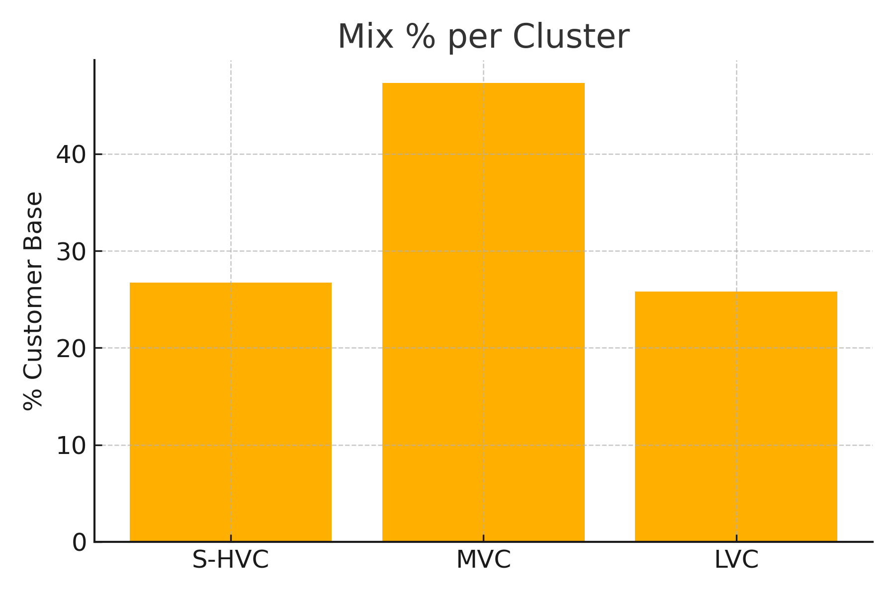
Customer Base Mix per Cluster
S‑HVC 26.7% (3.7M)
MVC 47.3% (6.5M)
LVC 25.8% (3.4M)
Notes:
Source: /mnt/data/windtre_hvc_club_strategy_20250611191346.pdf

Slide 3
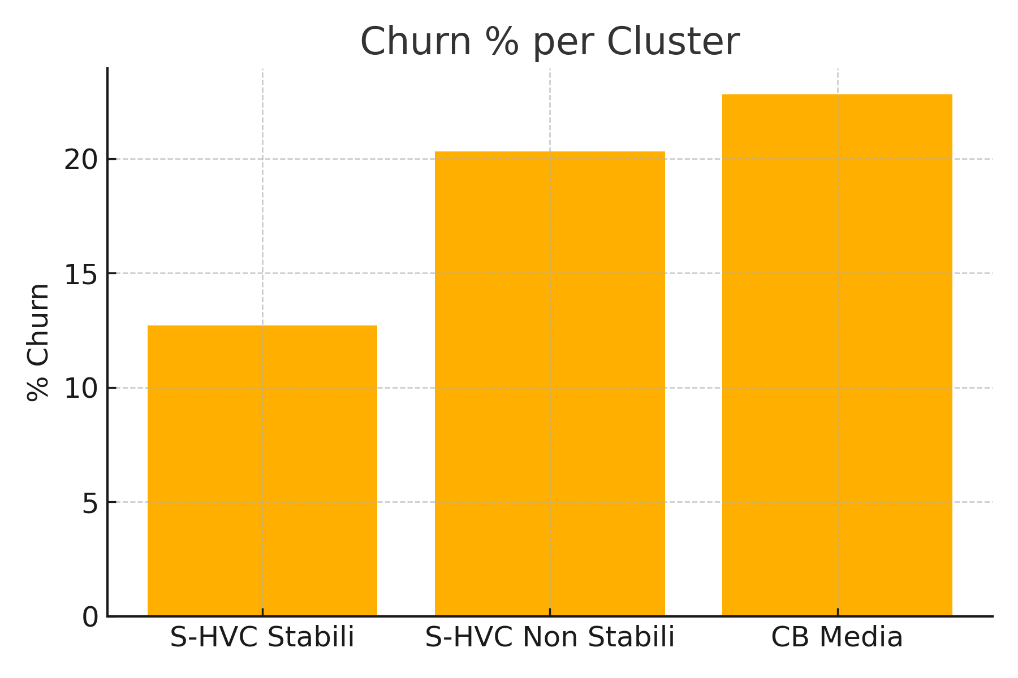
Churn Rate per Cluster
S‑HVC Stabili: 12.7%
S‑HVC Non Stabili: 20.3%
Media CB: 22.8%
Notes:
Source: /mnt/data/windtre_hvc_club_strategy_20250611191346.pdf

Slide 4
S‑HVC Stabili vs Non Stabili – KPIs
Metric | Stabili | Non Stabili
Bill Size € | Churn % | Easy Pay/Tied %
20.7 | 12.7 | 82
17.3 | 20.3 | 32
Notes:
Source: /mnt/data/windtre_hvc_club_strategy_20250611191346.pdf

Slide 5
Obiettivo 1 – Fidelizzare S‑HVC Stabili
North‑star: Churn ≤8% entro Dic 2025
Club esclusivo, benefici automatici, CX premium
Timeframe: Lug 2025 – Dic 2025
Notes:
Source: /mnt/data/windtre_hvc_club_strategy_20250611191346.pdf

Slide 6
Obiettivo 2 – Stabilizzare S‑HVC Non Stabili
North‑star: Churn ≤15.5% entro Dic 2025
Conversione Easy Pay, bundle PPU, device a rate
Timeframe: Ago 2025 – Dic 2025
Notes:
Source: /mnt/data/windtre_hvc_club_strategy_20250611191346.pdf

Slide 7
Obiettivo 3 – Up‑sell MVC & LVC
North‑star: ARPU MVC ≥13.5€; Convergenza ≥27%
Cross/up‑selling FWA/FTTH, servizi Energy & Insurance, piani Family
Timeframe: Set 2025 – Dic 2025
Notes:
Source: /mnt/data/windtre_hvc_club_strategy_20250611191346.pdf

Slide 8
Club S‑HVC – Value Proposition
Accesso automatico dopo 3 mesi S‑HVC stabile
Tier: Gold (16‑25€/m) & Diamond (>25€/m)
Benefici: caring compleanno/anniversario, priority support, coupon partner
Touchpoint dedicati: App, PDV, Care
Notes:
Source: /mnt/data/windtre_hvc_club_strategy_20250611191346.pdf

Slide 9
Benefici Club vs Costo Stimato
Benefit | Costo €/anno | KPI Impatto
Caring Compleanno | 0.05 | +12 NPS
Priority Care 24/7 | 0.15 | -0.8pp Churn
Coupon Partner | 0.00 | +2 Engagement
Notes:
Source: /mnt/data/windtre_hvc_club_strategy_20250611191346.pdf

Slide 10
Benchmark Loyalty Reference
Programma | Tier | ARPU xMassMkt | Benefici Chiave
3HK Supreme | Gold/Diamond | 2‑3x | Shop premium, concierge
NOBO | Ultra | N/A | Smart home, events
Amazon Prime | - | N/A | Bundle servizi
Booking Genius | 1/2/3 | N/A | Sconti progressivi
Notes:
Source: /mnt/data/windtre_hvc_club_strategy_20250611191346.pdf

Slide 11
Roadmap di Implementazione (high‑level)
Fase 1 – Launch Club: Lug‑Ott 2025
Fase 2 – Stabilizzazione: Ott‑Dic 2025
Fase 3 – Scale‑up: 2026
Notes:
Source: /mnt/data/windtre_hvc_club_strategy_20250611191346.pdf

Slide 12
Funnel Campagne per Cluster
Cluster | Base (M) | Campagne | Conversion % | Attivazioni
S‑HVC Stabili | 2.1 | 12 | 75 | 1.58M
S‑HVC Non Stabili | 1.6 | 18 | 22 | 0.35M
MVC & LVC | 9.9 | 18 | 14 | 0.94M
Notes:
Source: /mnt/data/windtre_hvc_club_strategy_20250611191346.pdf

Slide 13
Target Quantitativi 2025
KPI | Base Giugno 25 | Target Dic 25
S‑HVC Mix % | 26.7 | 28.2
Churn Annualizzato % | 22.8 | 18.3
Retained HVC/anno | 0 | 165K
Service Margin € | 0 | +11.5M
Campagne O/B‑I/B | 0 | 48
Contatti Generati | 0 | 5.2M
Redemption % | 0 | 18
Notes:
Source: /mnt/data/windtre_hvc_club_strategy_20250611191346.pdf

Slide 14
Key Takeaways
ROI 6.1x nel primo anno, costo one‑off 680K€
Membership Club per 2.1M S‑HVC stabili
Churn S‑HVC previsto 18.3% (‑4.5pp)
Richiesta approvazione budget e go‑live Lug 2025
Notes:
Source: /mnt/data/windtre_hvc_club_strategy_20250611191346.pdf

