Slide 1
Pathfinder
By Derek Phanekham

Slide 2
What Pathfinder is
An app for tracking and sharing routes or “Paths”
Track a Path that you walk or run
Search for Nearby Paths created by others

Slide 3
What Pathfinder is
Allows you to save paths that you have traveled
You and others can then walk or run those paths again.

Slide 4
My Motivation
As a hiker, I decided to make an app that I would find useful
Specifically aimed at hikers, trail runners, runners, etc

Slide 5
Technology Overview
Maps API
Google play services library
Db4o

Slide 6
Maps API
Very powerful
Allows integration of Google maps into any sized view
Can customize many aspects
Allows for location tracking
Several unique tools for displaying data

Slide 7
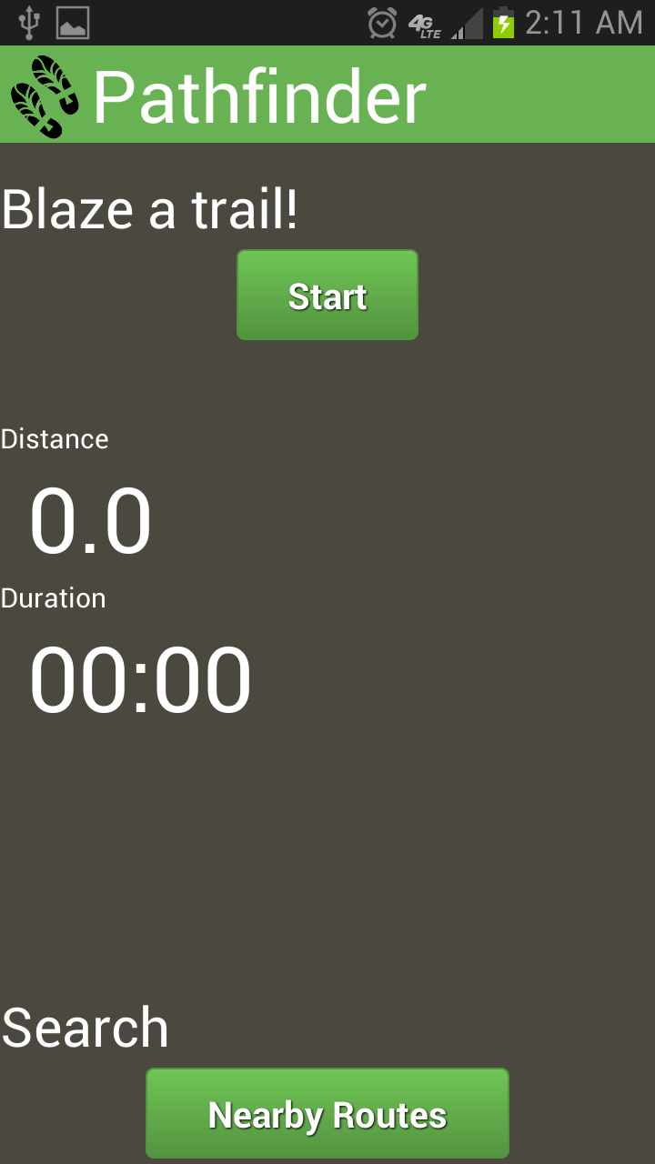
Main Menu
2 options
Start a tracking a new Path
Search for nearby Paths to follow

Slide 8
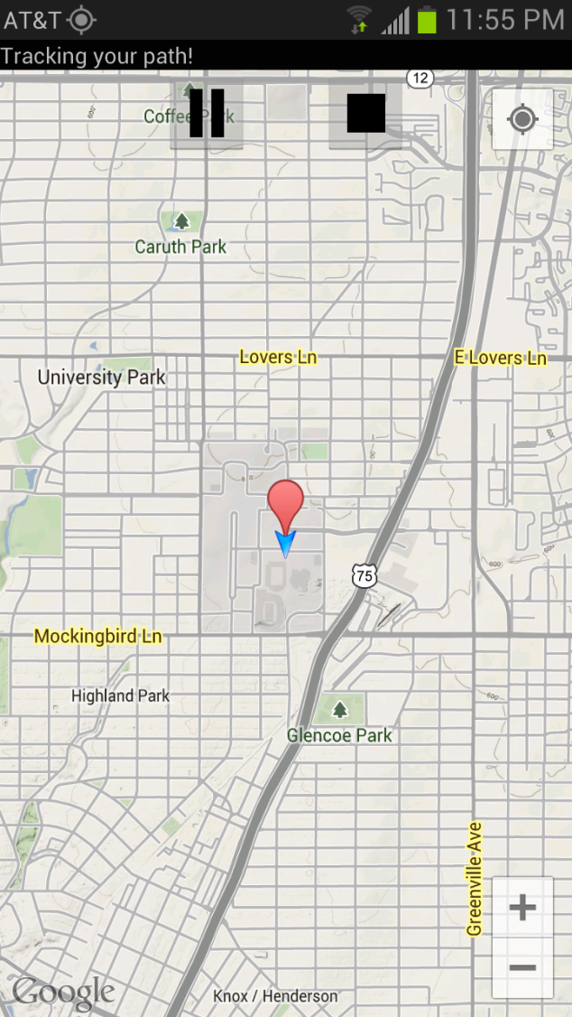
Map
Terrain Map
Polylines
Markers

Slide 9
Map
Text bar shows GPS tracking status
Pause and stop button
Map in Fragment

Slide 10
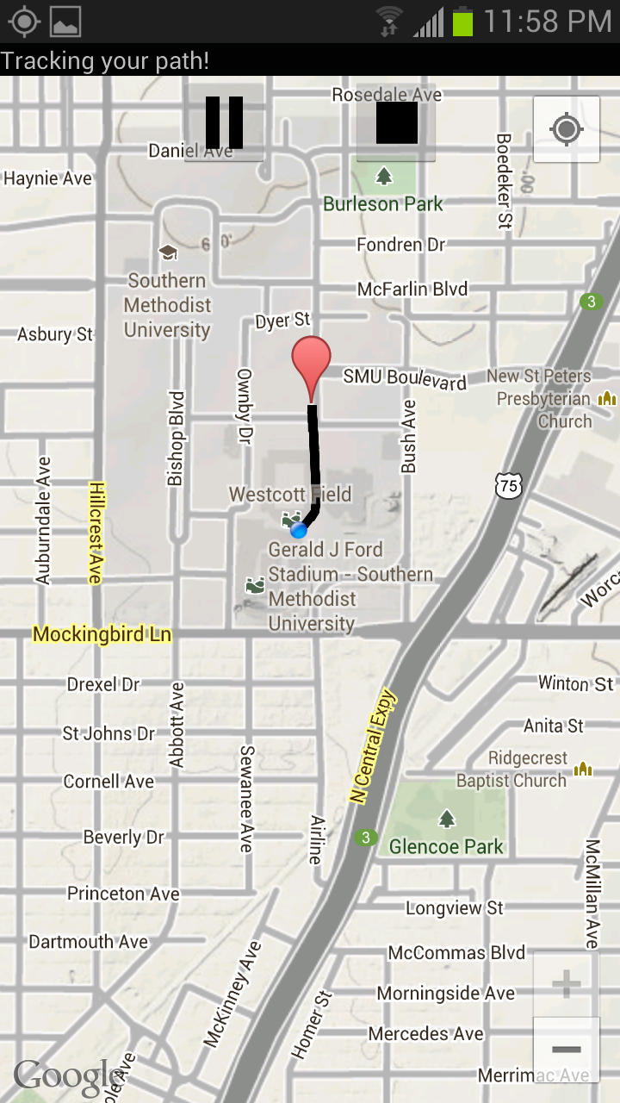
Location Tracking
Draws Polyline based on location
Tracks
Path
Distance
Time

Slide 11
Location Tracking
Google Maps location
Set enabled
Implement changelistener
Works through LocationManager

Slide 12
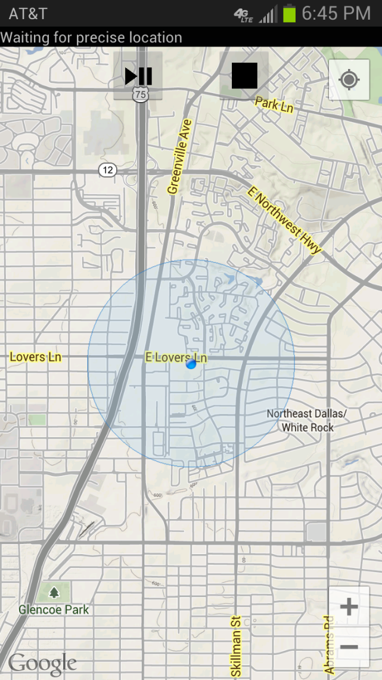
Location Tracking
2 types of location
Coarse
Fine
This app requires a fine location
Doesn’t start until one is obtained

Slide 13
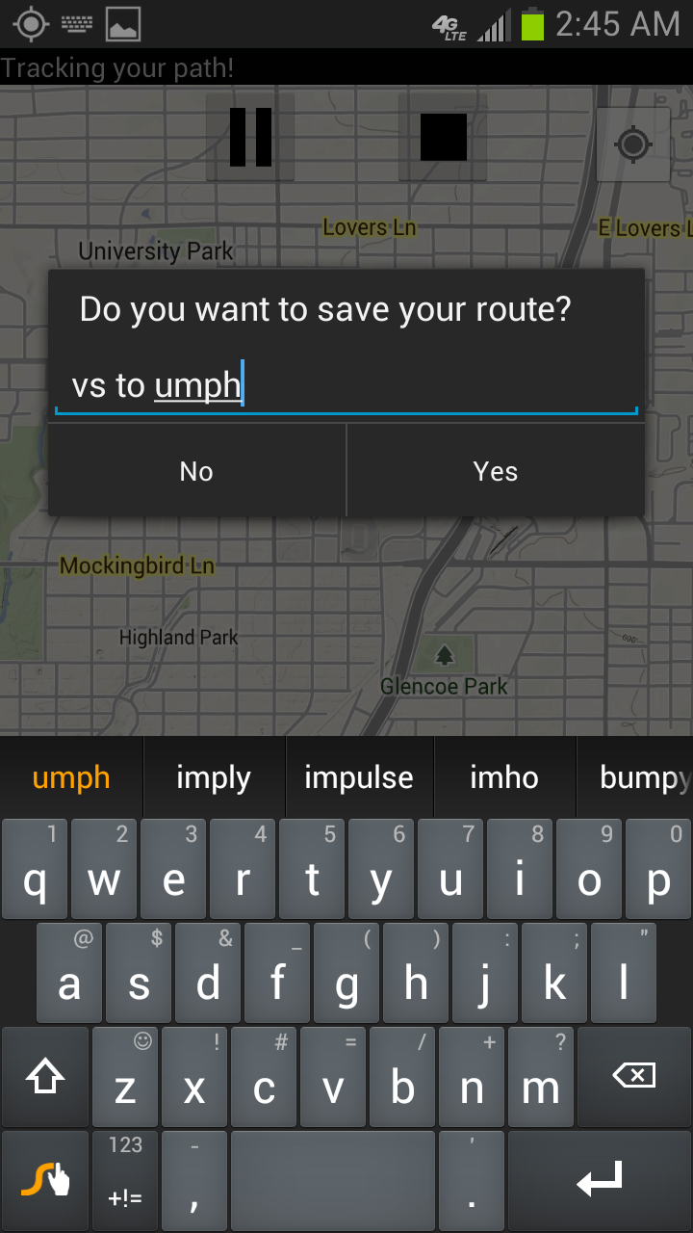
Saving
When click back or stop
Saved as a custom Path object
Stores information in PolylineOptions object
Basically an array of points

Slide 14
Path Object
Includes
PolylineOptions (points to create line)
MarkerOptions (point to create marker)
Length
Name
Starting latitude and longitude

Slide 15
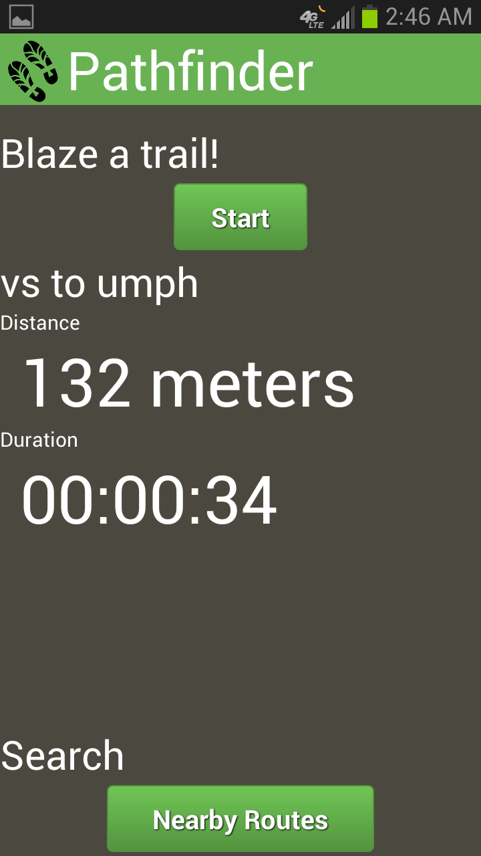
Displaying information
Title
Distance
Duration
Of Path that you have just finished

Slide 16
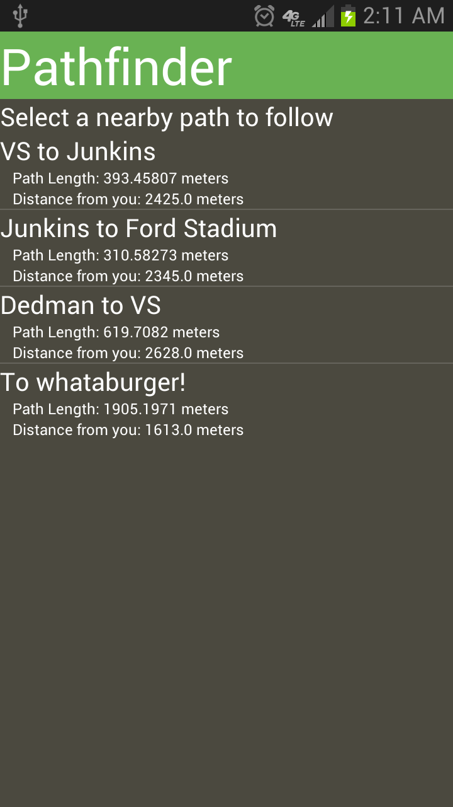
Sharing Paths
ListView of all nearby paths to follow
Custom Path Adapter

Slide 17
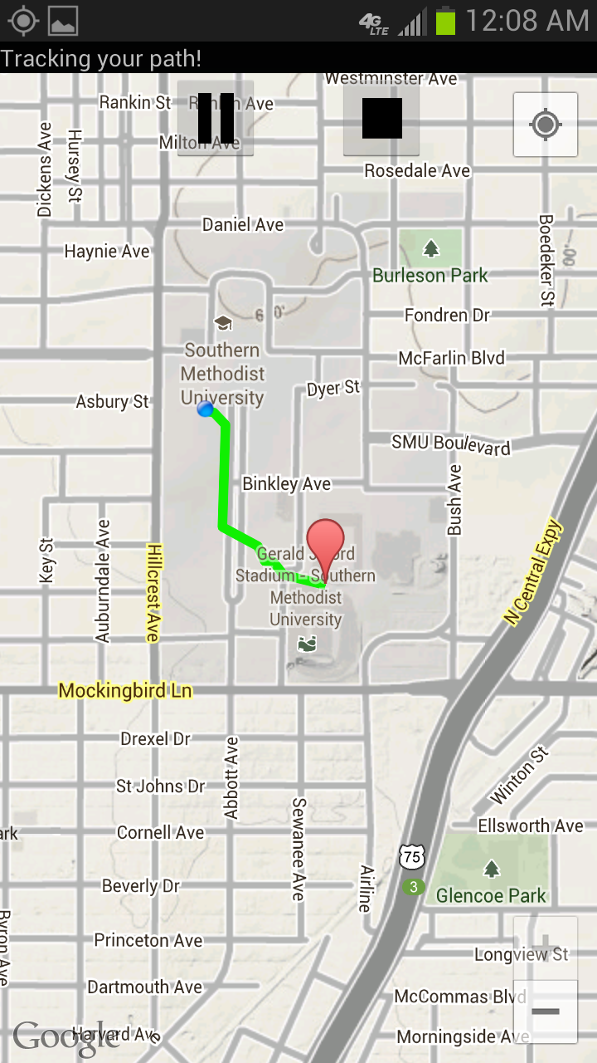
Other Paths
Path displayed as green line
Path is retrieved from database
Line is recreated by passing the map the list of points

Slide 18
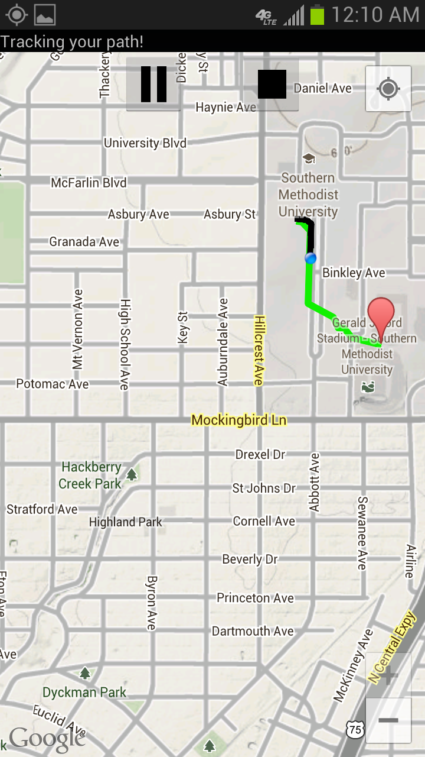
Follow another Path
Supports multiple Polylines
The path you have walked so far is black
Display over green

Slide 19
Database
Currently using db4o
Open Source object database
Simple to use
db.store(object);
Using local, but can easily expand

Slide 20
Future
Move to an online database
Log in
More options and statistics
Improved UI and functionality

