Slide 1

Email Spam Classification Using BERT and Naïve Bayes: A Semantic Deep Learning Approach
By:
Kalam Uddin, Abhigya Malla, Ronik Karki, Nischal Subedi

Slide 2

Project overview
Detecting Email Spam for Secure, Efficient
Compared traditional Naïve Bayes with deep learning BERT
Focused on context-aware VS frequency-based models
Used Kaggle Dataset of 5172 emails.

Slide 3
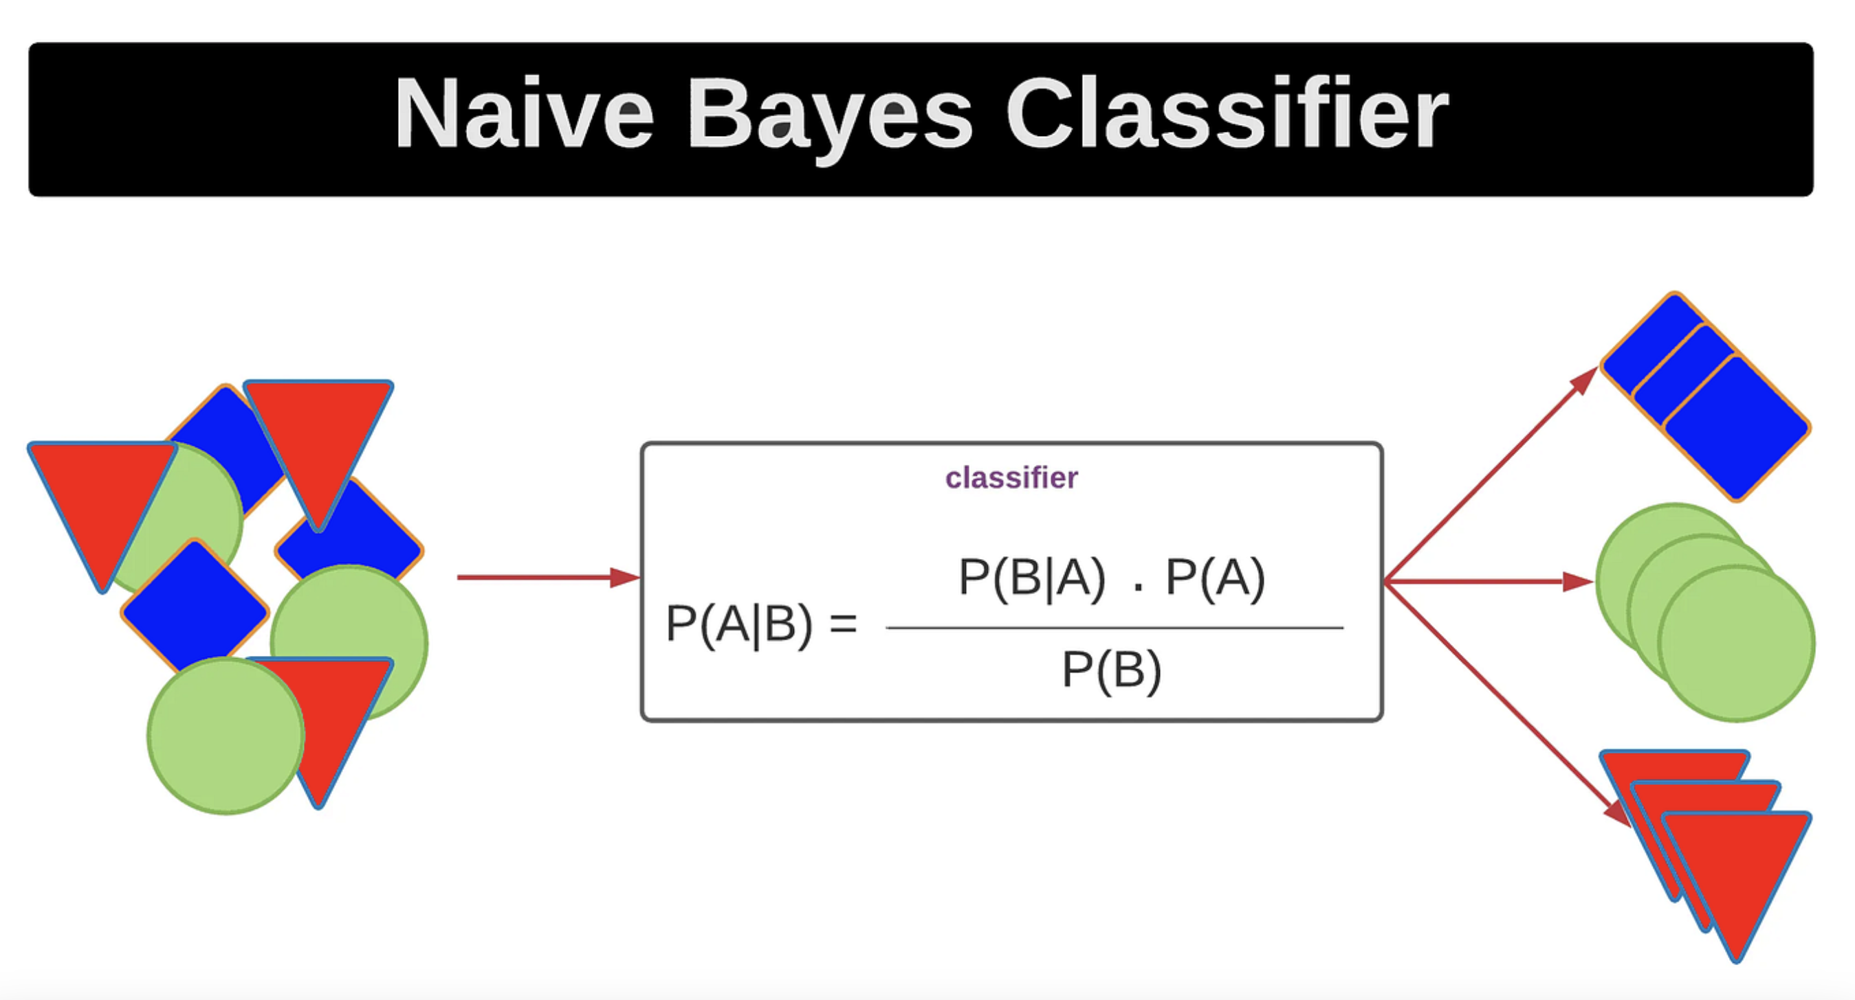
MethodologY(Naïve bayes approach)
Feature Extraction :
TF-IDF to convert text into numerical feature
Classifiers :
MultinomialNB – for frequency based features
Advantages
Fast, Simple, works with small datasets
Low Hardware requirements

Slide 4
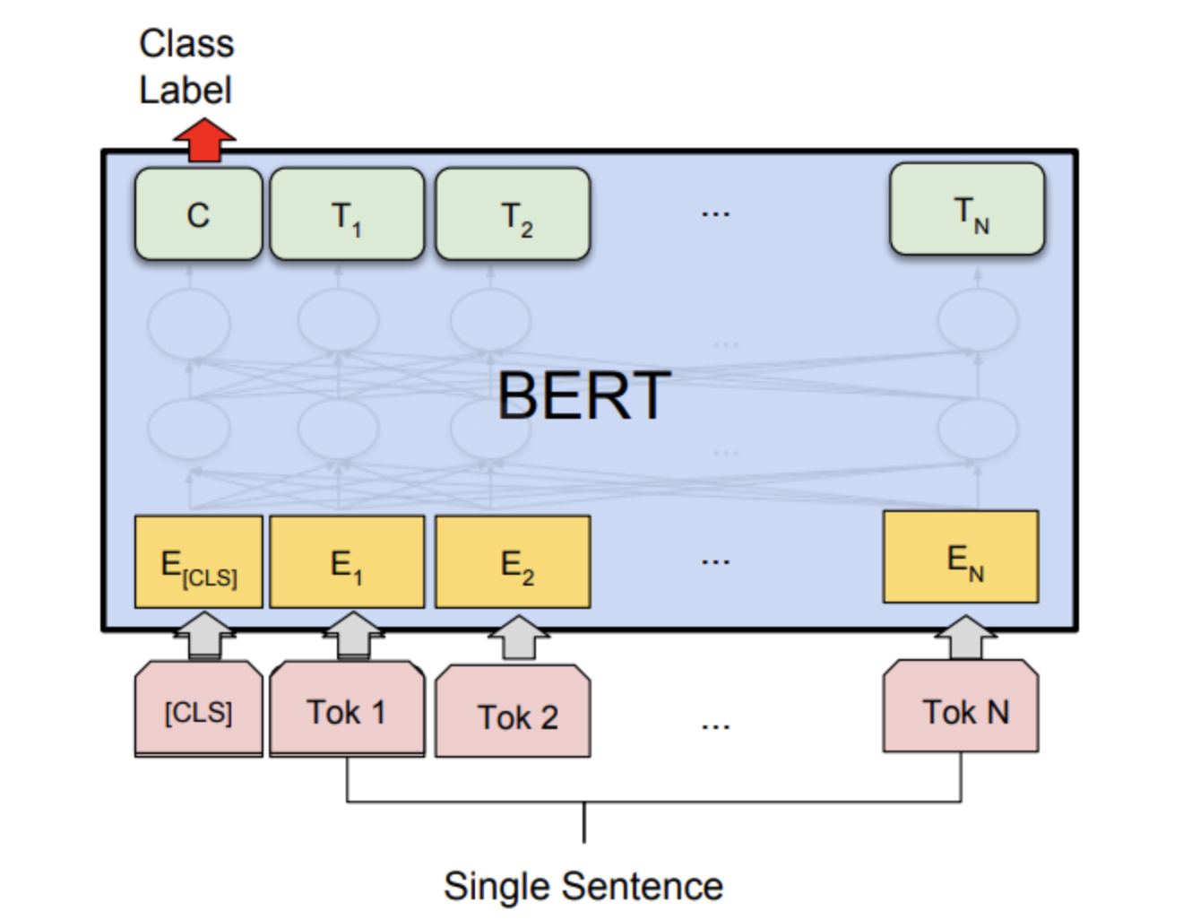
MethodologY(BERT Approach)
Feature Extraction :
TF-IDF to convert text into numerical feature
Tokenization Process :
Word Piece tokenization
Special tokens[CLS],[SEP]
Attention masks
Fine-Tuning Setup
3 epochs
AdamW optimizer
Linear Learning rate decay
Benefits
Context-aware
No manual feature engineering
Superior Semantic understanding

Slide 5
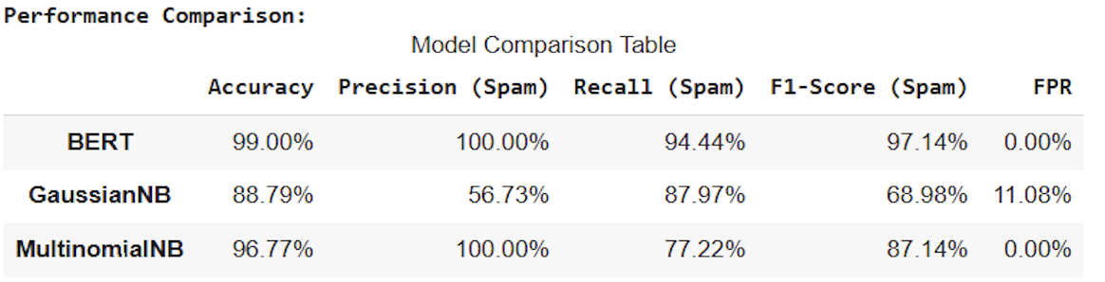
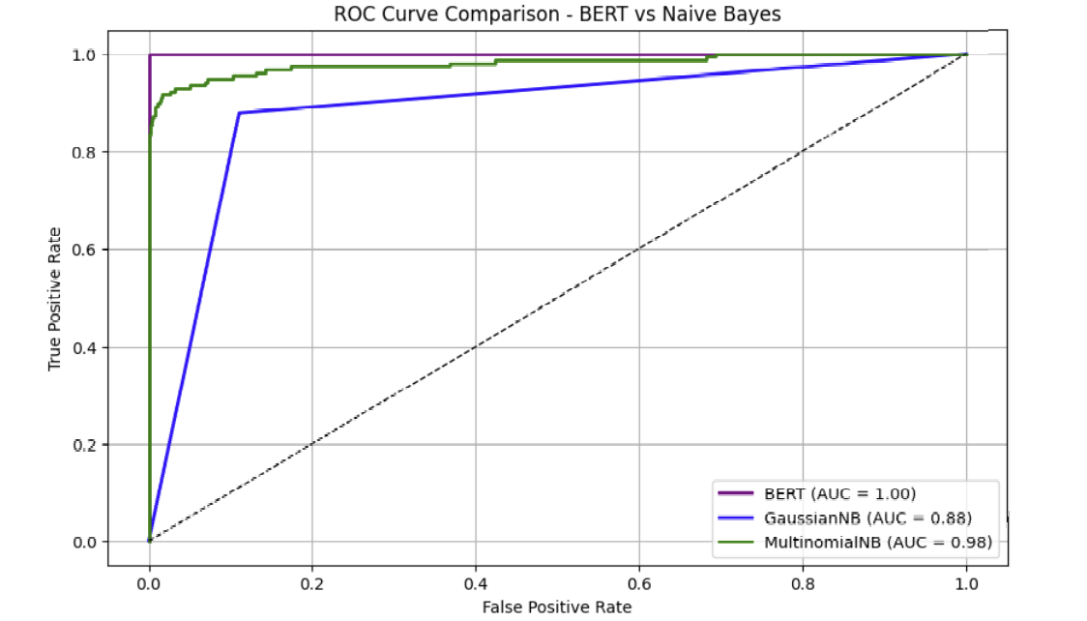
Result : Performance comparision
Model Performance:
BERT: 99% accuracy, precision, recall, F1-score
MultinomialNB: 96.77% accuracy, strong precision, moderate recall
GaussianNB: 88.79% accuracy, weak precision, higher FPR
ROC Curve Insights:
BERT AUC = 1.00 → perfect classification
MultinomialNB AUC = 0.98 → very good
GaussianNB AUC = 0.88 → decent, but higher errors

Slide 6
Discussion & Conclusion
Comparison
Naïve Bayes → Fast & effective but limited
BERT → Context-aware, Superior performance
Key Insights
BERT’s bidirectional processing enables better semantic understanding
Conclusion
Modern deep learning models like BERT significantly improve spam detection
Recommended for real-world spam filters where context analysis is crucial

Slide 7
Thank you

