Slide 1
Project Udyam Digital
One sitting. One bundle. One bill.
Ticchi Gang
Monis (Team Leader), Ubesh Siddiqui · NSUT Delhi
YTL Hackathon 2026, Enterprise Track A
Notes:
Team Ticchi Gang from NSUT Delhi: Monis (Team Leader), Ubesh Siddiqui. Project Udyam Digital is Accel Business onboarding for India’s small businesses. A shop owner describes the business, gets one clear monthly price, verifies with documents signed at source through DigiLocker, pays, and follows installation on a tracker, in one sitting on a phone. All data is synthetic, from the case pack.

Slide 2
Only 7 in 100 small-business leads go live, after 17.6 days
Leads
5,000
17.6 days
3 calls
Contacted
3,406 68%
lead to live
status chases per customer
Needs assessed
1,974 58%
Quote accepted
861 44%
← weakest step
₹15,053
2.0% vs 9.6%
KYC complete
588 68%
cost per activation
activation without vs with GSTIN
Activated
368 63%
1,291 leads lost to how we sell (visits, slow or complex quotes, paperwork) vs 621 on price
Notes:
Source: smb_leads.csv, April to June 2026. 5,000 leads produced 368 activations (7.4%). The steepest drop is from needs assessed to quote accepted: only 44% continue. Activated customers waited 17.6 days on average and called 3 times to chase status. Blended acquisition cost is ₹15,053 per activation. Leads with a GSTIN activate at 9.6%, without at 2.0%. Process losses: owner had no time for a visit 531, visit not scheduled 296, quote too complex 206, quote too slow 179, paperwork too long 79, total 1,291, about twice the 621 lost on price.

Slide 3




Professionals and micro shops go first, fully online
Micro retail & services
Professional offices
Small multi-site
Small manufacturers
Wave 1 · digital only
Wave 1 · digital
Wave 2 · with sales
Wave 2 · with sales
Share of base
55%
Share of base
25%
Share of base
15%
Share of base
5%
Activate
4.1%
Activate
11.1%
Activate
11.0%
Activate
12.8%
Cost / activation
₹20,007
Cost / activation
₹10,695
Cost / activation
₹15,614
Cost / activation
₹15,324
Dukaan Starter
Pro Office
Chain Connect (5 sites)
Factory Link
5G AirFiber + 1 business line
Fibre 300, 3 lines, email and security for 5, backup
Fibre, failover, 2 CCTV per site, SD-WAN, 5 lines
Leased line 20, failover, 4 lines, email for 10, firewall, 5 sensors
₹1,198 /month
₹4,015 /month
₹25,975 /month
₹13,689 /month
Lowest catalogue prices, before tax. Share of base from the case; activation and cost from smb_leads.csv.
Notes:
Wave 1 is fully digital: professional offices have the best cost per activation (₹10,695) and 11.1% activation; micro shops are 55% of the base but cost ₹20,007 per activation today, and field visits to them cost ₹53,026 per activation, so micro is digital only. Wave 2 (multi-site and factories) activate at 11 to 13% and need site work, so they get sales help. Bundles are priced from the catalogue minimum. Micro median spend today is ₹900 a month, so the ₹1,198 starter must be price-tested in the pilot.

Slide 4
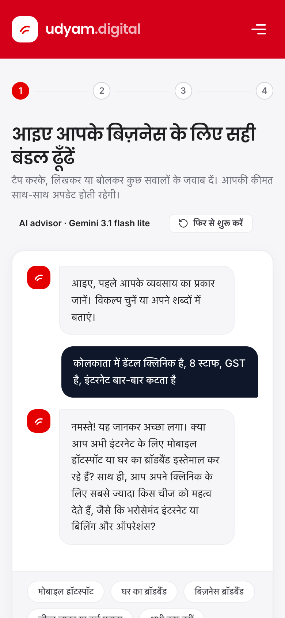
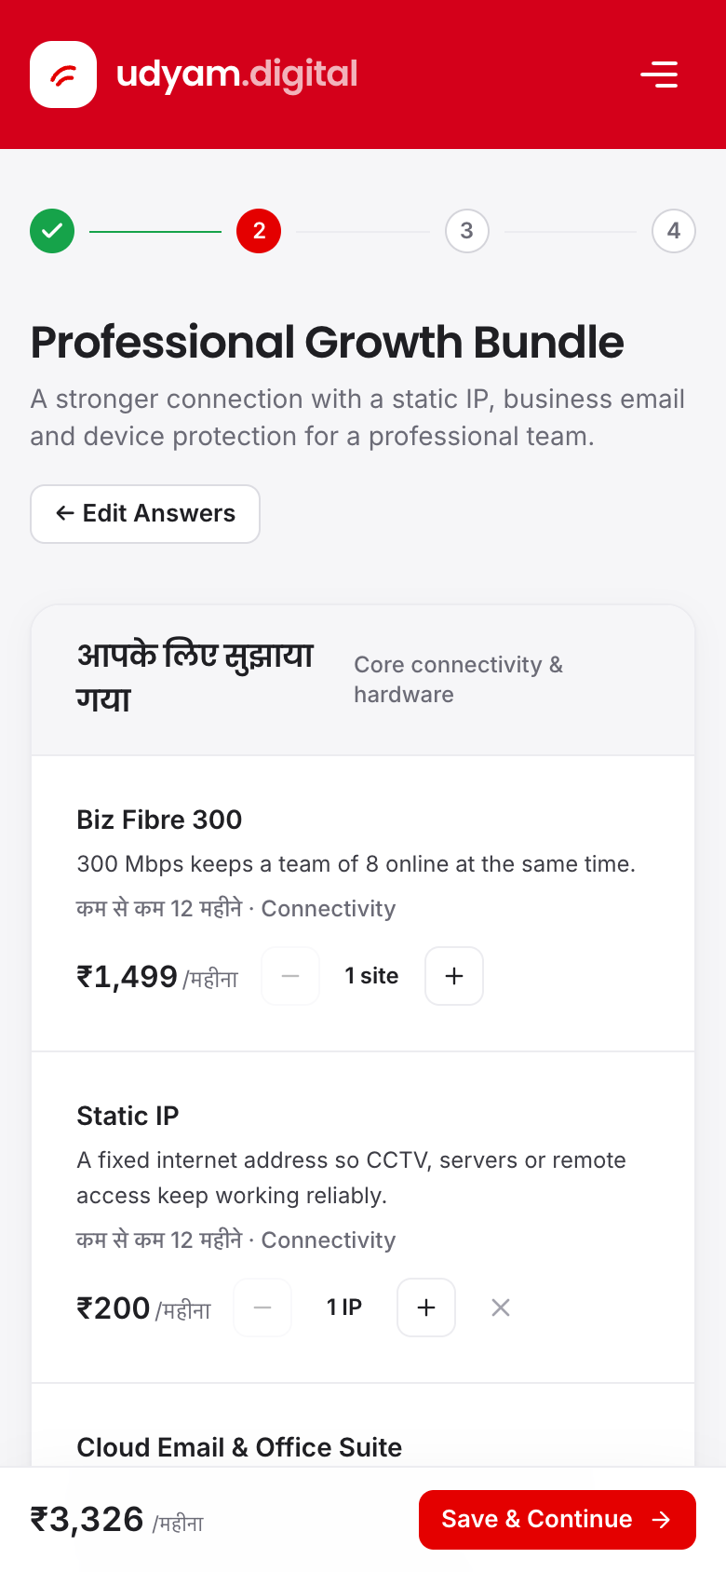
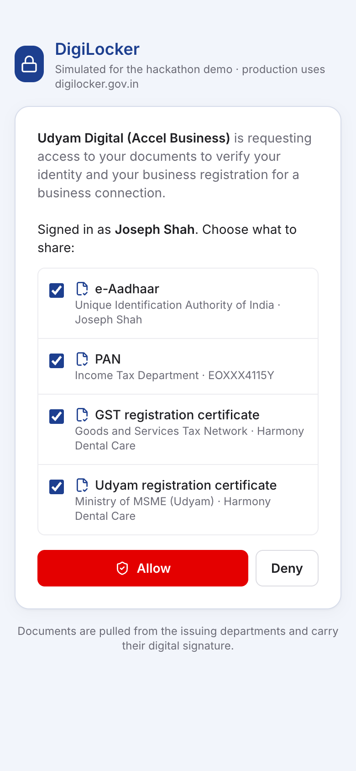
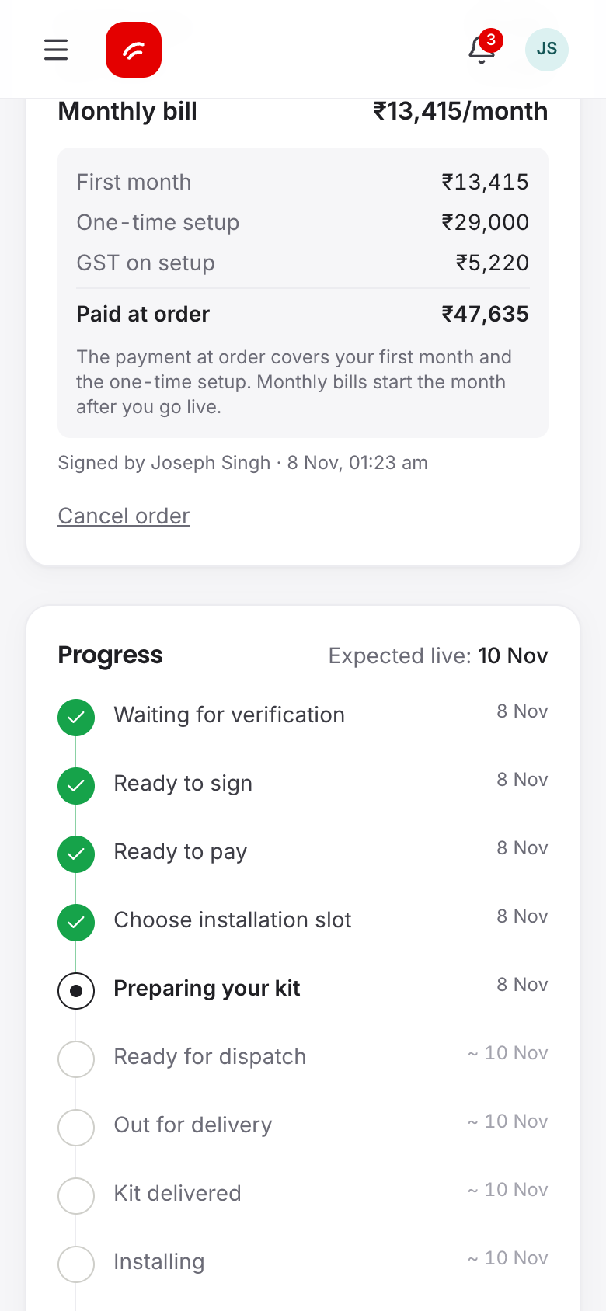
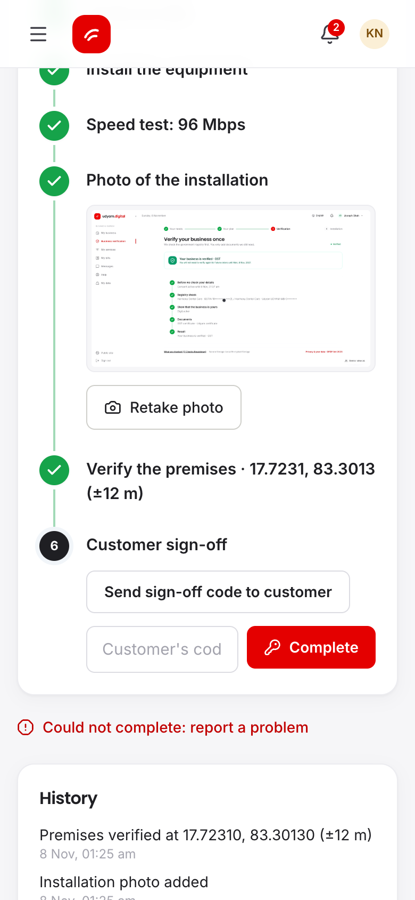
One sitting on a phone: from first question to a live line
1
Ask
2
Quote
3
Verify
4
Track
5
Go live
Describe the business in Hindi or English
One monthly price, toggle add-ons
Documents signed at source
Every step dated, no chasing
Geo-tagged install
Notes:
Real prototype screens. 1 Ask: the advisor understands Hindi, Hinglish and 8 other languages, by typing or voice. 2 Quote: one monthly price including GST, add-ons the owner can toggle, refusals explained. 3 Verify: DigiLocker returns e-Aadhaar, PAN, GST and Udyam certificates signed by the issuing departments. 4 Track: an 11-step tracker with dates, so the owner never calls to chase. 5 Go live: the technician checks in with GPS and confirms the address and signboard before the line is switched on.

Slide 5
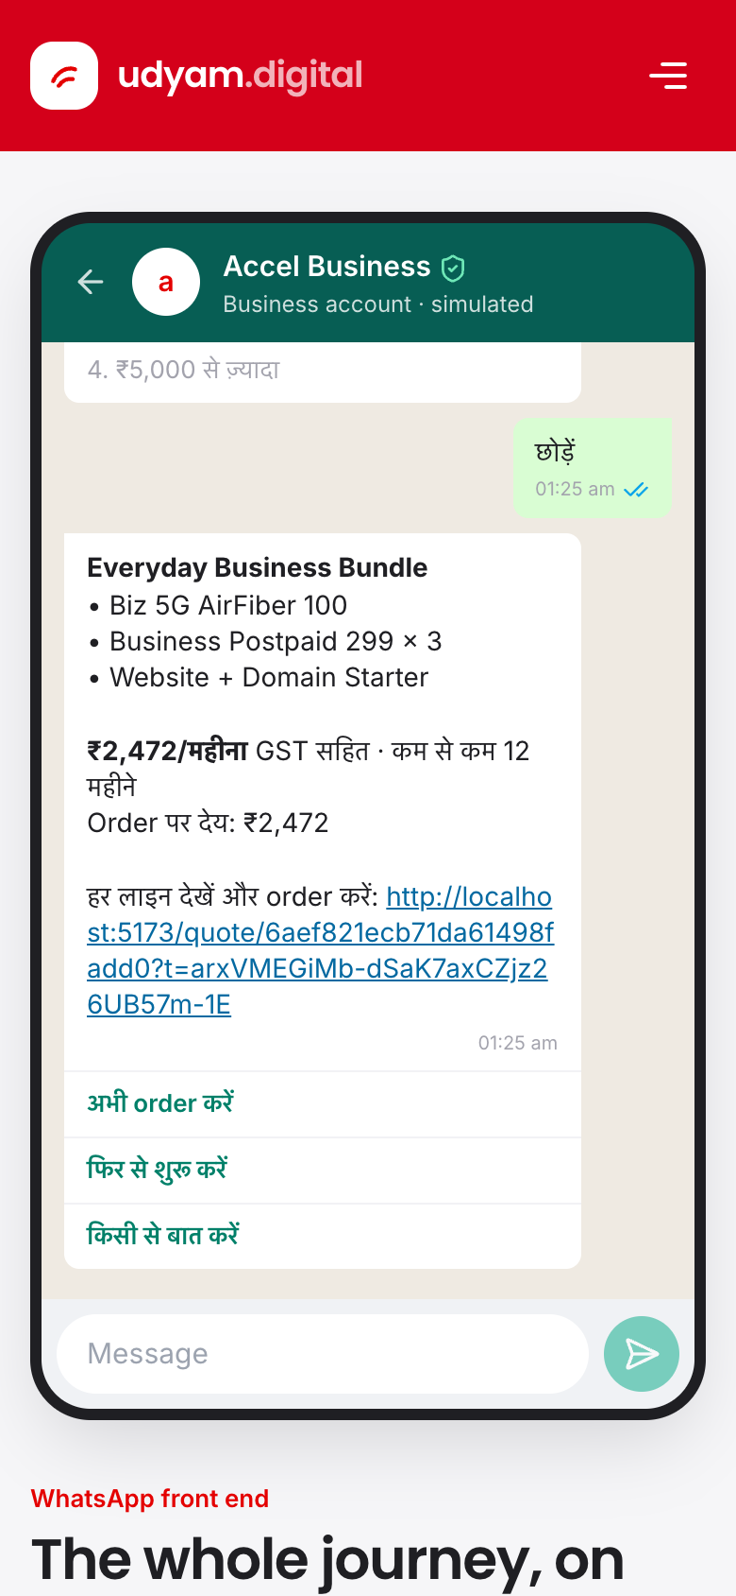








AI understands the owner; rules set every price
chat text
profile JSON
priced lines
order
Owner
AI advisor
Rules engine
Order check
Quote
Hindi, English, voice
reads the profile
decides products, price
every line re-validated
one monthly price
Fallback chain (8 s timeout)
Guardrails
slow
slow
Identifiers masked before AI
Schema-checked output
Gemini 3.5 Flash
Flash Lite
Local rules
AI never decides KYC or price
Notes:
Gemini only turns the owner’s words into profile fields. The pricing engine is the only place products, eligibility and prices are decided, and every order line is re-validated when the order is placed. Identifiers typed by mistake (GSTIN, PAN, Aadhaar, phone) are masked before anything reaches the AI. If Gemini takes more than 8 seconds, Flash Lite answers, then local multilingual rules; the screen shows which one replied. In 14 tricky test chats (Hindi, Tamil, prompt injection, edge sizes) no catalogue rule was broken and no product or price was invented.

Slide 6








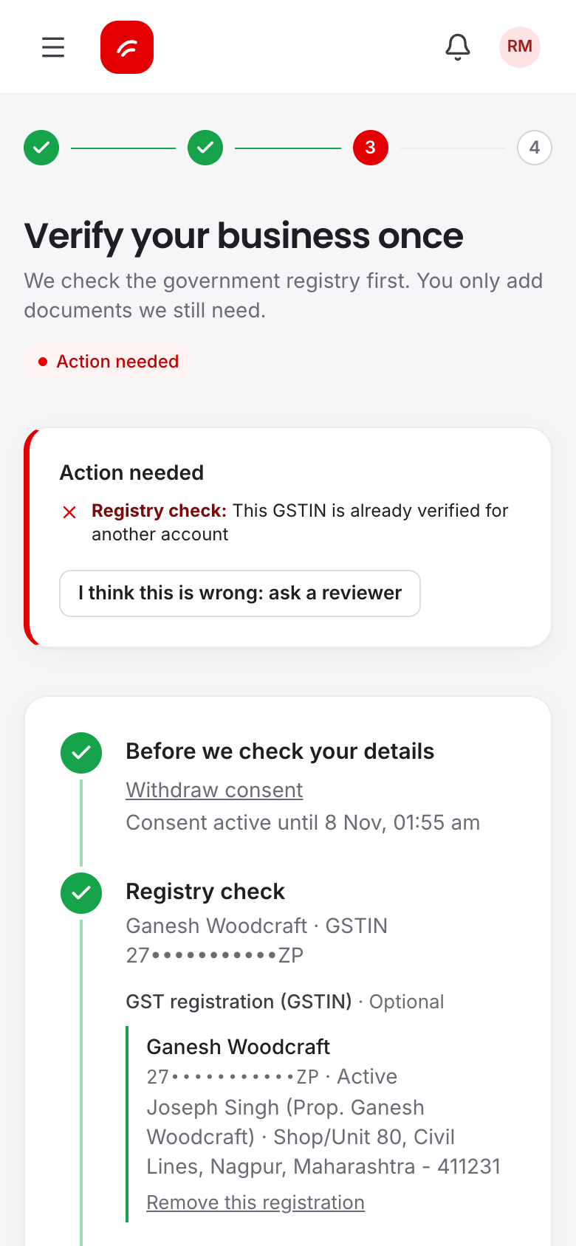

KYC with documents signed at source, not typed in
Consent
DigiLocker
Registry
Owner link
Decision
Geo-tag
Live
one purpose
Aadhaar OTP
GSTN, PAN
PAN, ₹1 bank
auto or 2 officers
technician
line switched on
Hard stops: no override, not even by an officer
Cancelled or suspended GSTIN
GSTIN, Aadhaar or bank already used by another owner
PAN does not match the GSTIN
Issuer signature fails
DPDP Act 2023
Consent first
One purpose
Minimum data
Masked IDs
Deletion rules
Notes:
Trust ladder: documents pulled from DigiLocker are signed by the issuing department and verified on our server, so nothing is typed in. If DigiLocker is unavailable, documents are read on our server twice (OCR and an AI reader); the phone’s reading is only a pre-fill, and any disagreement goes to a person. The applicant must prove control of the business: the registration in their own DigiLocker, or the business PAN plus a ₹1 bank check that returns the business name. Overrides need a reason and a second officer. In the prototype DigiLocker, GSTN, Protean PAN and the bank are simulated; MCA is planned.

Slide 7



Digital closes simple leads; partners get the big ones
Cost per activation by lead source (₹)
micro
Micro: digital only
never a field visit
Field sales
24,335
Channel partner
20,851
Segment
+ score
New lead
hot
Partner or field sales
Website form
6,352
bigger and hot leads
Inbound call
5,113
Referral
4,099
stuck
Inside sales
WhatsApp campaign
4,026
quote left or KYC failed
Field visits to micro shops: ₹53,026 per activation. Referrals activate 14.8%.
Partner commission paid on activation
Notes:
Routing keeps the field force for leads that need it. Micro shops never get a field visit: a visit costs ₹53,026 per micro activation against a starter bundle of about ₹1,200 a month. Hot multi-site and factory leads go to a local partner or field sales. Leads that stall (an abandoned quote, a failed payment, a KYC problem) go to inside sales with the exact reason. The partner desk ranks 5,000 historical leads by a propensity model trained on the case data, with readable reasons. Partners earn commission on activation, so digital is not a threat to them.

Slide 8



















AI proposes, rules decide, official sources verify
Users
Udyam Digital cloud (India region)
Official sources (simulated)
masked text
Services
Gemini API (live)
signed
docs
DigiLocker
Owners
Web app
AI advisor
Rules, prices
KYC engine
UIDAI e-KYC
e-sign,
UPI
GSTN, Udyam
WhatsApp
API gateway
Notifications
Field check
Orders
Protean PAN
Data layer
Partners, staff
Consoles
Bank ₹1 check
Advisor grounded on product_catalogue.csv (25 SKUs). KYC: Tesseract OCR + AI reader + rule matcher. Test data: 3,534 GSTIN, 2,723 Udyam, 47 KYC images. Lead model AUC 0.70 on 5,000 leads.
Atlas
Documents
Audit log
eSign, UPI
API
Compute
AI
Security
Messaging
Data
External
Notes:
Channels talk to one API gateway. The AI advisor only reads the conversation; the rules and pricing engine and the KYC engine make every decision. Official sources are simulated in the prototype and replaced in production by a KYC provider or API Setu for DigiLocker, a GST Suvidha Provider, Protean, MCA21, an eSign provider and a payment gateway. Identifiers are encrypted at rest with lookups by keyed hash, and every decision is written to an audit log. The full diagram is a separate deliverable.

Slide 9
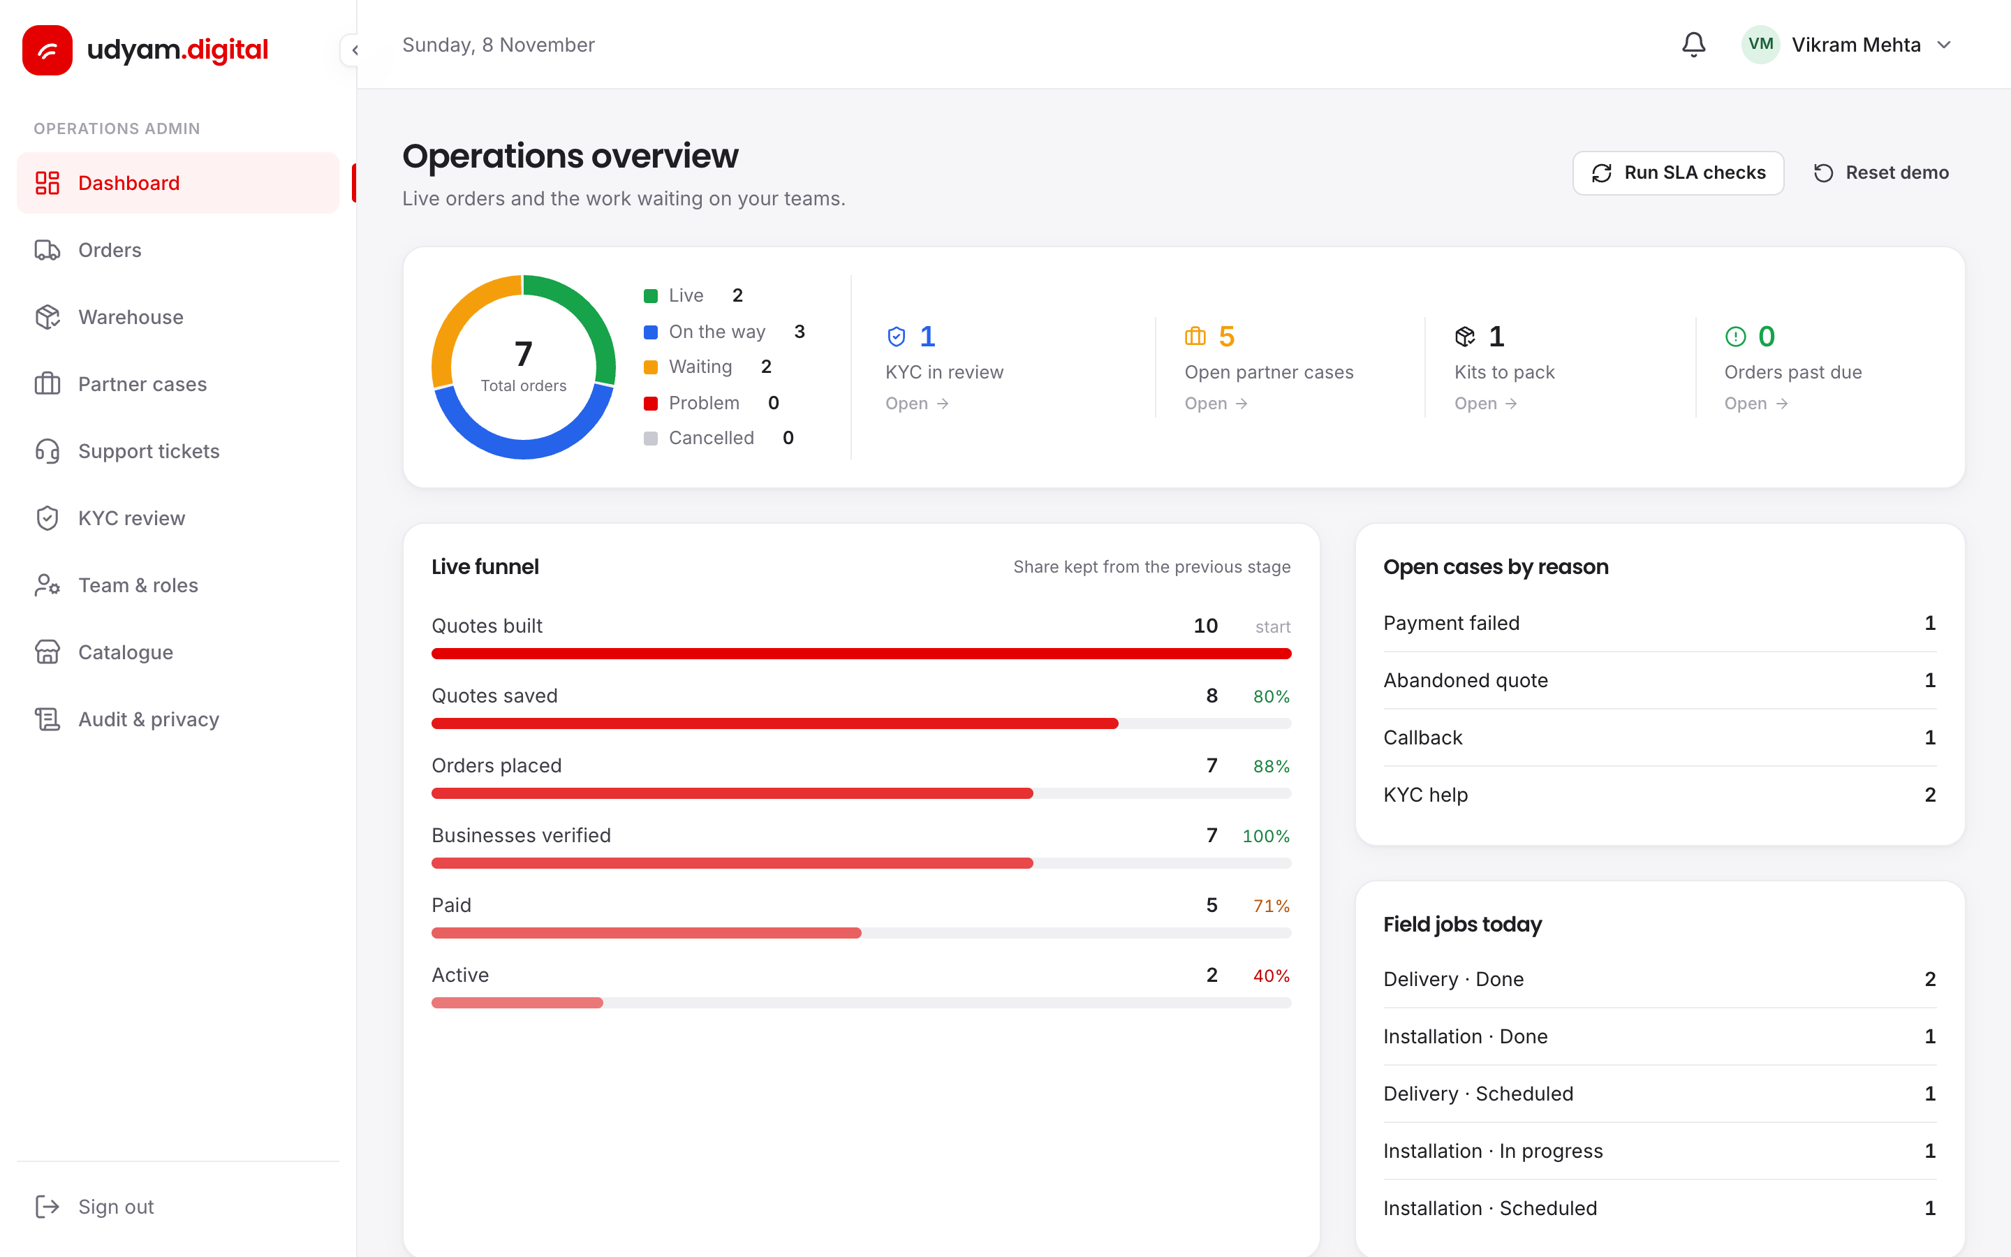
Five numbers decide the pilot
Lead to activation
7.4%
12%
Days to activate
17.6
≤ 7
Status calls per customer
3
< 0.5
Cost per activation
₹15,053
< ₹9,000
The ops dashboard tracks these live
6-month churn
15.2%
11%
Baselines from the case data; targets are our proposal.
Notes:
Baselines come from smb_leads.csv: 7.4% of leads activate, after 17.6 days, with 3 status calls, at ₹15,053 per activation, and 15.2% churn within six months. Churn rises with chasing: 5.9% for customers who called once against 27.9% for those who called five times, which is why the tracker matters. Targets are our proposal for a two-city pilot and will be set with Accel Business.

Slide 10






Roll out in three gated steps
Phase 1: Pilot
Phase 2: Scale
Phase 3: National
2 tier-1 cities · professionals and micro · English and Hindi · KYC provider for DigiLocker, GSTN, PAN
Tier 2 · multi-site and factories with sales help · WhatsApp · regional languages
All circles · telco order and billing integration
Gate: activation, days to live and status calls hit target
AI misreads a document
Customer data to an outside AI
Micro shops are price-sensitive
Sales see digital as a threat
Two readers plus registry match; a person reviews
Masked identifiers, enterprise AI tier, named in the notice
₹1,198 starter; price test in the pilot
Hot leads routed to them; commission on activation
Notes:
Pilot: two tier-1 cities, professional offices and micro shops, English and Hindi, with a licensed KYC provider for DigiLocker, GSTN and PAN. We move to the next step only when activation, days to live and status calls meet target. Scale adds tier-2 cities, multi-site and factory segments with sales help, WhatsApp and regional languages. National adds all circles and integration with the telco’s order and billing systems.

