Slide 1
Project Udyam Digital
One sitting. One bundle. One bill.
Team Ticchi Gang
Monis (Team Leader), Ubesh Siddiqui · NSUT Delhi
YTL Hackathon 2026 · Enterprise Track A
▶ Demo video
Code repository
Notes:
Team Ticchi Gang, NSUT Delhi: Monis (Team Leader), Ubesh Siddiqui. This one document carries all four deliverables: the working prototype (video and code, linked here), the solution architecture (slide 4), the business case (slides 2, 3, 5, 6) and the data privacy and security note (slide 7, full note linked). Demo video: https://drive.google.com/file/d/1rgxMdYljXDKgNvWEKjD9Pxg4HXMppS7V/view?usp=sharing. Code: https://github.com/dSAxmonis/airtel_sync_digital. All data is synthetic, from the case pack.

Slide 2




Only 7 in 100 small-business leads go live, after 17.6 days
7.4%
17.6 days
3 calls
₹15,053
2.0% vs 9.6%
of leads go live
lead to live
status chases per customer
cost per activation
activation without vs with GSTIN
Target customers: who we serve first, with the bundle and price each one gets
Micro retail & services
Professional offices
Small multi-site
Small manufacturers
Wave 1 · digital only
Wave 1 · digital
Wave 2 · with sales
Wave 2 · with sales
55% of base · 4.1% activate
25% of base · 11.1% activate
15% of base · 11.0% activate
5% of base · 12.8% activate
Dukaan Starter
Pro Office
Chain Connect
Factory Link
5G AirFiber + 1 business line
Fibre 300, 3 lines, email + security
Fibre, failover, CCTV, SD-WAN (5 sites)
Leased line, failover, firewall, sensors
₹1,198 /month
₹4,015 /month
₹25,975 /month
₹13,689 /month
Notes:
Source: smb_leads.csv (5,000 leads, April to June 2026): 368 activations (7.4%), 17.6 days lead to live, 3 status calls, ₹15,053 per activation; leads with a GSTIN activate at 9.6%, without at 2.0%. Wave 1 is fully digital: professional offices have the best economics; micro shops are 55% of the base and never get a field visit (₹53,026 per micro activation today). Wave 2 needs site work and gets sales help. Prices are the lowest catalogue prices, before tax.

Slide 3
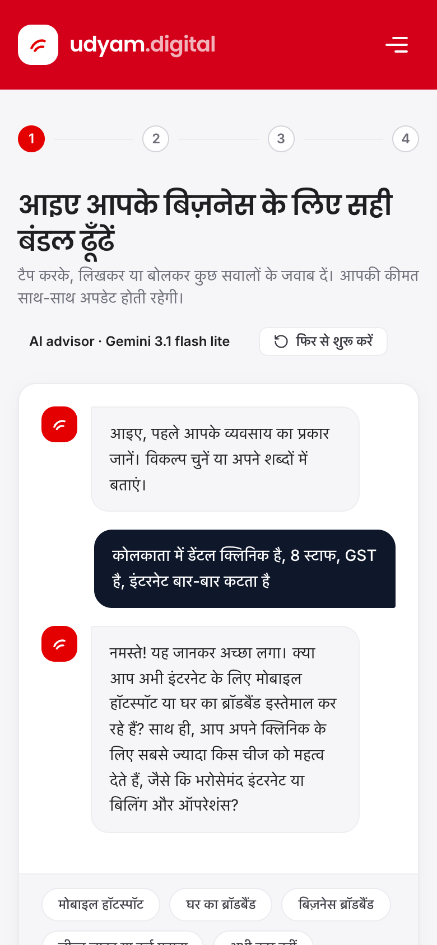
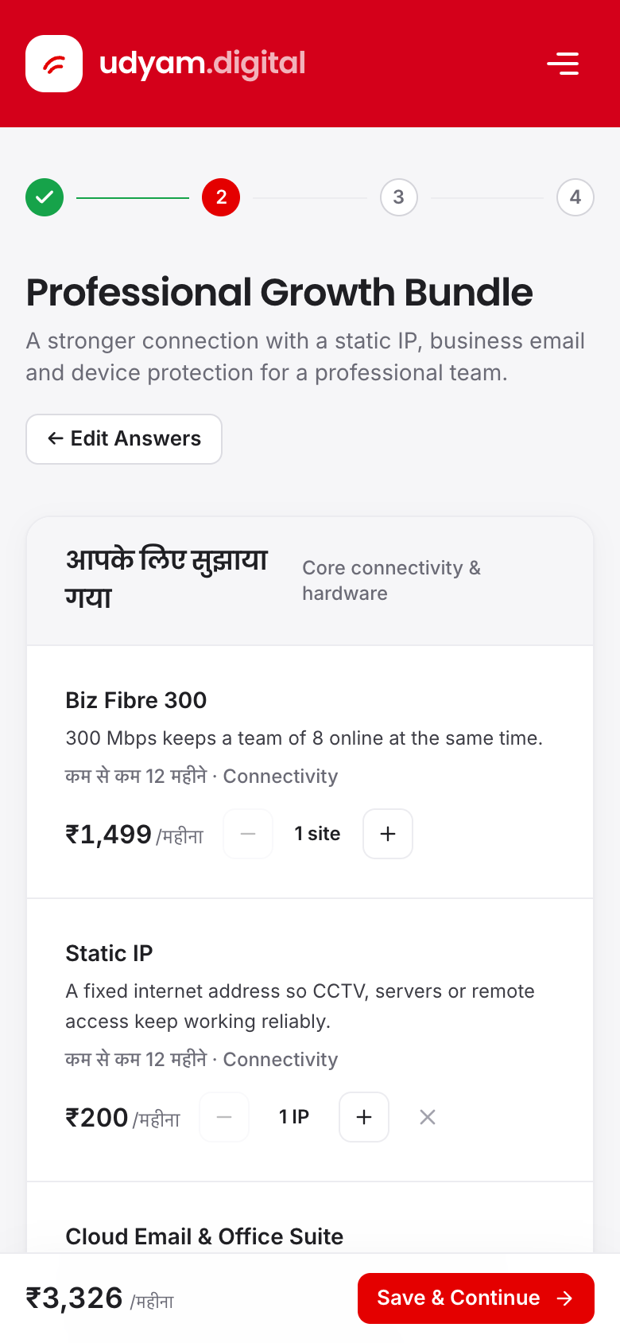
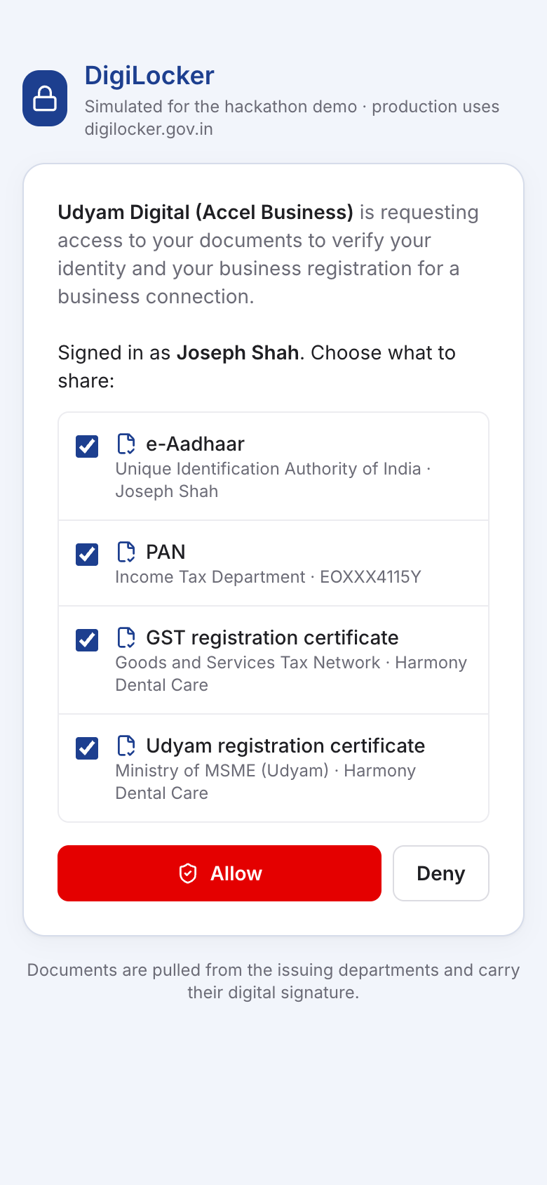
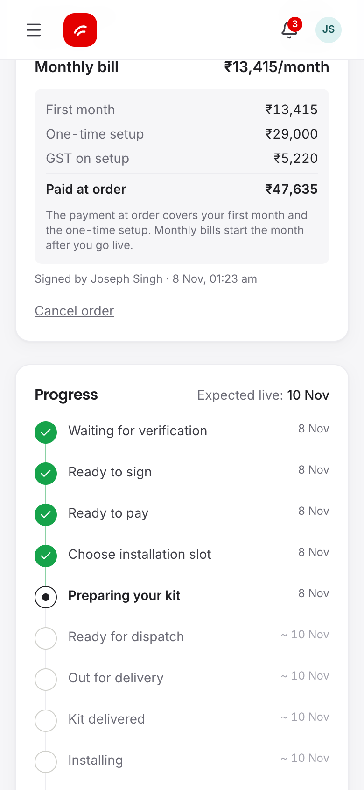
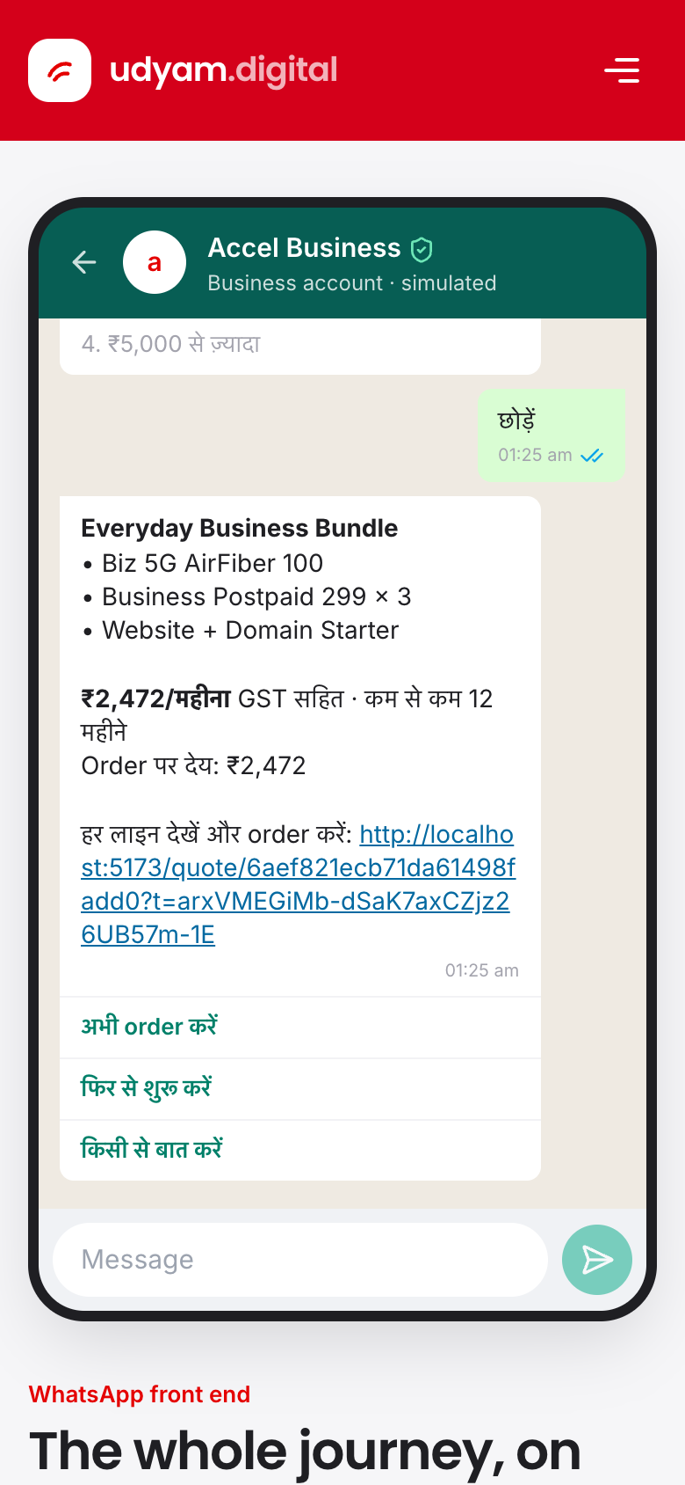






Working prototype: one sitting, every role covered
Advisor
Quote
Sign-in
KYC
e-Sign
UPI
Install
Live
KYC: DigiLocker in about a minute, or business PAN + ₹1 bank check + documents read on our server
Seven roles, one system
Business owner
Owner on WhatsApp
Channel partner
KYC officer (maker)
Second officer (checker)
Technician
Advisor in Hindi
One monthly price
DigiLocker
Live tracker
WhatsApp
Operations
Gemini grounded on catalogue
Rules set every product and price
10 languages, type or speak
Same journey on WhatsApp
Notes:
Real prototype screens. The owner describes the business in any of 10 languages, by typing or voice; Gemini turns that into a profile grounded on product_catalogue.csv, and the rules engine picks eligible products and prices. One sign-in, KYC through DigiLocker or the upload path, e-sign, UPI payment, an installation slot, and an 11-step tracker with WhatsApp updates. Seven roles each have their own screen: owner, WhatsApp, partner, KYC officer, second officer, technician and operations.

Slide 4
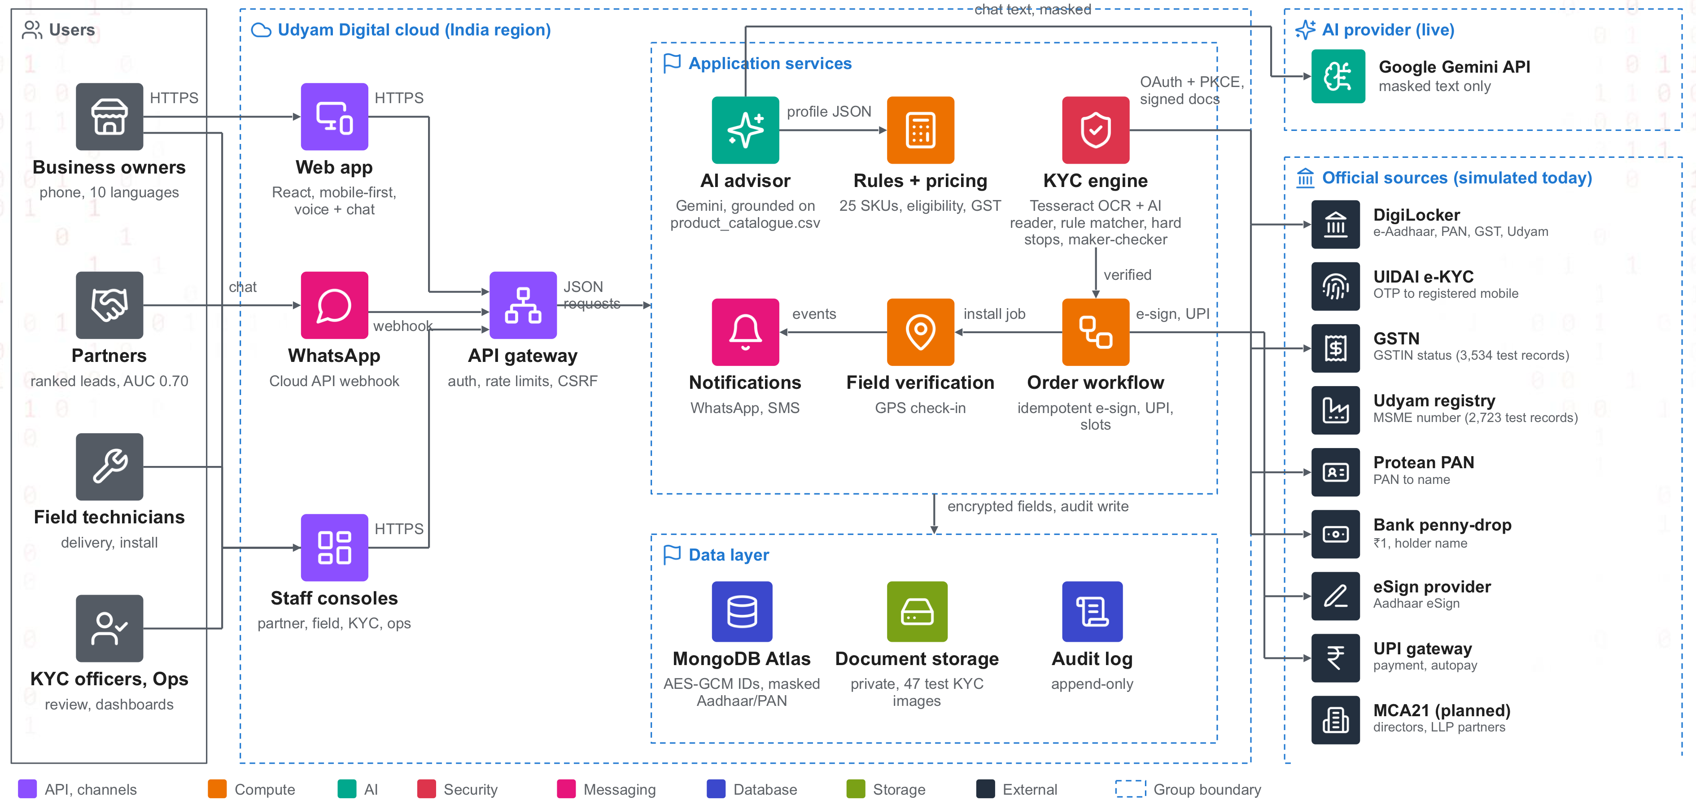
Solution architecture: components and data flows
Notes:
Channels (mobile-first React web app with voice and chat, WhatsApp Cloud API, staff consoles) go through one API gateway. The AI advisor (Gemini, grounded on product_catalogue.csv) only reads the conversation; the rules and pricing engine and the KYC engine (Tesseract OCR + AI reader, rule matcher, hard stops, maker-checker) make every decision. Data in MongoDB Atlas with identifiers AES-GCM encrypted and masked, private document storage, append-only audit log. Official sources are simulated in the prototype behind the same interfaces a licensed provider would use. The full-resolution diagram is in the repository.

Slide 5








Trust: verified at source, read twice, approved by two people
Consent
DigiLocker
Registry
Owner link
Decision
GPS check-in
Live
one purpose
or upload
GSTN, Udyam
PAN + ₹1 bank
auto or 2 officers
technician
owner sign-off code
Two ways to verify
Hard stops: no override
AI reliability
Fast path: DigiLocker returns e-Aadhaar, PAN, GST and Udyam, signed by the issuers; signatures checked
Cancelled or suspended GSTIN
AI only understands the owner; rules set product and price
GSTIN, Udyam, Aadhaar or bank already used by another owner
Every order line re-validated on the server
No DigiLocker: business PAN + ₹1 deposit returns the account holder's name
Tampered certificate (GSTIN checksum fails)
GSTIN, PAN, Aadhaar, phone masked before any AI call
Overrides need a reason and a second officer
AI never decides KYC
Uploads read on our server by Tesseract OCR and an AI reader, matched to the registry by rules
Line goes live only after GPS check-in and the owner's code
Fallback: Gemini 3.5 Flash → Flash Lite → local rules
Notes:
A GSTIN is public, so we check control, not just existence: the registration in the applicant's own DigiLocker, or the business PAN plus a ₹1 bank check that returns the account holder's name. Documents are read twice on our server; disagreement or signs of editing send the case to an officer, who sees only what failed. Hard stops cannot be overridden by anyone. AI is limited to understanding the conversation; prices and KYC decisions are rules. If Gemini is slow (8 s), Flash Lite answers, then local rules, so the journey never breaks.

Slide 6
Business case: faster to live, fewer calls, lower cost
3 min
~1 min
Tracker
Five numbers decide the pilot
Case baseline
Pilot target
to a clear quote, instead of 3–5 days
KYC with DigiLocker, 17 automatic checks
replaces 3 status calls; WhatsApp updates
Lead to activation
7.4%
12%
Days to activate
17.6
≤ 7
Pricing and savings
One monthly price incl. GST, from the catalogue: ₹1,198 (micro) to ₹25,975 (5-site chain). Digital channels cost ₹4,026–6,352 per activation vs ₹24,335 for field sales.
Status calls per customer
3
< 0.5
Rollout in three gated phases
Cost per activation
₹15,053
< ₹9,000
1. Pilot
2. Scale
3. National
2 tier-1 cities · professionals and micro · English, Hindi
Tier 2 · multi-site and factories with sales help · WhatsApp
All circles · telco order and billing integration
6-month churn
15.2%
11%
Baselines from the case data; targets are our proposal for the pilot. Lead ranking model: AUC 0.70 on held-out leads.
Notes:
Value: a quote in about 3 minutes instead of 3 to 5 days; KYC in about a minute with DigiLocker; a tracker and WhatsApp updates instead of status calls. Pricing comes from the catalogue: one monthly price including GST. Cost per activation by source from the case: field sales ₹24,335, partners ₹20,851, website ₹6,352, inbound ₹5,113, referral ₹4,099, WhatsApp ₹4,026, so shifting simple leads to digital lowers blended cost. Each phase starts only when activation, days to live and status calls hit target.

Slide 7








Risks, data privacy and security
Top risks and how we handle them
Privacy and security by design (DPDP Act 2023)
Risk | Mitigation
Fake or borrowed business identity | Proof of control, hard stops, maker-checker
AI misreads a document | Two readers + registry match; officer reviews
Customer data sent to an outside AI | Identifiers masked; enterprise AI tier; named in notice
AI slow or down | Flash Lite, then local rules; journey never stops
Micro shops are price-sensitive | ₹1,198 starter; price test in the pilot
Sales see digital as a threat | Hot leads routed to them; commission on activation
Consent
Minimisation
one stated purpose; expires in 30 min; can be withdrawn
only needed fields; Aadhaar last 4 digits only
Encryption
Masking
GSTIN, Udyam, Aadhaar ref AES-256-GCM; HMAC lookups
IDs masked on screens and before any AI call
Access
Owner rights
owner and KYC/ops only; every view audited
access and erasure in the app, 30-day due date
Security
Retention
httpOnly cookies, CSRF check, rate limits, hashed OTPs
erasure on request; scheduled purge planned
Full 1-page privacy and security note → All data is synthetic.
Links: ▶ Demo video · Code repository · Privacy note
Notes:
The privacy note covers purpose and consent, minimisation, masking and encryption, AI safeguards, fraud controls, retention, security and audit, and what is simulated versus what production needs. A scheduled purge of unverified data is planned, not built: today data is erased on the owner's request. Full note: https://github.com/dSAxmonis/airtel_sync_digital/blob/main/submission/privacy/Udyam_Digital_Privacy_Note.pdf

