Slide 1
Operating Systems Concepts
I/O Systems
Mass Storage Systems
File System Management

Slide 2
Outline
File Concept and Structure
Directory Structures
File Organizations
Access Methods
Protection

Slide 3
File Concept
  Contiguous logical address space
    OS abstracts from the physical properties of its storage device to define a logical storage unit called file.
    OS maps files to physical devices.
  Types
    Data
      numeric, character, binary
    Program
      source, object (load image)
    Documents

Slide 4
File Structure
  None - sequence of words/bytes
  Simple record structure
      Lines
      Fixed Length
      Variable Length
  Complex Structures
      Formatted document
      Re-locatable Load File
  Can simulate last two with first method by inserting appropriate control characters
  Who decides
      Operating System
      Program

Slide 5
File Attributes
  Name
      symbolic file-name, only information in human-readable form
  Type -
      for systems that support multiple types
  Location -
      pointer to a device and to file location on device
  Size -
      current file size, maximal possible size
  Protection -
      controls who can read, write, execute
  Time, Date and user identification
      data for protection, security and usage monitoring
  Information about files are kept in the directory structure, maintained on disk

Slide 6
File Operations
  A file is an abstract data type. It can be defined by operations:
    Create a file
    Write a file
    Read a file
    Reposition within file - file seek
    Delete a file
    Truncate a file
    Open(Fi)
      search the directory structure on disk for entry Fi, and move the content of entry to memory.
    Close(Fi)
      move the content of entry Fi in memory to directory structure on disk.

Slide 7
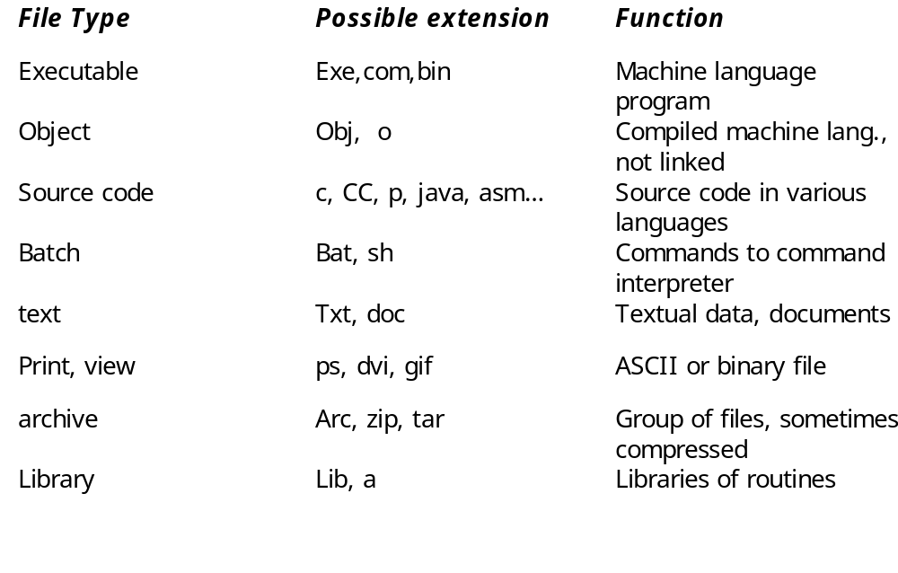
File types - name.extension

Slide 8
Directory Structure
  Number of files on a system can be extensive
      Break file systems into partitions ( treated as a separate storage device)
      Hold information about files within partitions.
  Device Directory: A collection of nodes containing information about all files on a partition.
  Both the directory structure and files reside on disk.
  Backups of these two structures are kept on tapes.

Slide 9
Information in a Device Directory
  File Name
  File Type
  Address or Location
  Current Length
  Maximum Length
  Date created, Date last accessed (for archival), Date last updated (for dump)
  Owner ID (who pays), Protection information
    Also on a per file, per process basis
      Current position - read/write position
      usage count

Slide 10
Operations Performed on Directory
  Search for a file
  Create a file
  Delete a file
  List a directory
  Rename a file
  Traverse the filesystem

Slide 11
Logical Directory Organization -- Goals
Efficiency - locating a file quickly
Naming - convenient to users
    Two users can have the same name for different files.
    The same file can have several different names.
Grouping
    Logical grouping of files by properties (e.g. all Pascal programs, all games…)

Slide 12
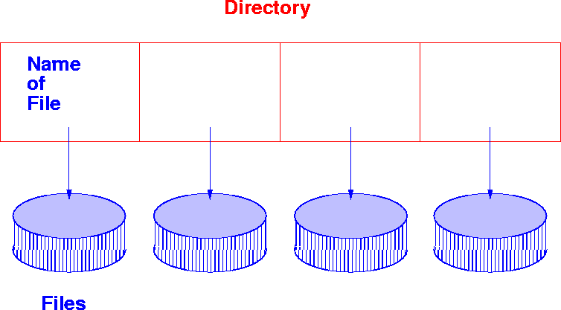
Single Level Directory
    A single directory for all users
    Naming Problem and Grouping Problem
      As the number of files increases, difficult to remember unique names
      As the number of users increase, users must have unique names.

Slide 13
Two Level Directory
Introduced to remove naming problem between users
  First Level contains list of user directories
  Second Level contains user files
  Need to specify Path name
  Can have same file names for different users.
  System files kept in separate directory or Level 1.
  Efficient searching

Slide 14
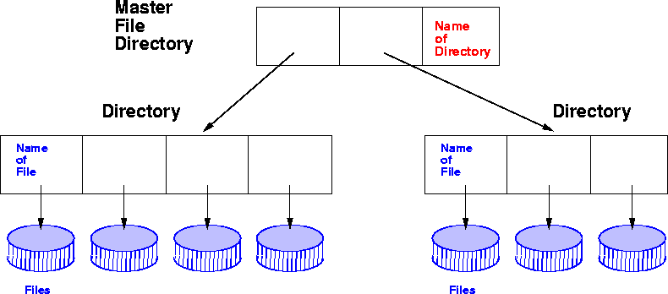
Two Level Directory

Slide 15
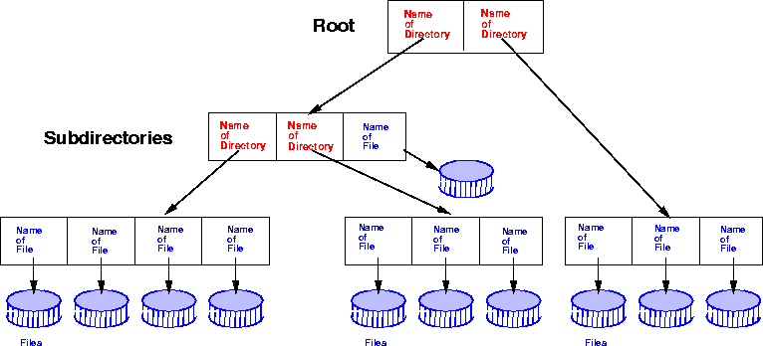
Tree structured Directories

Slide 16
Tree Structured Directories
Arbitrary depth of directories
    Leaf nodes are files, interior nodes are directories.
Efficient Searching
Grouping Capability
Current Directory (working directory)
    cd /spell/mail/prog
    type list
MS-DOS uses a tree structured directory

Slide 17
Tree Structured Directories
  Absolute or relative path name
      Absolute from root
      Relative paths from current working directory pointer.
  Creating a new file is done in current directory
  Creating a new subdirectory is done in current directory, e.g. mkdir <dir-name>
  Delete a file , e.g. rm file-name
  Deletion of directory
    Option 1 : Only delete if directory is empty
    Option 2: delete all files and subdirectories under directory

Slide 18
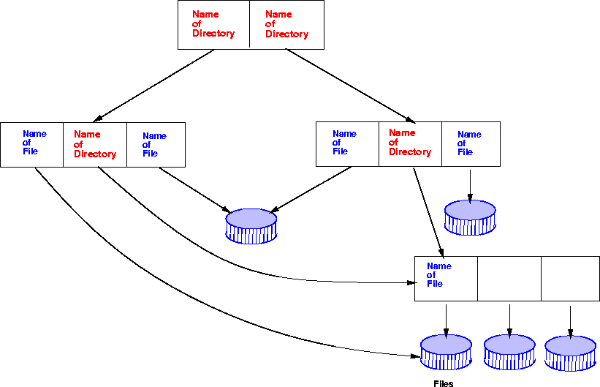
Acyclic Graph Directories

Slide 19
Acyclic Graph Directories
Acyclic graphs allow sharing
Implementation by links
    Links are pointers to other files or subdirectories
    Symbolic links or relative path name
      Directory entry is marked as a link and name of real file/directory is given. Need to resolve link to locate file.
Implementation by shared files
    Duplicate information in sharing directories
    Original and copy indistinguishable.
    Need to maintain consistency if one of them is modified.

Slide 20
Acyclic Graph Directories
  Naming : File may have multiple absolute path names
    Two different names for the same file
  Traversal
      ensure that shared data structures are traversed only once.
  Deletion
    Removing file when someone deletes it may leave dangling pointers.
    Preserve file until all references to it are deleted
      Keep a list of all references to a file or
      Keep a count of the number of references - reference count.
      When count = 0, file can be deleted.

Slide 21
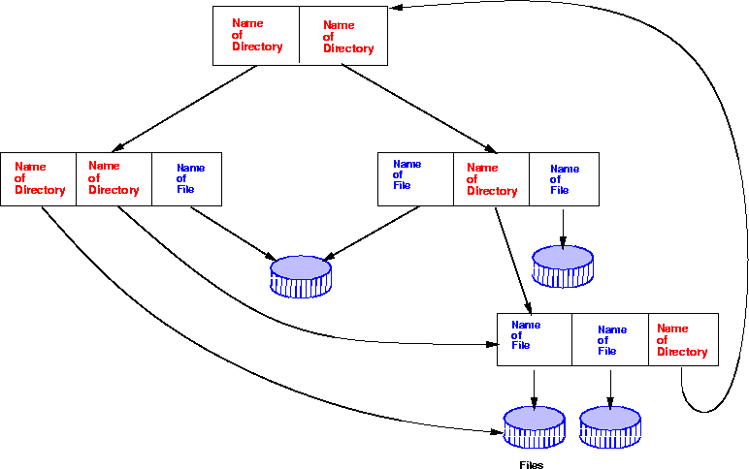
General Graph Directories

Slide 22
General Graph Directories (cont.)
  How do we guarantee no cycles in a tree structured directory?
      Allow only links to file not subdirectories.
      Every time a new link is added use a cycle detection algorithm to determine whether it is ok.
  If links to directories are allowed, we have a simple graph structure
      Need to ensure that components are not traversed twice both for correctness and for performance, e.g. search can be non-terminating.
  File Deletion - reference count can be non-zero
      Need garbage collection mechanism to determine if file can be deleted.

Slide 23
Access Methods
Sequential Access
      read next
      write next
      reset
      no read after last write (rewrite)
Direct Access ( n = relative block number)
      read n
      write n
      position to n
      read next
      write next
      rewrite n

Slide 24
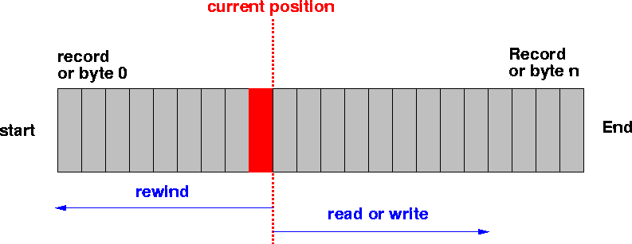
Sequential File Organization

Slide 25
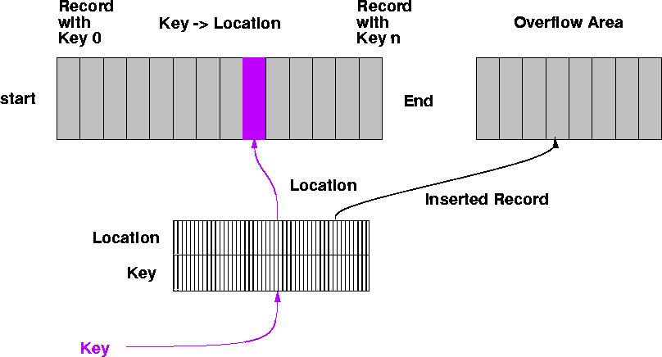
Indexed Sequential or Indexed File Organization

Slide 26
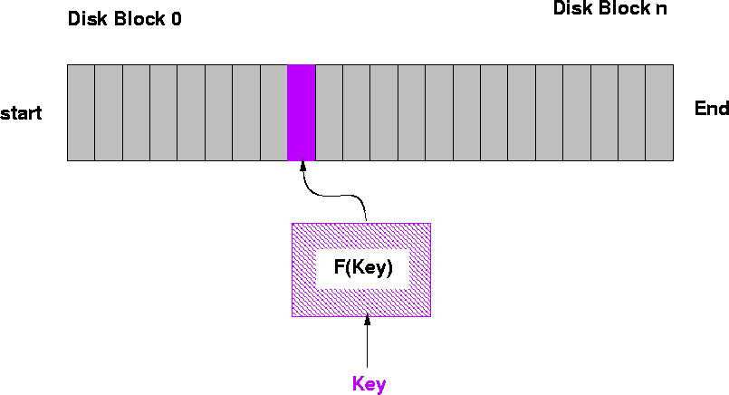
Direct Access File Organization

Slide 27
Protection
File owner/creator should be able to control
    what can be done
    by whom
Types of access
      read
      write
      execute
      append
      delete
      list

Slide 28
Access lists and groups
  Associate each file/directory with access list
    Problem - length of access list..
  Solution - condensed version of list
    Mode of access: read, write, execute
    Three classes of users
      owner access - user who created the file
      groups access - set of users who are sharing the file and need similar access
      public access - all other users
    In UNIX, 3 fields of length 3 bits are used.
      Fields are user, group, others(u,g,o),
      Bits are read, write, execute (r,w,x).
      E.g. chmod go+rw file , chmod 761 game

Slide 29
File-System Implementation
File System Structure
Allocation Methods
Free-Space Management
Directory Implementation
Efficiency and Performance
Recovery

Slide 30
File-System Structure
File Structure
    Logical Storage Unit with collection of related information
  File System resides on secondary storage (disks).
    To improve I/O efficiency, I/O transfers between memory and disk are performed in blocks.
      Read/Write/Modify/Access each block on disk.
File system organized into layers.
File control block - storage structure consisting of information about a file.

Slide 31
File System Mounting
File System must be mounted before it can be available to process on the system
    The OS is given the name of the device and the mount point (location within file structure at which files attach).
    OS verifies that the device contains a valid file system.
    OS notes in its directory structure that a file system is mounted at the specified mount point.

Slide 32
Allocation of Disk Space
Low level access methods depend upon the disk allocation scheme used to store file data
  Contiguous Allocation
  Linked List Allocation
  Block Allocation

Slide 33
Contiguous Allocation
  Each file occupies a set of contiguous blocks on the disk.
      Simple - only starting location (block #) and length (number of blocks) are required.
      Suits sequential or direct access.
      Fast (very little head movement) and easy to recover in the event of system crash.
    Problems
      Wasteful of space (dynamic storage-allocation problem). Use first fit or best fit. Leads to external fragmentation on disk.
      Files cannot grow - expanding file requires copying
      Users tend to overestimate space - internal fragmentation.
  Mapping from logical to physical - <Q,R>
      Block to be accessed = Q + starting address
      Displacement into block = R

Slide 34
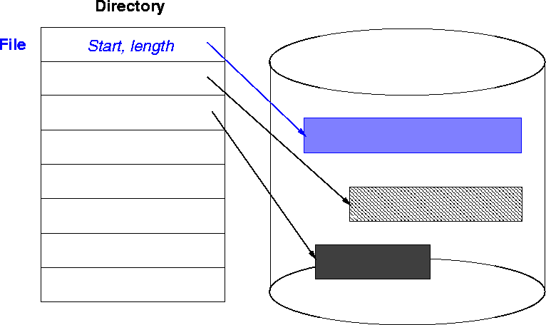
Contiguous Allocation

Slide 35
Linked Allocation
Each file is a linked list of disk blocks
    Blocks may be scattered anywhere on the disk.
    Each node in list can be a fixed size physical block or a contiguous collection of blocks.
    Allocate as needed and then link together via pointers.
      Disk space used to store pointers, if disk block is 512 bytes, and pointer (disk address) requires 4 bytes, user sees 508 bytes of data.
    Pointers in list not accessible to user.
pointer
Block =
Data

Slide 36
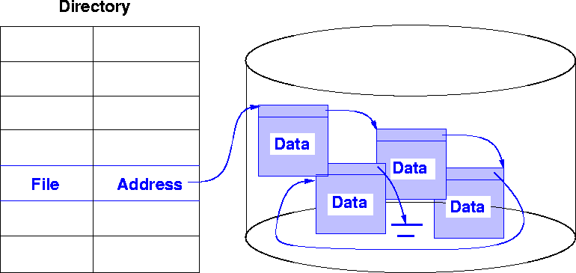
Linked Allocation

Slide 37
Linked Allocation
  Simple - need only starting address.
  Free-space management system - space efficient.
    Can grow in middle and at ends. No estimation of size necessary.
  Suited for sequential access but not random access.
  Directory Table maps files into head of list for a file.
  Mapping - <Q, R>
      Block to be accessed is the Qth block in the linked chain of blocks representing the file.
      Displacement into block = R + 1

Slide 38
Linked Allocation (cont.)
  Slow - defies principle of locality.
      Need to read through linked list nodes sequentially to find the record of interest.
  Not very reliable
      System crashes can scramble files being updated.
  Important variation on linked allocation method
    File-allocation table (FAT) - disk-space allocation used by MS-DOS and OS/2.

Slide 39
Indexed Allocation
Brings all pointers together into the index block.
Logical view
Index table

Slide 40
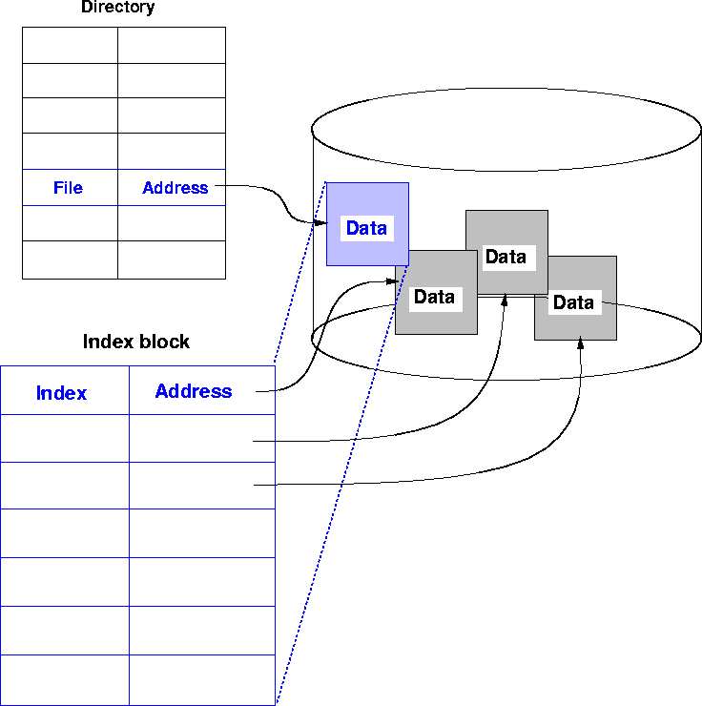
Indexed Allocation

Slide 41
Indexed Allocation (cont.)
Need index table.
Supports sequential, direct and indexed access.
Dynamic access without external fragmentation, but have overhead of index block.
  Mapping from logical to physical in a file of maximum size of 256K words and block size of 512 words. We need only 1 block for index table.
    Mapping - <Q,R>
      Q - displacement into index table
      R - displacement into block

Slide 42
Indexed Allocation - Mapping
  Mapping from logical to physical in a file of unbounded length.
  Linked scheme -
    Link blocks of index tables (no limit on size)
  Multilevel Index
    E.g. Two Level Index - first level index block points to a set of second level index blocks, which in turn point to file blocks.
    Increase number of levels based on maximum file size desired.
    Maximum size of file is bounded.

Slide 43
Indexed File - Linked Scheme
Index block
file block
link
link

Slide 44
Indexed Allocation - Multilevel index
2nd level Index
Index block
link
link

Slide 45
Combined Scheme: UNIX (4K bytes per block)
mode
data
owners
timestamps
data
Size block
count
data
Direct blocks
data
data
data
data
Single indirect
data
double indirect
data
Triple indirect
data

Slide 46
Free Space Management
Bit Vector (n blocks) - bit map of free blocks
    Block number calculation
      (number of bits per word) *
      (number of 0-value words) +
      offset of 1st bit
    Bit map requires extra space.
      Eg. Block size = 2^12 bytes, Disk size = 2^30 bytes
      n = 2^30/2^12 = 2^18 bits ( or 32K bytes)
    Easy to get contiguous files
    Example: BSD File system
0
1
2
n-1
{
0 implies block[i] free
bit[i] =
1 implies block[i] occupied

Slide 47
Free Space Management
  Linked list (free list)
      Keep a linked list of free blocks
      Cannot get contiguous space easily, not very efficient because linked list needs traversal.
      No waste of space
  Linked list of indices - Grouping
      Keep a linked list of index blocks. Each index block contains addresses of free blocks and a pointer to the next index block.
      Can find a large number of free blocks contiguously.
  Counting
      Linked list of contiguous blocks that are free
      Free list node contains pointer and number of free blocks starting from that address.

Slide 48
Free Space Management
Need to protect
    pointer to free list
    Bit map
      Must be kept on disk
      Copy in memory and disk may differ.
      Cannot allow for block[i] to have a situation where bit[i] = 1 in memory and bit[i] = 0 on disk
    Solution
      Set bit[i] = 1 in disk
      Allocate block[i]
      Set bit[i] = 1 in memory.

Slide 49
Directory Implementation
Linear list of file names with pointers to the data blocks
    simple to program
    time-consuming to execute - linear search to find entry.
    Sorted list helps - allows binary search and decreases search time.
Hash Table - linear list with hash data structure
    decreases directory search time
    collisions - situations where two file names hash to the same location.
    Each hash entry can be a linked list - resolve collisions by adding new entry to linked list.

Slide 50
Efficiency and Performance
  Efficiency dependent on:
      disk allocation and directory algorithms
      types of data kept in the files directory entry
      Dynamic allocation of kernel structures
  Performance improved by:
    On-board cache - for disk controllers
    Disk Cache - separate section of main memory for frequently used blocks. Block replacement mechanisms
      LRU
      Free-behind - removes block from buffer as soon as next block is requested.
      Read-ahead - request block and several subsequent blocks are read and cached.
    Improve PC performance by dedicating section of memory as virtual disk or RAM disk.

Slide 51
Recovery
Ensure that system failure does not result in loss of data or data inconsistency.
Consistency checker
    compares data in directory structure with data blocks on disk and tries to fix inconsistencies.
Backup
    Use system programs to back up data from disk to another storage device (floppy disk, magnetic tape).
Restore
    Recover lost file or disk by restoring data from backup.

Slide 52
End of File Systems Concepts

