Slide 1
Hardware – Operating System
Cache Memory Usage

Slide 2
Review of Memory Hierarchies
CPU
Cache
(SRAM)
Increasing Capacity
Physical Memory
Main Memory
(DRAM)
Increasing Speed
Virtual Memory
(Hard Disk)

Slide 3
Cache Memory Motivation
Processor speeds are increasing much faster than memory speeds
  Current top-end Pentium has a cycle time of about 0.3 ns
  High-end DRAMs have access times of about 30ns
    DRAM access takes 100 cycles minimum, not even counting time to send signals from the processor to the memory
Memory speed matters
  Each instruction needs to be fetched from memory
  Loads, stores are a significant fraction of instructions
  Amdahl’s Law tells us that increasing processor performance without speeding up memory won’t help much overall
Locality of references
  Locations that are close together in the address space tend to get referenced close together in time (spatial locality)
  Tend to reference the same memory locations over and over again (temporal locality)

Slide 4
Cache Memories
Relatively small SRAM memories located physically close to the processor
  SRAMs have low access times
  Physical proximity reduces wire delay
Similar in concept to virtual memory
  Keep commonly-accessed data in smaller, fast memory
  Use larger memory to hold data that’s accessed less frequently
Inclusion property
  Any data in a given level of the hierarchy must be contained in all levels below that in the hierarchy.
    Means that we never have to worry about whether we have space for data we need to evict from one level into a lower level

Slide 5
Caches vs. Virtual Memory
Virtual Memory
Use combination of hardware and software
Operate on larger blocks of data (pages)
  2-8 KB common
Allow any block to be mapped into any location in physical memory
Caches
Implemented completely in hardware
Operate on relatively small blocks of data (lines)
  32-128 bytes common
Often restrict which memory addresses can be stored in a given location in the cache

Slide 6
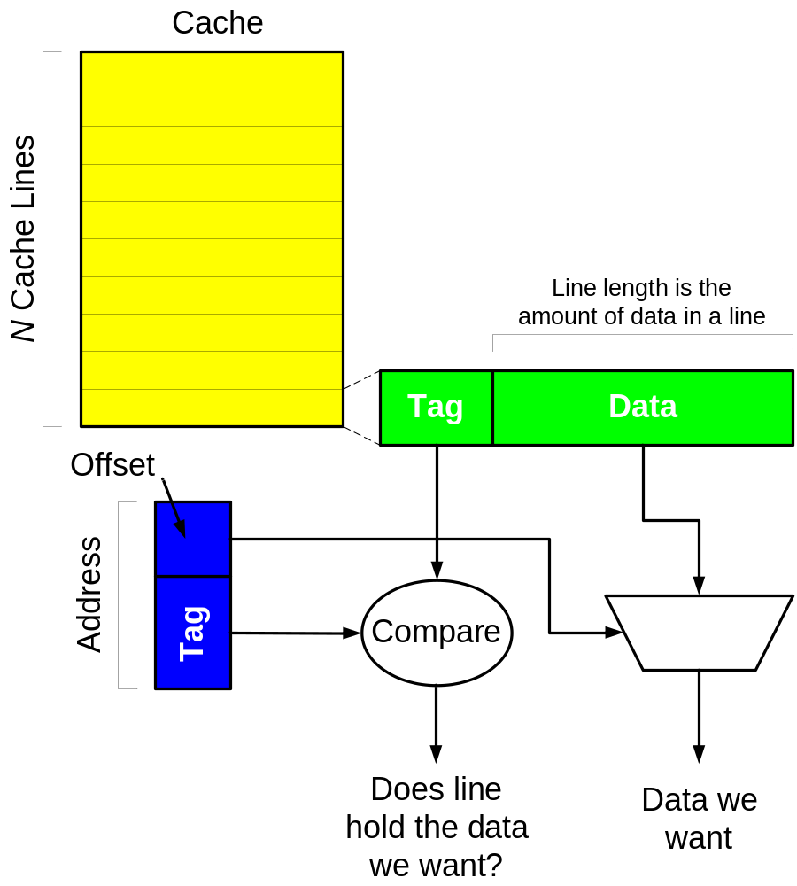
Cache Operation
On memory access, look in the cache first
If the address we want is in the cache, complete the operation, usually in one cycle
If not, complete the operation using the main memory (many cycles)

Slide 7
Performance of Memory Hierarchies
Basic Formula:
T_{avg} = P_{hit} * T_{hit} + P_{miss} * T_{miss}
T_{hit} = time to complete the memory reference if we hit in a given level of the hierarchy
T_{miss} = time to complete the memory reference if we miss and have to go down to the next level
P_{hit}, P_{miss} = Probabilities of hitting or missing in the level
  P_{hit} is always 100% for the bottom level of the hierarchy

Slide 8
Example 1
A memory system consists of a cache and a main memory. If it takes 1 cycle to complete a cache hit, and 100 cycles to complete a cache miss, what is the average memory access time if the hit rate in the cache is 97%?

Slide 9
Example 1
A memory system consists of a cache and a main memory. If it takes 1 cycle to complete a cache hit, and 100 cycles to complete a cache miss, what is the average memory access time if the hit rate in the cache is 97%?
Thit = 1 cycle
Tmiss = 100 cycles
Phit = .97
Pmiss = .03
T_{avg} = P_{hit} * T_{hit} + P_{miss} * T_{miss} = 0.97 * 1 + .03 * 100
= 3.97 cycles

Slide 10
Example 2
A memory system has a cache, a main memory, and a virtual memory. If the hit rate in the cache is 98% and the hit rate in the main memory is 99%, what is the average memory access time if it takes 2 cycles to access the cache, 150 cycles to fetch a line from main memory, and 100,000 cycles to access the virtual memory?

Slide 11
Example 2
Work from the bottom up
T_{avg, main} = T_{hit, main} * P_{hit, main} + T_{miss, main} * P_{miss,main}
= 150 * .99 + 100,000 * .01 = 1148.5
T_{avg, cache} = T_{hit, cache} * P_{hit, cache} + T_{miss, cache} * P_{miss,cache}
= T_{hit, cache} * P_{hit, cache} + T_{avg, main} * P_{miss,cache}
= 2 * .98 + 1148.5 * .02
= 24.93 cycles
Even though cache misses are only 2% of total accesses, they increase average memory access time by over a factor of 12!

Slide 12
Describing Caches
We characterize a cache using 5 parameters
Access Time: T_{hit}
Capacity: the total amount of data the cache can hold
  # of lines * line length
Line Length: The amount of data that gets moved into or out of the cache as a chunk
  Analagous to page size in virtual memory
What happens on a write?
Replacement Policy: What data is replaced on a miss?
Associativity: How many locations in the cache is a given address eligible to be placed in?
Unified, Instruction, Data: What type of data is kept in the cache?
  We’ll cover this in more detail next time

Slide 13
Capacity
In general, bigger is better
  The more data you can store in the cache, the less often you have to go out to the main memory
However, bigger caches tend to be slower
  Need to understand how both T_{hit} and P_{hit} change as you change the capacity of the cache.
  Declining return on investment as cache size goes up
    We’ll see why when we talk about causes of cache misses
  From the point of view of the processor, cache access time is always an integer number of cycles
    Depending on processor cycle time, changes in cache access time may be either really important or irrelevant.

Slide 14
Cache Line Length
Very similar concept to page size
  Cache groups contiguous addresses into lines
  Lines almost always aligned on their size
  Caches fetch or write back an entire line of data on a miss
    Spatial Locality
Reading/Writing a Line
  Typically, takes much longer to fetch the first word of a line than subsequent words
    Page Mode memories
T_{fetch} = T_{first} + (line length / fetch width) * T_{subsequent}

Slide 15
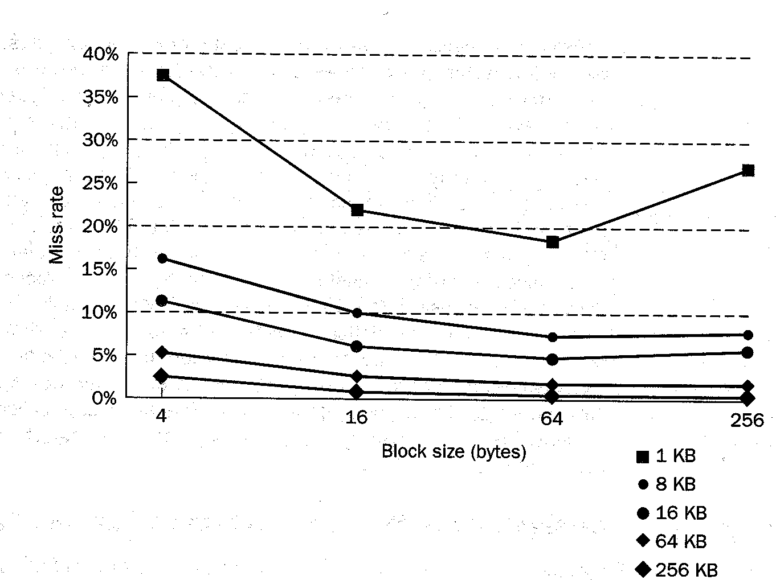
Impact of Line Length on Hit Rate
Figure Credit:
Computer Organization and Design: The Hardware / Software Interface, page 559

Slide 16
Hit Rate isn’t Everything
Average access time is better performance indicator than hit rate
T_{avg} = P_{hit} * T_{hit} + P_{miss} * T_{miss}
T_{miss} = T_{fetch} = T_{first} + (line length / fetch width) * T_{subsequent}
Trade-off: Increasing line length usually increases hit rate, but also increases fetch time
  As lines get bigger, increase in fetch time starts to outweigh increase in miss rate
  Lots of early cache research didn’t consider this, concluded that cache lines should be very long

Slide 17
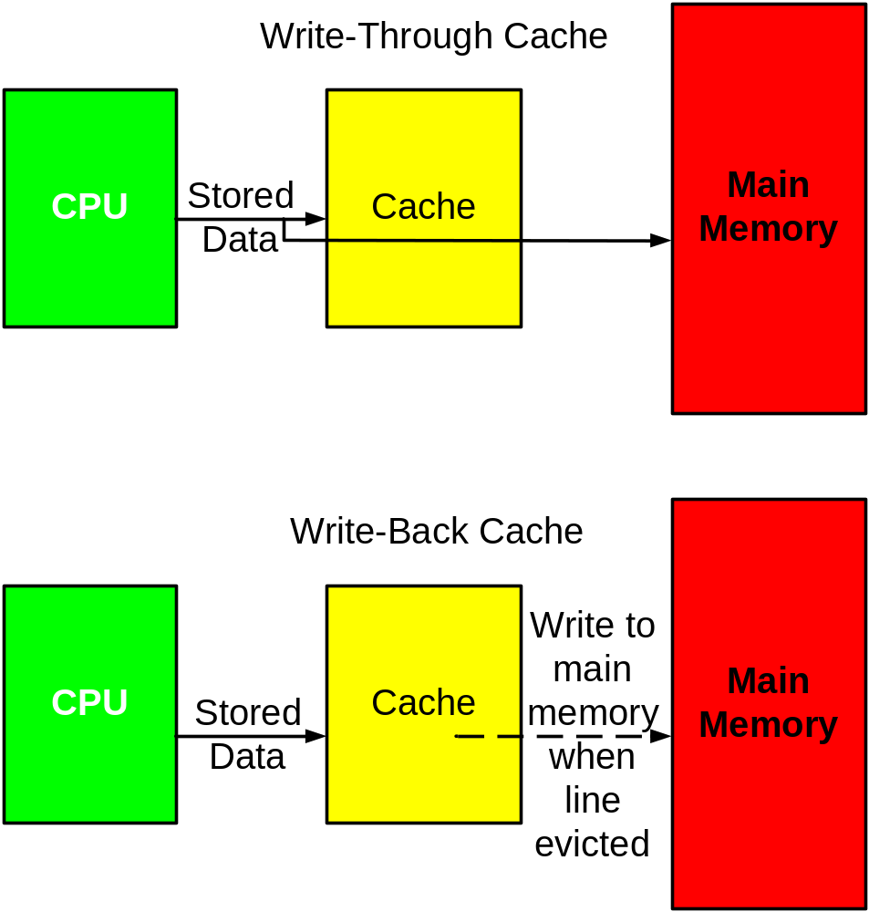
Write-back vs. Write-Through Caches

Slide 18
Tradeoffs
Write-back cache tends to have better performance
  Can combine multiple writes into one line writeback
  Locality of reference
Write-through cache is simpler to implement
  Don’t need dirty bit to keep track of whether a line has been written
  Never have to wait for line to be written back in order to make space for a new line
  No interface issues with I/O devices
Virtual memory systems are pretty much all write-back because of the huge penalty for going out to disk
  Caches tending towards write-back as well for performance

Slide 19
Write-Allocate vs. Write-no-Allocate
Two options if a store causes a miss in the cache
Write-allocate: Fetch line into cache, then perform the write in the cache
  This is the policy we’ve been assuming so far
  For write-through cache, write the data into main memory as well
  Better performance if data referenced again before it is evicted
Write-no-allocate: Pass the write through to the main memory, don’t bring the line into the cache
  Simpler write hardware
  May be better for small caches if written data won’t be read again soon

Slide 20
Associativity: Where Can Data Go?
In virtual memory systems, any page could be placed in any physical page frame
  Very flexible
  Use page table, TLB to track mapping between virtual address and physical page frame and allow fast translation
This doesn’t work so well for caches
  Can’t afford the time to do software search to see if a line is in the cache
    Need hardware to determine if we hit
  Can’t afford the space for a table of mappings for each virtual address
    Page tables are MB to GB on modern architectures, caches tend to be KB in size

Slide 21
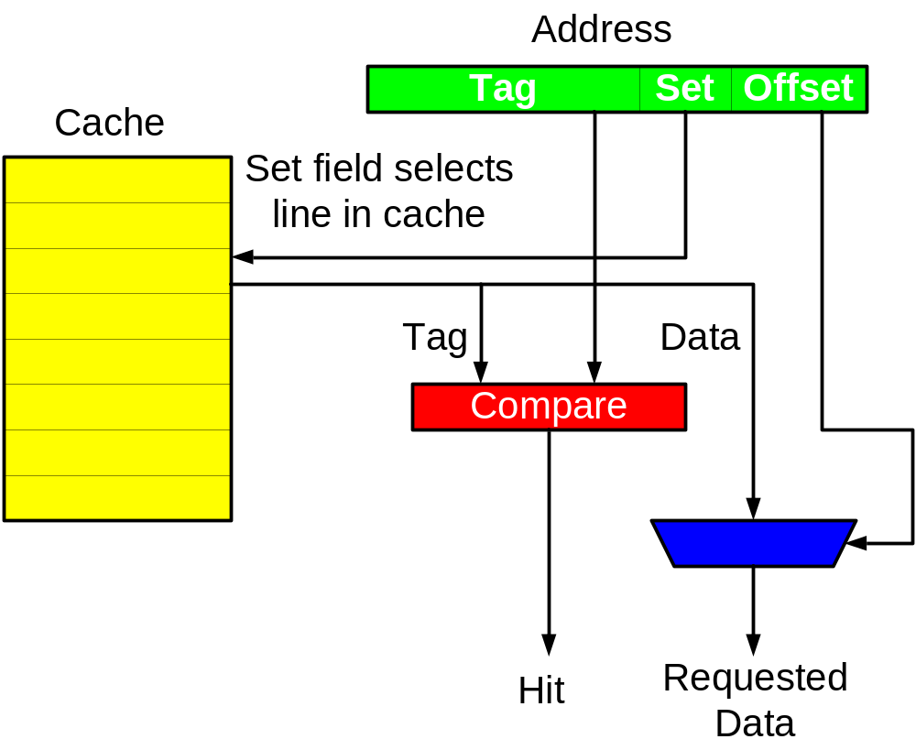
Direct-Mapped: One Location for Each Address

Slide 22
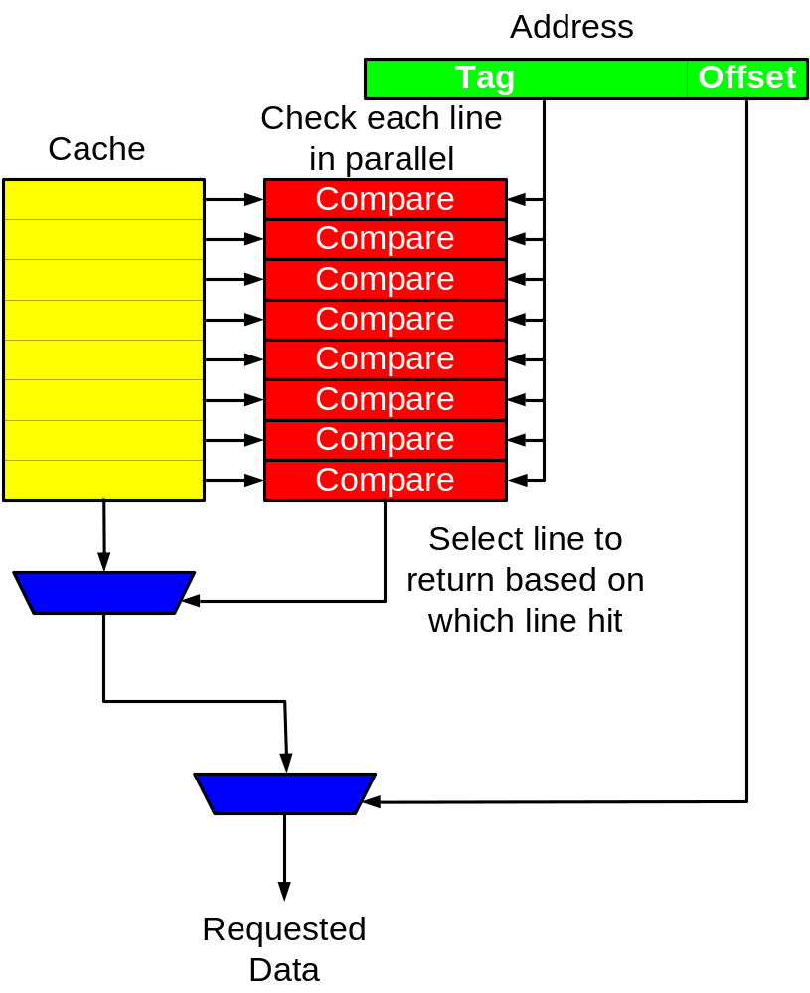
Fully-Associative: Anything Can Go Anywhere

Slide 23
Direct-Mapped vs. Fully-Associative
Direct-Mapped
  Require less area
    Only one comparator
    Fewer tag bits required
  Fast: can return data to processor in parallel with determining if a hit has occurred
  Conflict misses reduce hit rate
Fully-Associative
  No conflict misses, therefore higher hit rate in general
  Need one comparator for each line in the cache
Design trade-offs
  For a given chip area, will you get a better hit rate with a fully-associative cache or a direct-mapped cache with a higher capacity?
  Do you need the lower access time of a direct-mapped cache?

Slide 24
An Aside: Talking About Cache Misses
In single-processor systems, cache misses can be divided into three categories:
Compulsory: Misses caused by the first reference to each line of data
  In an infinitely-large fully-associative cache, these would be the only misses
Capacity: Misses caused because a program references more data than will fit in the cache
Conflict: Misses caused because more lines try to share a specific place in the cache than will fit

Slide 25
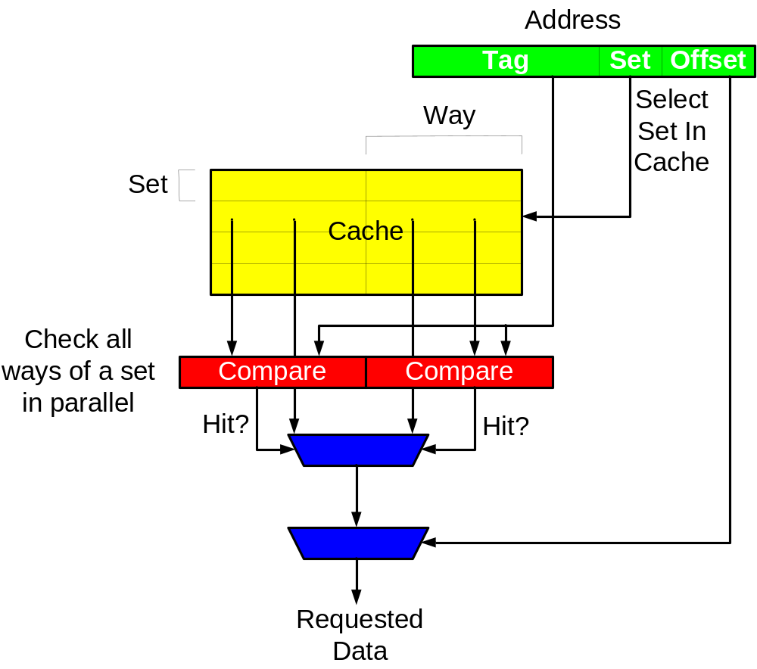
Compromise: Set-Associative Caches

Slide 26
Set-Associative Caches
More associativity generally gives better hit rate
  Effect drops off substantially after four-way set-associative
  Effect larger with small (low capacity) caches
More associativity means more comparators, greater area
Slower than direct-mapped
  Need to know which way in a set hit before you can start returning data

Slide 27
Replacement Policy: What Gets Evicted?
For direct-mapped cache: no policy
  Only one place for each address to go, no choice about what to evict
Set-Associative and Fully-Associative: Need to choose
  Multiple locations could hold a given address
Best policy would be to evict the line that would cause the fewest misses in the future
  Problem: can’t predict future accesses
  Need a heuristic that can be implemented

Slide 28
Replacement Policies
Least-Recently-Used (LRU): Evict the line that has been least recently referenced
  Need to keep track of order that lines in a set have been referenced
  Overhead to do this gets worse as associativity increases
Random: Just pick one at random
  Easy to implement
  Slightly lower hit rates than LRU on average
Not-Most-Recently-Used: Track which line in a set was referenced most recently, pick randomly from the others
  Compromise in both hit rate and implementation difficulty
Virtual memories use similar policies, but are willing to spend more effort to improve hit rate

Slide 29
What Data Can the Cache Hold?
So far, we’ve assumed that all memory references go to the cache, and that any data is eligible to be stored in the cache
  This is called a unified cache
In practice, commonly construct separate caches for instructions and data
  Sometimes called Harvard architecture (after the university)

Slide 30
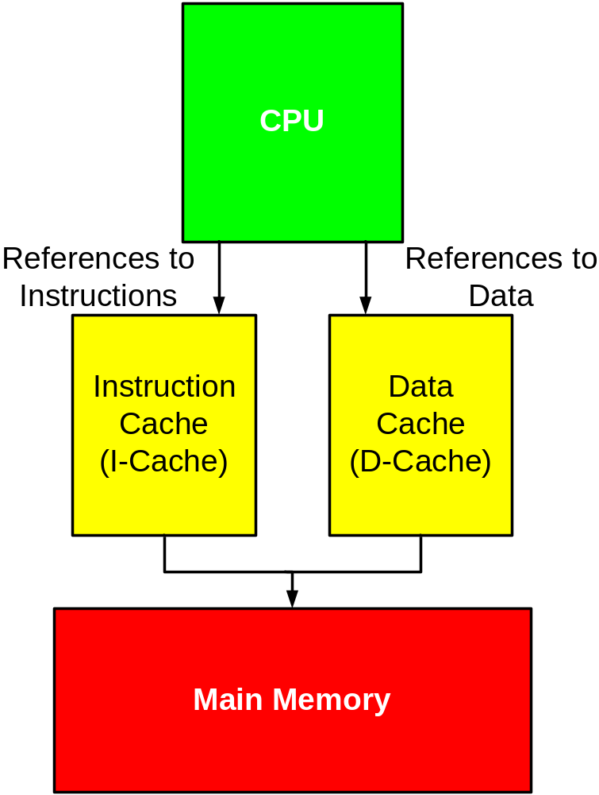
Instruction and Data Caches

Slide 31
Why Do We Do This?
Bandwidth: lets us access instructions and data in parallel
Most programs don’t modify their instructions
  Con: Makes self-modifying programs more complicated, as you have to flush instructions from both caches when you modify them
I-Cache can be simpler than D-Cache, since instruction references are never writes
Instruction stream has high locality of reference, can get higher hit rates with small cache
  Data references never interfere with instruction references

Slide 32
Multi-Level Caches
Problem: Often can’t make the cache both as big and as fast as we’d like to keep memory access time down
  Circuit issues
  Chip space
Solution: Add multiple levels of cache to the memory hierarchy
  Second- and lower-level caches are generally unified
  Usually see about a 4x increase in latency at each level in the cache
  Need 4x or more increase in capacity to make hit rate high enough to see significant benefit
    Lower levels in the hierarchy see less locality of reference, because references with high locality get handled by the upper levels

Slide 33
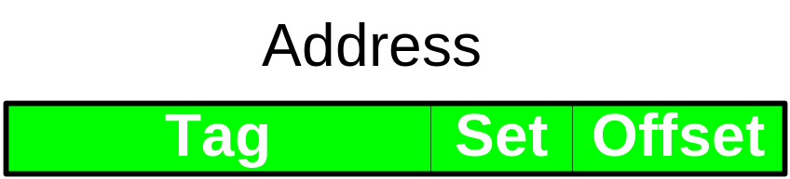
Sample Problem
A cache has a capacity of 32 KB and 256-byte lines. On a machine with a 32-bit virtual address space, how many bits long are the tag, set, and offset fields for
A direct-mapped implementation?
A four-way set-associative implementation?
A fully-associative implementation?

Slide 34
Sample problem
Offset field is 8 bits long for all versions of the cache
All versions have 128 total lines
Direct-mapped version has 128 sets, so needs 7 bits to select a set
  Offset field is 8 bits, set field is 7 bits, tag field is 32 – (8 + 7) = 17 bits
Four-way set-associative version has 128/4 = 32 sets, needs 5 bits to select a set
  Offset field is 8 bits, set field is 5 bits, tag field is 32 – (8 + 5) = 19 bits
Set-associative version has 1 set, so no bits used to select a set
  Offset field is 8 bits, set field 0 bits, tag field is 32 – 8 = 24 bits

Slide 35
Micro-architecture of Cache Memories
Address
Tag
Set
Offset
Tag Array
Data Array
Hit?
Hit?

Slide 36
Why This Organization?
Allows tag array to be faster than data array
  Tag array is smaller
Don’t really need output of data array until hit/miss detection complete
Overlap some of data array access time with hit/miss detection
Also integrates well with virtual memory, as we’ll see

Slide 37
Translation Look-a-side Buffers (TLBs)
Virtual memory provides two big things:
  Protection
  Capacity (use hard disk as memory)
Problem: Need to access memory at least once (often multiple times) in order to translate virtual address to physical address
  This seems very slow, but page tables are big, nowhere else to keep them
  If only there were some way to set things up so that the page table entries my program used most could be accessed quickly
    Wait, haven’t we seen this before?

Slide 38
TLB – a Cache for Page Table Entries
Virtual Address
VPN
Offset
TLB
V
D
VPN
PPN
Hit?
Yes
PPN
Offset
No
Physical Address
Use Page Table

Slide 39
TLB Designs
Relatively small number of entries
  128, 256 common sizes
Usually set-associative
  Often four-, eight-, or more-way because associativity really helps hit rate in small structures (lots of conflicts)
Remember that don’t need to store entire VPN if some of the bits of the address are used to select a set.
  Same as tag field in cache
Challenge: How do you make TLB big enough that TLB misses are rare, but fast enough that it’s not a limiting factor?
  Becoming increasingly a problem as memory capacity increases
  If just make pages bigger, wind up wasting memory when you have to allocate entire page to small data structure
  Many modern CPUs support two or more page sizes, one much bigger than the other

Slide 40
Caches and Virtual Memory
Do we send virtual or physical addresses to the cache?
  Virtual → faster, because don’t have to translate
    Issue: Different programs can reference the same virtual address, either creates security hole or requires flushing the cache every time you context switch
  Physical → slower, but no security issue
Actually, there are four possibilities

Slide 41
Virtually Addressed, Virtually Tagged
Virtual
Address
Only translate address
on cache miss
Tag
Set
Offset
Tag Array
Data Array
Hit?
Hit?

Slide 42
Physically Addressed, Physically Tagged
Virtual
Address
Tag
Set
Offset
TLB
Physical
Address
Tag
Set
Offset
Tag Array
Data Array
Hit?
Hit?

Slide 43
Physically Addressed, Virtually Tagged
Virtual
Address
Tag
Set
Offset
Worst of both worlds,
pretty much never used
TLB
Physical
Address
Tag
Set
Offset
Tag Array
Data Array
Hit?
Hit?

Slide 44
Virtually Addressed, Physically Tagged
Virtual
Address
Speed of using virtual address
for cache lookup, security of
using physical address for
hit/miss detection.
Very common in real systems
Tag
Set
Offset
TLB
Physical
Address
Tag
Set
Offset
Tag Array
Data Array
Hit?
Hit?

Slide 45
End of Cache Memory

