Slide 1
OPERATING SYSTEMS
Distributed System Structures

Slide 2
DISTRIBUTED STRUCTURES
VOCABULARY
Tightly coupled systems Same clock, usually shared memory. Multiprocessors. Communication is via this shared memory.
Loosely coupled systems Different clock, use communication links. Distributed systems.
sites = nodes = computers = machines = hosts
Local The resources on your "home" host.
Remote The resources NOT on your "home" host.
Server A host at a site that has a resource used by a Client.

Slide 3
NETWORK STRUCTURES
Vocabulary
Network Operating Systems
Users are aware of multiplicity of machines. Access to resources of various machines is done explicitly by:
  Remote logging into the appropriate remote machine (telnet, ssh)
  Transferring data from remote machines to local machines, via the File Transfer Protocol (FTP) mechanism
Distributed Operating Systems
Users not aware of multiplicity of machines
  Access to remote resources similar to access to local resources
  Data Migration – transfer data by transferring entire file, or transferring only those portions of the file necessary for the immediate task
  Computation Migration – transfer the computation, rather than the data, across the system

Slide 4
NETWORK STRUCTURES
Vocabulary
Clusters The hardware on which distributed systems run. A current buzzword. It allows more compute power, compared to a mainframe, by running on many inexpensive small machines.
Chapter 16 talks in great deal about distributed systems as a whole; meanwhile we'll discuss the components of these systems.

Slide 5
NETWORK STRUCTURES
Why
Distributed
OS?
Advantages of distributed systems:
Resource Sharing Items such as printers, specialized processors, disk farms, files can be shared among various sites.
Computation Speedup Load balancing - dividing up all the work evenly between sites. Making use of parallelism.
Reliability Redundancy. With proper configuration, when one site goes down, the others can continue. But this doesn't happen automatically.
Communications Messaging can be accomplished very efficiently. Messages between nodes are akin to IPCs within a Uni-Processor. Easier to talk/mail between users.

Slide 6
NETWORK STRUCTURES
Why
Distributed
OS?
Advantages of distributed systems:
Process Migration – Execute an entire process, or parts of it, at different sites
  Load balancing – distribute processes across network to even the workload
  Computation speedup – sub-processes can run concurrently on different sites
  Hardware preference – process execution may require specialized processor
  Software preference – required software may be available at only a particular site
  Data access – run process remotely, rather than transfer all data locally

Slide 7
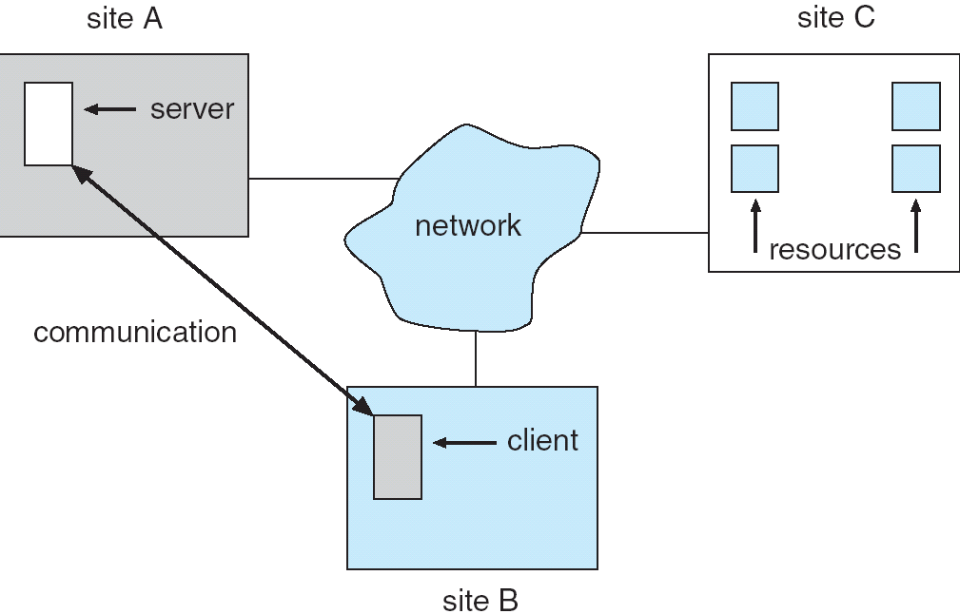
NETWORK STRUCTURES
Why
Distributed
OS?
Advantages of distributed systems:

Slide 8
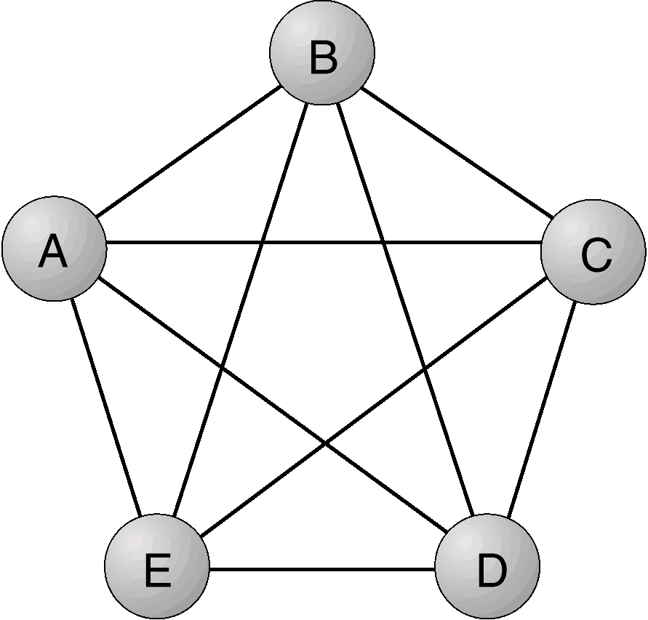
NETWORK STRUCTURES
Topology
Methods of connecting sites together can be evaluated as follows:
Basic cost: This is the price of wiring, which is proportional to the number of connections.
Communication cost: The time required to send a message. This is proportional to the amount of wire and the number of nodes traversed.
Reliability: If one site fails, can others continue to communicate.
Let's look at a number of connection mechanisms using these criteria:
FULLY CONNECTED
All sites are connected to all other sites.
Expensive( proportional to N squared ), fast communication, reliable.

Slide 9
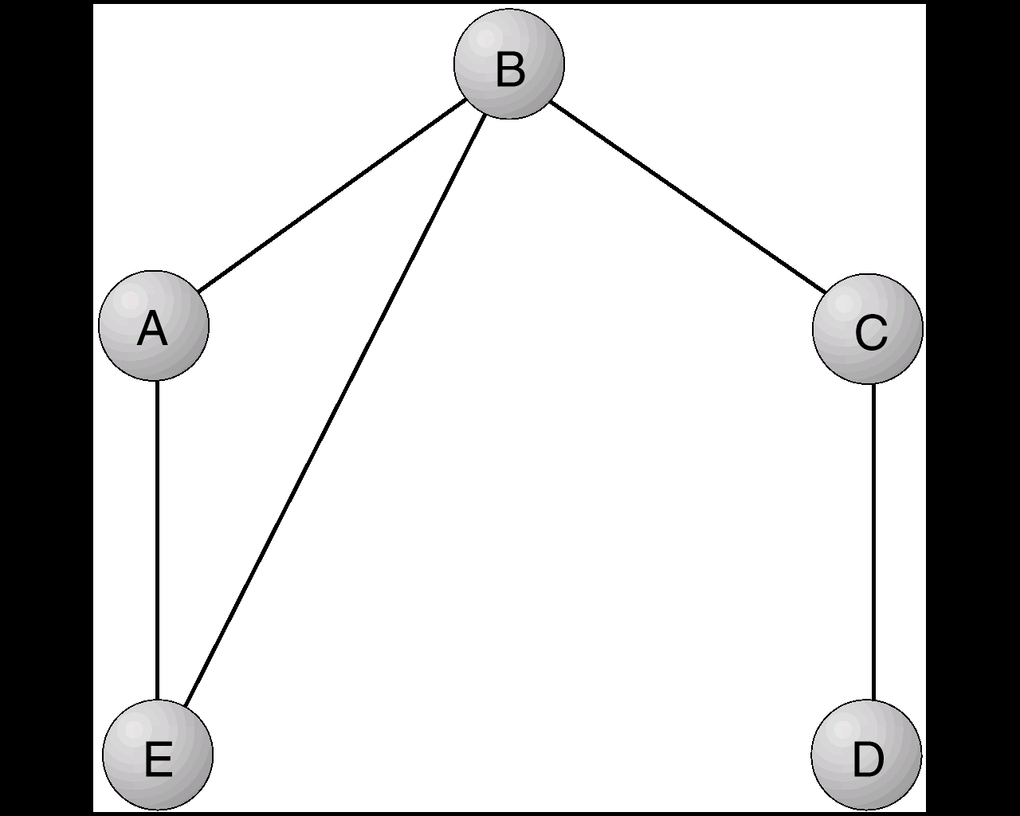
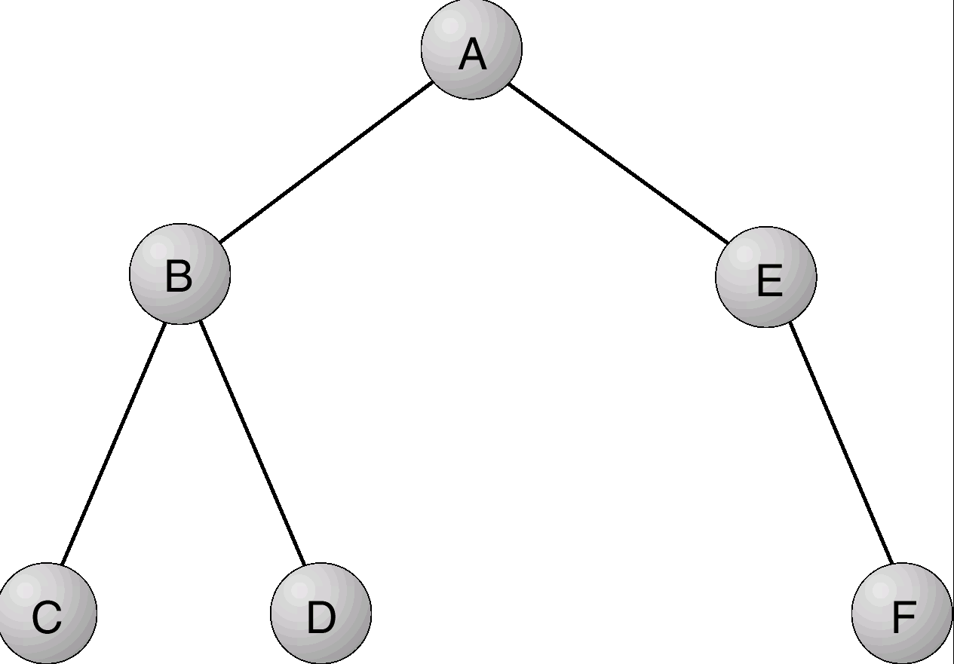
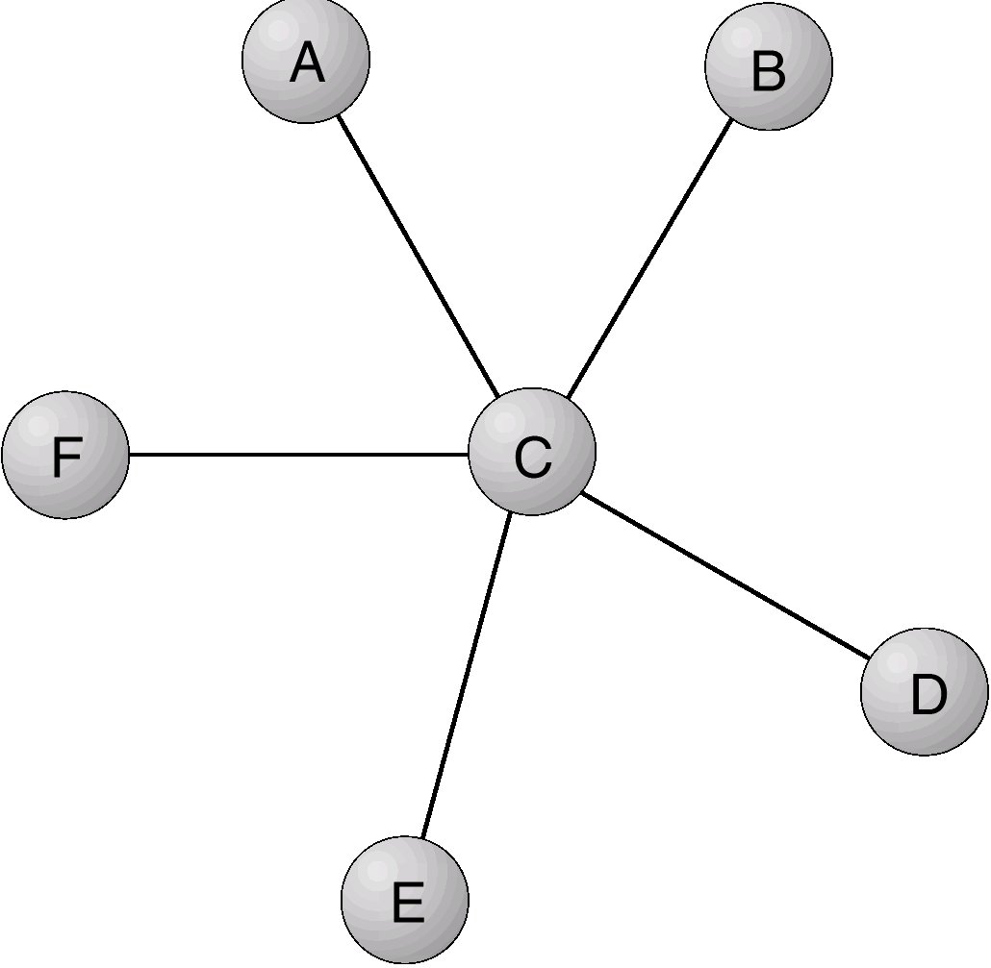
NETWORK STRUCTURES
Topology
PARTIALLY CONNECTED
Direct links exist between some, but not all, sites.
Cheaper, slower, an error can partition system.
HIERARCHICAL
Links are formed in a tree structure.
Cheaper than partially connected; slower; children of failed components can't communicate.
STAR
All sites connected through a central site.
Basic cost low; bottleneck and reliability are low at hub.

Slide 10
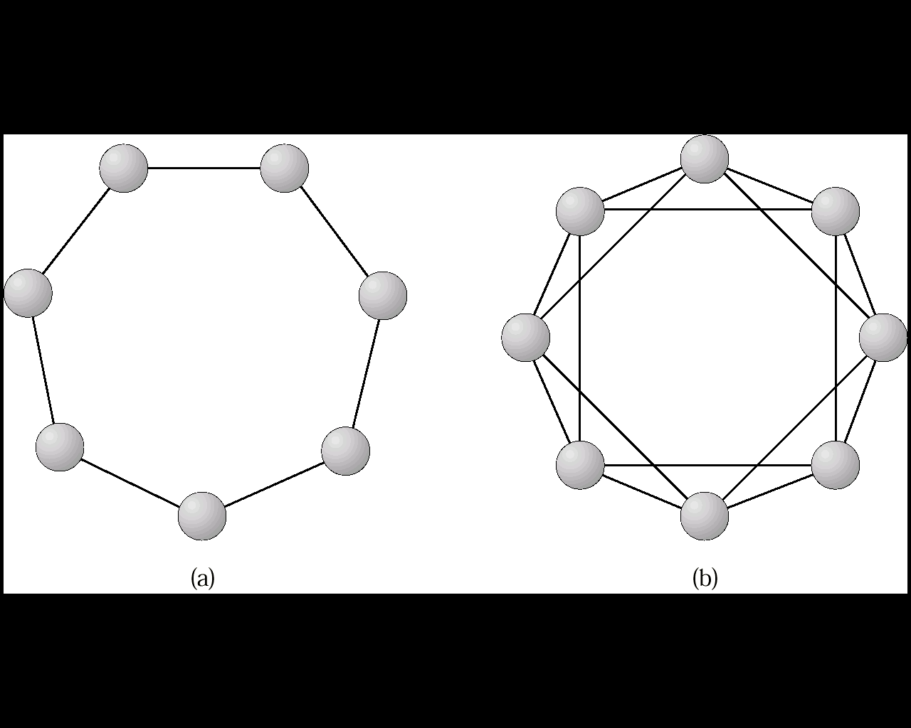
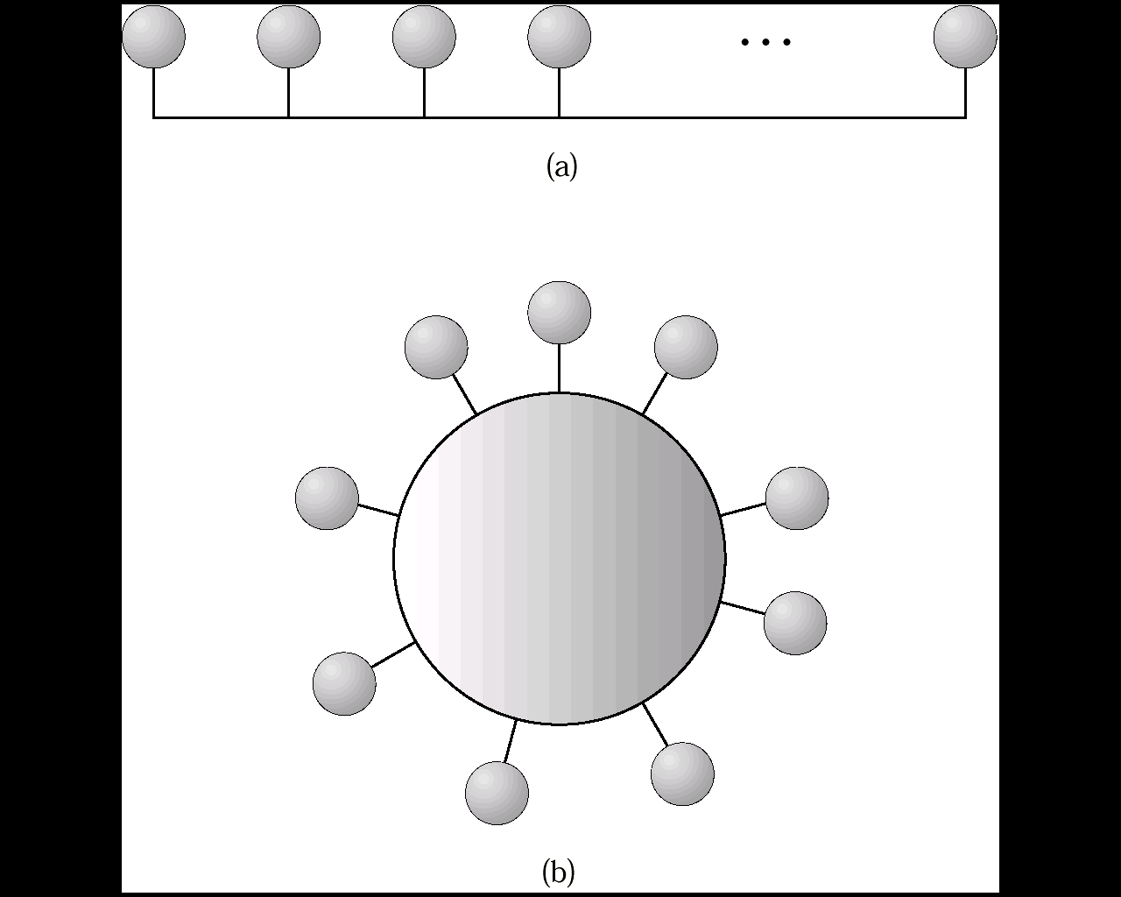
NETWORK STRUCTURES
Topology
RING
Uni or bi-directional, single, double link.
Cost is linear with number of sites; communication cost is high; failure of any site partitions ring.
MULTIACCESS BUS
Nodes hang off a ring rather than being part of it.
Cost is linear; communication cost is low; site failure doesn't affect partitioning.

Slide 11
NETWORK STRUCTURES
Network
Types
LOCAL AREA NETWORKS (LAN):
  Designed to cover small geographical area.
  Multi-access bus, ring or star network.
  Speed around 1 gigabit / second or higher.
  Broadcast is fast and cheap.
  usually workstations or personal computers with few mainframes.
WIDE AREA NETWORK (WAN):
  Links geographically separated sites.
  Point to point connections over long-haul lines (often leased from a phone company.)
  Speed around 1 megabits / second. (T1 is 1.544 megabits/second.)
  Broadcast usually requires multiple messages.
  Nodes usually contain a high percentage of mainframes.

Slide 12
NETWORK STRUCTURES
Design
Issues
When designing a communication network, numerous issues must be addressed:
Naming and name resolution How do two processes locate each other in order to communicate?
Routing Strategies How are messages sent through the network?
Connection Strategies How do two processes send a sequence of messages?
Contention Since the network is a shared resource, how do we resolve conflicting demands for its use?

Slide 13
NETWORK STRUCTURES
Name
Resolution
NAMING AND NAME RESOLUTION
Naming systems in the network.
Address messages with the process-id.
Identify processes on remote systems by < hostname, identifier > pair.
Domain name service -- specifies the naming structure of the hosts, as well as name to address resolution ( internet ).

Slide 14
NETWORK STRUCTURES
Routing
Strategies
FIXED ROUTING
  A path from A to B is specified in advance and does not change unless a hardware failure disables this path.
  Since the shortest path is usually chosen, communication costs are minimized.
  Fixed routing cannot adapt to load changes.
  Ensures that messages will be delivered in the order in which they were sent.
VIRTUAL CIRCUIT
  A path from A to B is fixed for the duration of one session. Different sessions involving messages from A to B may have different paths.
  A partial remedy to adapting to load changes.
  Ensures that messages will be delivered in the order in which they were sent.
DYNAMIC ROUTING
  The path used to send a message from site A to site B is chosen only when a message is sent.
  Usually a site sends a message to another site on the link least used at that particular time.
  Adapts to load changes by avoiding routing messages on heavily used path.
  Messages may arrive out of order. This problem can be remedied by appending a sequence number to each message.

Slide 15
NETWORK STRUCTURES
Connection
Strategies
Processes institute communications sessions to exchange information.
There are a number of ways to connect pairs of processes that want to communicate
over the network.
Circuit Switching A permanent physical link is established for the duration of the communication (i.e. telephone system.)
Message Switching A temporary link is established for the duration of one message transfer (i.e., post-office mailing system.)
Packet Switching Messages of variable length are divided into fixed-length packets that are sent to the destination.
Each packet may take a different path through the network.
The packets must be reassembled into messages at they arrive.
Circuit switching requires setup time, but incurs less overhead for shipping each message, and
may waste network bandwidth.
Message and packet switching require less setup time, but incur more overhead per message.

Slide 16
NETWORK STRUCTURES
Contention
Several sites may want to transmit information over a link simultaneously. Techniques to avoid repeated collisions include:
CSMA/CD.
Carrier sense with multiple access (CSMA) collision detection (CD)
A site determines whether another message is currently being transmitted over that link. If two or more sites begin transmitting at exactly the same time, then they will register a CD and will stop transmitting.
When the system is very busy, many collisions may occur, and thus performance may be degraded.
(CSMA/CD) is used successfully in the Ethernet system, the most common network system.

Slide 17
NETWORK STRUCTURES
Contention
Token passing.
A unique message type, known as a token, continuously circulates in the system (usually a ring structure).
A site that wants to transmit information must wait until the token arrives.
When the site completes its round of message passing, it retransmits the token.
Message slots.
A number of fixed-length message slots continuously circulate in the system (usually a ring structure).
Since a slot can contain only fixed-sized messages, a single logical message may have to be broken down into smaller packets, each of which is sent in a separate slot.

Slide 18
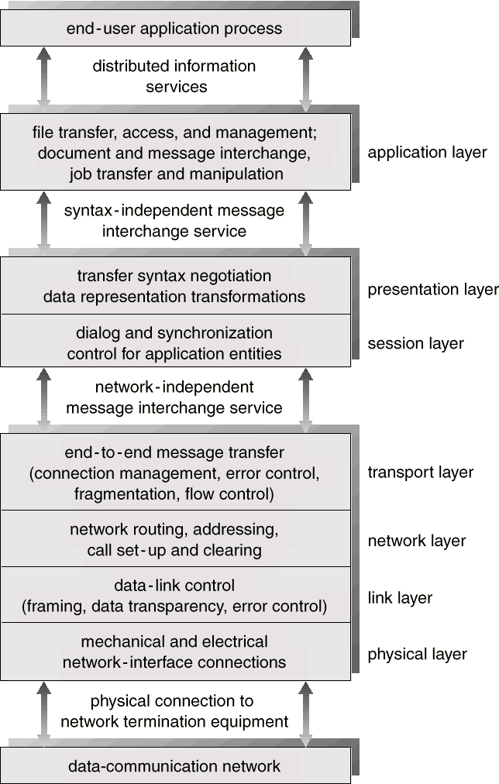
NETWORK STRUCTURES
Design
Structure
The communication network is partitioned into the following multiple layers:

Slide 19
NETWORK STRUCTURES
Design
Structure
Physical layer Handles the mechanical and electrical details of the physical transmission of a bit stream.
Data-link layer Handles the frames, or fixed-length parts of packets, including any error detection and recovery that occurred in the physical layer.
Network layer Provides connections and routing of packets in the communication network. Includes handling the address of outgoing packets, decoding the address of incoming packets, and maintaining routing information for proper response to changing load levels.
Transport layer Responsible for low-level network access and for message transfer between clients. Includes partitioning messages into packets, maintaining packet order, controlling flow, and generating physical addresses.

Slide 20
NETWORK STRUCTURES
Design
Structure
Presentation layer Resolves the differences in formats among the various sites in the network, including character conversions, and half duplex/full duplex (echoing).
Application layer Interacts directly with the users. Deals with file transfer, remote-login protocols and electronic mail, as well as schemas for distributed databases.

Slide 21
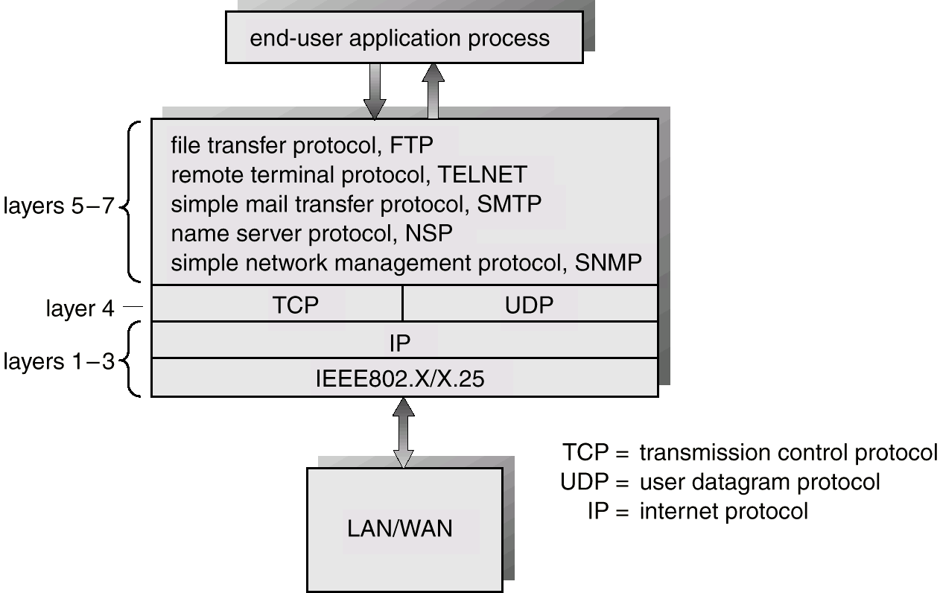
NETWORK STRUCTURES
Design
Structure
How this is really implemented can be seen in this figure:

Slide 22
DISTRIBUTED FILE SYSTEMS
Overview:
Background
Naming and Transparency
Remote File Access
Stateful versus Stateless Service
File Replication
An Example: AFS

Slide 23
DISTRIBUTED FILE SYSTEMS
Definitions
A Distributed File System ( DFS ) is simply a classical model of a file system ( as discussed before ) distributed across multiple machines. The purpose is to promote sharing of dispersed files.
This is an area of active research interest today.
The resources on a particular machine are local to itself. Resources on other machines are remote.
A file system provides a service for clients. The server interface is the normal set of file operations: create, read, etc. on files.

Slide 24
DISTRIBUTED FILE SYSTEMS
Definitions
Clients, servers, and storage are dispersed across machines. Configuration and implementation may vary -
  Servers may run on dedicated machines, OR
  Servers and clients can be on the same machines.
  The OS itself can be distributed (with the file system a part of that distribution.
  A distribution layer can be interposed between a conventional OS and the file system.
Clients should view a DFS the same way they would a centralized FS; the distribution is hidden at a lower level.
Performance is concerned with throughput and response time.

Slide 25
DISTRIBUTED FILE SYSTEMS
Naming and Transparency
Naming is the mapping between logical and physical objects.
  Example: A user filename maps to <cylinder, sector>.
  In a conventional file system, it's understood where the file actually resides; the system and disk are known.
  In a transparent DFS, the location of a file, somewhere in the network, is hidden.
  File replication means multiple copies of a file; mapping returns a SET of locations for the replicas.
Location transparency -
  The name of a file does not reveal any hint of the file's physical storage location.
  File name still denotes a specific, although hidden, set of physical disk blocks.
  This is a convenient way to share data.
  Can expose correspondence between component units and machines.

Slide 26
DISTRIBUTED FILE SYSTEMS
Naming and Transparency
Location independence -
  The name of a file doesn't need to be changed when the file's physical storage location changes. Dynamic, one-to-many mapping.
  Better file abstraction.
  Promotes sharing the storage space itself.
  Separates the naming hierarchy from the storage devices hierarchy.
Most DFSs today:
  Support location transparent systems.
  Do NOT support migration; (automatic movement of a file from machine to machine.)
  Files are permanently associated with specific disk blocks.

Slide 27
DISTRIBUTED FILE SYSTEMS
Naming and Transparency
The ANDREW DFS AS AN EXAMPLE:
  Is location independent.
  Supports file mobility.
  Separation of FS and OS allows for disk-less systems. These have lower cost and convenient system upgrades. The performance is not as good.
NAMING SCHEMES:
There are three main approaches to naming files:
1. Files are named with a combination of host and local name.
  This guarantees a unique name. NOT location transparent NOR location independent.
  Same naming works on local and remote files. The DFS is a loose collection of independent file systems.

Slide 28
DISTRIBUTED FILE SYSTEMS
Naming and Transparency
NAMING SCHEMES:
2. Remote directories are mounted to local directories.
  So a local system seems to have a coherent directory structure.
  The remote directories must be explicitly mounted. The files are location independent.
  SUN NFS is a good example of this technique.
3. A single global name structure spans all the files in the system.
  The DFS is built the same way as a local file system. Location independent.

Slide 29
DISTRIBUTED FILE SYSTEMS
Naming and Transparency
IMPLEMENTATION TECHNIQUES:
  Can Map directories or larger aggregates rather than individual files.
  A non-transparent mapping technique:
  name ----> < system, disk, cylinder, sector >
  A transparent mapping technique:
  name ----> file_identifier ----> < system, disk, cylinder, sector >
  So when changing the physical location of a file, only the file identifier need be modified. This identifier must be "unique" in the universe.

Slide 30
DISTRIBUTED FILE SYSTEMS
Remote File Access
CACHING
Reduce network traffic by retaining recently accessed disk blocks in a cache, so that repeated accesses to the same information can be handled locally.
If required data is not already cached, a copy of data is brought from the server to the user.
Perform accesses on the cached copy.
Files are identified with one master copy residing at the server machine,
Copies of (parts of) the file are scattered in different caches.
Cache Consistency Problem -- Keeping the cached copies consistent with the master file.

Slide 31
DISTRIBUTED FILE SYSTEMS
Remote File Access
CACHING
A remote service ((RPC) has these characteristic steps:
  The client makes a request for file access.
  The request is passed to the server in message format.
  The server makes the file access.
  Return messages bring the result back to the client.
This is equivalent to performing a disk access for each request.

Slide 32
DISTRIBUTED FILE SYSTEMS
Remote File Access
CACHE LOCATION:
Caching is a mechanism for maintaining disk data on the local machine. This data can be kept in the local memory or in the local disk. Caching can be advantageous both for read ahead and read again.
The cost of getting data from a cache is a few HUNDRED instructions; disk accesses cost THOUSANDS of instructions.
The master copy of a file doesn't move, but caches contain replicas of portions of the file.
Caching behaves just like "networked virtual memory".

Slide 33
DISTRIBUTED FILE SYSTEMS
Remote File Access
CACHE LOCATION:
What should be cached? << blocks <---> files >>.
Bigger sizes give a better hit rate;
Smaller give better transfer times.
Caching on disk gives:
  Better reliability.
Caching in memory gives:
  The possibility of diskless work stations,
  Greater speed,
Since the server cache is in memory, it allows the use of only one mechanism.

Slide 34
DISTRIBUTED FILE SYSTEMS
Remote File Access
CACHE UPDATE POLICY:
A write through cache has good reliability. But the user must wait for writes to get to the server. Used by NFS.
Delayed write - write requests complete more rapidly. Data may be written over the previous cache write, saving a remote write. Poor reliability on a crash.
Flush sometime later tries to regulate the frequency of writes.
Write on close delays the write even longer.
Which would you use for a database file? For file editing?

Slide 35
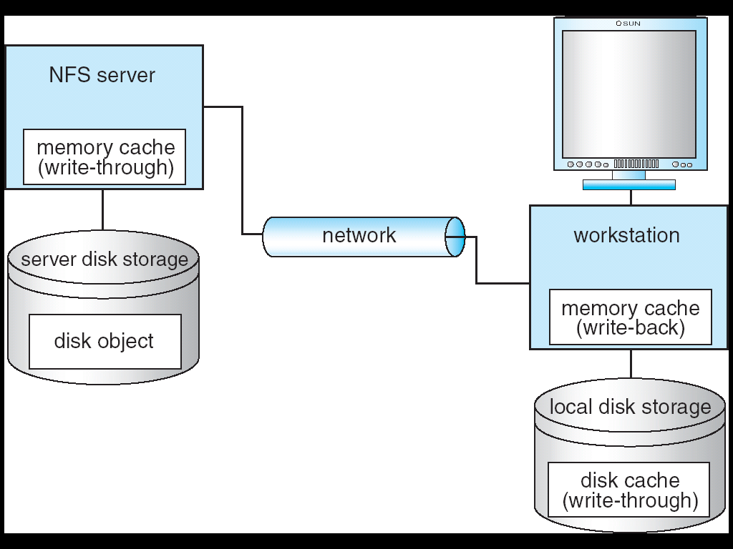
DISTRIBUTED FILE SYSTEMS
Example: NFS with Cachefs

Slide 36
DISTRIBUTED FILE SYSTEMS
Remote File Access
CACHE CONSISTENCY:
The basic issue is, how to determine that the client-cached data is consistent with what's on the server.
Client - initiated approach -
  The client asks the server if the cached data is OK. What should be the frequency of "asking"? On file open, at fixed time interval, ...?
Server - initiated approach -
  Possibilities: A and B both have the same file open. When A closes the file, B "discards" its copy. Then B must start over.
  The server is notified on every open. If a file is opened for writing, then disable caching by other clients for that file.
  Get read/write permission for each block; then disable caching only for particular blocks.

Slide 37
DISTRIBUTED FILE SYSTEMS
Remote File Access
COMPARISON OF CACHING AND REMOTE SERVICE:
Many remote accesses can be handled by a local cache. There's a great deal of locality of reference in file accesses. Servers can be accessed only occasionally rather than for each access.
Caching causes data to be moved in a few big chunks rather than in many smaller pieces; this leads to considerable efficiency for the network.
Cache consistency is the major problem with caching. When there are infrequent writes, caching is a win. In environments with many writes, the work required to maintain consistency overwhelms caching advantages.
Caching requires a whole separate mechanism to support acquiring and storage of large amounts of data. Remote service merely does what's required for each call. As such, caching introduces an extra layer and mechanism and is more complicated than remote service.

Slide 38
DISTRIBUTED FILE SYSTEMS
Remote File Access
STATEFUL VS. STATELESS SERVICE:
Stateful: A server keeps track of information about client requests.
  It maintains what files are opened by a client; connection identifiers; server caches.
  Memory must be reclaimed when client closes file or when client dies.
Stateless: Each client request provides complete information needed by the server (i.e., filename, file offset ).
  The server can maintain information on behalf of the client, but it's not required.
  Useful things to keep include file info for the last N files touched.

Slide 39
DISTRIBUTED FILE SYSTEMS
Remote File Access
STATEFUL VS. STATELESS SERVICE:
Performance is better for stateful.
  Don't need to parse the filename each time, or "open/close" file on every request.
  Stateful can have a read-ahead cache.
Fault Tolerance: A stateful server loses everything when it crashes.
  Server must poll clients in order to renew its state.
  Client crashes force the server to clean up its encached information.
  Stateless remembers nothing so it can start easily after a crash.

Slide 40
DISTRIBUTED FILE SYSTEMS
Remote File Access
FILE REPLICATION:
Duplicating files on multiple machines improves availability and performance.
Placed on failure-independent machines ( they won't fail together ).
  Replication management should be "location-opaque".
The main problem is consistency - when one copy changes, how do other copies reflect that change? Often there is a tradeoff: consistency versus availability and performance.
Example:
  "Demand replication" is like whole-file caching; reading a file causes it to be cached locally. Updates are done only on the primary file at which time all other copies are invalidated.
Atomic and serialized invalidation isn't guaranteed ( message could get lost / machine could crash. )

Slide 41
DISTRIBUTED FILE SYSTEMS
Andrew File System
A distributed computing environment (Andrew) under development since 1983 at Carnegie-Mellon University, purchased by IBM and released as Transarc DFS, now open sourced as OpenAFS.
OVERVIEW:
AFS tries to solve complex issues such as uniform name space, location-independent file sharing, client-side caching (with cache consistency), secure authentication (via Kerberos)
  Also includes server-side caching (via replicas), high availability
  Can span 5,000 workstations

Slide 42
DISTRIBUTED FILE SYSTEMS
Andrew File System
Clients have a partitioned space of file names:
  a local name space and a shared name space
Dedicated servers, called Vice, present the shared name space to the clients as an homogeneous, identical, and location transparent file hierarchy
Workstations run the Virtue protocol to communicate with Vice.
Are required to have local disks where they store their local name space
Servers collectively are responsible for the storage and management of the shared name space

Slide 43
DISTRIBUTED FILE SYSTEMS
Andrew File System
Clients and servers are structured in clusters interconnected by a backbone LAN
A cluster consists of a collection of workstations and a cluster server and is connected to the backbone by a router
A key mechanism selected for remote file operations is whole file caching
  Opening a file causes it to be cached, in its entirety, on the local disk

Slide 44
DISTRIBUTED FILE SYSTEMS
Andrew File System
SHARED NAME SPACE:
The server file space is divided into volumes. Volumes contain files of only one user. It's these volumes that are the level of granularity attached to a client.
A vice file can be accessed using a fid = <volume number, vnode >. The fid doesn't depend on machine location. A client queries a volume-location database for this information.
Volumes can migrate between servers to balance space and utilization. Old server has "forwarding" instructions and handles client updates during migration.
Read-only volumes ( system files, etc. ) can be replicated. The volume database knows how to find these.

Slide 45
DISTRIBUTED FILE SYSTEMS
Andrew File System
FILE OPERATIONS AND CONSISTENCY SEMANTICS:
Andrew caches entire files form servers
  A client workstation interacts with Vice servers only during opening and closing of files
Venus – caches files from Vice when they are opened, and stores modified copies of files back when they are closed
Reading and writing bytes of a file are done by the kernel without Venus intervention on the cached copy
Venus caches contents of directories and symbolic links, for path-name translation
Exceptions to the caching policy are modifications to directories that are made directly on the server responsibility for that directory

Slide 46
DISTRIBUTED FILE SYSTEMS
Andrew File System
IMPLEMENTATION – Flow of a request:
Deflection of open/close:
The client kernel is modified to detect references to vice files.
The request is forwarded to Venus with these steps:
Venus does pathname translation.
Asks Vice for the file
Moves the file to local disk
Passes inode of file back to client kernel.
Venus maintains caches for status ( in memory ) and data ( on local disk.)
A server user-level process handles client requests.
A lightweight process handles concurrent RPC requests from clients.
State information is cached in this process.
Susceptible to reliability problems.

Slide 47
DISTRIBUTED COORDINATION
Topics:
Event Ordering
Mutual Exclusion
Atomicity
Concurrency Control
Deadlock Handling
Election Algorithms
Reaching Agreement

Slide 48
DISTRIBUTED COORDINATION
Definitions:
Tightly coupled systems:
  Same clock, usually shared memory.
  Communication is via this shared memory.
  Multiprocessors.
Loosely coupled systems:
  Different clock.
  Use communication links.
  Distributed systems.

Slide 49
DISTRIBUTED COORDINATION
Event Ordering
"Happening before" vs. concurrent.
Here A --> B means A occurred before B and thus could have caused B.
Of the events shown on the next page, which are happened-before and which are concurrent?
Ordering is easy if the systems share a common clock ( i.e., it's in a centralized system.)
With no common clock, each process keeps a logical clock.
This Logical Clock can be simply a counter - it may have no relation to real time.
Adjust the clock if messages are received with time higher than current time.
We require that LC( A ) < LC( B ), the time of transmission be less than the time of receipt for a message.
So if on message receipt, LC( A ) >= LC( B ),
    then set LC( B ) = LC( A ) + 1.

Slide 50
DISTRIBUTED COORDINATION
Event Ordering
Time
P₄
Q₄
R₄
o
o
o
P₃
o
Q₃
o
R₃
o
P₂
o
Q₂
o
R₂
o
P₁
o
Q₁
o
R₁
o
P₀
o
Q₀
o
R₀
o
P
Q
R

Slide 51
DISTRIBUTED COORDINATION
Mutual Exclusion/
Synchronization
USING DISTRIBUTED SEMAPHORES
With only a single machine, a processor can provide mutual exclusion.
But it's much harder to do with a distributed system.
The network may not be fully connected so communication must be through an intermediary machine.
Concerns center around:
1. Efficiency/performance
2. How to re-coordinate if something breaks.
Techniques we will discuss:
1. Centralized
2. Fully Distributed
3. Distributed with Tokens
With rings
Without rings

Slide 52
DISTRIBUTED COORDINATION
Mutual Exclusion/
Synchronization
CENTRALIZED APPROACH
Choose one processor as coordinator who handles all requests.
A process that wants to enter its critical section sends a request message to the coordinator.
On getting a request, the coordinator doesn't answer until the critical section is empty (has been released by whoever is holding it).
On getting a release, the coordinator answers the next outstanding request.
If coordinator dies, elect a new one who recreates the request list by polling all systems to find out what resource each thinks it has.
Requires three messages per critical section entry;
  request, reply, release.
The method is free from starvation.

Slide 53
DISTRIBUTED COORDINATION
Mutual Exclusion/
Synchronization
FULLY DISTRIBUTED APPROACH
Approach due to Lamport. These are the general properties for the method:
  The general mechanism is for a process P[i] to send a request ( with ID and time stamp ) to all other processes.
  When a process P[j] receives such a request, it may reply immediately or it may defer sending a reply back.
  When responses are received from all processes, then P[i] can enter its Critical Section.
  When P[i] exits its critical section, the process sends reply messages to all its deferred requests.

Slide 54
DISTRIBUTED COORDINATION
Mutual Exclusion/
Synchronization
FULLY DISTRIBUTED APPROACH
The general rules for reply for processes receiving a request:
  If P[j] receives a request, and P[j] process is in its critical section, defer (hold off) the response to P[i].
  If P[j] receives a request,, and not in critical section, and doesn't want to get in, then reply immediately to P[i].
  If P[j] wants to enter its critical section but has not yet entered it, then it compares its own timestamp TS[j] with the timestamp TS[i] from T[i].
  If TS[j] > TS[i], then it sends a reply immediately to P[i]. P[i] asked first.
  Otherwise the reply is deferred until after P[j] finishes its critical section.

Slide 55
DISTRIBUTED COORDINATION
Mutual Exclusion/
Synchronization
The Fully Distributed Approach assures:
  Mutual exclusion
  Freedom from deadlock
  Freedom from starvation, since entry to the critical section is scheduled according to the timestamp ordering. The timestamp ordering ensures that processes are served in a first-come, first-served order.
  2 X ( n - 1 ) messages needed for each entry. This is the minimum number of required messages per critical-section entry when processes act independently and concurrently.
Problems with the method include:
  Need to know identity of everyone in system.
  Fails if anyone dies - must continually monitor the state of all processes.
  Processes are always coming and going so it's hard to maintain current data.

Slide 56
DISTRIBUTED COORDINATION
Mutual Exclusion/
Synchronization
TOKEN PASSING APPROACH
Tokens with rings
Whoever holds the token can use the critical section. When done, pass on the token. Processes must be logically connected in a ring -- it may not be a physical ring.
Advantages:
  No starvation if the ring is unidirectional.
  There are many messages passed per section entered if few users want to get in section.
  Only one message/entry if everyone wants to get in.
OK if you can detect loss of token and regenerate via election or other means.
If a process is lost, a new logical ring must be generated.

Slide 57
DISTRIBUTED COORDINATION
Mutual Exclusion/
Synchronization
TOKEN PASSING APPROACH
Tokens without rings ( Chandy )
A process can send a token to any other process.
Each process maintains an ordered list of requests for a critical section.
Process requiring entrance broadcasts message with ID and new count (current logical time).
When using the token, store into it the time-of-request for the request just finished.
If a process is holding token and not in critical section, send to first message received ( if time maintained in token is later than that for a request in the list, it's an old message and can be discarded.) If no request, hang on to the token.

Slide 58
DISTRIBUTED COORDINATION
Atomicity
Atomicity means either ALL the operations associated with a program unit are executed to completion, or none are performed.
Ensuring atomicity in a distributed system requires a transaction coordinator, which is responsible for the following:
  Starting the execution of a transaction.
  Breaking the transaction into a number of sub transactions, and distributing these sub transactions to the appropriate sites for execution.
  Coordinating the termination of the transaction, which may result in the transaction being committed at all sites or aborted at all sites.

Slide 59
DISTRIBUTED COORDINATION
Atomicity
Two-Phase Commit Protocol (2PC)
For atomicity to be ensured, all the sites in which a transaction T executes must agree on the final outcome of the execution. 2PC is one way of doing this.
Execution of the protocol is initiated by the coordinator after the last step of the transaction has been reached.
When the protocol is initiated, the transaction may still be executing at some of the local sites.
The protocol involves all the local sites at which the transaction executed.
Let T be a transaction initiated at site Si, and let the transaction coordinator at Si be Ci

Slide 60
DISTRIBUTED COORDINATION
Atomicity
Two-Phase Commit Protocol (2PC)
Phase 1: Obtaining a decision
Ci adds <prepare T> record to the log.
Ci sends <prepare T> message to all sites.
When a site receives a <prepare T> message, the transaction manager determines if it can commit the transaction.
  If no: add <no T> record to the log and respond to Ci with <abort T >.
  If yes:
    add <ready T > record to the log.
    force all log records for T onto stable storage.
    transaction manager sends <ready T > message to Ci .
Coordinator collects responses -
  If All respond "ready", decision is commit.
  If At least one response is "abort", decision is abort.
  If At least one participant fails to respond within timeout period, decision is abort.

Slide 61
DISTRIBUTED COORDINATION
Atomicity
Two-Phase Commit Protocol (2PC)
Phase 2: Recording the decision in the database
Coordinator adds a decision record ( <abort T >or <commit T > ) to its log and forces record onto stable storage.
Once that record reaches stable storage it is irrevocable (even if failures occur).
Coordinator sends a message to each participant informing it of the decision (commit or abort) .
Participants take appropriate action locally.

Slide 62
DISTRIBUTED COORDINATION
Atomicity
Failure Handling in Two-Phase Commit:
Failure of a participating Site:
The log contains a <commit T> record. In this case, the site executes redo (T)
The log contains an <abort T> record. In this case, the site executes undo (T)
The log contains a <ready T> record; consult Ci . If Ci is down, site sends query-status(T) message to the other sites.
The log contains no control records concerning (T). Then the site executes undo(T).
Failure of the Coordinator Ci:
If an active site contains a <commit T> record in its log, then T must be committed.
If an active site contains an <abort T> record in its log, then T must be aborted.
If some active site does not contain the record <ready T> in its log, then the failed coordinator Ci cannot have decided to commit T. Rather than wait for Ci to recover, it is preferable to abort T.
All active sites have a <ready T> record in their logs, but no additional control records. In this case we must wait for the coordinator to recover. Blocking problem - T is blocked pending the recovery of site Si.

Slide 63
DISTRIBUTED COORDINATION
Concurrency Control
We need to modify the centralized concurrency schemes to accommodate the distribution of transactions.
Transaction manager coordinates execution of transactions (or sub transactions) that access data at local sites.
Local transaction only executes at that site.
Global transaction executes at several sites.
Locking Protocols
Can use the two-phase locking protocol in a distributed environment by changing how the lock manager is implemented.
Nonreplicated scheme - each site maintains a local lock manager which administers lock and unlock requests for those data items that are stored in that site.
  Simple implementation involves two message transfers for handling lock requests, and one message transfer for handling unlock requests.
  Deadlock handling is more complex.

Slide 64
DISTRIBUTED COORDINATION
Concurrency Control
Locking Protocols == Single-coordinator approach:
A single lock manager resides in a single chosen site; all lock and unlock requests are made at that site.
Simple implementation
Simple deadlock handling
Possibility of bottleneck
Vulnerable to loss of concurrency controller if single site fails.

Slide 65
DISTRIBUTED COORDINATION
Concurrency Control
Locking Protocols == Multiple-coordinator approach:
Distributes lock-manager function over several sites.
Majority protocol:
Avoids drawbacks of central control by replicating data in a decentralized manner.
More complicated to implement.
Deadlock-handling algorithms must be modified; possible for deadlock to occur in locking only one data item.
Biased protocol:
Like majority protocol, but requests for shared locks prioritized over exclusive locks.
Less overhead on reads than in majority protocol; but more overhead on writes.
Like majority protocol, deadlock handling is complex.

Slide 66
DISTRIBUTED COORDINATION
Concurrency Control
Locking Protocols == Multiple-coordinator approach:
Primary copy:
One of the sites at which a replica resides is designated as the primary site. Request to lock a data item is made at the primary site of that data item.
Concurrency control for replicated data handled in a manner similar to that for un-replicated data.
Simple implementation, but if primary site fails, the data item is unavailable, even though other sites may have a replica.
Time-stamping:
Generate unique timestamps in distributed scheme:
  A) Each site generates a unique local timestamp.
  B) The global unique timestamp is obtained by concatenation of the unique local timestamp with the unique site identifier.
  C) Use a logical clock defined within each site to ensure the fair generation of timestamps.
Timestamp-ordering scheme - combine the centralized concurrency control timestamp scheme with the (2PC) protocol to obtain a protocol that ensures serializability with no cascading rollbacks.

Slide 67
DISTRIBUTED COORDINATION
Deadlock Handling
DEADLOCK PREVENTION
To prevent Deadlocks, must stop one of the four conditions (these should sound familiar!):
  Mutual exclusion,
  Hold and wait,
  No preemption,
  Circular wait.
Possible Solutions Include:
  Global resource ordering (all resources are given unique numbers and a process can acquire them only in ascending order.) Simple to implement, low cost, but requires knowing all resources. Prevents a circular wait.
  Banker's algorithm with one process being banker (can be bottleneck.) Large number of messages is required so method is not very practical.
  Priorities based on unique numbers for each process has a problem with starvation.

Slide 68
DISTRIBUTED COORDINATION
Deadlock Handling
DEADLOCK PREVENTION
Possible Solutions Include:
Priorities based on timestamps can be used to prevent circular waits. Each process is assigned a timestamp at its creation. Several variations are possible:
  Non-preemptive Requester waits for resource if older than current resource holder, else it's rolled back losing all its resources. The older a process gets, the longer it waits.
  Preemptive If the requester is older than the holder, then the holder is preempted ( rolled back ). If the requester is younger, then it waits. Fewer rollbacks here. When P(i) is preempted by P(j), it restarts and, being younger, ends up waiting for P(j).
Keep timestamp if rolled back ( don't reassign them ) - prevents starvation since a preempted process will soon be the oldest.
The preemption method has fewer rollbacks because in the non-preemptive method, a young process can be rolled back a number of times before it gets the resource.

Slide 69
DISTRIBUTED COORDINATION
Deadlock Handling
DEADLOCK DETECTION
The previous Prevention Techniques can unnecessarily preempt a resource. Can we do rollback only when a deadlock is detected??
Use Wait For Graphs - recall, with a single resource of a type, a cycle is a deadlock.
Each site maintains a local wait-for-graph, with nodes being local or remote processes requesting LOCAL resources. (see figure on next page)
To show no deadlock has occurred, show the union of graphs has no cycle. (see figures on next page)

Slide 70

DISTRIBUTED COORDINATION
Deadlock Handling
P1
P2
P2
P4
P5
P3
P3
Two local wait-for graphs.
P1
P2
P4
Resource Allocation Graph & It’s Wait-For Graph.
P5
P3
Global local wait-for graphs.

Slide 71
DISTRIBUTED COORDINATION
Deadlock Handling
DEADLOCK DETECTION
CENTRALIZED
In this method, the union is maintained in one process. If a global (centralized) graph has cycles, a deadlock has occurred.
Construct graph incrementally (whenever an edge is added or removed), OR periodically (at some fixed time period), OR whenever checking for cycles (because there's some reason to fear deadlock).
Can roll back unnecessarily due to false cycles {because information is obtained asynchronously ( a delete may not be reported before an insert )} and because cycles are broken by terminated processes.
Can avoid false cycles with timestamps that force synchronization.

Slide 72
DISTRIBUTED COORDINATION
Deadlock Handling
DEADLOCK DETECTION
FULLY DISTRIBUTED
All controllers share equally in detecting deadlocks.
See <<< FIGURE A >>>. At Site S1, P[ext] shows that P3 is waiting for some external process, and that some external process is waiting for P2 -- but beware, they may not be related external processes.
Each site collects such a local graph and uses this algorithm:
  If a local site has a cycle, not including a P[ext] , there is a deadlock.
  If there's no cycle, then there's no deadlock.
  If a cycle includes a P[ext] , then there MAY be a deadlock. Each site waiting for a P[ext] sends its graph to the site of the P[ext] it's waiting for. That site combines the two local graphs and starts the algorithm again.
P1
P2
Pext
P2
P4
P5
P3
Pext
P3
Figure A – Two local wait-for graphs.
Pext
P2
P4
P3
Augmented graph at S2.

Slide 73
DISTRIBUTED COORDINATION
Election Algorithms
Either upon a crash, or upon initialization, we need to know who should be the new coordinator. We’re calling this an “election”.
How we do it depends on configuration
THE BULLY ALGORITHM
Suppose P(i) sends a request to the coordinator which is not answered.
We want the highest priority process to be the new coordinator.
Steps to be followed:
  1. P(i) sends "I want to be elected" to all P(j) of higher priority.
  2. If no response, then P(i) has won the election.
  3. All living P(j) send "election" requests to THEIR higher priority P(k), and send "you lose" messages back to P(i).
  4. Finally only one process receives no response.
  5. That process sends "I am it" messages to all lower priority processes.

Slide 74
DISTRIBUTED COORDINATION
Election Algorithms
A RING ALGORITHM
Used where there are unidirectional links. The algorithm uses an "active list" that is filled in upon a failure. Upon completion, this list contains priority numbers and the active processes in the system.
Every site sends every other site its priority.
If coordinator not responding, start active list with its ID on it and send messages that it is holding election.
If this is first for receiver, create active list with received ID and its ID, send 2 messages, one for it and one for received ( second message ).
If not first ( and not same ID ), add to active list and pass on.
If receives message it sent, active list complete, and can name coordinator.

Slide 75
DISTRIBUTED COORDINATION
Reaching Agreement
Between Processes
The problem here is how to get agreement with an unreliable mechanism. In order to do an election, as we just discussed, it would be necessary to work around the following problems.
UNRELIABLE COMMUNICATIONS
Can have faulty links - can use a timeout to detect this.
FAULTY PROCESSES
Can have faulty processes generating bad messages.
Cannot guarantee agreement.

Slide 76
DISTRIBUTED COORDINATION
Wrap Up
We just looked at what it takes to synchronize happenings between processes when the communication costs between those processes is non-trivial.
Everything is very simple if processes can share memory or send very cheap messages between themselves when they need to coordinate.
But it’s not simple at all when every communication has a high overhead.

