Slide 1
OPERATING SYSTEMS
Memory Management
Virtual Memory

Slide 2
Memory Management
Just as processes share the CPU, they also share physical memory. Chapter 8 is about mechanisms for doing that sharing.

Slide 3
MEMORY MANAGEMENT
EXAMPLE OF MEMORY USAGE:
Calculation of an effective address
  Fetch from instruction
  Use index offset
Example: ( Here index is a pointer to an address )
loop:
load register, index
add 42, register
store register, index
inc index
skip_equal index, final_address
branch loop
... continue ....

Slide 4
MEMORY MANAGEMENT
Definitions
The concept of a logical address space that is bound to a separate physical address space is central to proper memory management.
  Logical address – generated by the CPU; also referred to as virtual address
  Physical address – address seen by the memory unit
Logical and physical addresses are the same in compile-time and load-time address-binding schemes; logical (virtual) and physical addresses differ in execution-time address-binding scheme

Slide 5
MEMORY MANAGEMENT
Definitions
Relocatable Means that the program image can reside anywhere in physical memory.
Binding Programs need real memory in which to reside. When is the location of that real memory determined?
  This is called mapping logical to physical addresses.
  This binding can be done at compile/link time. Converts symbolic to relocatable. Data used within compiled source is offset within object module.
Compiler: If it’s known where the program will reside, then absolute code is generated. Otherwise compiler produces relocatable code.
Load: Binds relocatable to physical. Can find best physical location.
Execution: The code can be moved around during execution. Means flexible virtual mapping.

Slide 6
MEMORY MANAGEMENT
Binding Logical To Physical
Source
This binding can be done at compile/link time. Converts symbolic to relocatable. Data used within compiled source is offset within object module.
  Can be done at load time. Binds relocatable to physical.
  Can be done at run time. Implies that the code can be moved around during execution.
The next example shows how a compiler and linker actually determine the locations of these effective addresses.
Compiler
Object
Other Objects
Linker
Executable
Libraries
Loader
In-memory Image

Slide 7
MEMORY MANAGEMENT
Binding Logical To Physical
4 void main()
5 {
6 printf( "Hello, from main\n" );
7 b();
8 }
9
10
11 void b()
12 {
13 printf( "Hello, from 'b'\n" );
14 }

Slide 8
MEMORY MANAGEMENT
Binding Logical To Physical
ASSEMBLY LANGUAGE LISTING
000000B0: 6BC23FD9 stw %r2,-20(%sp ; main()
000000B4 37DE0080 ldo 64(%sp),%sp
000000B8 E8200000 bl 0x000000C0,%r1 ; get current addr=BC
000000BC D4201C1E depi 0,31,2,%r1
000000C0 34213E81 ldo -192(%r1),%r1 ; get code start area
000000C4 E8400028 bl 0x000000E0,%r2 ; call printf
000000C8 B43A0040 addi 32,%r1,%r26 ; calc. String loc.
000000CC E8400040 bl 0x000000F4,%r2 ; call b
000000D0 6BC23FD9 stw %r2,-20(%sp) ; store return addr
000000D4 4BC23F59 ldw -84(%sp),%r2
000000D8 E840C000 bv %r0(%r2) ; return from main
000000DC 37DE3F81 ldo -64(%sp),%sp
STUB(S) FROM LINE 6
000000E0: E8200000 bl 0x000000E8,%r1
000000E4 28200000 addil L%0,%r1
000000E8: E020E002 be,n 0x00000000(%sr7,%r1)
000000EC 08000240 nop void b()
000000F0: 6BC23FD9 stw %r2,-20(%sp)
000000F4: 37DE0080 ldo 64(%sp),%sp
000000F8 E8200000 bl 0x00000100,%r1 ; get current addr=F8
000000FC D4201C1E depi 0,31,2,%r1
00000100 34213E01 ldo -256(%r1),%r1 ; get code start area
00000104 E85F1FAD bl 0x000000E0,%r2 ; call printf
00000108 B43A0010 addi 8,%r1,%r26
0000010C 4BC23F59 ldw -84(%sp),%r2
00000110 E840C000 bv %r0(%r2) ; return from b
00000114 37DE3F81 ldo -64(%sp),%sp

Slide 9
MEMORY MANAGEMENT
Binding Logical To Physical
EXECUTABLE IS DISASSEMBLED HERE
00002000 0009000F ; . . . .
00002004 08000240 ; . . . @
00002008 48656C6C ; H e l l
0000200C 6F2C2066 ; o , f
00002010 726F6D20 ; r o m
00002014 620A0001 ; b . . .
00002018 48656C6C ; H e l l
0000201C 6F2C2066 ; o , f
00002020 726F6D20 ; r o m
00002024 6D61696E ; m a i n
000020B0 6BC23FD9 stw %r2,-20(%sp) ; main
000020B4 37DE0080 ldo 64(%sp),%sp
000020B8 E8200000 bl 0x000020C0,%r1
000020BC D4201C1E depi 0,31,2,%r1
000020C0 34213E81 ldo -192(%r1),%r1
000020C4 E84017AC bl 0x00003CA0,%r2
000020C8 B43A0040 addi 32,%r1,%r26
000020CC E8400040 bl 0x000020F4,%r2
000020D0 6BC23FD9 stw %r2,-20(%sp)
000020D4 4BC23F59 ldw -84(%sp),%r2
000020D8 E840C000 bv %r0(%r2)
000020DC 37DE3F81 ldo -64(%sp),%sp
000020E0 E8200000 bl 0x000020E8,%r1 ; stub
000020E4 28203000 addil L%6144,%r1
000020E8 E020E772 be,n 0x000003B8(%sr7,%r1)
000020EC 08000240 nop

Slide 10
MEMORY MANAGEMENT
Binding Logical To Physical
EXECUTABLE IS DISASSEMBLED HERE
000020F0 6BC23FD9 stw %r2,-20(%sp) ; b
000020F4 37DE0080 ldo 64(%sp),%sp
000020F8 E8200000 bl 0x00002100,%r1
000020FC D4201C1E depi 0,31,2,%r1
00002100 34213E01 ldo -256(%r1),%r1
00002104 E840172C bl 0x00003CA0,%r2
00002108 B43A0010 addi 8,%r1,%r26
0000210C 4BC23F59 ldw -84(%sp),%r2
00002110 E840C000 bv %r0(%r2)
00002114 37DE3F81 ldo -64(%sp),%sp
00003CA0 6BC23FD9 stw %r2,-20(%sp) ; printf
00003CA4 37DE0080 ldo 64(%sp),%sp
00003CA8 6BDA3F39 stw %r26,-100(%sp)
00003CAC 2B7CFFFF addil L%-26624,%dp
00003CB0 6BD93F31 stw %r25,-104(%sp)
00003CB4 343301A8 ldo 212(%r1),%r19
00003CB8 6BD83F29 stw %r24,-108(%sp)
00003CBC 37D93F39 ldo -100(%sp),%r25
00003CC0 6BD73F21 stw %r23,-112(%sp)
00003CC4 4A730009 ldw -8188(%r19),%r19
00003CC8 B67700D0 addi 104,%r19,%r23
00003CCC E8400878 bl 0x00004110,%r2
00003CD0 08000258 copy %r0,%r24
00003CD4 4BC23F59 ldw -84(%sp),%r2
00003CD8 E840C000 bv %r0(%r2)
00003CDC 37DE3F81 ldo -64(%sp),%sp
00003CE0 E8200000 bl 0x00003CE8,%r1
00003CE8 E020E852 be,n 0x00000428(%sr7,%r1)

Slide 11
MEMORY MANAGEMENT
More Definitions
Dynamic loading
+ Routine is not loaded until it is called
+ Better memory-space utilization; unused routine is never loaded.
+ Useful when large amounts of code are needed to handle infrequently occurring cases.
+ No special support from the OS is required - implemented through program design.
Dynamic Linking
+ Linking postponed until execution time.
+ Small piece of code, stub, used to locate the appropriate memory-resident library routine.
+ Stub replaces itself with the address of the routine, and executes the routine.
+ Operating system needed to check if routine is in processes’ memory address.
+ Dynamic linking is particularly useful for libraries.
Memory Management Performs the above operations. Usually requires hardware support.

Slide 12
MEMORY MANAGEMENT
SINGLE PARTITION
ALLOCATION
BARE MACHINE:
  No protection, no utilities, no overhead.
  This is the simplest form of memory management.
  Used by hardware diagnostics, by system boot code, real time/dedicated systems.
  logical == physical
  User can have complete control. Commensurably, the operating system has none.
DEFINITION OF PARTITIONS:
  Division of physical memory into fixed sized regions. (Allows addresses spaces to be distinct = one user can't muck with another user, or the system.)
  The number of partitions determines the level of multiprogramming. Partition is given to a process when it's scheduled.
  Protection around each partition determined by
    bounds ( upper, lower )
    base / limit.
  These limits are done in hardware.

Slide 13
MEMORY MANAGEMENT
SINGLE PARTITION
ALLOCATION
RESIDENT MONITOR:
  Primitive Operating System.
  Usually in low memory where interrupt vectors are placed.
  Must check each memory reference against fence ( fixed or variable ) in hardware or register. If user generated address < fence, then illegal.
  User program starts at fence -> fixed for duration of execution. Then user code has fence address built in. But only works for static-sized monitor.
  If monitor can change in size, start user at high end and move back, OR use fence as base register that requires address binding at execution time. Add base register to every generated user address.
  Isolate user from physical address space using logical address space.
  Concept of "mapping addresses” shown on next slide.

Slide 14
MEMORY MANAGEMENT
SINGLE PARTITION
ALLOCATION
Limit
Register
Relocation
Register
MEMORY
CPU
Yes
<
+
Logical
Address
Physical
Address
No

Slide 15
MEMORY MANAGEMENT
CONTIGUOUS
ALLOCATION
All pages for a process are allocated together in one chunk.
JOB SCHEDULING
  Must take into account who wants to run, the memory needs, and partition availability. (This is a combination of short/medium term scheduling.)
  Sequence of events:
  In an empty memory slot, load a program
  THEN it can compete for CPU time.
  Upon job completion, the partition becomes available.
  Can determine memory size required ( either user specified or "automatically" ).

Slide 16
MEMORY MANAGEMENT
CONTIGUOUS
ALLOCATION
DYNAMIC STORAGE
  (Variable sized holes in memory allocated on need.)
  Operating System keeps table of this memory - space allocated based on table.
  Adjacent freed space merged to get largest holes - buddy system.
ALLOCATION PRODUCES HOLES
OS
OS
OS
process 1
process 1
process 1
Process 2
Terminates
process 4
process 2
Process 4
Starts
process 3
process 3
process 3

Slide 17
MEMORY MANAGEMENT
CONTIGUOUS
ALLOCATION
HOW DO YOU ALLOCATE MEMORY TO NEW PROCESSES?
First fit - allocate the first hole that's big enough.
Best fit - allocate smallest hole that's big enough.
Worst fit - allocate largest hole.
(First fit is fastest, worst fit has lowest memory utilization.)
  Avoid small holes (external fragmentation). This occurs when there are many small pieces of free memory.
  What should be the minimum size allocated, allocated in what chunk size?
  Want to also avoid internal fragmentation. This is when memory is handed out in some fixed way (power of 2 for instance) and requesting program doesn't use it all.

Slide 18
MEMORY MANAGEMENT
LONG TERM
SCHEDULING
If a job doesn't fit in memory, the scheduler can
  wait for memory
  skip to next job and see if it fits.
What are the pros and cons of each of these?
There's little or no internal fragmentation (the process uses the memory given to it - the size given to it will be a page.)
But there can be a great deal of external fragmentation. This is because the memory is constantly being handed cycled between the process and free.

Slide 19
MEMORY MANAGEMENT
COMPACTION
Trying to move free memory to one large block.
Only possible if programs linked with dynamic relocation (base and limit.)
There are many ways to move programs in memory.
Swapping: if using static relocation, code/data must return to same place. But if dynamic, can reenter at more advantageous memory.
OS
OS
OS
P1
P1
P1
P2
P3
P3
P2
P2
P3

Slide 20
MEMORY MANAGEMENT
PAGING
New Concept!!
Logical address space of a process can be noncontiguous; process is allocated physical memory whenever that memory is available and the program needs it.
Divide physical memory into fixed-sized blocks called frames (size is power of 2, between 512 bytes and 8192 bytes).
Divide logical memory into blocks of same size called pages.
Keep track of all free frames.
To run a program of size n pages, need to find n free frames and load program.
Set up a page table to translate logical to physical addresses.
Internal fragmentation.

Slide 21
Address Translation Scheme
MEMORY MANAGEMENT
PAGING
Address generated by the CPU is divided into:
  Page number (p) – used as an index into a page table which contains base address of each page in physical memory.
  Page offset (d) – combined with base address to define the physical memory address that is sent to the memory unit.
4096 bytes = 2^12 – it requires 12 bits to contain the Page offset
p
d

Slide 22
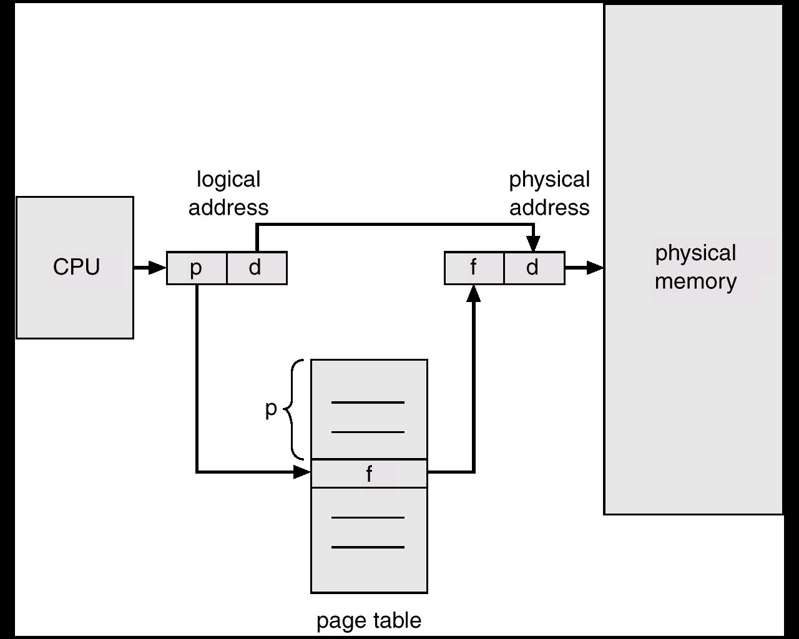
MEMORY MANAGEMENT
PAGING
Permits a program's memory to be physically noncontiguous so it can be allocated from wherever available. This avoids fragmentation and compaction.
Frames = physical blocks
Pages = logical blocks
Size of frames/pages is defined by hardware (power of 2 to ease calculations)
HARDWARE
An address is determined by:
page number ( index into table ) + offset
---> mapping into --->
base address ( from table ) + offset.

Slide 23
PAGING
MEMORY MANAGEMENT
0
Paging Example - 32-byte memory with 4-byte pages
4 I
j
k
l
0 a
1 b
2 c
3 d
8 m
n
o
p
0 5
1 6
2 1
3 2
4 e
5 f
6 g
7 h
12
16
8 I
9 j
10 k
11 l
Page Table
20 a
b
c
d
12 m
13 n
14 o
15 p
24 e
f
g
h
Physical Memory
28
Logical Memory

Slide 24

MEMORY MANAGEMENT
PAGING
  A 32 bit machine can address 4 gigabytes which is 4 million pages (at 1024 bytes/page). WHO says how big a page is, anyway?
  Could use dedicated registers (OK only with small tables.)
  Could use a register pointing to table in memory (slow access.)
  Cache or associative memory
  (TLB = Translation Look-a-side Buffer):
  simultaneous search is fast and uses only a few registers.
IMPLEMENTATION OF THE PAGE TABLE
  TLB = Translation Look-a-side Buffer

Slide 25
MEMORY MANAGEMENT
PAGING
IMPLEMENTATION OF THE PAGE TABLE
Issues include:
key and value
hit rate 90 - 98% with 100 registers
add entry if not found
Effective access time = %fast * time_fast + %slow * time_slow
Relevant times:
2 nanoseconds to search associative memory – the TLB.
20 nanoseconds to access processor cache and bring it into TLB for next time.
Calculate time of access:
hit = 1 search + 1 memory reference
miss = 1 search + 1 memory reference(of page table) + 1 memory reference.

Slide 26

MEMORY MANAGEMENT
PAGING
SHARED PAGES
Data occupying one physical page, but pointed to by multiple logical pages.
Useful for common code - must be write protected. (NO write-able data mixed with code.)
Extremely useful for read/write communication between processes.

Slide 27

MEMORY MANAGEMENT
PAGING
INVERTED PAGE TABLE:
One entry for each real page of memory.
Entry consists of the virtual address of the page stored in that real memory location, with information about the process that owns that page.
Essential when you need to do work on the page and must find out what process owns it.
Use hash table to limit the search to one - or at most a few - page table entries.

Slide 28
MEMORY MANAGEMENT
PAGING
PROTECTION:
Bits associated with page tables.
Can have read, write, execute, valid bits.
Valid bit says page isn’t in address space.
Write to a write-protected page causes a fault. Touching an invalid page causes a fault.
ADDRESS MAPPING:
Allows physical memory larger than logical memory.
Useful on 32 bit machines with more than 32-bit addressable words of memory.
The operating system keeps a frame containing descriptions of physical pages; if allocated, then to which logical page in which process.

Slide 29


MEMORY MANAGEMENT
PAGING
MULTILEVEL PAGE TABLE
A means of using page tables for large address spaces.

Slide 30
MEMORY MANAGEMENT
Segmentation
USER'S VIEW OF MEMORY
A programmer views a process consisting of unordered segments with various purposes. This view is more useful than thinking of a linear array of words. We really don't care at what address a segment is located.
Typical segments include
global variables
procedure call stack
code for each function
local variables for each
large data structures
Logical address = segment name ( number ) + offset
Memory is addressed by both segment and offset.

Slide 31
MEMORY MANAGEMENT
Segmentation
HARDWARE -- Must map a dyad (segment / offset) into one-dimensional address.
Segment Table
Limit Base
CPU
S D
MEMORY
Logical
Address
Yes
<
+
Physical
Address
No

Slide 32
MEMORY MANAGEMENT
Segmentation
HARDWARE
base / limit pairs in a segment table.
0
1
2
3
4
Limit
1000
400
400
1100
1000
Base
1400
6300
4300
3200
4700
1
1
4
2
0
3
2
4
3
Logical Address Space
Physical Memory

Slide 33
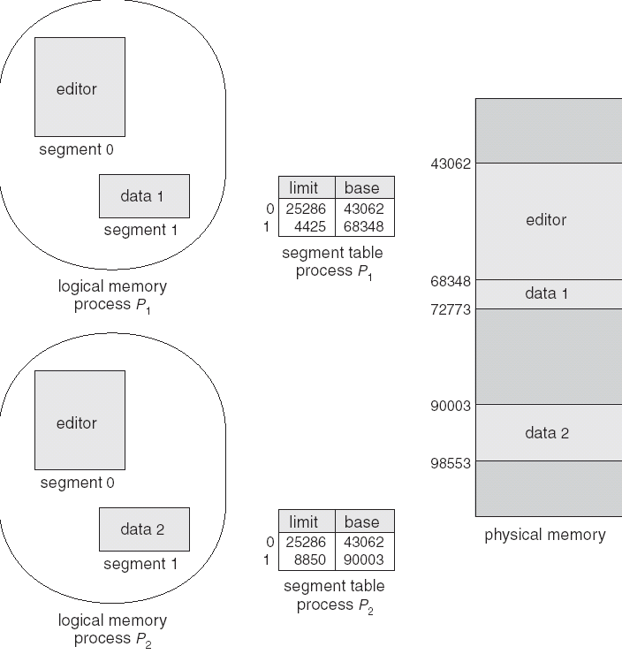
MEMORY MANAGEMENT
Segmentation
PROTECTION AND SHARING
Addresses are associated with a logical unit (like data, code, etc.) so protection is easy.
Can do bounds checking on arrays
Sharing specified at a logical level, a segment has an attribute called "shareable".
Can share some code but not all - for instance a common library of subroutines.
FRAGMENTATION
Use variable allocation since segment lengths vary.
Again have issue of fragmentation; Smaller segments means less fragmentation. Can use compaction since segments are relocatable.

Slide 34

MEMORY MANAGEMENT
Segmentation
PAGED SEGMENTATION
Combination of paging and segmentation.
address =
frame at ( page table base for segment
+ offset into page table )
+ offset into memory
Look at example of Intel architecture.

Slide 35
VIRTUAL MEMORY
WHY VIRTUAL MEMORY?
  We've previously required the entire logical space of the process to be in memory before the process could run. We will now look at alternatives to this.
  Most code/data isn't needed at any instant, or even within a finite time - we can bring it in only as needed.
VIRTUES
  Gives a higher level of multiprogramming
  The program size isn't constrained (thus the term 'virtual memory'). Virtual memory allows very large logical address spaces.
  Swap sizes smaller.

Slide 36
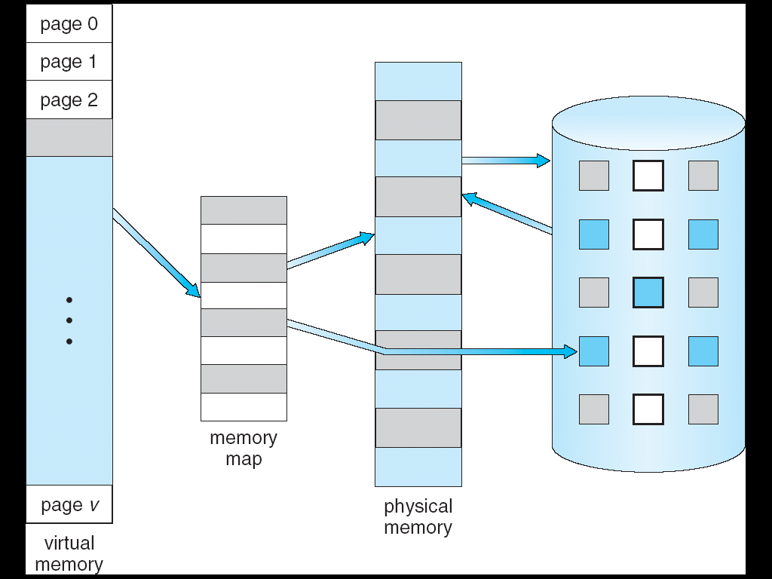
VIRTUAL MEMORY
Definitions
Virtual memory
The conceptual separation of user logical memory from physical memory. Thus we can have large virtual memory on a small physical memory.

Slide 37
VIRTUAL MEMORY
Definitions
Demand paging When a page is touched, bring it from secondary to main memory.
Overlays Laying of code data on the same logical addresses - this is the reuse of logical memory. Useful when the program is in phases or when logical address space is small.
Dynamic loading A routine is loaded only when it's called.

Slide 38
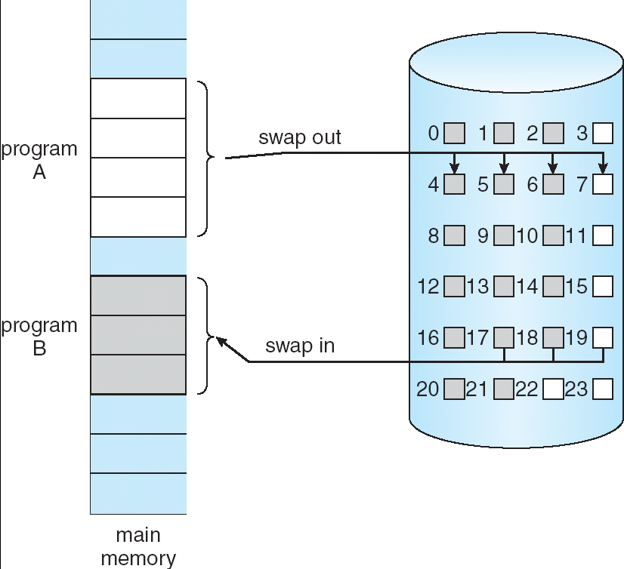
VIRTUAL MEMORY
Demand Paging
When a page is referenced, either as code execution or data access, and that page isn’t in memory, then get the page from disk and re-execute the statement.
Here’s migration between
memory and disk.

Slide 39
VIRTUAL MEMORY
Demand Paging
One instruction may require several pages. For example, a block move of data.
May page fault part way through an operation - may have to undo what was done. Example: an instruction crosses a page boundary.
Time to service page faults demands that they happen only infrequently.
Note here that the page table requires a "resident" bit showing that page is/isn't in memory. (Book uses "valid" bit to indicate residency. An "invalid" page is that way because a legal page isn't resident or because the address is illegal.
It makes more sense to have two bits - one indicating that the page is legal (valid) and a second to show that the page is in memory.
Frame #
valid-invalid bit
1
1
1
1
0
page table

0
Resident
valid-invalid bit
Frame #
1
1
0
0

Slide 40
VIRTUAL MEMORY
Demand Paging
STEPS IN HANDLING A PAGE FAULT
The process has touched a page not currently in memory.
Check an internal table for the target process to determine if the reference was valid (do this in hardware.)
If page valid, but page not resident, try to get it from secondary storage.
Find a free frame; a page of physical memory not currently in use. (May need to free up a page.)
Schedule a disk operation to read the desired page into the newly allocated frame.
When memory is filled, modify the page table to show the page is now resident.
Restart the instruction that failed
Do these steps using the figure you can see on the next page.

Slide 41

VIRTUAL MEMORY
Demand Paging

Slide 42
VIRTUAL MEMORY
Demand Paging
REQUIREMENTS FOR DEMAND PAGING (HARDWARE AND SOFTWARE ) INCLUDE:
Page table mechanism
Secondary storage (disk or network mechanism.)
Software support for fault handlers and page tables.
Architectural rules concerning restarting of instructions. (For instance, block moves across faulted pages.)

Slide 43
VIRTUAL MEMORY
Demand Paging
PERFORMANCE OF DEMAND PAGING
We are interested in the effective access time: a combination of "normal" and "paged" accesses.
It’s important to keep fraction of faults to a minimum. If fault ratio is "p", then
effective_access_time = ( 1 - p ) * memory_access_time
+ p * page_fault_time.
Calculate the time to do a fault as shown in the text:
fault time = 10 milliseconds ( why )
normal access = 100 nanoseconds ( why )
How do these fit in the formula?

Slide 44

VIRTUAL MEMORY
The Picture When All Pages Are Not In Memory
Some of the pages belonging to this process are in memory, and some are on the disk.
A bit in the page table tells where to find the page.

Slide 45

VIRTUAL MEMORY
Page Replacement
When we over-allocate memory, we need to push out something already in memory. Over-allocation may occur when programs need to fault in more pages than there are physical frames to handle.
Approach: If no physical frame is free, find one not currently being touched and free it. Steps to follow are:
1. Find requested page on disk.
2. Find a free frame.
a. If there's a free frame, use it
b. Otherwise, select a victim page.
c. Write the victim page to disk.
3. Read the new page into freed frame. Change page and frame tables.
4. Restart user process.
Hardware requirements include "dirty" or modified bit.

Slide 46
VIRTUAL MEMORY
Page Replacement
PAGE REPLACEMENT ALGORITHMS:
When memory is over-allocated, we can either swap out some process, or overwrite some pages. Which pages should we replace?? <--- here the goal is to minimize the number of faults.
Here is an example reference string we will use to evaluate fault mechanisms:
Reference string: 1, 2, 3, 4, 1, 2, 5, 1, 2, 3, 4, 5
FIFO
Conceptually easy to implement; either use a time-stamp on pages, or organize on a queue. (The queue is by far the easier of the two methods.)
1
1
5
4
2
2
1
5
10 page faults
3
3
2
4
4
3

Slide 47
VIRTUAL MEMORY
Page Replacement
OPTIMAL REPLACEMENT
  This is the replacement policy that results in the lowest page fault rate.
  Algorithm: Replace that page which will not be next used for the longest period of time.
  Impossible to achieve in practice; requires crystal ball.
  Reference string: 1, 2, 3, 4, 1, 2, 5, 1, 2, 3, 4, 5
1
4
2
6 page faults
3
4
5

Slide 48
VIRTUAL MEMORY
Page Replacement
LEAST RECENTLY USED ( LRU )
  Replace that page which has not been used for the longest period of time.
  Results of this method considered favorable. The difficulty comes in making it work.
  Implementation possibilities:
Time stamp on pages - records when the page is last touched.
Page stack - pull out touched page and put on top
Both methods need hardware assist since the update must be done on every instruction. So in practice this is rarely done.
  Reference string: 1, 2, 3, 4, 1, 2, 5, 1, 2, 3, 4, 5
1
5
2
8 page faults
3
5
4
4
3

Slide 49



VIRTUAL MEMORY
Page Replacement
PAGE REPLACEMENT ALGORITHMS :
Using another string:
FIFO
OPTIMAL
LRU

Slide 50

VIRTUAL MEMORY
Page Replacement
LRU APPROXIMATION
Uses a reference bit set by hardware when the page is touched. Then when a fault occurs, pick a page that hasn't been referenced.
Additional reference bits can be used to give some time granularity. Then pick the page with the oldest timestamp.
Second chance replacement: pick a page based on FIFO. If its reference bit is set, give it another chance. Envision this as a clock hand going around a circular queue. The faster pages are replaced, the faster the hand goes.
Maintain a modified bit, and preferentially replace unmodified pages.
Second-Chance (clock)
Page-Replacement Algorithm

Slide 51
VIRTUAL MEMORY
Page Replacement
ADD HOC ( OR ADD-ON ) ALGORITHMS
These methods are frequently used over and above the standard methods given above.
Maintain pools of free frames; write out loser at leisure
Occasional writes of dirties - make clean and then we can use them quickly when needed.
Write out and free a page but remember a page id in case the page is needed again - even though a page is in the free pool, it can be recaptured by a process (a soft page fault.)

Slide 52
VIRTUAL MEMORY
Page Allocation
ALLOCATION OF FRAMES:
What happens when several processes contend for memory? What algorithm determines which process gets memory - is page management a global or local decision?
A good rule is to ensure that a process has at least a minimum number of pages. This minimum ensures it can go about its business without constantly thrashing.
ALLOCATION ALGORITHMS
Local replacement -- the process needing a new page can only steal from itself. (Doesn't take advantage of entire picture.)
Global replacement - sees the whole picture, but a memory hog steals from everyone else
Can divide memory equally, or can give more to a needier process. Should high priority processes get more memory?

Slide 53

VIRTUAL MEMORY
Thrashing
Suppose there are too few physical pages (less than the logical pages being actively used). This reduces CPU utilization, and may cause increase in multiprogramming needs defined by locality.
A program will thrash if all pages of its locality aren’t present in the working set. Two programs thrash if they fight each other too violently for memory.

Slide 54

VIRTUAL MEMORY
Locality of Reference
Locality of reference: Programs access memory near where they last accessed it.

Slide 55

VIRTUAL MEMORY
Working Set Model
WORKING SET MODEL
The pages used by a process within a window of time are called its working set.
Changes continuously - hard to maintain an accurate number. How can the system use this number to give optimum memory to the process?

Slide 56

VIRTUAL MEMORY
Working Set Model
PAGE FAULT FREQUENCY
This is a good indicator of thrashing. If the process is faulting heavily, allocate it more frames. If faulting very little, take away some frames.

Slide 57
VIRTUAL MEMORY
Other Issues
PREPAGING
Bring lots of pages into memory at one time, either when the program is initializing, or when a fault occurs.
Uses the principle that a program often uses the page right after the one previously accessed (locality of reference.)
PAGE SIZE
If too big, there's considerable fragmentation and unused portions of the page.
If too small, table maintenance is high and so is I/O.
Has ramifications in code optimization.

Slide 58
VIRTUAL MEMORY
Other Issues
Memory Mapped IO
Allows file I/O to be treated as routine memory access by mapping a disk block to a page in memory
A file is initially read using demand paging. Multiple page-sized portions of the file are read from the file system into physical pages. Subsequent reads/writes to/from the file are treated as ordinary memory accesses.
Simplifies file access by treating file I/O through memory rather than read() write() system calls
Also allows several processes to map the same file allowing the pages in memory to be shared

Slide 59

VIRTUAL MEMORY
Other Issues
Memory Mapped IO

Slide 60
VIRTUAL MEMORY
Other Issues
Program structure
  int data [128][128];
  Each row is stored in one page
  Program 1
  for (j = 0; j <128; j++)
  for (i = 0; i < 128; i++)
  data[i][j] = 0;
  128 x 128 = 16,384 page faults
  Program 2
  for (i = 0; i < 128; i++)
  for (j = 0; j < 128; j++)
  data[i][j] = 0;
  128 page faults
Which method should you program??

Slide 61
VIRTUAL MEMORY
Wrap up
Virtual memory is how we stuff large programs into small physical memories.
We perform this magic by using demand paging, to bring in pages only when they are needed.
But to bring pages into memory, means kicking other pages out, so we need to worry about paging algorithms.

