Slide 1
WELCOME TO 286th ORT MEETING

Slide 2
Performance Highlights July - 2021

Slide 3
Performance Highlights July - 2021
Station PLF 75.90%
Sp. Coal Consum. 0.80Kg/Kwh
Sp. Oil Consum 0.11ml/Kwh
Aux.Power Consum 8.66%
DM water makeup 1.91%

Slide 4
MONTHLY DATA OF STAGE-I
Sl No | DESCRIPTION | UNITS | UNIT-I | UNIT-II | STAGE - I
1 | GENERATION | MU | 120.50 | 108.21 | 228.71
2 | PLANT LOAD FACTOR | % | 77.12 | 69.26 | 73.19
3 | RUNNING HOURS | Hrs-Mts | 744-00 | 682-13 | 1426-13
4 | AVAILABILITY FACTOR | % | 100.00 | 91.70 | 95.85
5 | LOADING FACTOR | % | 77.12 | 75.53 | 76.36
6 | PLANNED OUTAGES | No/Hrs-Mts | 0 | 0 | 0
7 | FORCED OUTAGES | No/Hrs-Mts | 0 | 1/61-47 | 1/61-47
8 | RESERVE OUTAGES | No/Hrs-Mts | 0 | 0 | 0
9 | TOTAL OUTAGES | No/Hrs-Mts | 0 | 1/61-47 | 1/61-47

Slide 5
PERFORMANCE LINKED ALLOWANCE
s_no | Description | weightage | percentage
1 | EAF (%) (75-88 & above) | 92.0 | 2.5
2 | OIL CONS.(ml/ Kwh) (0.92-0.27& below) | 0.11 | 1.5
3 | AUX. POWER CONS.(%) (10.80-9.50& below) | 8.66 | 0.50
4 | HEAT RATE (Kcal/Kwh) (2600-2449& below) | 2560 | 0.35
 | TOTAL |  | 4.85

Slide 6
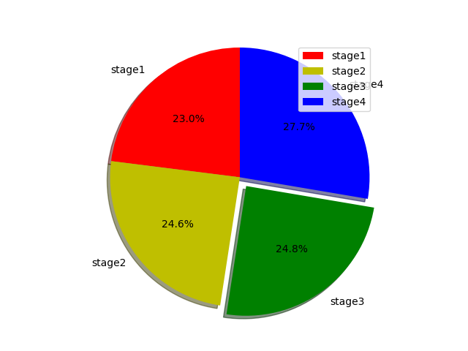
Stage wise Generation Chart

