Slide 1
Clustering
Sanjay Ranka
Distinguished Professor
Department of Computer and Information Science and Engineering
www.sanjayranka.com
sanjayranka@gmail.com
352 514 4213

Slide 2
DBSCAN
DBSCAN is a density based clustering algorithm
Density = number of points within a specified radius (Eps)
A point is a core point if it has more than specified number of points (MinPts) within Eps
Core point is in the interior of a cluster
A border point has fewer than MinPts within Eps but is in neighborhood of a core point
A noise point is any point that is neither a core point nor a border point

Slide 3
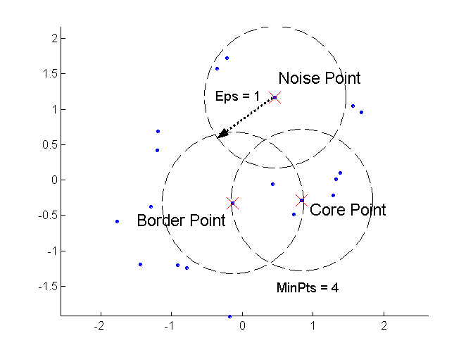
DBSCAN: Core, Border and Noise points

Slide 4
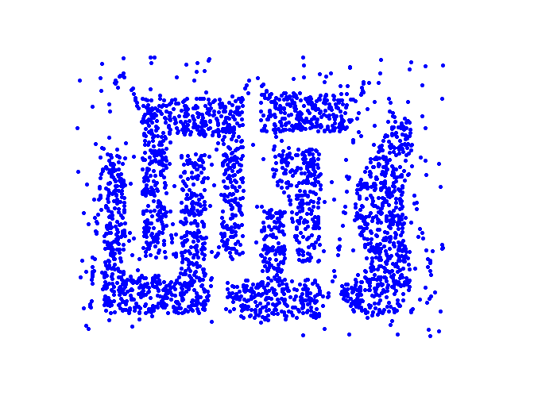
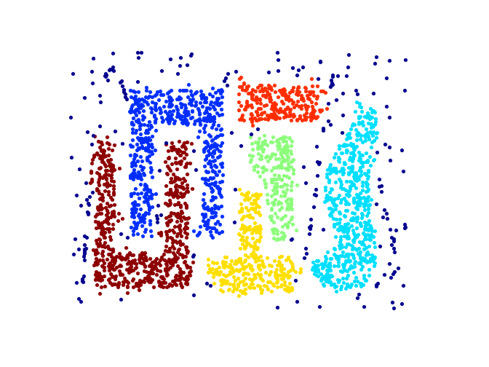
When DBSCAN works well
Original Dataset
Clusters found by DBSCAN

Slide 5
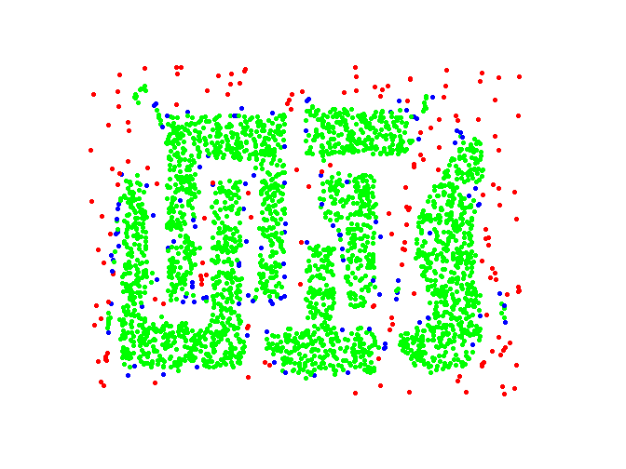
DBSCAN: Core, Border and Noise points
Original Points
Eps = 10, Minpts = 4
Point types:
Core
Border
Noise

Slide 6
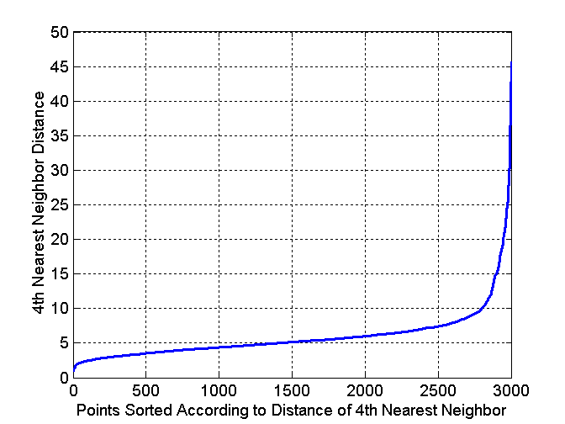
DBSCAN: Determining Eps and MinPts
Idea is that for points in a cluster, there k^{th} nearest neighbors are at roughly the same distance
Noise points have the k^{th} nearest neighbor at at farther distance
So, plot sorted distance of every point to its k^{th} nearest neighbor. (k=4 used for 2D points)

Slide 7
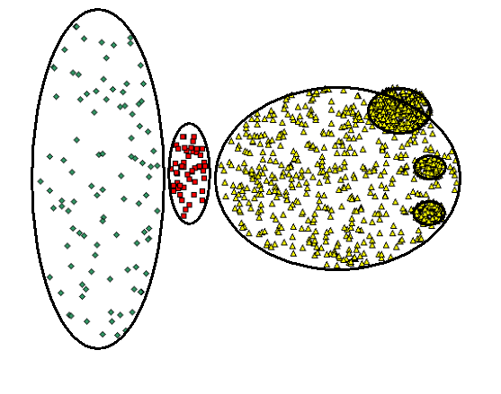
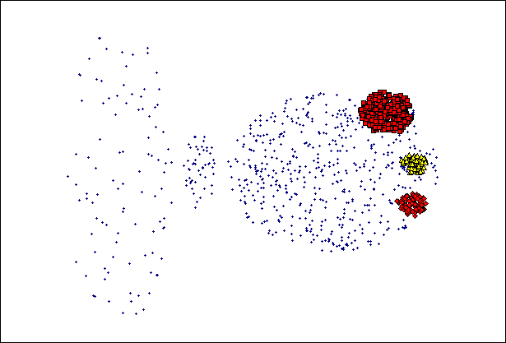
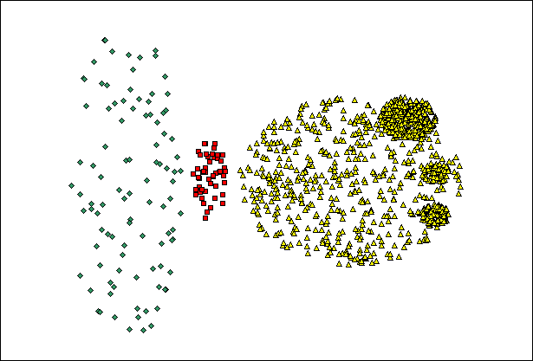
Where DBSCAN doesn’t work well
Minpts = 4, Eps = 9.75
Original Points
MinPts = 4, Eps = 9.92

Slide 8
Subspace clustering
Instead of using all the attributes (features) of a dataset, if we consider only subset of the features (subspace of the data), then the clusters that we find can be quite different from one subspace to another
The clusters we find depend on the subset of the attributes that we consider

Slide 9
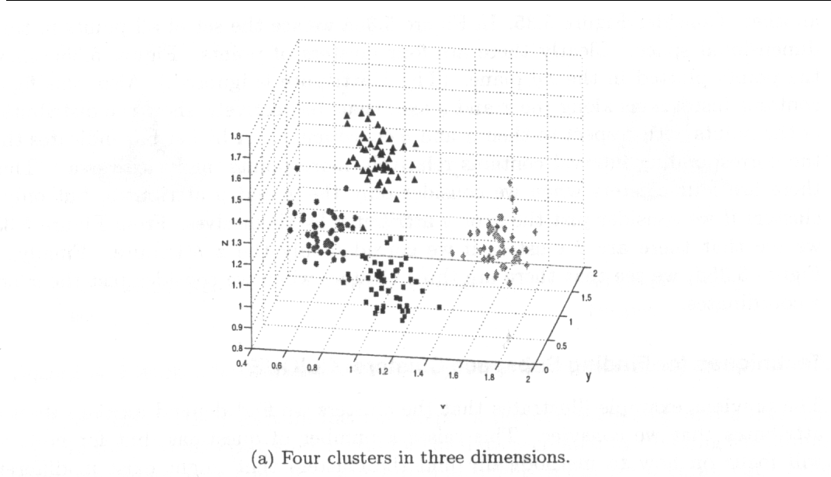
Subspace clustering

Slide 10
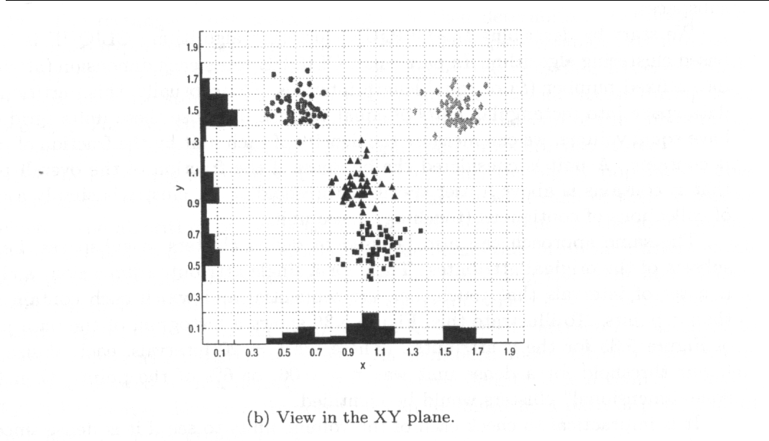
Subspace clustering

Slide 11
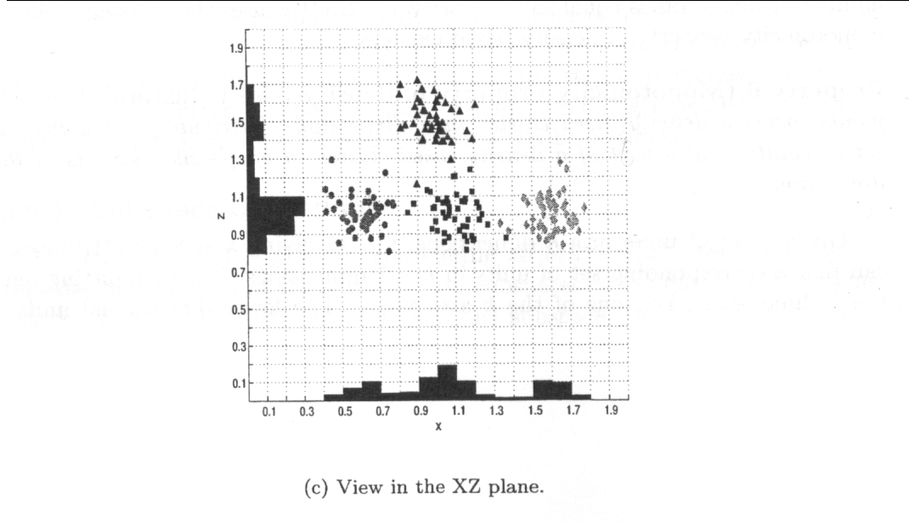
Subspace Clustering

Slide 12
CLIQUE
CLIQUE is a grid based clustering algorithm
CLIQUE splits each dimension (attribute) in to a fixed number (ξ) of equal length intervals. This partitions the data space in to rectangular units of equal volume
We can measure the density of each unit by the fraction of points it contains
A unit is considered dense if its density > user specified threshold τ
A cluster is a group of contiguous (touching) dense units

Slide 13
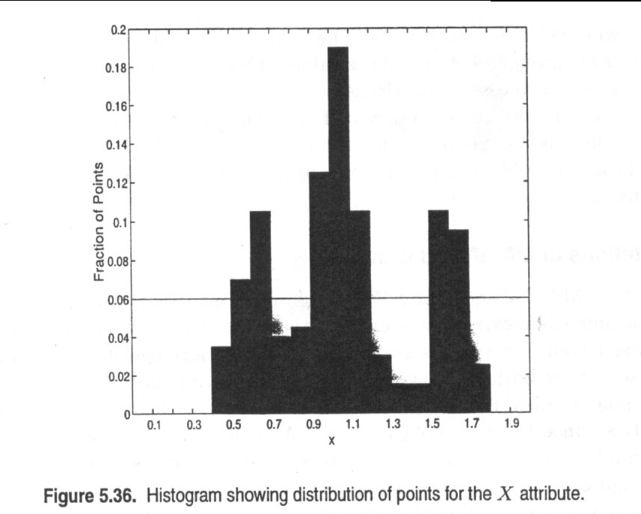
CLIQUE: Example

Slide 14
CLIQUE
CLIQUE starts by finding all the dense areas in the one dimensional spaces associated with each attribute
Then it generates the set of two dimensional cells that might possibly be dense by looking at pairs of dense one dimensional cells
In general, CLIQUE generates the possible set of k-dimensional cells that might possibly be dense by looking at dense (k-1)-dimensional cells. This is similar to APRIORI algorithm for finding frequent item sets
It then finds clusters finds clusters by taking union of all adjacent high density cells

Slide 15
MAFIA
Merging of Adaptive Finite Intervals (MAFIA) is a modification of CLIQUE that runs faster and finds better quality clusters.
The main modification over CLIQUE is the use of an adaptive grid
Initially each dimension is partitioned into a large number of intervals. A histogram is generated that shows the number of data points in each interval
Groups of adjacent intervals are grouped in to windows, and the maximum number of points in the window’s intervals becomes the value associated with the window

Slide 16
MAFIA
Adjacent windows are grouped together if the values of the two windows are close
As a special case, if all windows are combined into one window, the dimensions is partitioned in to a fixed number of cells and the threshold for being considered a dense unit is increased for that dimension

Slide 17
Limitations of CLIQUE and MAFIA
Time complexity is exponential in the number of dimensions
Will have difficulty if “too many” dense units are generated at lower stages
May fail if clusters are of widely differing densities, since the threshold is fixed
Determining the appropriate τ and ξ for a variety of data sets can be challenging
It is not typically possible to find all clusters using the same threshold

Slide 18
Clustering Scalability for Large Datasets
One very common solution is sampling, but the sampling could miss small clusters.
Data is sometimes not organized to make valid sampling easy or efficient.
Another approach is to compress the data or portions of the data.
Any such approach must ensure that not too much information is lost. (Scaling Clustering Algorithms to Large Databases, Bradley, Fayyad and Reina.)

Slide 19
Scalable Clustering: BIRCH
BIRCH (Balanced and Iterative Reducing and Clustering using Hierarchies)
BIRCH can efficiently cluster data with a single pass and can improve that clustering in additional passes.
Can work with a number of different distance metrics.
BIRCH can also deal effectively with outliers.

Slide 20
Scaleable Clustering: BIRCH
BIRCH is based on the notion of a clustering feature (CF) and a CF tree.
A cluster of data points (vectors) can be represented by a triplet of numbers
(N, LS, SS)
N is the number of points in the cluster
LS is the linear sum of the points
SS is the sum of squares of the points.
Points are processed incrementally.
Each point is placed in the leaf node corresponding to the “closest” cluster (CF).
Clusters (CFs) are updated.

Slide 21
Scalable Clustering: BIRCH
Basic steps of BIRCH
Load the data into memory by creating a CF tree that “summarizes” the data.
Perform global clustering.
Produces a better clustering than the initial step.
An agglomerative, hierarchical technique was selected.
Redistribute the data points using the centroids of clusters discovered in the global clustering phase, and thus, discover a new (and hopefully better) set of clusters.

Slide 22
Scalable Clustering: CURE
Clustering Using Representatives
Uses a number of points to represent a cluster
Representative points are found by selecting a constant number of points from a cluster and then “shrinking” them toward the center of the cluster
Cluster similarity is the similarity of the closest pair of representative points from different clusters
Shrinking representative points toward the center helps avoid problems with noise and outliers
CURE is better able to handle clusters of arbitrary shapes and sizes

Slide 23
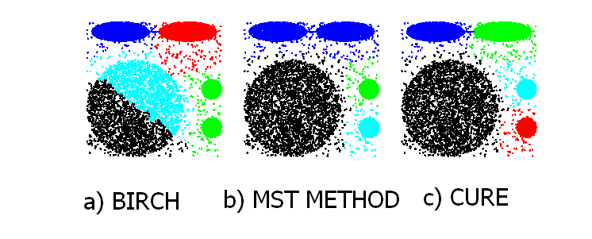
Experimental results: CURE

Slide 24
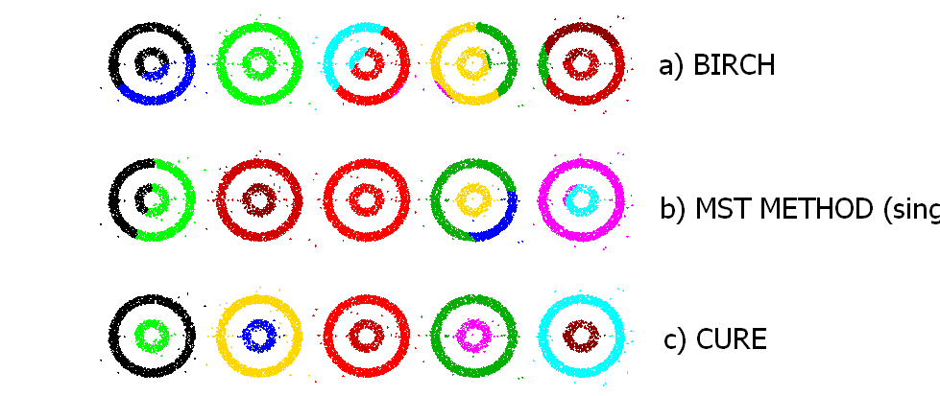
Experimental Results: CURE

Slide 25
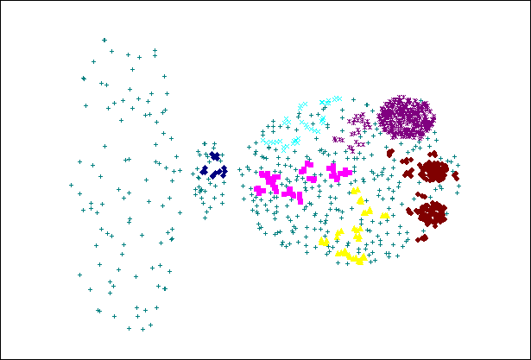
CURE can not handle differing densities
Original Points
CURE

Slide 26
Graph Based Clustering
Graph-Based clustering uses the proximity graph
Start with the proximity matrix
Consider each point as a node in a graph
Each edge between two nodes has a weight which is the proximity between the two points
Initially the proximity graph is fully connected
MIN (single-link) and MAX (complete-link) can be viewed as starting with this graph
In the most simple case, clusters are connected components in the graph

Slide 27
Graph Based Clustering: Sparsification
The amount of data that needs to be processed is drastically reduced
Sparsification can eliminate more than 99% of the entries in a similarity matrix
The amount of time required to cluster the data is drastically reduced
The size of the problems that can be handled is increased

Slide 28
Sparsification
Clustering may work better
Sparsification techniques keep the connections to the most similar (nearest) neighbors of a point while breaking the connections to less similar points.
The nearest neighbors of a point tend to belong to the same class as the point itself.
This reduces the impact of noise and outliers and sharpens the distinction between clusters.
Sparsification facilitates the use of graph partitioning algorithms (or algorithms based on graph partitioning algorithms.
Chameleon and Hypergraph-based Clustering

Slide 29
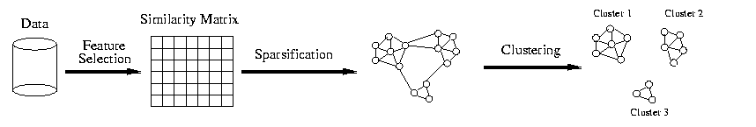
Sparsification

Slide 30
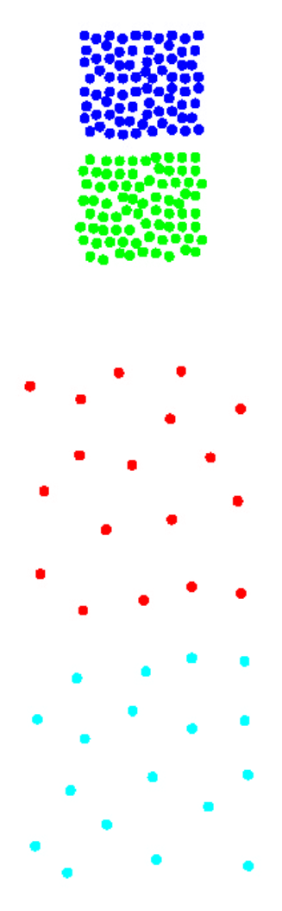
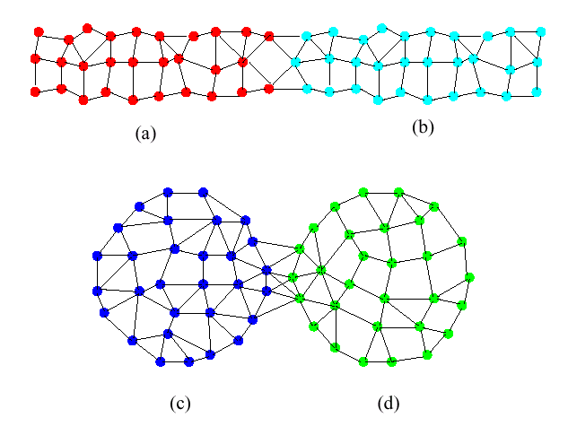
Limitations of Current Merging Schemes
Existing merging schemes are static in nature

Slide 31
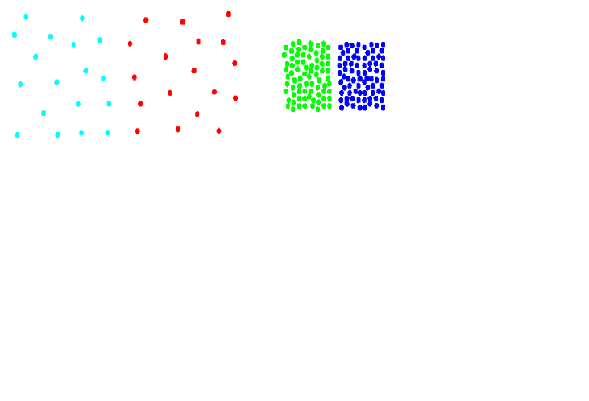
Chameleon: Clustering Using Dynamic Modeling
Adapt to the characteristics of the data set to find the natural clusters.
Use a dynamic model to measure the similarity between clusters.
Main property is the relative closeness and relative inter-connectivity of the cluster.
Two clusters are combined if the resulting cluster shares certain properties with the constituent clusters.
The merging scheme preserves self-similarity.
One of the areas of application is spatial data.

Slide 32
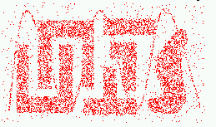
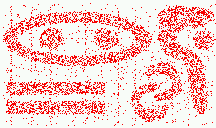
Characteristics of Spatial Datasets
Clusters are defined as densely populated regions of the space
Clusters have arbitrary shapes, orientation, and non-uniform sizes
Difference in densities across clusters and variation in density within clusters
Existence of special artifacts (streaks) and noise
The clustering algorithm must address the above characteristics and also require minimal supervision

Slide 33
Chameleon
Preprocessing Step: Represent the Data by a Graph
Given a set of points, we construct the k-nearest-neighbor (k-NN) graph to capture the relationship between a point and its k nearest neighbors.
Phase 1: Use a multilevel graph partitioning algorithm on the graph to find a large number of clusters of well-connected vertices.
Each cluster should contain mostly points from one “true” cluster, i.e., is a sub-cluster of a “real” cluster.
Graph algorithms take into account global structure.

Slide 34
Chameleon
Phase 2: Use Hierarchical Agglomerative Clustering to merge sub-clusters.
Two clusters are combined if the resulting cluster shares certain properties with the constituent clusters.
Two key properties are used to model cluster similarity:
Relative Interconnectivity: Absolute interconnectivity of two clusters normalized by the internal connectivity of the clusters.
Relative Closeness: Absolute closeness of two clusters normalized by the internal closeness of the clusters.

Slide 35
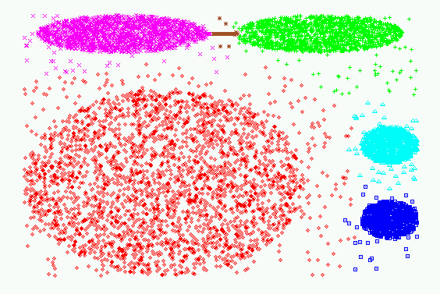
Experimental Results: Chameleon

Slide 36
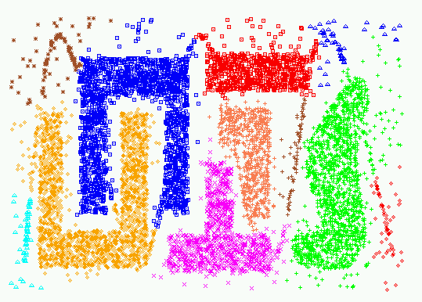
Experimental Results: Chameleon

Slide 37
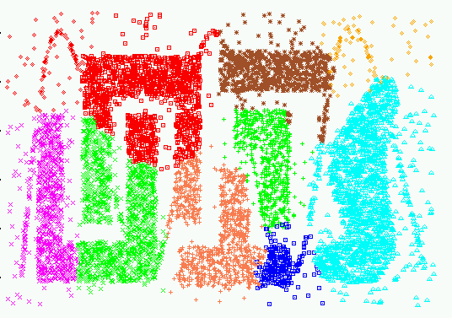
Experimental Results: CURE (10 clusters)

Slide 38
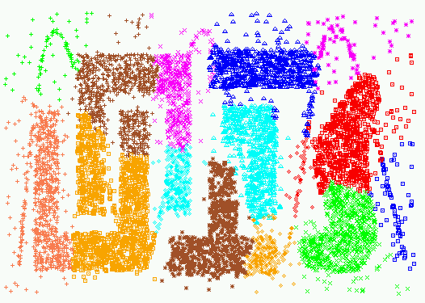
Experimental Results: CURE (15 clusters)

Slide 39
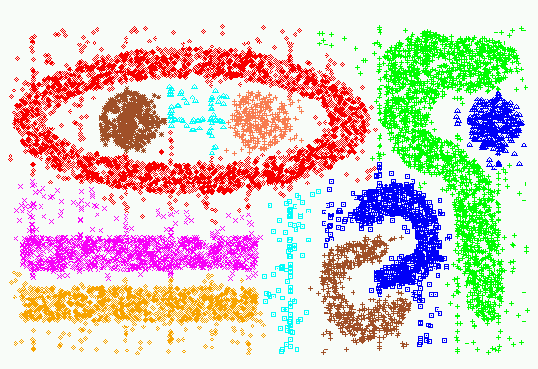
Experimental Results: Chameleon

Slide 40
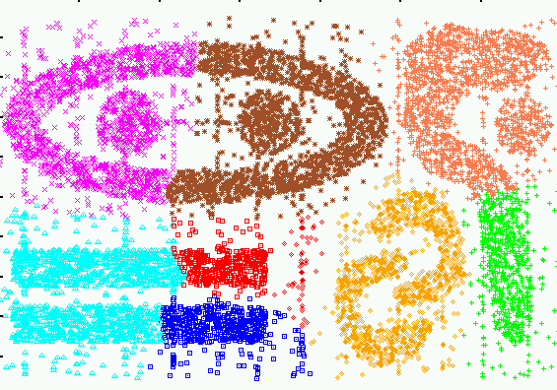
Experimental Results: CURE (9 clusters)

Slide 41
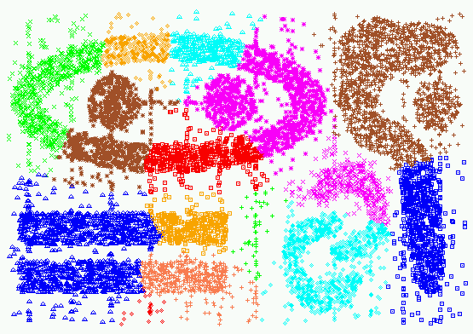
Experimental Results: CURE (15 clusters)

