Slide 1
In debt? Probably.
We are here to help with our simple debt management solution

Slide 2
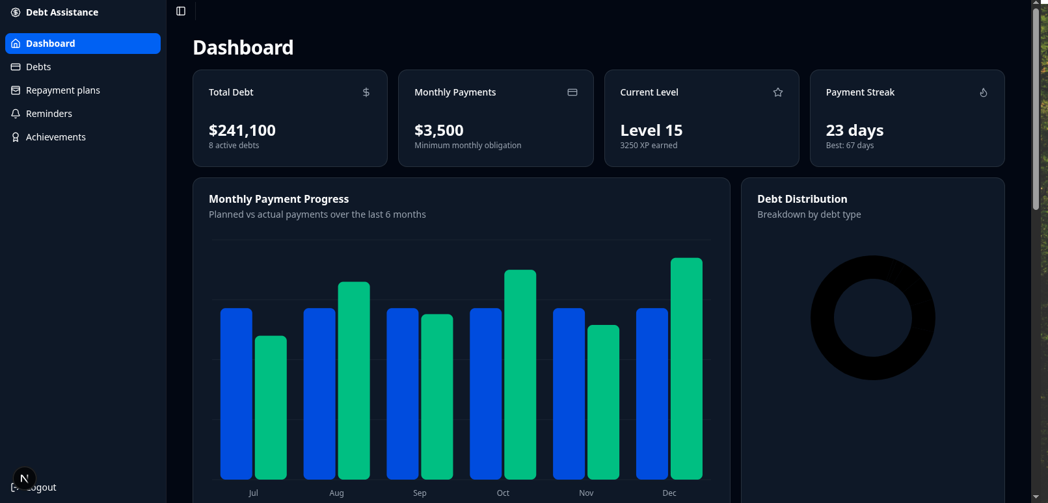
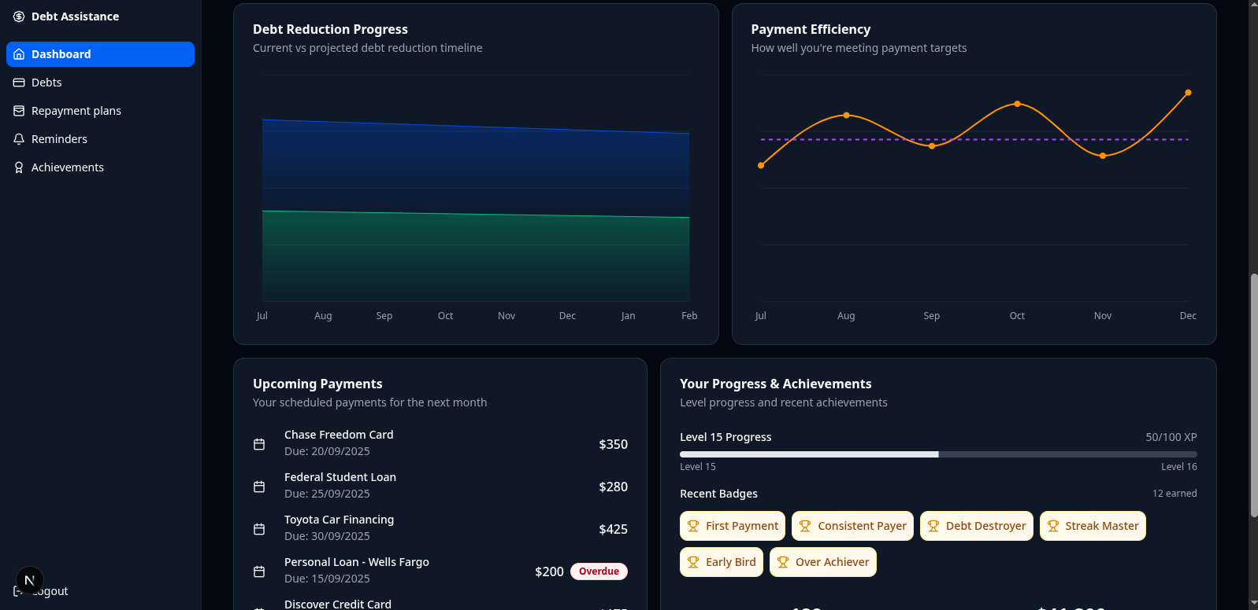
Greetings from Our Dashboard
Giving you a graphical overview of everything

Slide 3
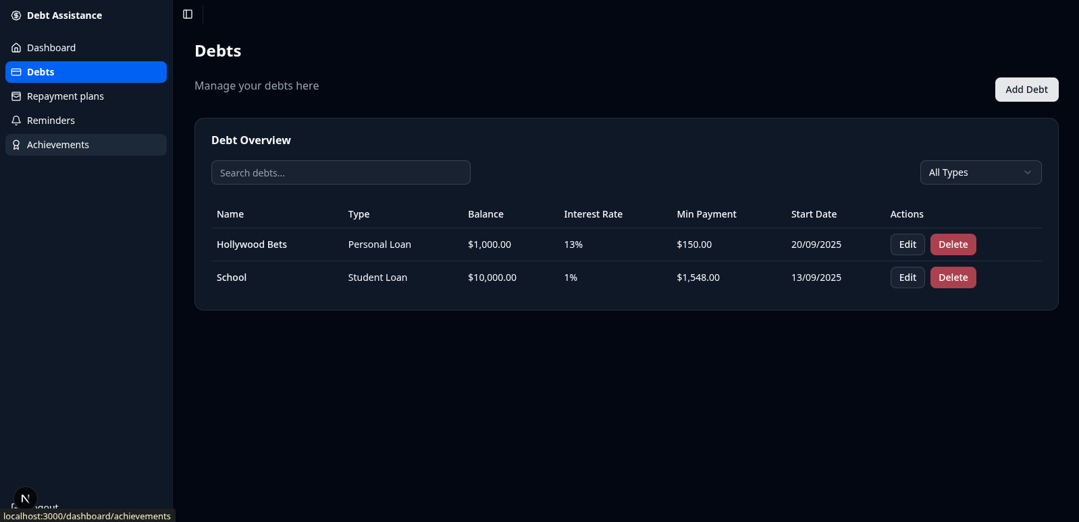
Debt Overview
Get a quick and easy overview of your current debts

Slide 4
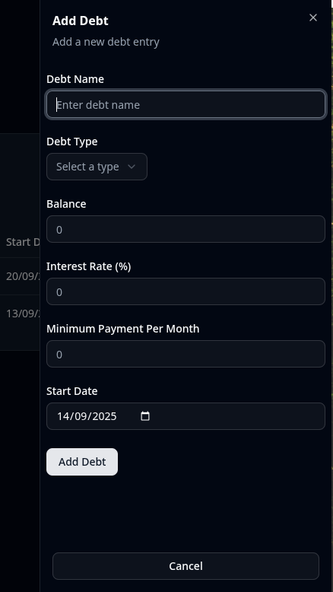
Add a Debt
Add your other debts to the tracker
with our convenient and
good-looking side bar

Slide 5
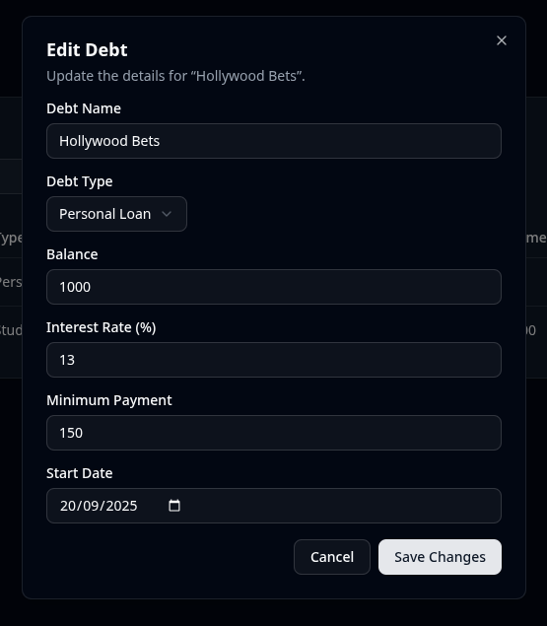
Edit Your Debts
Made a mistake? No worries. You can always update the info.

Slide 6
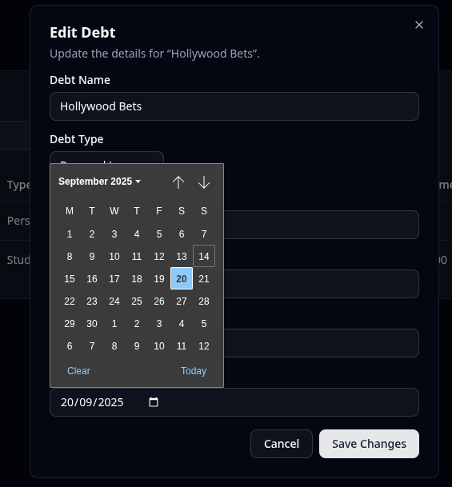
Even if it’s just to change the monthly repayment date

Slide 7
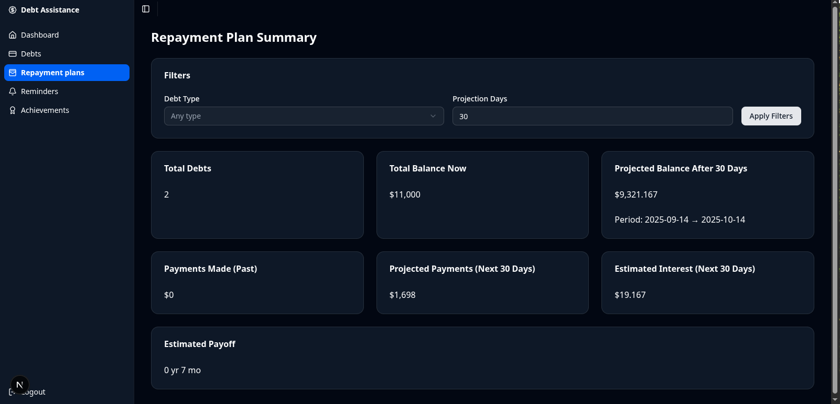
Track How Close You are To Being Debt-Free
With our convenient summary, which projects the
interest you will still pay
and how long
you’ll still be
paying for,
given the
minimum
repayment

Slide 8
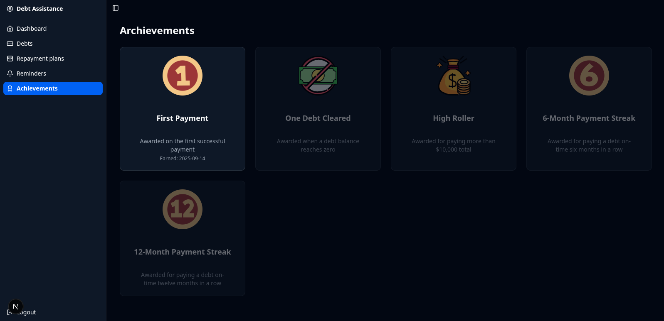
Make it Fun with Our Achievements Page
Get an overview of badges you can earn and which one’s
you’ve earned so far

