Slide 1
NYUMBASEARCH
INVESTOR DECK
Building the trusted operating layer for home discovery, tenancy and home services in Africa.
PROPTECH
HOUSING
DIGITAL SERVICES
nyumbasearch.com · August 2026
NYUMBASEARCH • INVESTOR DECK • AUGUST 2026
01

Slide 2
EXECUTIVE SUMMARY
One platform. The complete home journey.
NyumbaSearch connects people to homes while helping property businesses acquire tenants, manage properties and access trusted home services.
01
DISCOVER
Map · location · budget · property type · neighbourhood
02
VERIFY
Owner/listing verification · property validation · reviews · risk signals
03
MANAGE
Tenant portal · rent tracking · payments · leases · invoices · maintenance
04
SERVE
Movers · cleaners · repairs · security · solar · interior services
From discovery to move-in and beyond.
NYUMBASEARCH • INVESTOR DECK • AUGUST 2026
02

Slide 3
THE PROBLEM
Housing discovery is fragmented. Trust is expensive.
01
Discovery is fragmented
02
Trust is expensive
Agents · social media · classifieds · WhatsApp · property sites
Information is inconsistent across channels
Time · transport · effort visiting unavailable listings
Inaccurate or poorly represented properties
03
The journey ends too early
04
Owners lack modern tools
Most platforms stop at the listing
Tenancy · rent · management · services not connected
Lead management · tenant records · rent tracking
Maintenance workflows · portfolio visibility
Own the user relationship before, during and after the move.
NYUMBASEARCH • INVESTOR DECK • AUGUST 2026
03

Slide 4
OUR SOLUTION
A trusted operating layer for the entire home journey.
SEARCH
VERIFY
MANAGE
SERVE
Map-first discovery
Neighbourhood + budget + type
→
Owner/listing verification
Property signals · reviews
→
Rent tracking · leases
Invoices · tenant management
→
Verified home services
Moving · cleaning · repairs
One relationship. Multiple high-value touchpoints.
TENANTS
PROPERTY OWNERS
SERVICE PROVIDERS
Find the right home.
Acquire and manage tenants.
Access verified demand.
NYUMBASEARCH • INVESTOR DECK • AUGUST 2026
04

Slide 5
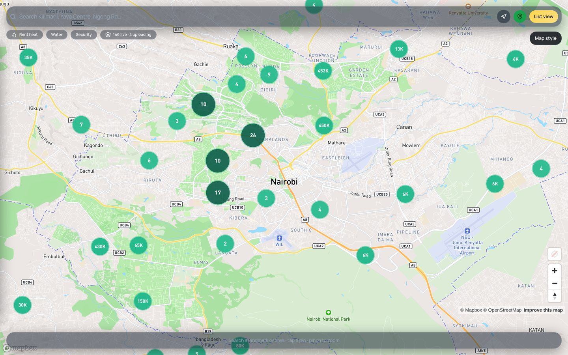
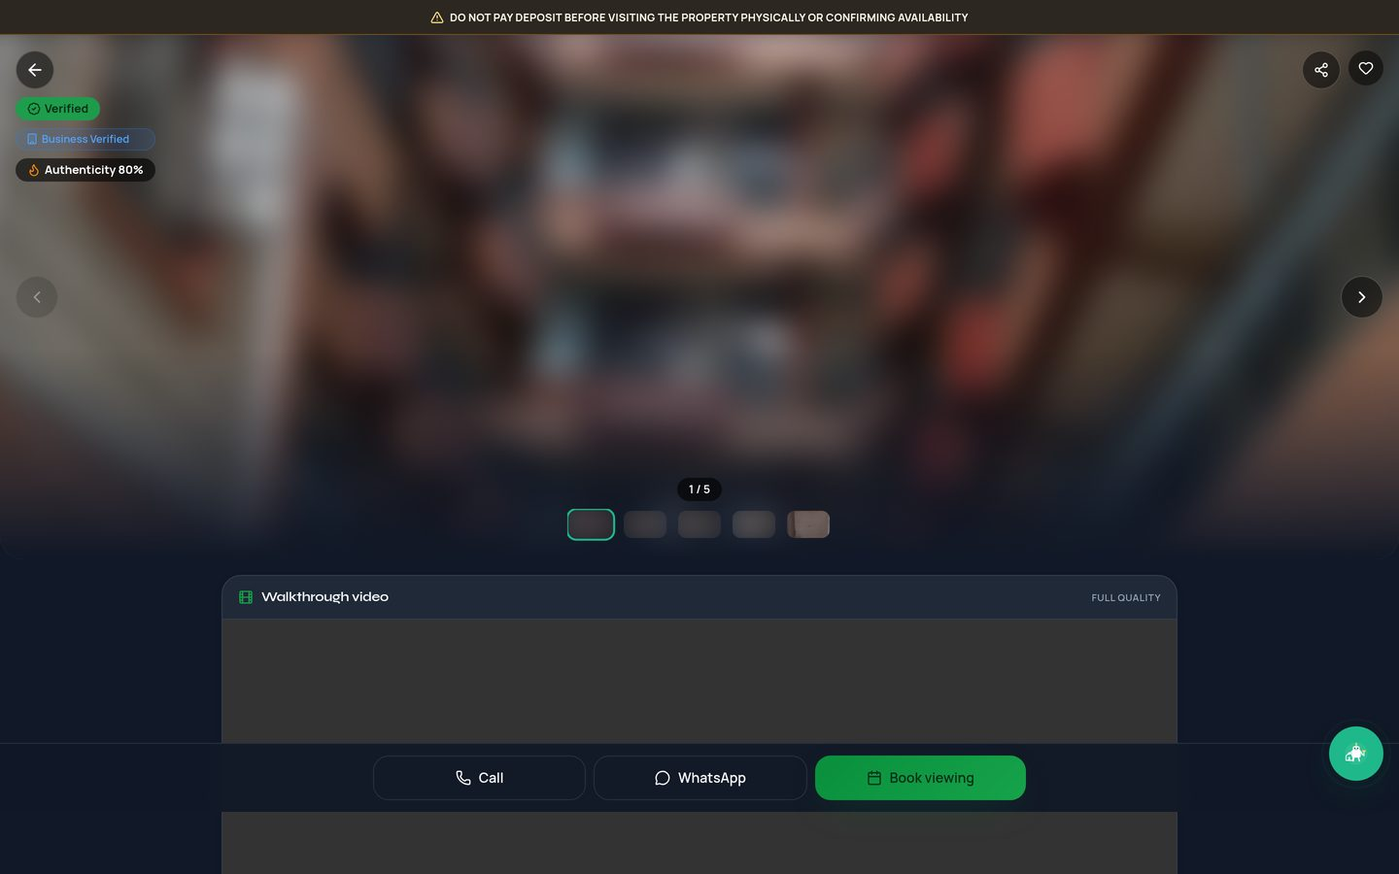
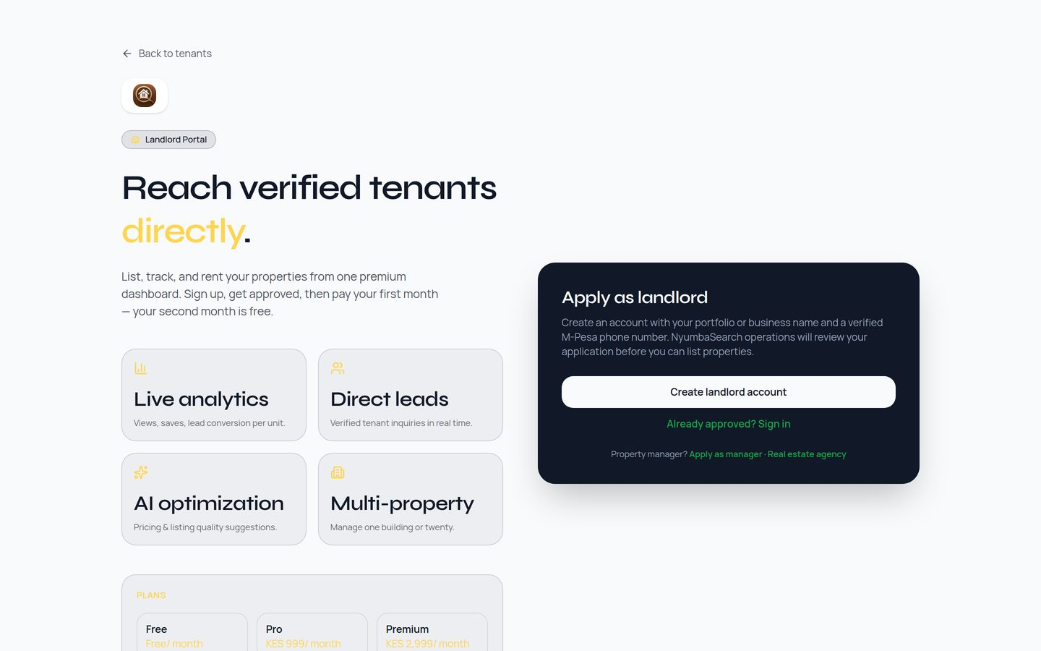
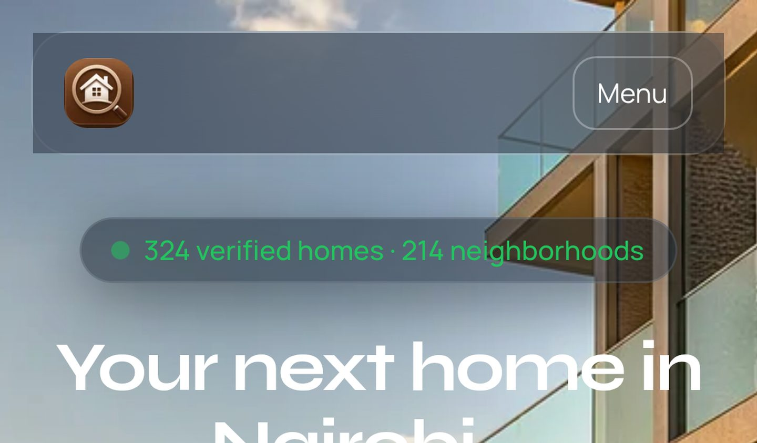
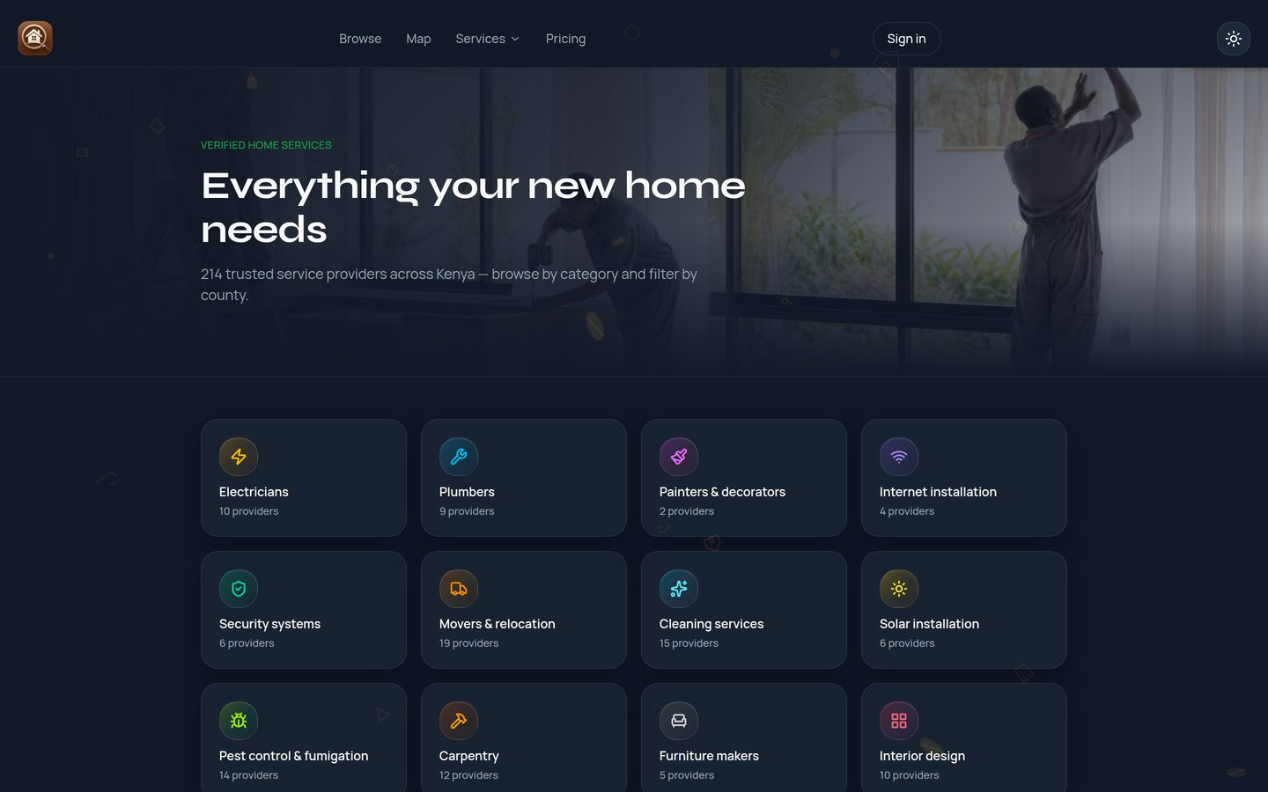
PRODUCT
One product. Multiple high-value touchpoints.
Home discovery
Property listing
Property management
Rent & payments
Home services
Discovery → verification → tenancy → services.
UI from live nyumbasearch.com product surfaces · August 2026
NYUMBASEARCH • INVESTOR DECK • AUGUST 2026
05

Slide 6
TRACTION & CURRENT ANALYTICS
Early product-market signal — with a live platform.
LIVE
LIVE
LIVE
336+
219+
214+
VERIFIED
HOMES
NEIGHBOUR-
HOODS
TRUSTED SERVICE
PROVIDERS
INTERNAL
INTERNAL
INTERNAL
132+
24+
109+
USERS /
TENANTS
LISTING
ACCOUNTS
LEAD
ACTIONS
Live platform snapshot (nyumbasearch.com)
The product is live. Supply is being built. The next growth phase is distribution, repeat usage and monetization.
300+ homes in tenant browse · 24+ service categories with providers · 336+ indexed property pages
Relative platform activity
Homes
Providers
Users
Accounts
Leads
Live analytics pulled from nyumbasearch.com · August 2026
NYUMBASEARCH • INVESTOR DECK • AUGUST 2026
06

Slide 7
MARKET & TIMING
Kenya is digitally connected while housing demand keeps rising.
~2M
85.2%
48.6M
Nairobi houses projected required by 2030
Smartphone penetration in Kenya
Mobile-money subscriptions
Reference material market statistic
Sep 2025 · reference material
Sep 2025 · reference material
WHY NOW?
Consumers discover through mobile products
Housing remains frequent and locally fragmented
Mobile money enables digital transactions
Trust remains a major issue
Property operations remain underserved
PHASE 1
PHASE 2
PHASE 3
Nairobi
→
Kenya
→
Selected African urban markets
NYUMBASEARCH • INVESTOR DECK • AUGUST 2026
07

Slide 8
TARGET MARKET
Three sides of the ecosystem. One network effect.
TENANTS & HOME SEEKERS
PROPERTY OWNERS & MANAGERS
HOME SERVICE PROVIDERS
Includes:
Includes:
Includes:
Students · young professionals · families · relocators
Landlords · managers · agencies · developers · institutions
Movers · cleaners · repairs · security · solar · interior
Needs:
Needs:
Needs:
Trustworthy listings · easy discovery · verification · convenience
Tenant acquisition · portfolio visibility · rent & tenant management
Qualified demand · customer acquisition · repeat business · visibility
NYUMBASEARCH • INVESTOR DECK • AUGUST 2026
08

Slide 9
BUSINESS MODEL
Multiple monetization layers, with recurring revenue at the core.
01
Landlord & listing plans
02
Property management SaaS
KSh 999–4,999/month
KSh 2,000–10,000/month
Premium listings · visibility · lead mgmt · verification
Rent collection · leases · invoices · tenant records
03
Service provider monetization
04
Financial & protection referrals
KSh 1,500–5,000/month
Revenue-share model
Subscriptions · premium placement · qualified leads
Mortgages · insurance · savings · rent-related products
Illustrative pricing assumptions — subject to validation. Full-sector activation estimate: USD 2.5M – 4.5M+ annually. Current revenue: not disclosed.
NYUMBASEARCH • INVESTOR DECK • AUGUST 2026
09

Slide 10
REVENUE POTENTIAL · ESTIMATE
Illustrative revenue as all sectors activate.
FUTURE REVENUE POTENTIAL — not current revenue
Year 5 illustrative annual revenue
USD 4.8M
Illustrative planning scenario based on assumptions; actual results may differ. Current revenue: not disclosed.
NYUMBASEARCH • INVESTOR DECK • AUGUST 2026
10

Slide 11
PROGRESS VS. POTENTIAL
From early traction to a scaled housing network.
WHERE WE ARE TODAY
WHERE WE ARE HEADED
August 2026 · CURRENT
3–5 year potential · TARGET
336+ verified homes
219+ neighbourhoods
214+ service providers
132+ users / tenants
24+ listing accounts
109+ lead actions
Live product · manager portal · services marketplace
50,000+ verified homes
250,000+ active users
5,000+ property owners/managers
10,000+ service providers
USD 4.8M illustrative annual revenue
Regional expansion across Africa
→
EARLY TRACTION
→
DISTRIBUTION
→
NETWORK EFFECT
→
MARKET LEADERSHIP
NYUMBASEARCH • INVESTOR DECK • AUGUST 2026
11

Slide 12
COMPETITIVE LANDSCAPE
We compete with discovery channels — but our ambition is broader.
Capability | Property24 | Lamudi | Jiji | Social / WhatsApp | NyumbaSearch
Listing discovery | Strong | Strong | Partial | Partial | Core
Verified listings / owners | Varies | Varies | Limited | Limited | Productized
Property risk signals | Limited | Limited | Limited | Limited | Built-in
End-to-end tenancy tools | Limited | Limited | Limited | No | In-platform
Rent collection | Limited | Limited | No | No | Productized
Property management SaaS | No | No | No | No | In-platform
Home services | Limited | Partial | Partial | Ad hoc | 214+ live
Financial integration | Limited | Limited | No | No | Referral paths
All-in-one ecosystem | Listing-led | Listing-led | Classifieds | Informal | Combined
Most alternatives help users FIND a property. NyumbaSearch aims to help users FIND, VERIFY, MANAGE and SERVE the entire home journey.
NYUMBASEARCH • INVESTOR DECK • AUGUST 2026
12

Slide 13
PARTNERSHIP STRATEGY
Distribution is the next growth engine.
01
Student residences & universities
02
Banks & financial institutions
Exclusive student inventory · acquisition · verified discovery · digital tenancy workflows
Rent payments · savings · insurance · mortgages · customer acquisition
Pipeline / strategic target
Pipeline / strategic target
03
Property owners & managers
04
Corporate & housing partners
Portfolio onboarding · lead generation · PM SaaS · rent collection
Employee housing · relocation · institutional accommodation
Active supply channel
Future opportunity
05
Service providers
Movers · cleaners · repairs · security · solar · interior
214+ live today
Partners → Supply → Users → Transactions → Data & trust → More partners
NYUMBASEARCH • INVESTOR DECK • AUGUST 2026
13

Slide 14
INVESTMENT ASK
USD 1.5M Pre-Series A
Capital to convert early product traction into repeatable distribution, stronger infrastructure and regional scale.
USD 1,500,000
Product development
30%
USD 450,000
Team & talent
20%
USD 300,000
Marketing & growth
20%
USD 300,000
Operations & support
15%
USD 225,000
Partnerships & integrations
10%
USD 150,000
Legal & compliance
5%
USD 75,000
NYUMBASEARCH • INVESTOR DECK • AUGUST 2026
14

Slide 15
ROADMAP
Build the network, then compound the network.
2026
2027
2028
2029–30
Deepen product
Expand distribution
Scale transactions
Regional scale
PM · payments · verification · leads · service network
Student residences · banks · property groups · corporate housing
Rent collection · services · subscriptions · financial referrals
Selected African urban markets
→
→
→
Product → Partnerships → Transactions → Recurring revenue → Regional scale
NYUMBASEARCH • INVESTOR DECK • AUGUST 2026
15

Slide 16
INVESTMENT OPPORTUNITY
The next home infrastructure layer.
NyumbaSearch is building more than a property marketplace.
We are building a trusted ecosystem connecting people, properties, payments and home services.
DISCOVER
VERIFY
MANAGE
SERVE
Find the right home.
Move with confidence.
Operate the tenancy.
Access trusted services.
Partner with us. Invest in the infrastructure of Africa's housing journey.
NyumbaSearch · nyumbasearch.com · August 2026
Less stress. Better homes. Stronger communities.
NYUMBASEARCH • INVESTOR DECK • AUGUST 2026
16

