Slide 1
Midterm Presentation
Multi-Instrument Recognition, Mix-Parameter Estimation and Timbre Characterization using Deep Neural Networks
Hannes Bradl
Supervisor: Univ.-Prof. Dipl.-Ing. Dr.mont. Franz Pernkopf

Slide 2

Outline
Multi-Instrument Recognition
  Pre-training
  Transfer Learning
Timbre Representation Learning
Outlook

Slide 3
Outline
Multi-Instrument Recognition
  Pre-training
  Transfer Learning
Timbre Representation Learning
Outlook

Slide 4
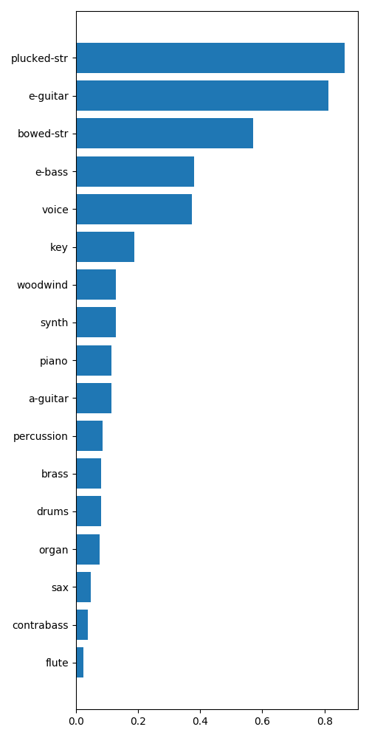

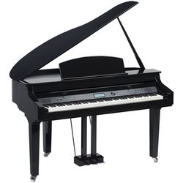
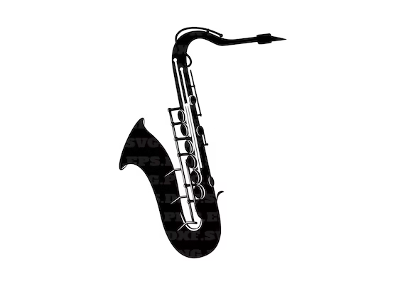
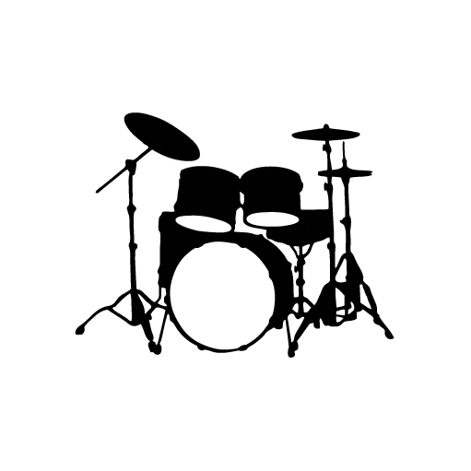
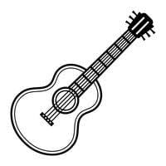
Goal
Model
Multi-label classification problem
  Each sample can belong to multiple classes
  Can be viewed as multiple binary classification problems
Output: probability for each class

Slide 5
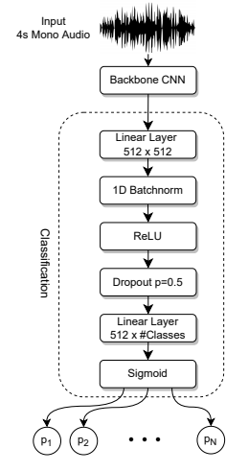
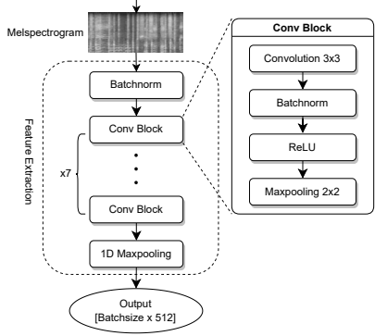
Model Architecture
Backbone CNN

Slide 6
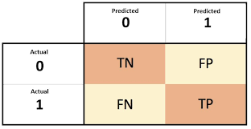
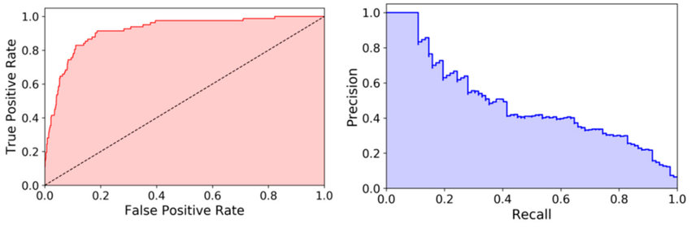
Evaluation metrics for binary classification
True Positive Rate = TP / (TP + FN)
False Positive Rate = FP / (FP + TN)
Precision = TP / (TP + FP)
Recall = TP / (TP + FN)
Threshold independent metrics: ROC-AUC and PR-AUC
ROC-AUC
PR-AUC

Slide 7
Outline
Multi-Instrument Recognition
  Pre-training
  Transfer Learning
Timbre Representation Learning
Outlook

Slide 8
Dataset
MTG-Jamendo Dataset
~55000 audio tracks
Tags:
  Genre: rock, jazz, ambient etc.
  Instrument: piano, synthesizer, drums etc.
  Mood/theme: happy, dark, inspiring etc.

Slide 9
Outline
Multi-Instrument Recognition
  Pre-training
  Transfer Learning
Timbre Representation Learning
Outlook

Slide 10
Instrument Families and Classes
Families:
  Voice
  Percussion
  Plucked string
  Bowed string
  Woodwind
  Brass
  Key
  Synth
Other Classes (specific Instruments):
  Drums
  Piano
  A-Guitar
  E-Guitar
  E-Bass
  Contrabass
  Sax
  Flute
  Organ
17 classes in total
Taxonomy inspired by Hornbostel-Sachs System

Slide 11
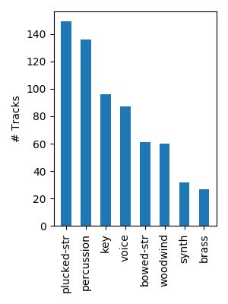
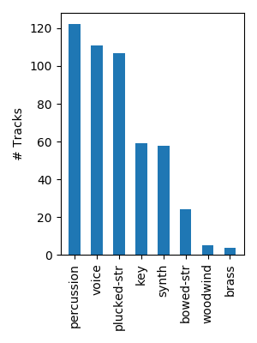
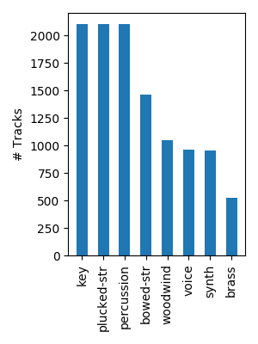
Datasets
Multi-track dataset → contains separate tracks from recordings
Used combination of 3 datasets
MedleyDB
Mixing-Secrets
Slakh

Slide 12
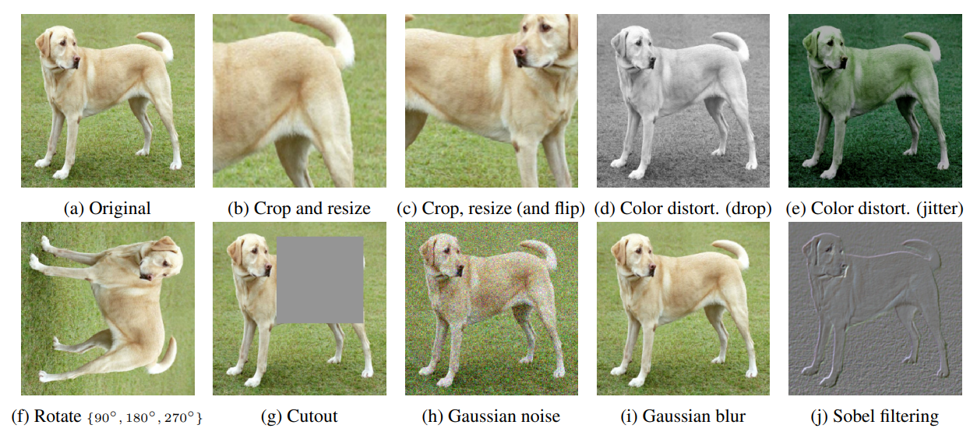
Data Augmentation
Generate new training samples by modifying existing samples
Random mixing of tracks
Random gain
Random pitch-shifting and time-stretching
Random filtering

Slide 13
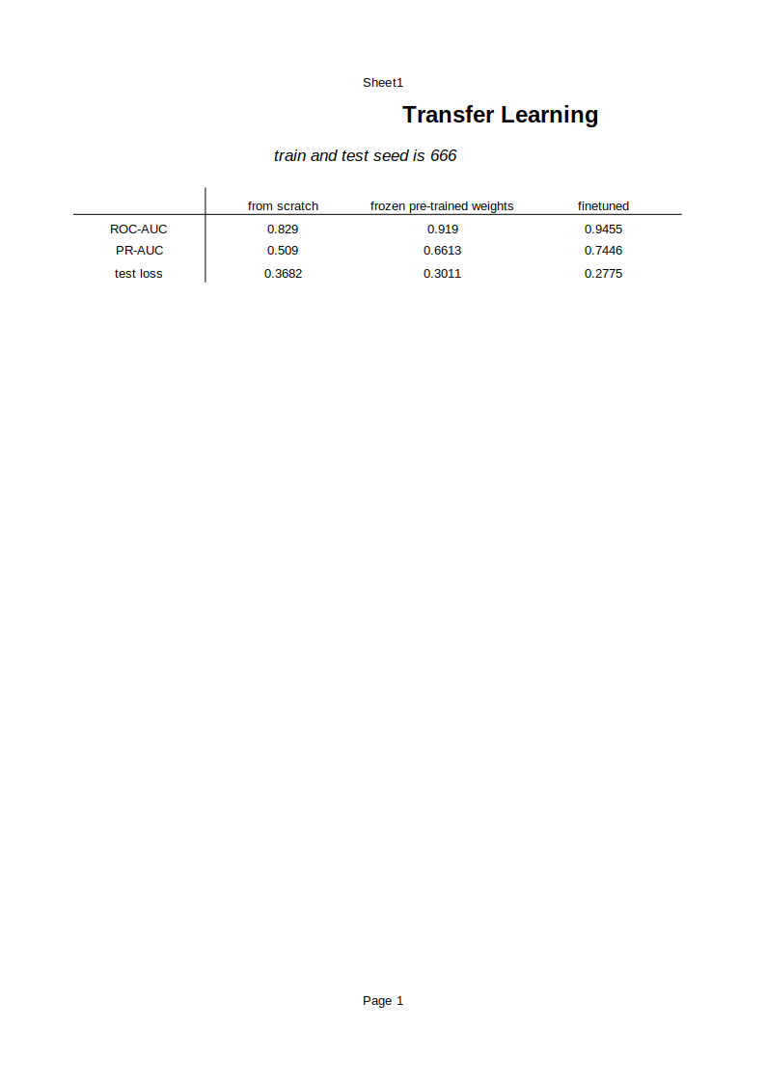
Which Layers should be learnable during Transfer Learning?
‘from scratch’
‘frozen pre-trained backbone’
‘finetuning‘

Slide 14

Mix sources from different songs?
Is it important that training samples are time-synchronized and
key-synchronized, i.e. sound „musically“?
only mixes from same song
only mixes from multiple songs

Slide 15
Outline
Multi-Instrument Recognition
  Pre-training
  Transfer Learning
Timbre Representation Learning
Outlook

Slide 16
Goal
For each instrument family
  learn an embedding space where recordings with similar timbre
are close together
Problem: We have coarse-grained (e.g. string section) and
fine-grained (e.g. viola) labels
Solution: Use hierarchical taxonomy!
clean
e-guitar
plucked strings
percussion
distorted
e-guitar
mallets
drumset
a-guitar
e-bass
snare
drums
bass
drums
cymbals

Slide 17
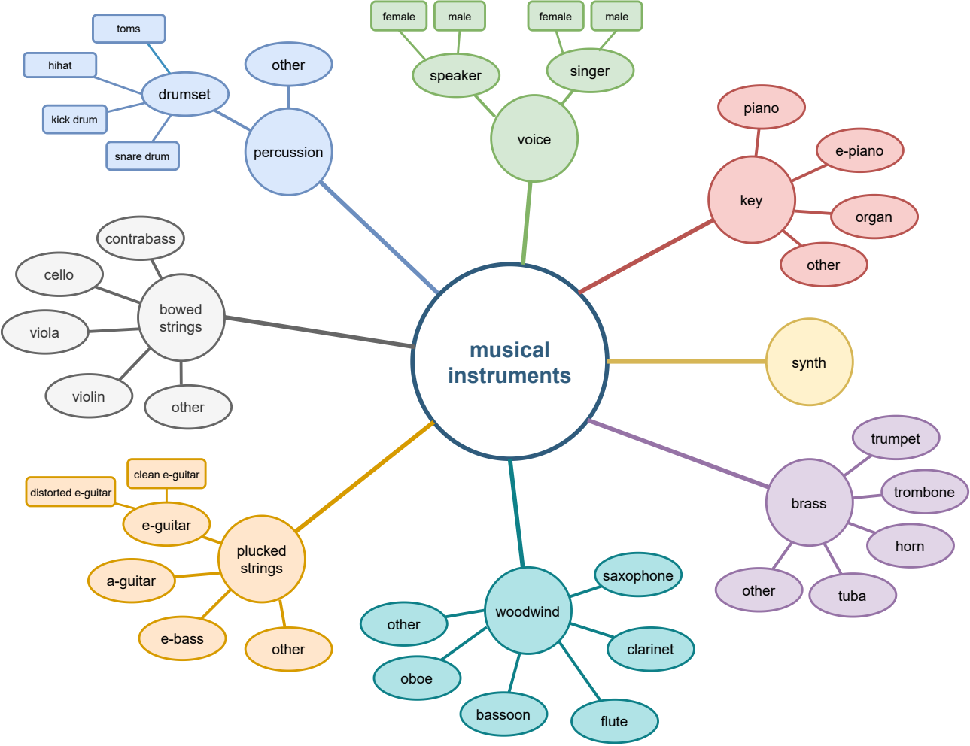
Instrument Taxonomy

Slide 18
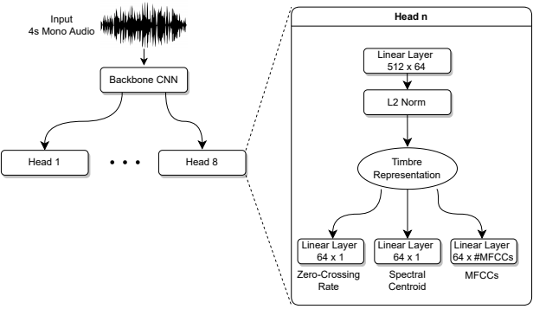
Model Architecture
Learn 64-dimensional timbre specific representation for each instrument family
TODO: explain how training works … feature reconstruction loss and NCA loss

Slide 19
Outlook
Visualize embeddings
Learn disentangled timbre representations ?
Create class prototypes to classify new samples

Slide 20
Questions
Size of timbre representations ?
Which timbre descriptors to use for training ?
8 individual embedding spaces or one space for all families ?
Which loss function for minimising the distance between embeddings from same class and maximise distance between different classes ?
        Neighbourhood component analysis???

