Slide 1
Master Thesis
Multi-Instrument Recognition, Mix-Parameter Estimation and Timbre Characterization using Deep Neural Networks
Hannes Bradl
Supervisor: Univ.-Prof. Dipl.-Ing. Dr. mont. Franz Pernkopf

Slide 2
Aim of the Work
Identify all instruments in a recording, determine the respective loudness and characterize their timbre
Possible applications:
  automatically label datasets
  browse large music collections

Slide 3
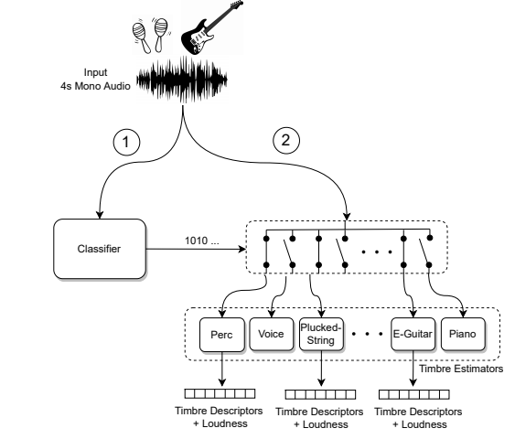
Proposed System

Slide 4
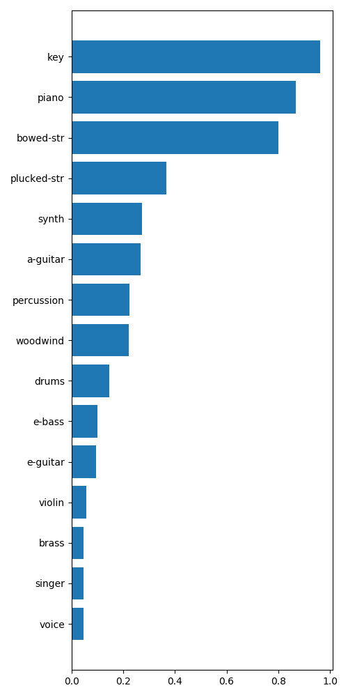
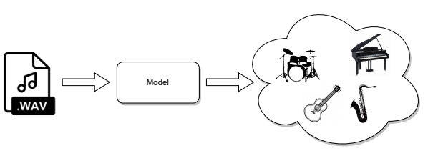
Classification
Multi-label classification problem
  Each sample can belong to multiple classes
  Can be viewed as multiple binary classification problems
Output: probability for each class

Slide 5
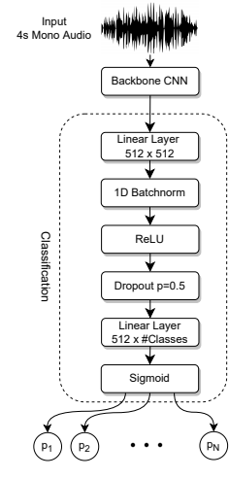
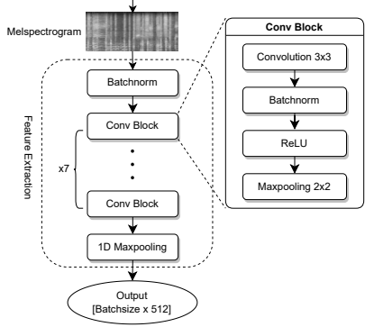
Architecture of the Classifier
Backbone CNN

Slide 6
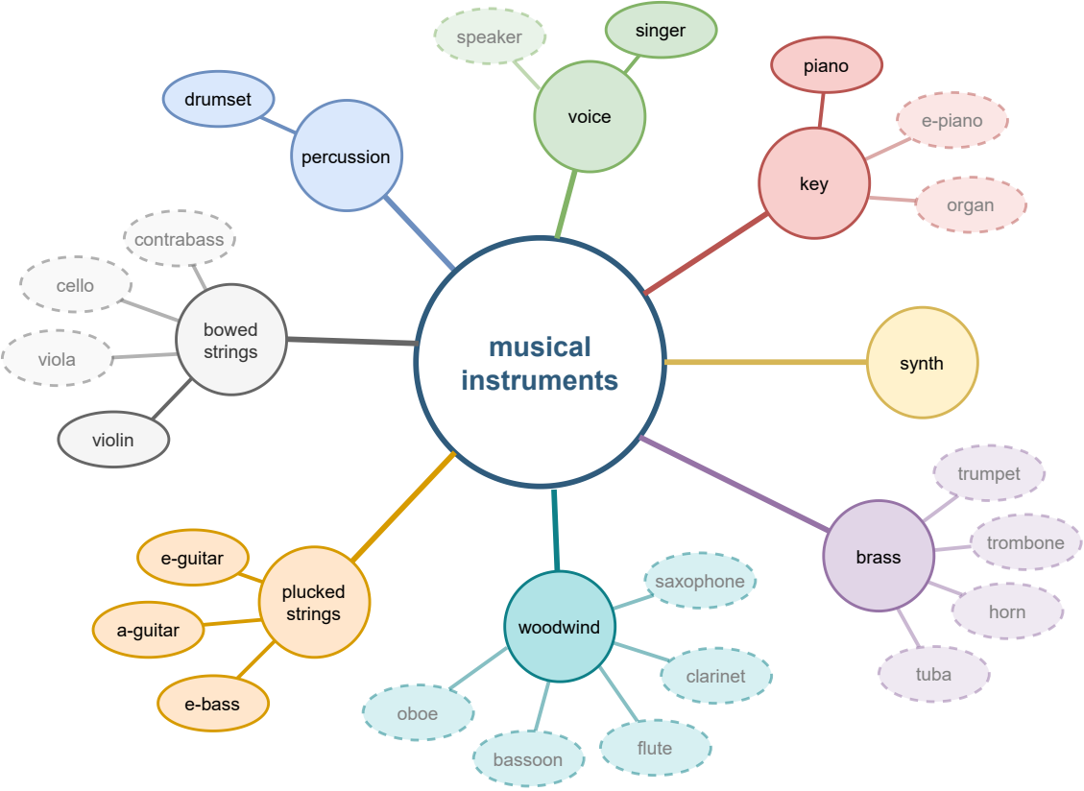
Hierarchical Taxonomy
Leverage „exotic“ instruments with few samples
8 families + 7 specific instruments = 15 classes in total
Taxonomy inspired by Hornbostel-Sachs System

Slide 7
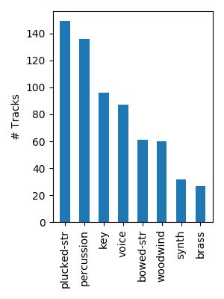
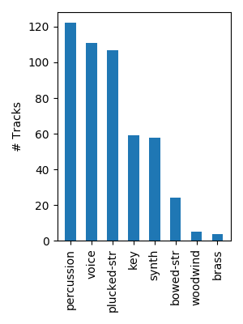
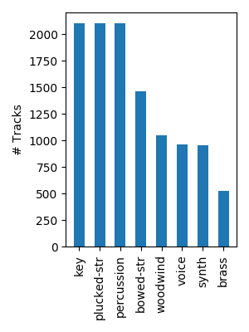
Datasets
Multi-track datasets
  contain separate tracks from recordings
Combination of 3 datasets (+ 1 for pre-training)
MedleyDB
Mixing-Secrets
Slakh

Slide 8
Data Augmentation
Random mixing of individual sources
  Two mixing strategies: musical mixing and non-musical mixing
Random selection of a 4-second chunk in a track
Random gain
Random pitch-shifting and time-stretching
Random filters (high shelf, low shelf and peaking filter)

Slide 9
Pre-Training
MTG-Jamendo Dataset
Music tagging dataset
~55000 audio tracks
Tags:
  Genre: rock, jazz, ambient etc.
  Instrument: piano, synthesizer, drums etc.
  Mood/theme: happy, dark, inspiring etc.

Slide 10
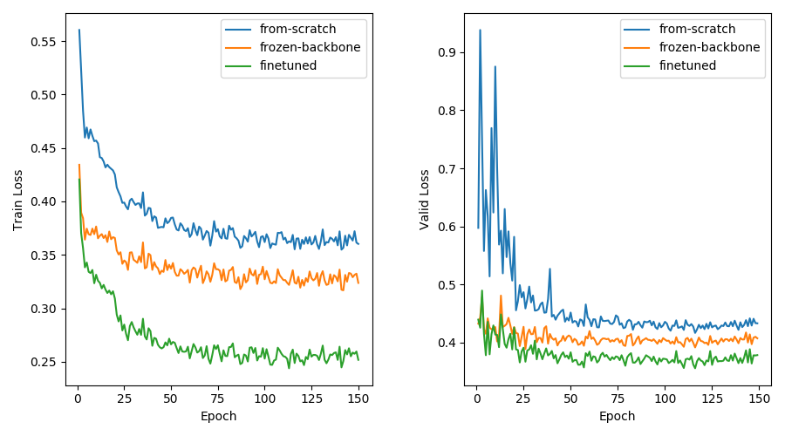
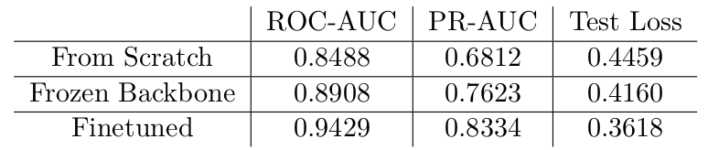
Transfer Learning – Which Layers to train?

Slide 11
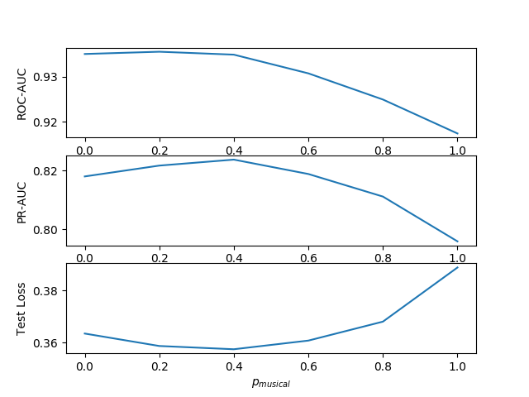
Mixing Strategy
Is it important that mixes (=training samples) are time-synchronized and
key-synchronized, i.e. sound „musically“?
only non-musical mixes
only musical mixes

Slide 12
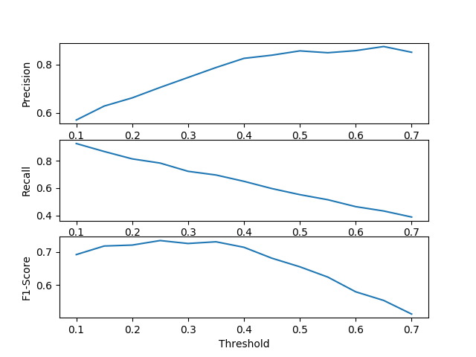
Classification Threshold
Selected threshold = 0.35
High precision is important

Slide 13
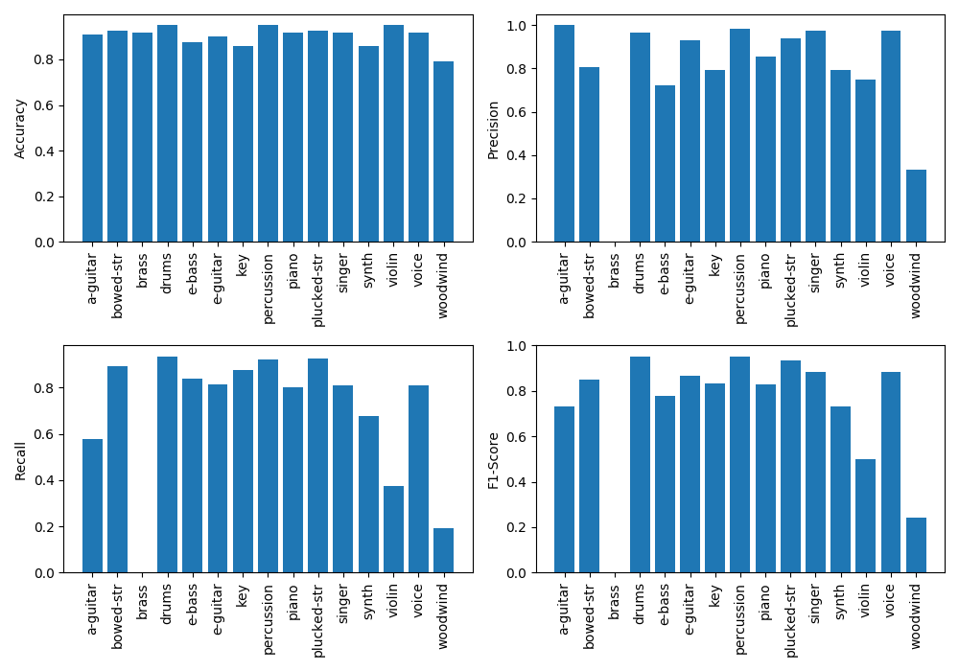
Performance of the Classifier

Slide 14
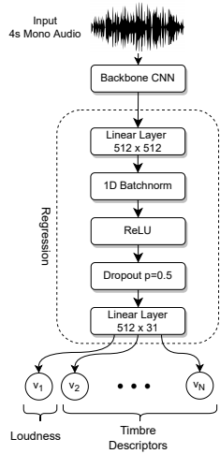
Timbre Estimation
15 models … one for each class (or family)
Predict timbre descriptors of a target instrument
from the mix
Multi-output regression problem
Challenge: How to choose appropriate descriptors?

Slide 15
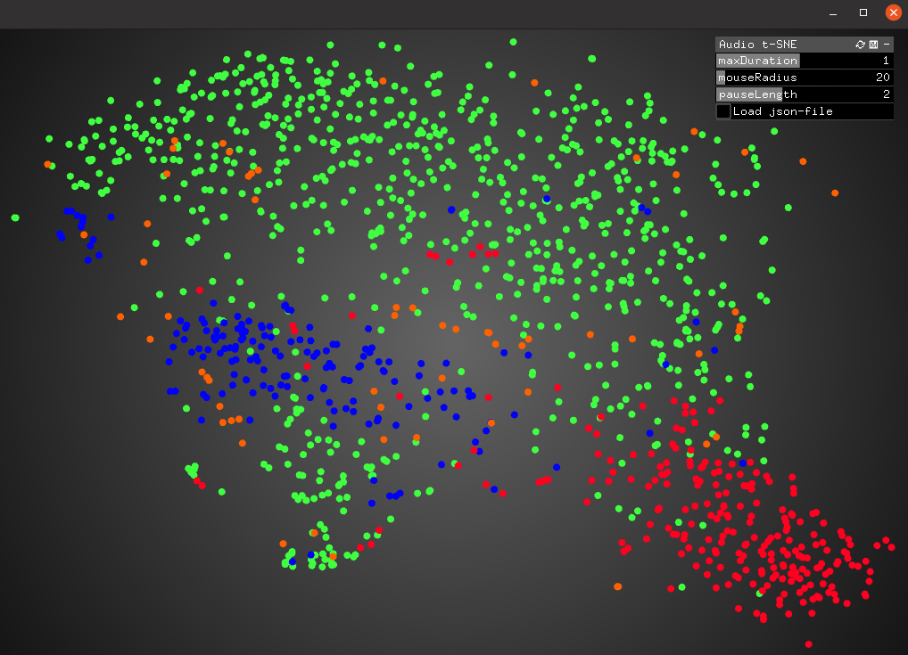
Timbre Descriptors
Set of descriptors experimentally determined
extract 2s-chunks of each single-instrument track
select + compute descriptors
create interactive 2D t-SNE plot
evaluate by ear
repeat 2 - 4
Final set: 12 MFCCs, spectral centroid, zero-crossing rate, spectral flatness
use median and interquartile range for each descriptor
Challenge: Each descriptor has different magnitude!

Slide 16


Standardize Targets
E.g.: spectral centroid ~ 10³, spectral flatness ~ 10⁻³
  Loss function focuses on optimizing the spectral centroid
All variables should be in the same order of magnitude
Prior to training: compute standardized targets from original targets
At inference:

Slide 17
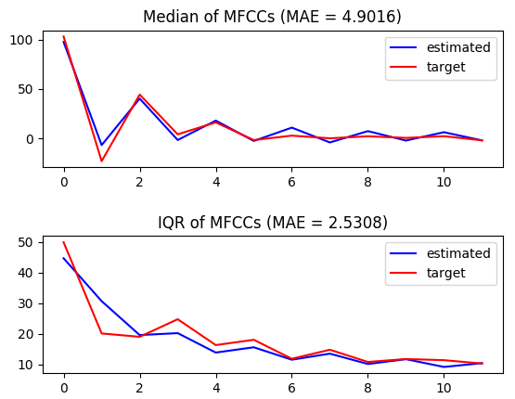
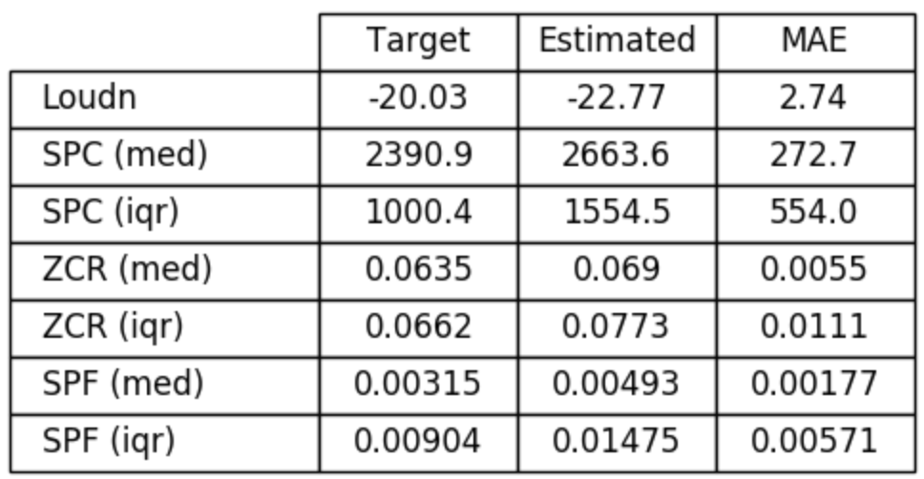
Performance of the Timbre Estimators
Example 1
Percussion model
Input: pop song with drum set, electric bass and vocals

Slide 18
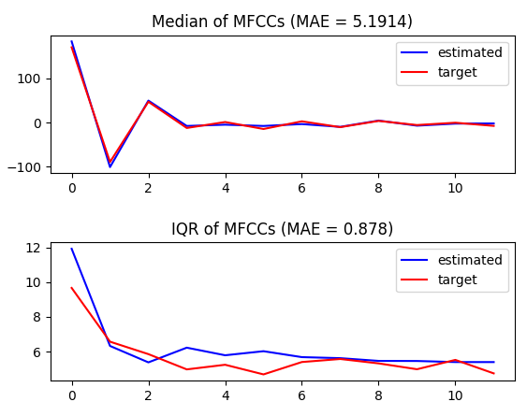
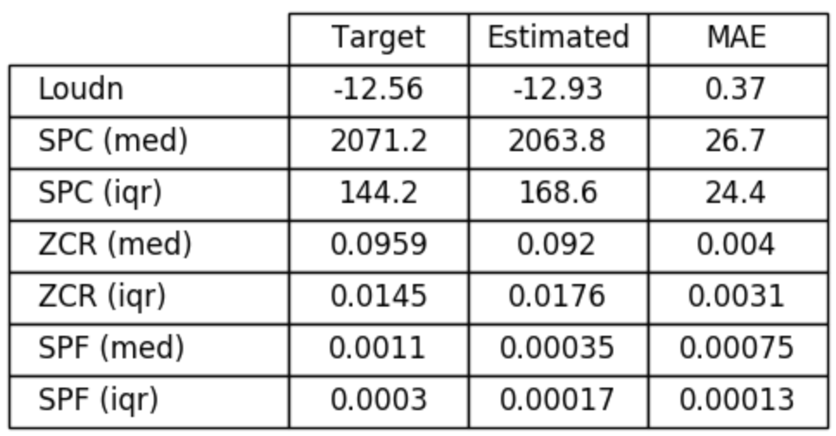
Performance of the Timbre Estimators
Example 2
E-guitar model
Input: metal song with drum set, electric bass and highly distorted electric guitar

Slide 19
Conclusion
Developed a system for automatic
  identification of 8 instrument families and 7 specific instruments
  prediction of the loudness of the involved instruments
  characterization of the timbre of the involved instruments
Obtained state-of-the-art performance in instrument recognition
Obtained good results in timbre estimation
  hard to evaluate (no baseline)

Slide 20
Future Work
Allow more than 15 classes
Review the usefulness of the Slakh dataset
Use more sophisticated data splits
Check out other timbre descriptors
Experiment with different architectures for timbre estimation
Better method to evaluate timbre estimators?
Predict other mix parameters besides loudness

Slide 21
Thank you for your attention!

