Slide 1
Smart Contracts
Nürnberg, Oktober 2016

Slide 2

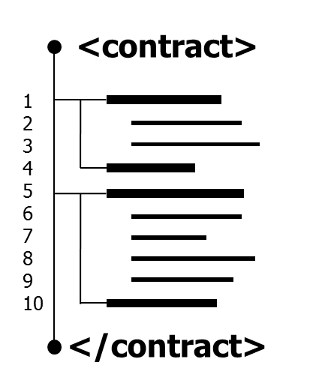
Smart Contracts
Definition, Nick Szabo, 1994:
„A smart contract is a computerized transaction protocol that executes the terms of a contract. The general objectives are to satisfy common contractual conditions (such as payment terms, liens, confidentiality, and even enforcement), minimize exceptions both malicious and accidental, and minimize the need for trusted intermediaries. Related economic goals include lowering fraud loss, arbitrations and enforcement costs, and other transaction costs.“
25.10.2016

Slide 3
Example – Membership Fitness Studio
Smart Contract Code describes:
Fees
Payment modalities
Conditions for contract termination
Logic to block members access card, when payment is overdue

Slide 4
Theory established in 1990ies
Practical use boosted by Blockchain in the last 3 years
Public access to all content
Immutability of content
Crypto currencies for fees and contract logic

Slide 5


Blockchain
Decentralized database
Peer-to-peer protocol
Proposed in 2008 (Satoshi Nakamoto, Whitepaper Bitcoin)
No double spending
No changes in historic data
No down time

Slide 6
Blocks and chains
Collect transactions
Combine them to build a new block
Add hash of the last block in the chain
Append new block to the end of the chain
Distribute new block in the network
Block Chain
Block n+1
hash last block
Transactions
Block n
hash last block
Transaktionen
Block n-1
hash last block
Transaktionen
…

Slide 7




Creating new blocks
Consensus over the state of the chain required
Mechanism based on Proof of Work (PoW)
Miner
Miner
Miner

Slide 8
Creating new blocks
?
?
Miner
Miner
Miner

Slide 9

Creating new blocks
✔
✔
Miner
Miner
Miner

Slide 10

Mining
Text
Motivation
Securing the network
Transaction fees from other peers
Newly created currency as mining reward by the network
Verification
Sender has to account
Account holds required funds
No double spending
Control of the hash value for the last block

Slide 11
Cryptocurrencies
Blockchain was invented as a base for cryptocurrencies
Value only based on acceptancy
Sender and receiver are pseudonymous
Uses
Cheap infrastructure for Micro Payments
Component for Smart Contract Platforms

Slide 12
Scaling the Blockchain is hard
Visa
Bitcoin (2016)
Delay for TRX confirmation
TRX confirmation < 1 minute
TRX confirmation ~10 minutes
Maximum volume
Avg. 2000 TRX/sec.
Max. 56.000 TRX/sec.
Avg. 3 TRX/sec.
Max. 7 TRX/sec.
Cost per TRX
Share of value
~5$ (hardware, energy, bandwidth)
Storage requirement
centralized storage by Visa
Blockchain size ~82 GB per node

Slide 13

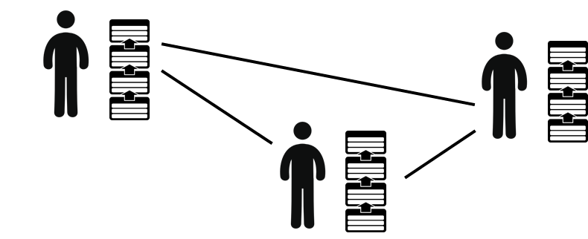
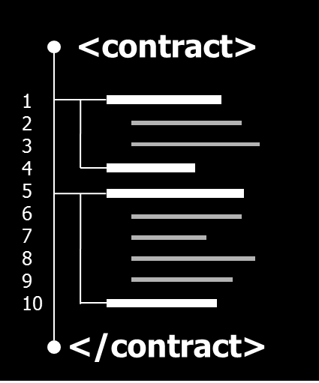
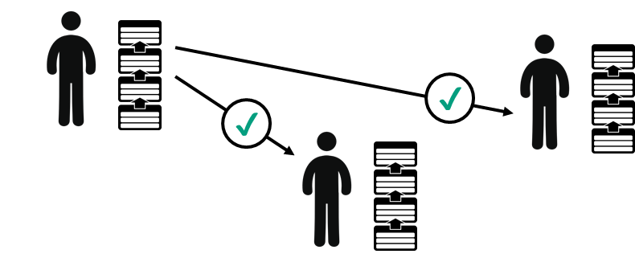
Core components of Smart Contracts
Cryptographic TRX system
Peer-to-peer architecture
Cryptographically secured ledger for the management of transactions and accounts
Decentralized network of equal nodes
Computer implemented as Software
Executes Smart Contracts
Code is stored on Blockchain
Mechanism to agree on current state of system based on POW
Virtuelle Maschine
Konsens-Algorithmus

Slide 14
Unique features with unique drawbacks
No centralized
control
No regulating
authorities
No manipulation
No correction of
errors
No downtime
No off switch
Information
symmetry
No confident
information
World computer
No changing/update
of code

Slide 15

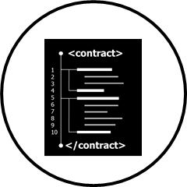
Should I use it in the real world?
Blockchain
Stable for systems with a low volume of TRX
Different approaches for scaling in evaluation
Adaptations of the Blockchain concept
Encrypted content
Reduction of consensus mechanism to trusted entities
Edit function for historic TRX
stable
Smart Contracts
High complexity means more errors and attack vectors
Several experimental platforms but no standard
Tool Stack for developers in constant change and unfinished
instable

Slide 16


Examples
Payments
ripple
Solution for international inter-bank payments to reduce transaction costs and settlement risk
Based on custom Blockchain
Conversion into all major physical currencies
https://ripple.com
Prediction Markets
Augur
Trading platform for the outcome of events
Participants buy stakes on possible outcomes, e.g. the winner of an election
Sum of invested money is distributed amongst participants who tipped correct outcome
Based on Ethereum
https://www.augur.net/

Slide 17


Examples
Gaming
FirstBlood
Platform for players of online multiplayer games to challenge each other
Players bet money on winning a game
Smart Contracts calculate the price money based on the result of the game
Based on Ethereum
https://firstblood.io/
Music industry
MUSE
Blockchain optimized for the management of copyrights and fees
Smart Contracts define the distribution of funds among rights holders
Used by platform PeerTracks to enable the sale of music directly by the artist
http://museblockchain.com/

Slide 18

Examples
Social Media
steem.io
Social media platform based on Blockchain
Rewards for content generators and curators
Distribution of funds with voting rights based on individual contribution of participants
https://steem.io

Slide 19


Examples
Automotive
DocuSign
Prototype for paperless car leasing in cooperation with Visa
Automated payment by linked Visa card
User interaction managed by car display
Leasing contract stored on Bitcoin Blockchain
https://www.docusign.com/
Energy
Transactive Grid
P2P market place for renewable energy
Smart Contracts ensure the secure trade of energy between producers and consumers
Consumers can chose energy producer directly
Based on Blockchain
http://transactivegrid.net/

Slide 20

Examples
Access Control
slock.it
Platform to connect real objects with the Blockchain
Objects receive unique addresses as well as the possibility to receive payments
They are included into complex contracts
Use cases are the autonomous operation of production machinery and the rental of cars and flats
https://slock.it

