Slide 1
Smart Contracts
Solidity
Munich, November 2016

Slide 2
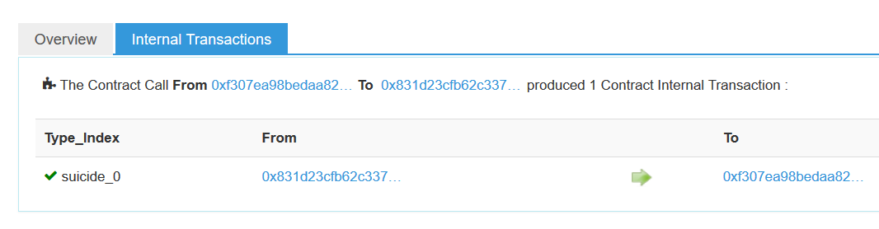
self_destruct(owner)
Solidity Language-features
// this contract is used to make other contracts „killable“
contract mortal {
/* Define variable owner of the type address*/
address owner;
/* this function sets the owner of the contract (at initi) */
function mortal() { owner = msg.sender; }
/* Function to recover the funds on the contract */
function kill() { if (msg.sender == owner) selfdestruct(owner); }
}
contract greeter is mortal {
/* see next slide ... */
Notes:
http://ethereum.stackexchange.com/questions/315/why-are-suicides-used-in-contract-programming
Suicides in Ethereum are an operation (an OPCODE actually) at the EVM level, independent of what language or client you are using.
For example, calling suicide(address) sends all of the contract's current balance to address.
This is useful when you are finished with a contract, because it costs far less gas than just sending the balance with address.send(this.balance).
In fact, the SUICIDE opcode uses negative gas because the operation frees up space on the blockchain by clearing all of the contract's data.
This negative gas deducts from the total gas cost of the transaction, so if you're doing some clean-up operations first, SUICIDE can reduce your gas costs.

Slide 3
Message (msg) Object, this, send()
Solidity Language-features
// this contract is used to make other contracts „killable“
contract mortal {
/* Define variable owner of the type address*/
address owner;
/* this function sets the owner of the contract (at initi) */
function mortal() { owner = msg.sender; }
/* Function to recover the funds on the contract */
function kill() { if (msg.sender == owner) selfdestruct(owner); }
}
msg.sender = the address of the account (Contract-Account or User-Account) that triggered the transaction.
msg.value = the money amount set in the transaction.
For retrieving the address of the current contract use the key-word this.
To send money from one contract to another use the function send:
//(...)
msg.sender.send(amount);
//(...)

Slide 4
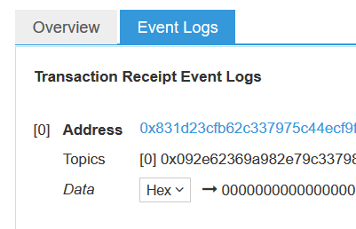
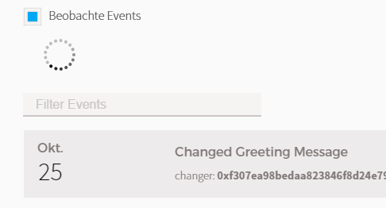
Events (Logging)
Solidity Language-features
contract greeter is mortal {
/* define variable greeting of the type string */
string greeting;
event ChangedGreetingMessage(address changer);
// (...)
/* change the greeting message */
function changeGreeting(string _greeting) {
greeting = _greeting;
ChangedGreetingMessage(msg.sender);
}
}

Slide 5
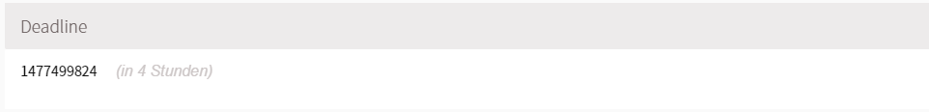
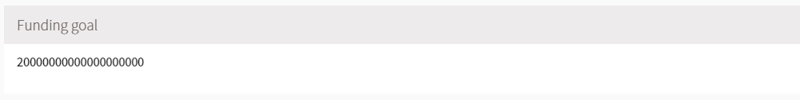
Umrechnungseinheiten (es gibt keine Floating-Point Typen)
Solidity Language-features
/* at initialization, setup the owner */
function Crowdsale(
address ifSuccessfulSendTo,
uint fundingGoalInEthers,
uint durationInMinutes,
uint etherCostOfEachToken,
token addressOfTokenUsedAsReward
) {
beneficiary = ifSuccessfulSendTo;
fundingGoal = fundingGoalInEthers * 1 ether;
deadline = now + durationInMinutes * 1 minutes;
price = etherCostOfEachToken * 1 ether;
tokenReward = token(addressOfTokenUsedAsReward);
}
= 4 hours in hundred milliseconds

Slide 6
Unnamed function (Fallback function)
Solidity Language-features
function () payable {
if (crowdsaleClosed) throw;
uint amount = msg.value;
balanceOf[msg.sender] += amount;
amountRaised += amount;
tokenReward.transfer(msg.sender, amount / price);
FundTransfer(msg.sender, amount, true);
}
Die empty function is the fallback function of the contract.
This function is called when no other function matches the signature.
The function can neither specify input parameters nor a return value.
This function is used to accept money transactions to a contract (see „send()“).

Slide 7
Modifier (generell)
Solidity Language-features
modifier afterDeadline() { if (now >= deadline) _; }
function checkGoalReached() afterDeadline {
if (amountRaised >= fundingGoal){
fundingGoalReached = true;
GoalReached(beneficiary, amountRaised);
}
crowdsaleClosed = true;
}
Modifiers are code pieces that are executed before a certain function is executed (similar to an aspect in AOP). Usually they contain check-criteria that define if a function is to be executed or not.
When you decorate a function with a modifier the modifier will be called first upon function call. The modifier can then decide if the function‘s code should be executed or not.
The execution of the function code is triggered by “_”.

Slide 8
Modifier: payable
Solidity Language-features
function () payable {
if (crowdsaleClosed) throw;
uint amount = msg.value;
balanceOf[msg.sender] += amount;
amountRaised += amount;
tokenReward.transfer(msg.sender, amount / price);
FundTransfer(msg.sender, amount, true);
}
payable is a special modifier that marks a function as money-transaction function. If you decorate a function with payable you can send ether to the contract through this function.
Since solidity 0.4.x you also have to decorate the empty function with payable in order to let her accept money transactions to the contract.
You can also decorate other functions than the empty function with payable. If you do this these functions will accept money transactions.

Slide 9
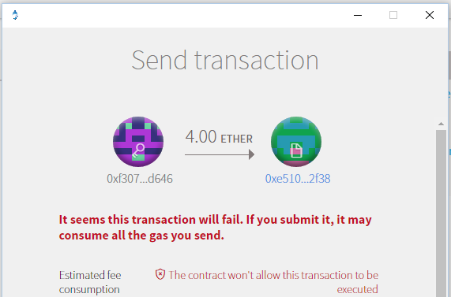
Exception Handling: throw
Solidity Language-features
bool public crowdsaleClosed;
// (...)
function () payable {
if (crowdsaleClosed) throw;
uint amount = msg.value;
// (...)
}
Throw stops the execution of a contract (exception).
Before you actually execute a function (when you prepare to send a transaction) the Mist client actually checks if the function will run into a „throw“ with the settings you are calling it with. If a throw will be reached Mist will show a „standard“ error:
„It seems this transaction will fail. If you submit it, it my consum all the gas you send.“
„The contract won‘t allow this transaction to be executed.“
At the moment you cannot define any other exceptions. If you see this message you should not execute the transaction but you should find the error in your contract code.

