Slide 1
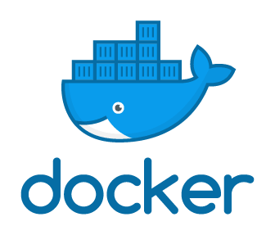
Docker Deep Dive
The Dockerfile, Builds and Network Configuration

Slide 2
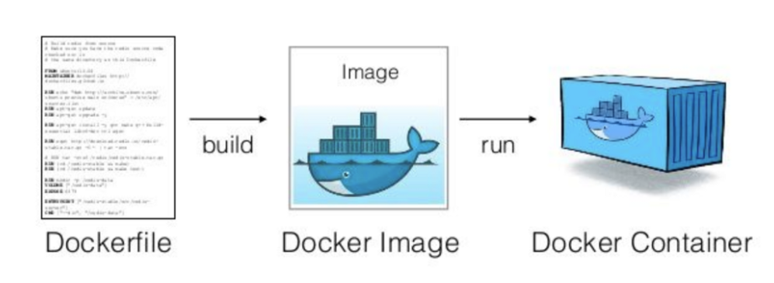
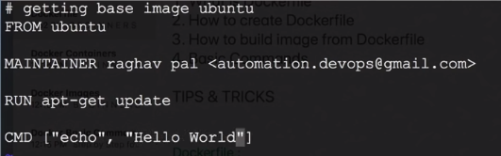
The Dockerfile
Dockerfile is a text file with instructions to build image
Docker runs instructions in a Dockerfile in order. A Dockerfile must start with a `FROM` instruction. The FROM instruction specifies the Base Image from which you are building.
Using docker build users can create an automated build that executes several command-line instructions in succession.

Slide 3


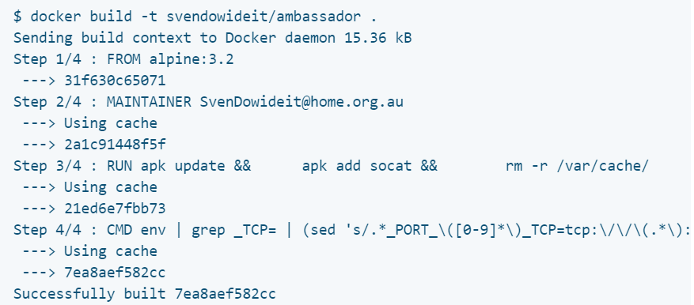
The Dockerfile
Using docker build users can create an automated build that executes several command-line instructions in succession.
Use the -f flag with docker build to point to a Dockerfile anywhere in your file system.
Specify a repository and tag at which to save the new image if the build succeeds

Slide 4
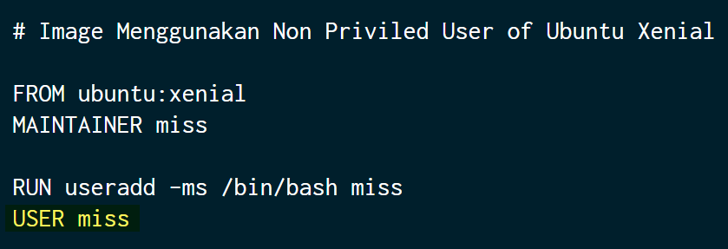
Dockerfile Directives: USER and RUN
The Docker USER directive in Dockerfile is a part of the official Docker feature set.
The USER directive is used to set the start up user ID in the new Docker image. BY default, the container will be launched with root user. You can modify the default user ID from root to the one specified in this directive.
You can see the syntax of the USER directive as follows:
*Note: The Username and UID must match with a valid user name, otherwise the docker run subcommand will fail.

Slide 5
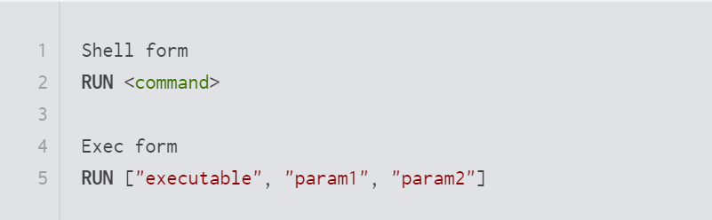
Dockerfile Directives: USER and RUN
RUN executes the command(s) that you give in a new layer and creates a new image. This is mainly used for installing a new package.
The RUN instruction is used during the build time, and it can run any command/argument. This directive lets you execute a command on top of an existing layer and create a new layer with the results of command execution.
RUN command can be used in two forms:
Ex:
To createdirectory inside of your Docker image then: RUN mkdir -p /path/to/folder.
To install a package RUN apt-get install

Slide 6
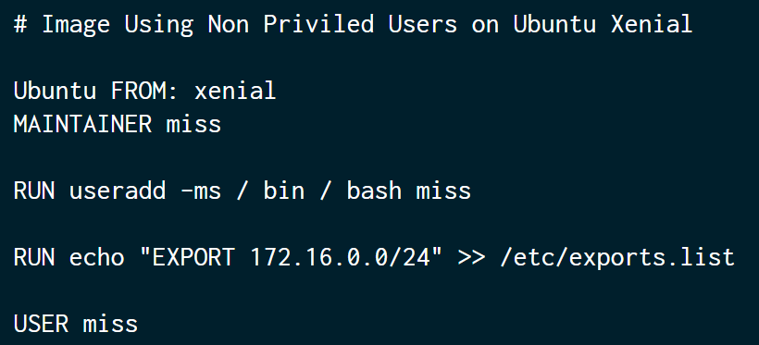
Dockerfile Directives: RUN Order of Execution
Dockerfile Directives: RUN must be run in a manner logical to the system.
Dockerfile adheres to a system which will execute commands from top to bottom in sequence.
If the echo RUN line is placed at the bottom, during Docker build, it will encounter a PERMISSION DENIED error (because the user who is playing the role is a user miss not root).
As a result, to avoid errors, the command is placed in the middle while the user is still the user root.

Slide 7
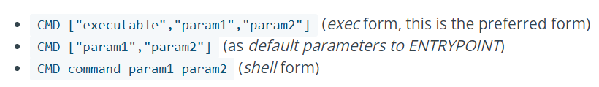
Dockerfile Directives: CMD vs. RUN
RUN lets you execute commands inside of your Docker image. These commands get executed once at build time and get written into your Docker image as a new layer.
CMD lets you define a default command to run when your container starts. (program to run within container)
There can only be one CMD instruction in a Dockerfile. If you list more than one CMD then only the last CMD will take effect.
https://nickjanetakis.com/blog/docker-tip-7-the-difference-between-run-and-cmd

Slide 8



Dockerfile Directives: ENV
The ENV directive is used to set an environment variable in the Docker image (By hard-coding it directly into your dockerfile).
An environment variable can be accessed by any script or application. The Linux applications use the environment variables for a starting configuration.
docker run -it <image>
*An environment variable is a dynamic "object" on a computer, containing an editable value, which may be used by one or more software programs. Environment variables help programs know what directory to install files in, where to store temporary files, and where to find user profile settings. They help shape the environment in which programs run on your computer.

Slide 9



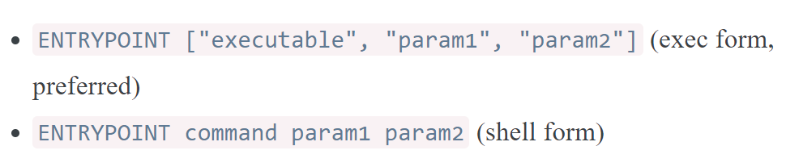

Dockerfile Directives: ENTRYPOINT
Ex:
Dockerfile:
Run container as:
Output
Run container as:
Output:
The ENTRYPOINT directive can be used to set the primary command for the image.
ENTRYPOINT instruction allows you to configure a container that will run as an executable. It looks similar to CMD, because it also allows you to specify a command with parameters. The difference is ENTRYPOINT command and parameters are not ignored when Docker container runs with command line parameters.
ENTRYPOINT has two forms:

Slide 10



Dockerfile Directives: EXPOSE
The EXPOSE directive can be used to opens up a container network port for communicating between the container and the outside world.
The sample syntax of the EXPOSE instruction is as follows:
This is an optional field provided for a specific transport protocol, such as TCP and UDP.
The EXPOSE directive also allows you to specify multiple ports in a single line. You can expose the port number 8080 as a UDP port and the port number 80 as a TCP port is as follows:
Does not make the ports of the container accessible to the host
*A network port is a number that identifies one side of a connection between two computers. Computers use port numbers to determine to which process or application a message should be delivered.

Slide 11
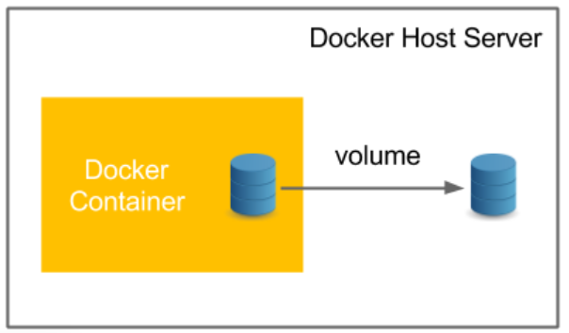
Container Volume Management
A Docker image is a collection of read-only layers. When you launch a container from an image, Docker adds a read-write layer to the top of that stack of read-only layers. Docker calls this the Union File System.
Any time a file is changed, Docker makes a copy of the file from the read-only layers up into the top read-write layer. This leaves the original (read-only) file unchanged.
When a container is deleted, that top read-write layer is lost. This means that any changes made after the container was launched are now gone.
A volume allows data to persist, even when a container is deleted. Volumes are also a convenient way to share data between the host and the container.
Mounting a volume is a good solution if you want to:
Push data to a container.
Pull data from a container.
Share data between containers.
Docker volumes exist outside the Union File System of read-only and read-write layers. The volume is a folder which is shared between the container and the host machine. Volumes can also be shared between containers.
https://www.ionos.com/community/server-cloud-infrastructure/docker/understanding-and-managing-docker-container-volumes/

Slide 12

Container Volume Management
Volumes are the preferred mechanism for persisting data generated by and used by Docker containers. While bind mounts are dependent on the directory structure of the host machine, volumes are completely managed by Docker. Volumes have several advantages over bind mounts:
Volumes are easier to back up or migrate than bind mounts.
You can manage volumes using Docker CLI commands or the Docker API.
Volumes work on both Linux and Windows containers.
Volumes can be more safely shared among multiple containers.
Volume drivers let you store volumes on remote hosts or cloud providers, to encrypt the contents of volumes, or to add other functionality.
New volumes can have their content pre-populated by a container.
In addition, volumes are often a better choice than persisting data in a container’s writable layer, because a volume does not increase the size of the containers using it, and the volume’s contents exist outside the lifecycle of a given container.
To launch a container which will use a volume you have created with docker volume create, add the following argument to the docker run command:

Slide 13
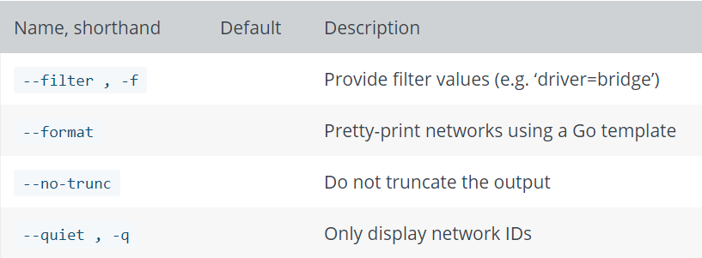

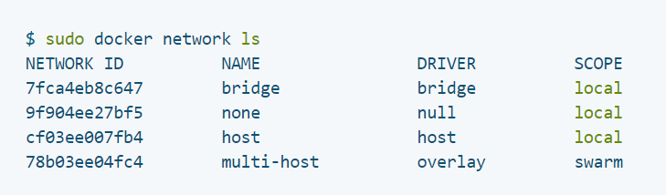
Docker Network: List and Inspect
List is used to display detailed information on one or more networks.
Lists all the networks the Engine daemon knows about. This includes the networks that span across multiple hosts in a cluster.
Ex:

Slide 14

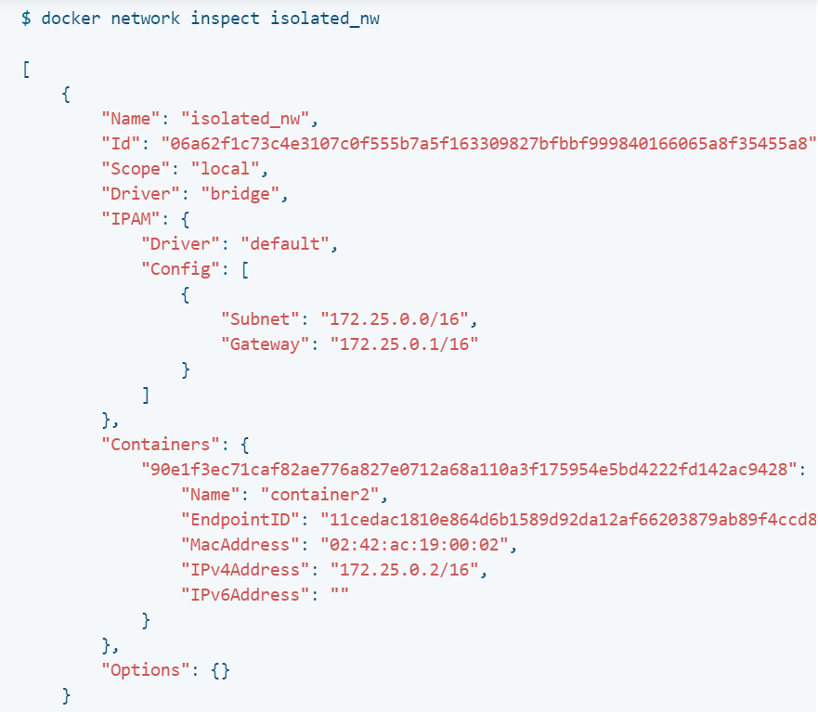
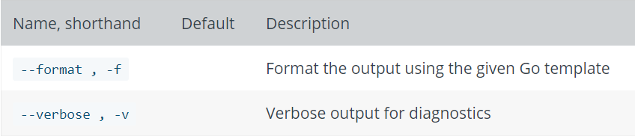
Docker Network: List and Inspect
Returns detailed information about one or more networks. By default, this command renders all results in a JSON object.

Slide 15
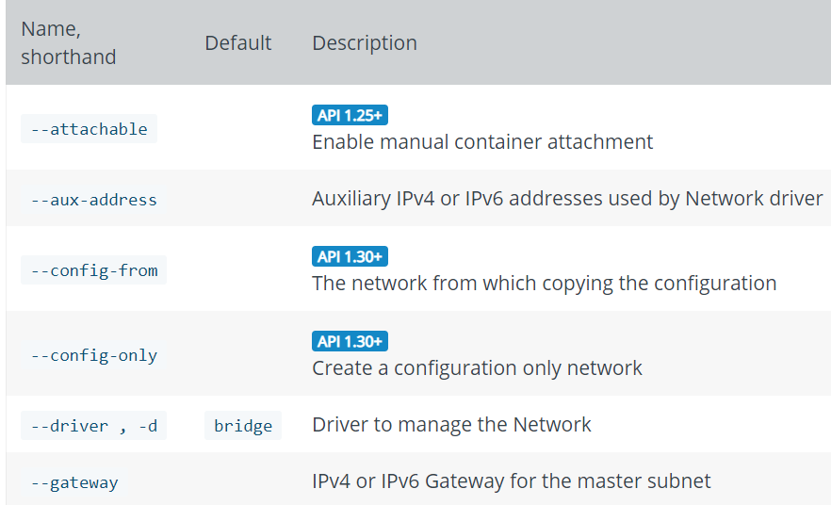

Docker Network: Create and Remove
Creates a new network. The DRIVER accepts bridge or overlay which are the built-in network drivers. If you have installed a third party or your own custom network driver you can specify that DRIVER here also.
If you don’t specify the --driver option, the command automatically creates a bridge network for you. When you install Docker Engine it creates a bridge network automatically. This network corresponds to the docker0 bridge that Engine has traditionally relied on.
When you launch a new container with docker run it automatically connects to this bridge network. You cannot remove this default bridge network, but you can create new ones using the network create command.
Examples of Options

Slide 16




Docker Network: Create and Remove
Removes one or more networks by name or identifier. To remove a network, you must first disconnect any containers connected to it.
Use docker container stop containerid, then docker container rm containerid.
To remove all unused networks:
Examples:
To remove the network named ‘my-network’
To delete multiple networks in a single docker network rm command, provide multiple network names or ids. The following example deletes a network with id 3695c422697f and a network named my-network:
*When you specify multiple networks, the command attempts to delete each in turn. If the deletion of one network fails, the command continues to the next on the list and tries to delete that. The command reports success or failure for each deletion.

Slide 17
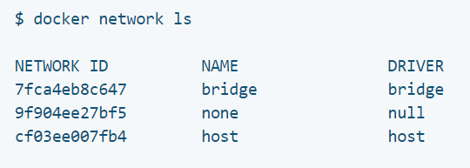
Docker Network: Assign to Containers
These three networks are built into Docker. (Created automatically when you install it).
You can use the docker run --network=<network-name> container1 option to start a container and immediately connect it to a network.
If the container is running, use docker network connect multi-host-network container1
You can connect a container by name or by ID. Once connected, the container can communicate with other containers in the same network
https://docs.docker.com/v17.09/engine/userguide/networking/#default-networks

