Slide 1
DOU University Development

Slide 2
If-else statement
If state is used to specify a block of code to be executed if the condition is met, if the condition is not met, we will execute what is inside the else statement

Slide 3
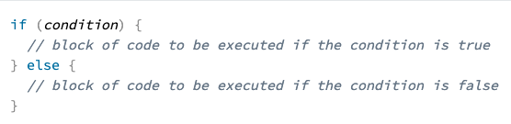
Basic structure

Slide 4
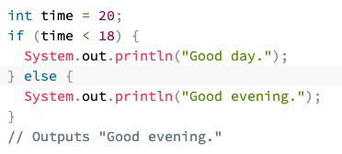
example

Slide 5
Other examples

Slide 6
switch
Use switch statement to select one of many code blocks to be executed.

Slide 7
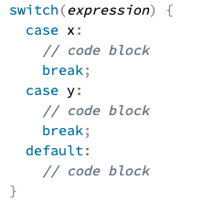
Basic structure

Slide 8
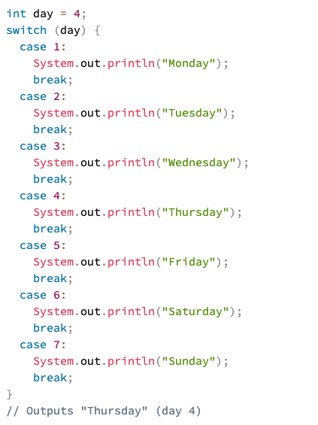
example

Slide 9
loops

Slide 10

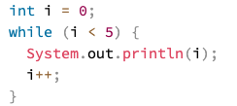
While Loop:
Loops through a block of code as long as specified condition is true
Syntax:
Example:

Slide 11


For Loop:
When you know exactly how many times you want to loop through a block of code.
Syntax:
Example:

Slide 12
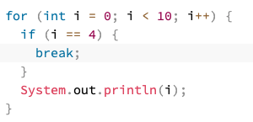
Break – continue statement
Break: Similar to the one on the Switch, break statement is used to ”jump out” of a loop.
Example:

Slide 13
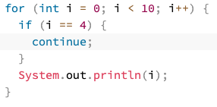
Break – continue statement
Continue: Breaks one iteration (in the loop), if a specified condition occurs, and continues with the next iteration.
Example:

Slide 14
ARRAYS

Slide 15

Arrays are used to store multiple values in a single variable, instead of declaring a lot of variables.
How to declare an array:
To insert values:

Slide 16
Ejercicios
Leer dos numeros del usuario, luego mostrar el siguiente menu (S=suma, R=resta, M=multi, D, division) y de acuerdo a lo que el usuario seleccione realizar la operacion y mostrar en pantalla el resultado
Escribir un programa que obtenga la suma de los pares e impares de los primero 35 numeros naturales
Leer 3 numeros del teclado y ordenarlos de forma ascendente y descendente
Palindromo
Mostrar productos con sus precios empleando arreglos

