Slide 1
POLAR MOVE
by
Bastian Walter, Riku Tuisku and Aleksandar Raynov

Slide 2




Technologies

Slide 3
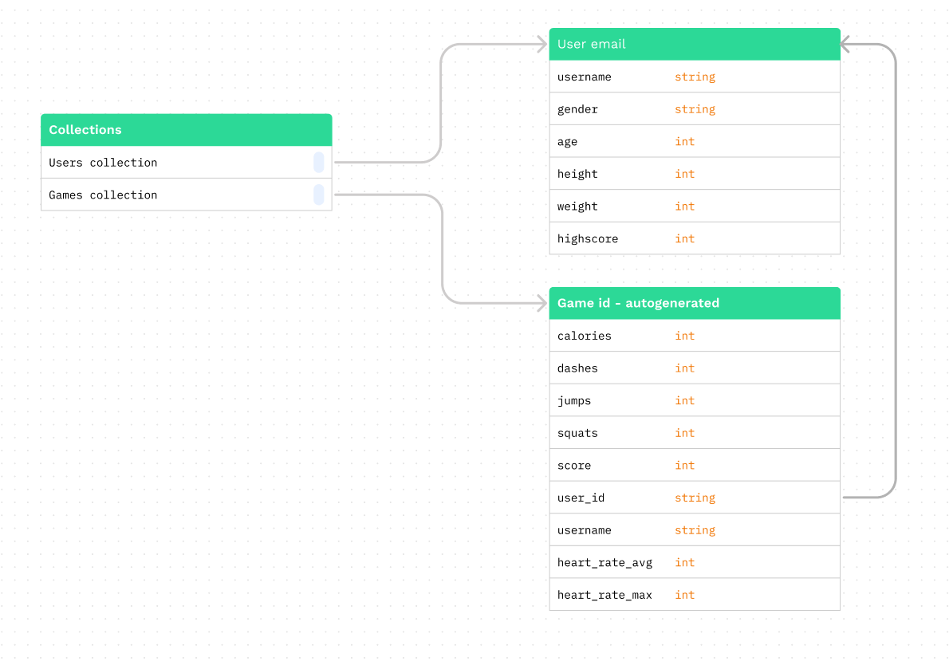
Firebase DB structure

Slide 4
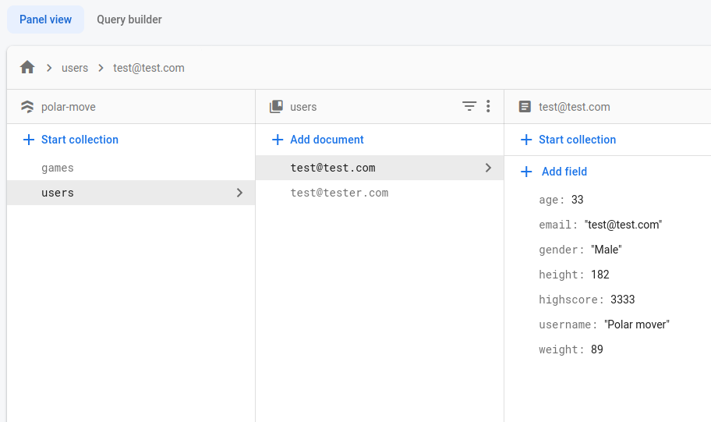
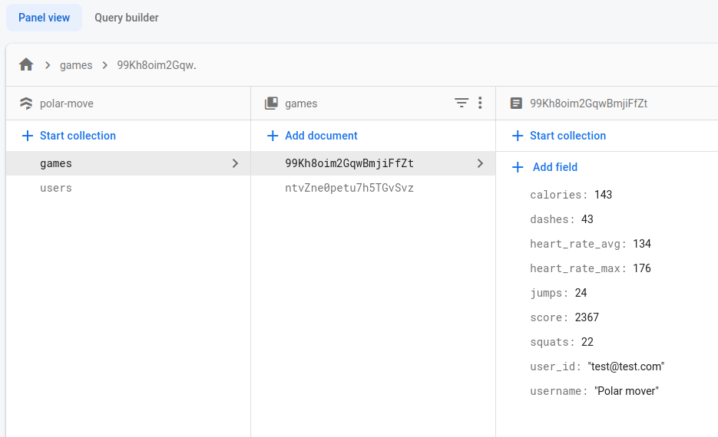
Firebase examples

Slide 5
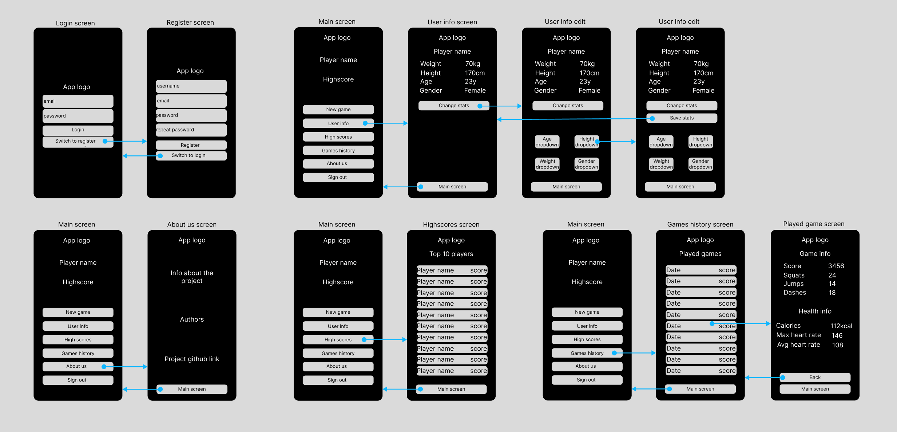
App layouts and navigation

Slide 6
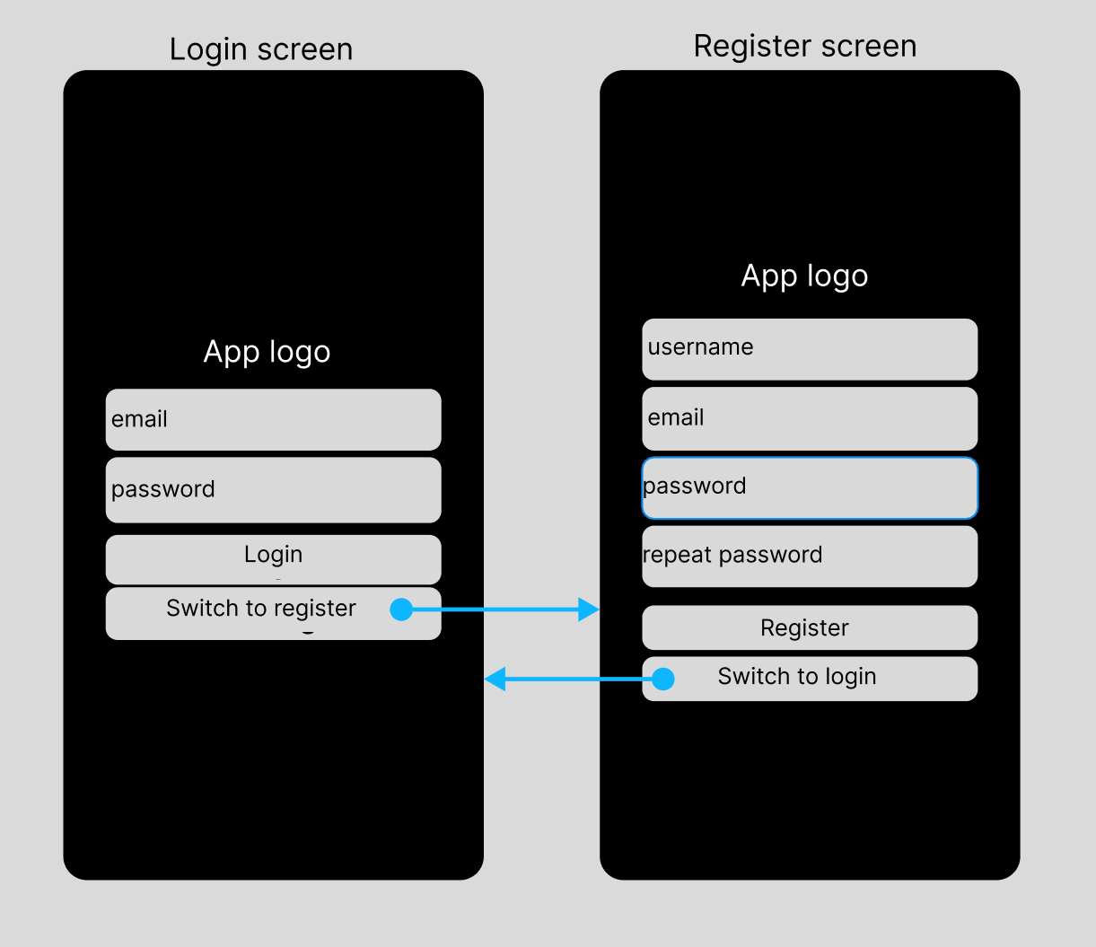
Login and Register

Slide 7
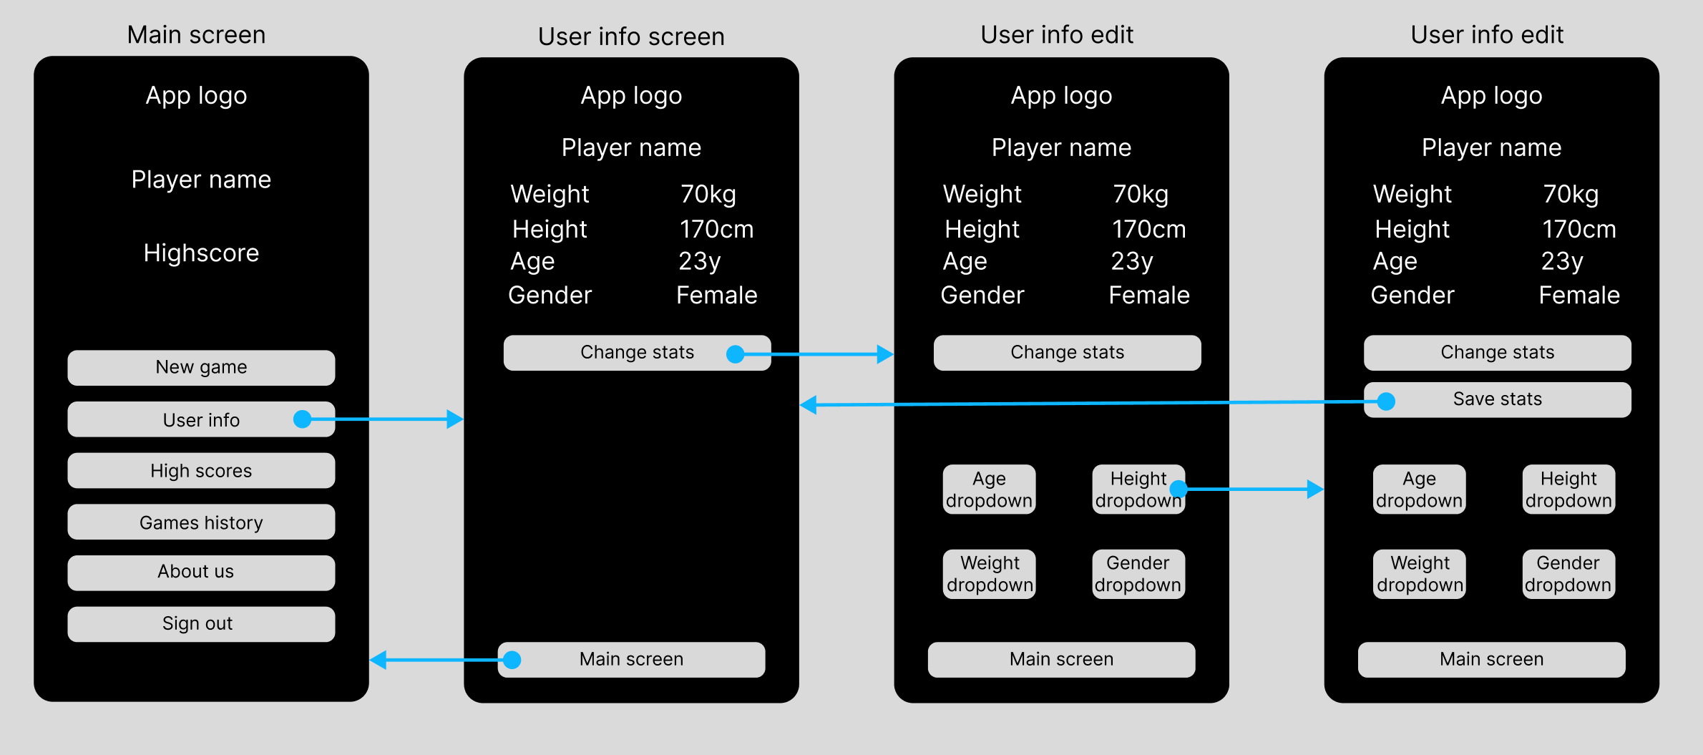
User info

Slide 8
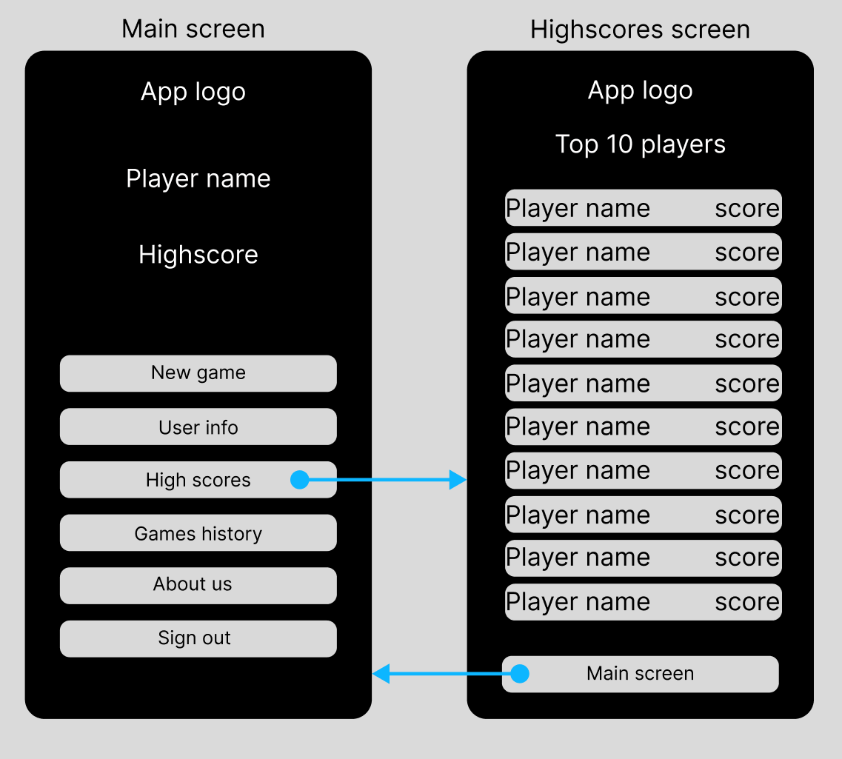
Highscores

Slide 9
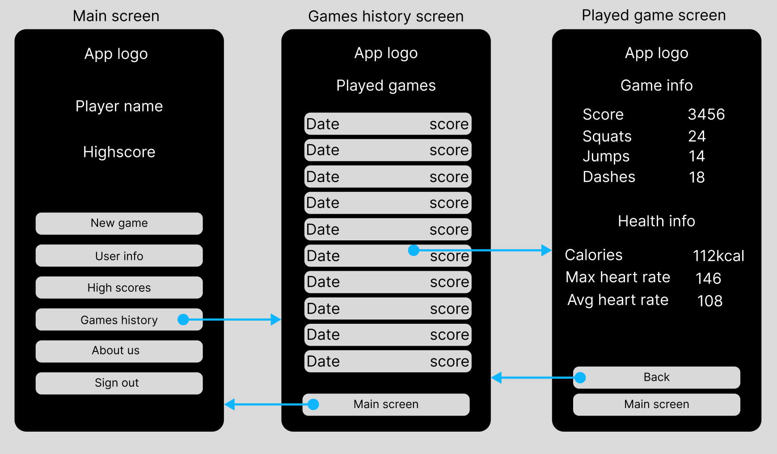
Games history

Slide 10
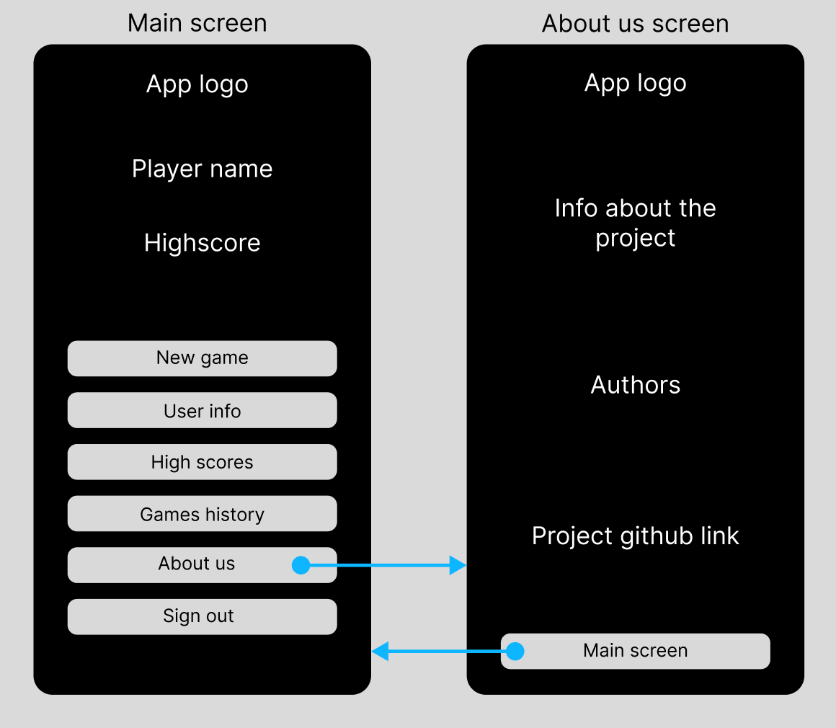
About us

Slide 11
Sensor
Hardcoded connection
Data comes in batches
Average out data
Threshold for input

Slide 12
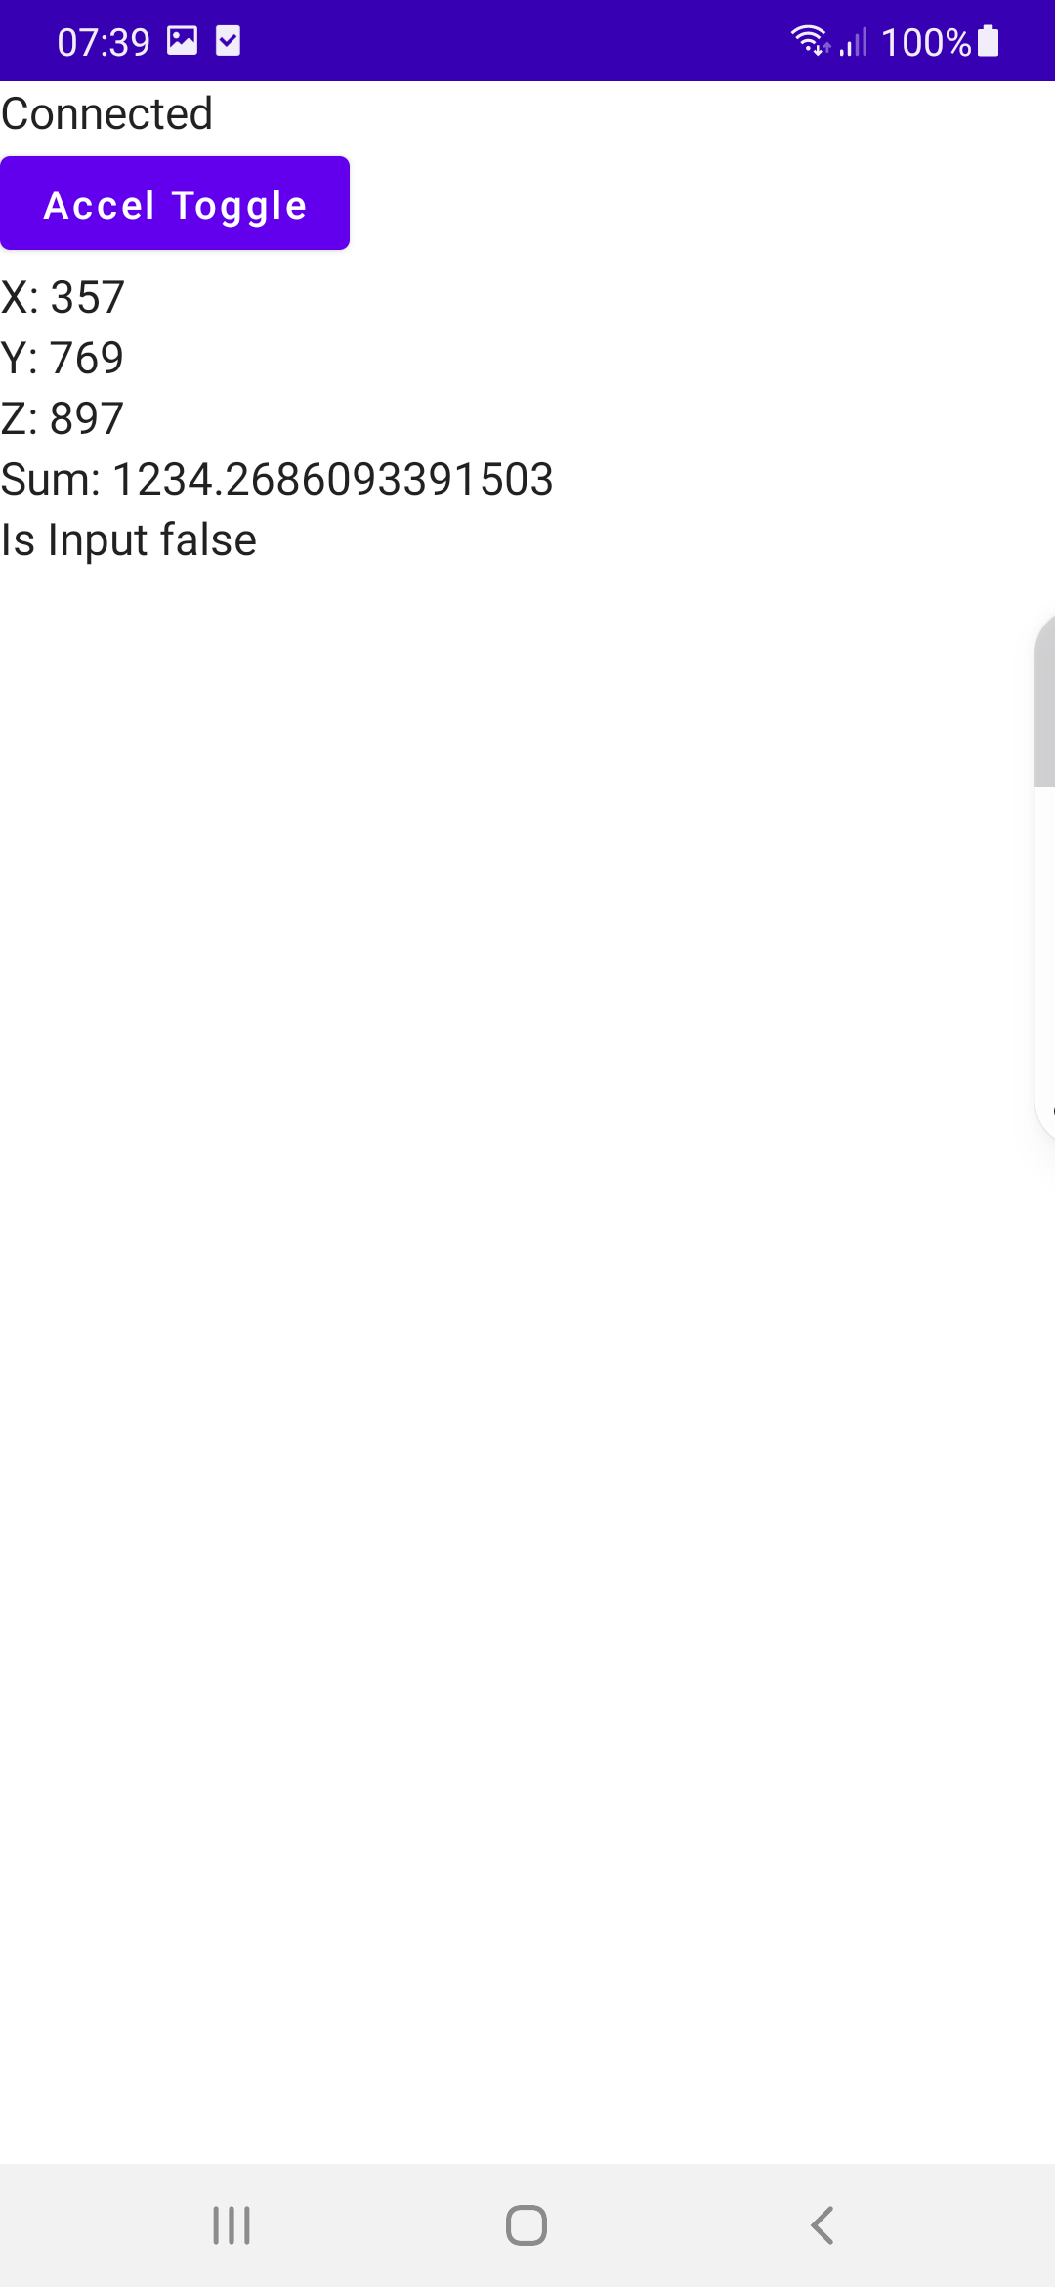
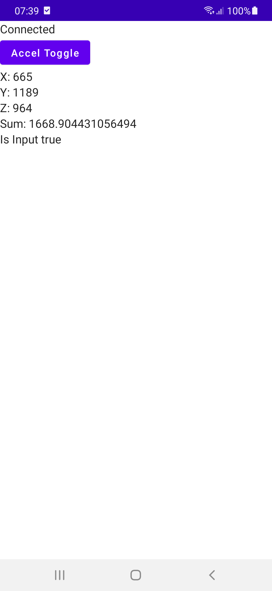
Sensor

Slide 13
Sensor
More generalized connection to device
Directional Input
Smaller sampeling range

Slide 14


Game art
The theme of the game has been decided to be in a neighborhood area, where the main character will evade incoming objects.
Made with

Slide 15
Player model objects
Player character
Walk cycle
Crouch/slide
Jump

Slide 16


Player models
Walk cycle

Slide 17


Player models
Jump
Crouch

Slide 18
Obstacle objects
Jumping over
Sliding under
Blocking lane

Slide 19


Object for jumping over
A trash can for jumping over
Final version of the trash can and the old version

Slide 20
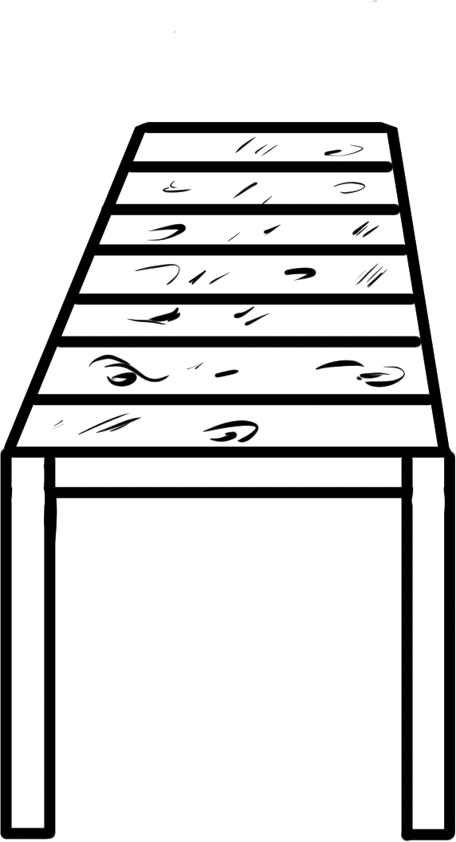

Object for sliding under
A bench for sliding under, but at the moment it looks like something you can jump on too.
Mailbox was the first version of the object to slide under, but it seemed quite silly for a mailbox to appear in the middle of the road

Slide 21


Object for blocking 1 lane
A grandma was decided to the blocking object for blocking a lane.
A fence was the first version of the object to block a lane, but it was later changed to be a grandma

Slide 22


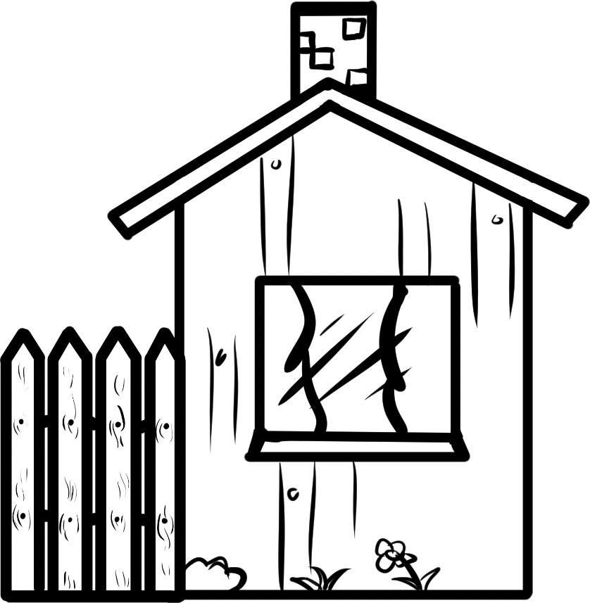
Background objects
Houses
Trees
Clouds
Mailbox

Slide 23




Extra objects for scenery
I decided to add extra objects like flowers, weeds, bushes and a spruce to make the scenery look nice

Slide 24
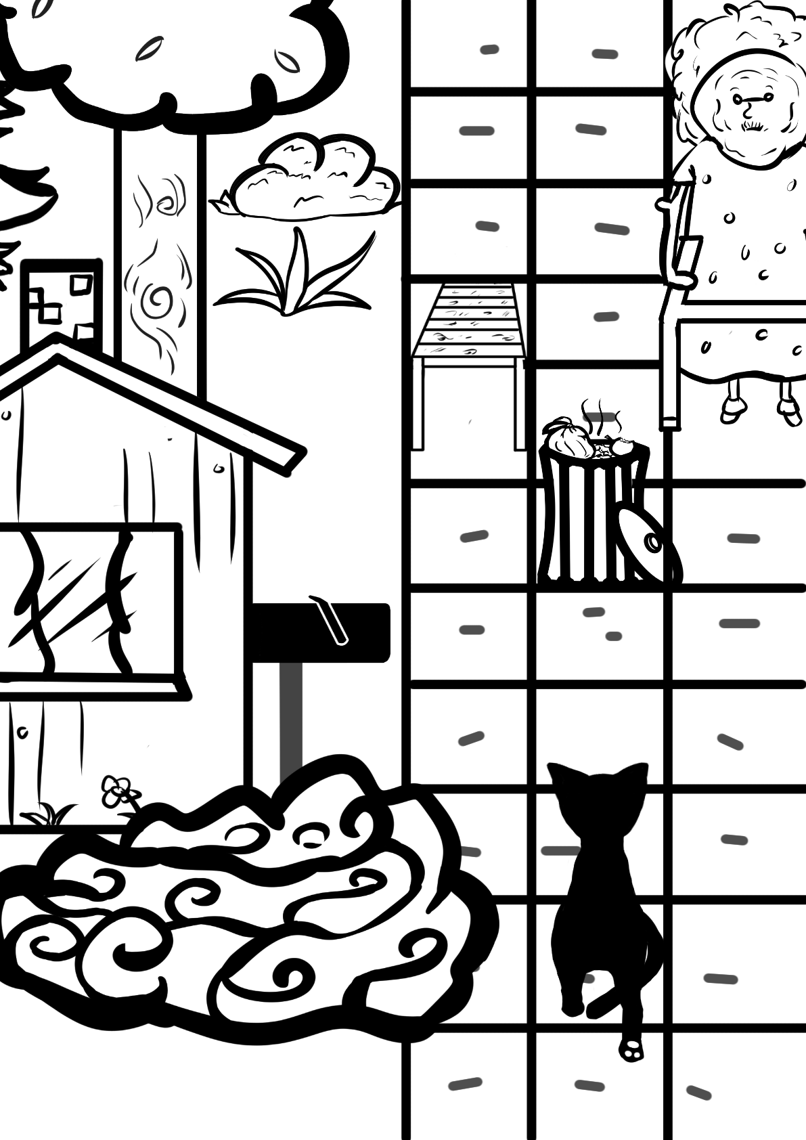
How the final product might look like

