Slide 1
Bachelor-Praktikum Tsunami-Simulation
Assignment 3
Raphael Dümig, Thomas Blocher (Gruppe 2)

Slide 2
1 – NetCDF output
Partial Dambreak using netCDF for saving

Slide 3
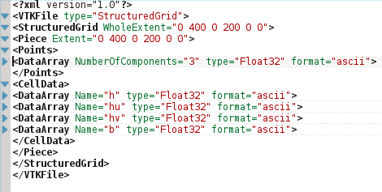
1 – NetCDF output
VTK files:
  XML-structure
  elements of data arrays separated by whitespaces and newlines

Slide 4
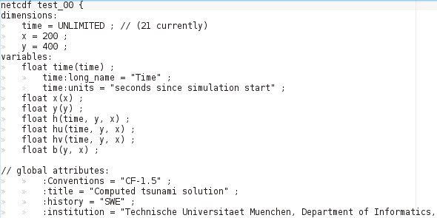
1 – NetCDF output
netCDF files:
  binary coded (in compressed form)
  preamble
  structure similar to C++-class

Slide 5
2 – NetCDF input
Artificial Tsunami: „tsunami in a swimming pool“
- builtin displacement and bathymetry

Slide 6
2 – NetCDF input
Artificial Tsunami: „tsunami in a swimming pool“
- bathymetry and displacement from separate files

Slide 7
2 – NetCDF input
builtin data:
  easier to program
  low flexibility: recompiling necessary when the data changes
nc data files:
  high flexibility: input data can be changed without recompiling

Slide 8
4 – Tsunami Simulation
Tohoku Tsunami:
  simulation crashed due to extreme values in the f-wave solver in the first timestep
  cell size:
    x range: 7000km => 7km cell size
    y range: 4000km => 4km cell size

Slide 9
4 – Tsunami Simulation
Chile Tsunami:
  cell size:
    x range: 15540km => 15,54km cell size
    y range: 11655km => 11,655km cell size

