Slide 1
SWE-LAB
Dynamic Displacement
Final Presentation
Thomas Blocher

Slide 2
1. Dynamic Displacement
2. Boyes
3. Extending the Code
4. Refactoring and Performance optimization

Slide 3
Dynamic Displacement
What is Dynamic Displacement?
What needed to be done?
What is the difference?

Slide 4
What needed to be done?
1 Extend Writer
2 Extend Scenario
3 Extend Block
4 Extend Main

Slide 5
What is the Difference?
Not known => Boyes

Slide 6
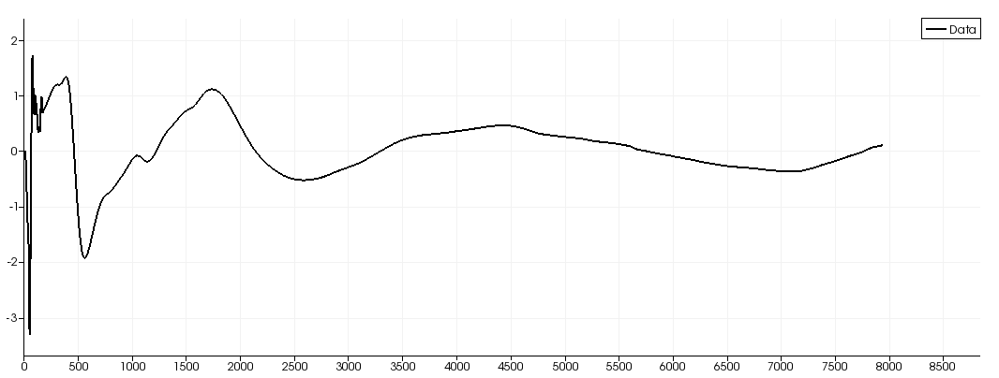
Boyes

Slide 7
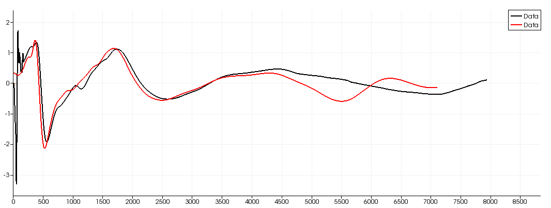
Comparence of Boyes

Slide 8
Extending the Code
Restore lost funktionality
Improve scons
Make Pseudo-Static
Checkpointing for Boyes
Input arguments for boyes and checkpoints in Start-Phase

Slide 9
Refaktoring, Bug searching and Performance optimization
Problems:
  Larger Input Files
  Wet cells can get dry and the other way
  Larger output Files because of Bathymetry Data

Slide 10
NetCDF
Binary FileSystem

Slide 11
Wet and Dry Cells
  Wet Cells are allowed to run dry
  Dry Cells aren't allowed to get wet
  => Dry Cells don't get Bathymetry updates

