Slide 1


Data Structures
ETCCDS202
Dr. Aarti
Faculty
School of Engineering & Technology
K.R. Mangalam University
Unit 2 : Linear Data Structures

Slide 2

Unit-2 Linear Data Structures
SESSION 11 Arrays – 1D & 2D
SESSION 12 Static & Dynamic Arrays
SESSION 13 Linked Lists Types
SESSION 14 Linked List Operations
SESSION 15 Stack ADT & Operations
SESSION 16 Stack Applications
SESSION 17 Queue ADT
SESSION 18 Queue Applications
SESSION 19 BFS using Queue
SESSION 20 Revision (Unit–2)
Notes:
New Courses replaced with New Programmes

Slide 3
Revision (Unit-2)
Session 20
Arrays: 1-D & 2-D (Core Concepts)
Static vs Dynamic Arrays
Linked List: Types & Operations
Stack ADT & Operations
Stack Applications (Expression Evaluation, Conversion, Recursion)
Queue ADT & Operations
Linear Queue & Circular Queue
Queue Applications
BFS using Queue
Numerical Problems & Tracing Techniques
Key Takeaways
References
Notes:
New Courses replaced with New Programmes

Slide 4
Learning Objectives
After this revision session, students will be able to:
Recall the concepts of arrays, linked lists, stacks, and queues
Recall the difference between static and dynamic arrays
Identify types of linked lists and perform basic operations
Apply stack algorithms for expression evaluation and conversion
Recall queue operations including circular queue conditions
Trace numerical problems involving stack and queue
Notes:
New Courses replaced with New Programmes

Slide 5
Revision Summary: Arrays (1D, 2D, Static & Dynamic)
Arrays – Core Concepts
Linear data structure storing same data type elements
Stored in contiguous memory locations
Accessed using index (starts from 0)
1-D Arrays
Store elements in a single row
Common operations: traversal, sum, search, update
2-D Arrays
Array of arrays (rows × columns)
Access format: array[row][column]
Used for matrices, tables, grids
Notes:
New Courses replaced with New Programmes

Slide 6
Revision Summary: Arrays (1D, 2D, Static & Dynamic)
Static Arrays
Size fixed at compile time
Stored in stack memory
Faster access, less flexible
Dynamic Arrays
Size decided at runtime
Stored in heap memory
Flexible, efficient memory usage
Python list behaves as a dynamic array
Comparison
Feature | Static Array | Dynamic Array
Size | Fixed | Resizable
Memory | Stack | Heap
Speed | Faster | Slightly slower
Flexibility | Low | High
Notes:
New Courses replaced with New Programmes

Slide 7
Revision Summary: Linked Lists (Types & Operations)
Linked List – Core Idea
Linear data structure of nodes
Each node = data + pointer(s)
Stored in non-contiguous memory
First node → Head
Types of Linked Lists:
Singly Linked List | Doubly Linked List | Circular Linked List
One pointer (next) Forward traversal only Least memory usage | Two pointers (prev, next) Bidirectional traversal More memory overhead | Last node points to head No NULL pointer Circular Doubly Linked List Combines doubly + circular features
Notes:
New Courses replaced with New Programmes

Slide 8
Revision Summary: Linked Lists (Types & Operations)
Linked List Operations
Traversal – visit all nodes (O(n))
Insertion
Beginning → O(1) (fastest)
End / Middle → O(n)
Deletion
Beginning → O(1)
End / Middle → O(n)
Search → O(n)
Notes:
New Courses replaced with New Programmes

Slide 9
Revision Summary: Linked Lists (Types & Operations)
Key Advantages
Dynamic size
Efficient insertion & deletion
No memory wastage due to resizing
Key Disadvantages
No direct access
Extra memory for pointers
Slower traversal than arrays
Notes:
New Courses replaced with New Programmes

Slide 10
What is a Stack?
A Stack is a linear data structure that follows a particular order in which operations are performed. The order may be LIFO (Last In, First Out) or FILO (First In, Last Out).
Key Characteristics:
Abstract Data Type (ADT): Defined by its behavior rather than its implementation.
Restricted Access: Elements can only be added or removed from one end, called the TOP.
Stack Operations:
Push
Pop
Notes:
New Courses replaced with New Programmes

Slide 11
Operations on Stack Numerical
Perform the following sequence of operations on an initially empty stack and show the stack's contents after each operation:
PUSH(10)
PUSH(20)
POP()
PUSH(30)
PUSH(40)
POP()
POP()
Notes:
New Courses replaced with New Programmes

Slide 12
Operations on Stack Numerical
Solution:
Operation | Stack Contents (from bottom to top)
Initially Empty | [ ]
PUSH(10) | [10]
PUSH(20) | [10, 20]
POP() | [10] (20 is popped)
PUSH(30) | [10, 30]
PUSH(40) | [10, 30, 40]
POP() | [10, 30] (40 is popped)
POP() | [10] (30 is popped)
Notes:
New Courses replaced with New Programmes

Slide 13
Postfix Expression Evaluation
Postfix: Operators appear after their operands (e.g., AB+).
Evaluation using Stack:
Scan expression left-to-right.
If operand, push onto stack.
If operator, pop two operands, perform operation, push result back.
Final result is the single value left on stack.
Notes:
New Courses replaced with New Programmes

Slide 14
Postfix Expression Evaluation Numerical
Evaluate the postfix expression: 5 2 + 8 4 / - 3 *
Scanned Element | Operation/Stack State | Stack (bottom to top)
5 | Push 5 | [5]
2 | Push 2 | [5, 2]
+ | Pop 2, Pop 5. Calculate 5 + 2 = 7. Push 7. | [7]
8 | Push 8 | [7, 8]
4 | Push 4 | [7, 8, 4]
/ | Pop 4, Pop 8. Calculate 8 / 4 = 2. Push 2. | [7, 2]
- | Pop 2, Pop 7. Calculate 7 - 2 = 5. Push 5. | [5]
3 | Push 3 | [5, 3]
* | Pop 3, Pop 5. Calculate 5 * 3 = 15. Push 15. | [15]
Result | The final value on the stack is 15. | [15]
Notes:
New Courses replaced with New Programmes

Slide 15
Infix to Postfix Conversion
Infix: Standard notation with operators between operands (e.g., A + B).
Conversion using Stack: Uses an operator stack and considers operator precedence and associativity.
Operand: Append to postfix string.
'(': Push onto stack.
')': Pop operators from stack and append to postfix until '(' is encountered (pop '(' too).
Operator: Pop operators from the stack and append to the postfix while the stack’s top operator has a higher or equal precedence. Then push the current operator.
Notes:
New Courses replaced with New Programmes

Slide 16
Infix to Postfix Conversion
Precedence
(Higher to Lower):
^ (Exponentiation)
*, /
+, -
Notes:
New Courses replaced with New Programmes

Slide 17
Infix to Postfix Conversion Numerical
Convert the infix expression (A + B) * C - D / E to postfix.
Scanned Character | Operator Stack | Postfix Expression | Explanation
( | [ ( ] |  | Push '('
A | [ ( ] | A | Operand: Append to postfix.
+ | [ (, + ] | A | Operator: Push '+'
B | [ (, + ] | A B | Operand: Append to postfix.
) | [ ] | A B + | Pop until '(': '+' popped.
* | [ * ] | A B + | Operator: Push '*'
Notes:
New Courses replaced with New Programmes

Slide 18
Infix to Postfix Conversion Numerical
C - D / E
Scanned Character | Operator Stack | Postfix Expression | Explanation
C | [ * ] | A B + C | Operand: Append to postfix.
- | [ - ] | A B + C * | Operator '-': Pop '*' (higher precedence) then push '-'.
D | [ - ] | A B + C * D | Operand: Append to postfix.
/ | [ -, / ] | A B + C * D | Operator '/': Push '/' (higher precedence than '-' on stack top).
E | [ -, / ] | A B + C * D E | Operand: Append to postfix.
End | [ ] | A B + C * D E / - | Pop remaining operators: '/' then '-'.
Final Postfix Expression: A B + C * D E / -
Notes:
New Courses replaced with New Programmes

Slide 19
Stack ( Arithmetic Conversion Practice Question)
Question 1: Translate the following infix expression to its postfix equivalent expression: A + B * (C + D) / F + D * E. Also write the algorithm that you used for this conversion and evaluate the postfix expression’s value for A=10, B=27, C=3 D=5 F=4 and E= 2.
Notes:
New Courses replaced with New Programmes

Slide 20
Solution:-
Algorithm (Converting Infix to Postfix)
Initialize an empty stack for operators and an empty list for the output (postfix expression).
Read each token (operand, operator, or parenthesis) from the infix expression from left to right:
If the token is an operand (A-Z, 0-9), append it to the output list.
If the token is an operator (+, -, *, /, etc.):
While the stack is not empty and the top of the stack has an operator of greater than or equal precedence to the current token, pop operators from the stack to the output list.
Push the current token onto the stack.
Notes:
New Courses replaced with New Programmes

Slide 21
Solution:-
c. If the token is a left parenthesis '(', push it onto the stack.
d. If the token is a right parenthesis ')':
Pop from the stack to the output list until a left parenthesis is encountered.
Discard the left parenthesis from the stack.
3. After reading all tokens, pop any remaining operators from the stack to the output list.
The output list now contains the postfix expression.
Notes:
New Courses replaced with New Programmes

Slide 22
Step | Read Token | Stack | Output (Postfix)
1 | A |  | A
2 | + | + | A
3 | B | + | A B
4 | * | + * | A B
5 | ( | + * ( | A B
6 | C | + * ( | A B C
7 | + | + * ( + | A B C
8 | D | + * ( + | A B C D
9 | ) | + * | A B C D +
10 | / | + / | A B C D + *
11 | F | + / | A B C D + * F
12 | + | + | A B C D + * F /
13 | D | + | A B C D + * F / D
14 | * | + * | A B C D + * F / D
15 | E | + * | A B C D + * F / D E
16 | End |  | A B C D + * F / + D E * +
Notes:
New Courses replaced with New Programmes

Slide 23
Evaluating Postfix Expression Given values:
A=10, B=27, C=3, D=5, F=4, E=2
Step | Read Token | Stack Before | Operation | Stack After
1 | A (10) |  | Push 10 | 10
2 | B (27) | 10 | Push 27 | 10 27
3 | C (3) | 10 27 | Push 3 | 10 27 3
4 | D (5) | 10 27 3 | Push 5 | 10 27 3 5
5 | + | 10 27 3 5 | 3 + 5 = 8 | 10 27 8
6 | * | 10 27 8 | 27 * 8 = 216 | 10 216
7 | F (4) | 10 216 | Push 4 | 10 216 4
8 | / | 10 216 4 | 216 / 4 = 54 | 10 54
9 | + | 10 54 | 10 + 54 = 64 | 64
10 | D (5) | 64 | Push 5 | 64 5
11 | E (2) | 64 5 | Push 2 | 64 5 2
12 | * | 64 5 2 | 5 * 2 = 10 | 64 10
13 | + | 64 10 | 64 + 10 = 74 | 74
Notes:
New Courses replaced with New Programmes

Slide 24
Arithmetic Conversion Practice Question
Question 2: What is the equivalent infix expression of the following postfix expression?
M, N, O, +, *, P, /, Q, R, S, T, /, +, *, –
Notes:
New Courses replaced with New Programmes

Slide 25
Arithmetic Conversion Practice Question
Rule Used
If the symbol is an operand → push to stack
If the symbol is an operator →
Pop two operands from stack
Form: (operand1 operator operand2)
Push result back to stack
Notes:
New Courses replaced with New Programmes

Slide 26
Arithmetic Conversion Practice Question
Step | Symbol | Action | Stack Content
1 | M | Push | M
2 | N | Push | M, N
3 | O | Push | M, N, O
4 | + | Pop N, O → (N+O) | M, (N+O)
5 | * | Pop M, (N+O) → M*(N+O) | (M*(N+O))
6 | P | Push | (M*(N+O)), P
7 | / | Pop (M*(N+O)), P → (M*(N+O))/P | ((M*(N+O))/P)
8 | Q | Push | ((M*(N+O))/P), Q
9 | R | Push | ((M*(N+O))/P), Q, R
10 | S | Push | ((M*(N+O))/P), Q, R, S
11 | T | Push | ((M*(N+O))/P), Q, R, S, T
12 | / | Pop S, T → (S/T) | ((M*(N+O))/P), Q, R, (S/T)
13 | + | Pop R, (S/T) → R+(S/T) | ((M*(N+O))/P), Q, (R+(S/T))
14 | * | Pop Q, (R+(S/T)) → Q*(R+(S/T)) | ((M*(N+O))/P), (Q*(R+(S/T)))
15 | – | Pop both → Final expression | Result
Notes:
New Courses replaced with New Programmes

Slide 27
Applications of Stacks
Expression Evaluation and Conversion: Infix to Postfix/Prefix, Postfix Evaluation.
Recursion Management: Function call stack.
Undo/Redo Functionality: In text editors, software applications.
Backtracking Algorithms: Solving mazes, knight's tour.
Browser History: Navigating back through web pages.
Syntax Parsing: Compilers use stacks to check for balanced parentheses, braces, etc.
Notes:
New Courses replaced with New Programmes

Slide 28
Recursion
A programming technique where a function calls itself, directly or indirectly, to solve a problem.
How Stacks are Involved?
The "Call Stack" (or "Execution Stack") is a crucial data structure used by the computer's operating system and programming language runtime to manage function calls.
When a function is called, a "stack frame" (or "activation record") is pushed onto the call stack. This frame contains: Local variables, Parameters & Return address
When the function finishes, its stack frame is popped from the call stack, and control returns to the address specified in the frame.
Notes:
New Courses replaced with New Programmes

Slide 29
Assignment
Evaluate the following postfix expressions. Show each step of the evaluation, including the stack's state.
a) 8 4 2 / + 5 *
b) 10 2 3 * + 6 –
Convert the following infix expressions to their equivalent postfix form. Show the state of the operator stack and the postfix expression at each significant step. Assume the standard operator precedence:
A + B * C – D
(P - Q) * R + S / T
Notes:
New Courses replaced with New Programmes

Slide 30
Recap of Queues
Definition: A linear data structure with FIFO order.
Analogy: Like a ticket counter queue.
Order: Front = deletion end, Rear = insertion end.
Key Characteristics:
Abstract Data Type (ADT): Defined by its behavior.
Restricted Access: Elements are added at one end (Rear/Tail) and removed from the other end (Front/Head).
Notes:
New Courses replaced with New Programmes

Slide 31
Linear Queue Operations
Enqueue (Insertion): Adds an element to the rear of the queue.
If the queue is full, it's an Overflow condition.
Dequeue (Deletion): Removes an element from the front of the queue.
If the queue is empty, it's an Underflow condition.
Front: Points to the first element in the queue.
Rear: Points to the last element in the queue.
Limitation: After several Dequeue operations, even if space becomes available at the front, new elements can only be added at the rear, leading to "queue full" even if the array isn't entirely used.
Notes:
New Courses replaced with New Programmes

Slide 32
Numerical Problem: Linear Queue Trace
Perform the following sequence of operations on an initially empty linear queue with a maximum size of 5. Show the queue's contents and the Front and Rear pointers after each operation.
ENQUEUE(10)
ENQUEUE(20)
DEQUEUE()
ENQUEUE(30)
ENQUEUE(40)
DEQUEUE()
ENQUEUE(50)
ENQUEUE(60)
DEQUEUE()
Notes:
New Courses replaced with New Programmes

Slide 33
Numerical Problem: Linear Queue Trace
Solution
Operation | Queue Contents (Front to Rear) | Front | Rear | Notes
Initially Empty | [ ] | -1 | -1
ENQUEUE(10) | [10] | 0 | 0
ENQUEUE(20) | [10, 20] | 0 | 1
DEQUEUE() | [20] | 1 | 1 | 10 removed
ENQUEUE(30) | [20, 30] | 1 | 2
ENQUEUE(40) | [20, 30, 40] | 1 | 3
DEQUEUE() | [30, 40] | 2 | 3 | 20 removed
ENQUEUE(50) | [30, 40, 50] | 2 | 4
ENQUEUE(60) | Queue Full | 2 | 4 | Cannot add 60. Array size is 5 (indices 0-4).
DEQUEUE() | [40, 50] | 3 | 4 | 30 removed
Notes:
New Courses replaced with New Programmes

Slide 34
Circular Queue Operations
Enqueue: Adds to the rear.
Rear = (Rear + 1) % MaxSize.
Dequeue: Removes from the front.
Front = (Front + 1) % MaxSize.
Conditions:
Empty: Front = -1 (or Front = Rear depending on implementation).
Full: (Rear + 1) % MaxSize == Front.
Notes:
New Courses replaced with New Programmes

Slide 35
Circular Queue Numerical Problem
Perform the following sequence of operations on an initially empty circular queue with a maximum size of 5. Show the queue's contents and the Front and Rear pointers after each operation. Assume Front = -1 and Rear = -1 for an empty queue.
ENQUEUE(A)
ENQUEUE(B)
DEQUEUE()
ENQUEUE(C)
ENQUEUE(D)
ENQUEUE(E)
DEQUEUE()
ENQUEUE(F)
ENQUEUE(G)
Notes:
New Courses replaced with New Programmes

Slide 36
Circular Queue Numerical problem
Solution:
Operation | Queue Contents | Front | Rear | Notes
Initially Empty | [ , , , , ] | -1 | -1
ENQUEUE(A) | [A, , , , ] | 0 | 0
ENQUEUE(B) | [A, B, , , ] | 0 | 1
DEQUEUE() | [ , B, , , ] | 1 | 1 | 'A' removed.
Notes:
New Courses replaced with New Programmes

Slide 37
Circular Queue Numerical problem
Operation | Queue Contents | Front | Rear | Notes
ENQUEUE(D) | [ , B, C, D, ] | 1 | 3
ENQUEUE(E) | [ , B, C, D, E] | 1 | 4
DEQUEUE() | [ , , C, D, E] | 2 | 4 | 'B' removed.
ENQUEUE(F) | [F, , C, D, E] | 2 | 0 | 'F' added at index 0 (circular wrap-around, Rear = (4+1)%5 = 0).
ENQUEUE(G) | Queue Full (B,C,D,E,F -> 5 elements) | 2 | 0 | Cannot add 'G'. (Rear + 1) % MaxSize == Front ((0+1)%5 == 1 which is not 2). Let's recheck full condition. If (Rear+1)%MaxSize == Front, it is full. Here (0+1)%5 = 1, and Front is 2. So not full.
Notes:
New Courses replaced with New Programmes

Slide 38
Queue Practice Question
Question 1. Suppose a circular queue of capacity (n – 1) elements is implemented with an array of n elements. Assume that the insertion and deletion operations are carried out using REAR and FRONT as array index variables, respectively. Initially, REAR = FRONT = 0. What are the conditions to detect a queue full and a queue empty?
Notes:
New Courses replaced with New Programmes

Slide 39
Solution:
Explanation: Suppose we start filling the queue.
Let the maximum QueueSize (Capacity of the Queue) be 4. Therefore, the size of the array used to implement this circular queue is 5, which is n. In the beginning when the queue is empty, FRONT and REAR point to 0 index in the array. REAR represents insertion at the REAR index. FRONT represents deletion from the FRONT index.
enqueue(“a”); REAR = (REAR+1)%5; ( FRONT = 0, REAR = 1)
enqueue(“b”); REAR = (REAR+1)%5; ( FRONT = 0, REAR = 2)
enqueue(“c”); REAR = (REAR+1)%5; ( FRONT = 0, REAR = 3)
enqueue(“d”); REAR = (REAR+1)%5; ( FRONT = 0, REAR = 4)
Now the queue size is 4, which is equal to the maxQueueSize. Hence overflow condition is reached.
Notes:
New Courses replaced with New Programmes

Slide 40
Solution:
Now, we can check for the conditions.
When Queue Full :
( REAR+1)%n = (4+1)%5 = 0
FRONT is also 0. Hence, ( REAR + 1 ) %n is equal to FRONT.
When the Queue is Empty :
REAR was equal to FRONT when empty (because in the starting before filling the queue, FRONT = REAR = 0 )
Notes:
New Courses replaced with New Programmes

Slide 41
Queue
Question 2:
Implement a circular queue using an array with a capacity of 5 elements. Perform enqueue operations with values 2, 4, 6, and 8. What will be the front and rear indices of the queue after these operations?
Notes:
New Courses replaced with New Programmes

Slide 42
Solutions:-
To implement a circular queue using an array with a capacity of 5 elements and perform the specified operations, let's follow these steps:
Initialize the circular queue:
Create an array of size 5.
Initialize front and rear indices to -1 to indicate that the queue is initially empty.
Enqueue operations:
Enqueue 2
Enqueue 4
Enqueue 6
Enqueue 8
Notes:
New Courses replaced with New Programmes

Slide 43
Solution:-
Circular Queue Initialization
Array: [ , , , , ] // Initial empty array of size 5 , Front: -1, Rear: -1
Enqueue Operation 1: Enqueue 2
Since the queue is initially empty (front is -1), set front to 0.
Increment rear to 0 and place the value at index 0.makefile
Array: [2, , , , ] Front: 0 Rear: 0
Notes:
New Courses replaced with New Programmes

Slide 44
Solution:-
Enqueue Operation 2: Enqueue 4, Increment rear to 1, and place the value at index 1.
Array: [2, 4, , , ] Front: 0, Rear: 1
Enqueue Operation 3: Enqueue 6, Increment rear to 2, and place the value at index 2.
Array: [2, 4, 6, , ]Front: 0, Rear: 2
Enqueue Operation 4: Enqueue 8, Increment rear to 3, and place the value at index 3.
Array: [2, 4, 6, 8, ] Front: 0, Rear: 3
Final State of the Circular Queue
After performing all the enqueue operations, the circular queue looks like this:
Array: [2, 4, 6, 8, ] Front: 0, Rear: 3
Notes:
New Courses replaced with New Programmes

Slide 45
Queue Applications
Operating Systems:
CPU Scheduling
Printer Spooling
Disk Scheduling
Networking:
Packet Buffering
Traffic Management:
Data Processing:
Asynchronous Data Transfer
Breadth-First Search (BFS): Graph traversal algorithm.
Simulation
Notes:
New Courses replaced with New Programmes

Slide 46
Key Takeaways
Arrays store elements in contiguous memory; linked lists use non-contiguous memory.
Static arrays have fixed size; dynamic arrays are resizable.
Linked lists support efficient insertion/deletion but lack direct access.
Stack is a LIFO structure used in expression evaluation, recursion, and backtracking.
Queue is a FIFO structure used in scheduling, buffering, and BFS.
Circular queues improve memory utilization.
BFS traverses graphs level by level using a queue.
Correct pointer/index updates are crucial in stack and queue operations.
Notes:
New Courses replaced with New Programmes

Slide 47
References
Textbooks
Cormen, T. H., Leiserson, C. E., Rivest, R. L., & Stein, C., Introduction to Algorithms, MIT Press.
Lipschutz, S., Schaum’s Outline of Data Structures with C++, McGraw-Hill Education.
Reference Books
Weiss, M. A., Data Structures and Algorithm Analysis in C++, 5th Edition, Pearson Education.
Skiena, S. S., The Algorithm Design Manual, 3rd Edition, Springer.
Online Resources
https://www.geeksforgeeks.org/dsa/dsa-tutorial-learn-data-structures-and-algorithms/
https://www.w3schools.com/dsa/dsa_data_stacks.php
https://www.programiz.com/dsa/queue
https://www.tutorialspoint.com/data_structures_algorithms/linked_list_algorithms.htm
Notes:
New Courses replaced with New Programmes

Slide 48
THANK YOU

Slide 49
Data Structures
ETCCDS202
Dr. Aarti
Faculty
School of Engineering & Technology
K.R. Mangalam University
Unit 2 : Linear Data Structures

Slide 50
Unit-2 Linear Data Structures
SESSION 11 Arrays – 1D & 2D
SESSION 12 Static & Dynamic Arrays
SESSION 13 Linked Lists Types
SESSION 14 Linked List Operations
SESSION 15 Stack ADT & Operations
SESSION 16 Stack Applications
SESSION 17 Queue ADT
SESSION 18 Queue Applications
SESSION 19 BFS using Queue
SESSION 20 Revision (Unit–2)
Notes:
New Courses replaced with New Programmes

Slide 51
BFS using Queue
Session 19
Introduction to Graphs
Graph Traversal Techniques (BFS & DFS)
Breadth-First Search (BFS): Concept & Properties
BFS Algorithm (Steps)
BFS – Worked Example (Level-order traversal)
BFS Implementation using Queue
Applications of BFS
Key Takeaways
References
Notes:
New Courses replaced with New Programmes

Slide 52
Learning Objectives
After this lecture, students will be able to:
Define a graph and identify its components
Differentiate between BFS and DFS
Explain BFS as a level-by-level traversal technique
Describe the role of a queue in BFS
Write the algorithm and pseudocode for BFS
Implement BFS using a queue
Notes:
New Courses replaced with New Programmes

Slide 53
Recapitulation (Queue Applications)
Queues implement FIFO for fair task processing.
Used in CPU scheduling, printer spooling, BFS, packet handling, customer service, and traffic control.
Circular queues optimize memory usage.
Priority queues serve high-priority tasks first.
Queue operations are efficient and essential for system design.
Notes:
New Courses replaced with New Programmes

Slide 54
Quick Quiz
Queue follows the __________ principle.
Circular queue overcomes the problem of __________ in linear queue.
A queue that serves higher priority elements first is called __________ queue.
Which operation inserts an element into a queue?
Which operation removes an element?
Name one OS application of queue.
Notes:
New Courses replaced with New Programmes

Slide 55
Quick Quiz (Answers)
FIFO
unused/vacant space
Priority
Enqueue
Dequeue
CPU scheduling/printer spooling
Notes:
New Courses replaced with New Programmes

Slide 56
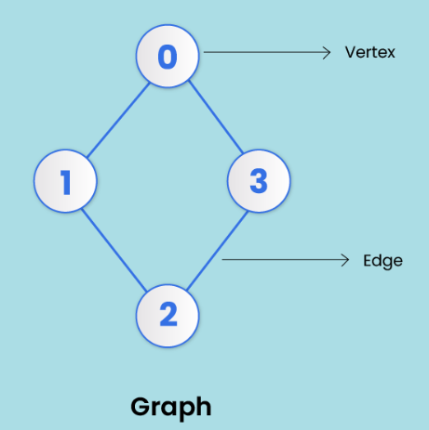
Introduction to Graphs
A graph is a non-linear data structure made up of nodes or vertices and edges.
The edges connect any two nodes in the graph, and the nodes are also known as vertices.
Notes:
New Courses replaced with New Programmes

Slide 57
Graph Traversal
Graph traversal is a method used to search nodes in a graph.
There are two traversal Techniques :
Breadth First Search
Depth First Search
Notes:
New Courses replaced with New Programmes

Slide 58
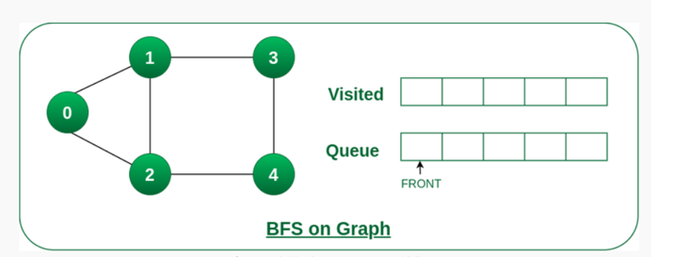
BFS (Breadth-First Search)
Breadth-First Search (BFS) is a graph traversal algorithm, where we start from a selected(source) node and traverse the graph level by level, by exploring the neighbor nodes at each level.
Notes:
New Courses replaced with New Programmes

Slide 59
Algorithm for BFS
Step 1 : Define a queue based on the number of nodes.
Step 2 : Start from any node, visit it, and add it to the queue.
Step 3 : Visit non-visited adjacent nodes in the queue.
Step 4 : Delete nodes without edges and not in the queue.
Step 5 : Empty the queue and form the spanning tree
Notes:
New Courses replaced with New Programmes

Slide 60
Example of BFS
BFS stands for __________ First Search.
BFS explores nodes __________ by __________.
The data structure used in BFS is a __________.
Queue follows the __________ principle.
Why is a queue suitable for BFS?
Which traversal technique explores deep before wide?
Notes:
New Courses replaced with New Programmes

Slide 61
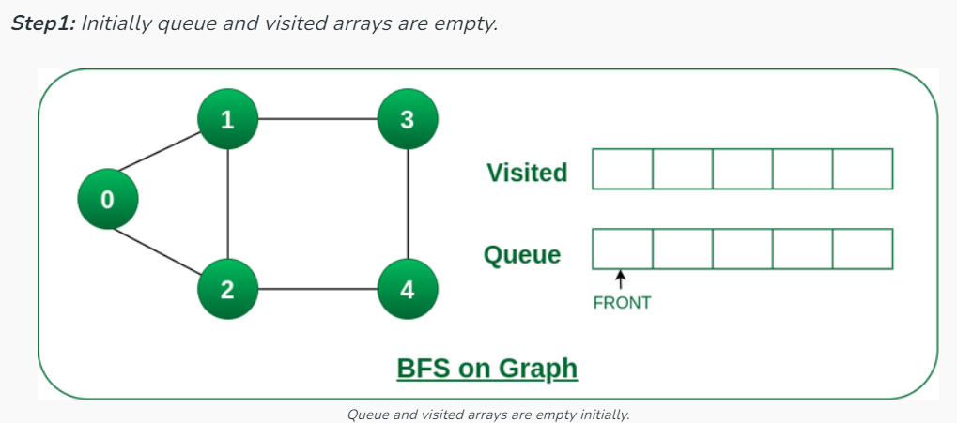
Example of BFS
Starting from the root, all the nodes at a particular level are visited first, and then the nodes of the next level are traversed till all the nodes are visited.
Notes:
New Courses replaced with New Programmes

Slide 62
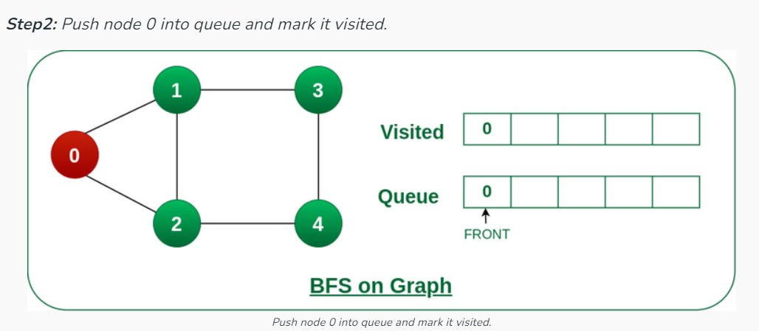
Example of BFS
Notes:
New Courses replaced with New Programmes

Slide 63
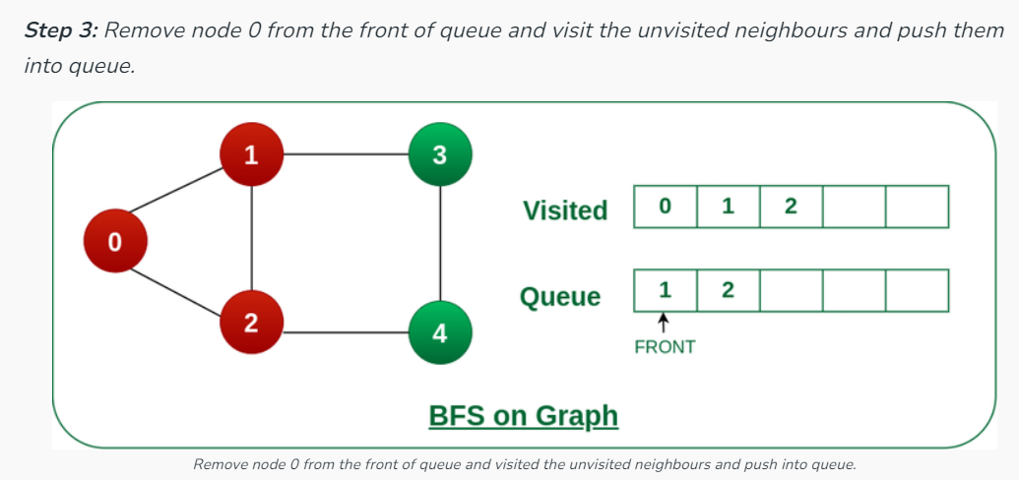
Example of BFS
Notes:
New Courses replaced with New Programmes

Slide 64
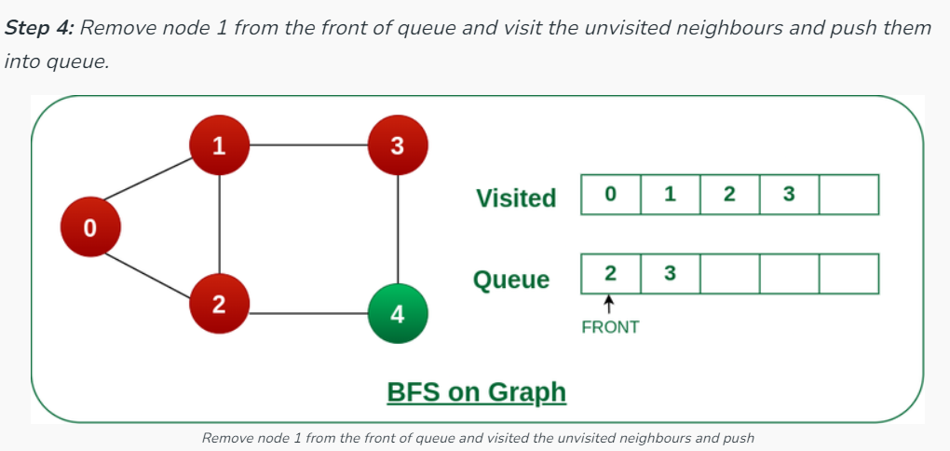
Example of BFS
Notes:
New Courses replaced with New Programmes

Slide 65
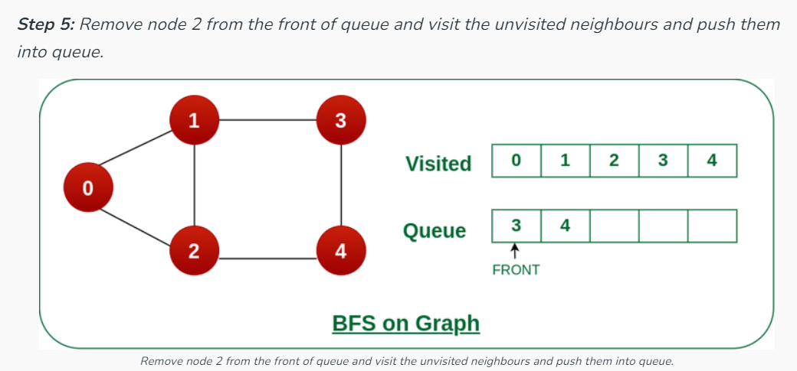
Example of BFS
Notes:
New Courses replaced with New Programmes

Slide 66
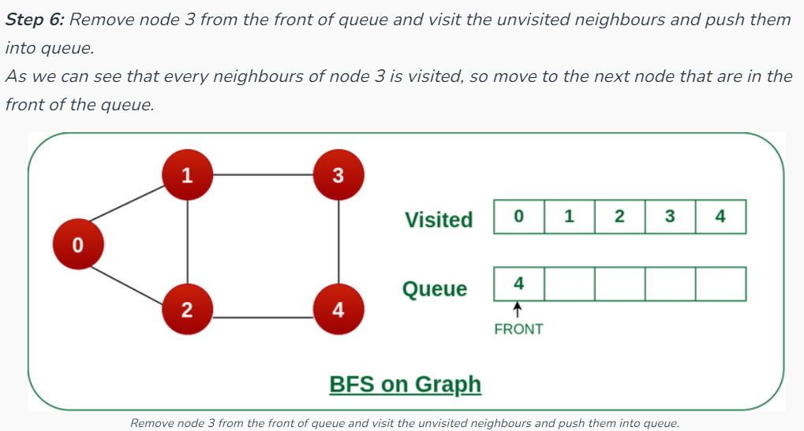
Example of BFS
Notes:
New Courses replaced with New Programmes

Slide 67
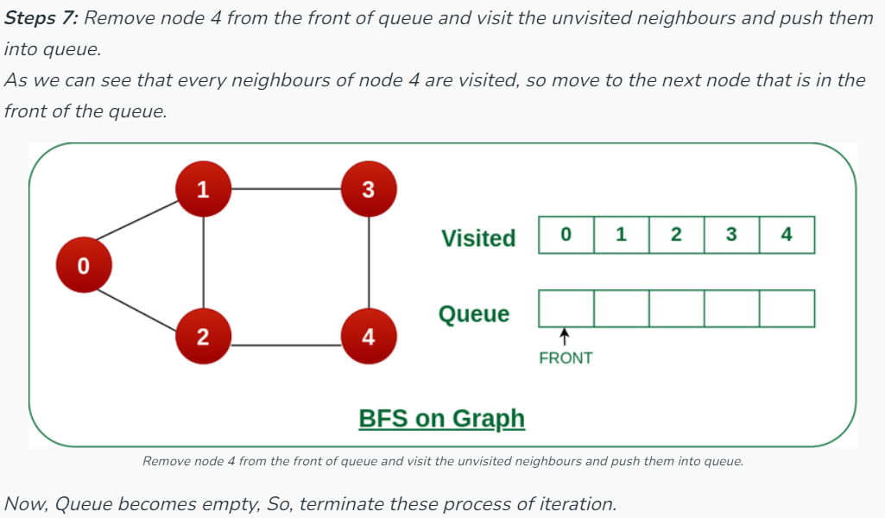
Example of BFS
Notes:
New Courses replaced with New Programmes

Slide 68

Implementing BFS traversal in Graph
BFS Traversal (PYTHON)
from collections import deque
def bfs(graph, start):
visited = set() # to keep track of visited nodes
queue = deque() # queue for BFS
visited.add(start)
queue.append(start)
print("BFS Traversal:", end=" ")

Slide 69
Implementing BFS traversal in Graph
BFS Traversal (PYTHON)
while queue:
node = queue.popleft() # dequeue
print(node, end=" ")
for neighbor in graph[node]:
if neighbor not in visited:
visited.add(neighbor)
queue.append(neighbor)

Slide 70
Implementing BFS traversal in Graph
BFS Traversal (PYTHON)
# Example graph (adjacency list)
graph = {
'A': ['B', 'C'],
'B': ['A', 'D', 'E'],
'C': ['A', 'F'],
'D': ['B'],
'E': ['B', 'F'],
'F': ['C', 'E']
}
# Call BFS
bfs(graph, 'A')

Slide 71
QUICK CHECK
How many times is a node visited in BFS?
What is enqueued first: the start node or its neighbors?
Which operation removes a vertex from the queue?
State one application of BFS.
Notes:
New Courses replaced with New Programmes

Slide 72
BFS APPLICATIONS
GPS and Map Navigation (Unweighted paths): Determines shortest routes when all edges have equal weight.
Network Broadcasting: Used to send data to all nodes in minimum time steps.
Social Network Analysis: Finds people at a certain “distance” (friends, friends of friends).
Puzzle Solving & Game AI: Used in problems like maze solving and minimum-move puzzles.
Garbage Collection Algorithms: Marks reachable memory blocks in memory management.
Notes:
New Courses replaced with New Programmes

Slide 73
Test Your Knowledge
Q1 A person wants to visit some places. He starts from a vertex and then wants to visit every place connected to this vertex and so on. What algorithm he should use? a) Depth First Search b) Breadth First Search c) Trim’s algorithm d) Kruskal’s algorithm
Answer (B)
Q2 Which of the following is not an application of Breadth First Search? a) Finding shortest path between two nodes b) Finding bipartiteness of a graph c) GPS navigation system d) Path Finding
Answer (D)
Notes:
New Courses replaced with New Programmes

Slide 74
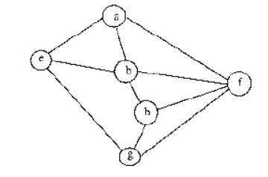
Test Your Knowledge
Q3 In BFS, how many times a node is visited? a) Once b) Twice c) Equivalent to number of indegree of the node d) Thrice
Answer (C)
Q4 Consider the following graph, Among the following sequences:Which is breadth first traversals of the above graph?
A) a → e → b → f → g → h B) a → b → e → h → g → f C) a → f → b → e → h → g D) a → e → g → b → h → f
Answer (A)
Notes:
New Courses replaced with New Programmes

Slide 75
KEY TAKEAWAYS
BFS is a graph traversal algorithm that visits vertices level by level.
It uses a queue (FIFO) to manage the traversal order.
Each vertex is visited once and marked to avoid repetition.
BFS is ideal for shortest path (unweighted graphs), bipartite checking, and level-order traversal.
Time Complexity: O(V + E)
Space Complexity: O(V) (for queue + visited array)
Notes:
New Courses replaced with New Programmes

Slide 76
References
https://www.boardinfinity.com/blog/graphs-in-data-structure/.
https://www.geeksforgeeks.org/what-is-graph-data-structure/
https://www.tutorialspoint.com/data_structures_algorithms/graph_data_structure.html.
https://www.simplilearn.com/tutorials/data-structure-tutorial/graphs-in-data-structure
https://www.geeksforgeeks.org/applications-of-graph-data-structure/
https://www.upgrad.com/blog/graphs-in-data-structure/
https://www.youtube.com/watch?v=4IZ80K72OXo
Notes:
New Courses replaced with New Programmes

Slide 77
THANK YOU

Slide 78
Data Structures
ETCCDS202
Dr. Aarti
Faculty
School of Engineering & Technology
K.R. Mangalam University
Unit 2 : Linear Data Structures

Slide 79
Unit-2 Linear Data Structures
SESSION 11 Arrays – 1D & 2D
SESSION 12 Static & Dynamic Arrays
SESSION 13 Linked Lists Types
SESSION 14 Linked List Operations
SESSION 15 Stack ADT & Operations
SESSION 16 Stack Applications
SESSION 17 Queue ADT
SESSION 18 Queue Applications
SESSION 19 BFS using Queue
SESSION 20 Revision (Unit–2)
Notes:
New Courses replaced with New Programmes

Slide 80
Queue Applications
Session 18
Introduction to Queue Applications
Why FIFO is important for real systems
Applications of Queue – Overview
Circular Queue – Need & Concept
Circular Queue Operations & Algorithms (Array)
Advantages & Disadvantages of Circular Queue
Applications of Circular Queue
Priority Queue – Concept & Operations
Priority Queue Implementations (Array/Heap/Linked List)
Key Takeaways
References
Notes:
New Courses replaced with New Programmes

Slide 81
Recapitulation (Queue ADT)
Queue follows the FIFO principle.
Insertion is done using enqueue at the rear.
Deletion is done using dequeue from the front.
Implementations: array-based and linked-list-based.
Overflow occurs when the queue is full; underflow occurs when it is empty.
Notes:
New Courses replaced with New Programmes

Slide 82
Quick Quiz
Queue follows the __________ principle.
The pointer that indicates the first element is called __________.
The operation used to insert an element is __________.
Queue underflow occurs when __________.
Which operation removes an element from a queue?
Name one application of queue.
Which implementation allows dynamic size?
Notes:
New Courses replaced with New Programmes

Slide 83
Learning Objectives
After this lecture, students will be able to:
Explain how queues are used in operating systems, networking, and algorithms
Describe the role of FIFO in CPU scheduling, buffering, and BFS
Differentiate between linear queue, circular queue, deque, and priority queue
Apply queue operations to solve real-world problems
Choose an appropriate queue type for a given application
Notes:
New Courses replaced with New Programmes

Slide 84
Applications of Queue
CPU Scheduling
Printer Spooling
Process Synchronization
Breadth-First Search (BFS)
Network Packet Handling
Customer Service Systems
Traffic Management System
Notes:
New Courses replaced with New Programmes

Slide 85
Check Your Understanding
Queue follows the __________ principle.
In CPU scheduling, processes wait in the __________ queue.
BFS explores nodes __________ by __________.
In printer spooling, print jobs are processed in __________ order.
Why is queue suitable for customer service systems?
Name one networking application of queue.
Notes:
New Courses replaced with New Programmes

Slide 86

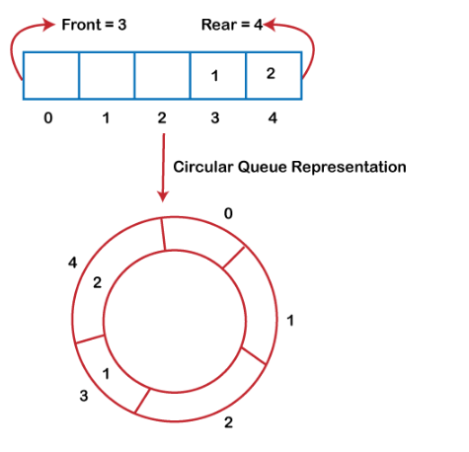
Why was the circular queue?
If the rear reaches to the end position of the Queue then there might be possibility that some vacant spaces are left in the beginning which cannot be utilized.
To overcome such limitations, the concept of the circular queue was introduced.
https://www.javatpoint.com/data-structure-queue
Notes:
New Courses replaced with New Programmes

Slide 87
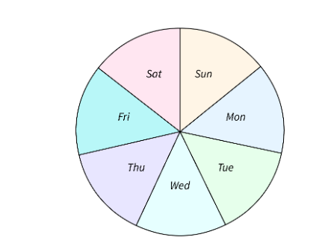
Circular Queue?
It is also based on the FIFO (First In First Out) principle except that the last position is connected to the first position in a circular queue that forms a circle.
It is also known as a Ring Buffer.
https://www.scaler.com/topics/data-structures/queue-in-data-structure/
Notes:
New Courses replaced with New Programmes

Slide 88
Operations
Front: It is used to get the front element from the Queue.
Rear: It is used to get the rear element from the Queue.
EnQueue(value): This function is used to insert the new value in the Queue. The new element is always inserted from the rear end.
DeQueue(): This function deletes an element from the Queue. The deletion in a Queue always takes place from the front end.
https://www.youtube.com/watch?app=desktop&v=gYxdHbbjn_8
Notes:
New Courses replaced with New Programmes

Slide 89
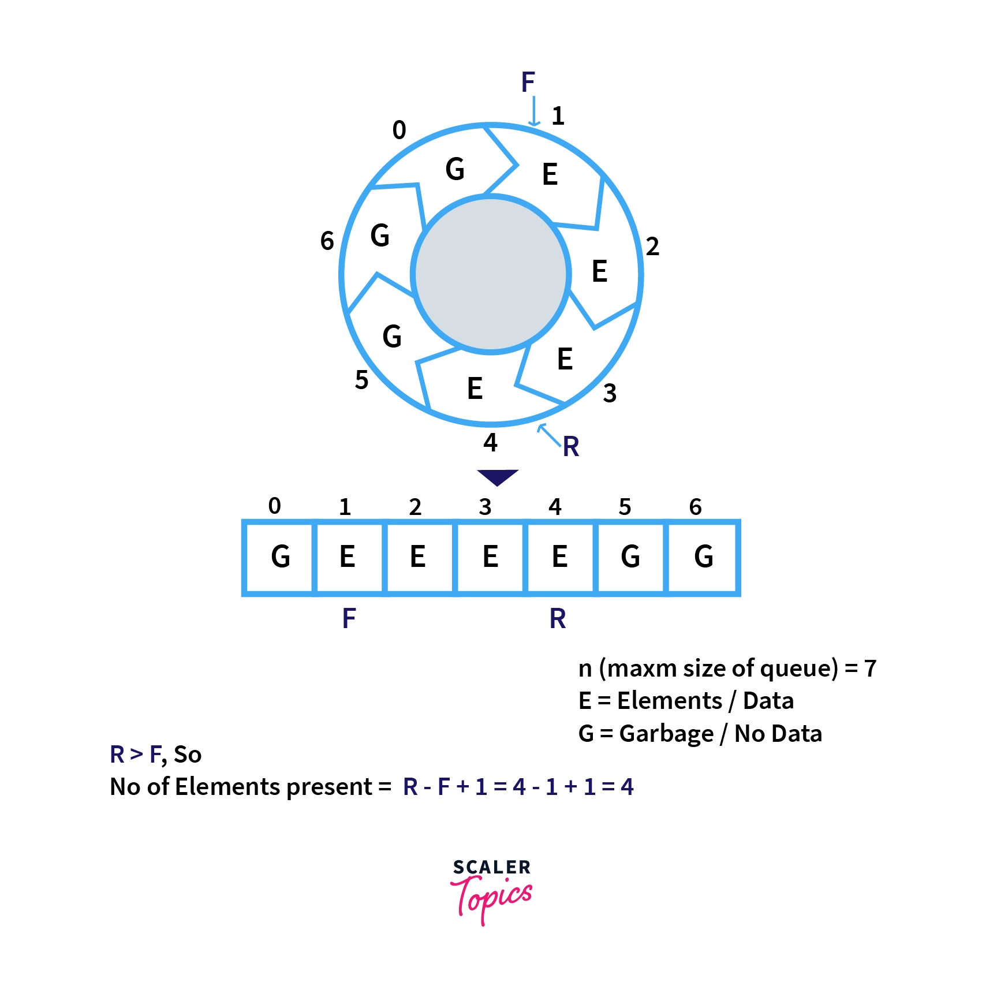
Representation using Array
https://www.youtube.com/watch?app=desktop&v=gYxdHbbjn_8
Notes:
New Courses replaced with New Programmes

Slide 90
Implement Circular Queue using Array:
Insertion
Step 1 : If FRONT = (REAR + 1) % MAXSIZE : then
Write : “Queue Overflow” and return.
[End of If structure]
Step 2 : Read NUM to be inserted in Circular Queue.
Step 3 : If FRONT= -1 : then
Set FRONT = REAR =0.
Else
Set REAR=(REAR + 1) % MAXSIZE.
[End of If Else structure]
Step 4 : Set CQUEUE[REAR]=NUM;
Step 5 : Exit
Notes:
New Courses replaced with New Programmes

Slide 91
Implement Circular Queue using Array:
Deletion
Step 1 : If FRONT = - 1 : then
Write : “Queue Underflow” and return.
[End of If Structure]
Step 2 : Set NUM = CQUEUE[FRONT].
Step 3 : Write ‘Deleted element from circular queue is : ",NUM.
Step 4 : If FRONT = REAR : then
Set FRONT = REAR = -1;
Else
Set FRONT = (FRONT + 1) % MAXSIZE.
Step 5 : Exit
Notes:
New Courses replaced with New Programmes

Slide 92
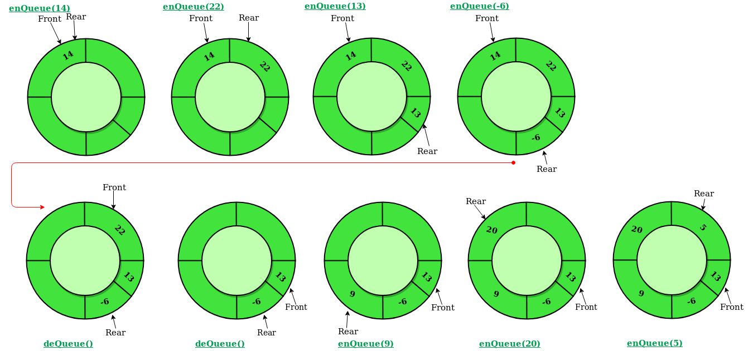
Illustration of Circular Queue Operations:
https://www.geeksforgeeks.org/introduction-to-circular-queue/
Notes:
New Courses replaced with New Programmes

Slide 93
Advantages of Circular Queue Operations
Efficient space utilization: Circular queues efficiently use the available memory space.
No shifting of elements: Elements are continuously added and removed without the need to shift remaining elements.
Simple implementation: It's relatively straightforward to implement a circular queue using an array.
Notes:
New Courses replaced with New Programmes

Slide 94
Disadvantage of Circular Queue Operations
Fixed size: Circular queues have a fixed capacity determined by the size of the underlying array.
Potential for confusion: The circular nature of the queue can sometimes lead to confusion in understanding its behavior, especially with wraparound scenarios.
Notes:
New Courses replaced with New Programmes

Slide 95
Applications of Circular Queue Operations
Applications:
Operating systems for managing task scheduling.
Networking for managing packets in routers and switches.
Memory management in embedded systems.
Simulation of resource allocation scenarios.
Notes:
New Courses replaced with New Programmes

Slide 96
Code for insertion &deletion Operation Of Queue (Python)
queue = [0] * 5
front = -1
rear = -1
size = 5
def enqueue(value):
global front, rear
if rear == size - 1:
print("Queue Overflow")
else:
if front == -1:
front = 0
rear += 1
queue[rear] = value
print(value, "inserted")
def dequeue():
global front, rear
if front == -1 or front > rear:
print("Queue Underflow")
else:
print("Deleted element:", queue[front])
front += 1
# Example usage
enqueue(10)
enqueue(20)
enqueue(30)
dequeue()
dequeue()
Notes:
New Courses replaced with New Programmes

Slide 97
Output
Elements in Circular Queue are:
14 22 6
Deleted value = 14
Deleted value = 22
Elements in Circular Queue are: 6
Elements in Circular Queue are: 6 9 20;
Notes:
New Courses replaced with New Programmes

Slide 98
Test Yourself
A standard circular Queue 'q' implemented whose size is 11 from 0 to 10. The front & rear pointers start to point at q[2]. The ninth element be added at which position?
q[0]
q[1]
q[9]
q[10]
Solution: a. q[0]
Notes:
New Courses replaced with New Programmes

Slide 99
Test Yourself
Choose the incorrect statement?
If Queue is implemented through the linked list, keeping track of a front pointer will change only rear pointer "s" during insertion into non-empty Queue.
The Queue can be used to implement the least recently used page fault algorithm and Quicksort algorithm.
The Queue can be used to implement the Quicksort algorithm but not least recently used (LRU) page fault algorithm.
Both (A) and (C)
Solution: c. The Queue can be used to implement the Quicksort algorithm but not least recently used (LRU) page fault algorithm.
Notes:
New Courses replaced with New Programmes

Slide 100
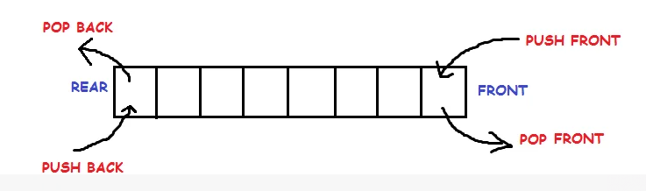
Doubly Ended Queue
Notes:
New Courses replaced with New Programmes

Slide 101
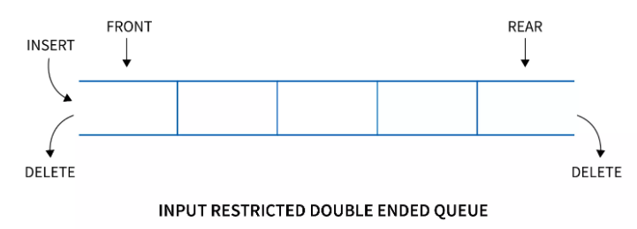
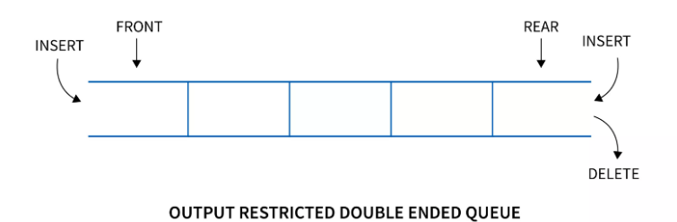
Doubly Ended Queue
Types
Input restricted queue
Output restricted queue
Notes:
New Courses replaced with New Programmes

Slide 102
Operations performed on Deque
There are the following operations that can be applied on a deque -
Insertion at front
Insertion at rear
Deletion at front
Deletion at rear
Get the front item from the deque
Get the rear item from the deque
Check whether the deque is full or not
Checks whether the deque is empty or not
Notes:
New Courses replaced with New Programmes

Slide 103

Priority Queues
https://www.simplilearn.com/tutorials/data-structure-tutorial/priority-queue-in-data-structure
Notes:
New Courses replaced with New Programmes

Slide 104
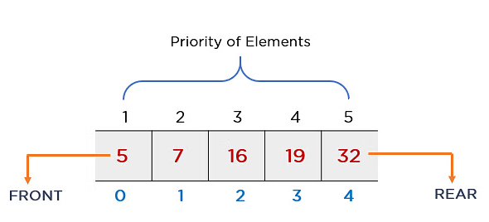
Priority Queues
The priority of elements determines the order of removal in a queue, i.e., the element with higher priority will leave the queue first, whereas the element with the lowest priority at last
https://www.simplilearn.com/tutorials/data-structure-tutorial/priority-queue-in-data-structure
Notes:
New Courses replaced with New Programmes

Slide 105
Priority Queues
Priority Order
Ascending Order
Descending Order
Notes:
New Courses replaced with New Programmes

Slide 106
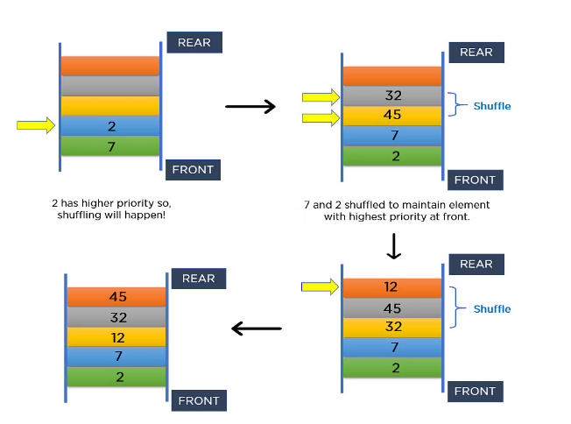
Priority Queues
https://www.simplilearn.com/tutorials/data-structure-tutorial/priority-queue-in-data-structure
Notes:
New Courses replaced with New Programmes

Slide 107
Priority Queues
https://www.simplilearn.com/tutorials/data-structure-tutorial/priority-queue-in-data-structure
Notes:
New Courses replaced with New Programmes

Slide 108
Priority Queue Applications
Operating systems
Time-activated events
Managing responsibilities
Sorting
Djikstra’s Algorithm
Prim’s Algorithm
Notes:
New Courses replaced with New Programmes

Slide 109
Implementation of Priority Queue
Using Linked List
Using Binary Heap
Using Array
Binary Search Tree
Notes:
New Courses replaced with New Programmes

Slide 110
Operation on Priority Queue
Insertion:
Insertion operation is used to insert a new element into the queue. Whenever a new element is inserted,
The new element is moved to an empty slot top to bottom and left to right.
If the inserted element is not in the correct position. It will be compared with the parent element.
And if the element is not in the correct order, then elements are swapped until the inserted element gets to the correct position.
Notes:
New Courses replaced with New Programmes

Slide 111
Operation on Priority Queue
Algorithm:
if (the queue is empty)
Create a node
else //when node is already present
Insert the new node at the end of the queue (last node from left to right) heapify the array
Notes:
New Courses replaced with New Programmes

Slide 112
Operation on Priority Queue
Deletion:
Deletion operation is used to remove any element from the queue, For deleting any element,
Choose the element which needs to be deleted.
Swap it with the last element.
Remove the last element
Heapify the array.
Notes:
New Courses replaced with New Programmes

Slide 113
Operation on Priority Queue
Deletion:
Algorithm:
if (node== leaf node)
delete node
else //when node is not leaf node
Swap node with leaf node
Delete the leaf node
heapify the array
Notes:
New Courses replaced with New Programmes

Slide 114
Implementation of Priority Queue Using Array:
The basic implementation using array is:
struct node
{
int node:
int priority:
}
Notes:
New Courses replaced with New Programmes

Slide 115
Implementation of Priority Queue Using Array:
Operations in array:
enqueue(): It is used to insert new element into the priority queue.
dequeue(): It removes an element with the highest priority from the priority queue.
peek(): It is used to determine the highest priority element in the queue without removing it.
Notes:
New Courses replaced with New Programmes

Slide 116
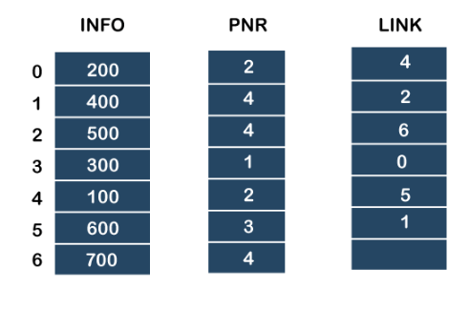
Implementation of Priority Queue
https://www.javatpoint.com/ds-priority-queue
Notes:
New Courses replaced with New Programmes

Slide 117
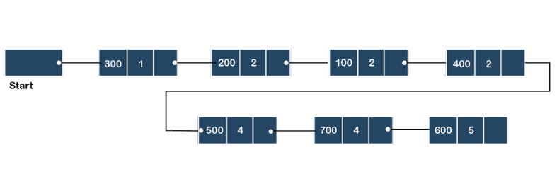
Implementation of Priority Queue
Using link list
https://www.javatpoint.com/ds-priority-queue
Notes:
New Courses replaced with New Programmes

Slide 118
Algorithm for Insertion at rear end
Step-1: [Check for overflow]
if(rear==MAX)
Print("Queue is Overflow”);
return;
Step-2: [Insert Element]
else
rear=rear+1;
q[rear]=no;
[Set rear and front pointer]
if rear=0
rear=1;
if front=0
front=1;
Step-3: return
Notes:
New Courses replaced with New Programmes

Slide 119
Algorithm for Insertion at front end
Step-1 : [Check for the front position]
if(front<=1)
Print("Cannot add item at the front”);
return;
Step-2 : [Insert at front]
else
front=front-1;
q[front]=no;
Step-3 : Return
Notes:
New Courses replaced with New Programmes

Slide 120
Algorithm for Deletion from front end
Step-1 [ Check for front pointer]
if front=0
print(" Queue is Underflow”);
return;
Step-2 [Perform deletion]
else no=q[front];
print(“Deleted element is”,no);
[Set front and rear pointer]
if front=rear
front=0;
rear=0;
else front=front+1;
Step-3 : Return
Notes:
New Courses replaced with New Programmes

Slide 121
Algorithm for Deletion from rear end
Step-1 : [Check for the rear pointer]
if rear=0
print(“Cannot delete value at rear end”);
return;
Step-2: [ perform deletion]
else no=q[rear];
[Check for the front and rear pointer]
if front= rear
front=0;
rear=0;
else rear=rear-1;
print(“Deleted element is”,no);
Step-3 : Return
Notes:
New Courses replaced with New Programmes

Slide 122
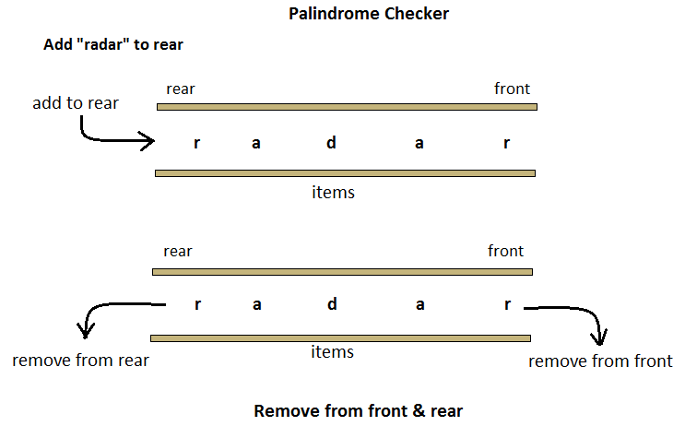
Applications
Notes:
New Courses replaced with New Programmes

Slide 123
Check Your Understanding
Why was the circular queue introduced?
What condition indicates overflow in a circular queue?
Which queue removes elements based on priority?
What is the time complexity of enqueue and dequeue in a circular queue?
Notes:
New Courses replaced with New Programmes

Slide 124
Key Takeaways
Queue is fundamental for fair and ordered processing (FIFO).
It is widely used in CPU scheduling, printer spooling, BFS, networking, and traffic systems.
Circular queues improve space utilization over linear array queues.
Priority queues process elements based on priority, not arrival time.
Choosing the right queue type improves performance and resource utilization.
Notes:
New Courses replaced with New Programmes

Slide 125
References
Textbooks
Cormen, T. H., Leiserson, C. E., Rivest, R. L., & Stein, C., Introduction to Algorithms, MIT Press.
Lipschutz, S., Schaum’s Outline of Data Structures with C++, McGraw-Hill Education.
Reference Books
Weiss, M. A., Data Structures and Algorithm Analysis in C++, 5th Edition, Pearson Education.
Skiena, S. S., The Algorithm Design Manual, 3rd Edition, Springer.
Online Resources
GeeksforGeeks – Queue Applications https://www.geeksforgeeks.org/queue-data-structure/
JavaTpoint – Queue & Circular Queue https://www.javatpoint.com/data-structure-queue
Scaler – Circular Queue https://www.scaler.com/topics/data-structures/queue-in-data-structure/
Simplilearn – Priority Queue https://www.simplilearn.com/tutorials/data-structure-tutorial/priority-queue-in-data-structure
Programiz – Queue in Python https://www.programiz.com/dsa/queue
Notes:
New Courses replaced with New Programmes

Slide 126
THANK YOU

Slide 127
Data Structures
ETCCDS202
Dr. Aarti
Faculty
School of Engineering & Technology
K.R. Mangalam University
Unit 2 : Linear Data Structures

Slide 128
Unit-2 Linear Data Structures
SESSION 11 Arrays – 1D & 2D
SESSION 12 Static & Dynamic Arrays
SESSION 13 Linked Lists Types
SESSION 14 Linked List Operations
SESSION 15 Stack ADT & Operations
SESSION 16 Stack Applications
SESSION 17 Queue ADT
SESSION 18 Queue Applications
SESSION 19 BFS using Queue
SESSION 20 Revision (Unit–2)
Notes:
New Courses replaced with New Programmes

Slide 129
Queue ADT
Session 17
Introduction to Queue ADT
Definition of Queue & FIFO Principle
Basic Queue Operations
Array Representation of Queue
Algorithms for Enqueue & Dequeue (Array)
Implementation of Queue Using Array
Drawbacks of Array Implementation
Linked List Representation of Queue
Algorithms for Linked Queue Operations
Key Takeaways
References
Notes:
New Courses replaced with New Programmes

Slide 130
Recapitulation (Stack Applications)
Stack is used for expression evaluation and conversion (infix, prefix, postfix).
It helps in function call management using the call stack.
It supports backtracking (e.g., Tower of Hanoi).
It is used to reverse data and check balanced parentheses.
Notes:
New Courses replaced with New Programmes

Slide 131
Quick Quiz
Postfix expressions are evaluated using a __________.
Tower of Hanoi is solved using __________ and stack.
Stack stores function return addresses in the __________ stack.
Infix to postfix conversion uses a stack to store __________.
Which notation places operator after operands?
Name one real-life application of stack.
Which principle is used by stack?
Notes:
New Courses replaced with New Programmes

Slide 132
Learning Objectives
After this lecture, students will be able to:
Define Queue ADT and explain the FIFO principle
Describe different types of queues
Perform basic operations on Queue
Implement queue using arrays and linked lists
Write algorithms for queue operations
Analyze advantages and limitations of different implementations
Notes:
New Courses replaced with New Programmes

Slide 133
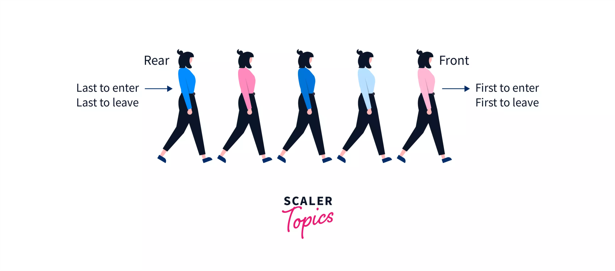
Structure of Queues?
Fig 1 : QUEUE
https://www.scaler.com/topics/data-structures/queue-in-data-structure/
Notes:
New Courses replaced with New Programmes

Slide 134
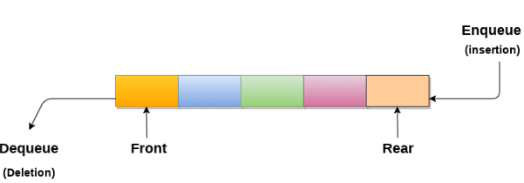
Queues?
An ordered list which enables insert operations to be performed at one end called REAR and delete operations to be performed at another end called FRONT.
Referred to be as First In First Out list.
https://www.javatpoint.com/data-structure-queue
Notes:
New Courses replaced with New Programmes

Slide 135
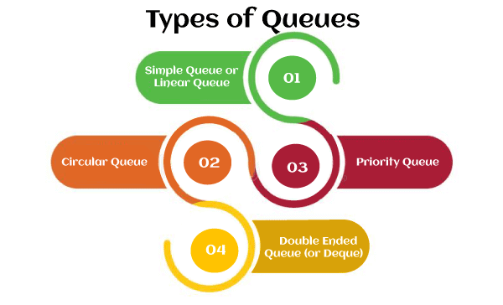
Types
https://www.javatpoint.com/data-structure-queue
Notes:
New Courses replaced with New Programmes

Slide 136
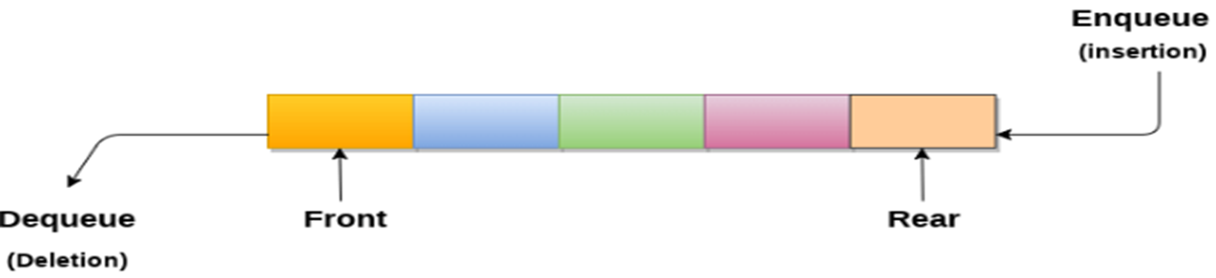



Types
https://www.javatpint.com/data-structure-queue
Notes:
New Courses replaced with New Programmes

Slide 137
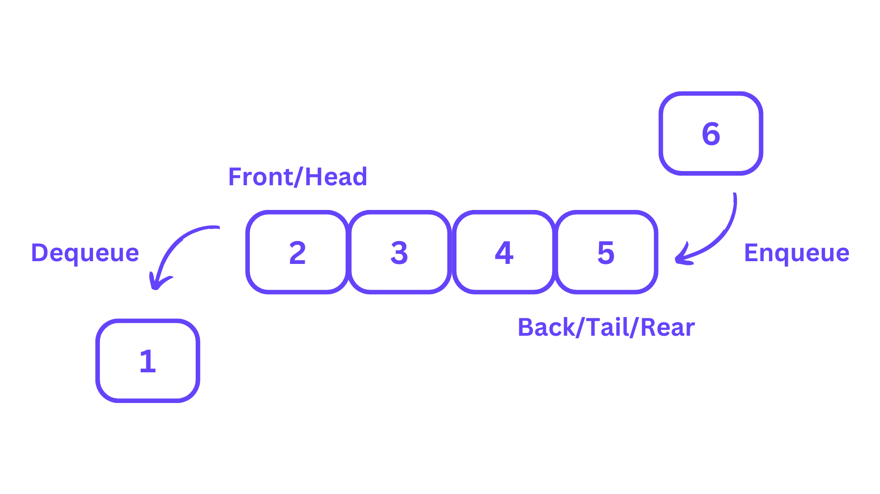
Operations
Enqueue (Insert): Adds an element to the rear of the queue.
Dequeue (Delete): Removes and returns the element from the front of the queue.
Peek: Returns the element at the front of the queue without removing it.
isEmpty: Checks if the queue is empty.
isFull: Checks if the queue is full.
https://learnloner.com/queues-in-data-structures-and-algorithms-dsa/
Notes:
New Courses replaced with New Programmes

Slide 138
Check Your Understanding
Queue follows the __________ principle.
Insertion in a queue is performed at the __________ end.
Deletion in a queue is performed from the __________ end.
The operation used to remove an element is called __________.
What is queue overflow?
Name any one type of queue.
Notes:
New Courses replaced with New Programmes

Slide 139
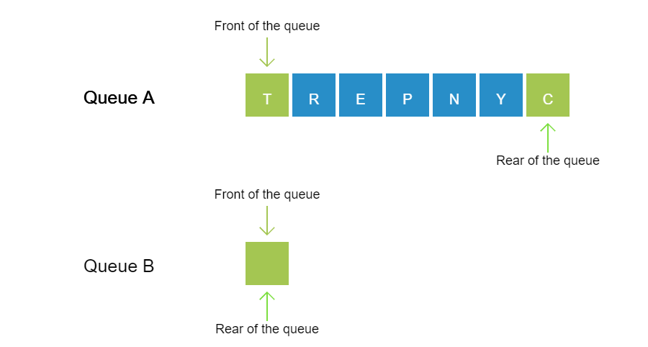
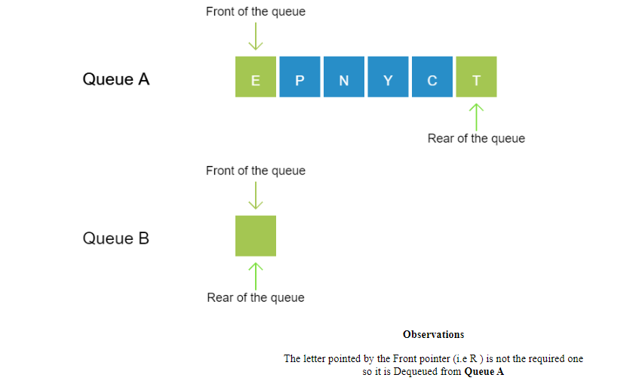
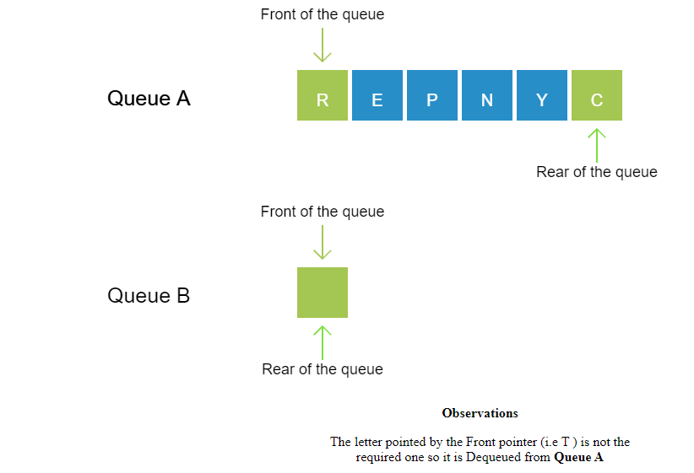
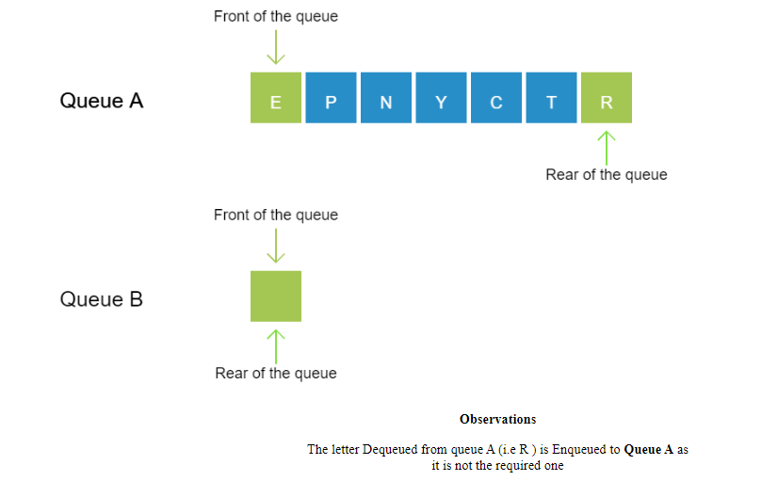
Working of Queue
Observe: The letters in the word "ENCRYPT" are stored in Queue A in a random manner. Observe the operations performed to display the letters in their correct order in Queue B so as to form the actual word.
Notes:
New Courses replaced with New Programmes

Slide 140
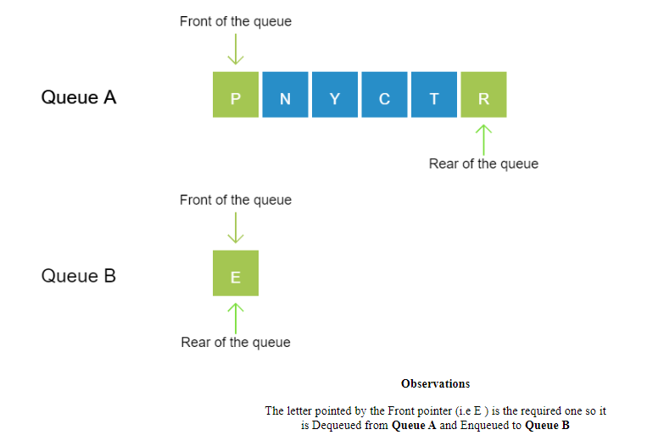
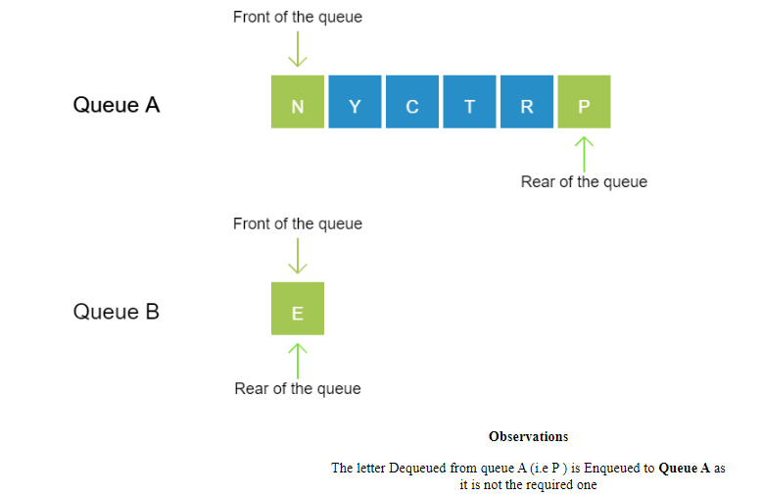
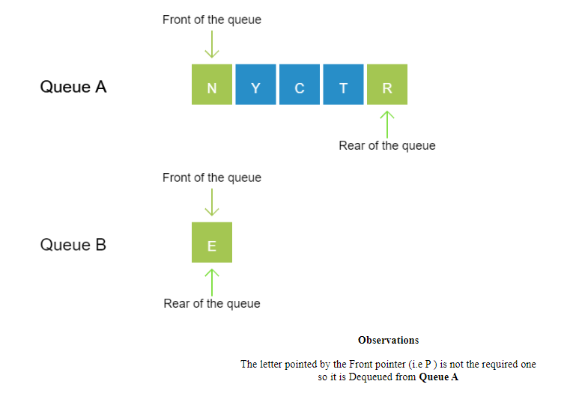
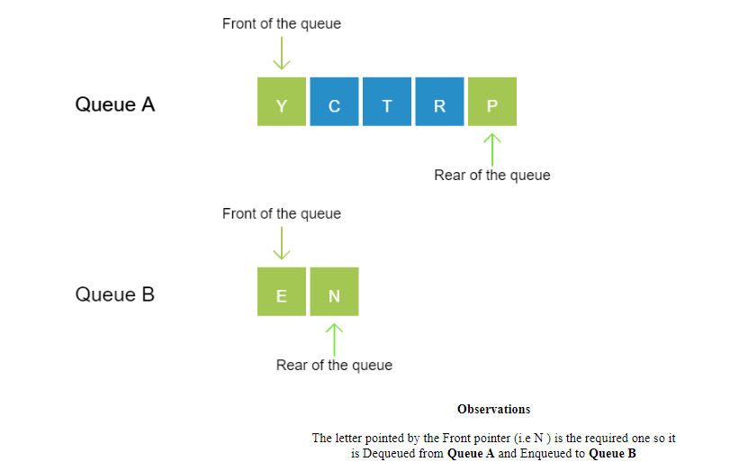
Notes:
New Courses replaced with New Programmes

Slide 141
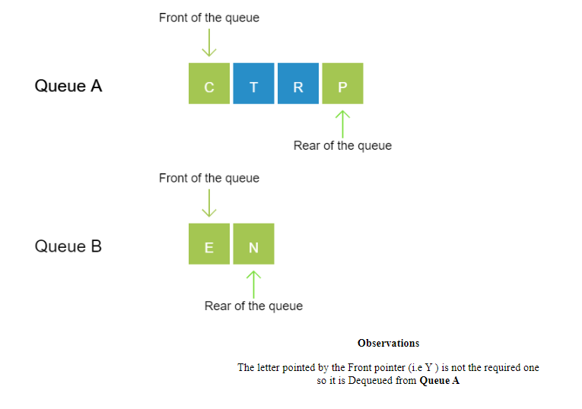
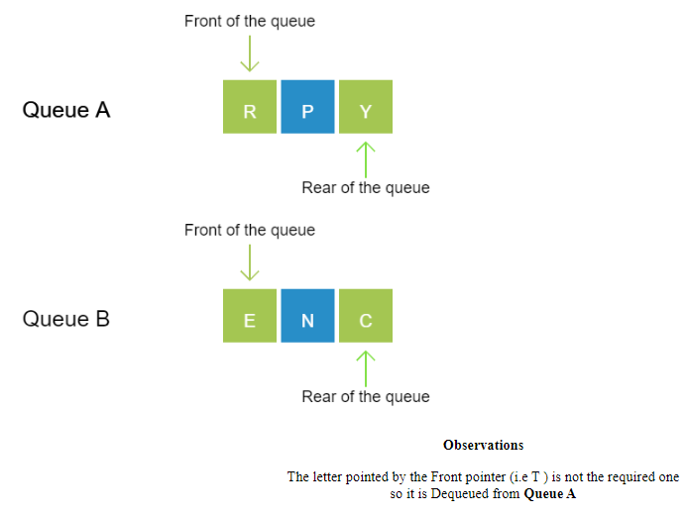
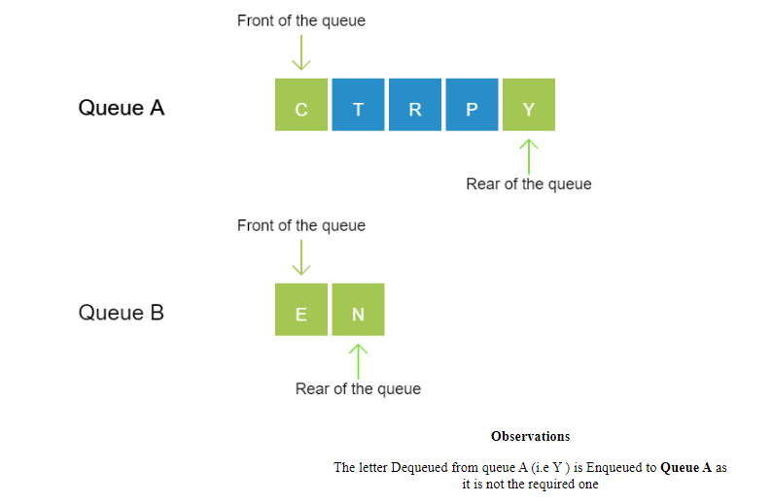
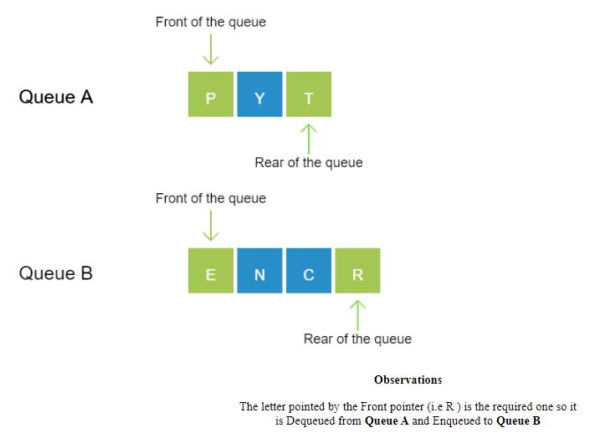
Notes:
New Courses replaced with New Programmes

Slide 142
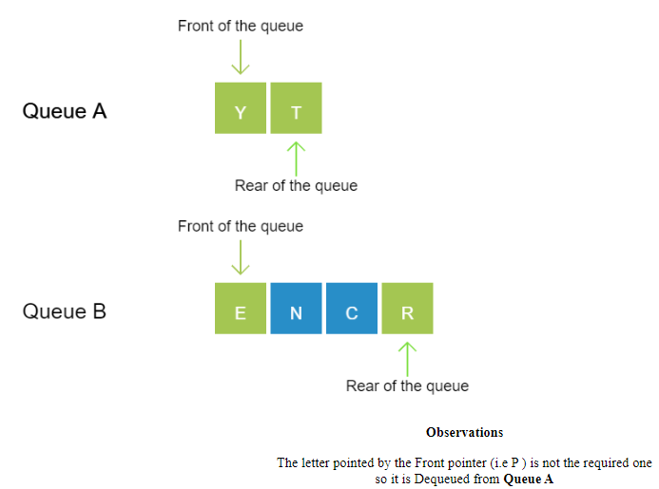
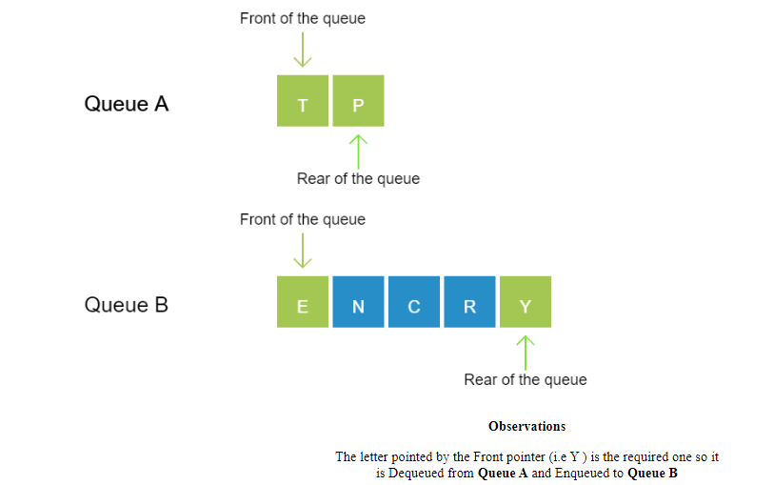
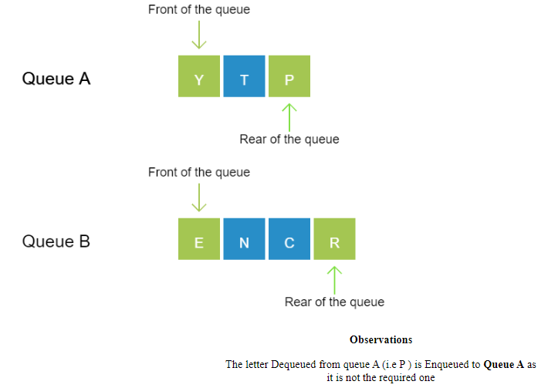
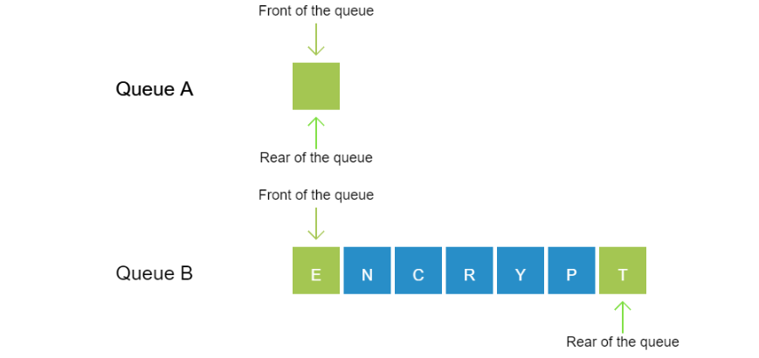
Notes:
New Courses replaced with New Programmes

Slide 143
Test Yourself
Which operation adds an element to the end of a Queue?
Enqueue
Dequeue
Peek
Push
Which operation removes an element from the front of a Queue?
Enqueue
Dequeue
Peek
Push
Notes:
New Courses replaced with New Programmes

Slide 144
Implementation of Linear Queues
Queue can be implemented using:
Arrays
Linked
Notes:
New Courses replaced with New Programmes

Slide 145
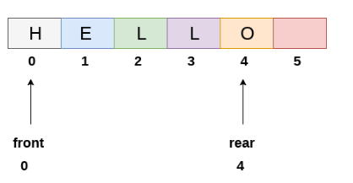
Array based implementation of linear Queues
https://www.javatpoint.com/array-representation-of-queue
Notes:
New Courses replaced with New Programmes

Slide 146
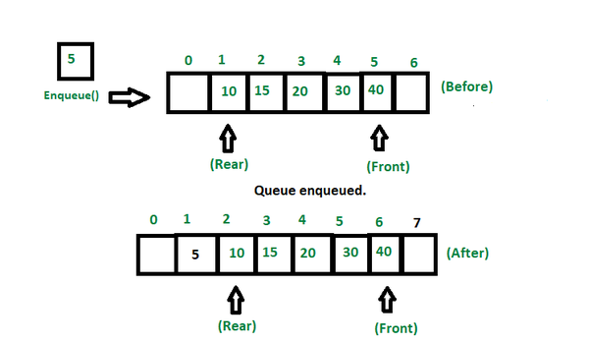
Enqueue Operations
Enqueue (Insert): Algorithm
Step 1: IF REAR = MAX - 1 Write OVERFLOW Go to step [END OF IF]
Step 2: IF FRONT = -1 and REAR = -1 SET FRONT = REAR = 0 ELSE SET REAR = REAR + 1 [END OF IF]
Step 3: Set QUEUE[REAR] = NUM
Step 4: EXIT
https://www.geeksforgeeks.org/basic-operations-for-queue-in-data-structure/
Notes:
New Courses replaced with New Programmes

Slide 147
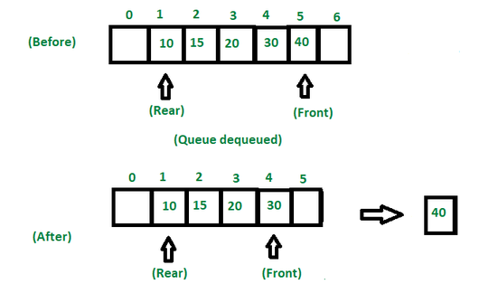
Dequeue Operation
Step 1: IF FRONT = -1 or FRONT > REAR Write UNDERFLOW ELSE SET VAL = QUEUE[FRONT] SET FRONT = FRONT + 1 [END OF IF]
Step 2: EXIT
https://www.geeksforgeeks.org/basic-operations-for-queue-in-data-structure/
Notes:
New Courses replaced with New Programmes

Slide 148
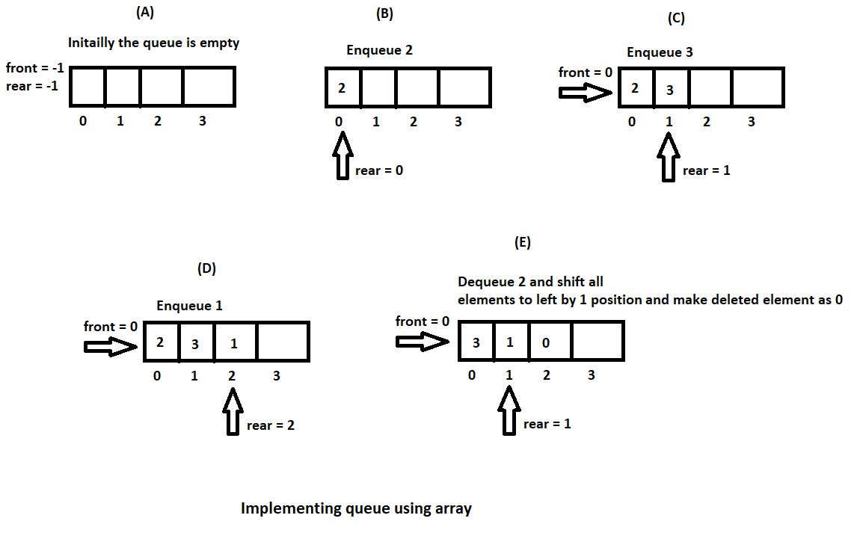
Implementation
https://hetalrachh.home.blog/2020/02/24/implementing-queue-using-array-in-java/
Notes:
New Courses replaced with New Programmes

Slide 149
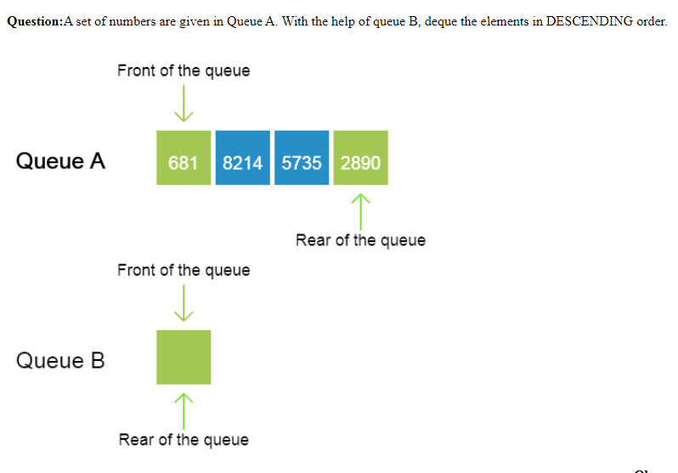
Practice
Question: A set of numbers are given in Queue A. With the help of queue B, deque the elements in DESCENDING order.
Notes:
New Courses replaced with New Programmes

Slide 150
Code for Queue Operations Using Array (Python)
# Queue implementation using array
queue = [0] * 100
n = 100
front = -1
rear = -1
def insert():
global front, rear
if rear == n - 1:
print("Queue Overflow")
else:
if front == -1:
front = 0
val = int(input("Insert the element in queue: "))
rear += 1
queue[rear] = val
def delete():
global front, rear
if front == -1 or front > rear:
print("Queue Underflow")
else:
print("Element deleted from queue is:", queue[front])
front += 1
def display():
if front == -1 or front > rear:
print("Queue is empty")
else:
print("Queue elements are:", end=" ")
for i in range(front, rear + 1):
print(queue[i], end=" ")
print()
Notes:
New Courses replaced with New Programmes

Slide 151
Code for Queue Operations Using Array (Python)
def main():
while True:
print("\n1) Insert element to queue")
print("2) Delete element from queue")
print("3) Display all the elements of queue")
print("4) Exit")
ch = int(input("Enter your choice: "))
if ch == 1:
insert()
elif ch == 2:
delete()
elif ch == 3:
display()
elif ch == 4:
print("Exit")
break
else:
print("Invalid choice")
if __name__ == "__main__":
main()
Notes:
New Courses replaced with New Programmes

Slide 152
Output
Insert element to queue
Delete element from queue
Display all the elements of queue
Exit Enter your choice : 1
Insert the element in queue : 4
Enter your choice : 1
Insert the element in queue : 3
Enter your choice : 1
Insert the element in queue : 5
Enter your choice : 2
Element deleted from queue is : 4
Enter your choice : 3
Queue elements are : 3 5
Enter your choice : 7 Invalid
Notes:
New Courses replaced with New Programmes

Slide 153
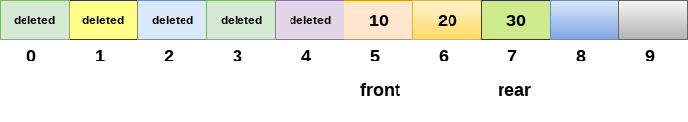
Drawback of array implementation
Memory wastage
Deciding the array size
Notes:
New Courses replaced with New Programmes

Slide 154
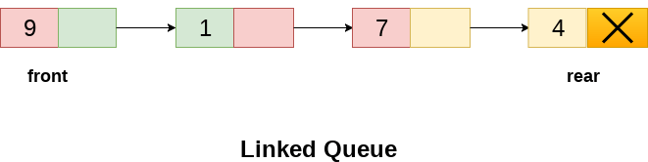
Implementation of Queue using Linked List
In a linked queue, each node of the queue consists of two parts i.e. data part and the link part.
Each element of the queue points to its immediate next element in the memory.
Notes:
New Courses replaced with New Programmes

Slide 155
Operation on Linked Queue
Insert operation
The new element will be the last element of the queue.
Firstly, allocate the memory for the new node ptr
ptr = (struct node *) malloc (sizeof(struct node));
Notes:
New Courses replaced with New Programmes

Slide 156
Operation on Linked Queue
There can be two scenarios of inserting this new node ptr into the linked queue.
Queues is empty
ptr -> data = item;
if(front == NULL)
{
front = ptr;
rear = ptr;
front -> next = NULL;
rear -> next = NULL;
}
Notes:
New Courses replaced with New Programmes

Slide 157
Operation on Linked Queue
2. The queue contains more than one element.
rear -> next = ptr;
rear = ptr;
rear->next = NULL;
Notes:
New Courses replaced with New Programmes

Slide 158
Algorithm for insert Operation on Linked Queue
Step 1: Allocate the space for the new node PTR
Step 2: SET PTR -> DATA = VAL
Step 3: IF FRONT = NULL SET FRONT = REAR = PTR SET FRONT -> NEXT = REAR -> NEXT = NULL ELSE SET REAR -> NEXT = PTR SET REAR = PTR SET REAR -> NEXT = NULL [END OF IF]
Step 4: END
Notes:
New Courses replaced with New Programmes

Slide 159
Delete Operation on Linked Queue
Deletion operation removes the element that is first inserted among all the queue elements.
ptr = front;
front = front -> next;
free(ptr);
Notes:
New Courses replaced with New Programmes

Slide 160
Algorithm for Delete Operation on Linked Queue
Step 1: IF FRONT = NULL Write " Underflow " Go to Step 5 [END OF IF]
Step 2: SET PTR = FRONT
Step 3: SET FRONT = FRONT -> NEXT
Step 4: FREE PTR
Step 5: END
Notes:
New Courses replaced with New Programmes

Slide 161
Key Takeaways
Queue is a linear data structure based on FIFO.
Insertion happens at rear; deletion happens from front.
Main operations: enqueue, dequeue, peek, isEmpty, isFull.
Queue can be implemented using arrays or linked lists.
Array-based queue is simple but may cause memory wastage and fixed size issues.
Linked list implementation allows dynamic size.
Notes:
New Courses replaced with New Programmes

Slide 162
References
Textbooks
Cormen, T. H., Leiserson, C. E., Rivest, R. L., & Stein, C., Introduction to Algorithms, MIT Press.
Lipschutz, S., Schaum’s Outline of Data Structures with C++, McGraw-Hill Education.
Reference Books
Weiss, M. A., Data Structures and Algorithm Analysis in C++, 5th Edition, Pearson Education.
Skiena, S. S., The Algorithm Design Manual, 3rd Edition, Springer.
Online Resources
GeeksforGeeks – Queue in Data Structures https://www.geeksforgeeks.org/queue-data-structure/
Scaler – Queue in Data Structures https://www.scaler.com/topics/data-structures/queue-in-data-structure/
JavaTpoint – Queue Data Structure https://www.javatpoint.com/data-structure-queue
Programiz – Queue in Python https://www.programiz.com/dsa/queue
TutorialsPoint – Queue Operations https://www.tutorialspoint.com/data_structures_algorithms/queue_algorithm.htm
Notes:
New Courses replaced with New Programmes

Slide 163
THANK YOU

Slide 164
Data Structures
ETCCDS202
Dr. Aarti
Faculty
School of Engineering & Technology
K.R. Mangalam University
Unit 2 : Linear Data Structures

Slide 165
Unit-2 Linear Data Structures
SESSION 11 Arrays – 1D & 2D
SESSION 12 Static & Dynamic Arrays
SESSION 13 Linked Lists Types
SESSION 14 Linked List Operations
SESSION 15 Stack ADT & Operations
SESSION 16 Stack Applications
SESSION 17 Queue ADT
SESSION 18 Queue Applications
SESSION 19 BFS using Queue
SESSION 20 Revision (Unit–2)
Notes:
New Courses replaced with New Programmes

Slide 166
Stack Applications
Session 16
Introduction to Stack Applications
Why Stack is Suitable for Problem Solving (LIFO)
Applications of Stack – Overview
Expression Evaluation Using Stack
Expression Conversion Using Stack
Algorithms for Expression Conversion
Evaluation of Prefix & Postfix Expressions
Reversing Data Using Stack
Function Calls & Call Stack
Backtracking – Tower of Hanoi
Key Takeaways
Quick Quiz
References
Notes:
New Courses replaced with New Programmes

Slide 167
Recapitulation (Stack ADT and Operations)
A stack is a linear data structure that follows the LIFO (Last In, First Out) principle.
All insertions and deletions occur only at one end called the TOP.
Basic stack operations are: push, pop, peek/top, isEmpty, isFull.
Implemented using arrays (fixed size) or linked lists (dynamic size).
Notes:
New Courses replaced with New Programmes

Slide 168
Quick Quiz
Stack follows the __________ principle.
The end of the stack where insertion and deletion occur is called the __________.
The operation used to insert an element into a stack is called __________.
Stack underflow occurs when we try to __________ from an empty stack.
Name the operation that removes the top element of the stack.
Which data structure is used to implement a dynamic stack?
Notes:
New Courses replaced with New Programmes

Slide 169
Quick Quiz (Answers)
LIFO
TOP
Push
Pop
Pop
Linked list
Notes:
New Courses replaced with New Programmes

Slide 170
Learning Objectives
After this lecture, students will be able to:
List major applications of stack in data structures
Explain how LIFO helps in solving computational problems
Differentiate between infix, prefix, and postfix expressions
Convert expressions between different notations using stack
Evaluate prefix and postfix expressions using stack algorithms
Notes:
New Courses replaced with New Programmes

Slide 171
Application of Stack in Data Structure are :
Evaluation of Arithmetic Expressions
Reverse a Data
Processing Function Calls
Backtracking (Tower of Hanoi Problem)
Delimiter Checking
Notes:
New Courses replaced with New Programmes

Slide 172
Expression Evaluation Using Stack
An arithmetic expression can be represented as a string consisting of:
Operands (numbers or variables)
Operators (+ , − , * , /)
Parentheses ( )
You may assume that:
All parentheses are well-matched
Only binary operators (+ , − , * , /) are used
Notes:
New Courses replaced with New Programmes

Slide 173
Expression Evaluation Using Stack
Arithmetic expressions can be written in different notations:
Infix Notation – Operator is placed between operands: A + B
Prefix Notation (Polish Notation) – Operator is placed before operands: + A B
Postfix Notation (Reverse Polish Notation) – Operator is placed after operands: A B +
Stacks are commonly used to convert between these notations and to evaluate prefix and postfix expressions efficiently.
Notes:
New Courses replaced with New Programmes

Slide 174
The standard precedence rules for arithmetic expression
Operators | Associativity | Precedence
^ exponentiation | Right to left | Highest followed by *Multiplication and /division
*Multiplication, /division | Left to right | Highest followed by + addition and - subtraction
+ addition, - subtraction | Left to right | lowest
Notes:
New Courses replaced with New Programmes

Slide 175

Conversion
Infix to Postfix
Infix to Prefix
Postfix to Prefix
Postfix to In fix
Pre fix to Infix
Pre fix to postfix
Notes:
New Courses replaced with New Programmes

Slide 176
Infix to Postfix
Algorithm for Conversion of Infix to Postfix :
Initialize an empty stack and an empty postfix string.
Scan the infix expression from left to right.
If the symbol is an operand, append it to postfix.
If (, push it onto the stack.
If ), pop and append operators until ( is removed.
If an operator, pop higher or equal precedence operators from stack and append, then push it.
After scanning, pop and append all remaining stack operators.
Output the postfix expression.
Notes:
New Courses replaced with New Programmes

Slide 177


Infix to Postfix
Notes:
New Courses replaced with New Programmes

Slide 178

Infix to Postfix
Notes:
New Courses replaced with New Programmes

Slide 179

Infix to Postfix
https://www.prepbytes.com/blog/stacks/infix-to-postfix-conversion-using-stack/
Notes:
New Courses replaced with New Programmes

Slide 180
Quick Check
Here is an infix expression: 4 + 3*(6*3-12). Suppose that we are using the usual stack algorithm to convert the expression from infix to postfix notation. The maximum number of symbols that will appear on the stack AT ONE TIME during the conversion of this expression?
a) 1 b) 2 c) 3 d) 4
Notes:
New Courses replaced with New Programmes

Slide 181

Infix to Prefix
Converting Infix Expression to Prefix Expression:
Reverse the infix expression and interchange ( with ).
Convert the reversed expression to postfix, popping only higher-precedence operators.
Reverse the obtained postfix expression to get the prefix form.
Notes:
New Courses replaced with New Programmes

Slide 182
Quick Check
1. What would be the Prefix notation for the given equation?
A^B^C^D
^^^ABCD
^A^B^CD
ABCD^^^
AB^C^D
2. What would be the Prefix notation for the given equation?
a+b-c/d&e|f
|&-+ab/cdef
&|-+ab/cdef
|&-ab+/cdef
|&-+/abcdef
Notes:
New Courses replaced with New Programmes

Slide 183
Postfix to Prefix
Conversion of Postfix to Prefix expression :
Scan the postfix expression from left to right.
If the symbol is an operand, push it onto the stack.
If the symbol is an operator, pop two operands from the stack and form a new expression as operator + operand2 + operand1, then push it back onto the stack.
Repeat until all symbols are processed.
The element at the top of the stack is the required prefix expression.
Notes:
New Courses replaced with New Programmes

Slide 184


Postfix to Prefix
Notes:
New Courses replaced with New Programmes

Slide 185


Postfix to Prefix
Notes:
New Courses replaced with New Programmes

Slide 186


Postfix to Prefix
https://www.prepbytes.com/blog/stacks/postfix-to-prefix conversion/#:~:text=For%20converting%20Postfix%20to%20Prefix,will%20be%20our%20prefix%20expression%20.
Notes:
New Courses replaced with New Programmes

Slide 187
Postfix to Infix
Scan the postfix expression from left to right.
If the symbol is an operand, push it onto the stack.
If the symbol is an operator, pop two operands, form (operand2 operator operand1), and push it back.
After processing all symbols, the stack top contains the required infix expression.
Notes:
New Courses replaced with New Programmes

Slide 188

Postfix to Infix
Notes:
New Courses replaced with New Programmes

Slide 189
Prefix to Infix converter step by step
Scan the prefix expression from right to left.
If the symbol is an operand, push it onto the stack.
If the symbol is an operator, pop two operands, form (operand1 operator operand2), and push it back.
After scanning all symbols, the stack top gives the required infix expression.
Notes:
New Courses replaced with New Programmes

Slide 190


Prefix to Infix converter step by step
Notes:
New Courses replaced with New Programmes

Slide 191


Prefix to Infix converter step by step
Notes:
New Courses replaced with New Programmes

Slide 192


Prefix to Infix converter step by step
https://www.prepbytes.com/blog/stacks/conversion-of-prefix-expression-to-infix-expression/
Notes:
New Courses replaced with New Programmes

Slide 193
Prefix to Postfix converter step by step
Scan the prefix expression from right to left.
If the symbol is an operand, push it onto the stack.
If the symbol is an operator, pop two operands, form operand1 + operand2 + operator, and push it back.
After processing all symbols, the stack top contains the required postfix expression.
Notes:
New Courses replaced with New Programmes

Slide 194

Postfix Evaluation Example
Notes:
New Courses replaced with New Programmes

Slide 195

Prefix Evaluation Example
Notes:
New Courses replaced with New Programmes

Slide 196
Infix Expression to Postfix Expression
Question: Validate the given expression: 69 ^ 87 - 67 / 29 + 77 * 44
Step 1: ( 69 ^ 87 ) - 67 / 29 + 77 * 44 Note: Since ^ has highest priority it is parenthesized first.
Step 2: ( 69 ^ 87 ) - ( 67 / 29 ) + 77 * 44 / and * have the next priority but / is parenthesized first because they follow left associativity.
Step 3: ( 69 ^ 87 ) - ( 67 / 29 ) + ( 77 * 44 ) / and * have the next priority but * is parenthesized second because they follow left associativity.
Step 4: ( ( 69 ^ 87 ) - ( 67 / 29 ) ) + ( 77 * 44 )
Step 5: ( ( ( 69 ^ 87 ) - ( 67 / 29 ) ) + ( 77 * 44 ) )
Notes:
New Courses replaced with New Programmes

Slide 197

Reverse a Data
Notes:
New Courses replaced with New Programmes

Slide 198

Function Calls
A stack is used to manage function calls in a program.
If function A calls B and B calls C, each function’s information is pushed onto the stack and popped after execution in reverse order.
Notes:
New Courses replaced with New Programmes

Slide 199

Function Calls
Consider addrA, addrB, addrC be the addresses of the statements to which control is returned after completing the function A, B, and C, respectively.
Notes:
New Courses replaced with New Programmes

Slide 200

Tower of Hanoi Problem
https://www.geeksforgeeks.org/c-program-for-tower-of-hanoi//
Notes:
New Courses replaced with New Programmes

Slide 201
Tower of Hanoi Problem
Calculate the total number of moves required i.e. "pow(2, n) - 1" here n is number of disks.
If number of disks (i.e. n) is even then interchange destination pole and auxiliary pole.
for i = 1 to total number of moves:
if i%3 == 1: legal movement of top disk between source pole and destination pole if i%3 == 2: legal movement top disk between source pole and auxiliary pole if i%3 == 0: legal movement top disk between auxiliary pole and destination pole
Notes:
New Courses replaced with New Programmes

Slide 202
Code for Tower of Hanoi
void towerOfHanoi(int n, char from_rod, char to_rod,
char aux_rod)
{
if (n == 0) {
return;
}
towerOfHanoi(n - 1, from_rod, aux_rod, to_rod);
cout << "Move disk " << n << " from rod " << from_rod
<< " to rod " << to_rod << endl;
towerOfHanoi(n - 1, aux_rod, to_rod, from_rod);
}
Complete code here
Notes:
New Courses replaced with New Programmes

Slide 203
Test Yourself
1. What is the postfix representation of the following infix expression?
(A + B) * C – D * E / F
A B + C * D E * F – /
A B * C + D E * F / –
A B + C – D E * F / *
A B + C * D E * F / –
2. The result evaluating the postfix expression 10 5 + 60 6 / * 8 − is
284
213
142
71
Notes:
New Courses replaced with New Programmes

Slide 204
Key Takeaways
Stack is widely used because of its LIFO behavior.
Expression conversion and evaluation become simple using stack.
Stack helps manage function calls and recursion via the call stack.
Backtracking problems like Tower of Hanoi rely on stack/recursion.
Stack is useful in reversing data, checking balanced parentheses, and parsing expressions.
Notes:
New Courses replaced with New Programmes

Slide 205
References
Textbooks
Cormen, T. H., Leiserson, C. E., Rivest, R. L., & Stein, C., Introduction to Algorithms, MIT Press.
Lipschutz, S., Schaum’s Outline of Data Structures with C++, McGraw-Hill Education.
Reference Books
Weiss, M. A., Data Structures and Algorithm Analysis in C++, 5th Edition, Pearson Education.
Skiena, S. S., The Algorithm Design Manual, 3rd Edition, Springer.
Online Resources
https://practicepaper.in/gate-cse/stack
https://www.geeksforgeeks.org/introduction-to-stack-data-structure-and-algorithm-tutorials/?ref=lbp
https://www.javatpoint.com/data-structure-stack
https://www.fullstack.cafe/interview-questions/stacks
https://www.interviewkickstart.com/learn/stack-data-structure
https://www.youtube.com/watch?v=HRDHgKrYHgU
https://www.youtube.com/watch?v=Ci9jZSRn3os
https://www.udemy.com/topic/data-structures/
Notes:
New Courses replaced with New Programmes

Slide 206
THANK YOU

Slide 207
Data Structures
ETCCDS202
Dr. Aarti
Faculty
School of Engineering & Technology
K.R. Mangalam University
Unit 2 : Linear Data Structures

Slide 208
Unit-2 Linear Data Structures
SESSION 11 Arrays – 1D & 2D
SESSION 12 Static & Dynamic Arrays
SESSION 13 Linked Lists Types
SESSION 14 Linked List Operations
SESSION 15 Stack ADT & Operations
SESSION 16 Stack Applications
SESSION 17 Queue ADT
SESSION 18 Queue Applications
SESSION 19 BFS using Queue
SESSION 20 Revision (Unit–2)
Notes:
New Courses replaced with New Programmes

Slide 209
Stack ADT & Operations
Session 15
Introduction to Stack
Stack Definition & LIFO Principle
Real-World Analogies of Stack
Types of Stack (Fixed & Dynamic)
Stack Representation
Basic Stack Operations
Algorithms for Stack Operations
Stack Implementation
Stack vs Array
Stack vs Linked List
Summary & Key Takeaways
Quiz / Test Yourself
References
Notes:
New Courses replaced with New Programmes

Slide 210
Recapitulation (Linked List Operations)
Traversal visits each node starting from the head until NULL
Insertion can be done at the beginning, end, or after a given node
Deletion removes nodes from the beginning, end, or after a given node
Insertion/deletion at the beginning takes O(1) time
Operations at the end generally take O(n) time due to traversal
Notes:
New Courses replaced with New Programmes

Slide 211
Quick Quiz
Traversal of a linked list always starts from the __________ node.
Insertion at the beginning of a linked list has time complexity __________.
Deletion from the end of a singly linked list requires __________ of the list.
The last node of a singly linked list points to __________.
Fastest insertion operation in a linked list
Pointer used to move to the next node
Notes:
New Courses replaced with New Programmes

Slide 212
Learning Objectives
After completing this lecture, students will be able to:
Define Stack as an Abstract Data Type (ADT)
Explain the LIFO (Last In First Out) principle
Describe stack operations: push, pop, peek, isEmpty, isFull
Implement stack using arrays and linked lists
Analyze time complexity of stack operations
Compare stack with array and linked list
Notes:
New Courses replaced with New Programmes

Slide 213

Data Structure Types
https://www.geeksforgeeks.org/data-structure-meaning/
Notes:
New Courses replaced with New Programmes

Slide 214

What is Stack?
A Stack is a linear data structure that holds a linear, ordered sequence of elements.
It is an abstract data type.
Follows LIFO (Last In First Out) or (FILO).
A stack is basically a container where items are inserted and removed from one end, called the top of the stack.
Limited Capacity
https://www.geeksforgeeks.org/dsa/introduction-to-stack-data-structure-and-algorithm-tutorials/
Notes:
New Courses replaced with New Programmes

Slide 215


Stack Data Structure
Fig 1 : Stack Data Structure
https://www.javatpoint.com/applications-of-stack-in-data-structure
Notes:
New Courses replaced with New Programmes

Slide 216
Types of Stack
Fixed Size Stack :
Fixed size and cannot grow or shrink dynamically.
Dynamic Size Stack :
Can grow or shrink dynamically.
Dynamic stack: Automatically grows when full and shrinks when empty.
Implementation: Uses a linked list for easy resizing.
https://www.geeksforgeeks.org/dsa/introduction-to-stack-data-structure-and-algorithm-tutorials/
Notes:
New Courses replaced with New Programmes

Slide 217


Representation of a stack
Array Representation of Stacks
Linked List Representation of Stacks
Notes:
New Courses replaced with New Programmes

Slide 218
Stack Operations
push() to insert an element into the stack
pop() to remove an element from the stack
peek() or top() returns the topmost element of the Stack without deleting it from the Stack.
Is Empty() returns true if stack is empty else false.
size() returns the size of stack.
Please Refer :
https://www.youtube.com/watch?v=HRDHgKrYHgU
Notes:
New Courses replaced with New Programmes

Slide 219

Stack Operations Push & Pop
https://prepinsta.com/data-structures/introduction-to-stacks-in-data-structures/
Notes:
New Courses replaced with New Programmes

Slide 220

Conditions in Stack
Overflow
Underflow
https://www.geeksforgeeks.org/dsa/stack-data-structure/
Notes:
New Courses replaced with New Programmes

Slide 221

PUSH Operation
Algorithm:
Step-1: If TOP = Max-1
Print “Overflow”
Goto Step 4
Step-2: Set TOP= TOP + 1
Step-3: Set Stack[TOP]= ELEMENT
Step-4: END
Fig: Push operation
https://www.scaler.com/topics/stack-operations-in-data-structures/
Notes:
New Courses replaced with New Programmes

Slide 222

Pop Operations
Algorithm:
Step 1: START
Step 2: if top==-1
then Write “Stack is Underflow”
Step 3: otherwise
print “deleted element”
top=top-1;
Step 4: END
Notes:
New Courses replaced with New Programmes

Slide 223

Top of Peek Operation
Algorithm:
Step-1: If TOP = NULL
PRINT “Stack is Empty”
Goto Step 3
Step-2: Return Stack[TOP]
Step-3: END
https://www.geeksforgeeks.org/dsa/introduction-to-stack-data-structure-and-algorithm-tutorials/
Notes:
New Courses replaced with New Programmes

Slide 224

isEmpty Operation
Algorithm:
Check for the value of top in stack.
If (top == -1), then the stack is empty so return true .
Otherwise, the stack is not empty so return false .
https://www.geeksforgeeks.org/dsa/introduction-to-stack-data-structure-and-algorithm-tutorials/
Notes:
New Courses replaced with New Programmes

Slide 225

isFull Operation
Algorithm:
Check for the value of top in stack.
If (top == capacity-1), then the stack is full so return true.
Otherwise, the stack is not full so return false.
https://www.geeksforgeeks.org/dsa/introduction-to-stack-data-structure-and-algorithm-tutorials/
Notes:
New Courses replaced with New Programmes

Slide 226
Check for Understanding
❓ What happens when we push into a full stack?
❓ Which end of the stack is used for insertion?
❓ What does pop() return?
Notes:
New Courses replaced with New Programmes

Slide 227
Code for push & pop operation in Python
stack = []
# Push operation
def push(val):
stack.append(val)
print(val, "pushed into stack")
# Pop operation
def pop():
if len(stack) == 0:
print("Stack Underflow")
else:
popped = stack.pop()
print("Popped element:", popped)
# Example usage
push(10)
push(20)
push(30)
pop()
pop()
print("Final Stack:", stack)
OUTPUT:
10 pushed into stack
20 pushed into stack
30 pushed into stack
Popped element: 30
Popped element: 20
Final Stack: [10]
Notes:
New Courses replaced with New Programmes

Slide 228
Practice Question
Example:
Push 10, 20, 30 into an empty stack
Pop one element
Show:
Step-by-step stack content
TOP movement
Notes:
New Courses replaced with New Programmes

Slide 229

Complexity Analysis of Operations on Stack Data Structure
Notes:
New Courses replaced with New Programmes

Slide 230
Stack vs Array
Feature | Stack | Array
Nature | Abstract Data Type (ADT) | Linear data structure
Access | Restricted (LIFO – only top element) | Random access using index
Insertion/Deletion | Only at one end (TOP) | At any position
Principle | Last In First Out (LIFO) | No specific order
Operations | push, pop, peek | insert, delete, update, access
Use case | Function calls, undo/redo, expression evaluation | Storing and accessing data by index
Notes:
New Courses replaced with New Programmes

Slide 231
Stack vs Linked List
Feature | Stack | Linked List
Type | Abstract Data Type (ADT) | Linear data structure
Access | Only top element | Any node (via traversal)
Insertion/Deletion | Only at top | At beginning, end, or any position
Memory | Can be array-based or linked-list-based | Uses dynamic memory (nodes + pointers)
Order | LIFO | No fixed order
Implementation | Can use array or linked list | Uses nodes with pointers
Notes:
New Courses replaced with New Programmes

Slide 232
Quick Quiz
Which principle does Stack follow?
Which operation removes the top element?
What is stack underflow?
What is stack overflow?
Notes:
New Courses replaced with New Programmes

Slide 233

Stack Implementation
Stack can be implemented using:
Arrays
Linked List
Fig: Array Representations
https://prepinsta.com/data-structures/representation-of-a-stack/
Notes:
New Courses replaced with New Programmes

Slide 234
Limitations of Stack Implementation Using Array
Fixed Size
Wasted Space
Resizing Issues
Notes:
New Courses replaced with New Programmes

Slide 235
Stack Implementation using array in Python
# Stack implementation using array
stack = [0] * 100
n = 100
top = -1
def push(val):
global top
if top >= n - 1:
print("Stack Overflow")
else:
top += 1
stack[top] = val
def pop():
global top
if top <= -1:
print("Stack Underflow")
else:
print("The popped element is", stack[top])
top -= 1
def display():
if top >= 0:
print("Stack elements are:")
for i in range(top, -1, -1):
print(stack[i], end=" ")
print()
else:
print("Stack is empty")
Notes:
New Courses replaced with New Programmes

Slide 236
Contd.
def main():
while True:
print("\n1) Push in stack")
print("2) Pop from stack")
print("3) Display stack")
print("4) Exit")
ch = int(input("Enter choice: "))
if ch == 1:
val = int(input("Enter value to be pushed: "))
push(val)
elif ch == 2:
pop()
elif ch == 3:
display()
elif ch == 4:
print("Exit")
break
else:
print("Invalid Choice")
if __name__ == "__main__":
main()
Notes:
New Courses replaced with New Programmes

Slide 237
Test Your self
Which of the following permutation can be obtained in the same order using a stack assuming that input is the sequence 5, 6, 7, 8, 9 in that order?
7, 8, 9, 5, 6
5, 9, 6, 7, 8
7, 8, 9, 6, 5
9, 8, 7, 5, 6
Notes:
New Courses replaced with New Programmes

Slide 238

Implementation of Stack using Linked List
In the Linked List implementation of a stack, the nodes are maintained non-contiguously in memory.
Each node contains a pointer to its immediate successor node in the stack.
Stack is said to be overflown if the space left in the memory heap is not enough to create a node.
Notes:
New Courses replaced with New Programmes

Slide 239

Adding a node to the stack (Push operation)
Step 1: Allocate memory for the new node and name it as NEW_NODE
Step 2: SET NEW_NODE-> DATA=VAL
Step 3: IF TOP=NULL
SET NEW_NODE->NEXT=NULL
SET TOP=NEW_NODE
ELSE
SET NEW_NODE->NEXT=TOP
SET TOP=NEW_NODE
[END OF IF]
Step 4: END
Notes:
New Courses replaced with New Programmes

Slide 240

Deleting a node from the stack (POP operation)
Step 1: IF TOP=NULL
PRINT "UNDERFLOW"
Goto Step 5
[END OF IF]
Step 2: SET PTR=TOP
Step 3: SET TOP=TOP->NEXT
Step 4: FREE PTR
Step 5: END
Notes:
New Courses replaced with New Programmes

Slide 241
Key Takeaways
Stack is a linear data structure based on the LIFO principle.
All insertions and deletions happen only at the TOP.
Main operations are push, pop, peek, isEmpty, and isFull.
Stack can be implemented using arrays or linked lists.
Linked list implementation allows dynamic size but uses extra memory for pointers.
Notes:
New Courses replaced with New Programmes

Slide 242
References
Textbooks
Cormen, T. H., Leiserson, C. E., Rivest, R. L., & Stein, C., Introduction to Algorithms, MIT Press.
Lipschutz, S., Schaum’s Outline of Data Structures with C++, McGraw-Hill Education.
Reference Books
Weiss, M. A., Data Structures and Algorithm Analysis in C++, 5th Edition, Pearson Education.
Skiena, S. S., The Algorithm Design Manual, 3rd Edition, Springer.
Online Resources
GeeksforGeeks – Stack Introduction https://www.geeksforgeeks.org/stack-data-structure/
PrepInsta – Stack Operations https://prepinsta.com/data-structures/introduction-to-stacks-in-data-structures/
Scaler – Stack Operations Algorithms https://www.scaler.com/topics/stack-operations-in-data-structures/
JavaTpoint – Applications of Stack https://www.javatpoint.com/applications-of-stack-in-data-structure
Programiz – Stack in Python https://www.programiz.com/dsa/stack
Notes:
New Courses replaced with New Programmes

Slide 243
THANK YOU

Slide 244
Data Structures
ETCCDS202
Dr. Aarti
Faculty
School of Engineering & Technology
K.R. Mangalam University
Unit 2 : Linear Data Structures

Slide 245
Unit-2 Linear Data Structures
SESSION 11 Arrays – 1D & 2D
SESSION 12 Static & Dynamic Arrays
SESSION 13 Linked Lists Types
SESSION 14 Linked List Operations
SESSION 15 Stack ADT & Operations
SESSION 16 Stack Applications
SESSION 17 Queue ADT
SESSION 18 Queue Applications
SESSION 19 BFS using Queue
SESSION 20 Revision (Unit–2)
Notes:
New Courses replaced with New Programmes

Slide 246
Linked List Operations
Session 14
Introduction to Linked List Operations
Singly Linked List Representation
Traversal Operation
Insertion Operations
Deletion Operations
Search Operation
Advantages and Disadvantages
Key Takeaways
Quick Quiz
References
Notes:
New Courses replaced with New Programmes

Slide 247
Learning Objectives
After this lecture, students will be able to:
Explain basic operations performed on a linked list
Perform traversal, insertion, deletion, and search operations
Write and understand algorithms and code for linked list operations
Analyze time complexity of different linked list operations
Identify common errors while performing pointer manipulations
Notes:
New Courses replaced with New Programmes

Slide 248
Recapitulation (Linked List Types)
A linked list is a linear data structure made up of nodes, where each node contains data and pointer(s).
The head points to the first node, and the last node points to NULL (except in circular lists).
Singly linked list: One pointer; forward traversal only.
Doubly linked list: Two pointers; forward and backward traversal.
Circular linked list: No NULL pointer; last node points to head.
Linked lists: Dynamic memory with efficient insertion and deletion.
Notes:
New Courses replaced with New Programmes

Slide 249
Quick Quiz
A linked list is composed of a series of connected __________.
Each node of a singly linked list contains __________ pointer(s).
In a circular linked list, the last node points to the __________.
A doubly linked list supports __________ traversal.
Linked lists store elements in __________ memory locations.
Pointer to the first node of a linked list
Notes:
New Courses replaced with New Programmes

Slide 250
Linked List Operations
The basic operations on a linked list are:
Traversal: Visiting every element and displaying it
Insertion: Add a new element to the list- beginning, end, after another node
Deletion: Removing an item from a list- beginning, end, after a given node
Search: The supplied key is used to search element
Notes:
New Courses replaced with New Programmes

Slide 251

Singly linked list Representation
Nodes are sequentially linked using pointers.
Dynamic memory allocation allows flexible node creation and deletion.
Elements are accessed by traversing the list from the head.
Notes:
New Courses replaced with New Programmes

Slide 252

Implementation of Single Linked List
Create a start node to access the linked list.
Define a self-referential structure with data and a next pointer.
Initialize the start pointer to NULL.
Notes:
New Courses replaced with New Programmes

Slide 253
Traversal operation
Traversal is the process of visiting each node of the linked list exactly once to access or display data.
Traversal starts from head and continues until NULL.
Algorithm: Traverse Linked List
Start from head
If head is NULL, stop
Print the data of current node
Move to the next node
Repeat until current node becomes NULL
Notes:
New Courses replaced with New Programmes

Slide 254


Algorithm
STEP 1: SET PTR = HEAD
STEP 2: IF PTR = NULL
WRITE "EMPTY LIST" GOTO STEP 7 END OF IF
STEP 4: REPEAT STEP 5 AND 6 UNTIL PTR != NULL
STEP 5: PRINT PTR→ DATA
STEP 6: PTR = PTR → NEXT
[END OF LOOP]
STEP 7: EXIT
Complete code here.
Notes:
New Courses replaced with New Programmes

Slide 255
Traversal Code
struct node *temp = head; printf("\n\nList elements are - \n");
while(temp != NULL) {
printf("%d --->",temp->data);
temp = temp->next; }
Notes:
New Courses replaced with New Programmes

Slide 256

Insertion Operations at the beginning
Insertion at beginning means adding a new node before the current head.
Fastest insertion operation.
Notes:
New Courses replaced with New Programmes

Slide 257
Algorithm: Insert At Beginning
Step 1: IF AVAIL = NULL
Write OVERFLOW
Go to Step 7 [END OF IF]
Step 2: SET NEW_NODE = AVAIL
Step 3: SET AVAIL = AVAIL -> NEXT
Step 4: SET NEW_NODE -> DATA = VAL
Step 5: SET NEW_NODE -> NEXT = HEAD
Step 6: SET HEAD = NEW_NODE
Step 7: EXIT
Notes:
New Courses replaced with New Programmes

Slide 258
Insertion at beginning Code
def insert_begin(head, value):
new_node = Node(value)
new_node.next = head
return new_node
Notes:
New Courses replaced with New Programmes

Slide 259

Insertion at End
Insertion at end means adding a new node after the last node.
Requires traversal.
Notes:
New Courses replaced with New Programmes

Slide 260
Algorithm: Insert At End
Step 1: IF AVAIL = NULL
Write OVERFLOW
Go to Step 10 [END OF IF]
Step 2: SET NEW_NODE = AVAIL
Step 3: SET AVAIL = AVAIL -> NEXT
Step 4: SET NEW_NODE -> DATA = VAL
Step 5: SET NEW_NODE -> NEXT = NULL
Step 6: SET PTR = HEAD
Step 7: Repeat Step 8 while PTR -> NEXT != NULL Step
Step 8: SET PTR = PTR -> NEXT [END OF LOOP]
Step 9: SET PTR -> NEXT = NEW_NODE
Step 10: EXIT
Notes:
New Courses replaced with New Programmes

Slide 261
Insertion at End Code
Insertion at End – Python Code
def insert_end(head, value): new_node = Node(value) if head is None: return new_node temp = head while temp.next: temp = temp.next temp.next = new_node return head
Notes:
New Courses replaced with New Programmes

Slide 262

Insert a Node after a given Node in a Linked list
Notes:
New Courses replaced with New Programmes

Slide 263
Algorithm: Insert After An Element
Step 1: IF AVAIL = NULL Write OVERFLOW Go to Step 12 [END OF IF]
Step 2: SET NEW_NODE = AVAIL
Step 3: SET AVAIL = AVAIL -> NEXT
Step 4: SET NEW_NODE -> DATA = VAL
Step 5: SET PTR = HEAD
Step 6: SET PREPTR = PTR
Step 7: Repeat Steps 8 and 9 while PREPTR -> DATA != NUM
Step 8: SET PREPTR = PTR
Step 9: SET PTR = PTR -> NEXT [END OF LOOP]
Step 10 : PREPTR -> NEXT = NEW_NODE
Step 11: SET NEW_NODE -> NEXT = PTR
Step 12: EXIT
Notes:
New Courses replaced with New Programmes

Slide 264
Check Your Understanding
Traversal of a linked list always starts from the __________ node.
Insertion at the beginning of a linked list requires updating the __________ pointer.
Which insertion operation does not require traversal?
What will be the time complexity of inserting a node at the beginning of a linked list?
Notes:
New Courses replaced with New Programmes

Slide 265
Deleting Elements from a Linked List
The first node is deleted.
The last node is deleted.
The node after a given node is deleted
Notes:
New Courses replaced with New Programmes

Slide 266

Deleting First Element from a Linked List
Deletion from beginning removes the first node of the linked list.
Notes:
New Courses replaced with New Programmes

Slide 267
Algorithm: Delete From Beginning
Step 1: IF HEAD = NULL
Write UNDERFLOW
Go to Step 5 [END OF IF]
Step 2: SET PTR = HEAD
Step 3: SET HEAD = HEAD -> NEXT
Step 4: FREE PTR
Step 5: EXIT
Notes:
New Courses replaced with New Programmes

Slide 268
Deletion from Beginning Code
Deletion from Beginning – Python Code
def delete_begin(head): if head is None: return None return head.next
Notes:
New Courses replaced with New Programmes

Slide 269

Deletion from End of a Linked list
Deletion from end removes the last node of the linked list.
Notes:
New Courses replaced with New Programmes

Slide 270
Algorithm: Delete From End
Step 1: IF HEAD = NULL Write UNDERFLOW Go to Step 8 [END OF IF]
Step 2: SET PTR = HEAD
Step 3: Repeat Steps 4 and 5 while PTR -> NEXT != NULL
Step 4: SET PREPTR = PTR
Step 5: SET PTR = PTR -> NEXT [END OF LOOP]
Step 6: SET PREPTR -> NEXT = NULL
Step 7: FREE PTR
Step 8: EXIT
Notes:
New Courses replaced with New Programmes

Slide 271
Deletion from End Code
Deletion from End – Python Code
def delete_end(head): if head is None or head.next is None: return None temp = head while temp.next.next: temp = temp.next temp.next = None return head
Notes:
New Courses replaced with New Programmes

Slide 272

Delete the Node after a given Node
Notes:
New Courses replaced with New Programmes

Slide 273
Algorithm: Delete After A Node
Step 1: IF HEAD = NULL Write UNDERFLOW Go to Step 10 [END OF IF]
Step 2: SET PTR = HEAD
Step 3: SET PREPTR = PTR
Step 4: Repeat Steps 5 and 6 while PREPTR -> DATA != NUM
Step 5: SET PREPTR = PTR
Step 6: SET PTR = PTR -> NEXT [END OF LOOP]
Step 7: SET TEMP = PTR
Step 8: SET PREPTR -> NEXT = PTR -> NEXT
Step 9: FREE TEMP
Step 10 : EXIT
Notes:
New Courses replaced with New Programmes

Slide 274
Code
void del(node *before_del)
{
if (before_del == NULL || before_del->next == NULL)
return;
node* temp = before_del->next;
before_del->next = temp->next;
delete temp;
}
Complete code here
Notes:
New Courses replaced with New Programmes

Slide 275
Check Your Understanding
Which node is removed during deletion from the beginning of a linked list?
Deletion from the end of a singly linked list requires locating the __________ node.
What happens if deletion is attempted on an empty linked list?
What is the time complexity of deleting the last node in a singly linked list?
Notes:
New Courses replaced with New Programmes

Slide 276

Search (Algorithm)
Step 1: [INITIALIZE] SET PTR = HEAD
Step 2: Repeat Steps 3 and 4 while PTR != NULL
Step 3: If ITEM = PTR -> DATA SET POS = PTR Go To Step 5 ELSE SET PTR = PTR -> NEXT [END OF IF] [END OF LOOP]
Step 4: SET POS = NULL
Step 5: EXIT
Notes:
New Courses replaced with New Programmes

Slide 277
Advantages and disadvantages
Advantages | Disadvantages
Efficient insertion and deletion: Only pointer adjustments are needed. Dynamic size: List can grow or shrink without contiguous memory. Flexible: No fixed size limit for data storage. | No direct access: Elements must be accessed by traversing from the head. Extra memory overhead: Each node stores an additional pointer. Inefficient reverse traversal: No backward pointers in singly linked lists.
Notes:
New Courses replaced with New Programmes

Slide 278
Test Yourself
A linked list is made up of a collection of __________.
The pointer to the first node of a linked list is called the __________.
In a singly linked list, the last node points to __________.
Traversal of a linked list starts from the __________ node.
Insertion at the beginning of a linked list has time complexity __________.
Notes:
New Courses replaced with New Programmes

Slide 279
Key Takeaways
Linked list operations rely heavily on pointer manipulation
Traversal is required to access or modify most nodes
Insertion and deletion at the beginning are the fastest operations
Deletion and insertion at the end require traversal
Proper handling of head and NULL conditions is critical
Notes:
New Courses replaced with New Programmes

Slide 280
References
Textbooks
Cormen, T. H., Leiserson, C. E., Rivest, R. L., & Stein, C., Introduction to Algorithms, MIT Press.
Lipschutz, S., Schaum’s Outline of Data Structures with C++, McGraw-Hill Education.
Reference Books
Weiss, M. A., Data Structures and Algorithm Analysis in C++, 5th Edition, Pearson Education.
Skiena, S. S., The Algorithm Design Manual, 3rd Edition, Springer.
Online Resources
GeeksforGeeks – Linked List Operations https://www.geeksforgeeks.org/linked-list-set-1-introduction/
GeeksforGeeks – Insertion & Deletion in Linked List https://www.geeksforgeeks.org/linked-list-set-2-inserting-a-node/
TutorialsPoint – Linked List Operations https://www.tutorialspoint.com/data_structures_algorithms/linked_list_algorithms.htm
Programiz – Linked List in Python https://www.programiz.com/dsa/linked-list
MIT OpenCourseWare – Introduction to Algorithms https://ocw.mit.edu
Notes:
New Courses replaced with New Programmes

Slide 281
THANK YOU

Slide 282
Data Structures
ETCCDS202
Dr. Aarti
Faculty
School of Engineering & Technology
K.R. Mangalam University
Unit 2 : Linear Data Structures

Slide 283
Unit-2 Linear Data Structures
SESSION 11 Arrays – 1D & 2D
SESSION 12 Static & Dynamic Arrays
SESSION 13 Linked Lists Types
SESSION 14 Linked List Operations
SESSION 15 Stack ADT & Operations
SESSION 16 Stack Applications
SESSION 17 Queue ADT
SESSION 18 Queue Applications
SESSION 19 BFS using Queue
SESSION 20 Revision (Unit–2)
Notes:
New Courses replaced with New Programmes

Slide 284
Linked List Types
Session 13
Introduction to Linked Lists
Why Linked Lists?
Representation of a Linked List
Creation of Node and Declaration of Linked List
Advantages and Disadvantages of Linked Lists
Importance of Linked Lists
Linked List vs Array
Time Complexity Analysis (Linked List vs Array)
Types of Linked Lists
Applications of Linked List Types
Key Takeaways
Quick Quiz
References
Notes:
New Courses replaced with New Programmes

Slide 285
Learning Objectives
After this lecture, students will be able to:
Define a linked list and explain its basic structure
Describe the need for linked lists over arrays
Differentiate between singly, doubly, circular, and circular doubly linked lists
Identify advantages and disadvantages of linked lists
Compare linked lists and arrays in terms of performance and memory
Identify suitable applications for each linked list type
Notes:
New Courses replaced with New Programmes

Slide 286
Recapitulation (Static and Dynamic Arrays)
Static arrays have a fixed size, and are usually stored in stack memory.
Dynamic arrays allow runtime resizing, are stored in heap memory, and provide better memory flexibility.
In Python, lists act as dynamic arrays, automatically resizing when elements are added.
Static arrays are faster but rigid, whereas dynamic arrays are flexible but complex.
Notes:
New Courses replaced with New Programmes

Slide 287
Pretest
Arrays store elements in __________ memory locations.
The size of a static array is decided at __________ time.
Dynamic arrays are stored in __________ memory.
In Python, a __________ behaves as a dynamic array.
The append() operation in Python lists has __________ time complexity (amortized).
Memory used by static arrays
Data structure used to implement dynamic arrays in Python
Type of memory used by dynamic arrays
Notes:
New Courses replaced with New Programmes

Slide 288
Pretest (Answers)
Contiguous
Compile
Heap
List
O(1)
Stack
List
Heap
Notes:
New Courses replaced with New Programmes

Slide 289

Linked List
Source: AI Generated Image
Notes:
New Courses replaced with New Programmes

Slide 290

Linked List
Linked list is a linear data structure with series of connected nodes.
Elements are stored in nodes
Each node contains:
Data
Address of next node
A linked list is a linear data structure
The first node is pointed by Head
The last node of the list contains a pointer to the null
https://www.geeksforgeeks.org/what-is-linked-list/
Notes:
New Courses replaced with New Programmes

Slide 291
Why Linked List?
Arrays have the following limitations.
The size of the array is fixed: The size of an array must be known in advance
Insertion operation is expensive: Space must be created for the new element, which requires shifting existing elements to new positions.
Notes:
New Courses replaced with New Programmes

Slide 292
Example
In a system, if we maintain a sorted list of IDs in an array id[].
id[] = [1000, 1010, 1050, 2000, 2040].
To insert a new ID 1005, we have to move all the elements after 1000 (excluding 1000).
To delete 1010 in id[], everything after 1010 has to be moved.
Notes:
New Courses replaced with New Programmes

Slide 293
Representation
A linked list is represented by a pointer to the first node of the linked list.
The first node is called the head. If the linked list is empty, then the value of the head is NULL.
Each node in a list consists of at least two parts:
Data
Pointer (or Reference) to the next node
Notes:
New Courses replaced with New Programmes

Slide 294

Creation of Node and Declaration of Linked Lists
struct node
{
int data;
struct node * next;
};
struct node * n;
n=(struct node*)malloc(sizeof(struct node*));
Notes:
New Courses replaced with New Programmes

Slide 295

Applications
Source: AI Generated Image
Notes:
New Courses replaced with New Programmes

Slide 296
Advantages And Disadvantages
Advantages
Dynamic data structure
Implementation
Insertion and deletion
Versatility
Persistence
Disadvantages
Memory usage
Accessing an element
More complex implementation
Lack of cache locality
Notes:
New Courses replaced with New Programmes

Slide 297
Importance of Linked List
Dynamic Data structure
Ease of Insertion/Deletion.
Efficient Memory Utilization
Implementation
Notes:
New Courses replaced with New Programmes

Slide 298
Linked List vs Array
Array | Linked List
Arrays are stored in contiguous location. | Linked Lists are not stored in contiguous location.
Fixed size. | Dynamic Size
Memory is allocated at compile time. | Memory is allocated at run time.
Uses less memory than Linked Lists. | Uses more memory than Arrays as it stores both data and address of next node.
Elements can be accessed easily in O(1) time. | Elements can be access by traversing through all the nodes till we reach the required node.
Insertion and deletion operation is slower than Linked List. | Insertion and deletion operation is faster than Linked List.
Notes:
New Courses replaced with New Programmes

Slide 299
Time Complexity Analysis of Linked List and Array
Operation | Linked list | Array
Random Access | O(N) | O(1)
Insertion and deletion at beginning | O(1) | O(N)
Insertion and deletion at end | O(N) | O(1)
Insertion and deletion at a random position | O(N) | O(N)
Notes:
New Courses replaced with New Programmes

Slide 300

Types of linked list
Notes:
New Courses replaced with New Programmes

Slide 301

Singly Linked List
A Singly Linked List is a linked list in which:
Each node contains one pointer
Pointer points to the next node
Last node points to NULL
Singly Linked List – Node Structure:
Data field
Next pointer
Notes:
New Courses replaced with New Programmes

Slide 302
Singly Linked List- Key Features
One-directional traversal
Less memory usage
Simple implementation
Traversal possible only in forward direction
Notes:
New Courses replaced with New Programmes

Slide 303
Check Your Understanding
❓ How many pointers does a node have in a singly linked list? ❓ What does the last node point to?
Notes:
New Courses replaced with New Programmes

Slide 304
Check Your Understanding (Answers)
❓ How many pointers does a node have in a singly linked list?
A node in a singly linked list has one pointer.
❓ What does the last node point to?
The last node points to NULL.
Notes:
New Courses replaced with New Programmes

Slide 305
Doubly Linked List
A Doubly Linked List is a linked list in which:
Each node contains two pointers
One points to the previous node
One points to the next node
Node Structure:
Previous pointer
Data field
Next pointer
Notes:
New Courses replaced with New Programmes

Slide 306
Doubly Linked List – Key Features
Bidirectional traversal
Easier deletion
Requires more memory
Extra pointer increases memory overhead
Notes:
New Courses replaced with New Programmes

Slide 307
Check Your Understanding (Answers)
❓ How many pointers are present in a doubly linked list node? A doubly linked list node has two pointers (previous and next).
❓ Can traversal happen in both directions?
Yes, traversal can happen in both forward and backward directions
Notes:
New Courses replaced with New Programmes

Slide 308
Circular Linked List
A Circular Linked List is a linked list in which:
The last node does not point to NULL
It points back to the first node (head)
Circular Linked List – Representation
Note: No NULL pointer in the list
Notes:
New Courses replaced with New Programmes

Slide 309

Circular Doubly Linked List
Combines features of doubly and circular linked lists
Last node points to first
First node points to last
Circular Doubly Linked List – Structure
Notes:
New Courses replaced with New Programmes

Slide 310
Applications of Linked List Types
Singly Linked List: Music playlists
Doubly Linked List: Browser back & forward navigation
Circular Linked List: CPU scheduling
Circular Doubly Linked List: Multiplayer games, navigation systems
Notes:
New Courses replaced with New Programmes

Slide 311

Identify the type of Linked List
Notes:
New Courses replaced with New Programmes

Slide 312

Identify the type of Linked List
Notes:
New Courses replaced with New Programmes

Slide 313
Key Takeaways
Linked lists use pointers to connect nodes
Different types exist based on pointer usage
Singly LL is memory efficient
Doubly LL allows backward traversal
Circular LL avoids NULL pointers
Notes:
New Courses replaced with New Programmes

Slide 314
Quick Quiz
Which linked list supports backward traversal?
Which linked list has no NULL pointer?
Which linked list uses the least memory?
Notes:
New Courses replaced with New Programmes

Slide 315
Quick Quiz (Answers)
Which linked list supports backward traversal? Doubly linked list supports backward traversal.
Which linked list has no NULL pointer? Circular linked list has no NULL pointer.
Which linked list uses the least memory? Singly linked list uses the least memory.
Notes:
New Courses replaced with New Programmes

Slide 316
Test Your self
1. As we have the memory address of nodes, can we traverse backwards in a linked list?
2. What are the advantages of a linked list?
a: Dynamic Memory Allocation
b: They require less memory than an array to store the same data.
c: We can easily traverse back to previous elements.
d: None of the above.
3. What is the time complexity for the insertion of an element into a linked list?
Notes:
New Courses replaced with New Programmes

Slide 317
Quiz Answers
Answer: No, we can’t.
Answer :a
Answer : O(n)
https://questions.examside.com/past-years/gate/question/pconsider-the-problem-of-reversing-a-singly-linked-list-t-gate-cse-theory-of-computation-finite-automata-and-regular-language-zpfpkf4re1g8xuff
Notes:
New Courses replaced with New Programmes

Slide 318
References
Textbooks
Cormen, T. H., Leiserson, C. E., Rivest, R. L., & Stein, C., Introduction to Algorithms, MIT Press.
Lipschutz, S., Schaum’s Outline of Data Structures with C++, McGraw-Hill Education.
Reference Books
Weiss, M. A., Data Structures and Algorithm Analysis in C++, 5th Edition, Pearson Education.
Skiena, S. S., The Algorithm Design Manual, 3rd Edition, Springer.
Online Resources
GeeksforGeeks – Linked List Introduction https://www.geeksforgeeks.org/what-is-linked-list/
GeeksforGeeks – Types of Linked Lists https://www.geeksforgeeks.org/types-of-linked-list/
TutorialsPoint – Data Structures: Linked List https://www.tutorialspoint.com/data_structures_algorithms/linked_list_algorithms.htm
MIT OpenCourseWare – Introduction to Algorithms https://ocw.mit.edu
Programiz – Linked List in Python https://www.programiz.com/dsa/linked-list
Notes:
New Courses replaced with New Programmes

Slide 319
THANK YOU

Slide 320
Data Structures
ETCCDS202
Dr. Aarti
Faculty
School of Engineering & Technology
K.R. Mangalam University
Unit 2 : Linear Data Structures

Slide 321
Unit-2 Linear Data Structures
SESSION 11 Arrays – 1D & 2D
SESSION 12 Static & Dynamic Arrays
SESSION 13 Linked Lists Types
SESSION 14 Linked List Operations
SESSION 15 Stack ADT & Operations
SESSION 16 Stack Applications
SESSION 17 Queue ADT
SESSION 18 Queue Applications
SESSION 19 BFS using Queue
SESSION 20 Revision (Unit–2)
Notes:
New Courses replaced with New Programmes

Slide 322
Static and Dynamic Arrays
Session 12
Introduction to Arrays
Recapitulation: 1-D and 2-D Arrays
Classification of Arrays
Static Arrays
Dynamic Arrays
Advantages and Limitations
Real-World Applications
Practice Questions
Key Takeaways
Quick Quiz
References
Notes:
New Courses replaced with New Programmes

Slide 323
Learning Objectives
After this lecture, students will be able to:
Define static arrays and dynamic arrays
Differentiate between static and dynamic arrays
Write programs using static and dynamic arrays
Decide when to use which type of array
Notes:
New Courses replaced with New Programmes

Slide 324
Recapitulation (Unit-2: 1-D Array)
Arrays: Store elements of the same data type
Elements are stored in contiguous memory locations
Each element is accessed using an index (starts from 0)
Why Arrays are Used?
Random access using index
Simplifies repetitive operations using loops
Notes:
New Courses replaced with New Programmes

Slide 325
Recapitulation (Unit-2: 2-D Array)
1-D Arrays
Store elements in a single row (linear form)
Common operations: Traversal, Sum of elements, Searching elements
Two-Dimensional Arrays (2-D Arrays)
Data stored in rows and columns
Index format: array[row][column]
Notes:
New Courses replaced with New Programmes

Slide 326
Recapitulation
Q1. What is an array?
a) A non-linear data structure b) A collection of elements of different types c) A collection of elements of the same type stored contiguously d) A dynamic data structure
Q2. What is the index of the first element in an array?
a) 1 b) -1 c) 0 d) Depends on compiler
Notes:
New Courses replaced with New Programmes

Slide 327
Recapitulation
Q3. Which of the following is true about arrays?
a) Arrays store elements of different data types b) Arrays grow automatically in size c) Arrays store elements in contiguous memory locations d) Arrays do not support indexing
Q4. How many indices are required to access an element in a 2-D array?
a) One b) Two c) Three d) Depends on data type
Notes:
New Courses replaced with New Programmes

Slide 328
Recapitulation
Quiz (Answers)
Q1: c) A collection of elements of the same type stored contiguously
Q2: c) 0
Q3: c) Arrays store elements in contiguous memory locations
Q4: b) Two
Notes:
New Courses replaced with New Programmes

Slide 329
What is an Array?
An array is a collection of elements of the same data type
Stored in contiguous memory
Accessed using index values
Index starts from 0
Example: int arr[5] = {10, 20, 30, 40, 50};
Notes:
New Courses replaced with New Programmes

Slide 330

Classification of arrays
Arrays can be classified based on:
Size declaration (Dimensions)
Memory allocation time
Fig.1: Types of Arrays
Notes:
New Courses replaced with New Programmes

Slide 331
Static Arrays
Example: Fixed seating in a classroom
Memory allocated at compile time.
Array is of fixed size.
Size must be known before execution
Size cannot be changed later during program execution
Size in square brackets [ ].
Example:
int arr[5] = {1, 2, 3, 4, 5};
Notes:
New Courses replaced with New Programmes

Slide 332
Static Array – Syntax and Initialization (Python)
 | Method-1 | Method-2
Syntax | arr = [0] * 5 | import array arr = array.array('i', [0, 0, 0, 0, 0])
Initialization | arr = [10, 20, 30, 40, 50] | import array arr = array.array('i', [1, 2, 3, 4, 5])
Explanation | Size is decided at creation Index-based access Size is treated as fixed in logic Python allows resizing, but we do not resize it → behaves like static array | 'i' → integer type All elements must be of the same type
Notes:
New Courses replaced with New Programmes

Slide 333
Example Program (Static Array Simulation in Python)
# Static array simulation in Python
arr = [10, 20, 30, 40, 50] # size fixed at creation
print("Static Array Elements:")
for i in range(5):
print(arr[i])
Output:
20
Key Points:
Size decided at creation
No append or resize operation used
Behaves like a static array conceptually
Notes:
New Courses replaced with New Programmes

Slide 334
Static Array – Memory Allocation
Memory allocated at compile time.
Usually stored in stack memory
Faster access
Limited flexibility
If array size is exceeded → memory wastage or overflow risk
Notes:
New Courses replaced with New Programmes

Slide 335
Static Array – Advantages & Limitations
Advantages:
Simple to declare and use
Fast access
Less overhead
Limitations:
Fixed size
Memory wastage possible
Not suitable when size is unknown
Notes:
New Courses replaced with New Programmes

Slide 336
Check Your Understanding
❓ Can the size of a static array be changed at runtime? ❓ What happens if the array size is exceeded?
Notes:
New Courses replaced with New Programmes

Slide 337
Check Your Understanding (Answers)
❓Can the size of a static array be changed at runtime? No, the size of a static array cannot be changed during runtime.
❓What happens if the array size is exceeded?
It may cause memory overflow or runtime errors, leading to unexpected behavior.
Notes:
New Courses replaced with New Programmes

Slide 338
Dynamic Arrays
Example: Expanding waiting list for admissions
Memory allocated at run time.
Array is not of fixed size.
Specify size during run time.
Stored in heap memory
Size can be modified using memory management functions.
Example:
int* arr = new int[5];
Notes:
New Courses replaced with New Programmes

Slide 339
Dynamic Array – Advantages & Limitations
Advantages:
Flexible size
Efficient memory utilization
Suitable for large data
Limitations:
Slower than static arrays
Memory leaks if not freed
More complex to manage
Notes:
New Courses replaced with New Programmes

Slide 340

Example of Static and Dynamic Arrays
Fig.2: Example of Static and Dynamic Arrays
Notes:
New Courses replaced with New Programmes

Slide 341
Dynamic Array Using Python List
Syntax
arr = []
Initialization
arr = [10, 20, 30]
Adding Elements (Dynamic Growth)
arr.append(40)
arr.append(50)
Accessing Elements
print(arr[2]) # Output: 30
Notes:
New Courses replaced with New Programmes

Slide 342
Dynamic Array – Example
Example Program
arr = []
for i in range(5):
arr.append(i * 10)
print(arr)
Output:
[0, 10, 20, 30, 40]
Python automatically resizes memory when needed.
Python lists are dynamic arrays by default.
Notes:
New Courses replaced with New Programmes

Slide 343
Comparison: Static vs Dynamic Array in Python
Feature | Static-like Array | Dynamic Array
Size | Fixed logically | Changes at runtime
Structure | List / array | List
Memory | Heap | Heap
Resize | Not allowed | Allowed
Flexibility | Low | High
Code Perspective
Initial size | Fixed | Zero
Resize allowed | No (by logic) | Yes
append() used | Avoided | Used
Flexibility | Low | High
Note: In Python, a dynamic array is implemented using lists, which automatically resize themselves when elements are added or removed during program execution.
Notes:
New Courses replaced with New Programmes

Slide 344
Check Your Understanding
Which Python data structure behaves as a dynamic array?
What happens internally when a list grows beyond capacity?
When to Use Dynamic Arrays?
Notes:
New Courses replaced with New Programmes

Slide 345
Check Your Understanding (Answers)
1. Python list behaves as a dynamic array.
2. Python allocates a larger memory block, copies existing elements to it, and updates the list reference, enabling amortized O(1) growth.
3. Dynamic Arrays are used:
When input size is unknown
When frequent insertions are required
When memory flexibility is needed
Notes:
New Courses replaced with New Programmes

Slide 346
Dynamic Array (Resizable) in Python
# Dynamic array in Python
arr = [] # empty list (dynamic array)
for i in range(5):
arr.append(i * 10)
print("Dynamic Array Elements:")
for i in range(len(arr)):
print(arr[i])
Key Points:
Size changes at runtime
Python lists are dynamic arrays by default.
Notes:
New Courses replaced with New Programmes

Slide 347


Visual Memory Representation
Fig.3 (a): Dynamic Arrays
Fig.3 (b): Static Arrays
Fig.3: Visual Memory Representation of Static and Dynamic Arrays
Notes:
New Courses replaced with New Programmes

Slide 348
Practice Questions
Task:
Declare a static array of size 5
Convert the same program using a dynamic array
Identify the memory location used in both cases
Exercise:
Write a program to:
Accept array size from the user
Allocate memory dynamically
Store and display elements
Notes:
New Courses replaced with New Programmes

Slide 349
Practice Questions- Task – Answer in Python
Declare a Static Array of Size 5 (Simulated in Python)
# Static array simulation in Python
arr = [10, 20, 30, 40, 50] # size fixed at creation
print(arr)
Explanation:
Python does not support true static arrays, so a fixed-size list is used and not resized, simulating static array behavior.
Notes:
New Courses replaced with New Programmes

Slide 350
Practice Questions- Task – Answer in Python
Convert the Same Program Using a Dynamic Array
arr = []
for i in range(5):
arr.append((i + 1) * 10)
print(arr)
Memory Location Used
Static array (simulated list): Heap memory
Dynamic array (list): Heap memory
Note: In Python, all lists are stored in heap memory.
Notes:
New Courses replaced with New Programmes

Slide 351
Practice Questions- Exercise – Answer in Python
# Dynamic array with user input program in Python
n = int(input("Enter the size of the array: "))
arr = []
# Store elements
for i in range(n):
element = int(input(f"Enter element {i+1}: "))
arr.append(element)
# Display elements
print("Array elements are:")
for i in range(len(arr)):
print(arr[i])
Notes:
New Courses replaced with New Programmes

Slide 352
Static Array Applications
Used to store fixed exam marks when the number of subjects is known.
Used to represent days of the week or months of the year with a fixed size.
Used in game boards like chess or tic-tac-toe, where the board size is constant.
Used in embedded systems for fixed sensor readings due to limited memory.
Notes:
New Courses replaced with New Programmes

Slide 353
Dynamic Array Applications
Used in shopping carts where items can be added or removed dynamically.
Used in social media feeds where posts load and grow at runtime.
Used in student registration systems where the number of students is not fixed.
Used in image and video processing where data size varies dynamically.
Notes:
New Courses replaced with New Programmes

Slide 354
Key Takeaways
Static arrays are simple but rigid
Dynamic arrays are flexible but complex
Memory management is crucial in dynamic arrays
Choose wisely based on data size predictability
Notes:
New Courses replaced with New Programmes

Slide 355
Quick Quiz
Which memory is used by dynamic arrays?
Which array type is faster?
When should static arrays be preferred?
Notes:
New Courses replaced with New Programmes

Slide 356
Quick Quiz (Answers)
Which memory is used by dynamic arrays?
Dynamic arrays use heap memory.
Which array type is faster?
Static arrays are faster due to fixed size and compile-time memory allocation.
When should static arrays be preferred?
Static arrays should be preferred when the data size is fixed and known in advance.
Notes:
New Courses replaced with New Programmes

Slide 357
Quick Quiz
Fill in the Blanks
The memory used by static arrays is ________.
The Python data structure that behaves as a dynamic array is ________.
Dynamic arrays are stored in ________ memory.
Static arrays have a ________ size decided before execution.
The append() method is used to add elements in a ________ array in Python.
Notes:
New Courses replaced with New Programmes

Slide 358
Quick Quiz (Answers)
Stack
List
Heap
Fixed
Dynamic
Notes:
New Courses replaced with New Programmes

Slide 359
References
Textbooks
Cormen, T. H., Leiserson, C. E., Rivest, R. L., & Stein, C., Introduction to Algorithms, MIT Press.
Lipschutz, S., Schaum’s Outline of Data Structures with C++, McGraw-Hill Education.
Reference Books
Weiss, M. A., Data Structures and Algorithm Analysis in C++, 5th Edition, Pearson Education.
Skiena, S. S., The Algorithm Design Manual, 3rd Edition, Springer.
Online Resources
GeeksforGeeks – Arrays in Data Structures https://www.geeksforgeeks.org/array-data-structure/
TutorialsPoint – Data Structures: Arrays https://www.tutorialspoint.com/data_structures_algorithms/array_data_structure.htm
MIT OpenCourseWare – Introduction to Algorithms https://ocw.mit.edu
Programiz – Python Lists (Dynamic Arrays) https://www.programiz.com/python-programming/list
Notes:
New Courses replaced with New Programmes

Slide 360
THANK YOU

Slide 361
Data Structures
ETCCDS202
Dr. Aarti
Faculty
School of Engineering & Technology
K.R. Mangalam University
Unit 2 : Linear Data Structures

Slide 362
Unit-2 Linear Data Structures
SESSION 11 Arrays – 1D & 2D
SESSION 12 Static & Dynamic Arrays
SESSION 13 Linked Lists Types
SESSION 14 Linked List Operations
SESSION 15 Stack ADT & Operations
SESSION 16 Stack Applications
SESSION 17 Queue ADT
SESSION 18 Queue Applications
SESSION 19 BFS using Queue
SESSION 20 Revision (Unit–2)
Notes:
New Courses replaced with New Programmes

Slide 363
Arrays – 1D & 2D
Session 11
Concept of Arrays
Need and Advantages of Arrays
Array Terminologies
Declaration and Initialization of Arrays
Accessing Array Elements
One-Dimensional Arrays (1-D Arrays)
Two-Dimensional Arrays (2-D Arrays)
Practice Problems and MCQs
Key Takeaways
Notes:
New Courses replaced with New Programmes

Slide 364
Learning Objectives
After this lecture, students will be able to:
Define an array and explain its characteristics
Declare, initialize, and access 1-D arrays
Understand the structure and usage of 2-D arrays
Apply arrays to solve simple computational and real-world problems
Notes:
New Courses replaced with New Programmes

Slide 365
Recapitulation (Unit-1: Data Structures & ADTs)
Data Structures: Way to store, organize, and manage data efficiently
Helps in fast access, insertion, deletion, and processing
Need for Data Structures
Efficient data handling
Better performance and reduced complexity in programs
Abstract Data Types (ADTs)
ADT defines what operations are performed, not how
Focuses on behavior and functionality
Notes:
New Courses replaced with New Programmes

Slide 366
Recapitulation (Unit-1: Time & Space Complexity)
Time Complexity: Measures how execution time grows with input size
Space Complexity: Measures memory usage of an algorithm
Case Analysis: Best Case, Average Case, Worst Case
Common Time Complexities
O(1) → Constant time, O(log n) → Logarithmic
O(n) → Linear,
O(n log n), O(n²), O(2ⁿ), O(n!)
Notes:
New Courses replaced with New Programmes

Slide 367
Recapitulation (Unit-1: Algorithm Design & Recursion)
Divide & Conquer: Divide problem → Solve subproblems → Combine results
Greedy Algorithm: Makes locally optimal choices but may not give global optimum solution.
Dynamic Programming: Solves overlapping subproblems
Used when Greedy fails
Recursion: Function calling itself
Uses call stack to store function calls
Notes:
New Courses replaced with New Programmes

Slide 368
Recapitulation (Unit-1)
Q1. Which best defines a data structure? a) Programming language b) Method of organizing data c) Operating system d) Algorithm
Q2. Which of the following is an ADT? a) Array b) Stack c) Pointer d) Variable
Notes:
New Courses replaced with New Programmes

Slide 369
Recapitulation (Unit-1)
Q3. Which notation represents the worst-case complexity? a) Θ b) Ω c) O d) n
Q4. Time complexity of linear search in worst case is: a) O(1) b) O(log n) c) O(n) d) O(n²)
Notes:
New Courses replaced with New Programmes

Slide 370
Recapitulation (Unit-1)
Quiz (Answers)
Q1: b) Method of organizing data
Q2: b) Stack
Q3: c) Big-O (O)
Q4: c) O(n)
Notes:
New Courses replaced with New Programmes

Slide 371

What is an Array?
An array is a collection of elements of the same data type
Elements are stored in contiguous memory locations
Fig.1: Examples of Array
Notes:
New Courses replaced with New Programmes

Slide 372


What is an Array? (Cont..)
Fig.2: Examples of Array
Notes:
New Courses replaced with New Programmes

Slide 373
Why Arrays are Used?
Efficient storage: Store multiple values using one variable name
Random Access: Easy access to data using an index
Iterative Operations
Reduces code length and complexity
Represent many instances in one variable
Notes:
New Courses replaced with New Programmes

Slide 374

Indexing Concept
Linear data structure
Same data type elements
Contiguous memory allocation
Each element has an index number
Index usually starts from 0
Elements accessed using index value
Fig.3: Representation of an Array
Notes:
New Courses replaced with New Programmes

Slide 375

Test your knowledge
Ques: What is the length of the array shown in Figure?
Fig.4: Question on Array
Notes:
New Courses replaced with New Programmes

Slide 376
Basic Terminologies of array
Array Index - Each item in an array is indexed starting with 0. Each element in an array is accessed through its index.
Array Element - An array element is a single data item located at a specific index within an array.
Array Length - Array length is the total number of elements that an array can hold.
Notes:
New Courses replaced with New Programmes

Slide 377
Basic Terminologies of array
mylist = []
mylist.append(1)
mylist.append(2)
mylist.append(3)
print(mylist[0]) # prints 1
print(mylist[1]) # prints 2
print(mylist[2]) # prints 3
# prints out 1,2,3
for x in mylist:
print(x)
OUTPUT:
Notes:
New Courses replaced with New Programmes

Slide 378
Classification of arrays
Fig.5: Types of Arrays
Notes:
New Courses replaced with New Programmes

Slide 379

One-dimensional Array(1-D Array)
1-D as a row
Elements stored one after other.
Fig.7: Example of One-dimensional Array
Notes:
New Courses replaced with New Programmes

Slide 380
One-dimensional Array(1-D Array)
# This line creates a 1-D array (list) named numbers with five integer elements.
numbers = [10, 20, 30, 40, 50]
# This statement accesses the element at index 2 of the list.
print(numbers[2])
OUTPUT:
30
Index Explanation
numbers[0] = 10
numbers[1] = 20
numbers[2] = 30
Notes:
New Courses replaced with New Programmes

Slide 381
One-dimensional Array(1-D Array)
# Declare and initialize a 1D array (list in Python)
numbers = [10, 20, 30, 40, 50]
sum = 0 # Variable to store the sum of the array elements
# Loop through the list
for i in range(5):
sum += numbers[i] # Add each element to sum
# Output the sum of the array elements
print("Sum of the array elements is:", sum)
OUTPUT:
Sum of the array elements is: 150
Notes:
New Courses replaced with New Programmes

Slide 382
Quick Check
What is the index of the first element of an array?
How many elements are there in the array [5, 10, 15]?
Predict the output:
arr = [1, 2, 3]
print(arr[1])
Identify the Error
arr = [1, 2, 3]
print(arr[3])
Notes:
New Courses replaced with New Programmes

Slide 383


Two-dimensional Array(2-D Array)
Array of arrays
Consists of rows and columns
A 2-D array stores data in rows and columns
Also called a matrix
Fig.8 (a): Examples of Two-dimensional Array
Notes:
New Courses replaced with New Programmes

Slide 384
2-D Array Memory Layout
Rows and Columns
Rows → Horizontal
Columns → Vertical
Index Format
array[row][column]
Example:
matrix[1][2]
Fig.8 (b): Example of Two-dimensional Array
Notes:
New Courses replaced with New Programmes

Slide 385

Worked Example – 2-D Array
matrix = [
[1, 2],
[3, 4]
]
#Traversal Using Loops
for i in range(2):
for j in range(2):
print(matrix[i][j])
OUTPUT:
1 2
3 4
Notes:
New Courses replaced with New Programmes

Slide 386
Worked Example – 2-D Array
matrix = [
[1, 2],
[3, 4]
]
matrix1= [
[1, 2],
[3, 4]
]
#Sum of Matrix Using Loops
for i in range(2):
for j in range(2):
print(matrix[i][j]+matrix1[i][j])
OUTPUT:
2
4
6
8
Notes:
New Courses replaced with New Programmes

Slide 387
Two-dimensional Array (2-D Array)
# Declare and initialize a 2D array (3x3 matrix)
matrix = [
[1, 2, 3],
[4, 5, 6],
[7, 8, 9]
]
# Declare a 2D array to store the transpose
transpose = [[0 for _ in range(3)] for _ in range(3)]
# Compute the transpose of the matrix
for i in range(3):
for j in range(3):
transpose[j][i] = matrix[i][j]
# Print the transpose matrix
print("Transpose of the matrix:")
for row in transpose:
print(row)
Transpose of the matrix:
[1, 4, 7]
[2, 5, 8]
[3, 6, 9]
Notes:
New Courses replaced with New Programmes

Slide 388
Quick Check
Q. Trace the Matrix
5 6
7 8
What is the value at matrix[1][0]?
What is the value at matrix[0][1]?
What is the value at matrix[1][2]?
Notes:
New Courses replaced with New Programmes

Slide 389
Practice Questions
Write a program to:
Store 5 elements in a 1-D array
Find their sum
Write a program to:
Add all elements of a 2-D array
Notes:
New Courses replaced with New Programmes

Slide 390
Key Takeaways (Summary)
1-D arrays store data in a single line
2-D arrays store data in rows and columns
Indexing usually starts from 0
Correct indexing avoids errors
Arrays make programs organized and efficient
Notes:
New Courses replaced with New Programmes

Slide 391
Situation- Based Questions
Q1 You are working on a scientific simulation that involves modeling weather patterns across a geographical area. Each grid cell in the simulation has various weather attributes, but many cells have default values due to the sparse nature of weather phenomena. Which type of array would you use to represent the weather data efficiently?
Q2 You are developing a game where players move around on a game board represented by a grid. Each cell in the grid can either be empty or contain an obstacle. How would you represent this game board using arrays, and which type of array would be most appropriate?
Notes:
New Courses replaced with New Programmes

Slide 392
Situation- Based Questions (Answers)
A1: Sparse array, as it efficiently handles datasets with many default or empty values, which is common in weather simulations.
A2: 2D array, as it provides a grid-like structure that matches the layout of the game board.
Notes:
New Courses replaced with New Programmes

Slide 393
References
Textbooks
Cormen, T. H., Leiserson, C. E., Rivest, R. L., & Stein, C., Introduction to Algorithms, MIT Press.
Lipschutz, S., Schaum’s Outline of Data Structures with C++, McGraw-Hill Education.
Reference Books
Weiss, M. A., Data Structures and Algorithm Analysis in C++, 5th Edition, Pearson Education.
Skiena, S. S., The Algorithm Design Manual, 3rd Edition, Springer.
Online Resources
GeeksforGeeks, Arrays in Data Structures
https://www.geeksforgeeks.org/array-data-structure/
TutorialsPoint, Data Structures – Arrays
https://www.tutorialspoint.com/data_structures_algorithms/array_data_structure.htm
MIT OpenCourseWare, Introduction to Algorithms
https://ocw.mit.edu
Notes:
New Courses replaced with New Programmes

Slide 394
THANK YOU

