Slide 1
Bike sharing data analysis
Date presented: 2021-09-03

Slide 2
Agenda
How do annual members and casual riders use Cyclistic bikes differently?
Why would casual riders buy Cyclistic annual memberships?
How can Cyclistic use digital media to influence casual riders to become members?

Slide 3
Data
c
b
a

Slide 4
Difference between members and casual users

Slide 5
This is a slide title
Here you have a list of items
And some text
But remember not to overload your slides with content
Your audience will listen to you or read the content, but won’t do both.

Slide 6
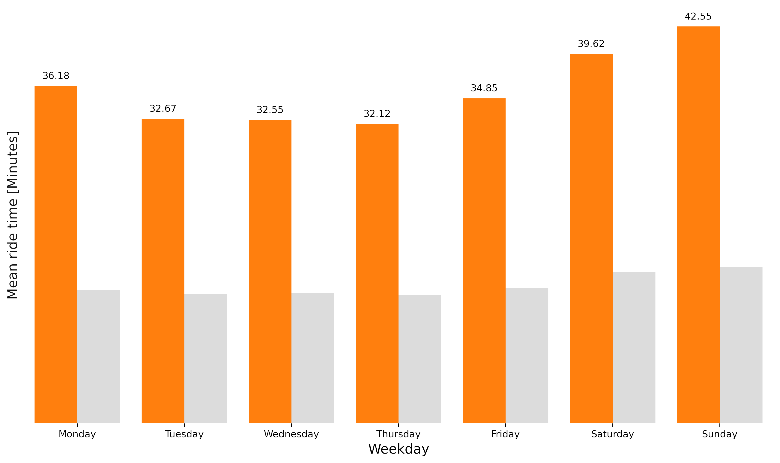
Average ride length of casual users by weekday
During 2020-08 and 2021-07
Figure 1

Slide 7
Recommendations
Yellow
Is the color of gold, butter and ripe lemons. In the spectrum of visible light, yellow is found between green and orange.
Blue
Is the colour of the clear sky and the deep sea. It is located between violet and green on the optical spectrum.
Red
Is the color of blood, and because of this it has historically been associated with sacrifice, danger and courage.

Slide 8
Thank you!
Dawid Marczak DATA SCIENTIST
Dave.Marczak@gmail.com
Person 2 JOB TITLE
email@email.com
Person 3 JOB TITLE
email2@email.com

Slide 9
SlidesCarnival icons are editable shapes.
This means that you can:
Resize them without losing quality.
Change fill color and opacity.
Change line color, width and style.
Isn’t that nice? :)
Examples:
Find more icons at slidescarnival.com/extra-free-resources-icons-and-maps

