Slide 1
Bike sharing data analysis
Date presented: 2021-09-03

Slide 2
Business task
Convert casual riders to annual members

Slide 3
Agenda
How do annual members and casual riders use Cyclistic bikes differently?
Why would casual riders buy Cyclistic annual memberships?
How can Cyclistic use digital media to influence casual riders to become members?

Slide 4
Data
Divvy bike trips
Time period: 2020-08 to 2021-07
Lacks a unique user ID

Slide 5
Difference between members and casual users

Slide 6
Majority user rides
55.5%
Of rides between 2020-08 to 2021-07
were completed by annual members
compared to 44.5% of casual user rides

Slide 7
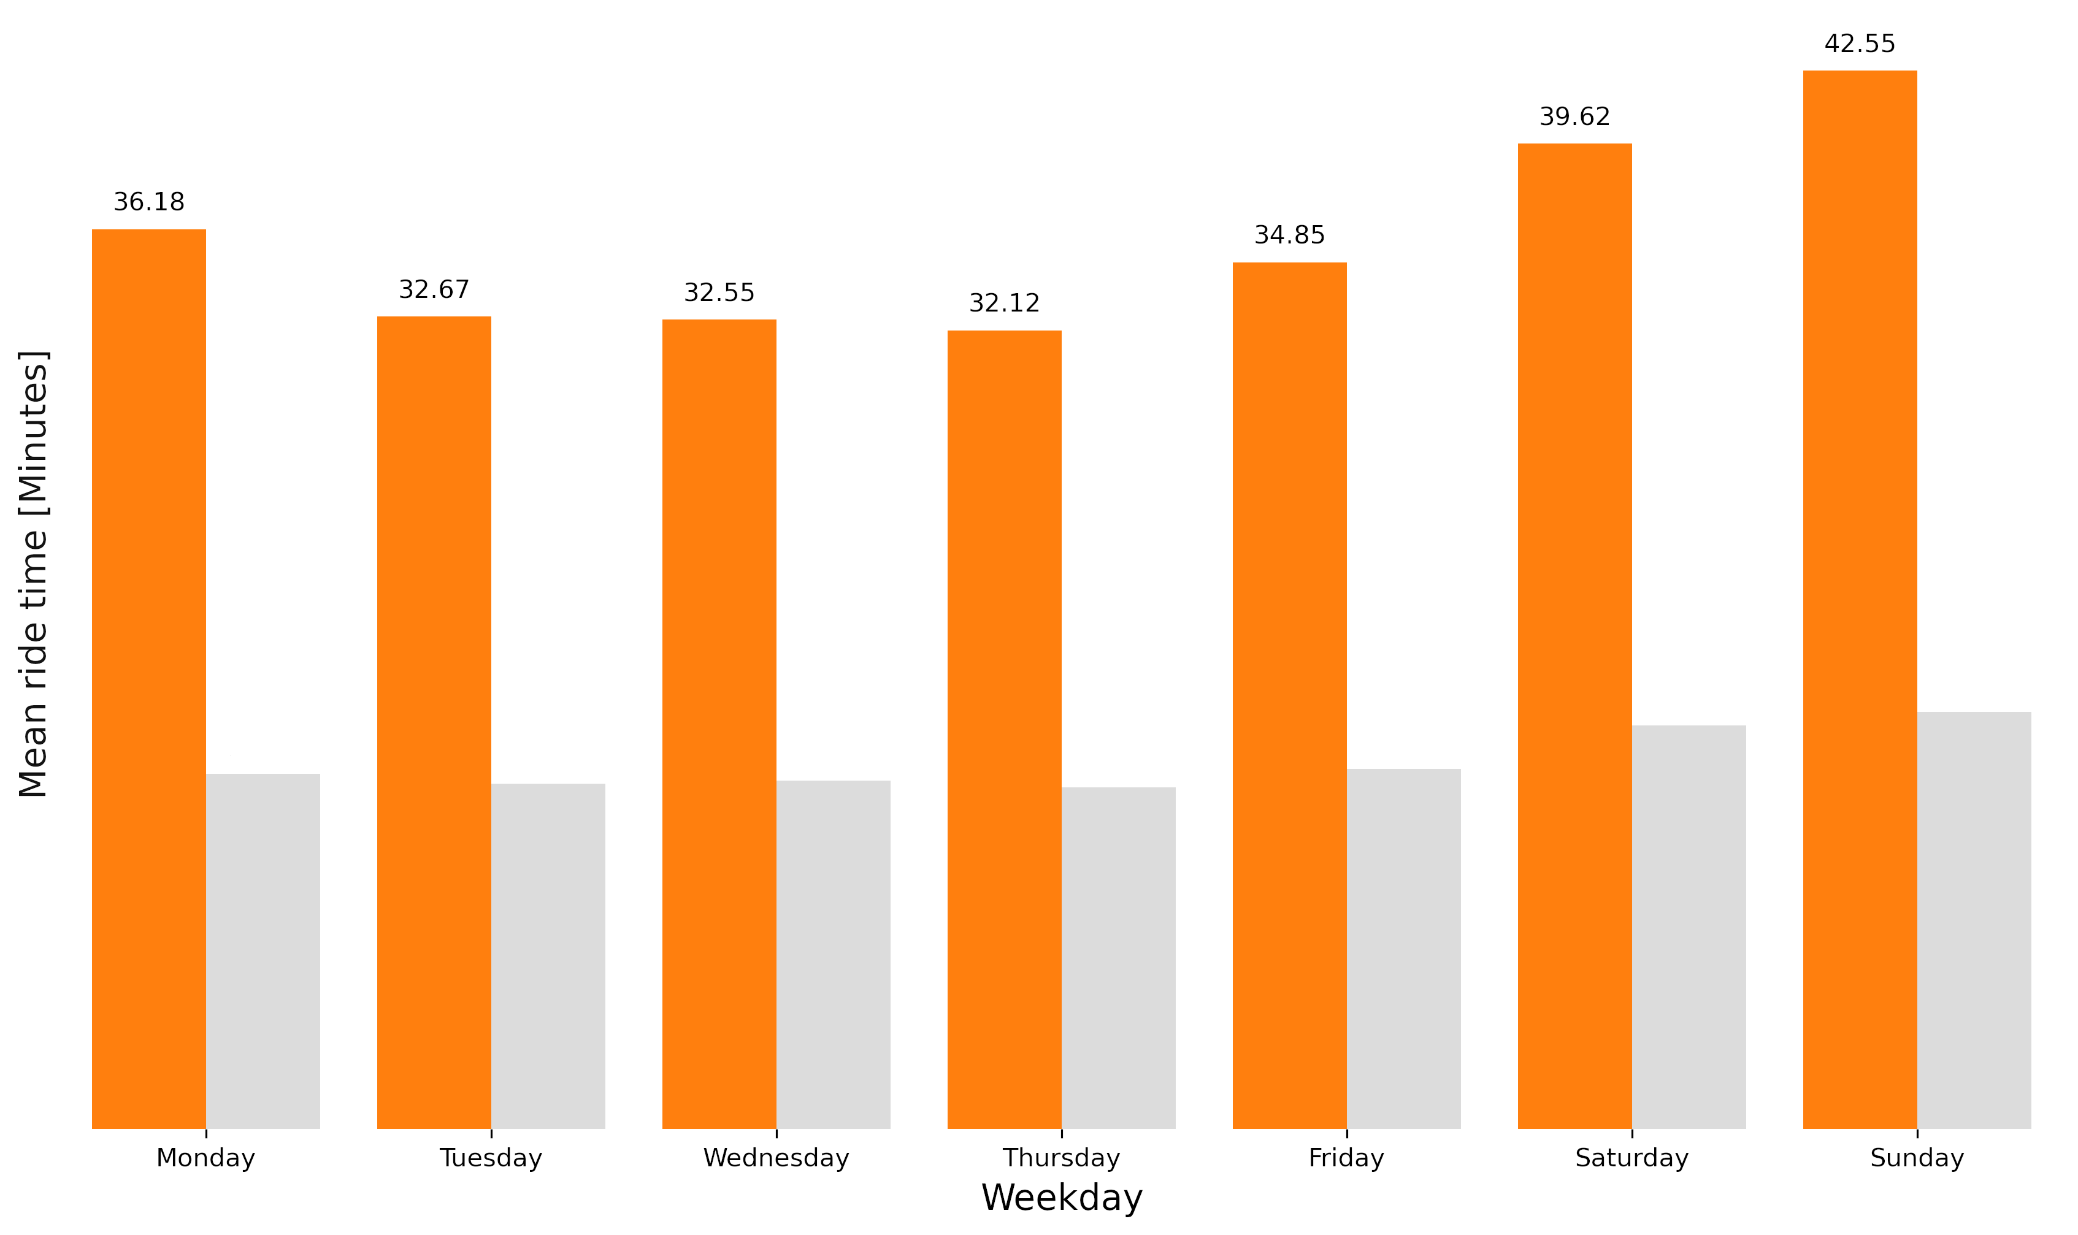
Average ride length of casual users by weekday
during 2020-08 and 2021-07
Figure 1

Slide 8
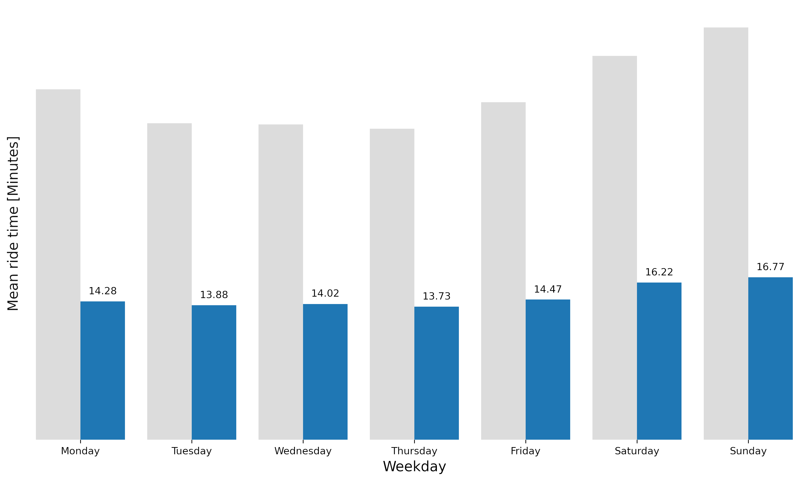
Average ride length of members by weekday
during 2020-08 and 2021-07
Figure 2

Slide 9
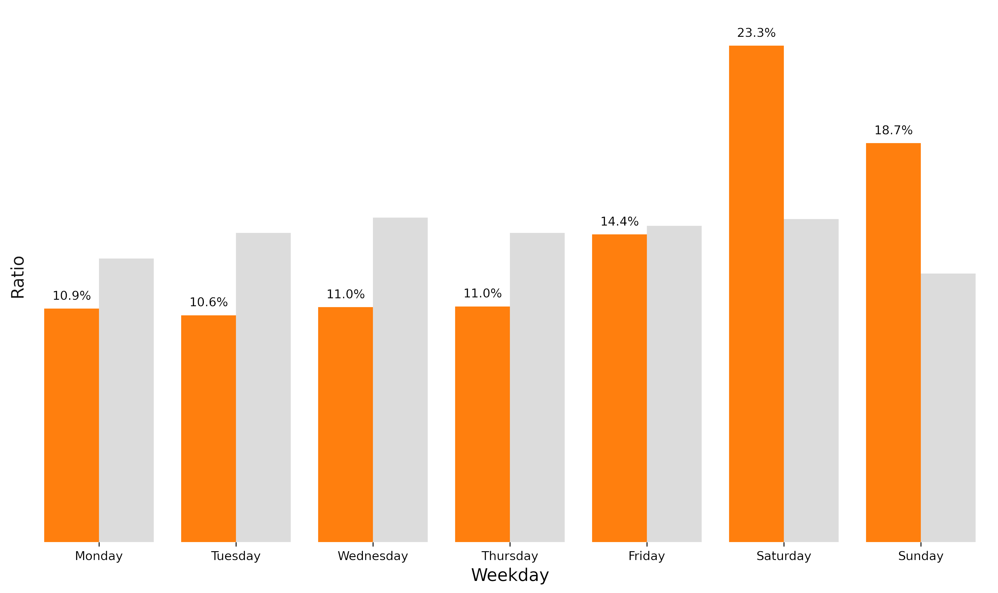
Weekday ratio of casual user rides
throughout 2020-08 and 2021-07
Figure 3

Slide 10
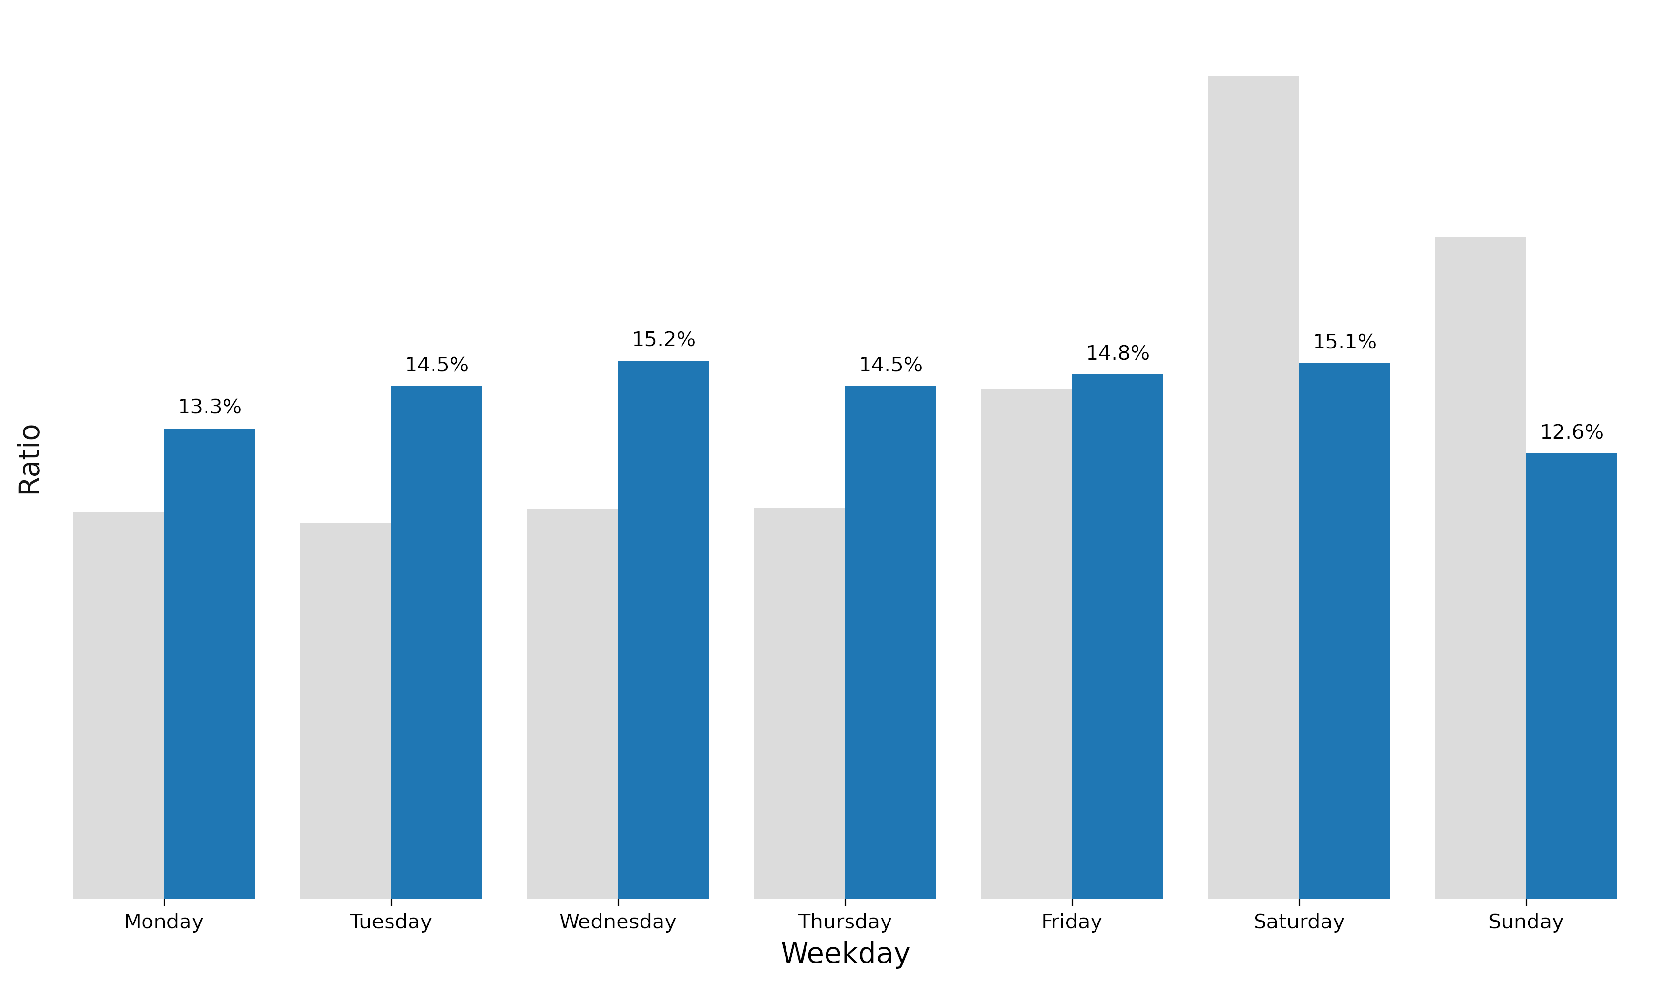
Weekday ratio of member rides
throughout 2020-08 and 2021-07
Figure 4

Slide 11
Key observations
1
Majority of last years rides were completed by annual members

Slide 12
Key observations
1
2
Majority of last years rides were completed by annual members
Casual users use bikes for longer period of time than members

Slide 13
Key observations
1
2
3
Majority of last years rides were completed by annual members
Casual users use bikes for longer period of time than members
Casual users tend to use bikes in the weekends whereas member rides are evenly distributed throughout the week

Slide 14
Why would casual riders buy annual memberships?

Slide 15
How to leverage digital media for conversion?

Slide 16
Recommendations
Yellow
Is the color of gold, butter and ripe lemons. In the spectrum of visible light, yellow is found between green and orange.
Blue
Is the colour of the clear sky and the deep sea. It is located between violet and green on the optical spectrum.
Red
Is the color of blood, and because of this it has historically been associated with sacrifice, danger and courage.

Slide 17
Thank you!
Dawid Marczak DATA SCIENTIST
Dave.Marczak@gmail.com
Person 2 JOB TITLE
email@email.com
Person 3 JOB TITLE
email2@email.com

