Slide 1
Bike sharing data analysis
Date presented: 2021-09-03

Slide 2
Business task
Convert casual riders to annual members

Slide 3
Agenda
How do annual members and casual riders use Cyclistic bikes differently?
Why would casual riders buy Cyclistic annual memberships?
How can Cyclistic use digital media to influence casual riders to become members?

Slide 4
Data
Divvy bike trips
Time period: 2020-08 to 2021-07
Lacks a unique user ID

Slide 5
Difference between members and casual users

Slide 6
User ride breakdown
There were
4.722.941
completed rides between 2020-08 to 2021-07.

Slide 7
User ride breakdown
There were
4.722.941
completed rides between 2020-08 to 2021-07. 55.5%
Of them were completed by annual members
compared to 44.5% of casual user rides.

Slide 8
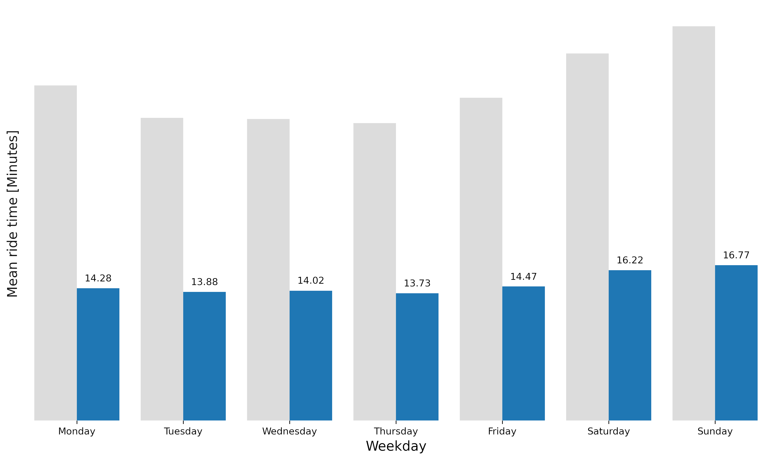
Average ride length of members by weekday
during 2020-08 and 2021-07
Figure 2

Slide 9
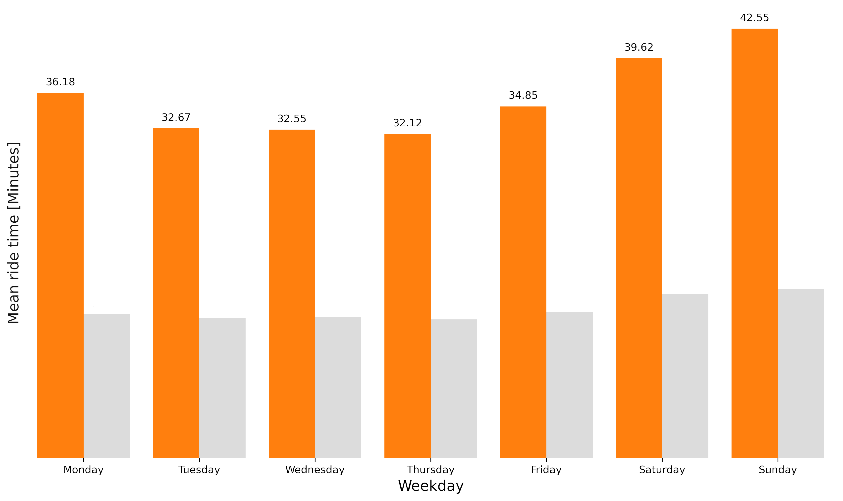
Average ride length of casual users by weekday
during 2020-08 and 2021-07
Figure 1

Slide 10
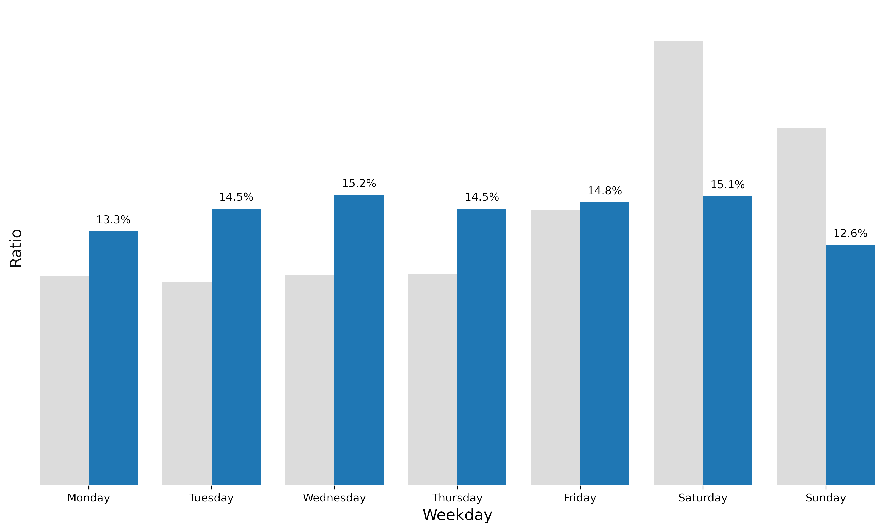
Weekday ratio of member rides
during 2020-08 and 2021-07
Figure 4

Slide 11
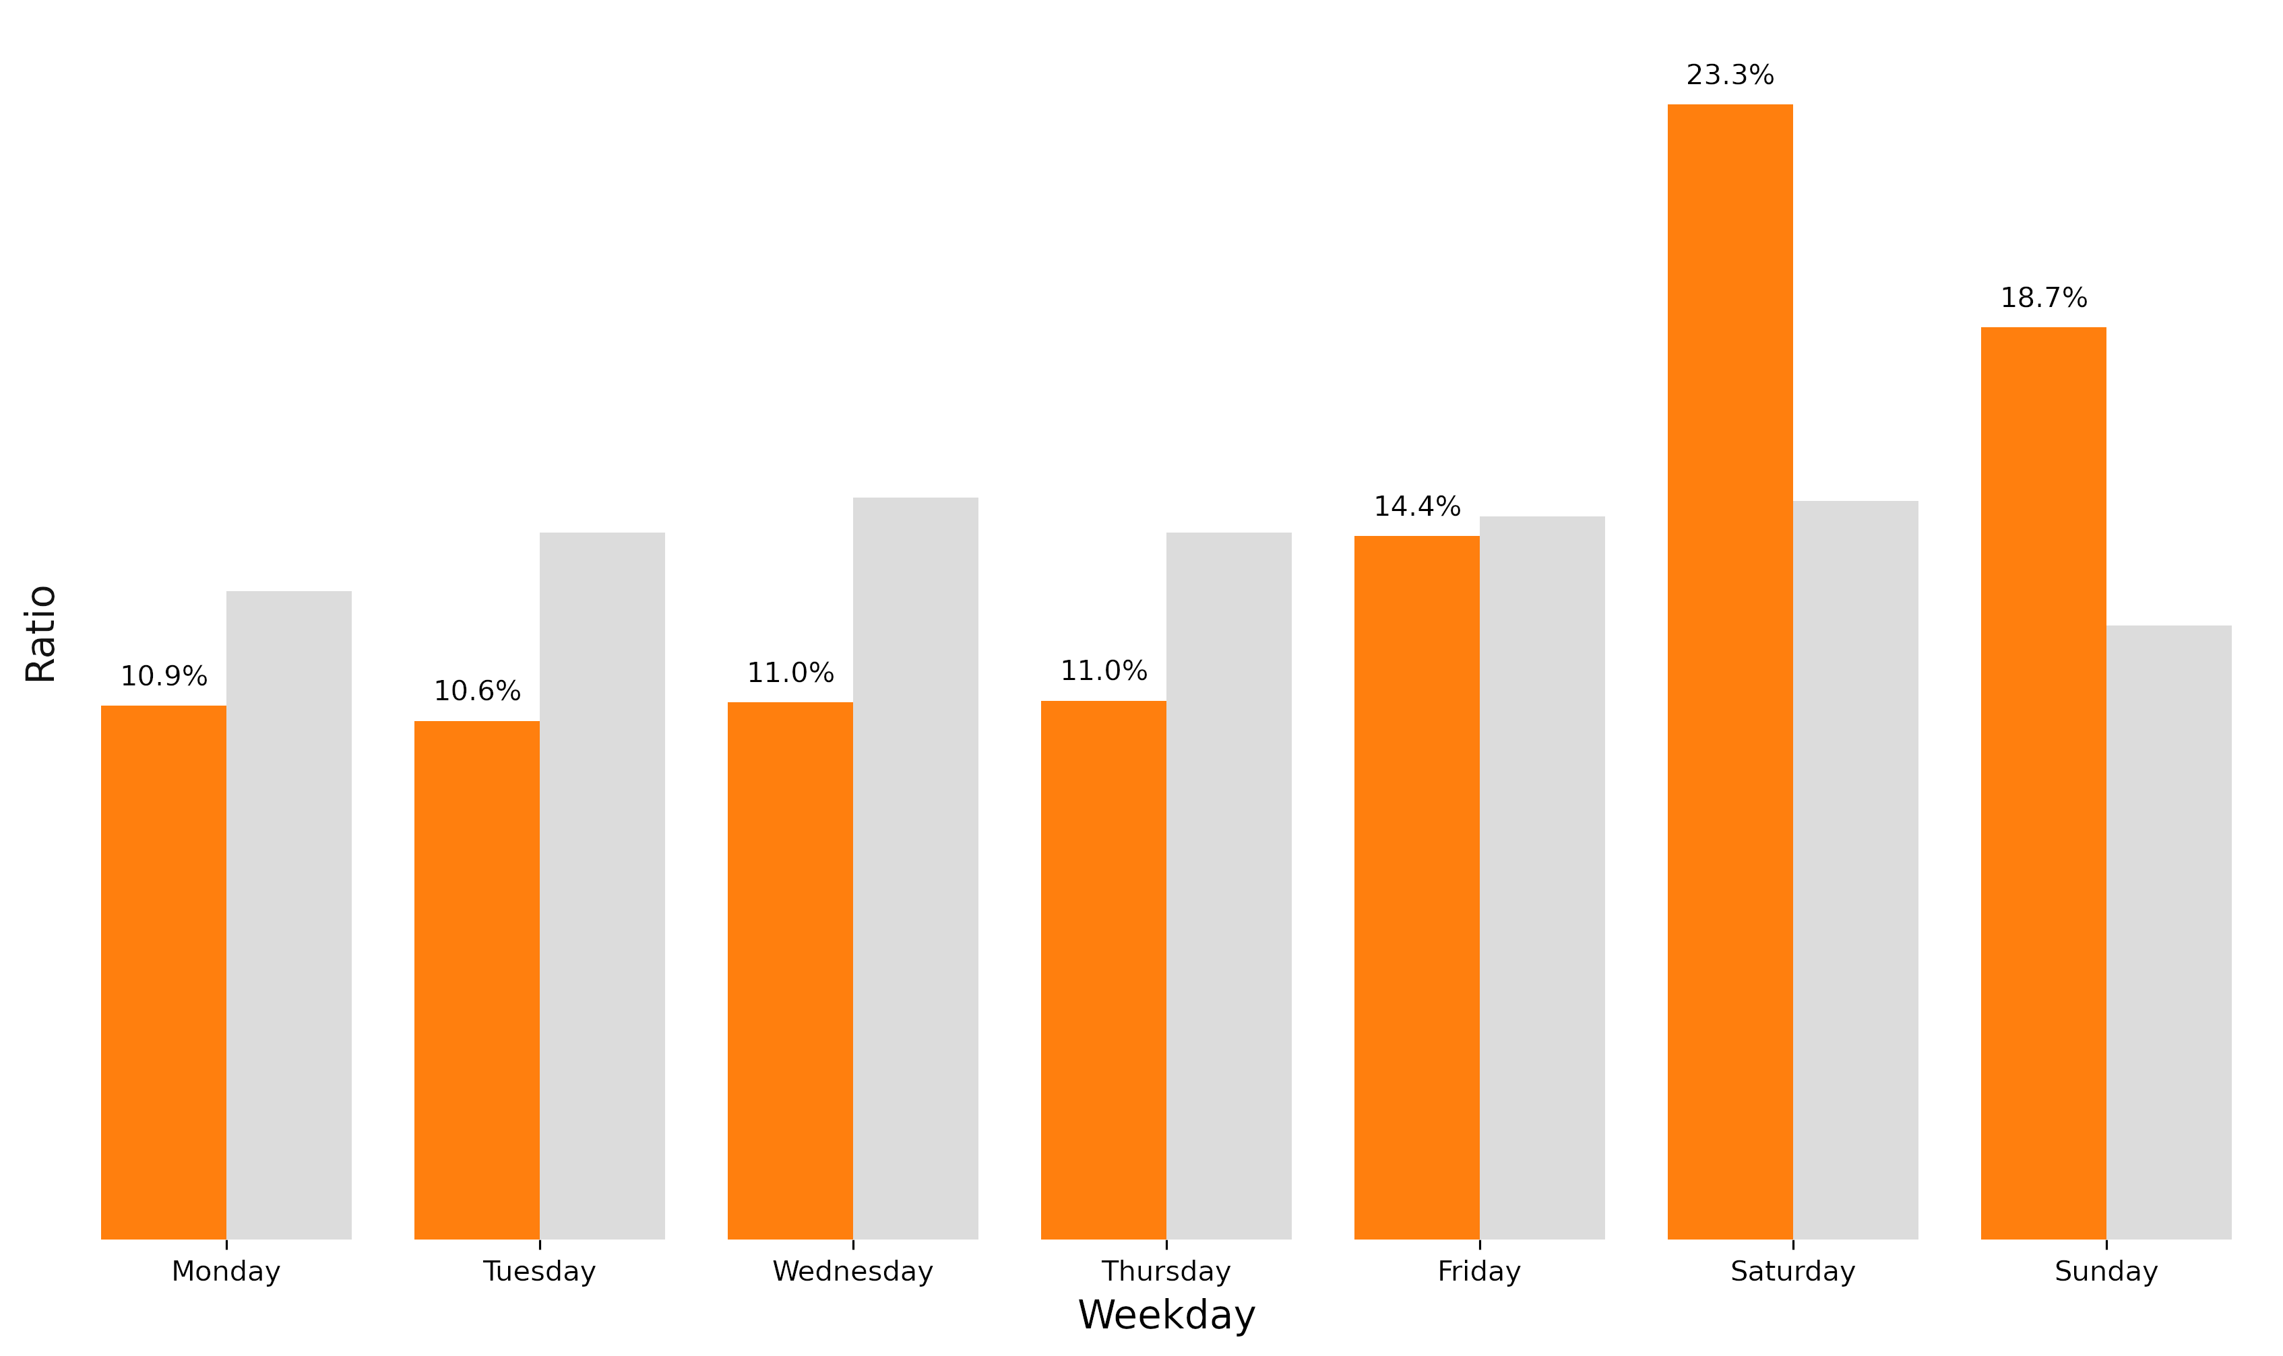
Weekday ratio of casual user rides
during 2020-08 and 2021-07
Figure 3

Slide 12
Key observations
1
Majority of last years rides were completed by annual members

Slide 13
Key observations
1
2
Majority of last years rides were completed by annual members
Casual users use bikes for longer period of time than members

Slide 14
Key observations
1
2
3
Majority of last years rides were completed by annual members
Casual users use bikes for longer period of time than members
Casual users tend to use bikes in the weekends whereas member rides are evenly distributed throughout the week

Slide 15
Why would casual riders buy annual memberships? (person 2)

Slide 16
How to leverage digital media for conversion? (person 3)

Slide 17
Recommendations
Target audience
Find a % of casual members who completed at least 3 rides a month and who could be interested in an annual membership.
Eco travel
Advertise bikes as an eco way of travelling to work. Bikes don’t have to be a weekend thing only.
Peace of mind
Underline the fact that annual members don’t need to worry about ride time limit because they don’t have it.

Slide 18
Thank you!
Dawid Marczak DATA SCIENTIST
Dave.Marczak@gmail.com
Person 2 JOB TITLE
email@email.com
Person 3 JOB TITLE
email2@email.com

