Slide 1
Database Management system for an efficient storage model of 16S metagenomics data
BY
Wahidul A. Brbhuiya
2320900010
Under the supervision of
Mr. Darshit Patel
Founder of Centenarian Life Science Pvt. Lmt.

Slide 2
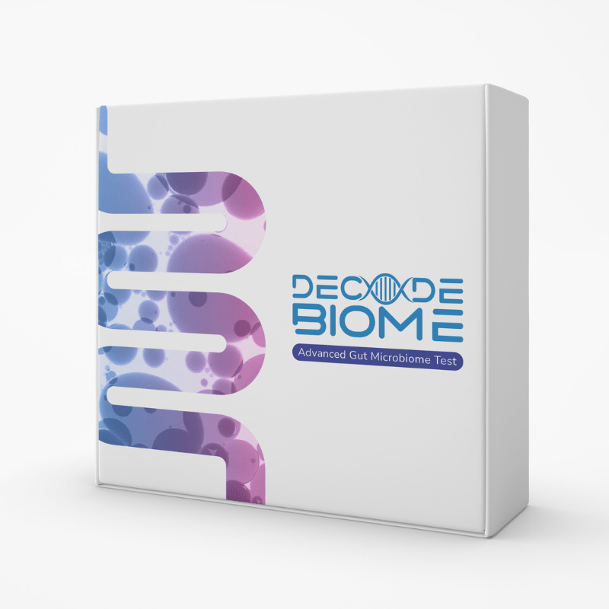
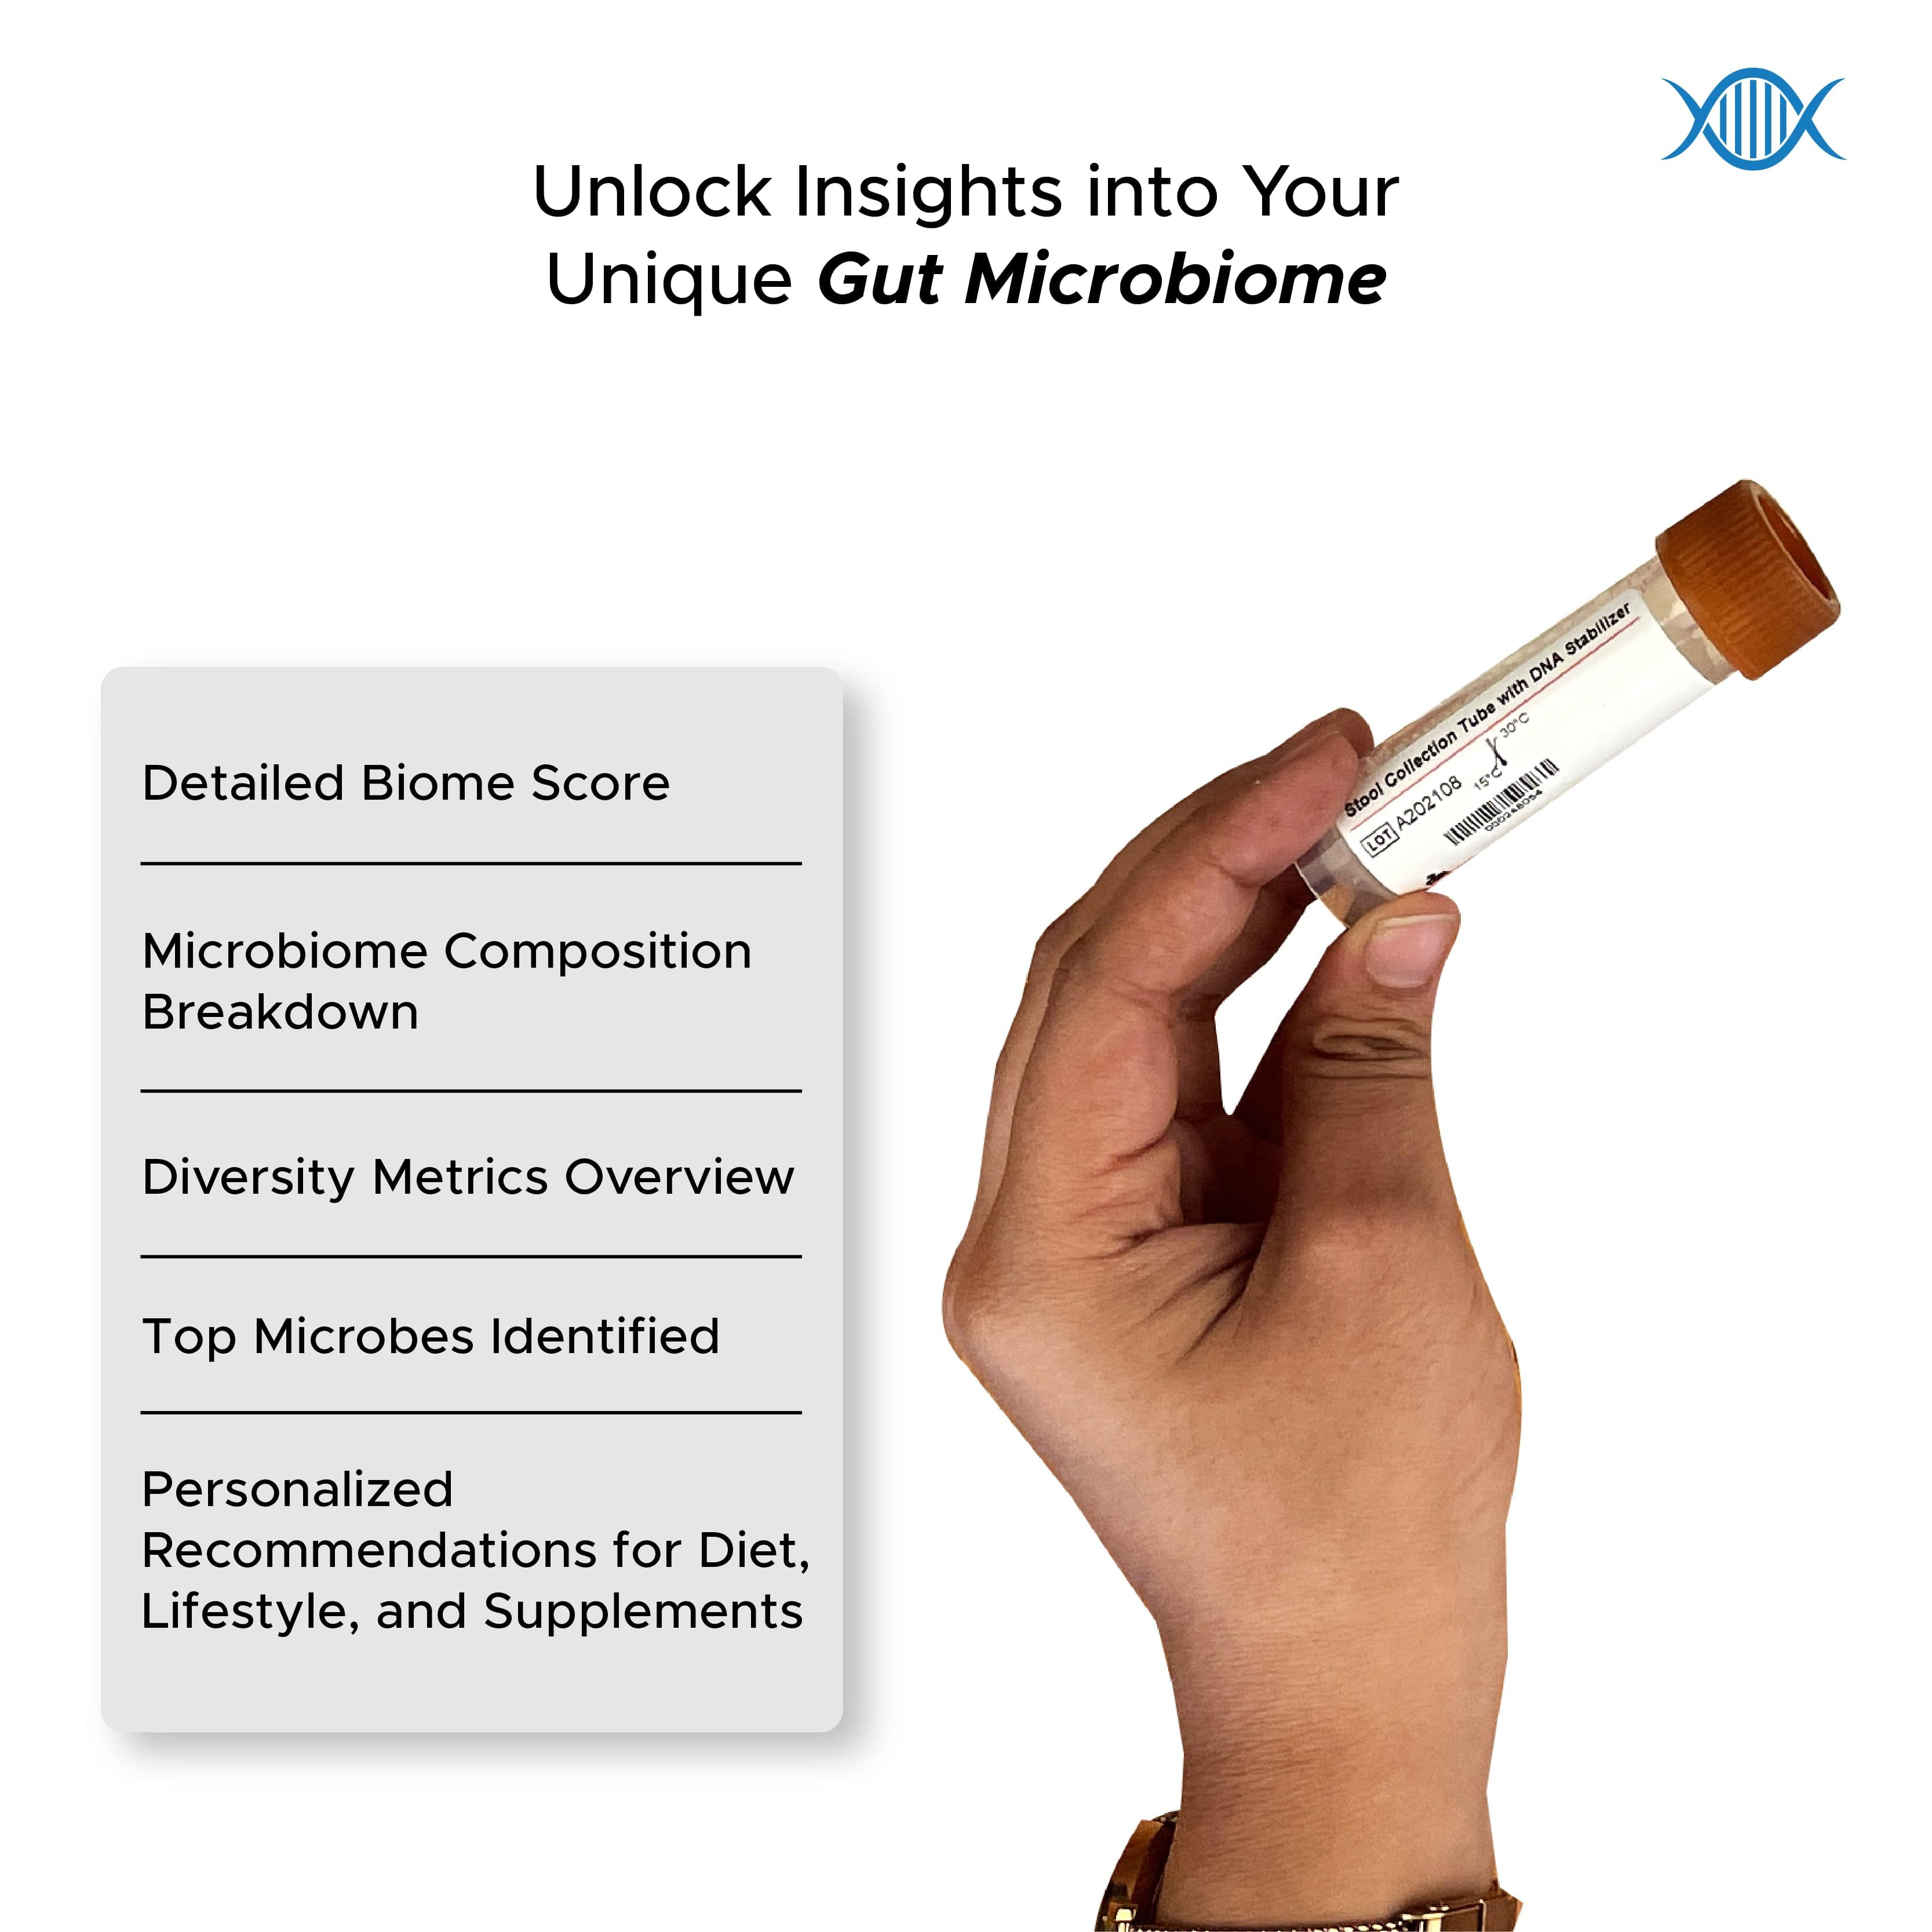
Decode Age
Decode Biome

Slide 3
Objective
Proper arrangement of unstructured data for lab protocol
Tracking data that are stored by a single unique barcode for each sample
Connecting bridge for lab-protocol and taxonomic analysis
Comparative study for abundance at different level

Slide 4
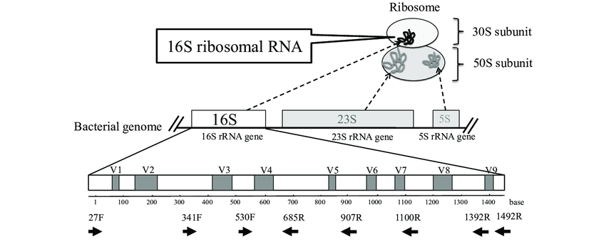
Data collection
Sample source
16S Metagenomics Data:
16S metagenomics is a field of microbiology that involves the study of microbial communities using 16S ribosomal RNA (rRNA) gene sequencing.
Microbial communities are complex and diverse, and 16S metagenomics provides a way to study them at a molecular level.

Slide 5
Features
Sign in /signup
Dashboard
Data processing workflow
Report
Visualization

Slide 6
Sample collection
Collect environmental samples from the target site
Transfer samples to a sterile container and store them at appropriate conditions (e.g. refrigeration, freezing, etc.)
Transport the samples to the lab for further processing

Slide 7
DNA Extraction
Homogenize the sample to ensure uniformity
Extract DNA using a suitable method such as bead beating, column-based, or enzymatic extraction
Purify the DNA to remove contaminants and inhibitors
Assess the quality and quantity of the extracted DNA using gel electrophoresis, spectrophotometry or fluorometry.

Slide 8
Library Preparation
Fragment the purified DNA to suitable sizes using physical or enzymatic methods
Add adapter sequences to the ends of the DNA fragments
Amplify the fragments using PCR or other suitable methods
Purify and size-select the amplified fragments to ensure proper size distribution
Verify the quality and quantity of the prepared libraries using techniques such as Qubit, Bioanalyzer, or qPCR.

Slide 9
Taxonomic Analysis
Taxonomic classification
Taxonomic classification involves assigning sequences to taxonomic groups based on their similarity to known sequences in a reference database.
It can be performed using various software and tools, such as BLAST, QIIME, and mothur.
Taxonomic classification can provide insight into the taxonomic composition of a sample and can be used to compare the relative abundance of different taxa across samples.
Relative Abundance:
Relative abundance refers to the proportion of each taxonomic group within a sample or community.
It is commonly reported at various taxonomic levels, such as species, genus, family, order, class, and phylum.
Relative abundance can be used to identify the dominant taxonomic groups within a community and to compare the relative contribution of different taxa across samples.

Slide 10
Differential Abundance Analysis:
Differential abundance analysis involves comparing the relative abundance of taxa between different groups or conditions.
It can be performed using various statistical methods, such as t-tests, ANOVA, and DESeq2.
Differential abundance analysis can identify taxonomic groups that are significantly enriched or depleted in one group compared to another and can provide insight into the functional and ecological roles of different taxa.

Slide 11
Diversity Indices:
Alpha diversity refers to the diversity within a single sample or community.
It is commonly measured using various indices, such as Shannon diversity index, Simpson's diversity index, and Chao1 richness estimator.
Shannon diversity index takes into account both the number of species present and their relative abundance, while Simpson's diversity index emphasizes the dominance of the most abundant species.
Pielou's evenness index, also known as Pielou's J or J' index, is a measure of evenness or equitability of species abundance in a community.

Slide 12
Methods
Front-end
HTML
CSS
Javascript
Backend
Flask
Database
MySQL

Slide 13
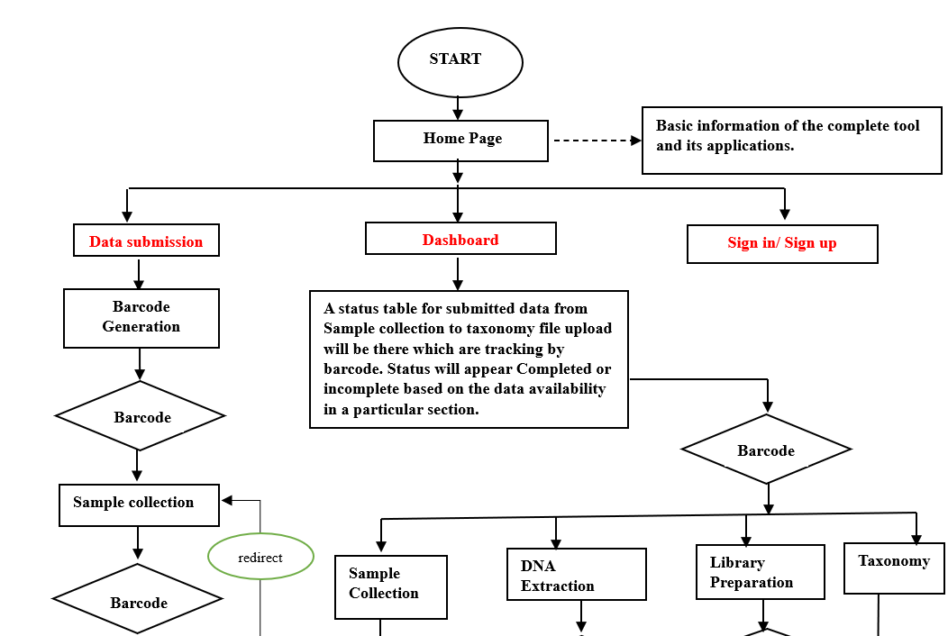
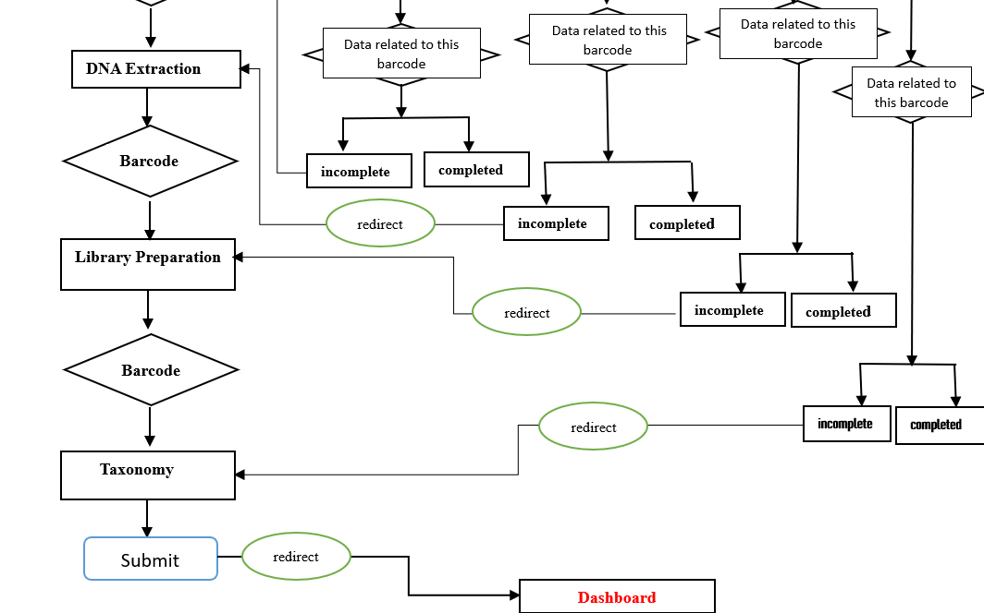
Workflow

Slide 14
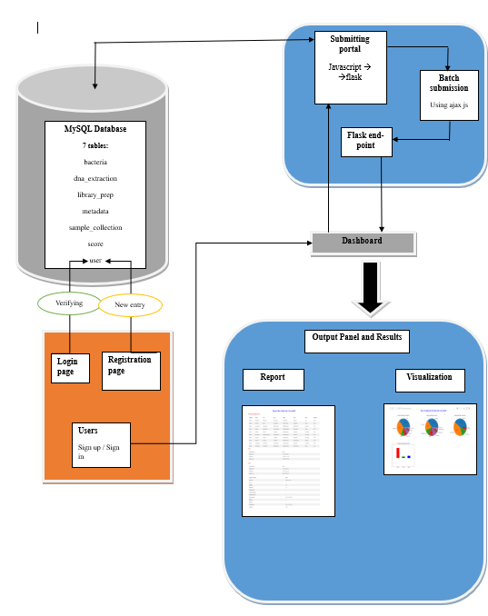
Database architecture

Slide 15
Future prospects
For taxonomic analysis We are planning to add qiime pipeline
For disease prediction

Slide 16
Conclusion
The API software is a versatile tool designed not only for lab data management but also for viewing outcomes of 16S taxonomic analysis.
The software helps users identify significant differences in the abundance of phylum, genus, and species level, allowing for better understanding of community structure.
Alpha diversity indices can be calculated using the software, providing insight into the diversity and evenness of the microbial community.
The software provides a link between lab processing for sequencing, making it easy to track and manage samples throughout the analysis process.
Interpretation of results is presented in a graphical format, making it easy to visualize the data and identify trends and patterns.

