Slide 1
DCM workshop
Part 1
Timerseries extraction
First-level DCM model
David Willinger

Slide 2
Workshop
Some backgound on effective connectivity analysis
How to identify functional networks
How to extract time series information
How to build a first-level DCM
Review model fit

Slide 3
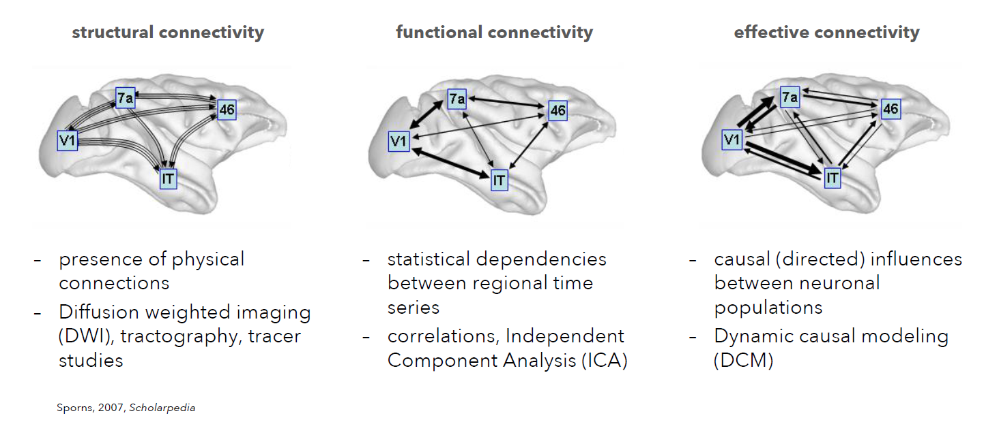
Background

Slide 4
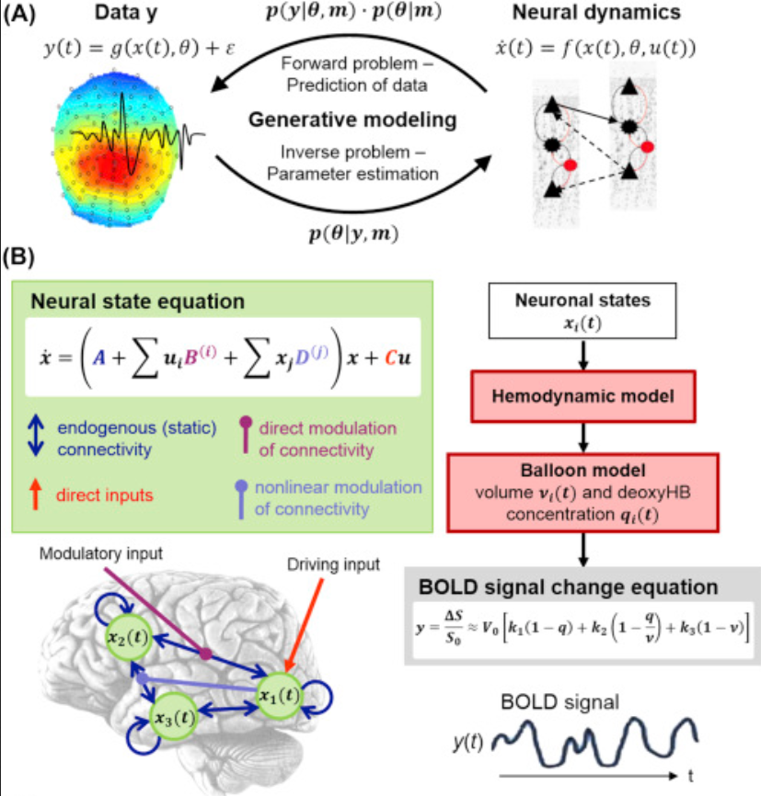
Conventional Dynamic Causal Modeling

Slide 5
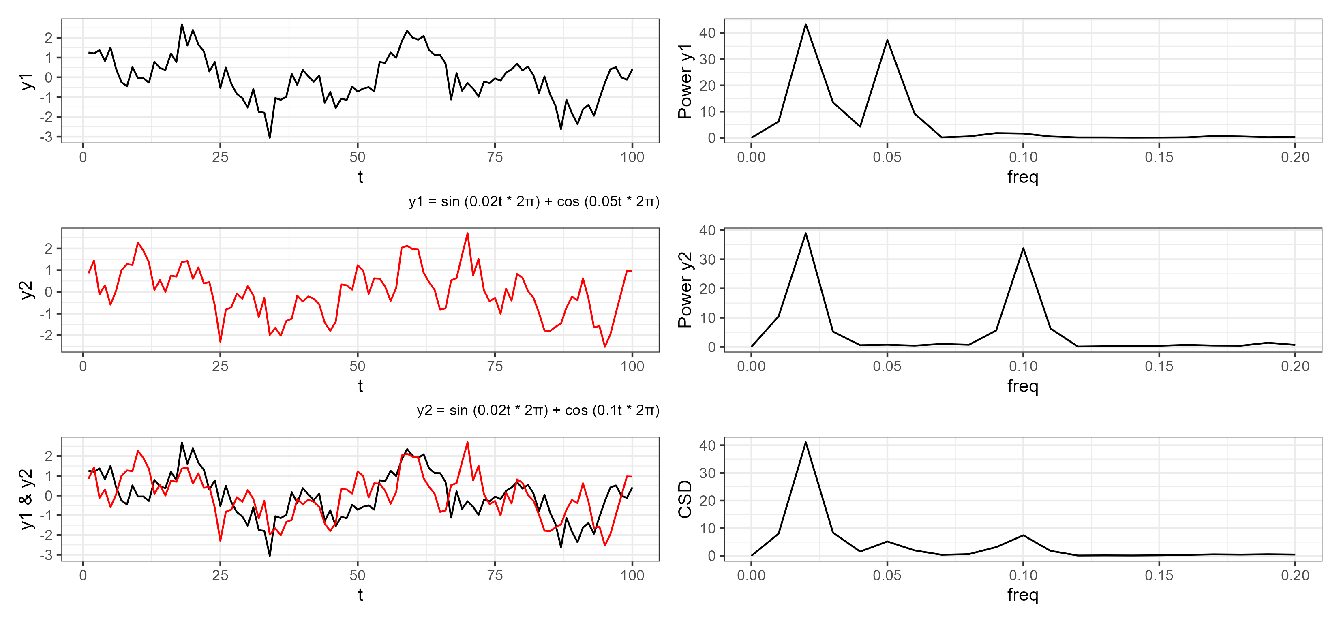
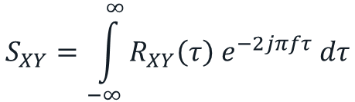
Resting state – spectral dynamic causal modeling (spDCM)
Connectivity is estimated from „cross spectra“ (Fourier-transformed cross-correlation function)
Easy estimation, fully determinstic
Shows high validity in recovery of simulated data
$$S_{XY}=\int_{−∞}^{∞}{R_{XY}\left(τ\right) e^{−2jπfτ} dτ}$$

Slide 6
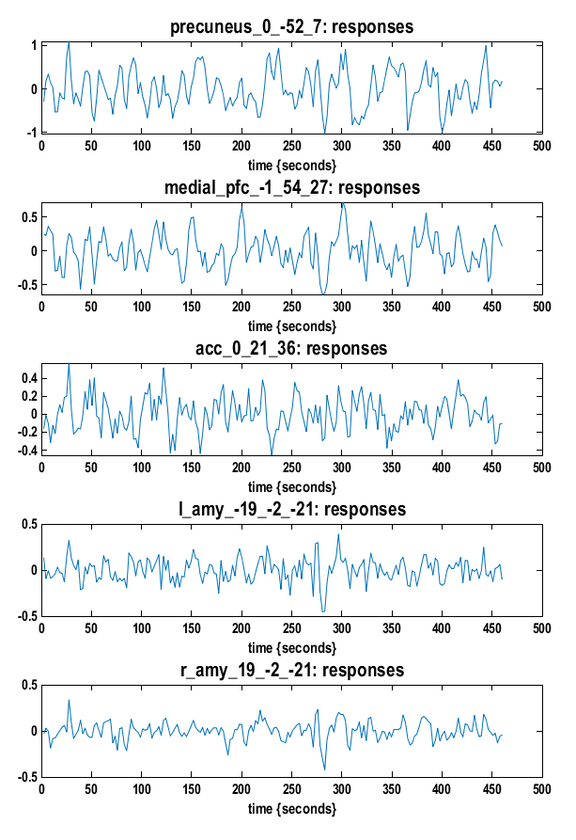
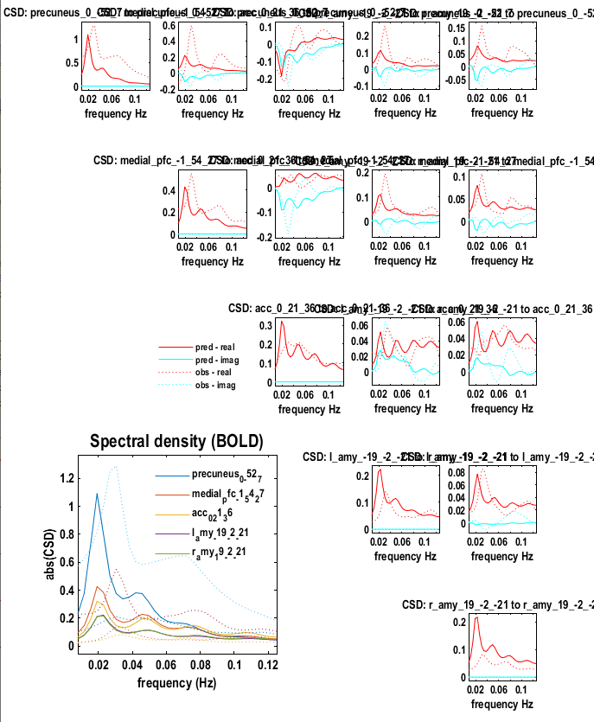

Slide 7
Resting state – spectral dynamic causal modeling (spDCM)
Connectivity is estimated from „cross spectra“ (Fourier-transformed cross-correlation function)
Easy estimation, fully determinstic
Assumes that the cross spectra are stable over time, or stationary
Shows high validity in recovery of simulated data
Generalization of functional connectivity (= cross-corr. with lag 0)
2nd-level analysis in Parametric Empirical Bayes framework
Network is based on previous work on emotion regulation / well-being literature (DMN + Salience network)
→ investigate the effective connectivity changes between the cortex involved in emotional regulation and AMY

Slide 8

DCM Example: Resting state
~6 minutes
Eyes open
Two groups: patients with depression vs. healthy controls
Notes:
Subjects are presented with a sound and a symbol at the same time. They need to learn whether the association is correct or not, they get feedback after each try.

Slide 9
Sample
 | Controls | MDD | Test statistic | p valueª
Age (years), range (min-max) | 16.2 (1.9), 11.2–18.8 | 16.1 (1.4), 12.8–18.7 | U = 553.5 | 0.425
Sex (males), No. (%) | 10 (30%) | 10 (33%) | χ²(1) = 0.07 | 0.796
Handedness (right), No. (%) | 32 (97%) | 28 (93%) | χ²(1) = 0.46 | 0.500
In-scanner movement (FD, mm) | 0.16 (0.06) | 0.17 (0.06) | t(61) = 0.69 | 0.492
CD-RISC | 72.9 (10.1) | 38.6 (15.6) | t(58) = 10.16 | <0.001
CDI | 8.4 (6.6) | 29.6 (9.3) | U = 38.0 | <0.001
RIAS IQ | 104.5 (6.9) | 108.0 (8.7) | t(60) = −1.75 | 0.079
PSS | 22.4 (6.6) | 28.8 (7.7) | t(57) = −3.44 | 0.001
SDQ | 8.8 (5.3) | 16.3 (5.6) | t(56) = −5.26 | <0.001
WISC-IV Digitspan (forward) | 8.9 (2.1) | 8.8 (2.0) | t(60) = 0.32 | 0.747
WISC-IV Digitspan (backward) | 8.6 (1.6) | 9.4 (2.0) | t(60) = −1.70 | 0.094
WISC-IV Mosaic | 57.0 (5.7) | 59.0 (6.2) | t(56) = −1.27 | 0.208
Current Medication, No. (%)
No medication | 33 (100%) | 10 (33%) | NA | NA
SSRI | 0 | 18 (60%) | NA | NA
No data recorded: „pmdd-49“

Slide 10
Prerequisites 1: Identify your hypothesis
DCM is not well-suited for exploratory analysis
It’s necessary to formulate hypotheses and networks we are interested in a priori
Typically:
How do groups differ in connectivity
How does connectivity vary with a covariate
Notes:
So what is the purpose of using effective connectivity models? They can give insight into the information flow in a network and can tell us how information is integrated – during tasks or resting-state. Models of effective connectivity, i.e. the causal influences that system elements exert over another, are essential for studying the functional integration of neuronal populations and for understanding the mechanisms that underlie neuronal dynamics (Friston, 2002a; Horwitz et al., 1999).
So why go to the trouble of creating realistic models of brain processes? Basically, because it allows one to compare different models or hypotheses about distributed neuronal computations generic approach for inferring hidden (unobserved) neuronal states from measured brain activity

Slide 11
Prerequisites 2: Identify your network
Goal: reveal the resting state brain networks, such that we can extract the timecourse?
If a GLM analysis does not show activity/endogenuous fluctuations in a region for any contrast, there is no motivation to include it in a DCM analysis → nothing ( = flat line) to explain by our model
Question to answer:
Is connectivity between regions supporting emotion processing affected?
Do patients with MDD differ in terms of brain connectivity during rest?

Slide 12
Resting state - data analysis pipeline (multi-echo)
Preprocessing
Despiking (matlab)
Slice timing (matlab, SPM)
Realignment (mcflirt, easy to apply transformation matrix to all echos)
Skull stripping (matlab, SPM)
TEDANA (python)
Segment T1 (matlab, SPM)
Coregistration (matlab, SPM)
Normalization (matlab, SPM)
Smoothing (matlab, SPM)

Slide 13
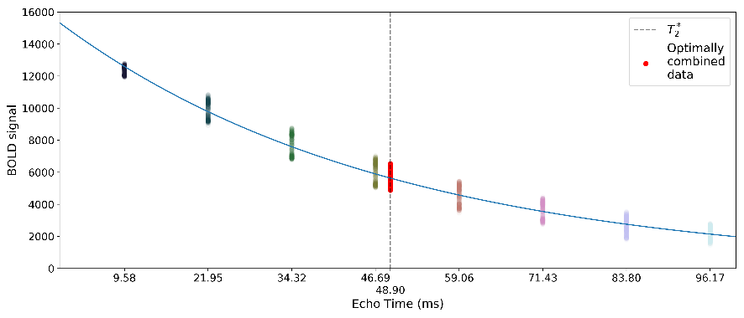
Tedana – Multiecho ICA
thermal noise
TE-independent noise
Input
Opt. comb.
PCA
ICA
Final image
Goals:
Find weights for optimally combined images
Denoising
Decomposition using PCA and ICA
Identify BOLD and non-BOLD components

Slide 14
Resting state - data analysis pipeline (multi-echo)
Preprocessing
Despiking (matlab)
Slice timing (matlab, SPM)
Realignment (mcflirt, easy to apply transformation matrix to all echos)
Skull stripping (matlab, SPM)
TEDANA (python)
Segment T1 (matlab, SPM)
Coregistration (matlab, SPM)
Normalization (matlab, SPM)
Smoothing (matlab, SPM)
GLM for data extraction (0_create_glm_rs.m)
Motion regressor
Band-pass filtering (DC basis set ranging from 0.01 to 0.1 Hz)
F-contrast to extract time series

Slide 15
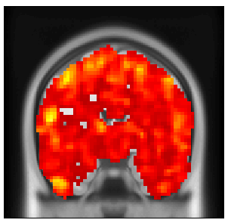
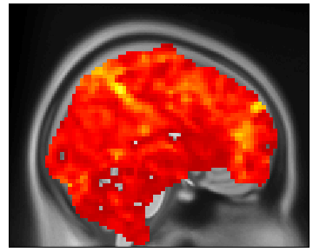
DCM Example: Identify your network
Main effect of fluctuations during rest (see 0_create_glm_rs.m)
AMY
PCC
ACC
MPFC
Identify key nodes of Default Mode Network and Salience Network based on literature (e.g., Razi et al., 2017)

Slide 16
Step 1: Timeseries extraction
Goal: Extract the timeseries from all regions for all subjects
This multivariate timeseries (or cross spectra) will be data to be modeled!
Important:
Contains only signal from voxels with at least some degree of experimental effect (p_{uncorr.} < 0.05)
Can be constrained functionally and/or anatomically
Size of regions depends on structures investigated and smoothing kernel! Rule of thumb (spherical region ~ smoothing kernel ~ 6-8mm)
After extraction check for subjects that do not show activity in single regions → will have to be excluded

Slide 17
For Tasks: Step 2: Create GLM for DCM
Goal: Create a model for DCM analysis (separate SPM.mat)
Includes all regressors that enter the DCM
Usually simpler than GLMs of activity analysis
If we have multiple sessions, we need to concatenate them
No need to do this for resting-state data
Notes:
Show how to concatenate

Slide 18
Step 3: Create DCMs
Goal: Create a model for DCM analysis based on previously created SPM.mat (results in a DCM.mat)
Stores information about model inputs, priors of connectivity and haemondynamic parameters, timing, onsets, …
Connectivity priors → do I have prior knowledge of connections?
[Task modulations]
[Model input = where does TASK enter? (“ping the network”)]
(not necessary for spDCM)

Slide 19
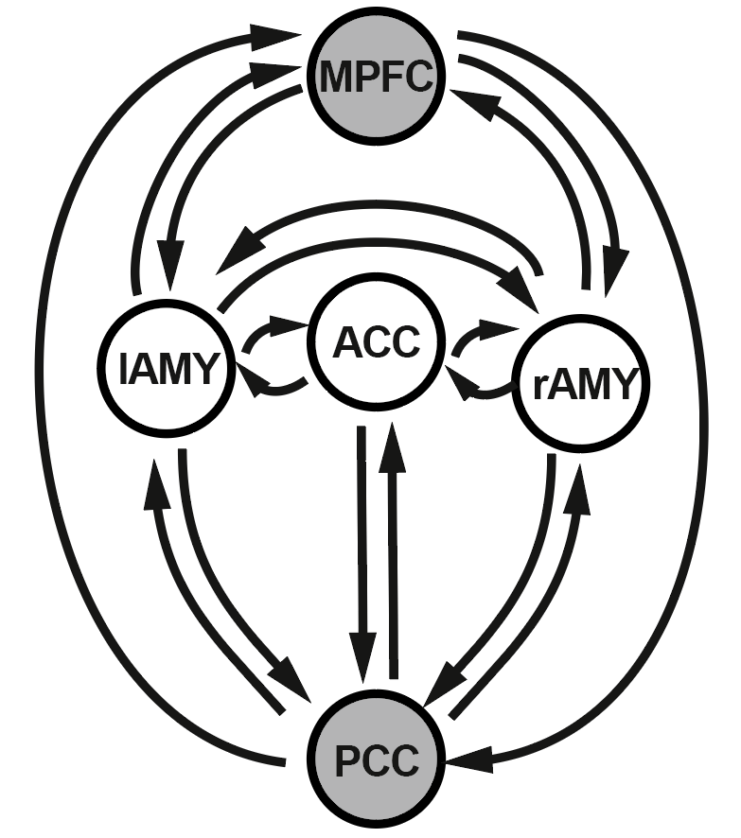
DCM example: start with a fully connected graph
Unless you have a very good reason to assume no connections between two regions

Slide 20
DCM example: Assessment of first-level results
spm_dcm_fmri_check

Slide 21
DCM example: Assessment of first-level results
spm_dcm_review

Slide 22
DCM workshop
Part 2
- Second-level PEB model
- Assessment of results
- Questions
David Willinger

Slide 23
DCM example
Where we are: estimated first-level
resting state

Slide 24
DCM: group study
We will follow the workflow described in Zeidman et al. (2019), using the Parametric Empirical Bayes (PEB) framework
What are the commonalities in effective connectivity across subjects within a group or differences between groups?
Which combination of connections best predicts a group difference (or covariate)?
Notes:
So what is the purpose of using effective connectivity models? They can give insight into the information flow in a network and can tell us how information is integrated – during tasks or resting-state. Models of effective connectivity, i.e. the causal influences that system elements exert over another, are essential for studying the functional integration of neuronal populations and for understanding the mechanisms that underlie neuronal dynamics (Friston, 2002a; Horwitz et al., 1999).
So why go to the trouble of creating realistic models of brain processes? Basically, because it allows one to compare different models or hypotheses about distributed neuronal computations generic approach for inferring hidden (unobserved) neuronal states from measured brain activity

Slide 25
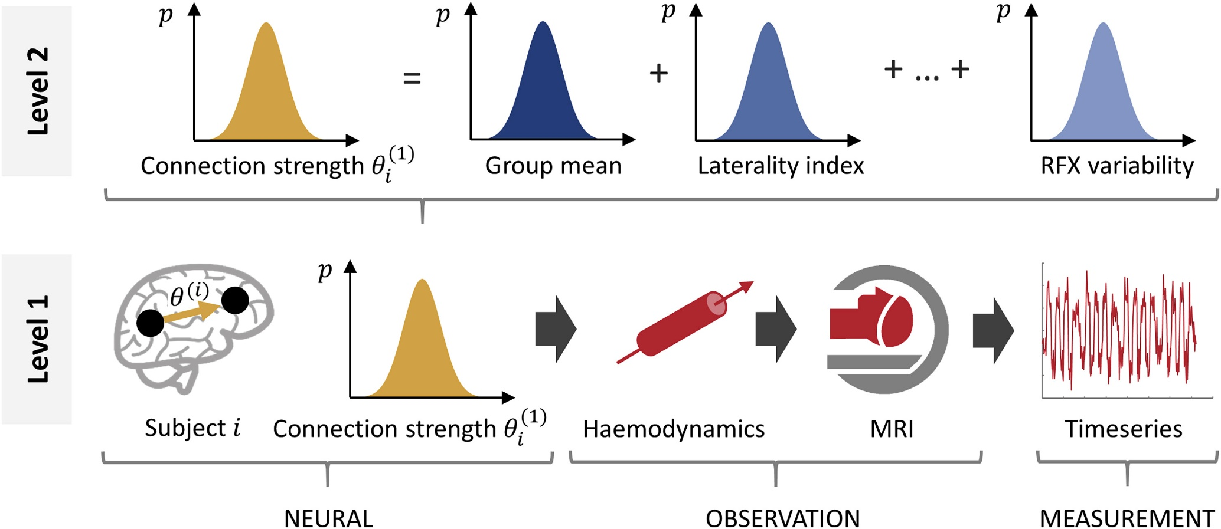
Group analaysis in the PEB framework
Zeidman et al. (2019), NeuroImage
Notes:
Last workshop we focused on the first-level analysis, recap.
In brief, it uses an estimation scheme called Variational Laplace (Friston et al., 2007) that tunes parameters (e.g. connection strengths) with the objective of making the predicted neuroimaging cross spectra match the observed timeseries as closely as possible, while penalizing movement of the parameters away from their prior values.
Ideal compromise between accuracy and complexity is the free energy F1.
The first level analysis (detailed in the companion paper) involves designing an architecture for each subject's model, i.e. deciding which brain regions to include, selecting which connections should be informed by the data, and selecting which connections can be modulated by the experimental manipulations.
But what we are interested now is: how to perform efficient analysis on the second level with the help
The second level analysis involves deciding which parameters to treat as random effects, i.e. sampled from the population, and including these in the PEB model. Typically, only the parameters that are relevant to the hypotheses will be included in the group analysis, and for task-based DCM studies these will primarily be matrix B of the DCM neural model, quantifying the modulations of connections by each experimental condition.

Slide 26

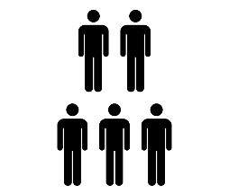

DCM with PEB
First-level
$$Y_{i}=Γ_{i}\left(θ_{i}^{\left(1\right)}\right)+X_{0}β_{i}+ε_{i}^{\left(1\right)}$$
Full model - Inversion with VB
Nested models – BMR
BOLD timeseries
DCM
Effects of no interest (e.g. mean)
Second-level
Group effects
Between-subject error
$$θ_{i}^{\left(1\right)}=Xθ^{(2)}+ε^{(2)}$$
DCM param.
Group-level design matrix
Expected values
Covariance matrix
$$θ^{(2)}=η+ε^{(3)}$$
Fixed group priors
Notes:
First level – inversion results in Free energy for full model; Free energy of the nested models can be obtained with Bayesian model reduction
Hierarchical model (resembles the summary approach many people here will be already familiar with)

Slide 27
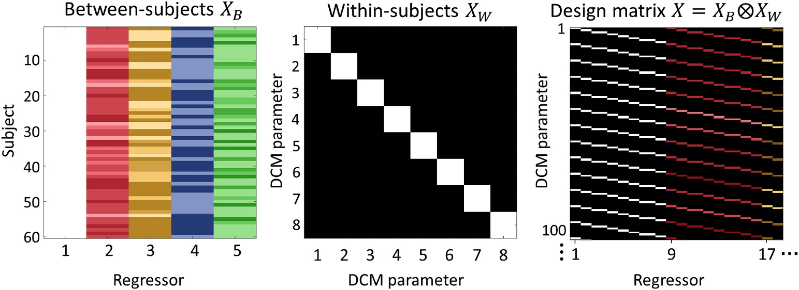
PEB: Design Matrix Specification
Mean
Covariates (e.g. age, sex, behavioural scores)
$$θ_{i}^{\left(1\right)}=Xθ^{(2)}+ε^{(2)}$$
Output: One estimate for each covariate and each parameter
Notes:
Left: the between-subjects design matrix, with regressors (covariates) modelling the group mean, laterality index, handedness, gender and age. Middle: the within-subjects design matrix, where the diagonal encodes which DCM parameters receive group-level effects. This was set to the identity matrix to include all between-subject effects on all DCM parameters. Right: The resulting design matrix, computed according to Equation (5). Each row corresponds to one DCM parameter from one subject and each column corresponds to one group-level effect (e.g. gender) on one DCM parameter. For display purposes only, the regressors were z-scored and thresholded to produce colours in a consistent range.

Slide 28
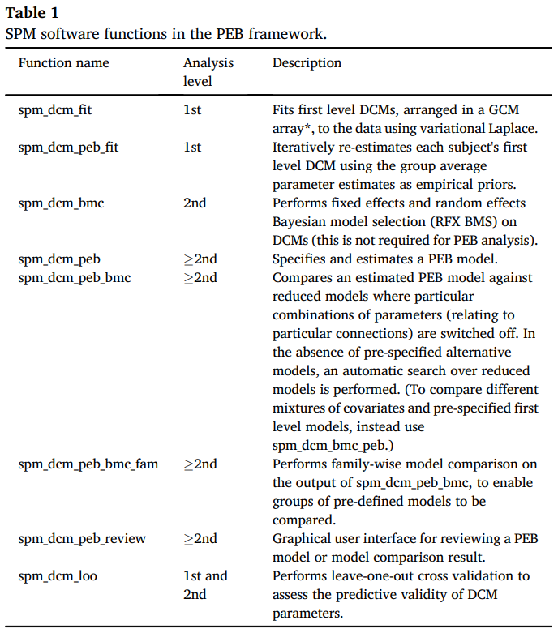
PEB is implemented in the SPM12 Toolbox
First-level estimation with empirical priors
Gives us - model evidence (quality) - group parameters
Performs greedy search over entire model space

Slide 29


Put the «E» in PEB
models
models
models
subjects
spm_dcm_fit
spm_dcm_bmr
spm_dcm_peb
Repeat
PEBs
$$θ_{i}^{\left(2\right)}$$
$$F^{(2)}$$
Free energy to compare models
Models with
empirical priors
spm_dcm_peb_fit
Notes:
What ist empirical about this framework?
Here is a schematic of how the DCM analysis will work on a gruop level. Each square represents a model, empty squares are unfitted models, filled squares are fitted models.
We first define the full model (the first column) for all subjects (rows). Then we estimate the connectivity parameters for each subejct. With a technique called Bayesian model reduction, nested models can be estimated rapidly.
For instance, to pull subjects’ parameter estimates out of local minima, the first level model estimation can be re-initialized multiple times, using the group-level posteriors from the PEB model as empirical priors for each subject (Friston et al., 2015).

Slide 30
DCM example: PEB group analysis
Inference based on Bayesian model selection
What is the model architecture that describes my data best?
Compares different hypotheses about model structure
You can also test families of models
Inference based on Bayesian model averaging
If there is no clear winner…
Average models weighted by their posterior probability
Look at connectivity estimates between regions
Uses a “greedy search” algorithm
Metric? – The free energy

Slide 31
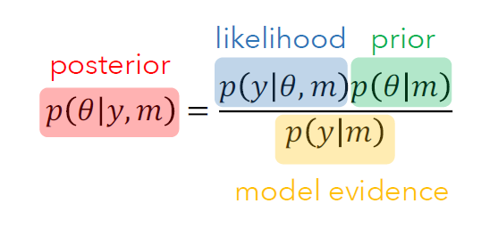
Free energy as approximated model evidence
Model evidence is the marginal likelihood across the entire parameter space
„Given all possible parameter values, how well can the model describe the data?“
For complex models (like DCM) often impossible to derive analytically ( = no formula available) → need for an approximation
Notes:
complexity higher the more independent prior parameters
complexity higher the more dependent posterior parameters
complexity higher the more posterior deviates from prior mean

Slide 32
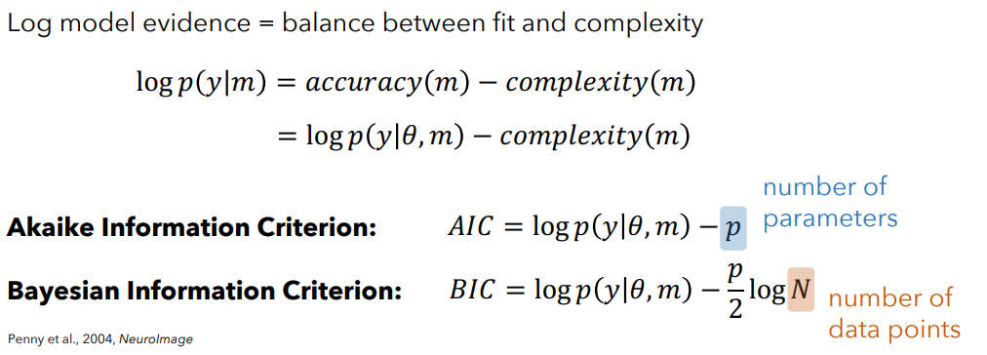

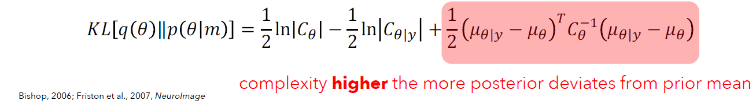
Free energy as approximated model evidence
Free Energy:
Stefan Frässle
Notes:
complexity higher the more independent prior parameters
complexity higher the more dependent posterior parameters
complexity higher the more posterior deviates from prior mean
Trade off between model fit an model complexity

Slide 33
DCM example: PEB group analysis
Build a model to test the overall connectivity changes across the entire group during the task

Slide 34
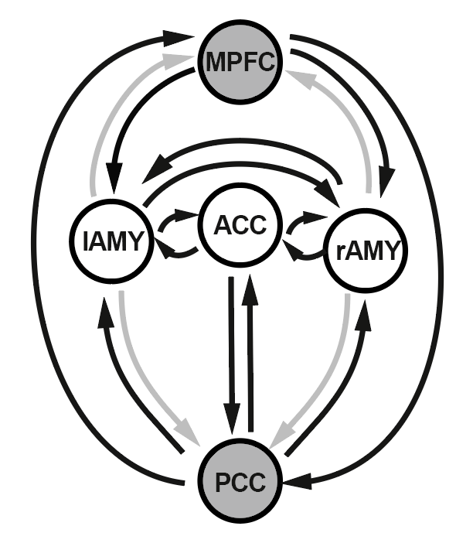
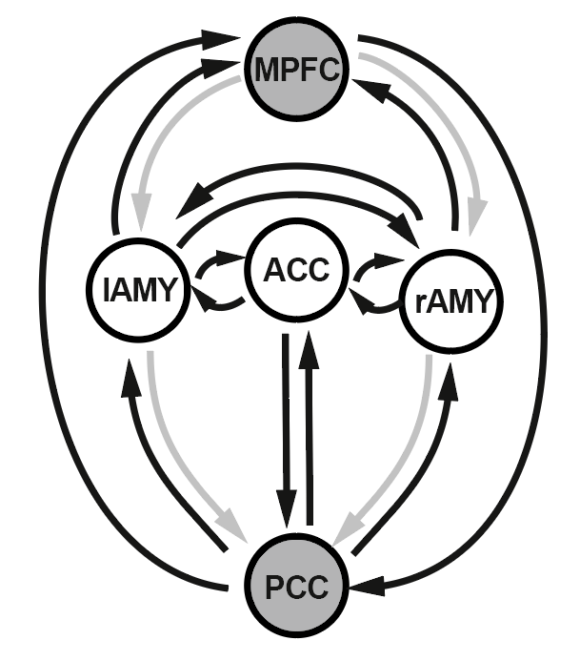
DCM example: 1. PEB Bayesian model selection
Steps:
Create a PEB model
Specify 2nd-level design matrix
Specify model space
Invert model
Perform model comparison
Full
„Top-down“
„Bottom-up“

Slide 35
DCM example: 2. PEB Bayesian model averaging with greedy search
Steps:
Create a PEB model
Specify 2nd-level design matrix
Specify model space
Invert model
Perform model comparison and remove parameters (FE with vs without)
?
?
?
?
?
?
?

Slide 36
DCM example: Add a covariate to your design matrix
To test for associations with a covariate or for group differences we can add regressors to the design matrix
Should be limited to a reasonable amount …
Are there group differences between patients and controls?

Slide 37
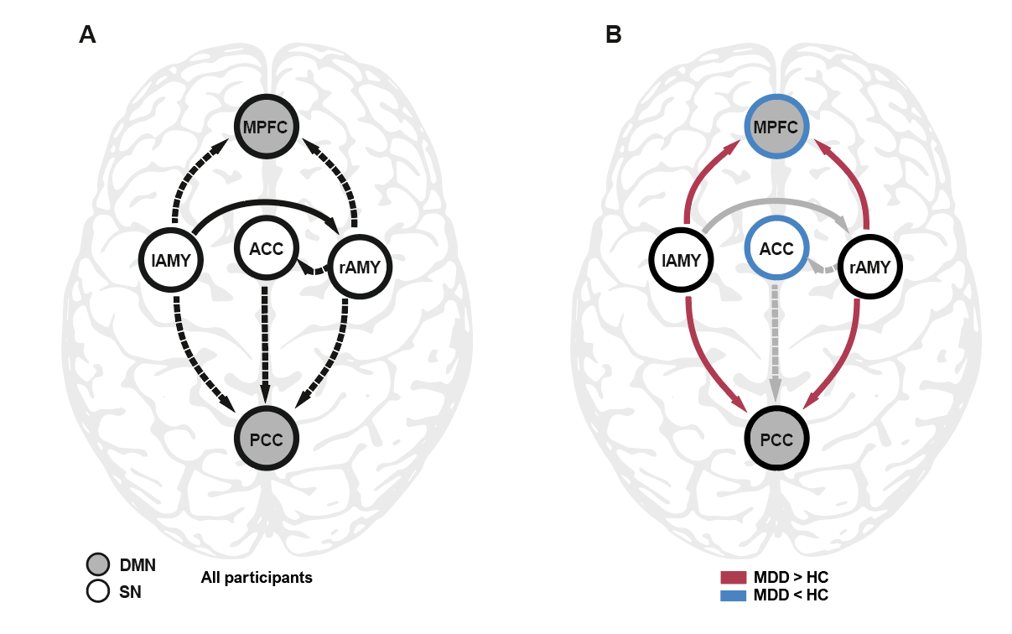
DCM example: Group differences
Poor readers show a decreased coupling between VWFA and STS compared to typical readers

Slide 38
DCM example: Leave-one-out cross-validation
Refits the model n-1 times and excludes one subject at a time
Can we predict the variable? (e.g. group membership)
Is the effect large enough to be meaningful?

Slide 39
Questions?

