Slide 1
Development of informational technology architecture for software development process improvement using dynamic planning problem statement based on CMMI model
PERFORMER:
Student of group KN-33j Bulyga a.V
SUPERVISOR:
Prof. GODLEVSKY M.D
Notes:
Good afternoon, my name is Bulyga Artem, I’m a student of group KN-33j, supervised by Mr. Godlevsky and I would like to present you my coursework:
*Topic*

Slide 2
List of abbreviations
SWDP – Software Development Process
CMMI – Capability Maturity Model Integration
Notes:
Here is the list of abbreviations that we will use often in the next slides, listed for convenience. All other abbreviations you can find in coursework body.

Slide 3
Problem statement
The object of the work is the software development process.
The subject of the work is architecture of a SWDP improvement software system and SWDP quality management model CMMI.
The goal of the work is to design architecture of a future software.
Notes:
The problem statement is following:

Slide 4
Problem actuality
SWDP is on the most important activities for a lot of companies.
CMMI has already shown some results on practice and it is tested by time.
Optimal trajectory of SWDP improvement allows companies to invest their resources wisely, which is really important in condition of limited resources.
Notes:
Problem actuality:

Slide 5
Tasks for goal achievement:
Analyze the domain area
Analyze SWDP assessment methods
Analyze CMMI model
Research applying of sliding planning task for CMMI model
Develop and analyze architecture of the future software
Notes:
Tasks that need to be accomplished to achieve the goal.

Slide 6
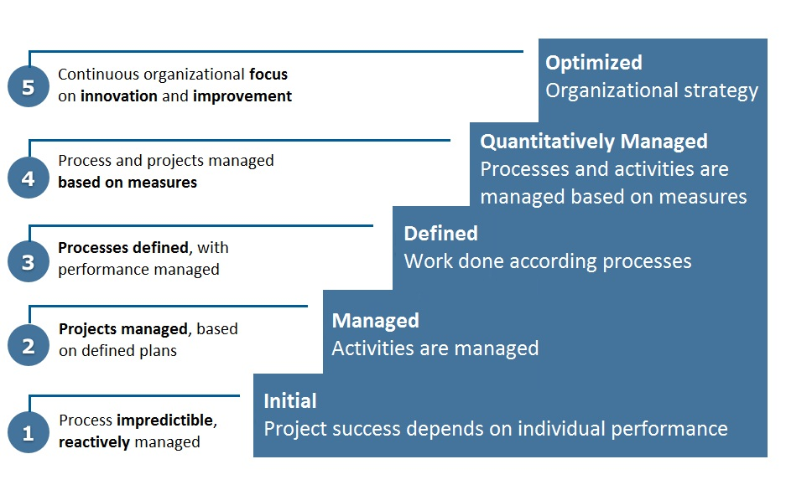
CMMI model
Notes:
CMMI model (Capability Maturity Model Integration) focused primarily on improving software development processes within the organization and obtaining their quality assessment. They key definition is a so called “Maturity” of organization, which is estimated by CMMI levels.

Slide 7
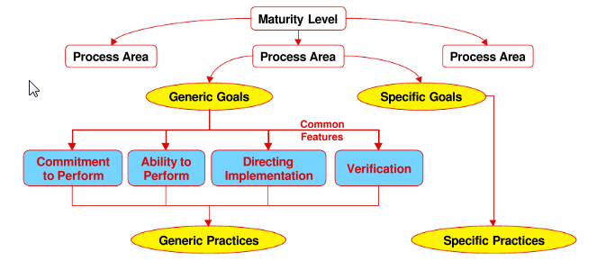
CMMI model
Notes:
*Describe structure of CMMI*

Slide 8
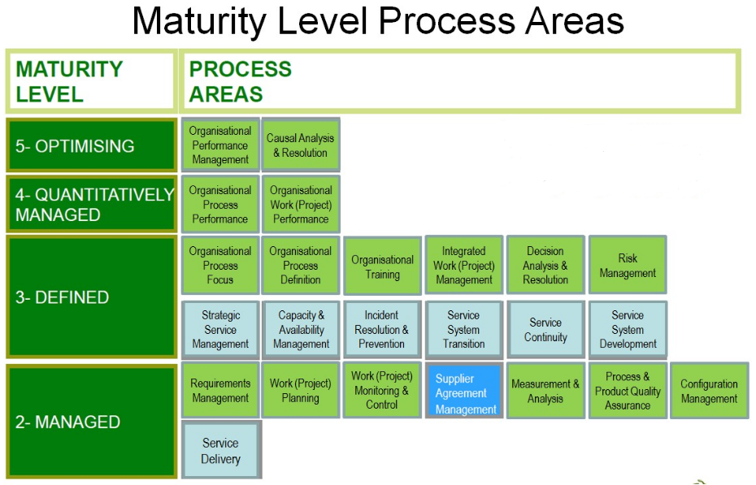
Notes:
Here we can see Maturity levels and Process areas which correspond to each of them. In order to company to reach some of this levels, all of the process areas of this levels, as well as previous one should reach some maturity level as well (i.e, they should be performed in a company).

Slide 9
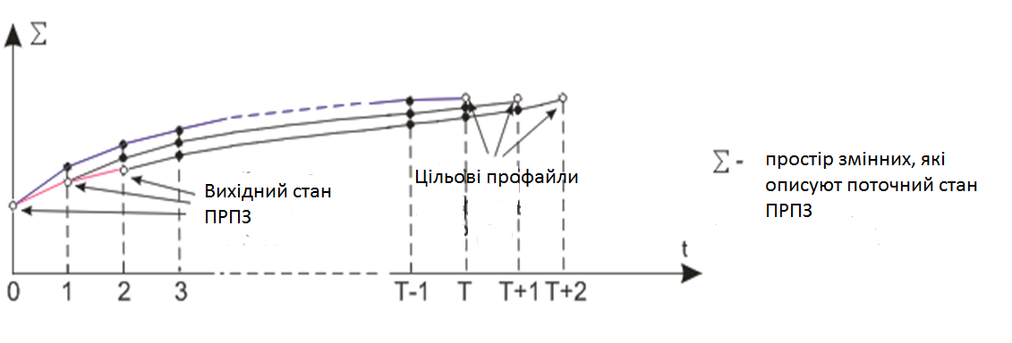
Sliding planning technique
Notes:
Unfortunately CMMI model doesn’t give any exact instructions what to, that’s why we apply sliding planning technique.
First, we take our initial profile of our SWDP(levels of our practices, which are described in terms of integer numbers), then form target profile that we want to reach.
After this, using sliding planning algorithms(finding optimal value of utility function(функция полезности) with constraints(financial and time resources) we find an optimal trajectory which shows how to improve our SWDP.
Here we can see on the X-axis: set of variables which characterize current status of SWDP on some period T(Y-axis, with subperiods)

Slide 10
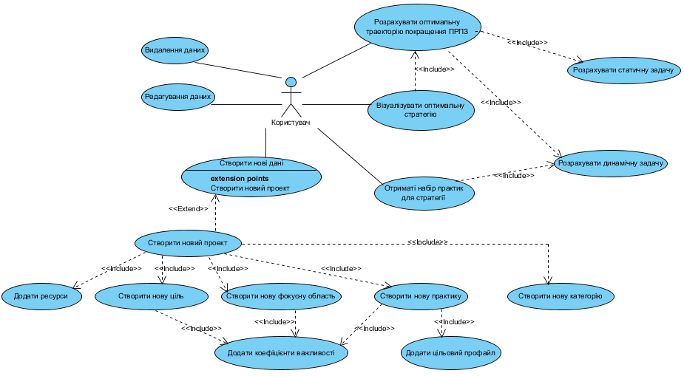
Requirements specification: use case
Notes:
Let’s look at the use case diagram which is a part of functional requirements specification of the software. The main task is to visualize our optimal strategy of SWDP improvement.

Slide 11
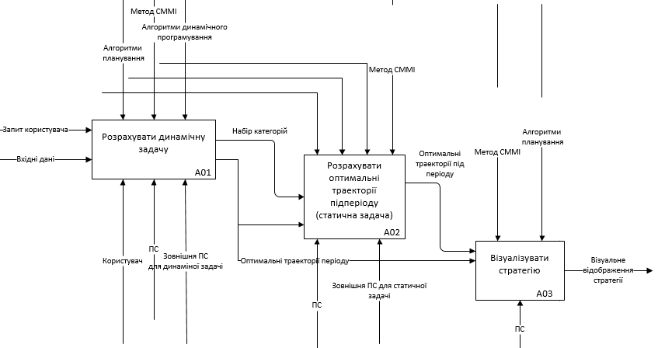
IDEF0 for main process: visualize optimal strategy
Notes:
Here we see the IDEF0 diagram for main use case of the problem – visualizing an optimal strategy of SWDP improvement.
*about diagram*

Slide 12
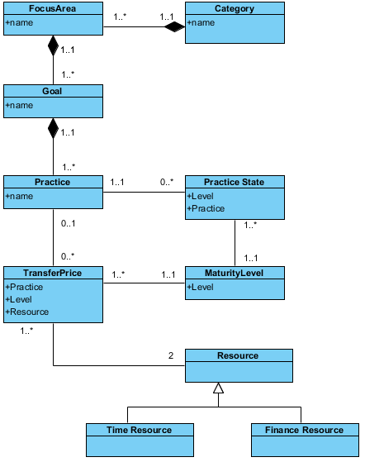
Requirements specification: Ontology of the project
Notes:
Here we can see the ontology for our domain. Category consists of FocuseAreas; FocusAreas consists of goals; To achieve some goal it is needed to transfer practice to new maturity level; We have our maturity level concept which represents maturity level of practice(e.g 0 level means that practice is not being implemented in company, while 4 level means it is formalized and automatized as consistently executing process in a company) TransferPrice is a price for transferring practice to some maturity level. It takes some resources; which can be either time or financial resources;

Slide 13
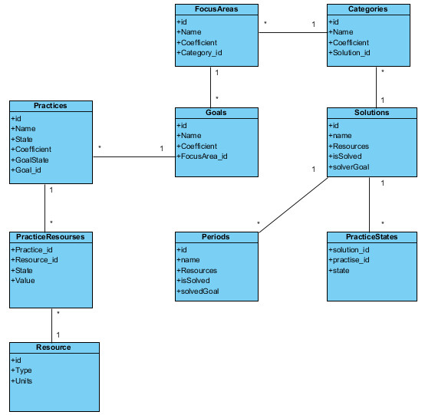

Conceptual Data Model
Notes:
Here we can see CMD for our domain. Relations are quite similar; we also have a Solutions concept which includes categories (in practice it will be a bunch of practices that we need to improve) with some periods and resources that are needed to perform transfer)

Slide 14
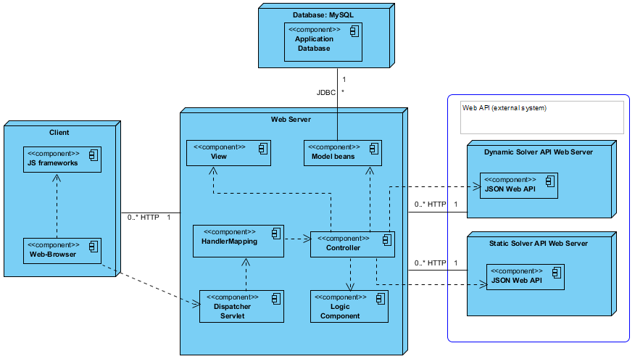
System architecture: deployment diagram
Notes:
I have chosen standard 3-layer architecture. Note that we software will use external existing API’s for solving dynamic and static tasks.

Slide 15
System architecture advantages
Independent from the software platform
High security
High scalability
Low performance requirements of the client work machine

Slide 16
System architecture: technologies of the future software
Java Development Kit (JDK)
Spring MVC
Apache Tomcat Java Servlet Container
Hibernate
Eclipse IDE

Slide 17
Conclusions
In this work, we have done the analysis of the domain area, as well as SWDP assessment. The CMMI model was researched and analyzed. The sliding planning task was applied for the problem. As the result, architecture of the future software was developed.

