Slide 1

NETWORK PROGRAMMING ProJECT P2P Chat APPlication
Group 13
nguyen duc hung - 20176779
Nguyen manh khang - 20176792

Slide 2
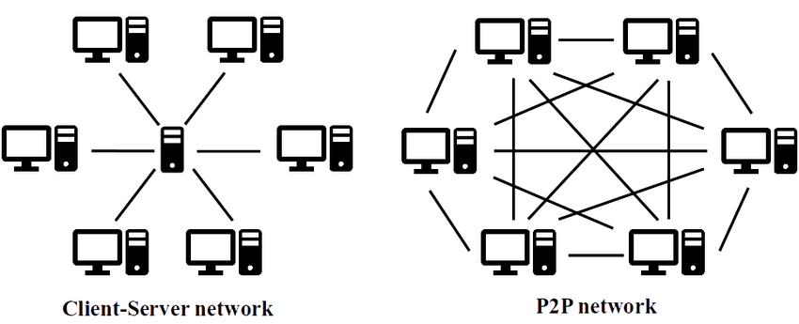
Overview of p2p network

Slide 3
P2p chatting application
Features:
Chat
P2P chatting
See who is online
Request to chat

Slide 4
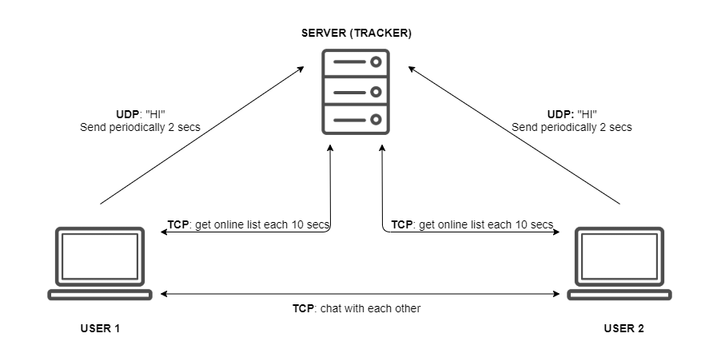
P2p chatting application
How does it work?

Slide 5
P2p chatting application
Main components:
Tracker: manage online list and their IP, port
Peer:
Creating peer interface
Online list interface
Chatting interface

Slide 6
THANKS !

