Slide 1

NETWORK PROGRAMMING ProJECT P2P Chat APPlication
Group 13
nguyen duc hung - 20176779
Nguyen manh khang - 20176792

Slide 2
REQUIREMENT ANALYSIS

Slide 3
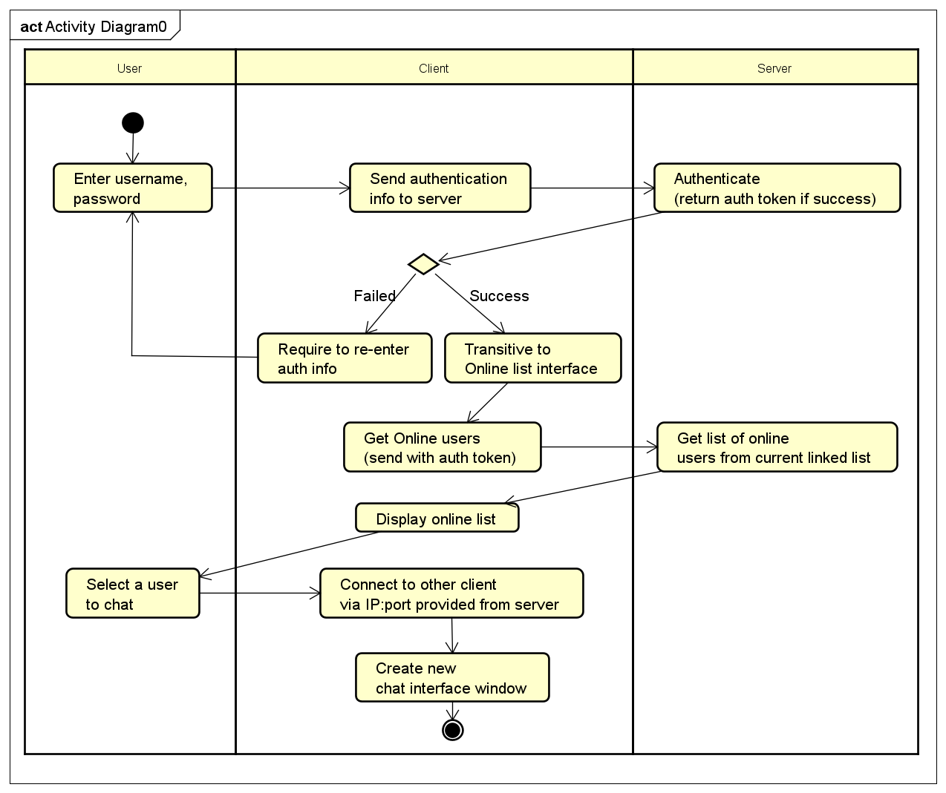
BASIC ACTIVITY

Slide 4
ARCHITECTURAL DESIGN

Slide 5
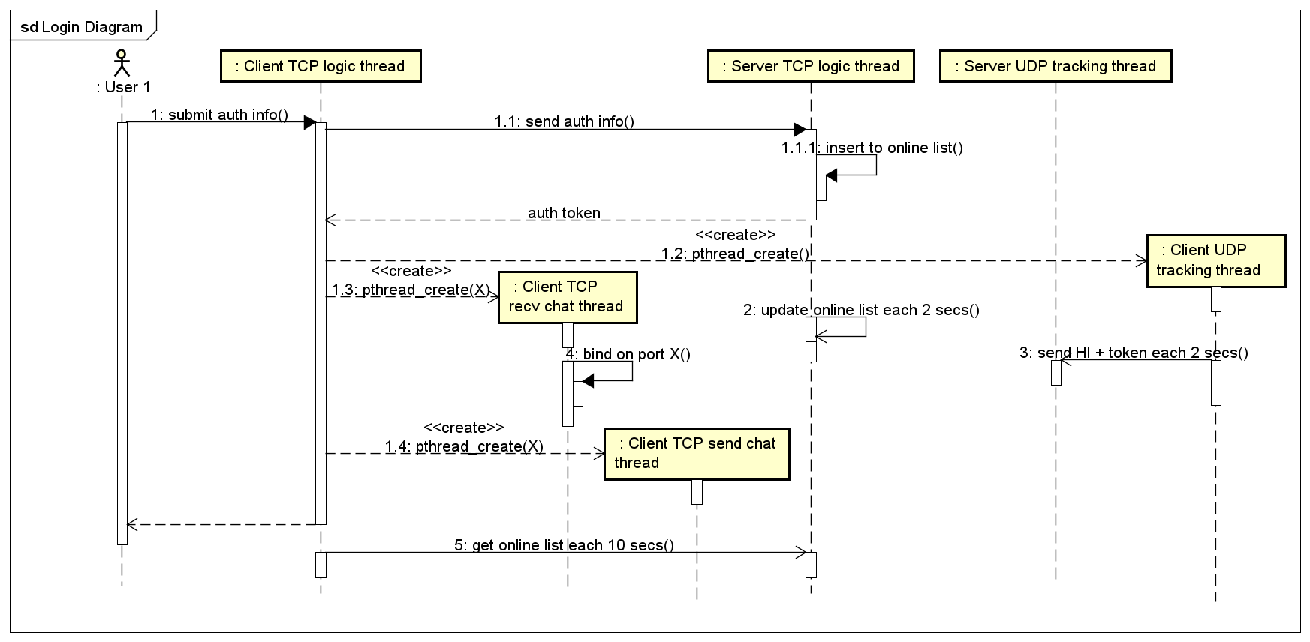
INTERACTION DIAGRAM

Slide 6
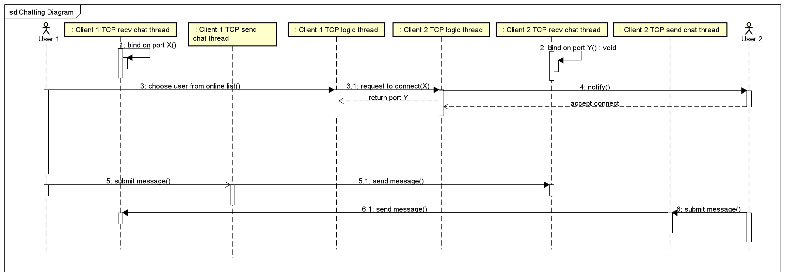
INTERACTION DIAGRAM

Slide 7
THANKS !

