Slide 1

NETWORK PROGRAMMING ProJECT P2P Chat APPlication
Group 13
nguyen duc hung - 20176779
Nguyen manh khang - 20176792

Slide 2
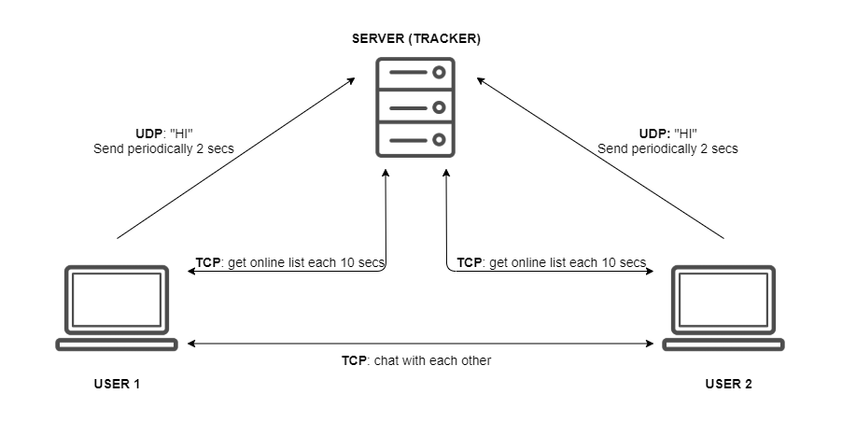
Brief overview

Slide 3
DaTA MODELING

Slide 4
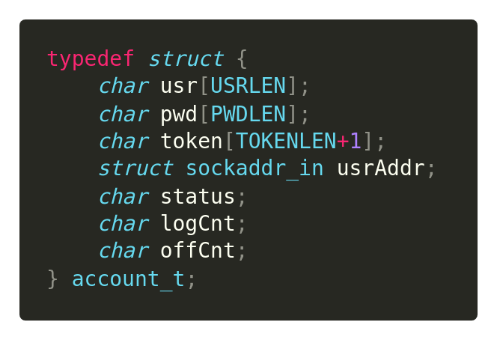
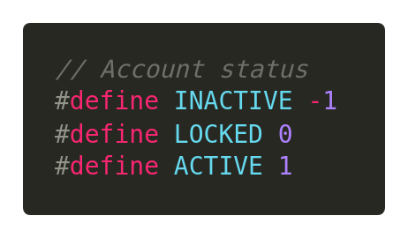
DATA Structure
Structure to manage user
+ usr : username
+ pwd : password
+ token : for authentication
+ usrAddr : address of peer
+ status : account status (see below)
+ logCnt : login attempt count
+ offCnt : offline interval time count

Slide 5
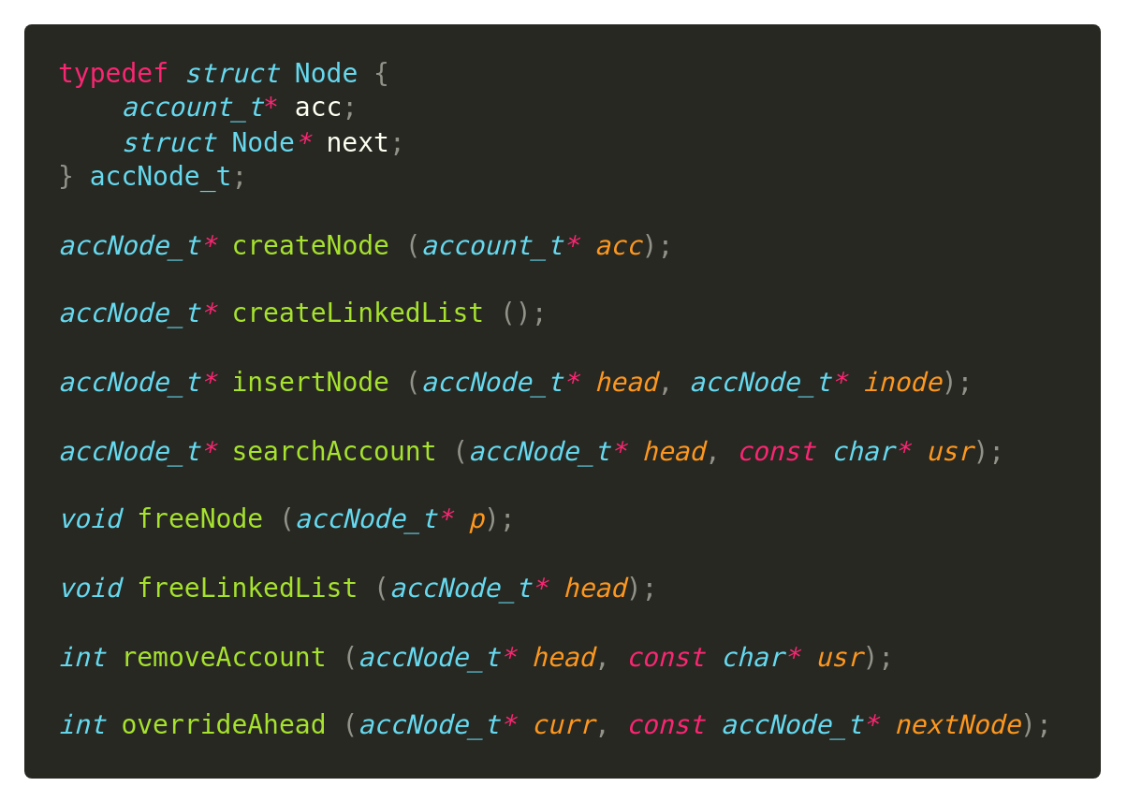
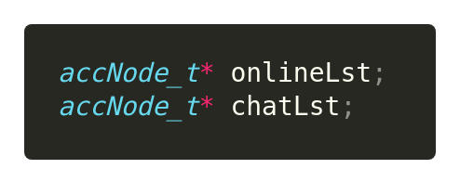
DATA Structure
Notes:
Accounts are organized into a linked list.
+ Online list: online account
+ Chat list: list of chatting user
Why linked list? -> easily to remove. Search operation can be optimized
-> Use a SQL database like SQLite, MySQL instead is much more optimize, but for demo purpose, we decide to use a simple data structure and storage instead

Slide 6
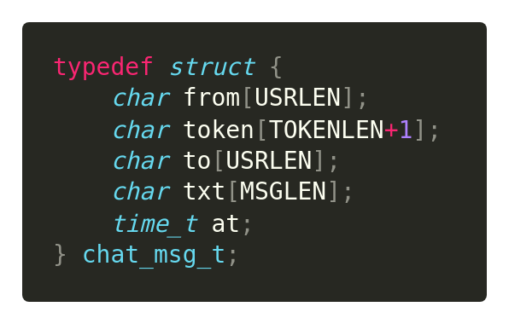
DATA Structure
Structure to manage chat message
+ from : username of sender
+ token : token of sender
+ to : username of receiver
+ txt : chat message
+ at : send time
Notes:
Receiver will compare the given token with stored token of sender to authenticate

Slide 7
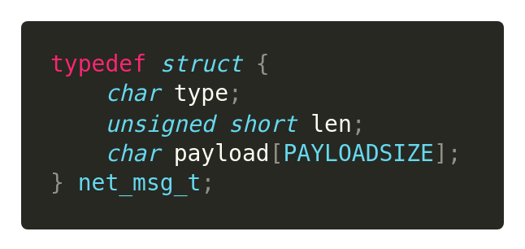
DATA Structure
Structure to exchange message over network
+ type : message type
+ len : payload length
+ payload : message content

Slide 8
MESSAGE EXCHANGE MODEL

Slide 9
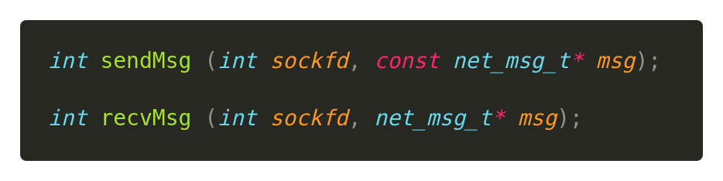
MESSAGE EXCHANGE
Functions to send and receive message over the network
+ sendMsg : caller prepares net_msg_t message to send through sockfd
+ recvMsg : caller have to allocate space for storing network message read in sockfd

Slide 10
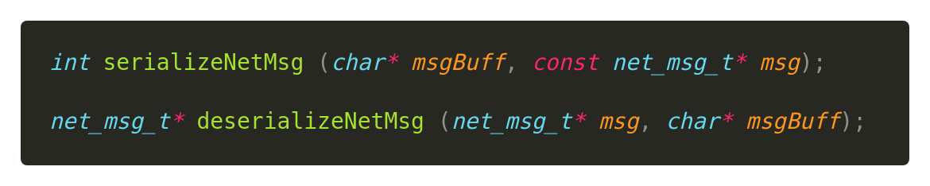
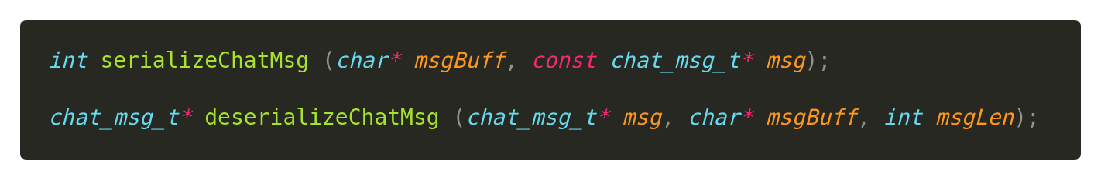
MESSAGE EXCHANGE
Serialize/Deserialize functions
+ Serialize : convert message structure into a formatted memory buffer
+ Deserialize : convert a formatted memory buffer into allocated data structure
Notes:
We need to turn an chat message structure into a buffer to store in net_msg_t.payload, and a network message structure into a memory buffer for easily exchange over network -> solution: serialize at sender, deserialize at receiver
+ Serialize : convert message structure (which is organized by C structure standard) into a formatted memory buffer (which can send through over network without worrying about memory padding, edianess)
+ Deserialize : convert a formatted memory buffer into allocated data structure

Slide 11
SERVER STRUCTURE

Slide 12
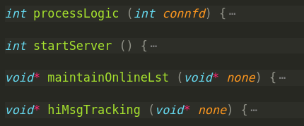
SEVER PROTOTYPE
Server logic of P2P network is simple!
Notes:
startServer: bind and listen to a port
processLogic: receive and handle message (authenticate message, get online list message)
maintainOnlineLst: run on a separate thread to manage online list each time interval
hiMsgTracking: run on a separate thread to receive HI message each time interval

Slide 13
CLIENT STRUCTURE

Slide 14
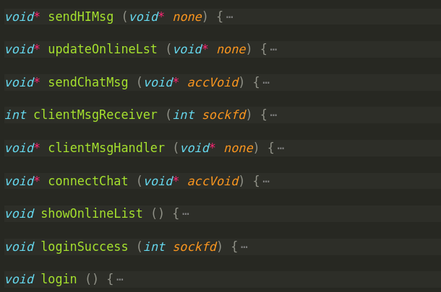
CLIENT PROTOTYPE
Notes:
sendHIMsg: run on a separate thread to send HI msg each time interval
updateOnlineLst: run on a separate thread to retrieve online list each time interval
sendChatMsg: run on a separate thread to send chat message
clientMsgHandler: run on separate thread to receive control message
clientMsgReceiver: run on the same thread with clientMsgHandler (called by clientMsgHandler to read and handle control message)
connectChat: run on a separate thread to request connect to other client
showOnlineList: run on main thread to show online list (called by loginSuccess)
loginSuccess: run on main thread to prepare things when login success (called by login)
Login: run on main thread to do authentication

Slide 15
GRAPHICAL DESIGN

Slide 16

TECHNOLOGY
GTK
+ GTK (formerly GTK+, GIMP ToolKit) is a free and open-source cross-platform widget toolkit for creating graphical user interfaces (GUIs).
+ It is licensed under the terms of the GNU Lesser General Public License, allowing both free and proprietary software to use it.
+ It is one of the most popular toolkits for the Wayland and X11 windowing systems

Slide 17
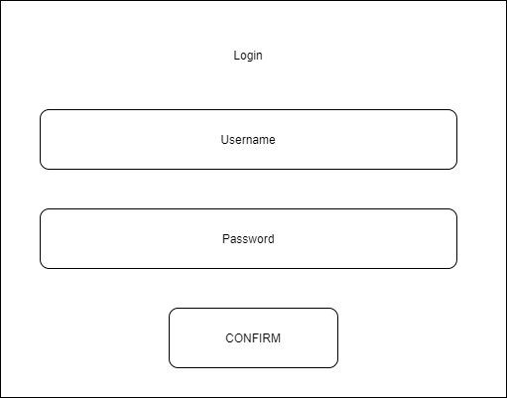
LOGIN SCREEN

Slide 18
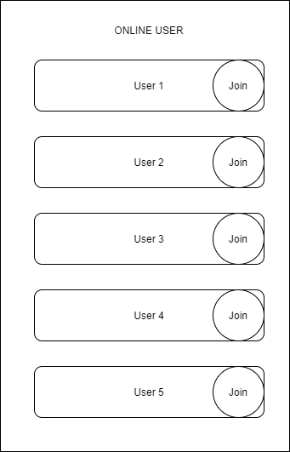
ONLINe list screen

Slide 19
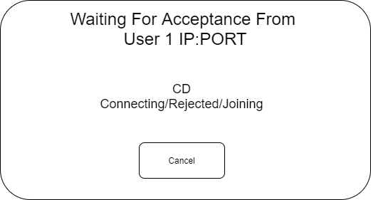
Request chat dialog

Slide 20
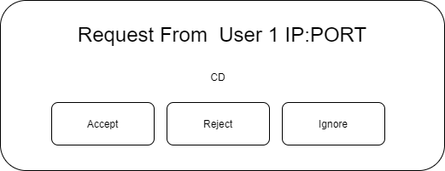
Receive request dialog

Slide 21
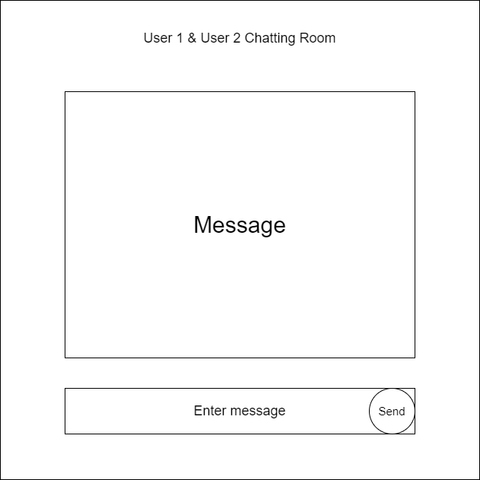
Chat screen

Slide 22
CLI DEMO

Slide 23
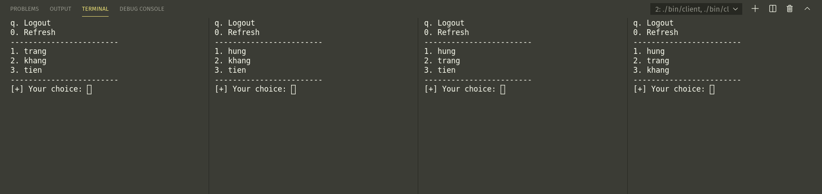
ONLINe list interface

Slide 24
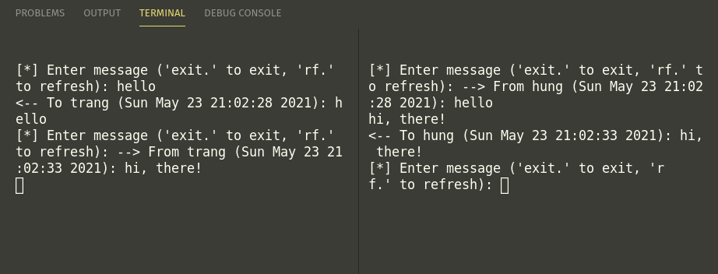
Chat interface
Notes:
Have some issue with displaying because of limitation of command line interface

Slide 25
Group member’s tasks

Slide 26
THANKS !

