Slide 1
Self gravitation and rotation

Slide 2
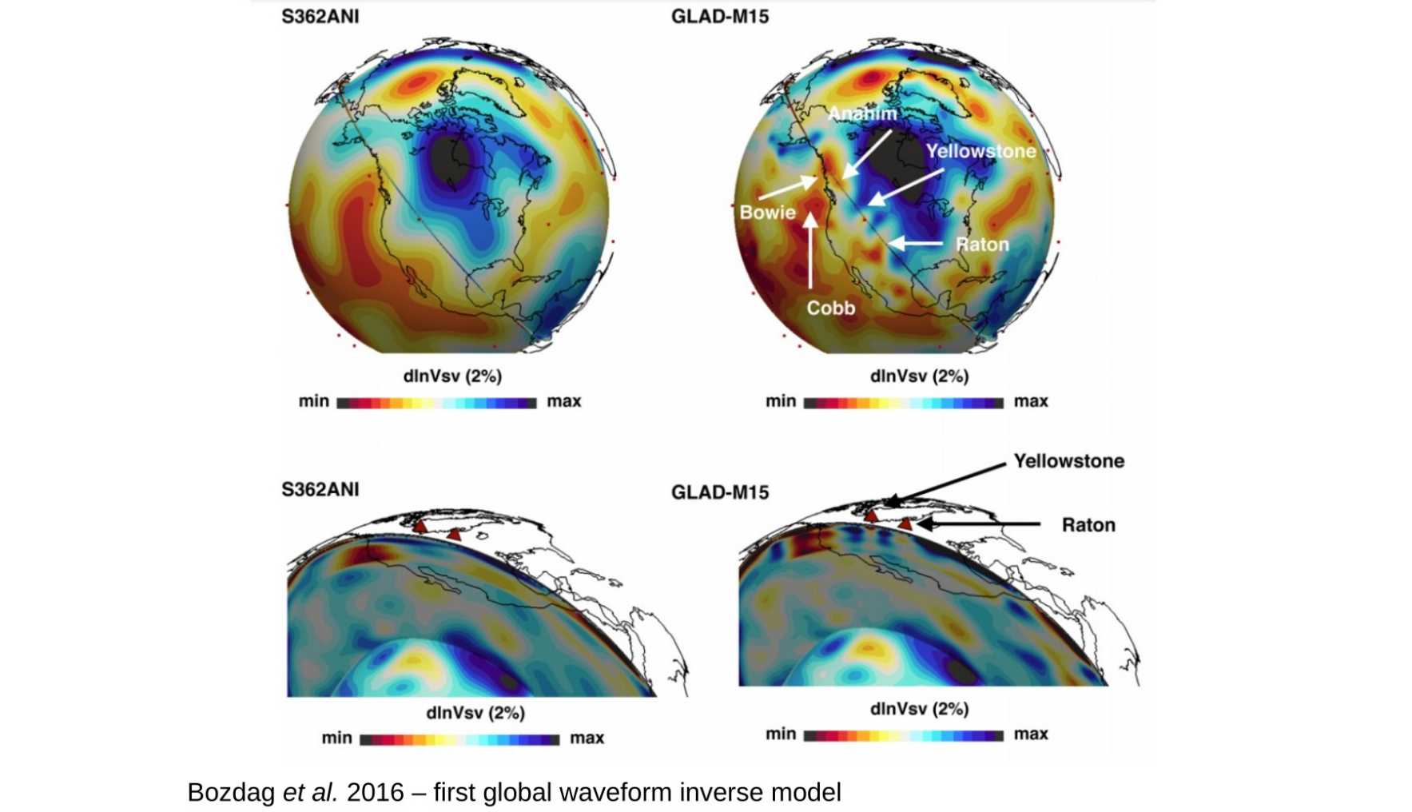
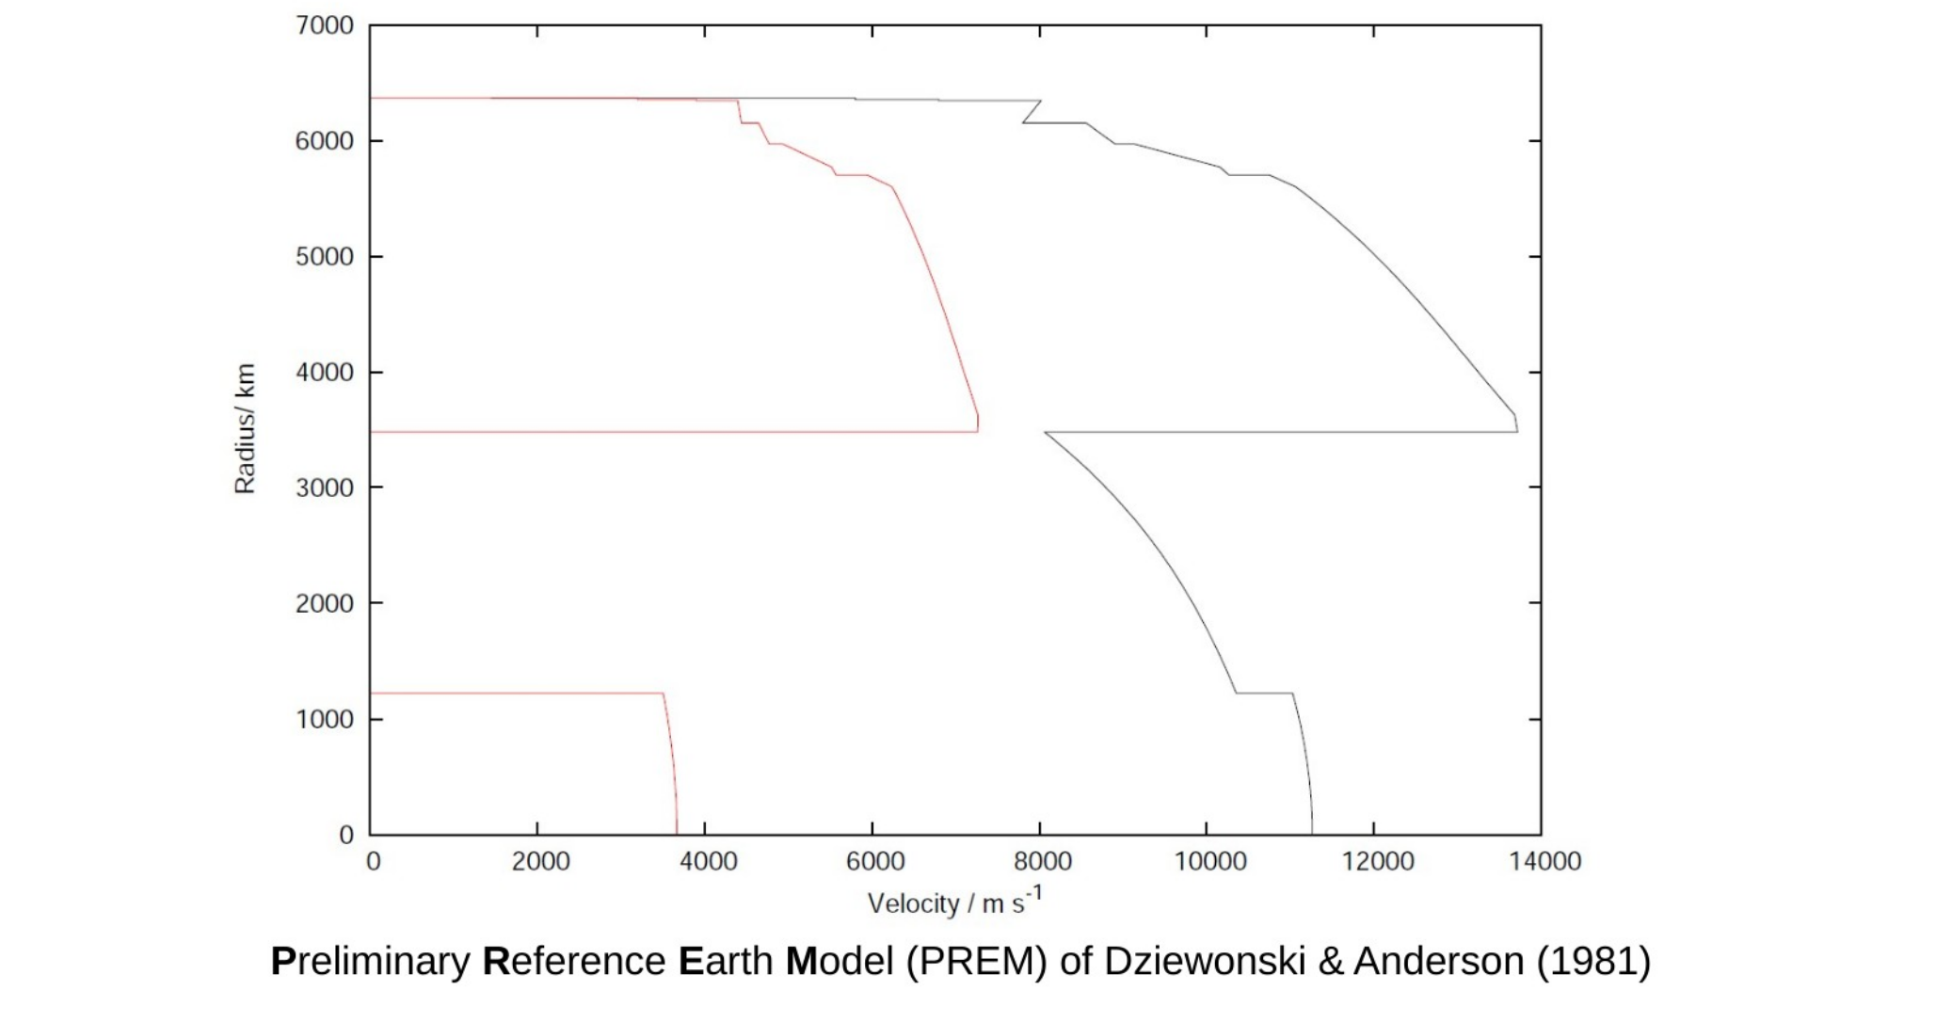
From earlier lectures

Slide 3
Newtonian gravity

Slide 4
Poisson’s equation
Gravitational potential satisfies:
Associated gravitational acceleration:
Equation subject to continuity conditions:
across any jumps in density, while the potential also tends to zero at infinity

Slide 5


Poisson’s equation
Solution to the problem can be expressed as a familiar integral:
and differentiating, the gravitational acceleration can be similarly written:

Slide 6
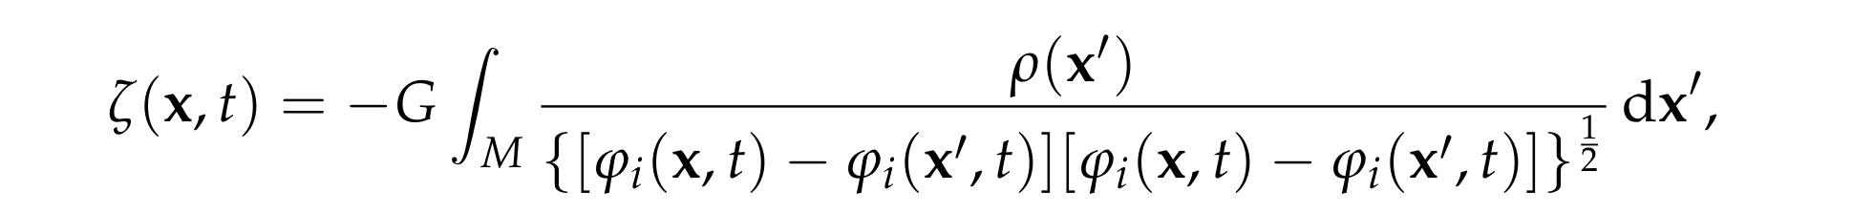
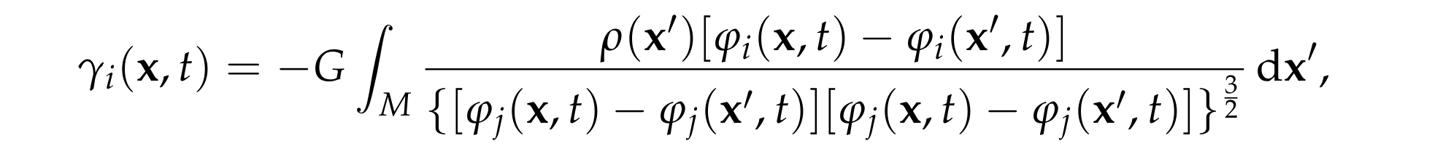
Transformation to the reference body
Using the motion of the body, we can define a referential gravitational potential:
Using conservation of mass, we can transform the integral solution to obtain:
Similarly for the referential gravitational acceleration:

Slide 7
Gravitational binding energy
This is the potential energy of a body associated with gravitational forces
Can be calculated by assuming the body is assembled bit-by-bit, summing up the work required to move each particles in from infinity relative the to current field
Calculation identical to that in 1B Electrodynamics for the energy of an electrostatic field:
Full details in the notes, but you won’t be asked to recall the calculation
Can express referentially:

Slide 8
Equations of motion

Slide 9
Hamilton’s principle
Potential energy is now the sum of elastic and gravitational contributions
Modified Lagrangian density:
Statement of Hamilton’s principle is unchanged
Derivation of Euler-Lagrange equations is harder because we have a non-local term in the Lagrangian – this reflects the action at a distance property of Newtonian gravity

Slide 10
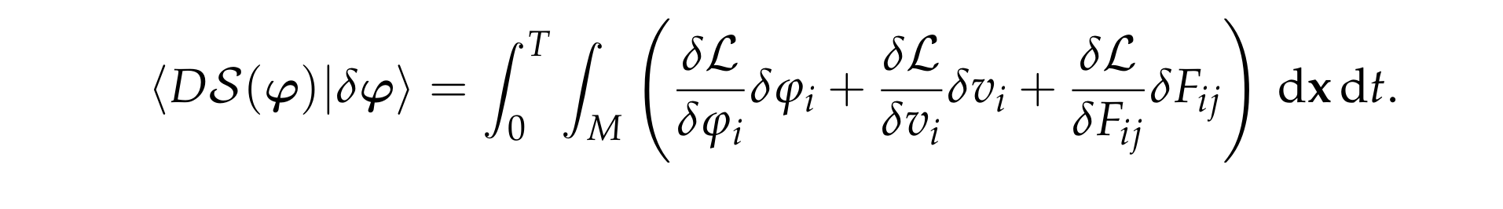
First variation of the action
Functional derivatives still defined through linear term in Taylor expansion
The result can be expressed in the form
The “derivative” terms here are, by definition, just the quantities multiplying the first-order perturbations to the fields
In the case of local Lagrangians, these are just normal partial derivatives
It is only the variation with respect to the motion that needs additional work

Slide 11




Euler-Lagrange equations
Follow the standard integrations by parts, we obtain:
As previously, we have:
In example sheet 4 you will show that:

Slide 12

Euler-Lagrange equations
The equations of motion can be written in the form:
As expected, we have just added a gravitational body force to the balance of linear momentum
This force is expressed in terms of the motion through an integral over the whole body
These are now integro partial differential equations

Slide 13
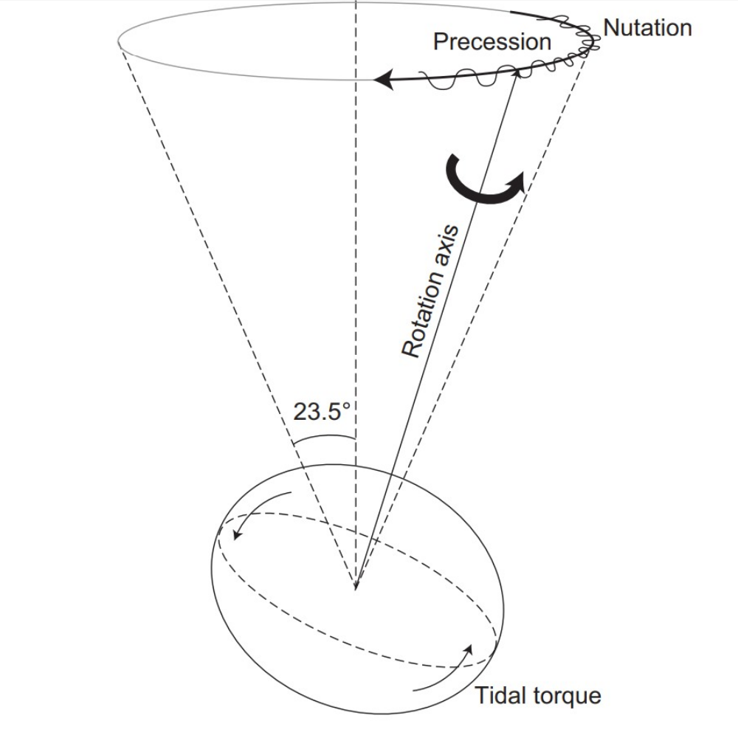
Co-rotating reference frames
We have described the motion relative to an inertial frame defined by the “fixed stars”
For applications to the Earth, it is more natural to use a rotating frame
The Earth’s rotation is not steady, varying due to both external and internal processes
Within seismology, it is common to use an steady and approximately co-rotating reference frame
This will introduce the usual fictitious forces into the equations of motion
Dehant & Matthews (2015)

Slide 14
Decomposition of the motion
The motion relative to inertial space can be written:
Translation vector represents motion of the origin of the reference frame
Rotation matrix represents rotation of the reference frame
On the right hand side we see the relative motion as seen from the non-inertial frame
Because of material frame indifference, the choice of frame has no effect on the potential energy associated with the motion

Slide 15

Relative velocity
Differentiating the motion in time, we find:
Introduction of the angular velocity as seen from the non-inertial frame:
The velocity can then be expressed in the form:

Slide 16
Relative acceleration and choice of frame
Differentiating again, we can write the acceleration:
At this point, we define an approximately co-rotating frame by setting:
This approach can be generalised to allow for interactions between different planets (e.g., Earth-Moon system)

Slide 17
Stress and gravity in the non-inertial frame
Differentiating the motion spatially, we find:
From the definition of the first Piola-Kirchhoff stress and frame indifference, we find:
Similarly, for the referential gravitational acceleration:

Slide 18

New equations of motion
Putting things together and cancelling common rotation factors:
All terms defined relative to the rotating reference frame
Identical to the inertial case except for the addition of Coriolis and centrifugal forces
From here on we will always work in the rotating frame and drop the overbars

Slide 19

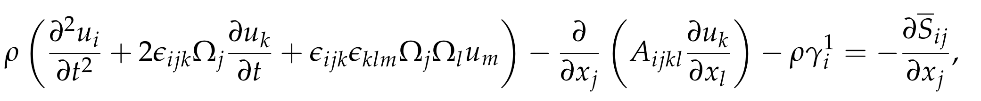
Linearisation
Same procedure as ever for linearisation on application of a small stress glut
At zeroth-order we have the equilibrium equations:
Stress-free equilibrium solutions are not now possible
At first order we have the linearised equations for the displacement vector:
Perturbation to referential gravitational acceleration given as an integral of the displacement vector – see handout for full expression

Slide 20
Scaling analysis

Slide 21

Order of magnitude estimates
Derivatives can be readily estimates in terms of typical time and length scales
Estimating the magnitude of the gravitational acceleration is a bit more work due to integral definition (see handout):

Slide 22


Relative importance of terms
Ratio of gravitational to elastic forces:
This shows that gravity is negligible at sufficient small wavelengths and hence at correspondingly high frequencies
Taking L to be the radius of the Earth:
At the longest wavelengths gravity is just an important as elasticity within the equations of motion – this fact means that we can learn about density directly

Slide 23

Relative importance of terms
Ratio of rotational to inertial forces:
If time-scale is much less than a day, rotation will be negligible
Longest period seismic free oscillations have periods on one hour – rotation is not negligible, but is a relatively small effect
For longer period deformation such as that due to tidal forces, rotation becomes a dominant feature within the dynamics

Slide 24
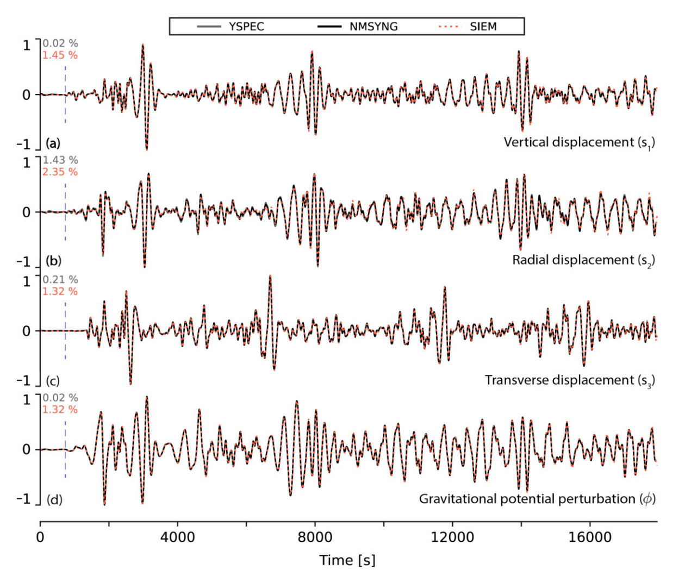
Gharti et al. (2023)

Slide 25
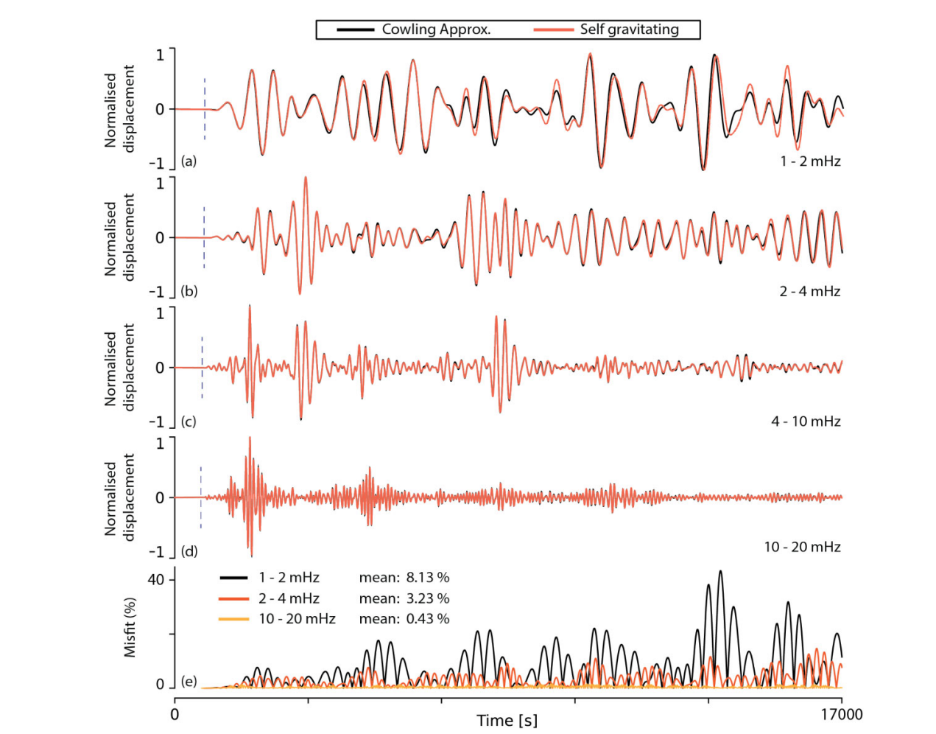
Gharti et al. (2023)

