Slide 1

Feedback form for the course
Please do fill this in before the end of term
We do take comments seriously, and they help to make the course better over time
https://cambridge.eu.qualtrics.com/jfe/form/SV_3z0oG7tq3O9xtpc

Slide 2
Mode splitting and coupling

Slide 3
From last lecture
Weak form of the equations of motion can be written:
Eigenvalue problem in non-rotating case:
Eigenfunction expansion solution in frequency-domain:

Slide 4
Spherically symmetric Earth models

Slide 5

Angular momentum operators
Gradient in spherical polar co-ordinates:
Used to define the tangential gradient operator on the unit sphere:
Associated operators related to those for angular momentum:

Slide 6
Spherical harmonics
Simultaneous eigenfunctions of commuting operators:
The degree, l, is a non-negative integer
For degree, l, the order is an integer between -l and l
Orthonormality condition:
Complete basis for scalar functions on the unit sphere

Slide 7

Vector spherical harmonics
To work with vector fields, we defined:
Orthogonality relations:
Complete basis for vector fields:

Slide 8
Eigenvalue problem
Eigenvalue in non-rotating case:
If the model is spherically symmetric we can use separation of variables
Angular dependence expressed in terms of vector spherical harmonics
For each degree and order, we get a radial ODE eigenvalue problem
Huge amount of algebra and the need to work in detail with vector and tensor spherical harmonic expansions
We will just summarise the main results

Slide 9
Toroidal modes
Two classes of eigenfunctions emerge from the separation of variables
Toroidal modes have eigenfunctions of the form:
Radial part, W, depends on degree but not order – results in (2l+1)-dimensional eigenspaces, this being characteristic of rotationally invariant systems
Eigenfunctions vanish in fluid regions (analogous to S-waves)
Displacements tangential to spherical surfaces, gravity not involved in their dynamics

Slide 10
Spheroidal modes
Spheroidal modes have the form:
Radial functions again independent of order – (2l+1)-dimensional eigenspaces
Eigenfunctions can be non-zero in both solid and fluid regions
Radial and tangential components to the displacement, self-gravity contributes to their dynamics

Slide 11

Toroidal eigenvalue problem
Spheroidal and toroidal modes are orthogonal due to properties of VSH
For toroidal modes of degree l and order m, we can take test functions:
It is then easy to show that:
Potential energy form similarly reduced to radial integral, but calculation harder

Slide 12
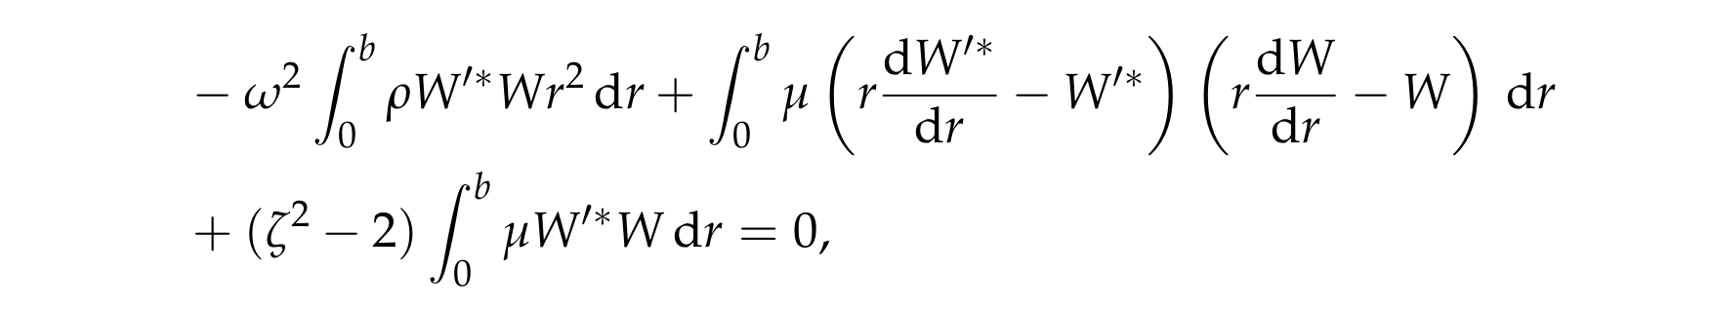
Toroidal eigenvalue problem
Weak form of the eigenvalue problem:
Equivalent to 2nd order ODE eigenvalue problem (or Strum Liouville type)
Closed-form solution in homogeneous planet using spherical Bessel functions
More generally, numerical methods needed
For each l, we get an infinite set of overtones labelled by an integer, n = 0,1,2,...

Slide 13
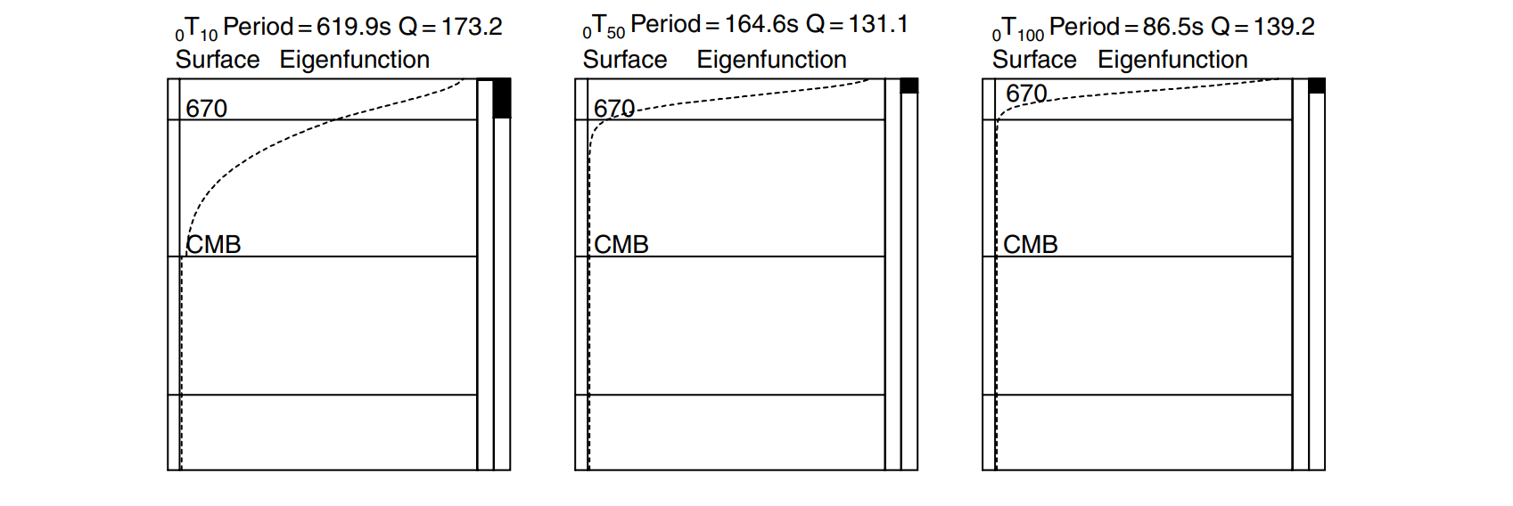
Toroidal eigenfunctions
Woodhouse & Deuss (2007)

Slide 14
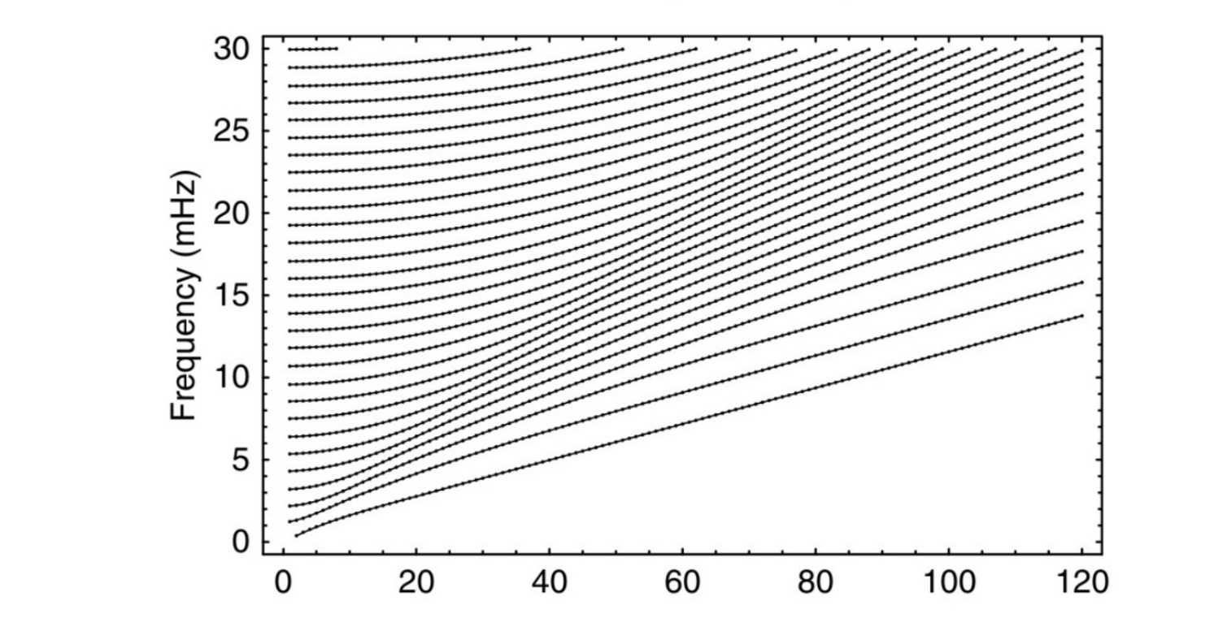
Toroidal mode eigenfrequencies
degree
Woodhouse & Deuss (2007)

Slide 15
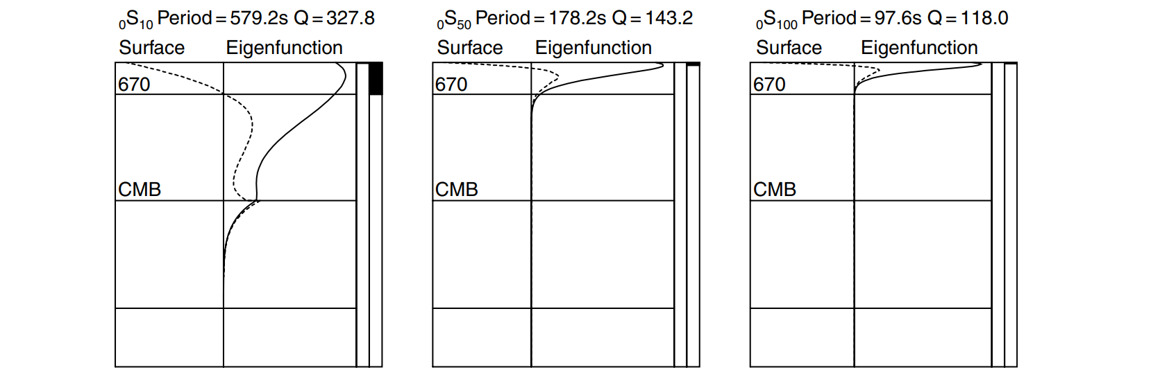
Spheroidal mode eigenfunctions
Woodhouse & Deuss (2007)

Slide 16
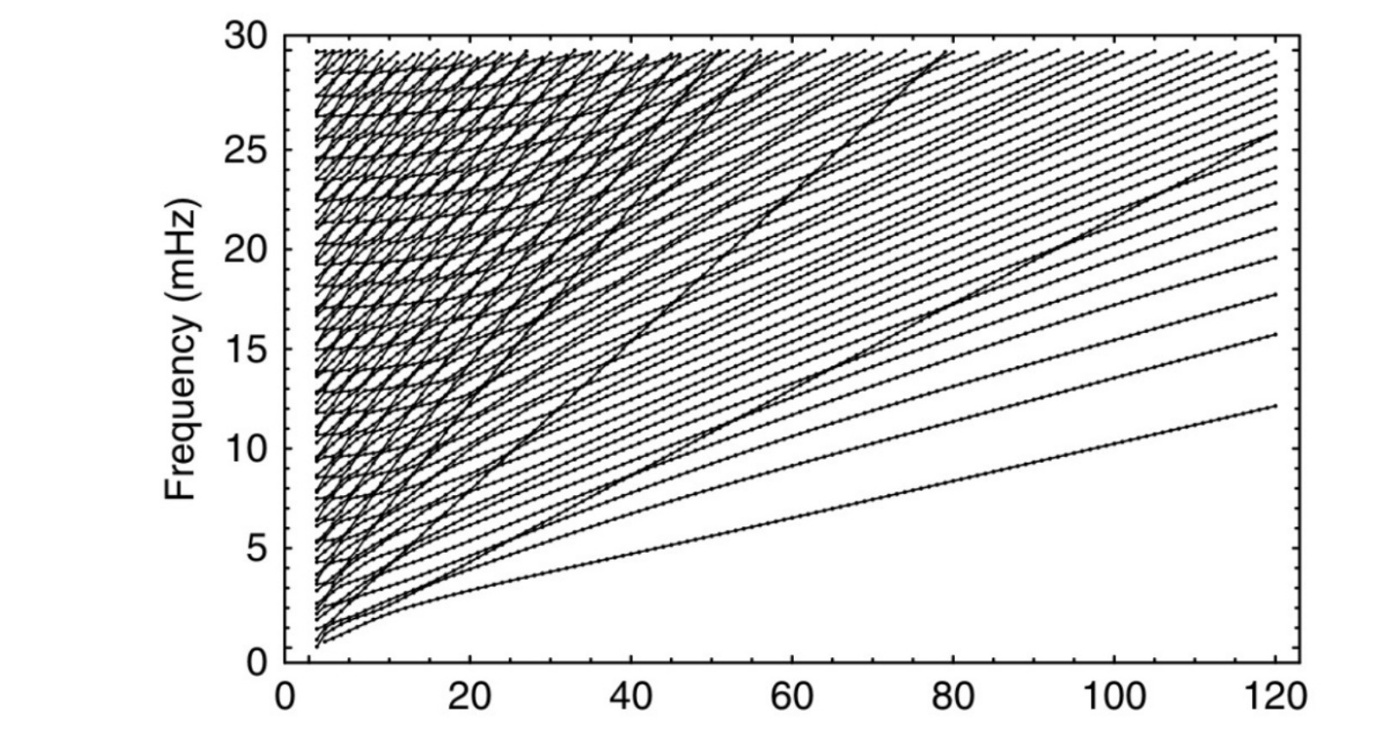
Spheroidal mode eigenfrequencies
degree
Woodhouse & Deuss (2007)

Slide 17
Multiplets and singlets
Each eigenspace labelled by three integers:
  Mode type, q, with 1 = spheroidal, 2 = toroidal
  Degree, l, a non-negative integer
  Overtone number, n, this being a non-negative integer
We call each such eigenspace a multiplet
Within each multiplet of degree l there are then (2l+1) eigenfunctions labelled by their order, m, lying between -l and l
Each eigenfunction is known as a singlet
To denote singlets, we use the notations:

Slide 18
First-order splitting theory

Slide 19
Perturbed eigenvalue problem
Suppose we have solved the spherical reference problem:
We consider lateral heterogeneity as a first-order perturbation:
Following degenerate perturbation theory, we look for solutions of the form:

Slide 20
Splitting of the degeneracy
Following the standard argument, the calculation is reduced to solution of an (2l+1)-dimensional Hermitian eigenvalue problem
This gives (2l+1) values for the perturbed eigenfrequencies along with a zeroth-order eigenfunction for each
Generically, the degeneracy will be removed, with the multiplet splitting into 2l+1 distinct eigenfrequecies
This is just like the Zeeman effect for the hydrogen atom

Slide 21
Rotational splitting
Rotational effects can be incorporated to first-order accuracy in the same way:
Various selection rules can be derived to determine the manner in which heterogeneity and rotation cause splitting
Extensions to quasi-degenerate perturbation theory are possible to account for coupling between two or more nearly degenerate multiplets

Slide 22
Spherically symmetric density

Slide 23
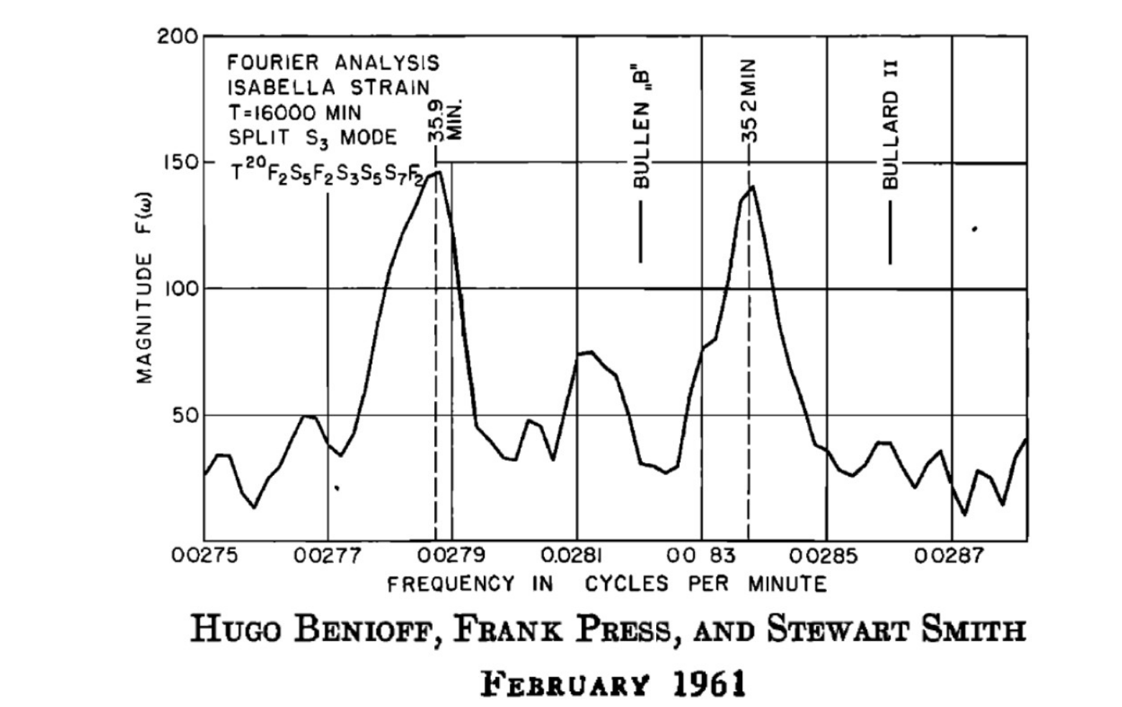
First observations of free oscillation spectra following the largest ever recorded earthquake

Slide 24
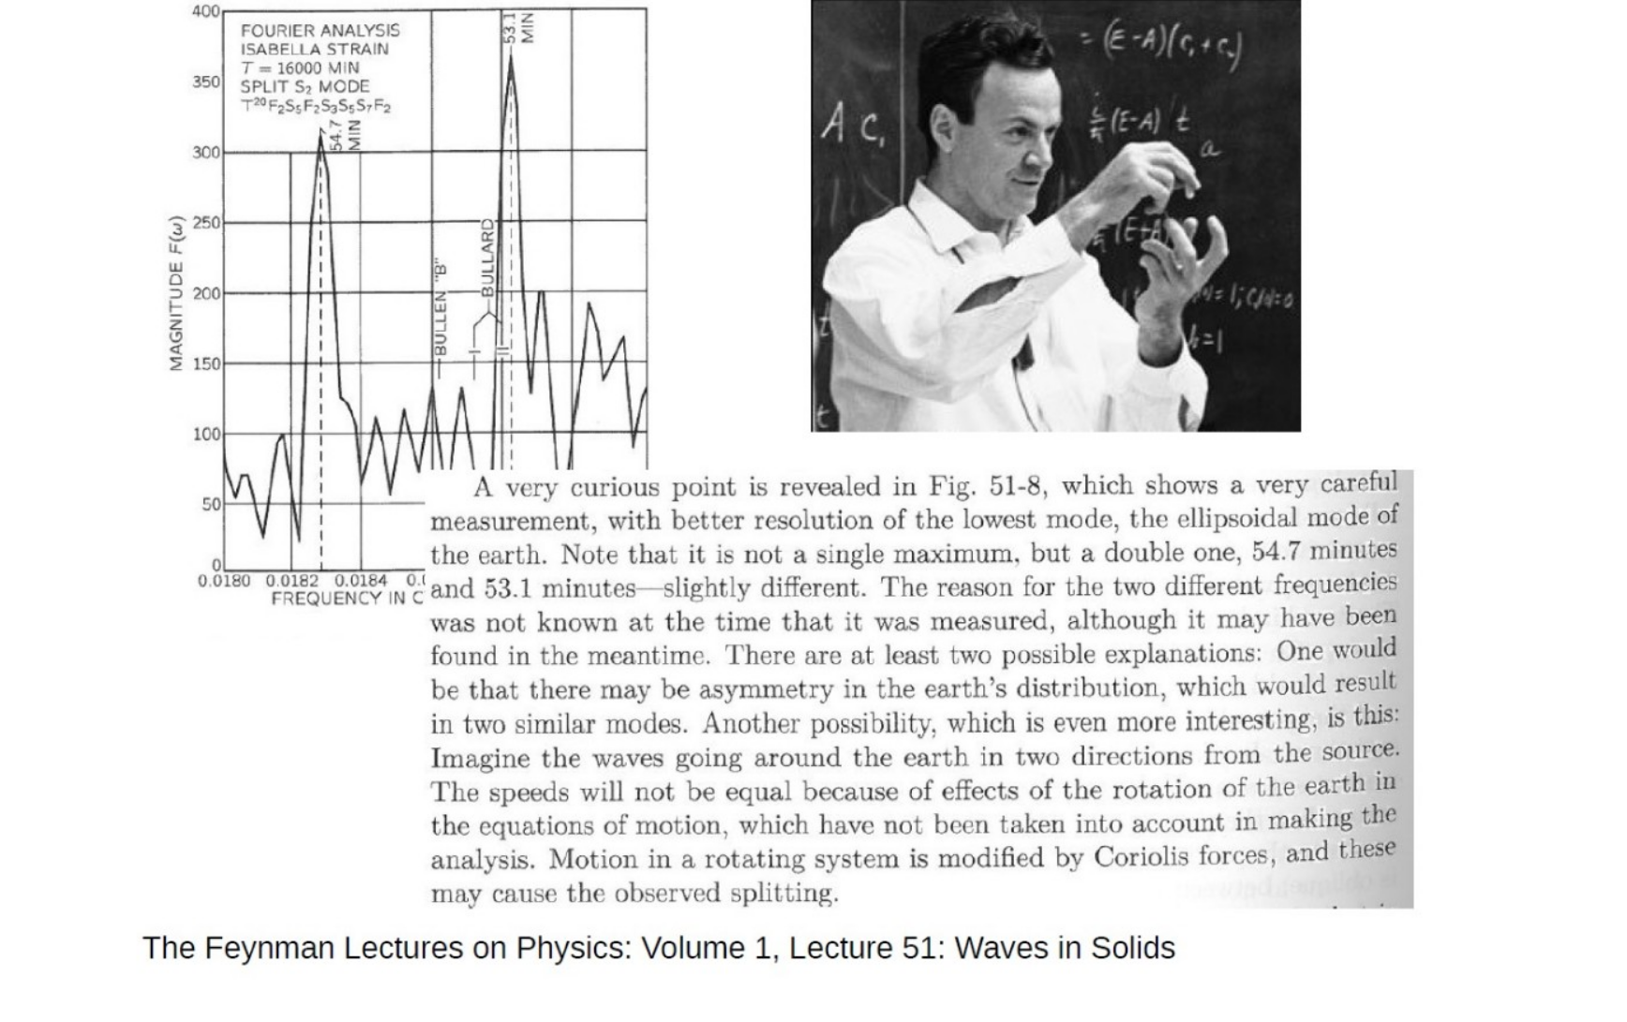

Slide 25
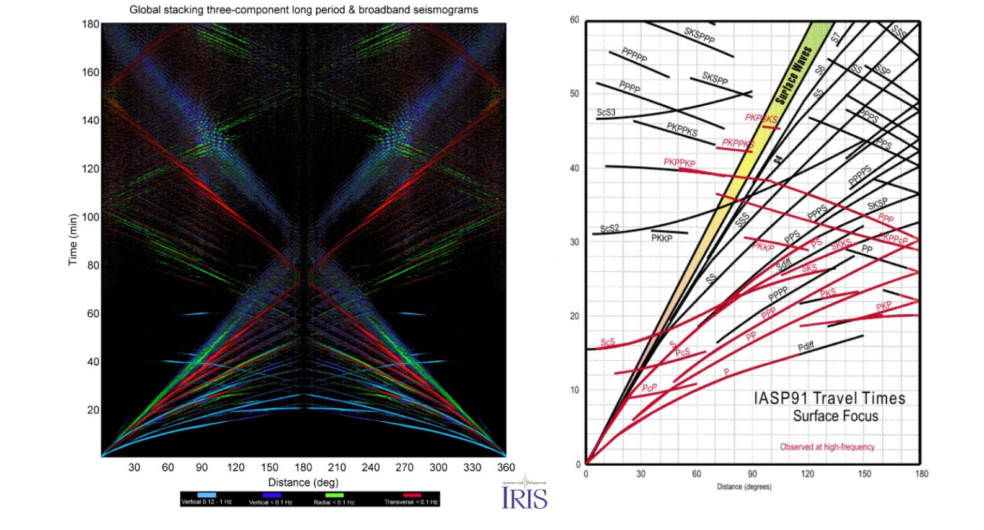
Travel times for the same epicentral angle can be averaged to try to remove the effect of laterally varying structure prior to inversions

Slide 26
Diagonal sum rule
Eigenvalue problem associated with degenerate perturbation theory:
Using symmetry arguments, it can be shown that the splitting matrix has zero trace – this implies that the eigenfrequency perturbations sum to zero
This is the diagonal sum rule due to Freeman Gilbert
It provides a rigorous basis for averaging observations of split eigenfrequencies within inversion for the spherically averaged structure

Slide 27
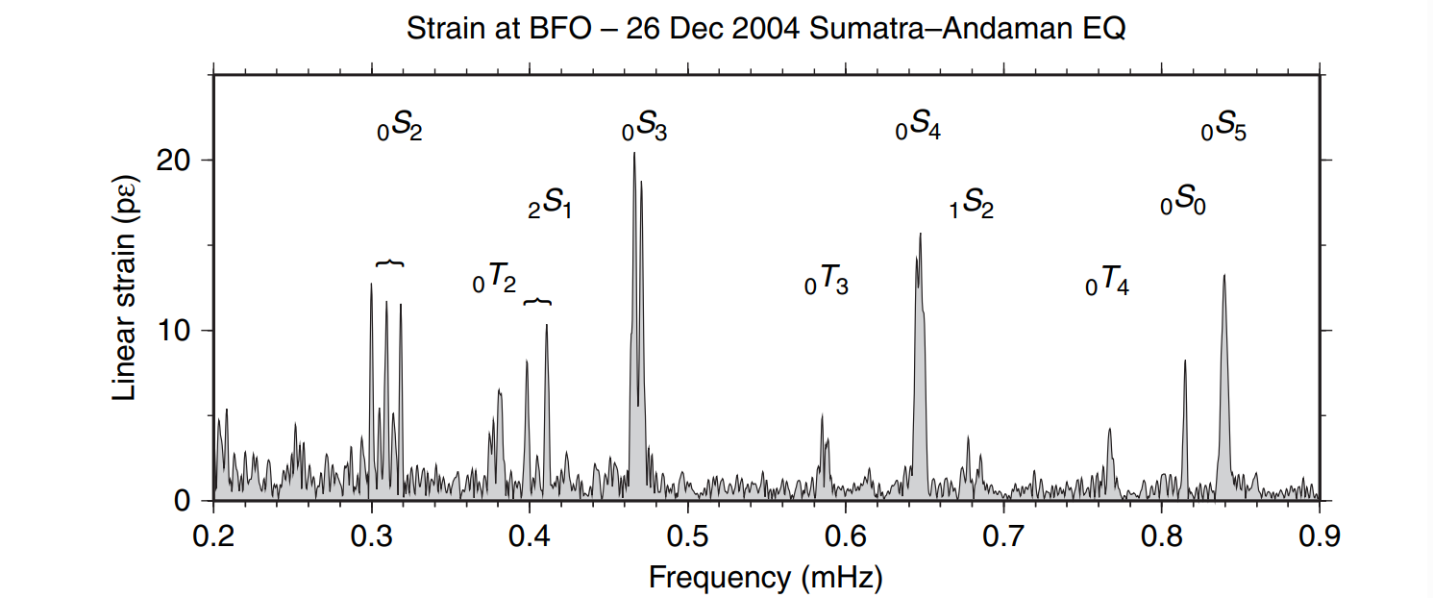
Widmer & Laske (2007)
It is relatively rare that all split singlets for a multiplet can be identified and measured, but the diagonal sum rule still forms the basis for more sophisticated methods for measuring eigenfrequencies

Slide 28
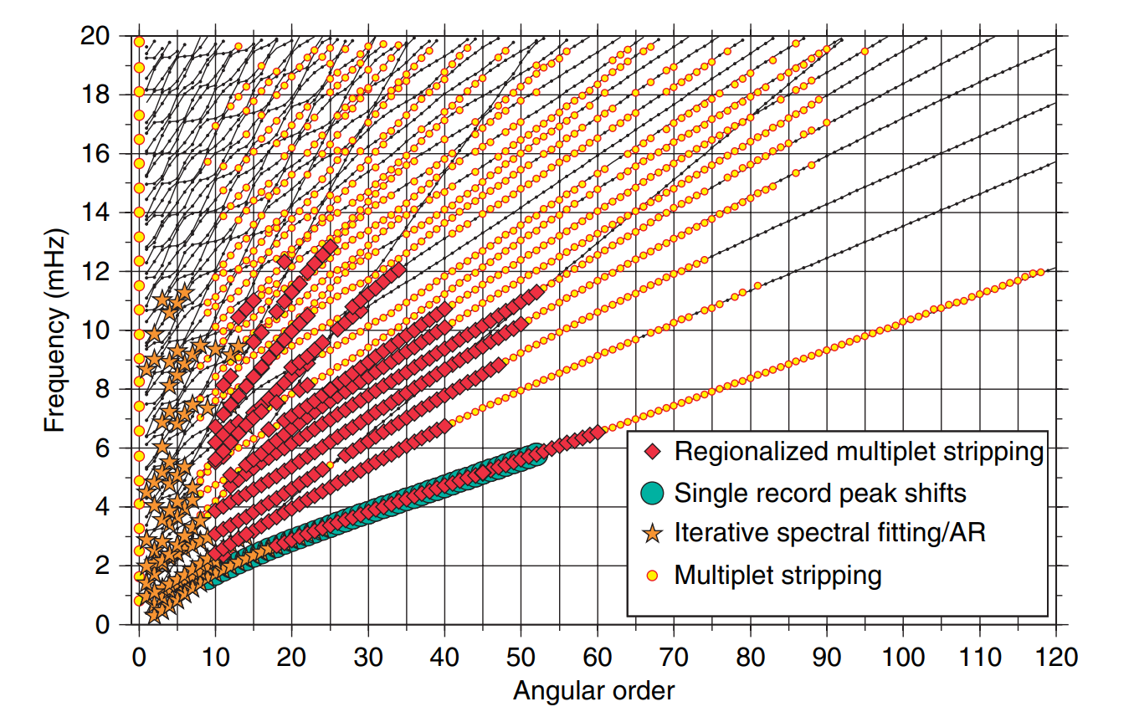
Widmer & Laske (2007)
By the late 70s, about 1000 eigenfrequencies had been measured

Slide 29
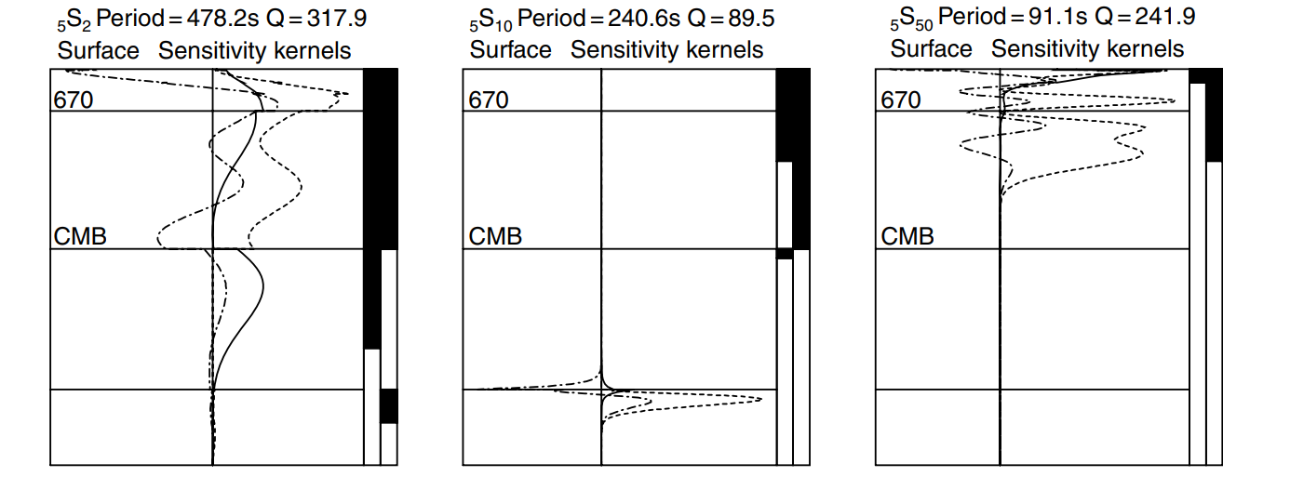
Woodhouse & Deuss (2007)
Using first-order perturbation theory, sensitivity kernels for eigenfrequencies with respect to radial velocity and density perturbations can be determined

Slide 30
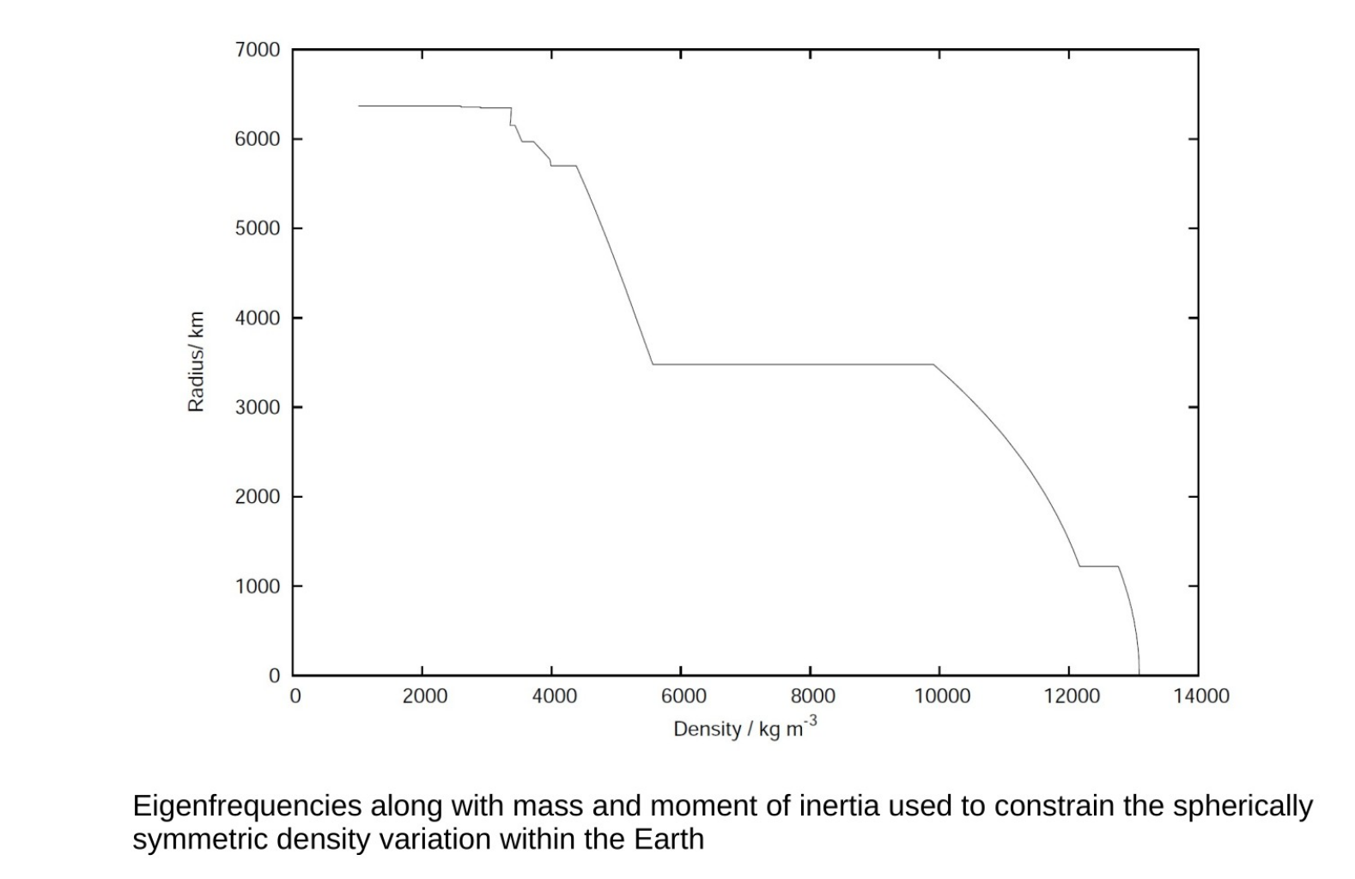

Slide 31
Lateral density variations

Slide 32
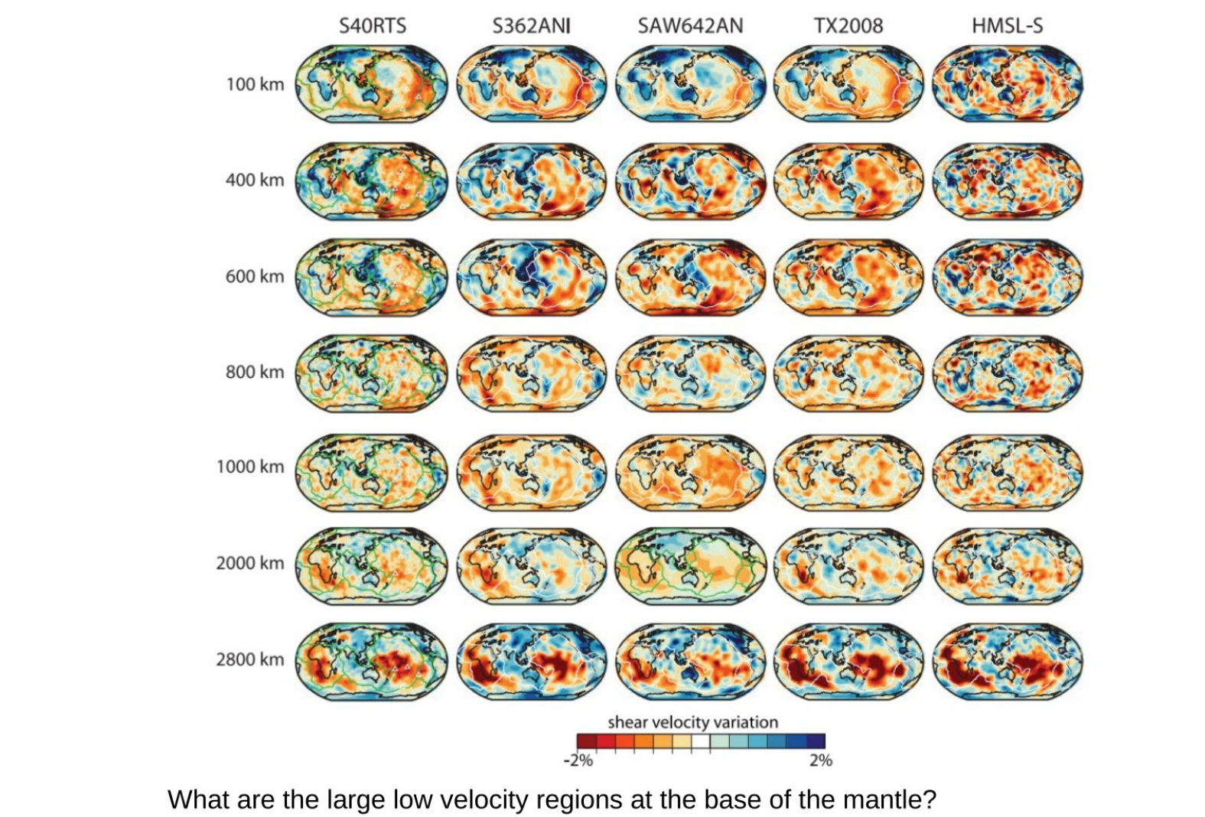

Slide 33


Thermal or compositional?
Bulk sound speed defined by:
If velocity variations are due to temperature alone:
Joint P- and S-wave tomography suggest these velocities anti-correlate in the lower mantle – suggests a role for compositional heterogeneity

Slide 34
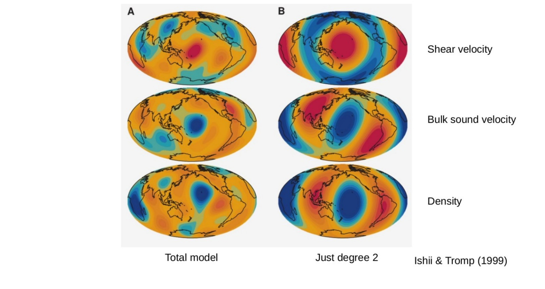
Early free oscillation tomography suggested LLSVPs are dense features – but conclusions have been questioned due to approximations in forward modelling

Slide 35
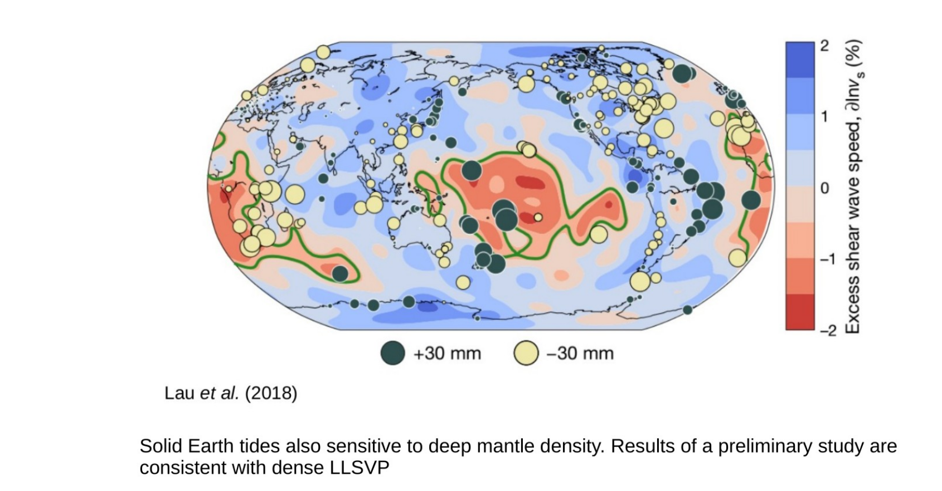

Slide 36
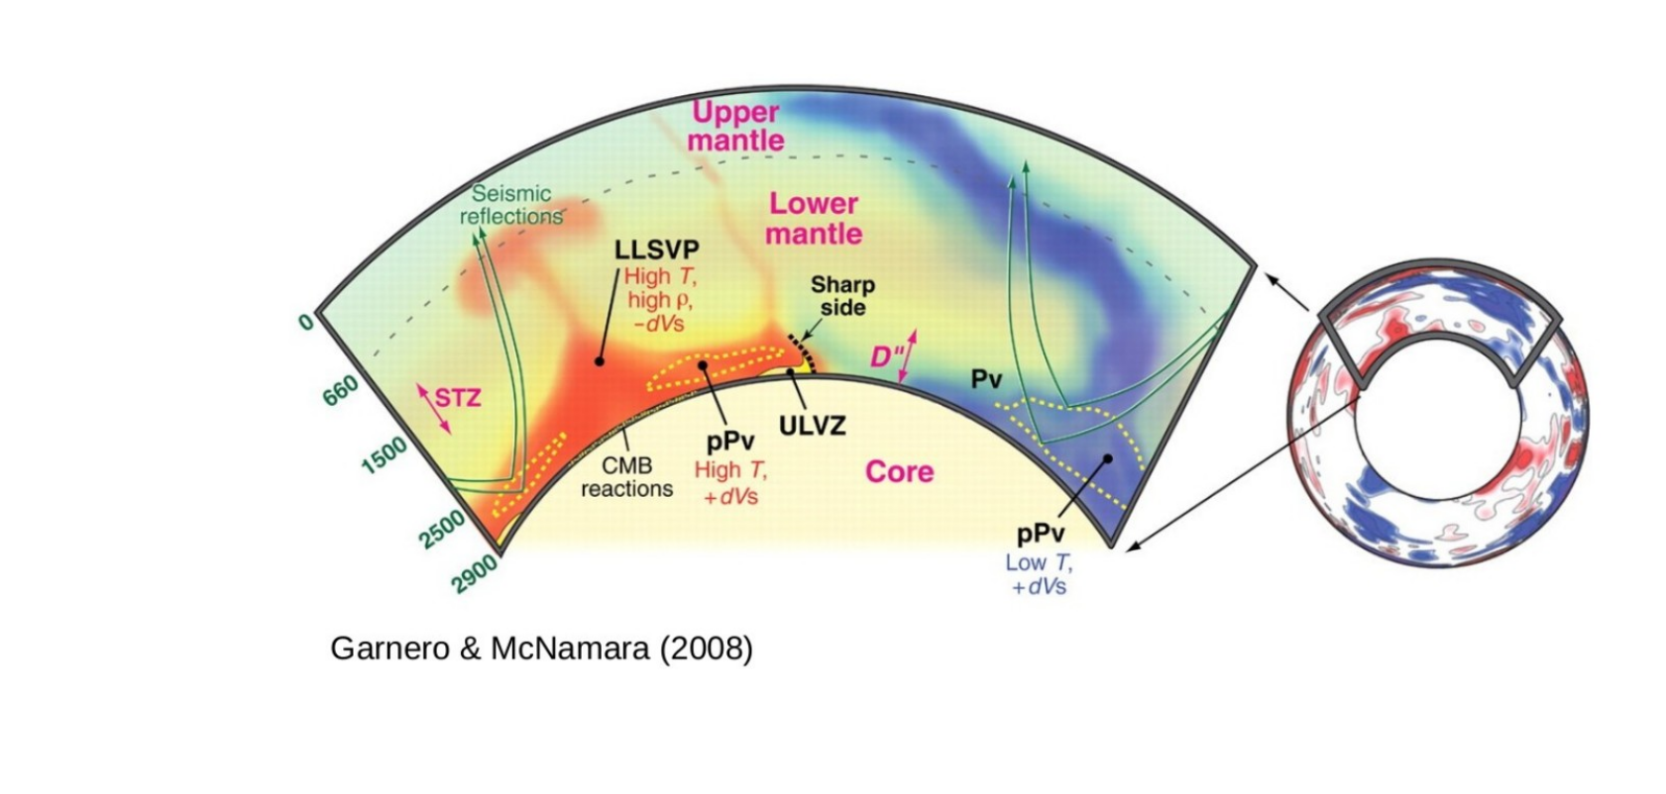
LLSVP origin?

